Slide 1
NLP
Md. Shahidul Salim

Slide 2
Basic NLP
Tokenization
Word-based, Character-based, subword-based
subword-based
Byte-level BPE, as used in GPT-2
WordPiece, as used in BERT
SentencePiece or Unigram, as used in several multilingual models
Removing Stop words
Lemmatization/stemming
Word2vec

Slide 3
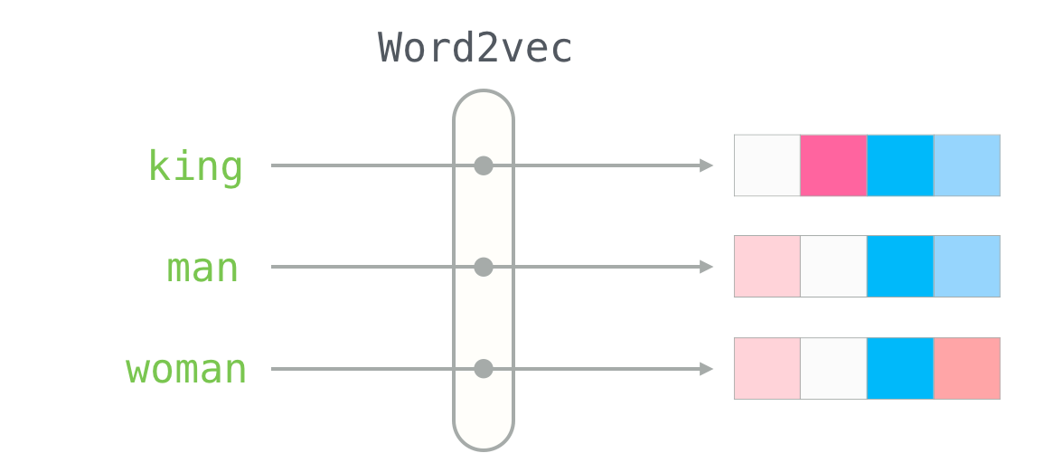
Word2Vec

Slide 4
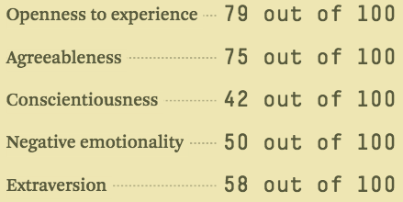
Word2Vec

Slide 5
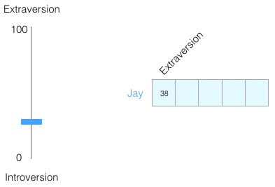
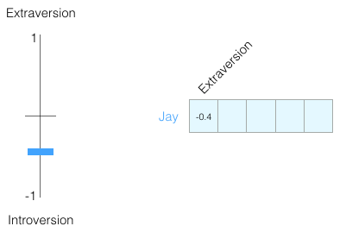
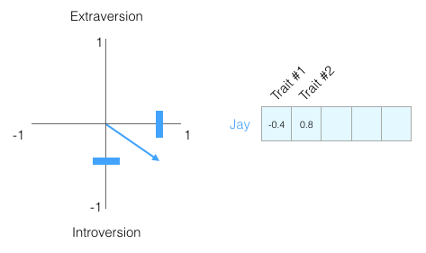
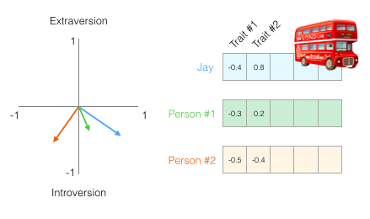

Slide 6
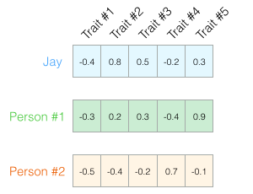
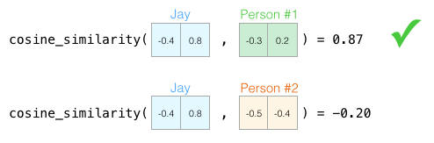
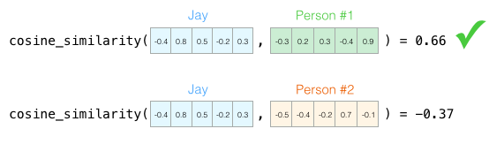
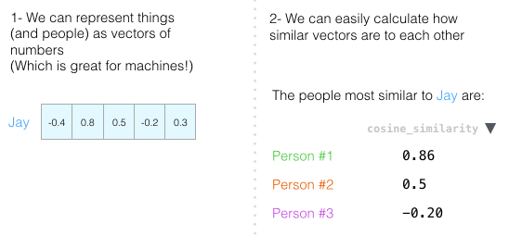

Slide 7
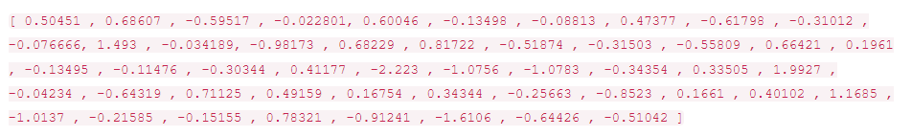
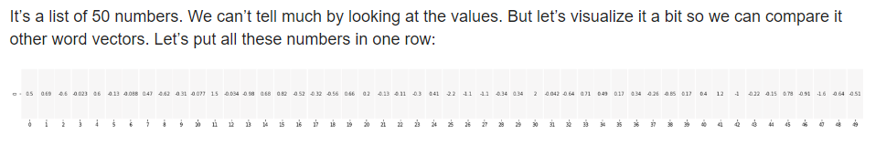
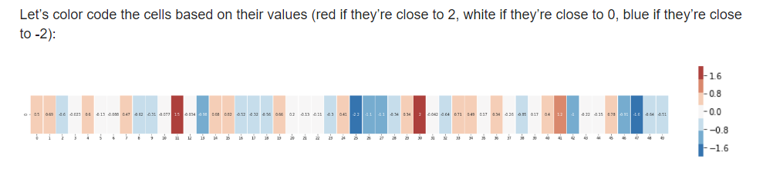
Word Embeddings
This is a word embedding for the word “king” (GloVe vector trained on Wikipedia):

Slide 8
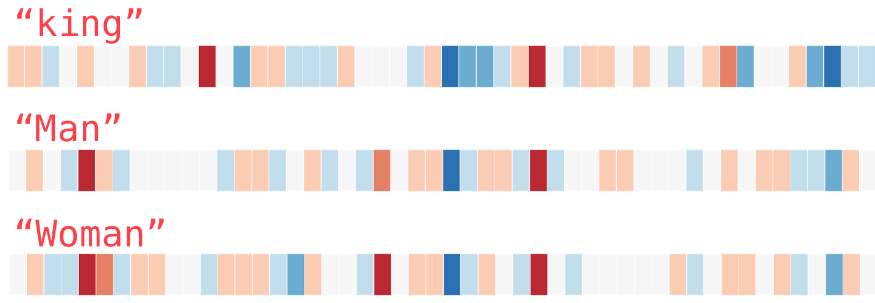
Word Embeddings

Slide 9
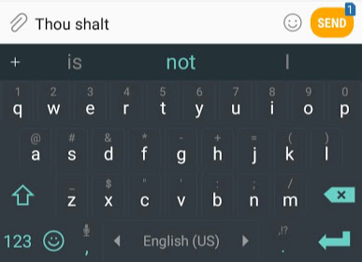
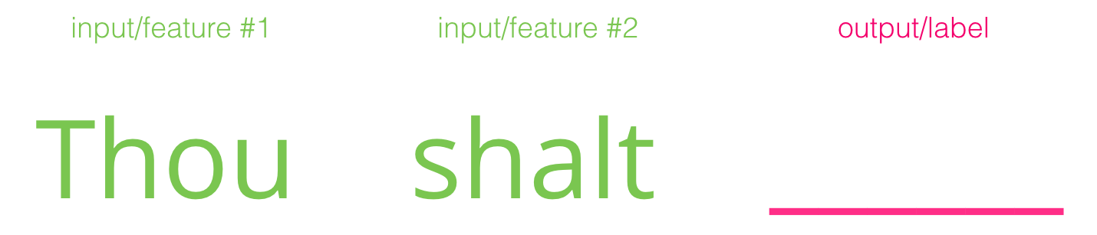
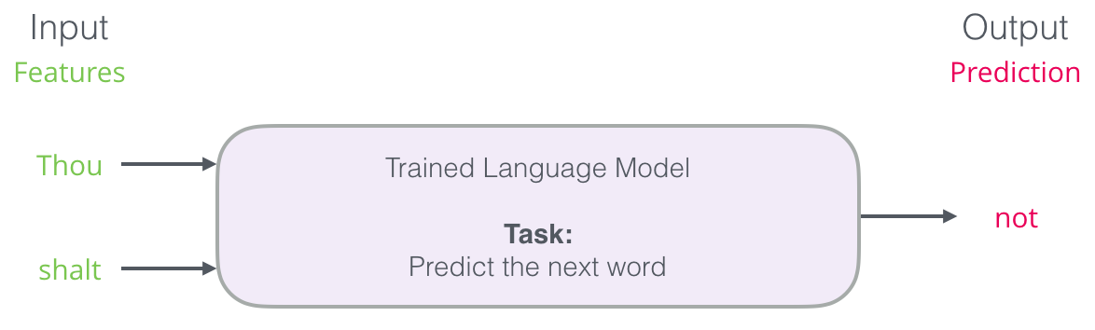
Language Modeling
Next-word prediction is a task that can be addressed by a language model. A language model can take a list of words (let’s say two words), and attempt to predict the word that follows them.

Slide 10
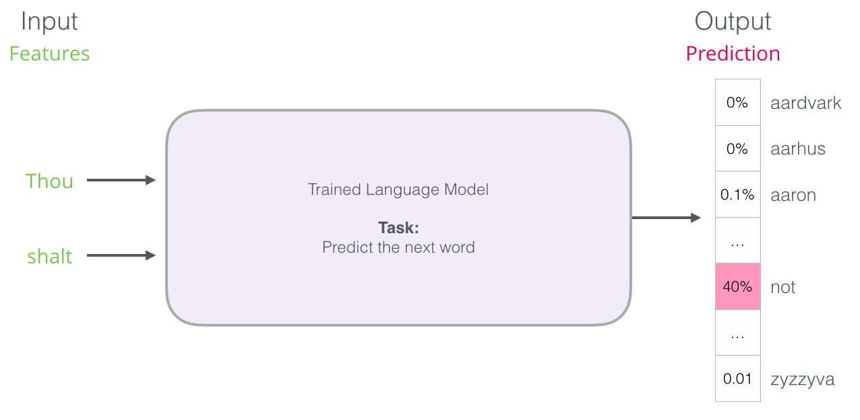
Trained language model

Slide 11
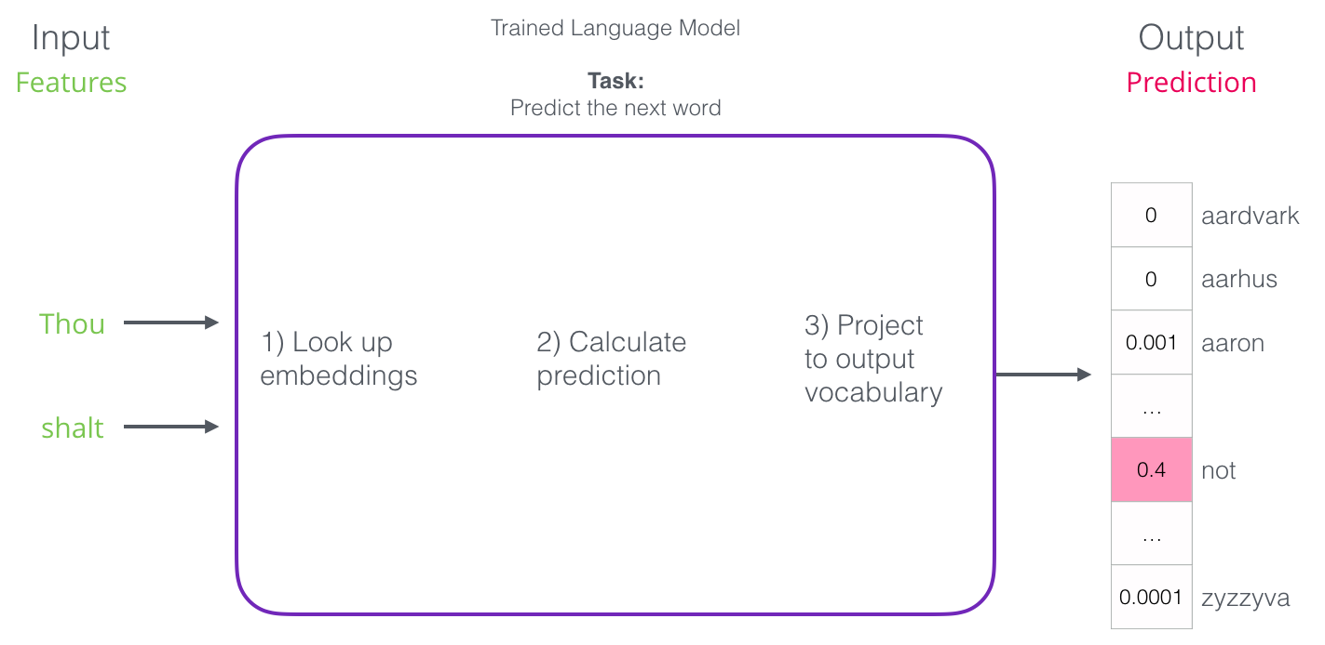
Trained language model

Slide 12
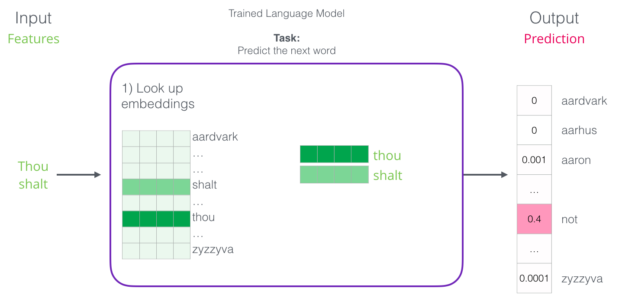

Slide 13
Language Model Training
We get a lot of text data (say, all Wikipedia articles, for example). then
We have a window (say, of three words) that we slide against all of that text.
The sliding window generates training samples for our model

Slide 14
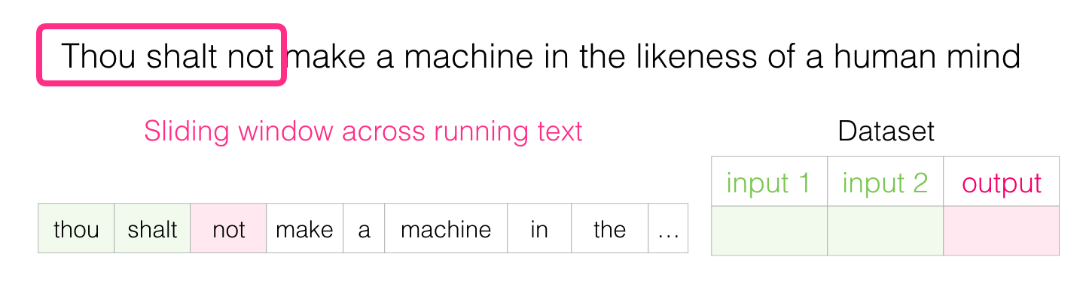
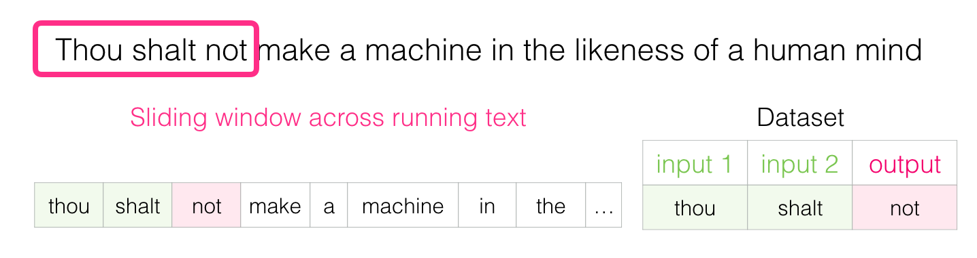
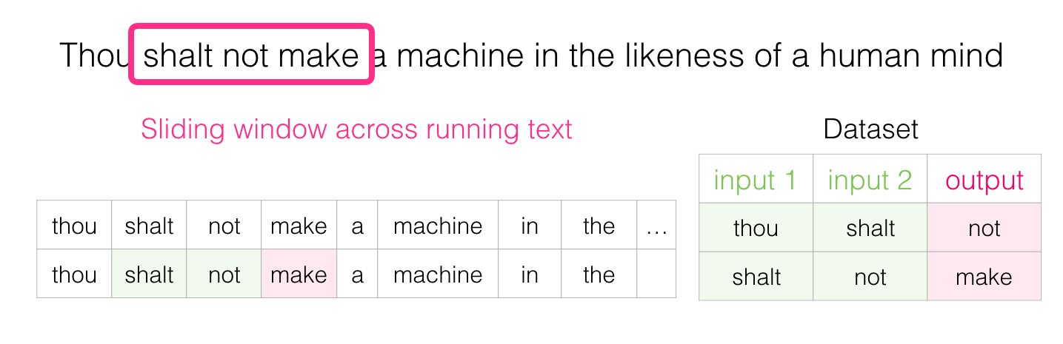

Slide 15
Train language models
Aside from neural-network-based approaches to language modeling, a technique called N-grams was commonly used to train language models

Slide 16
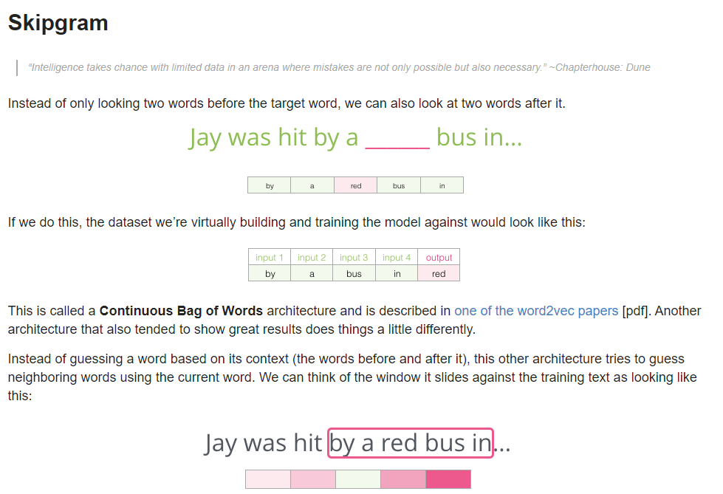

Slide 17
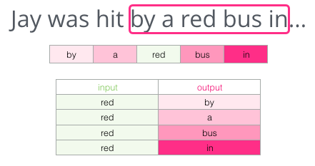
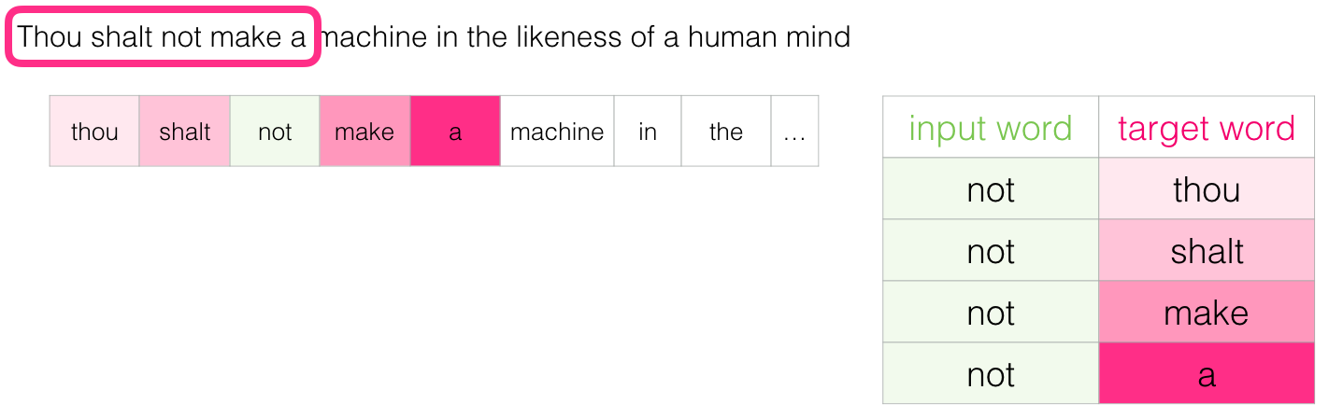
This method is called the skipgram architecture.

Slide 18
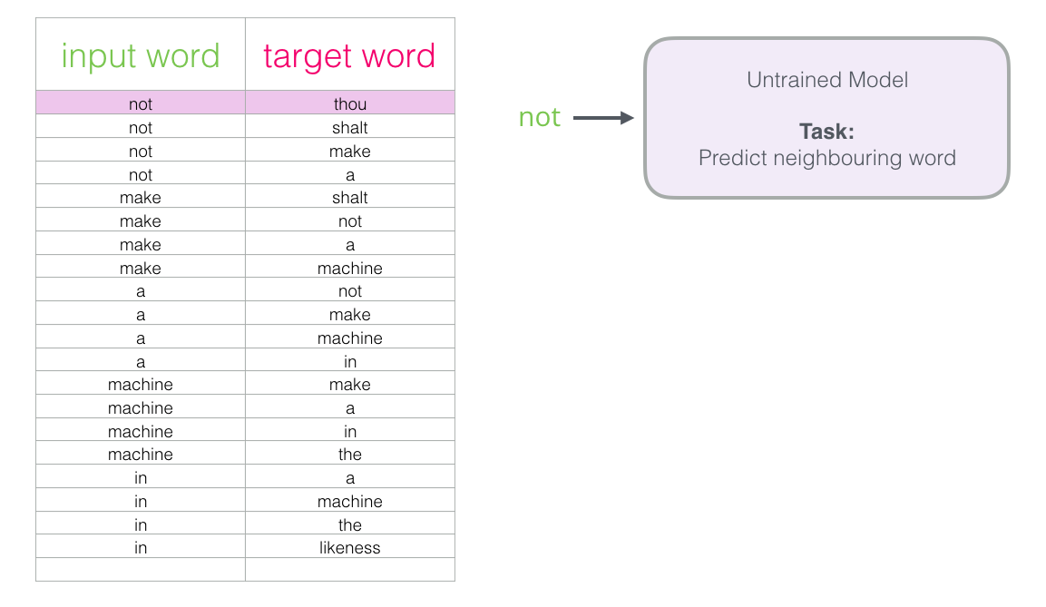
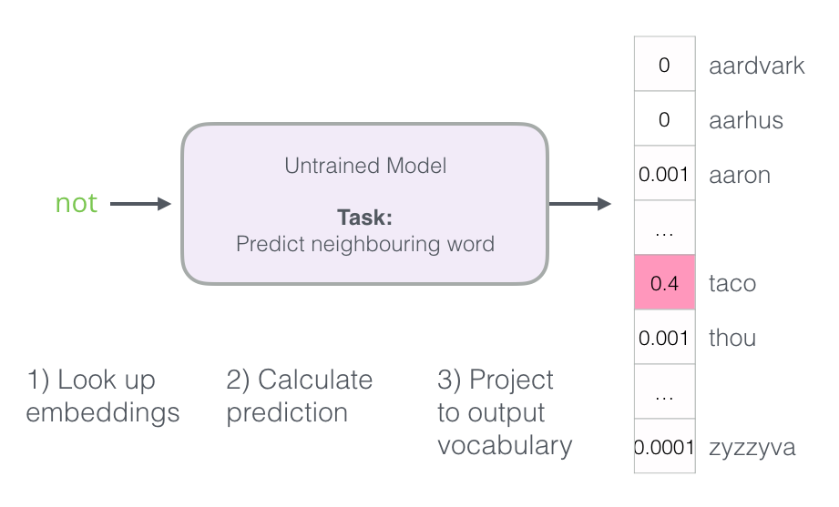
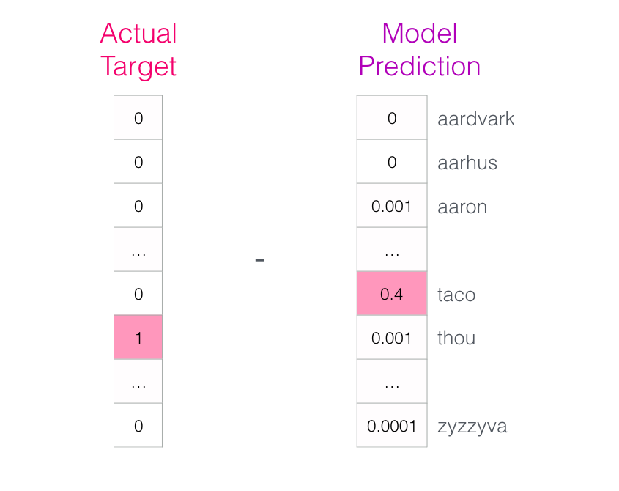
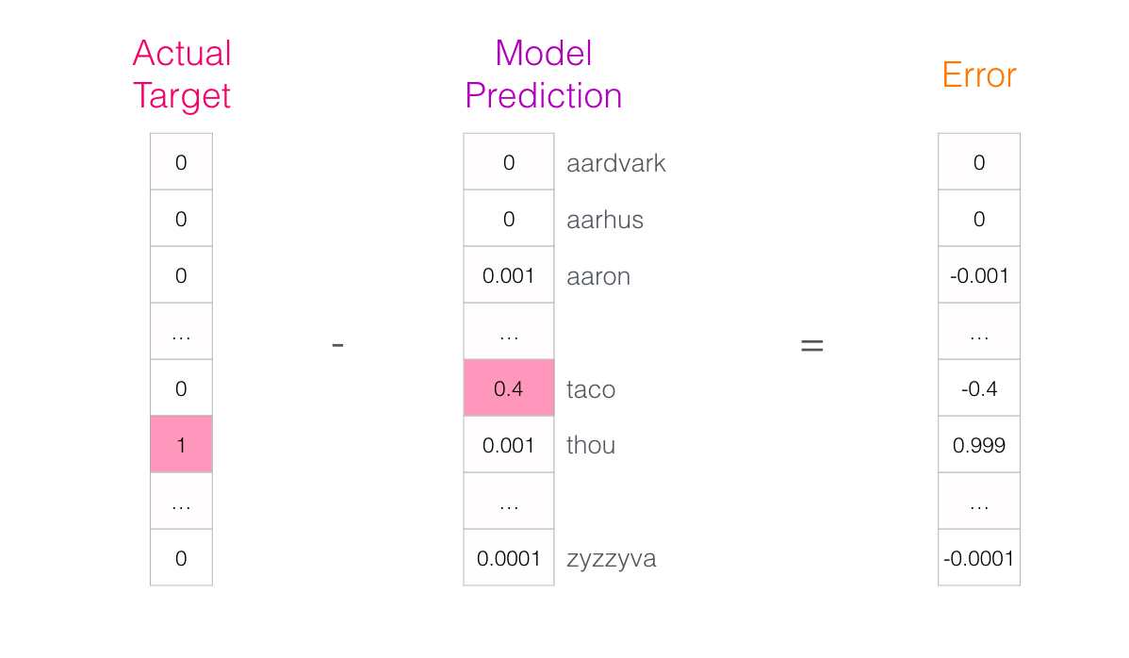
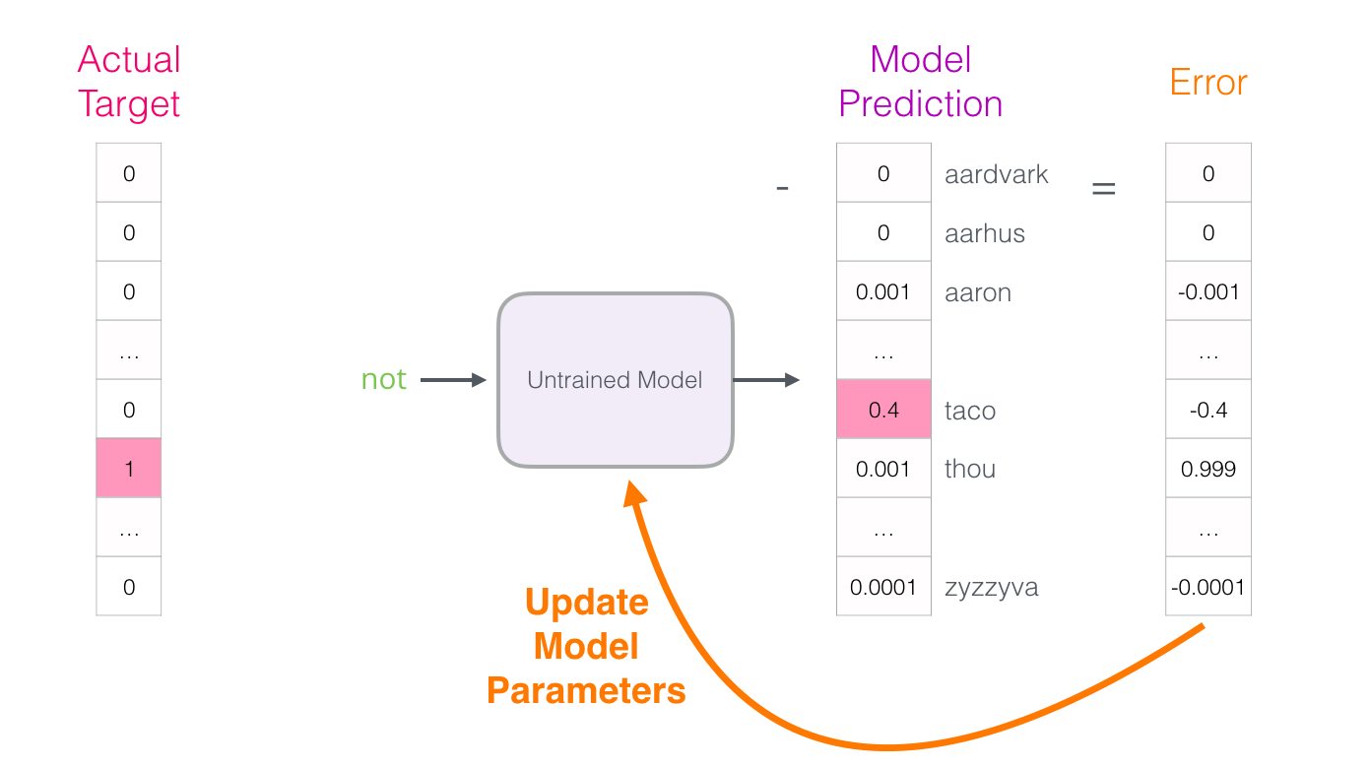
Training process

Slide 19
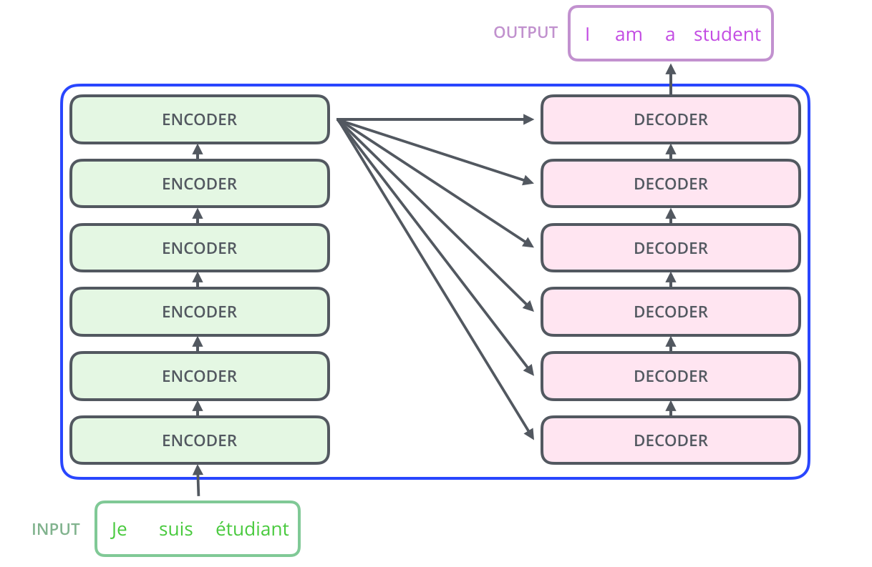
Transformer

Slide 20
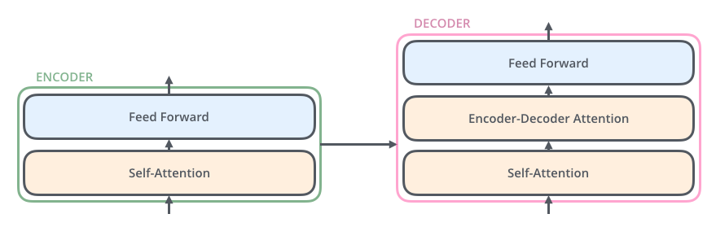
Encoder-Decoder

Slide 21

Embedding
The embedding only happens in the bottom-most encoder.
The abstraction that is common to all the encoders is that they receive a list of vectors each of the size 512 – In the bottom encoder that would be the word embeddings, but in other encoders, it would be the output of the encoder that’s directly below.
The size of this list is hyperparameter we can set – basically it would be the length of the longest sentence in our training dataset.

Slide 22
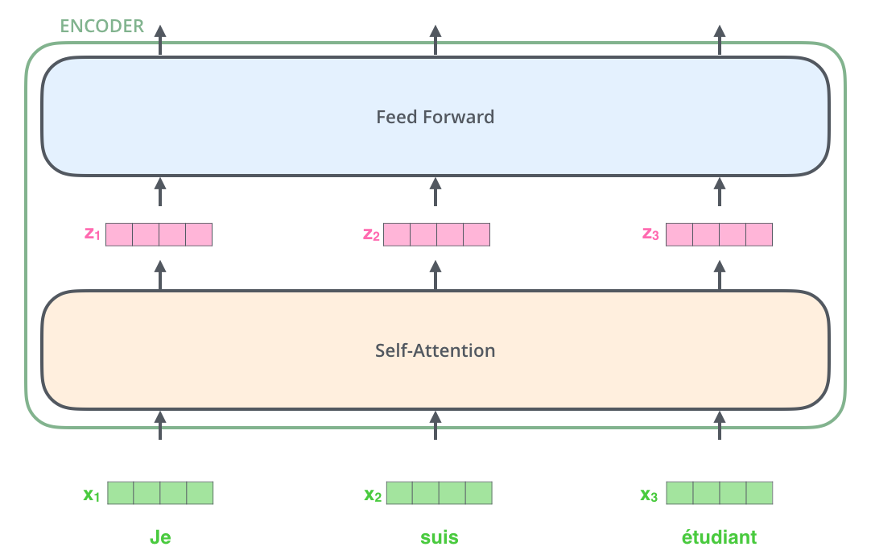
Here we begin to see one key property of the Transformer, which is that the word in each position flows through its own path in the encoder.
There are dependencies between these paths in the self-attention layer.
The feed-forward layer does not have those dependencies, however, and thus the various paths can be executed in parallel while flowing through the feed-forward layer.

Slide 23
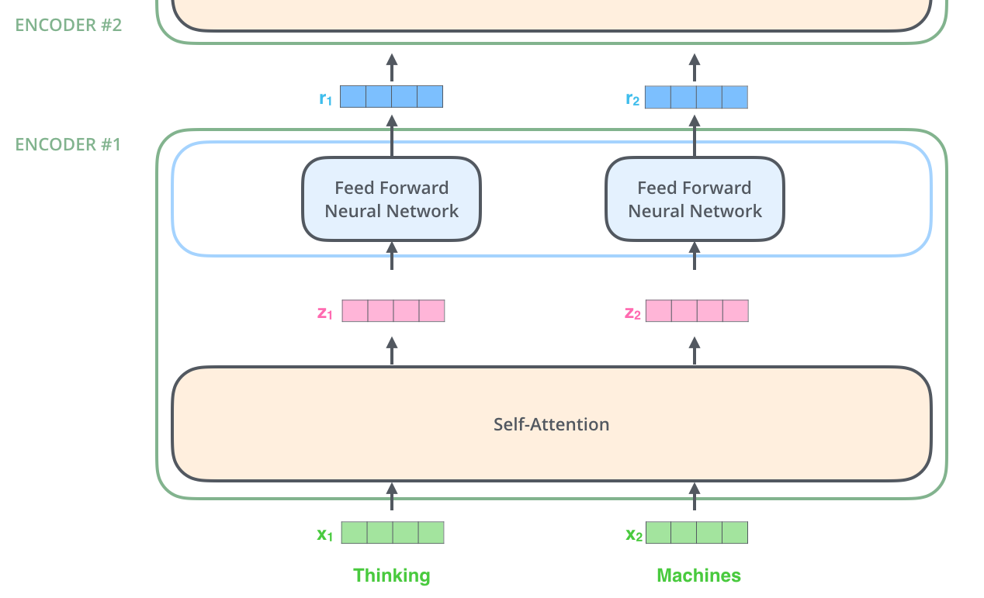
An encoder receives a list of vectors as input.
It processes this list by passing these vectors into a ‘self-attention’ layer, then into a feed-forward neural network, then sends out the output upwards to the next encoder.

Slide 24
Self-Attention at a High Level
Say the following sentence is an input sentence we want to translate:
”The animal didn't cross the street because it was too tired”
As the model processes each word (each position in the input sequence), self attention allows it to look at other positions in the input sequence for clues that can help lead to a better encoding for this word.
If you’re familiar with RNNs, think of how maintaining a hidden state allows an RNN to incorporate its representation of previous words/vectors it has processed with the current one it’s processing.
Self-attention is the method the Transformer uses to bake the “understanding” of other relevant words into the one we’re currently processing.

Slide 25
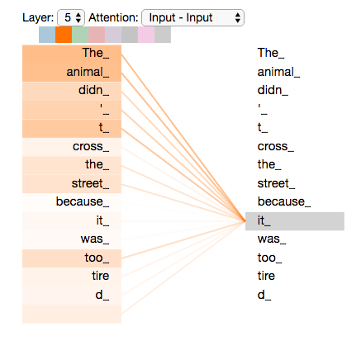

Slide 26
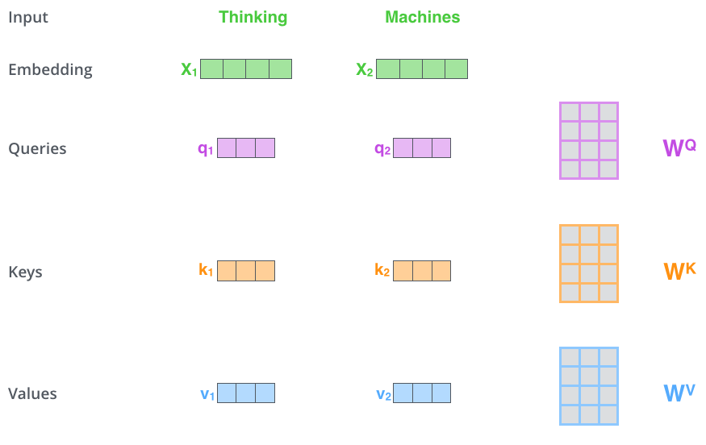
The first step in calculating self-attention is to create three vectors from each of the encoder’s input vectors (in this case, the embedding of each word).
So for each word, we create a Query vector, a Key vector, and a Value vector.
These vectors are created by multiplying the embedding by three matrices that we trained during the training process.

Slide 27
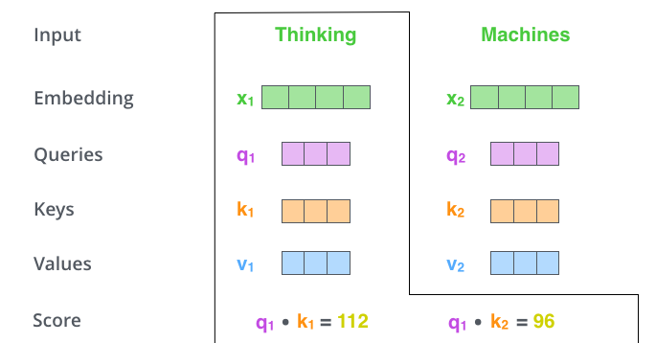
The second step in calculating self-attention is to calculate a score. Say we’re calculating the self-attention for the first word in this example, “Thinking”.
We need to score each word of the input sentence against this word.
The score determines how much focus to place on other parts of the input sentence as we encode a word at a certain position.
The score is calculated by taking the dot product of the query vector with the key vector of the respective word we’re scoring.
So if we’re processing the self-attention for the word in position #1, the first score would be the dot product of q1 and k1.
The second score would be the dot product of q1 and k2.

Slide 28
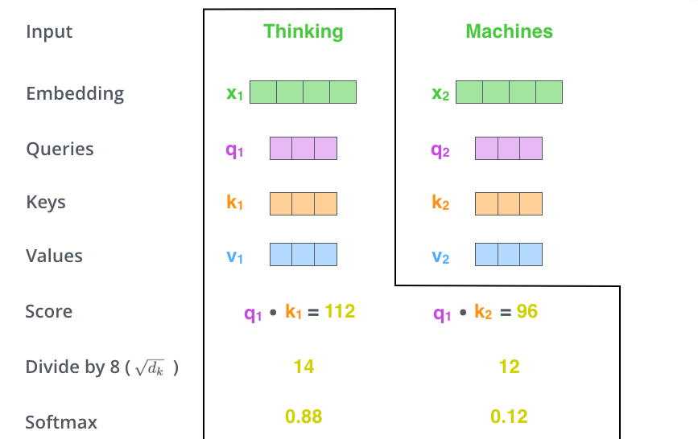
The third and fourth steps are to divide the scores by 8 (the square root of the dimension of the key vectors used in the paper – 64. This leads to having more stable gradients.
There could be other possible values here, but this is the default), then pass the result through a softmax operation. Softmax normalizes the scores so they’re all positive and add up to 1.
This softmax score determines how much each word will be expressed at this position.
Clearly the word at this position will have the highest softmax score, but sometimes it’s useful to attend to another word that is relevant to the current word.

Slide 29
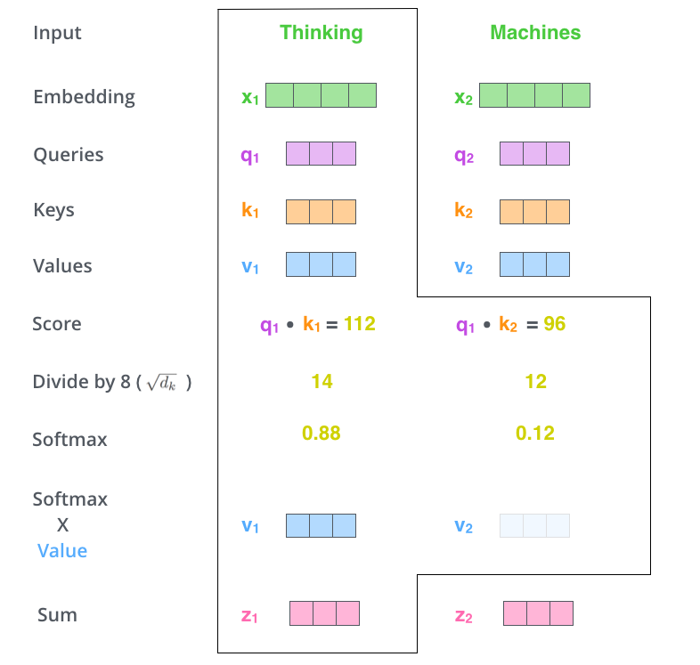
The fifth step is to multiply each value vector by the softmax score (in preparation to sum them up).
The intuition here is to keep intact the values of the word(s) we want to focus on, and drown-out irrelevant words (by multiplying them by tiny numbers like 0.001, for example).
The sixth step is to sum up the weighted value vectors. This produces the output of the self-attention layer at this position (for the first word).
The resulting vector is one we can send along to the feed-forward neural network. In the actual implementation, however, this calculation is done in matrix form for faster processing.

Slide 30
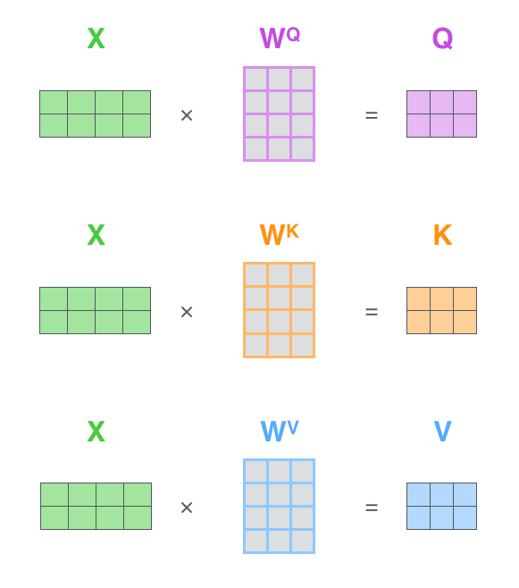
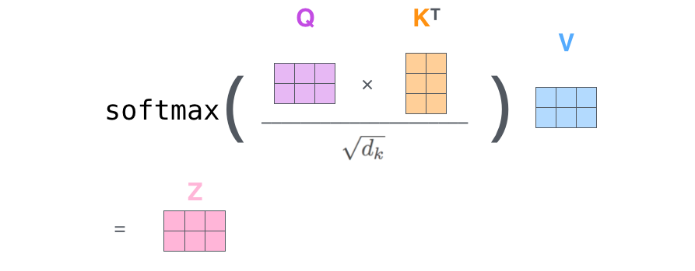
Matrix Calculation of Self-Attention
The first step is to calculate the Query, Key, and Value matrices. We do that by packing our embeddings into a matrix X, and multiplying it by the weight matrices we’ve trained (WQ, WK, WV).

Slide 31
References
https://jalammar.github.io/illustrated-transformer/
https://jalammar.github.io/illustrated-word2vec/
https://towardsdatascience.com/attention-is-all-you-need-discovering-the-transformer-paper-73e5ff5e0634
https://alok-shankar.medium.com/understanding-googles-attention-is-all-you-need-paper-and-its-groundbreaking-impact-c5237043540a
https://research.google/pubs/attention-is-all-you-need/

