Slide 1
Feature Matching , Homography finding, Fundamental Matrix with RANSAC
Md. Shahidul Islam
Student ID: 1907509

Slide 2
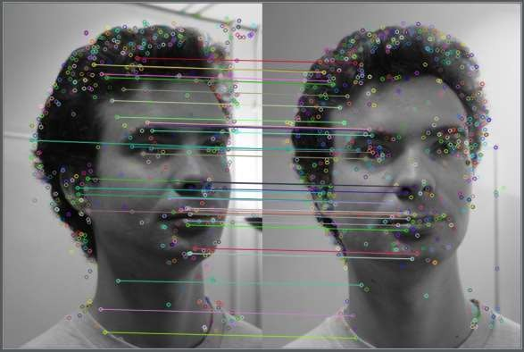
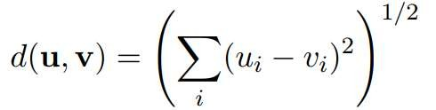

Feature Matching
Measure difference as Euclidean distance between feature
vectors:
Several possible matching strategies:
Return all feature vectors with d smaller than a threshold.
Nearest neighbor: feature vector with smallest d.
Nearest neighbor distance ratio:
d1, d2: distances to the nearest and 2nd nearest neighbors.
If NNDR is small, nearest neighbor is a good match.

Slide 3


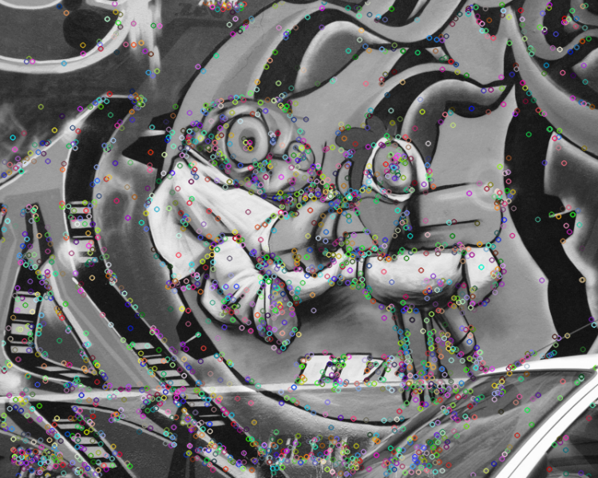
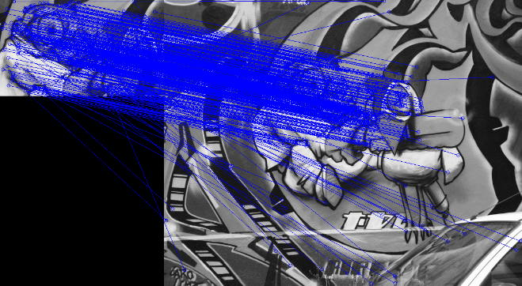
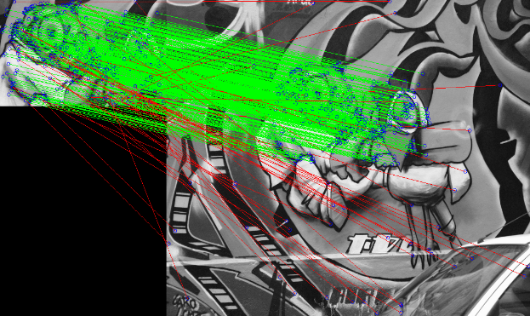
Feature Matching
Feature matching methods can give false matches.
Manually select good matches, or use robust method to remove false
matches.
Nearest neighbor search is computationally expensive.
Need efficient algorithm, e.g., using k-D Tree.
k-D Tree is not more efficient than exhaustive search for large dimensionality, e.g., > 20.
pic1
pic2
Matching keypoint between two image
Elemenating bad match point with RANSAC
Key point detected image

Slide 4
Fitting techniques
1.Least Squares
2.Total Least Squares
3.RANSAC
4.Hough Voting

Slide 5
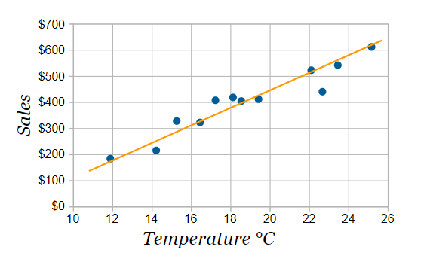
Least Squares
The method of least squares is a standard approach in regression analysis to approximate the solution of overdetermined systems, i.e., sets of equations in which there are more equations than unknowns.
y = how far up
x = how far along
m = Slope or Gradient (how steep the line is)
b = the Y Intercept (where the line crosses the Y axis)
y = mx + b

Slide 6
Least Squares
The method of least squares is a standard approach in regression analysis to approximate the solution of overdetermined systems, i.e., sets of equations in which there are more equations than unknowns.
y = how far up
x = how far along
m = Slope or Gradient (how steep the line is)
b = the Y Intercept (where the line crosses the Y axis)
y = mx + b

Slide 7
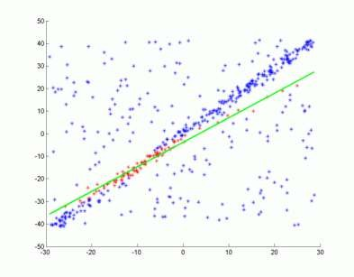
RANSAC (Random Sample Consensus)
Determines the best transformation that includes the most number of match features (inliers) from the the previews step.
RANSAC method, will fit a model to data, and help us identify the outliers.

Slide 8
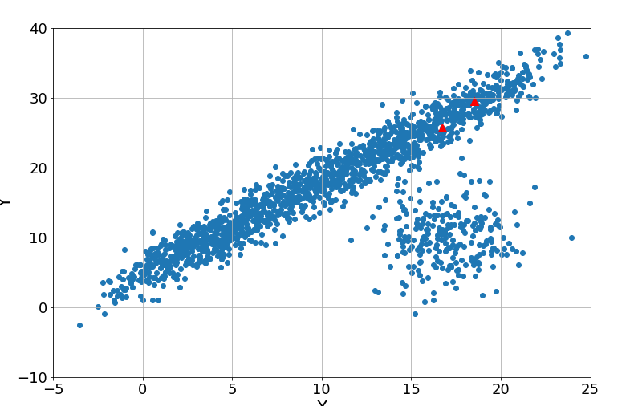
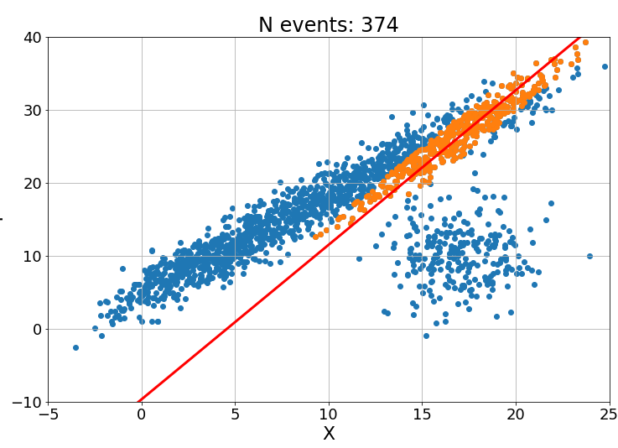
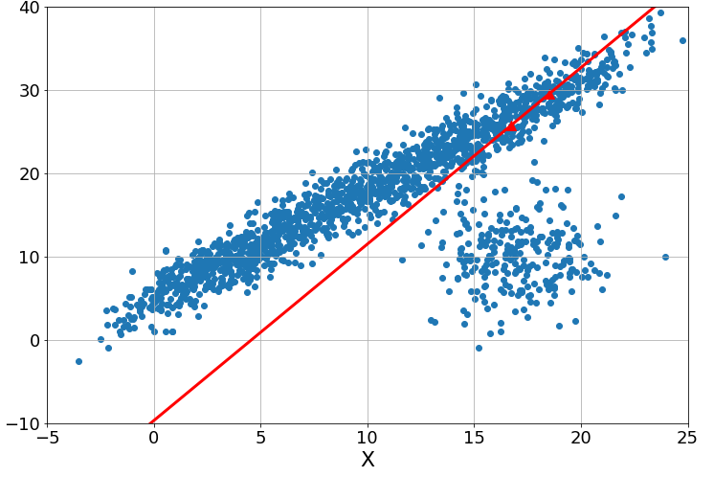
RANSAC (Random Sample Consensus)
RANSAC stands for RANdom SAmple Consensus, and was first introduced in 1981 by Fischler and Bowles, and follows the steps below:
STEP 1: Randomly select a number of data points from our data set. Since we are fitting a line in this example, lets select 2. If the number of outliers is small, there is a higher probability that the events we pick belong to the inliers.
STEP 2: Use the random sample to fit a line, or whatever curve we are interested in.
STEP 3: And then we count how many data point are within a predefined distance to the line, shown in orange in the plot below. These data points, are the inliers, while the blue ones are the outliers. Finally, we record the number of inlier events.
Step:01
Step:02
Step:03

Slide 9
RANSAC (Random Sample Consensus)
RANSAC stands for RANdom SAmple Consensus, and was first introduced in 1981 by Fischler and Bowles, and follows the steps below:
STEP 1: Randomly select a number of data points from your data set. Since we are fitting a line in this example, lets select 2. If the number of outliers is small, there is a higher probability that the events you pick belong to the inliers.
STEP 2: Use the random sample to fit a line, or whatever curve we are interested in.
STEP 3: And then we count how many data point are within a predefined distance to the line, shown in orange in the plot below. These data points, are the inliers, while the blue ones are the outliers. Finally, we record the number of inlier events.
Step:01
Step:02
Step:03
Final step

Slide 10
RANSAC (Random Sample Consensus)
RANSAC loop:
Select four feature pairs (at random)
Compute homography H (exact)
Compute inliers where SSD(p_{i}’, Hp_{i}) < ε
Keep largest set of inliers
Re-compute least-squares H estimate on all of the inliers

Slide 11
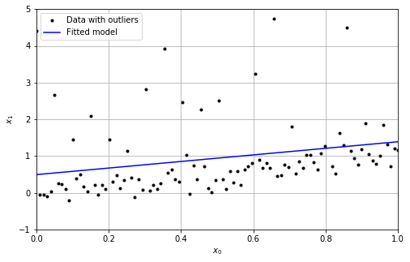
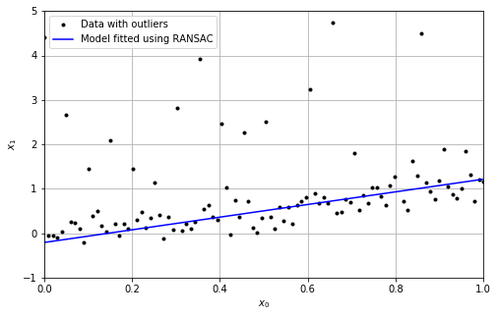
Least Squares vs RANSAC
Fig. . Model fitted using least squares on the data containing outliers
Fig. Model fitted using RANSAC around least squares on the data containing outliers
RANSAC fits N models using different random sample S of the whole available data each time. Then, for each model it evaluates its performance P (i.e. number of inliers or outliers) and chooses the best one. Note that RANSAC doesn’t determine what method should we use to find model parameters. So RANSAC works well for out layer data than least squares.

Slide 12
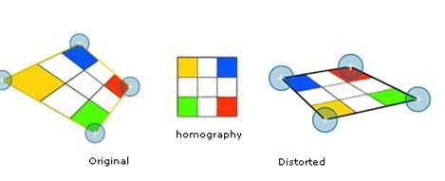
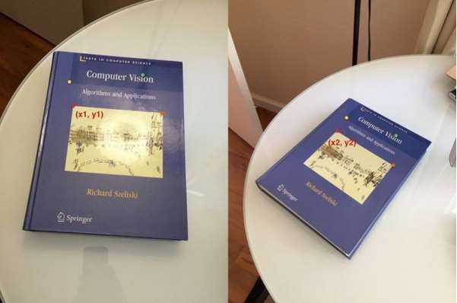


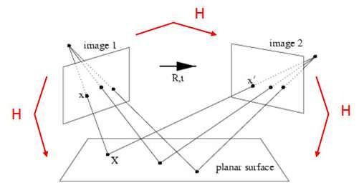


Homograhy:
Imporants of RANSAC for Homography
a transformation ( a 3×3 matrix ) that maps the points in one image to the
corresponding points in the other image.

Slide 13
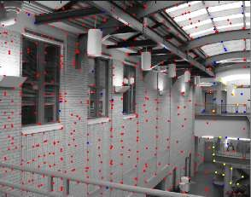
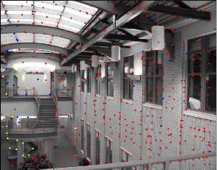
Imporants of RANSAC for Homography
Red = bad match
match
Blue = good match
yellow = correct

Slide 14


Homography
Now since a homography is a 3×3 matrix we can write it as:
Let us consider the first set of corresponding points —(x1,y1) in the first image and (x2,y2) in the second image. Then, the Homography H maps them in the following way:

Slide 15
Compute the fundamental matrix between two images.
Algorithm
(i) Interest points: Compute interest points in each image.
(ii) Putative correspondences: Compute a set of interest point matches based on proximity and similarity of their intensity neighbourhood.
(iii) RANSAC robust estimation: Repeat for N samples, where N is determined adaptively as in algorithm 4.5(p121): (a) Select a random sample of 7 correspondences and compute the fundamental matrix F. There will be one or three real solutions. (b) Calculate the distance d⊥ for each putative correspondence. (c) Compute the number of inliers consistent with F by the number of correspondences for which d⊥ < t pixels. (d) If there are three real solutions for F the number of inliers is computed for each solution, and the solution with most inliers retained. Choose the F with the largest number of inliers. In the case of ties choose the solution that has the lowest standard deviation of inliers.
(iv) Non-linear estimation: re-estimate F from all correspondences classified as inliers by minimizing a cost function, using the Levenberg–Marquardt algorithm.
(v) Guided matching: Further interest point correspondences are now determined using the estimated F to define a search strip about the epipolar line. The last two steps can be iterated until the number of correspondences is stable.

Slide 16
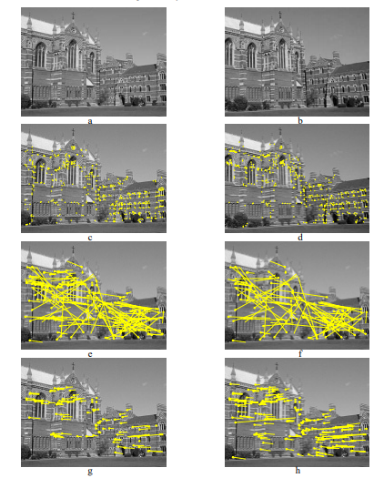
Fig. 11.4. Automatic computation of the fundamental matrix between two images using RANSAC.
(a) (b) left and right images of Keble College, Oxford. The motion between views is a translation and
rotation. The images are 640 × 480 pixels. (c) (d) detected corners superimposed on the images. There
are approximately 500 corners on each image. The following results are superimposed on the left image:

Slide 17
(e) 188 putative matches shown by the line linking corners, note the clear mismatches; (f) outliers – 89
of the putative matches. (g) inliers – 99 correspondences consistent with the estimated F; (h) final set of
157 correspondences after guided matching and MLE. There are still a few mismatches evident, e.g. the
long line on the left

Slide 18
Pros and Cons

Slide 19
Pros
Simple and General
Applicable to many different problems
Often works well in practice
Robust estimation
Output acquire relatively high accuracy

Slide 20
Cons
Random Nature
Lots of Parameters to tune
High Computation Time
Number of iterations required
Can fail for extremely Low Inlier Ratios
Extremely sensitive to its threshold value

Slide 21
Applications

Slide 22
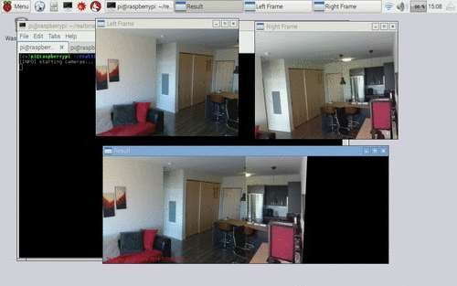
Image Stitching

Slide 23
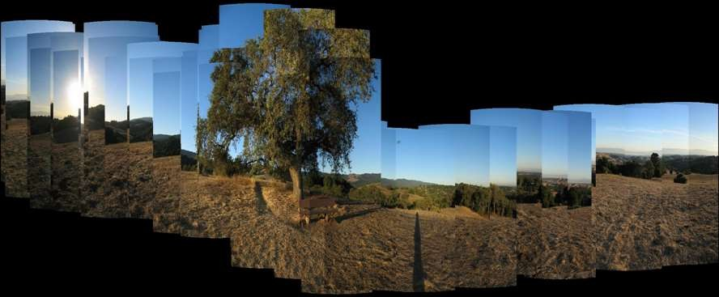
Panorama

Slide 24







Long Screenshot
Screen #1
Screen #2
Screen #3
Screen #6
Screen #4
Screen #5

Slide 25
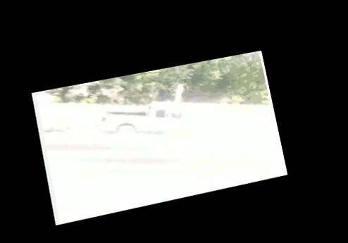
Video Stabilization

Slide 26
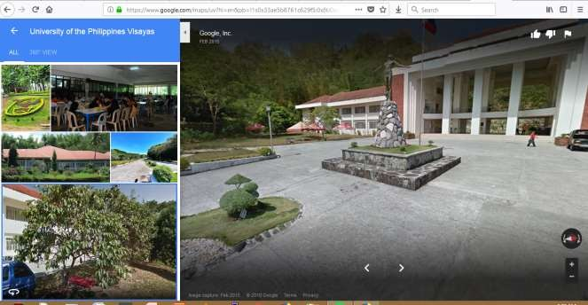
360-degree image
Google Map - Street view

Slide 27
Thanks

