Slide 1
Sweater Company Management System
Developed By:-
Md. Saddam hossain prodhan.
ID: 1244300 .
Batch ID: J2EE/APCL-A/37/01.
Submitted to:-
Mr. Md. Moshahidul Islam.
Consultant (IDB-BISEW)
Presentation Date: 06/12/2018

Slide 2
Purposes of this System
It is very easy to maintenance a sweater produce factory by using this system.
It helps both admin and production manager as well as maintain their expected task individually.
It helps production manager to get order and send efficient direction to the employees.
It helps PM to manage order, buyer request and delivery outline.
Overall this system helps to whole system of a garments factory.

Slide 3
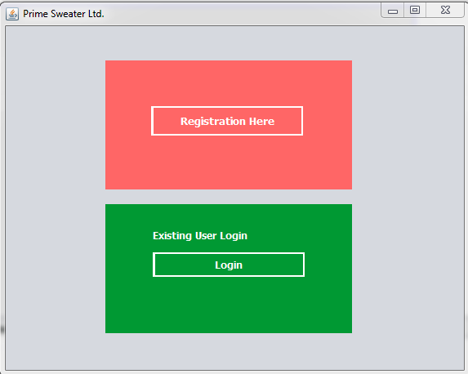
Overview page we can Registration or login use this page

Slide 4
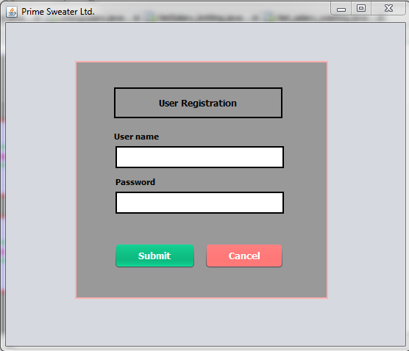
New user registration first use this system

Slide 5
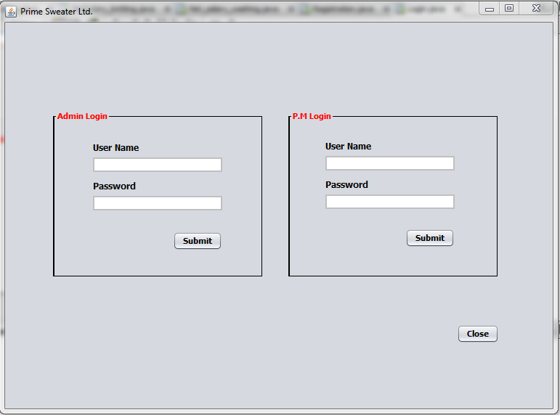
Existing register admin or P.M login the system use this page

Slide 6
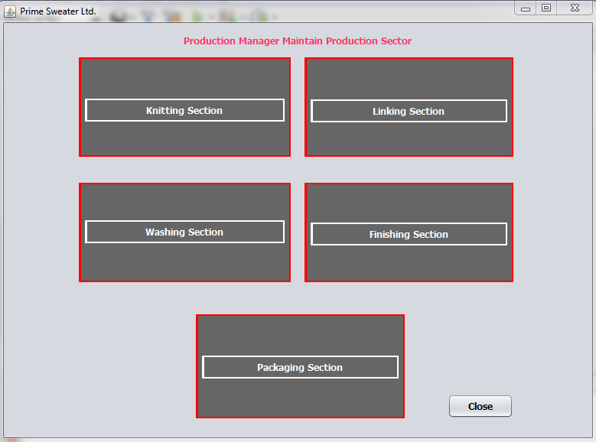
P.M use this sector and admin also use P.M activity

Slide 7
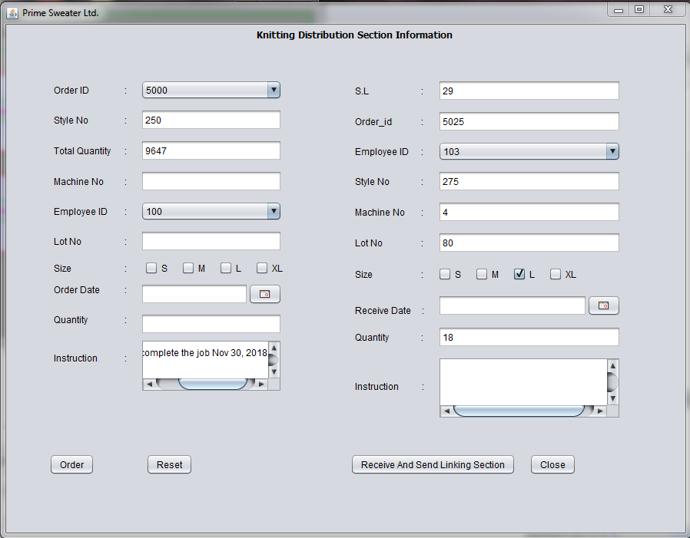
Knitting section distribution and receive and send next linking department

Slide 8
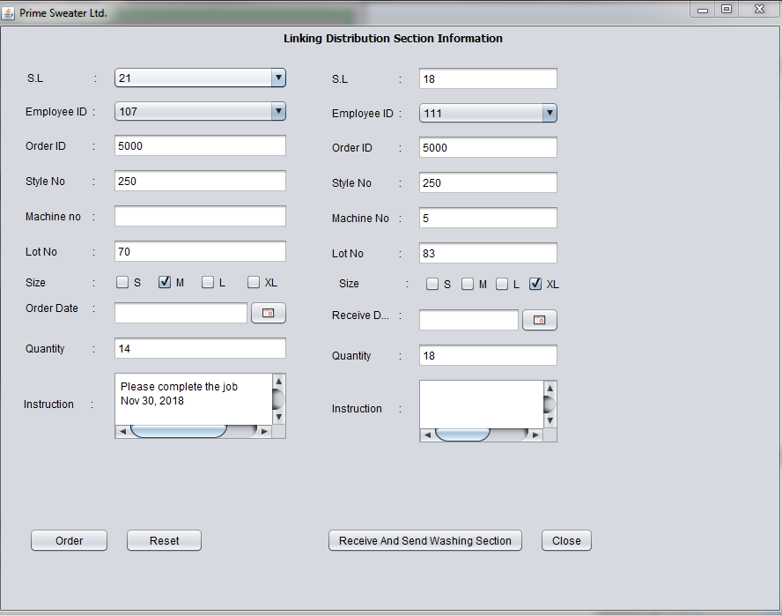
Linking section distribution and receive and send next washing department

Slide 9
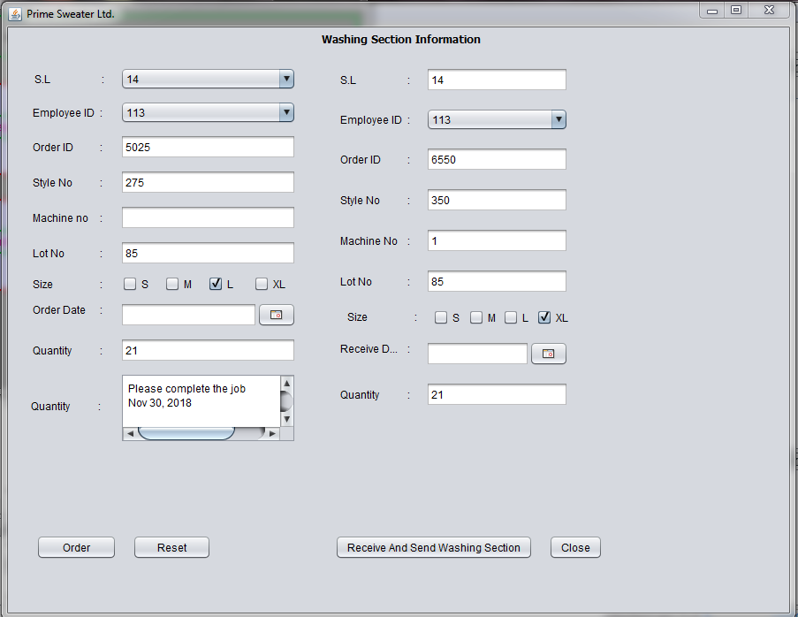
Washing section distribution and receive and send next finishing department

Slide 10
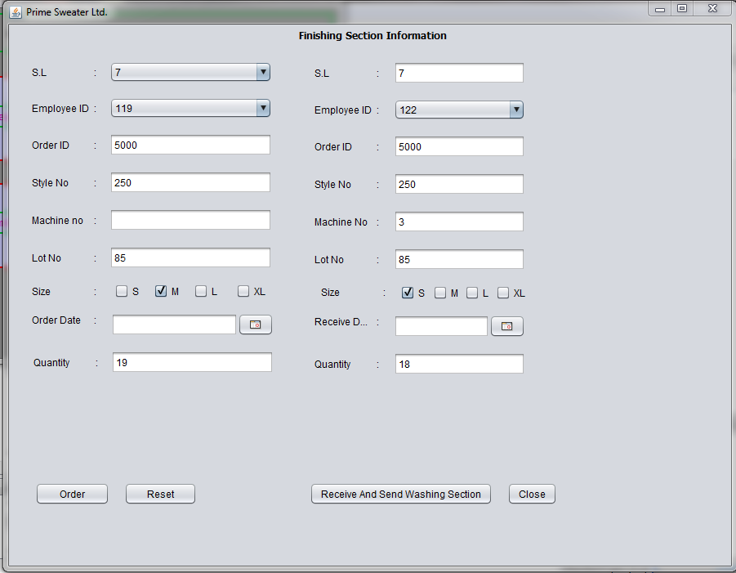
Finishing section distribution and receive and send next linking department

Slide 11
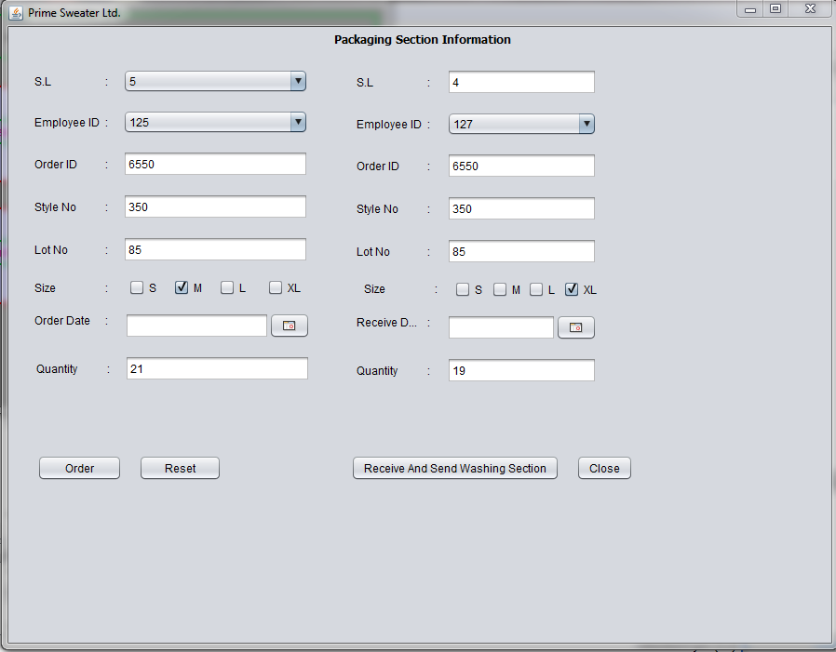
Knitting section distribution and receive and send next linking department

Slide 12
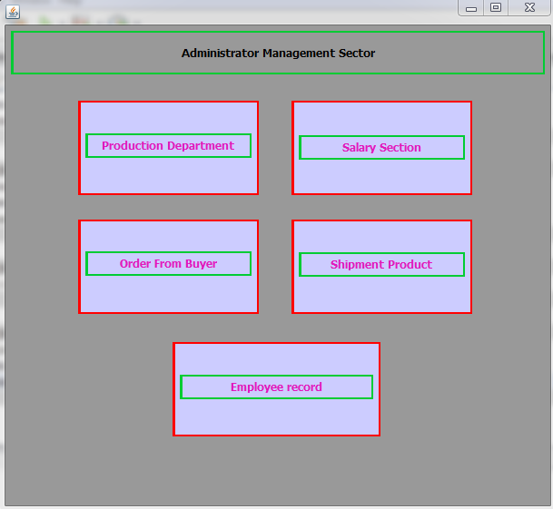
Admin login and management system that production department same P.M activity

Slide 13
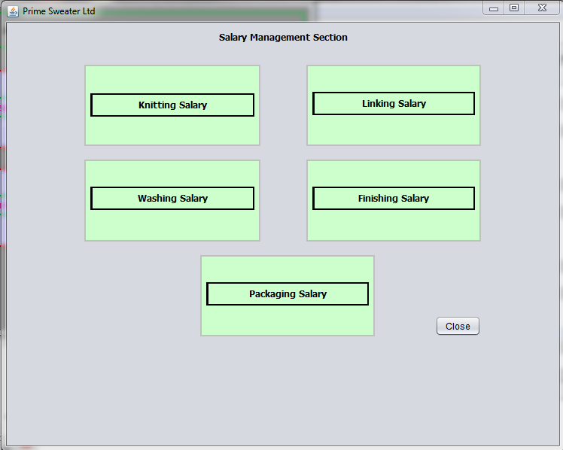
Salary department

Slide 14
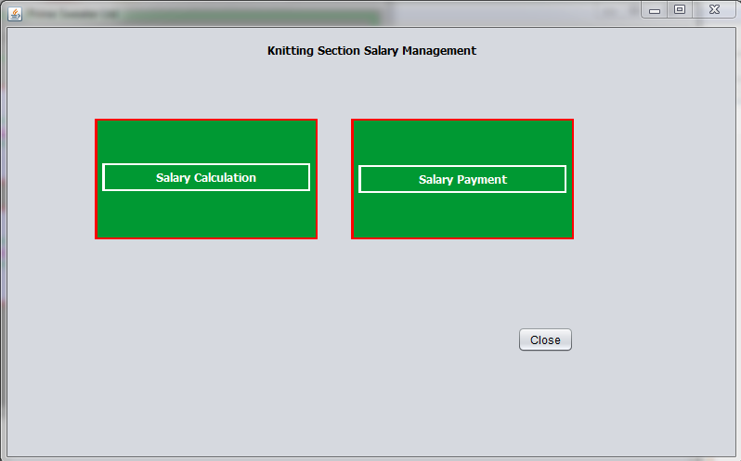
Knitting salary section login

Slide 15
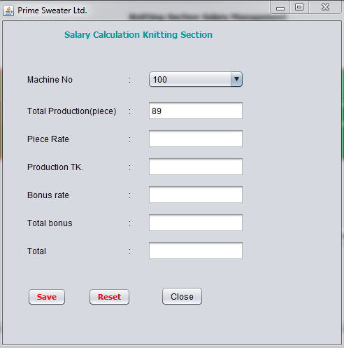
Knitting salary calculation

Slide 16
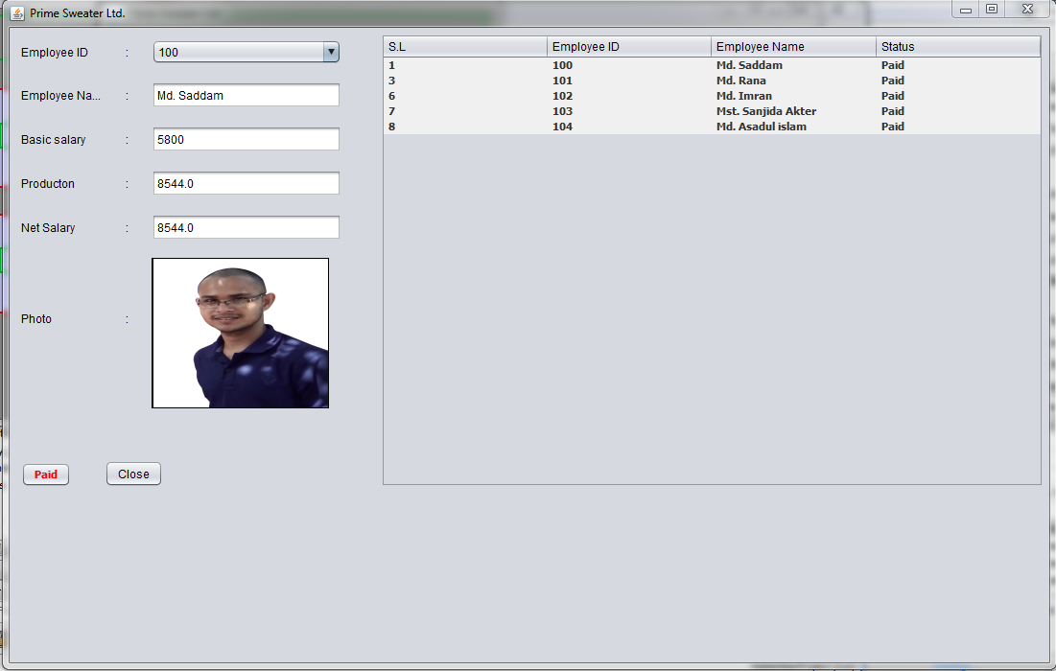
Knitting salary payment

Slide 17
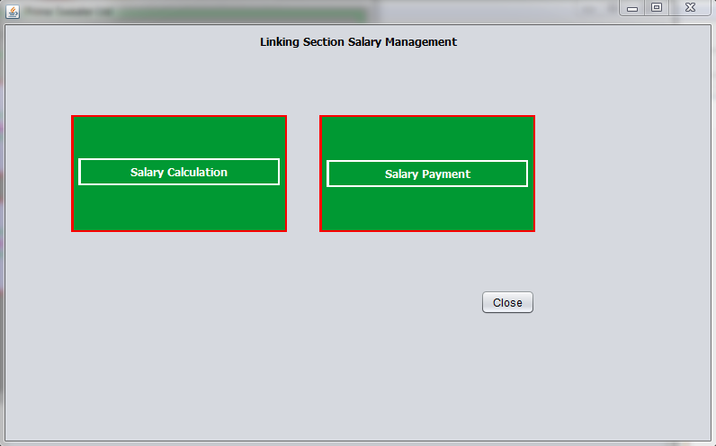
Linking salary section login

Slide 18
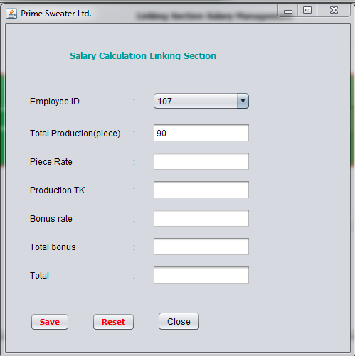
Linking salary calculation

Slide 19
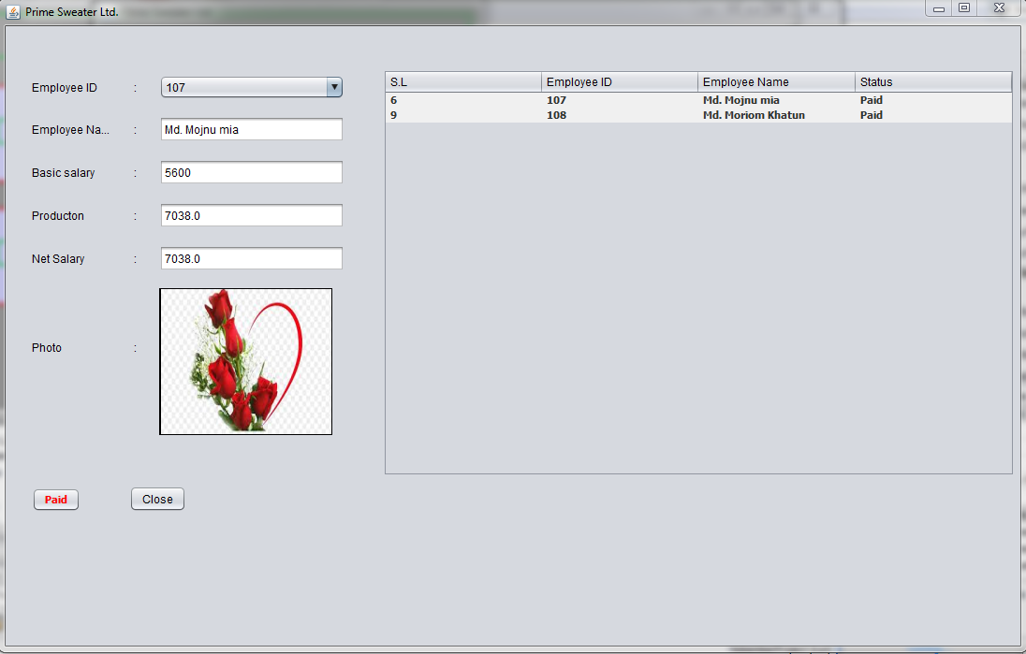
Linking section salary payment

Slide 20
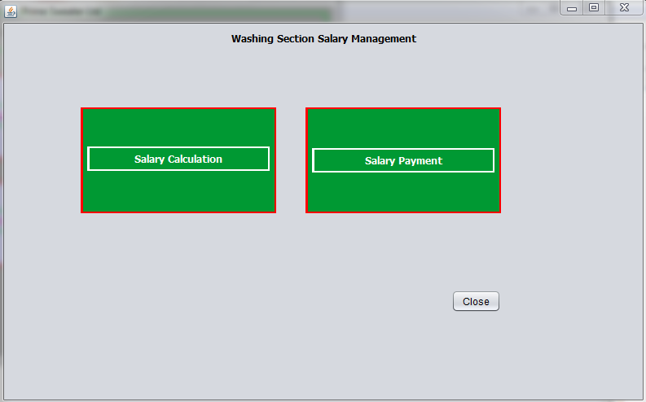
Washing salary section login

Slide 21
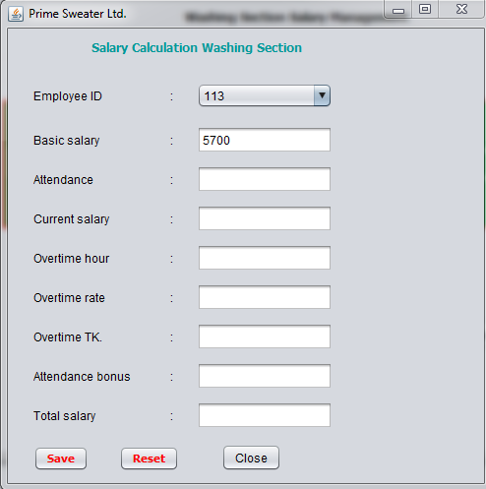
Washing section salary calculation

Slide 22
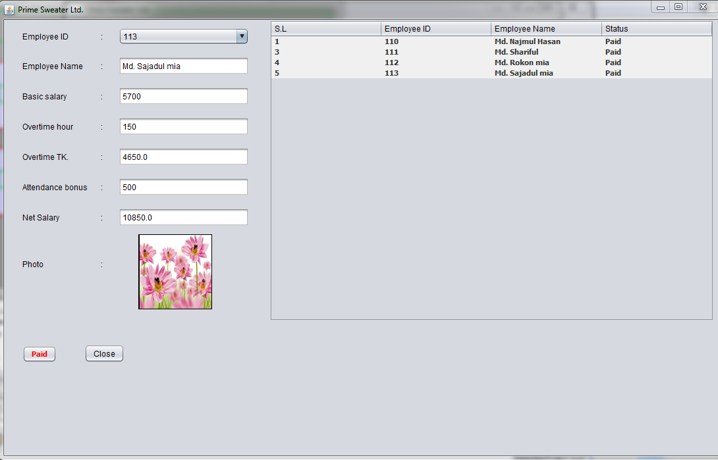
Washing section salary payment

Slide 23
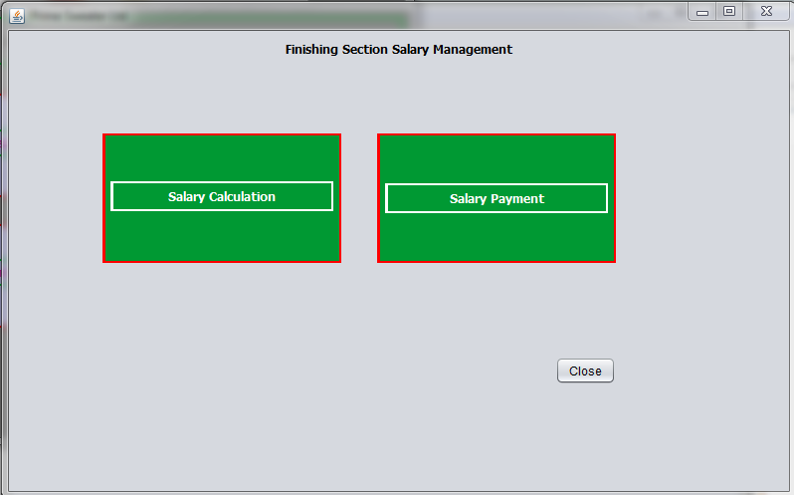
Finishing section salary login

Slide 24
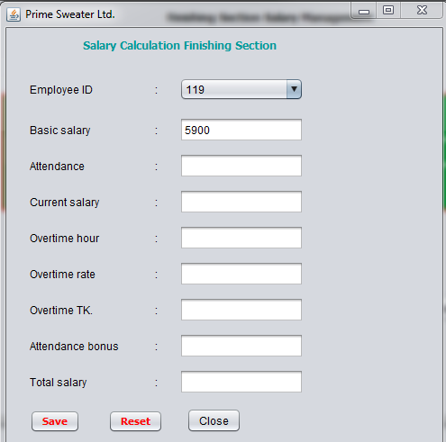
Finishing section salary calculation

Slide 25

Packaging section salary login

Slide 26
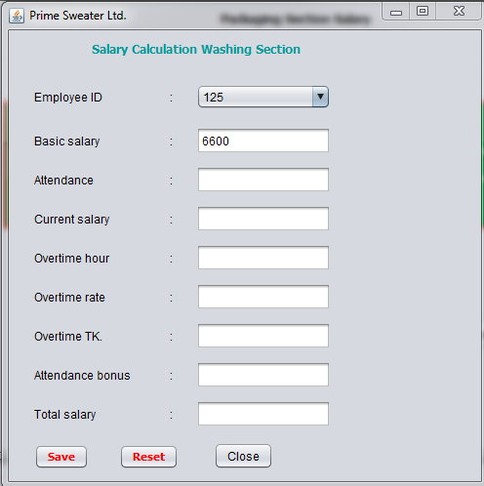
Packaging section salary calculation

Slide 27
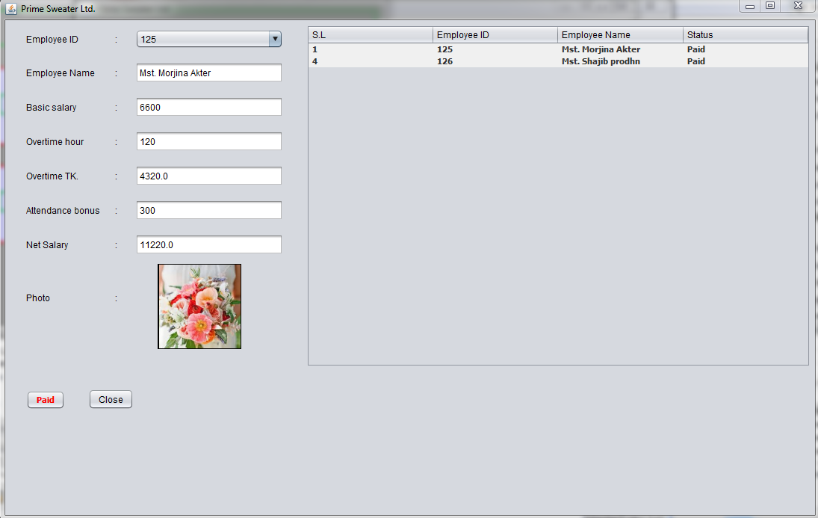
Packaging section salary payment

Slide 28
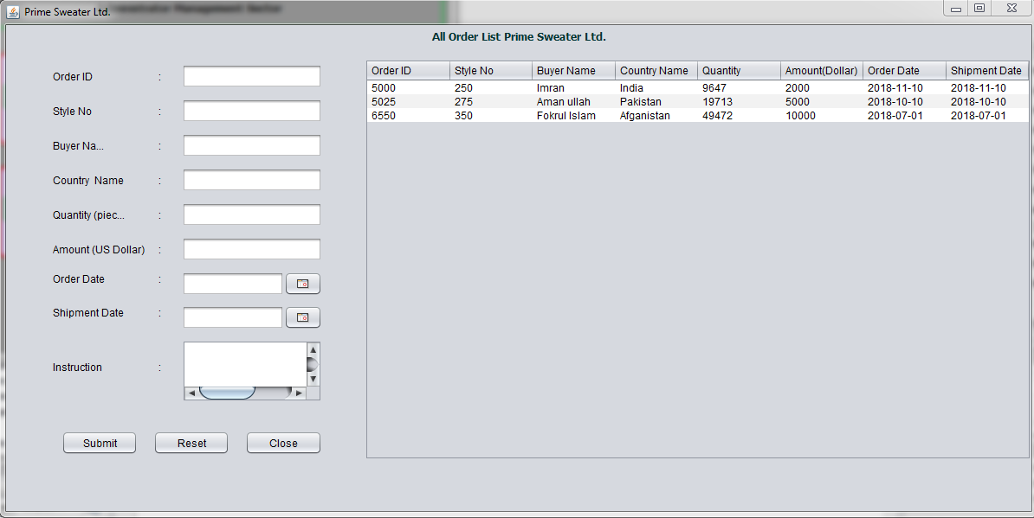
Total Order list for prime sweater ltd.

Slide 29
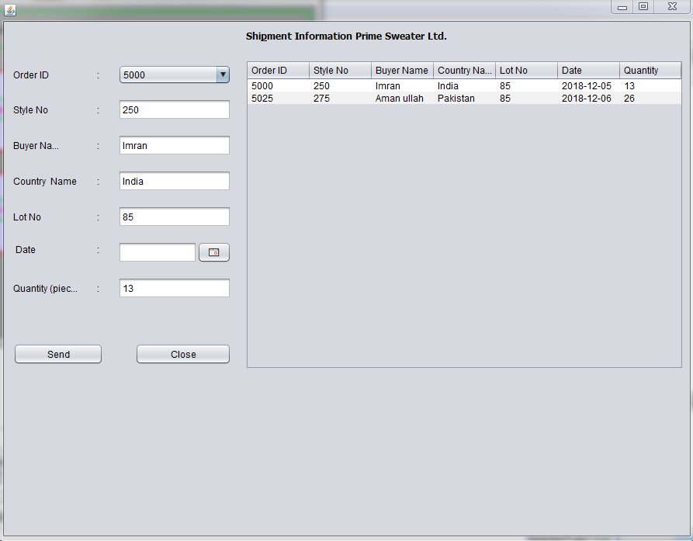
Shipment record table

Slide 30
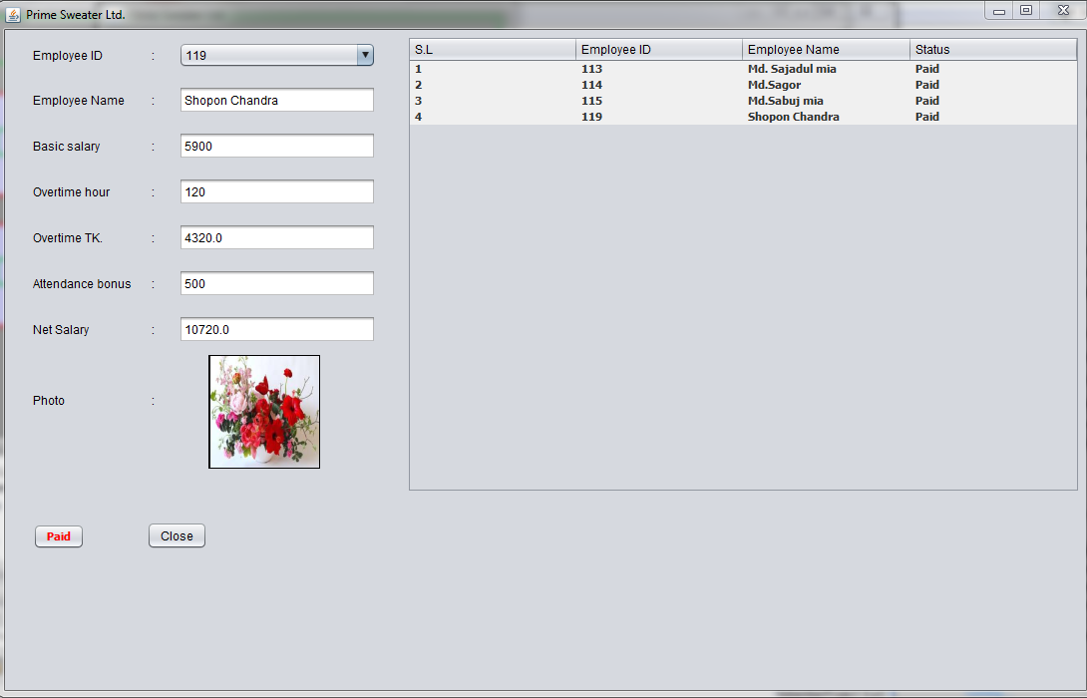
Finishing section salary payment

Slide 31
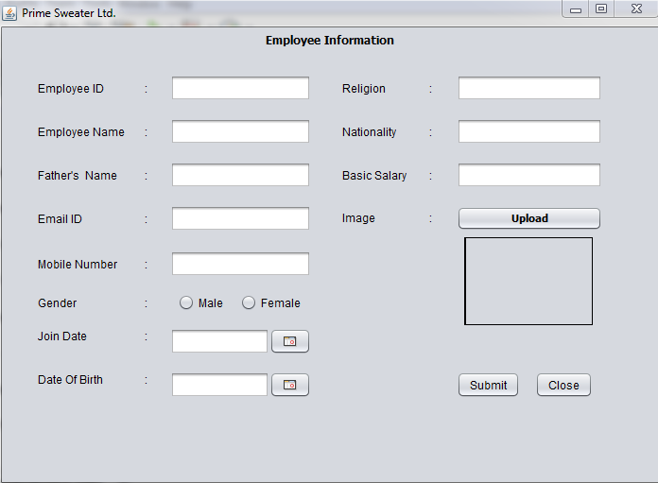
Employee information

Slide 32
Upcoming Features
Update employee information section
Total order count and send visual
Delete information every employee
Attendance for time section

Slide 33
Programs that are used here
Net Beans IDE
JAVA 8.2
MySQL Workbench 6.3
SQL Plus

