Slide 1

Notes Application "Dnote"

Slide 2
Presenters
Abdulla Al Shahid | 191002118

Slide 3

Content
Introduction
Motivation
Technology Used
How is it work ?
Future Scope
Conclusion

Slide 4
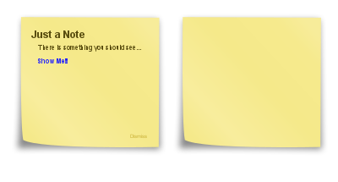
Introduction
Dnote is a simple note-taking application designed to help users organize and manage their personal or professional notes effectively. With its user-friendly interface and essential features, Dnote offers a convenient platform for users to create, edit, and delete notes on the go.

Slide 5

Motivation
The motivation behind developing Dnote was to address the need for a lightweight, user-friendly, and feature-rich note-taking application. In today's fast-paced world, where information is constantly flowing, individuals often require a tool to capture their thoughts and ideas in a convenient manner.

Slide 6

Technology Used
FrontEnd : Java ,Android Studio
Backend : Node,Express Database : Mongodb

Slide 7
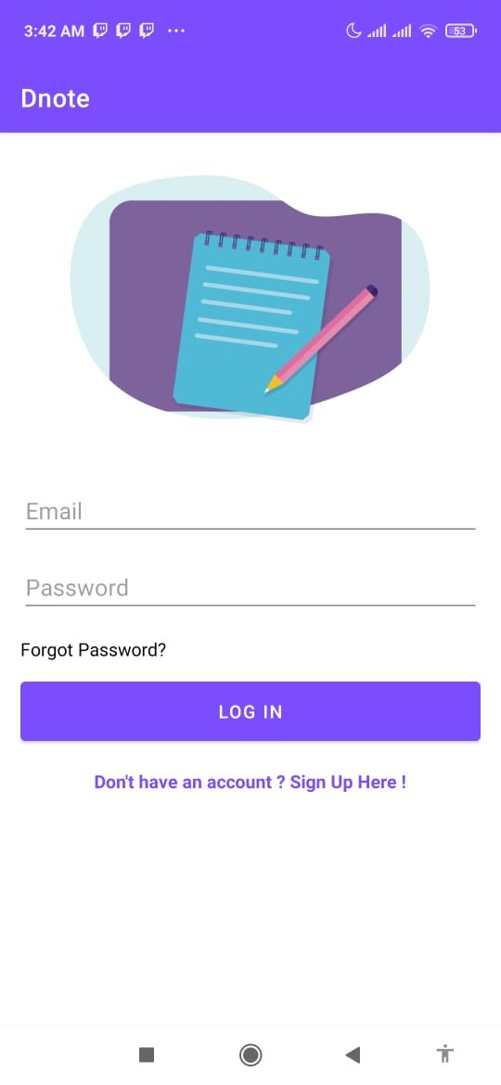
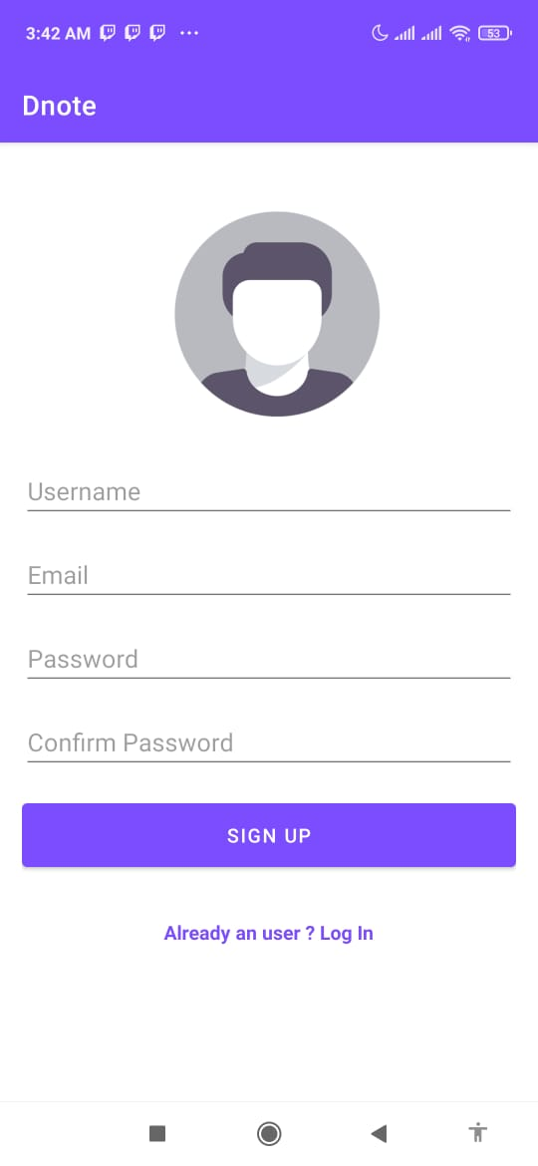
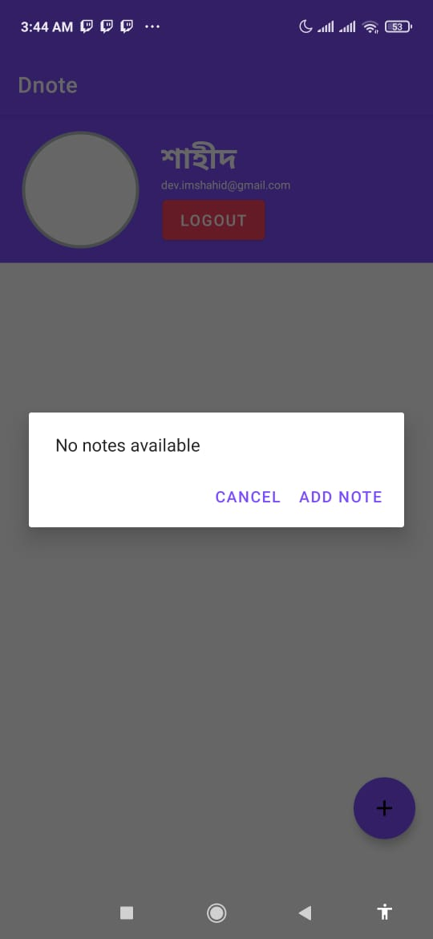
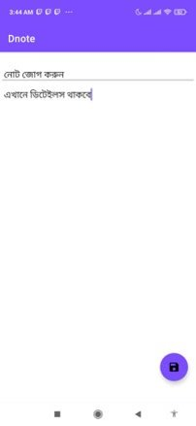
How it works

Slide 8
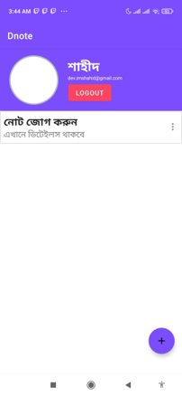
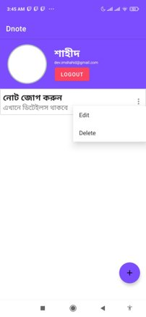
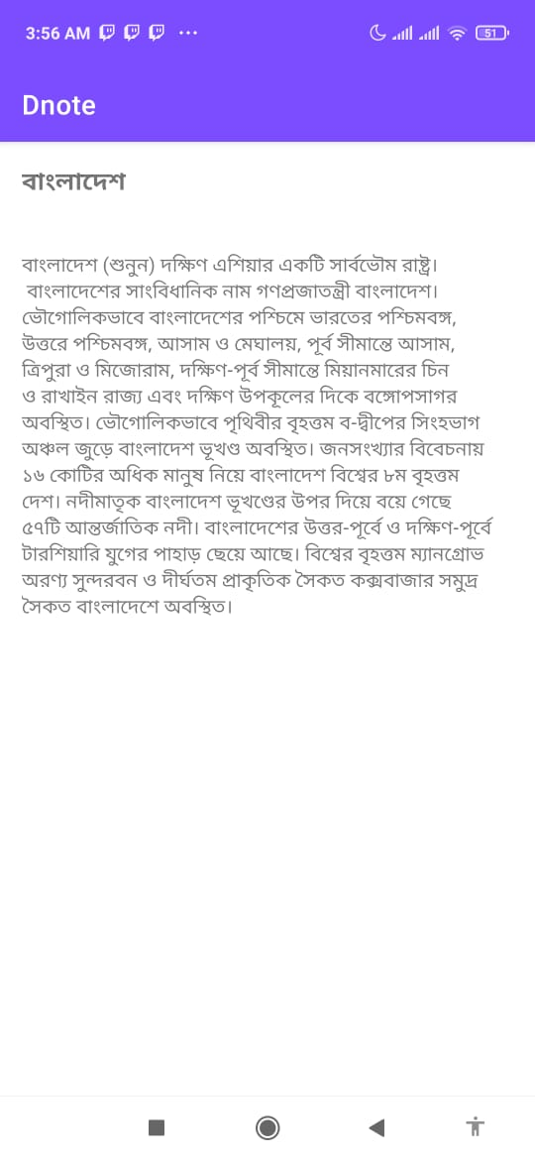
How it works

Slide 9

Future Scope
Collaboration: Introducing collaborative note-taking features that allow users to share and collaborate on notes with others. This would enable teams or groups to work together and enhance productivity.
Cloud Sync: Implementing cloud synchronization capabilities, which would enable users to access their notes seamlessly across multiple devices. This feature ensures that notes are always up to date and accessible from anywhere.
Advanced Organization: Enhancing the note organization capabilities by introducing folders, tags, and search functionalities. This would make it easier for users to categorize and retrieve specific notes quickly.

Slide 10

Conclusion
In summary, Dnote is a promising note-taking application that simplifies the process of capturing, organizing, and accessing notes. With future enhancements and the use of advanced technologies, Dnote aims to become a comprehensive solution for individuals and teams in managing their note-taking needs efficiently.

Slide 11
END
Any Questions ?

