Slide 1

Android Activity and Resource Management

Slide 2
Presenters
Mir Shadhin | 191002283
Abdulla Al Shahid | 191002118
Yamin Lam Bappi | 191002103
MD. Shahin Sarker | 193002060

Slide 3

Content
Introduction
What is an activity ?
Activity Life Cycle
Activity Stack
Resource Management
Optimizing Resource Usages
Best Practice for Resource Management
Conclusion

Slide 4

Introduction
Android is an operating system developed by Google for mobile devices
Android uses an event-driven architecture based on components, such as activities, services, broadcast receivers, and content providers
In this presentation, we will focus on activity and resource management in Android

Slide 5
What is an activity ?
An activity in Android is a single screen with a user interface that allows users to interact with an application. It manages the UI, handles user input, and transitions between different states to provide a seamless user experience.

Slide 6
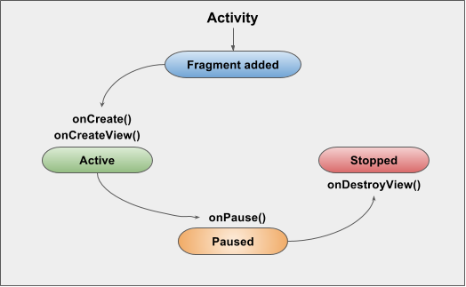
Activity Lifecycle
In general android activity has three steps :
Active:
The activity is in the active state when it is at the top of the activity stack and visible to the user.
Paused:
The activity enters the paused state when it loses focus but remains visible to the user.
Stopped:
The activity is in the stopped state when it is no longer visible to the user.

Slide 7
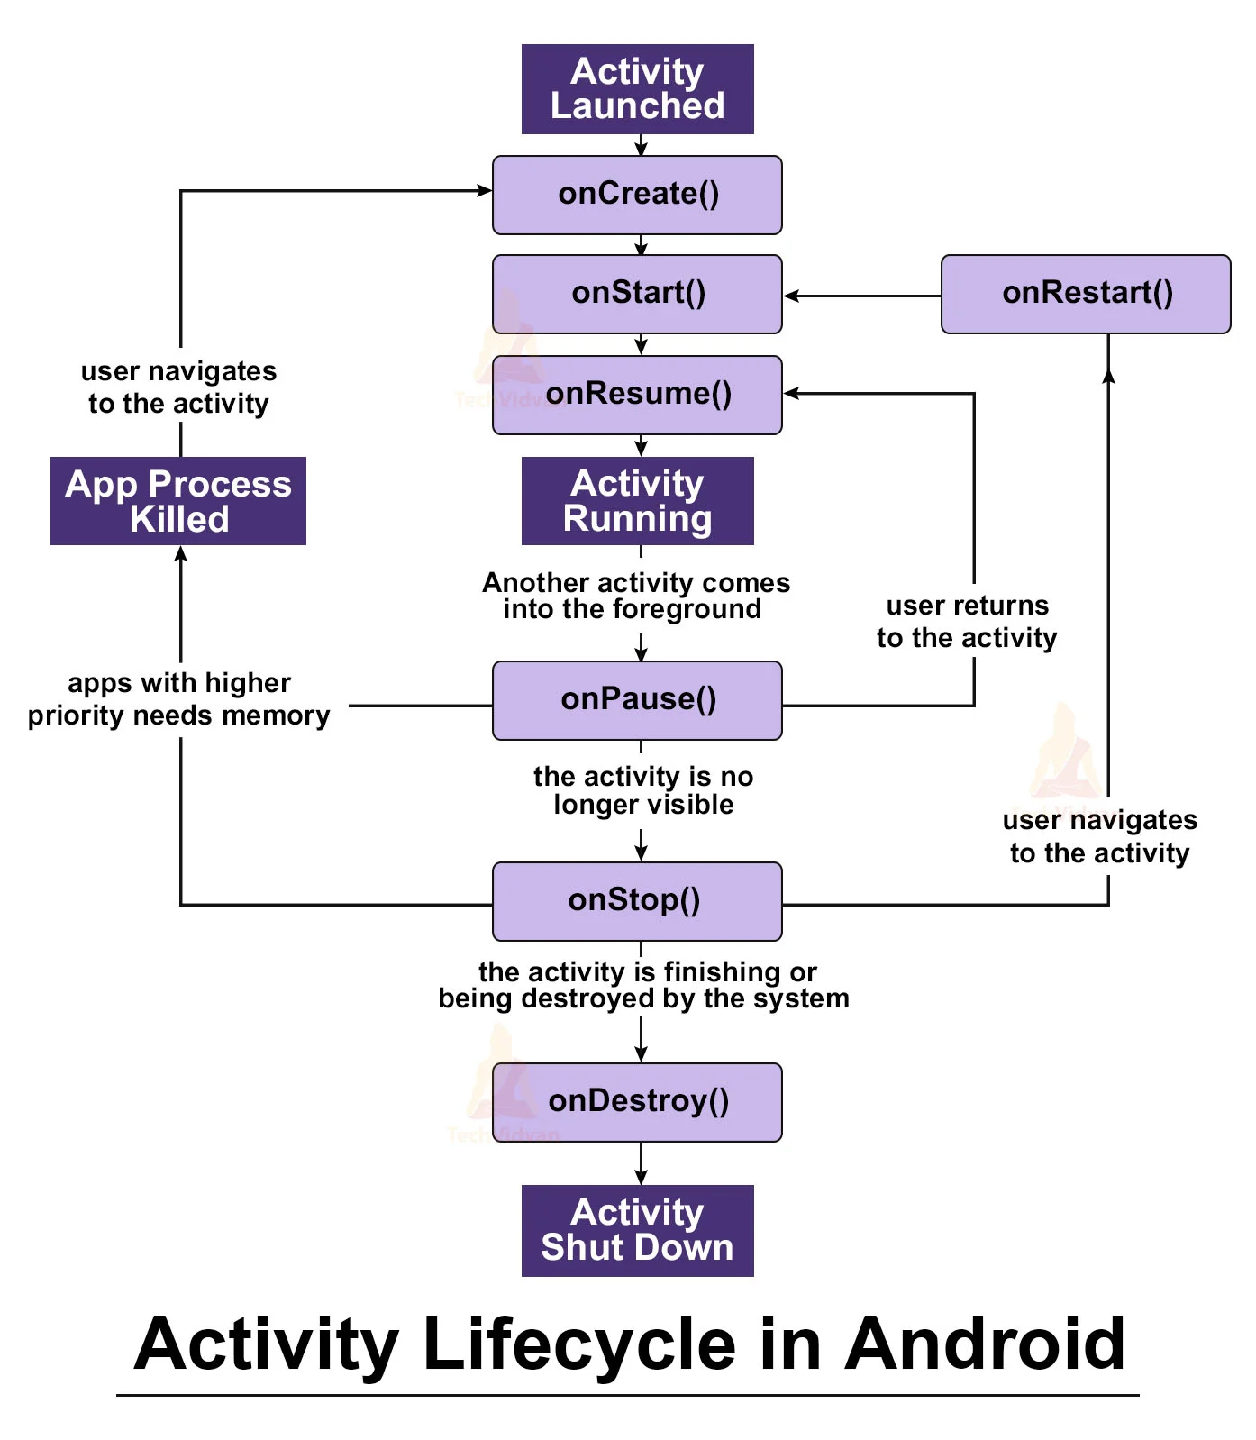
Activity Lifecycle
An activity is a user interface component that represents a single screen with a user interface
The activity lifecycle is a series of states that an activity goes through, from creation to destruction

Slide 8
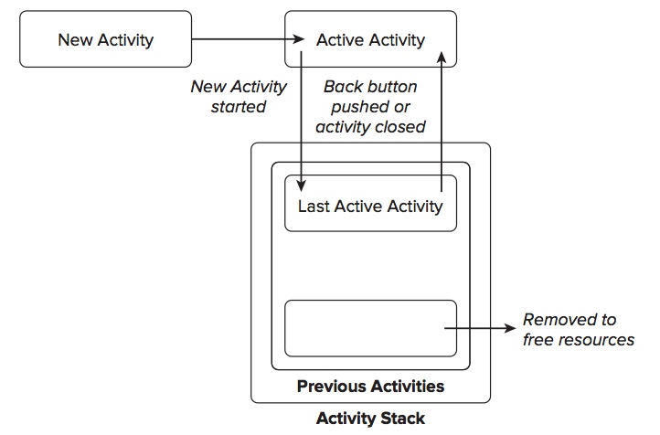
Activity Stack
The activity stack is a data structure that maintains the order of activities in an Android application.
Activities are pushed onto the stack when started and popped from the stack when finished or when the user navigates back.
The topmost activity on the stack is the one currently visible to the user, while lower activities remain paused or stopped until they are brought back to the foreground.

Slide 9
Resource Management
Android provides mechanisms for managing resources, including memory, CPU, and battery usage
The garbage collector automatically frees memory that is no longer in use
Developers can use the Android Profiler to monitor and optimize resource usage in their applications

Slide 10

Optimizing Resource Usage
Dealing with Different Screen Sizes
Use responsive layout techniques (RelativeLayout, LinearLayout, ConstraintLayout) to create UIs that adapt to different screen sizes.
Ensure a consistent user experience by accommodating various screen sizes and maintaining the visual integrity of the application.
Scaling Images
Utilize Android's image scaling techniques, such as scaleType attribute or Bitmap APIs, to resize images programmatically.
Optimize resource usage and maintain image quality by scaling down larger images, selecting the appropriate scaleType, or using 9-patch images.

Slide 11
Best Practices for Resource Management
Releasing
Releasing resources when they are no longer needed is essential for efficient management
Avoiding
Avoiding memory leaks by releasing object references when they are no longer required
Using
Using the appropriate threading model for different tasks helps optimize resource usage

Slide 12
Best Practices Resource Management (continued)
Utilizing the Android Profiler tool to monitor and optimize resource usage
01
Employing techniques like lazy loading and caching to minimize resource consumption
02
Following these best practices leads to improved performance and stability in Android applications
03

Slide 13
Conclusion
Activity and resource management are vital aspects of Android application development
Understanding the activity lifecycle and employing effective resource management techniques leads to better performance and stability
By following best practices and utilizing tools like the Android Profiler, developers can optimize resource usage and enhance the user experience

Slide 14
END
Any Questions ?

