Slide 1
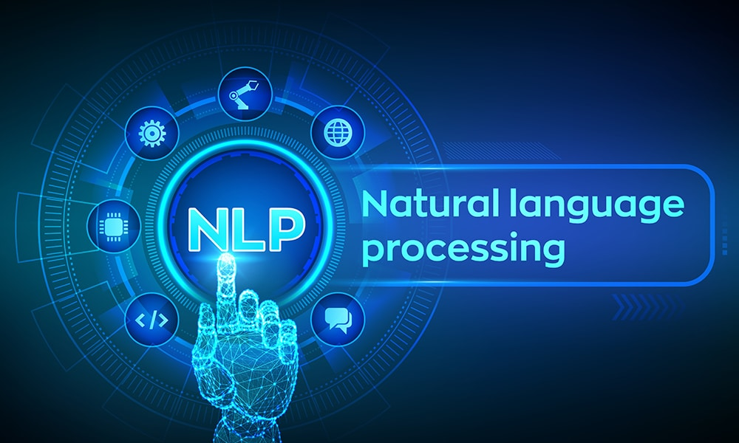

Slide 2
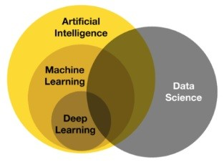
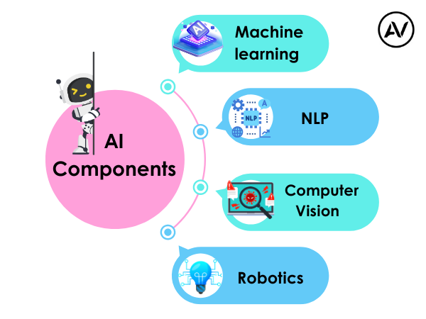
https://ellow.io/components-of-ai/

Slide 3
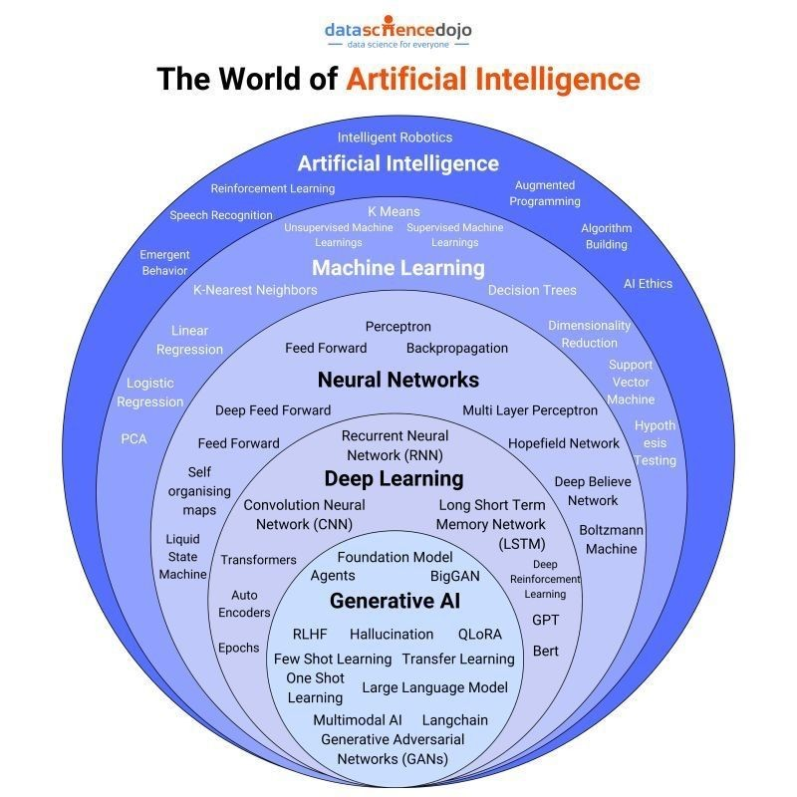
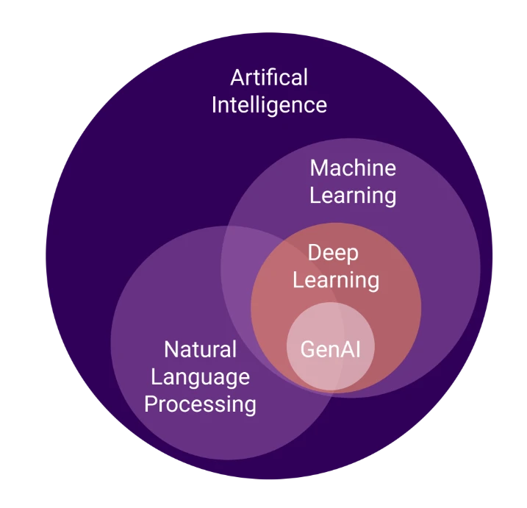
Algorithms and models

Slide 4
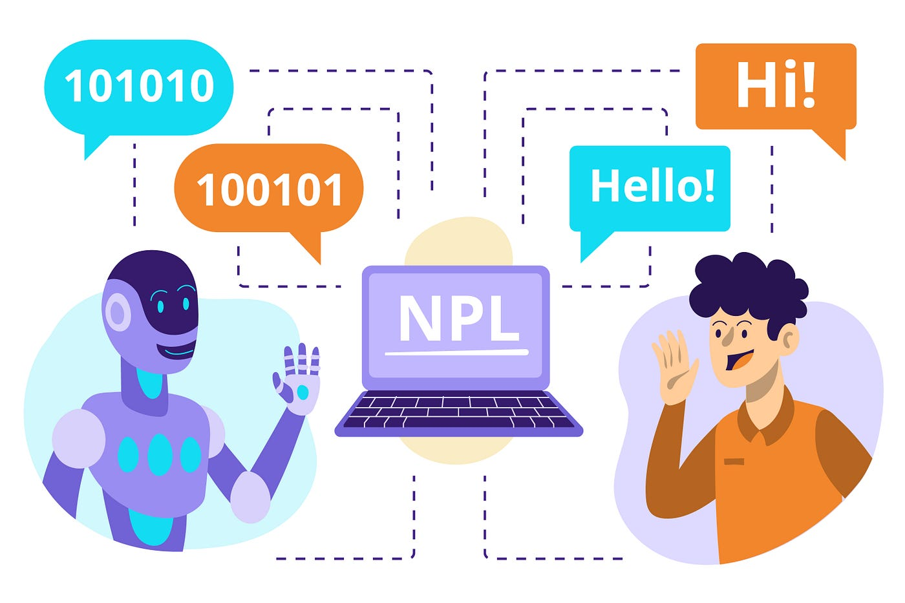

Slide 5
Before Learn NLP
Machine Learning
Deep Learning
1. Fundamentals of Neural Networks:
Introduction to Artificial Neural Networks (ANNs)
Perceptron model
Activation functions (sigmoid, ReLU, tanh)
Backpropagation algorithm
Loss Functions
Gradient descent optimization

Slide 6
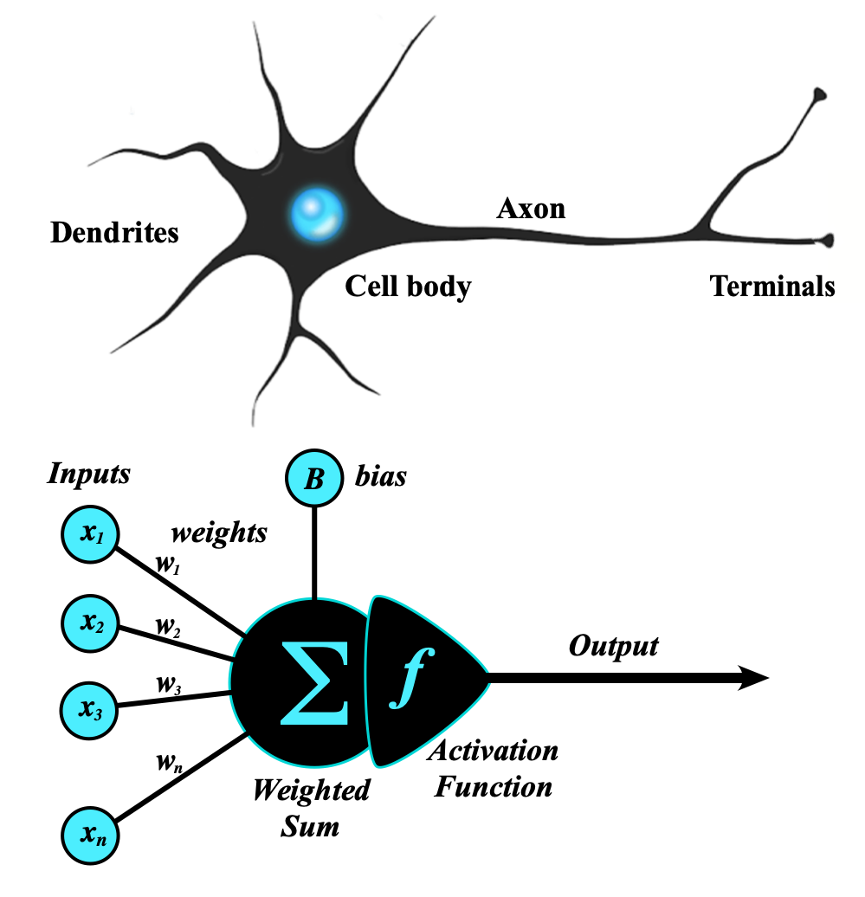
Artificial Neural Network
An artificial neural network (ANN) is a computational network (a system of nodes and the interconnection between nodes) inspired by biological neural networks, which are the complex networks of neurons in human brains (see Figure).
The nodes created in the ANN are supposedly programmed to behave like actual neurons, and hence they are artificial neurons.
The Perceptron was invented in 1957 by Frank Rosenblatt at the Cornell Aeronautics Laboratory. Based on the first concepts of artificial neurons, he proposed the “Perceptron learning rule“.
Perceptron Model
The perceptron is the simplest form of an artificial neural network and serves as the building block of more advanced models.
Components of a Perceptron:
Inputs: Feature values from the dataset.
Weights: Assigned to each input to signify importance.
Summation Function: Computes the weighted sum of inputs.
Activation Function: Applies a threshold to determine output.
https://www.geeksforgeeks.org/neural-networks-a-beginners-guide/
https://s.mriquestions.com/what-is-a-neural-network.html

Slide 7
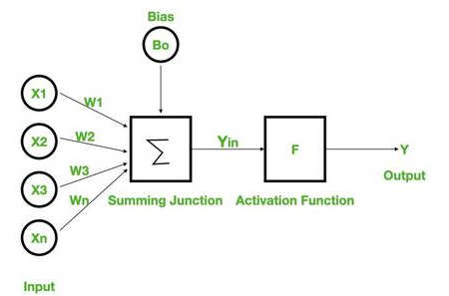
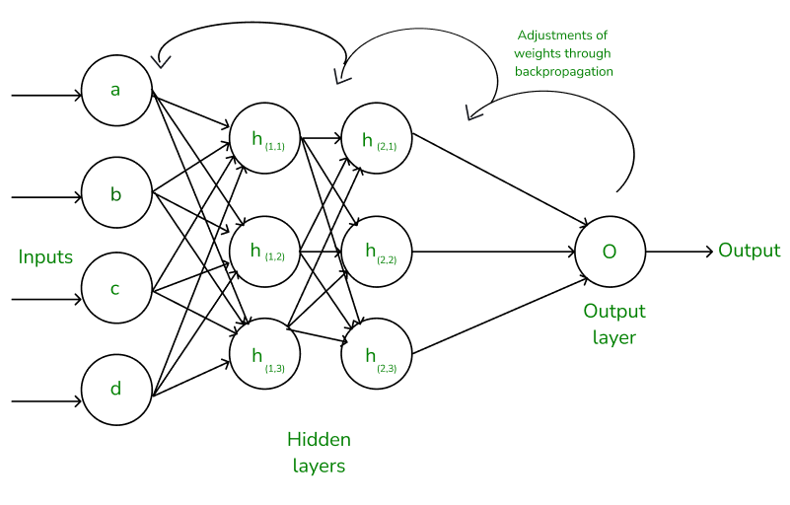
Types of Perceptron Models:
Single-layer perceptron: Can only solve linearly separable problems.
Multi-layer perceptron (MLP): Can solve non-linear problems using multiple layers.
Neural Networks Architecture:
the basic elements of the network's architecture.
made of three core layers:
Input layer
Hidden layers
Output layer

Slide 8
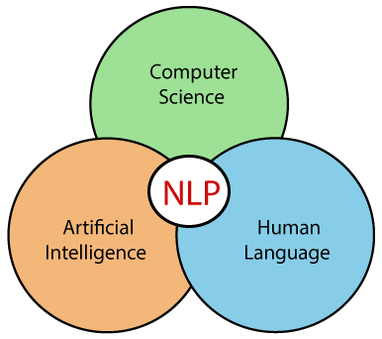
What we Learn in NLP

Slide 9
Introduction to NLP
What is Natural Language Processing
Uses of NLP
Application of NLP
Components of NLP
Stages of NLP
Machine Translation
Introduction to LLM
Sentiment Analysis
What is Sentiment Analysis
Challenges in Sentiment Analysis
Handling Emoticons
Sentiment Analysis with ANN
Assignment
Sequence Model
Sequential Data
Recurrent Neural Network
Multi-layer & Bi-directional RNN
Architecture of RNN
Vanishing Gradient Problem in RNN
Long Short Term Memory
Multi-layer & Bi-directional LSTM
Gated Recurrent Unit
Multi-layer & Bi-directional GRU
Assignment
Text Preprocessing
Tokenization
Non Alphabets Removal
Stopwords Removal
Bag of Words
Stemming & Lemmatization
Part of Speech Taging
Name Entity Recognition
Text Visualization
Assignment
Text Classification
CountVectorization/Text Vecorization
Text Classification with ML
TFIDF Vectorization
Text Classification with ANN
Embedding Layer in Natural Language
Assignment
Transformers Based Models
Sequence to Sequence Model
Attention Machanism
Transformers
Face Hugging Transformers

Slide 10
What we Learn in NLP Advance
Word embedding
Word2vac
Rnn
LSTM
GRU
encoder decoder
attentions
self attentions
transformer
BERT & GPT
Introduction of Prompt Engineering
Genrative AI
LLM
AGENT AI
Libraries
NLTK
SPACY

Slide 11
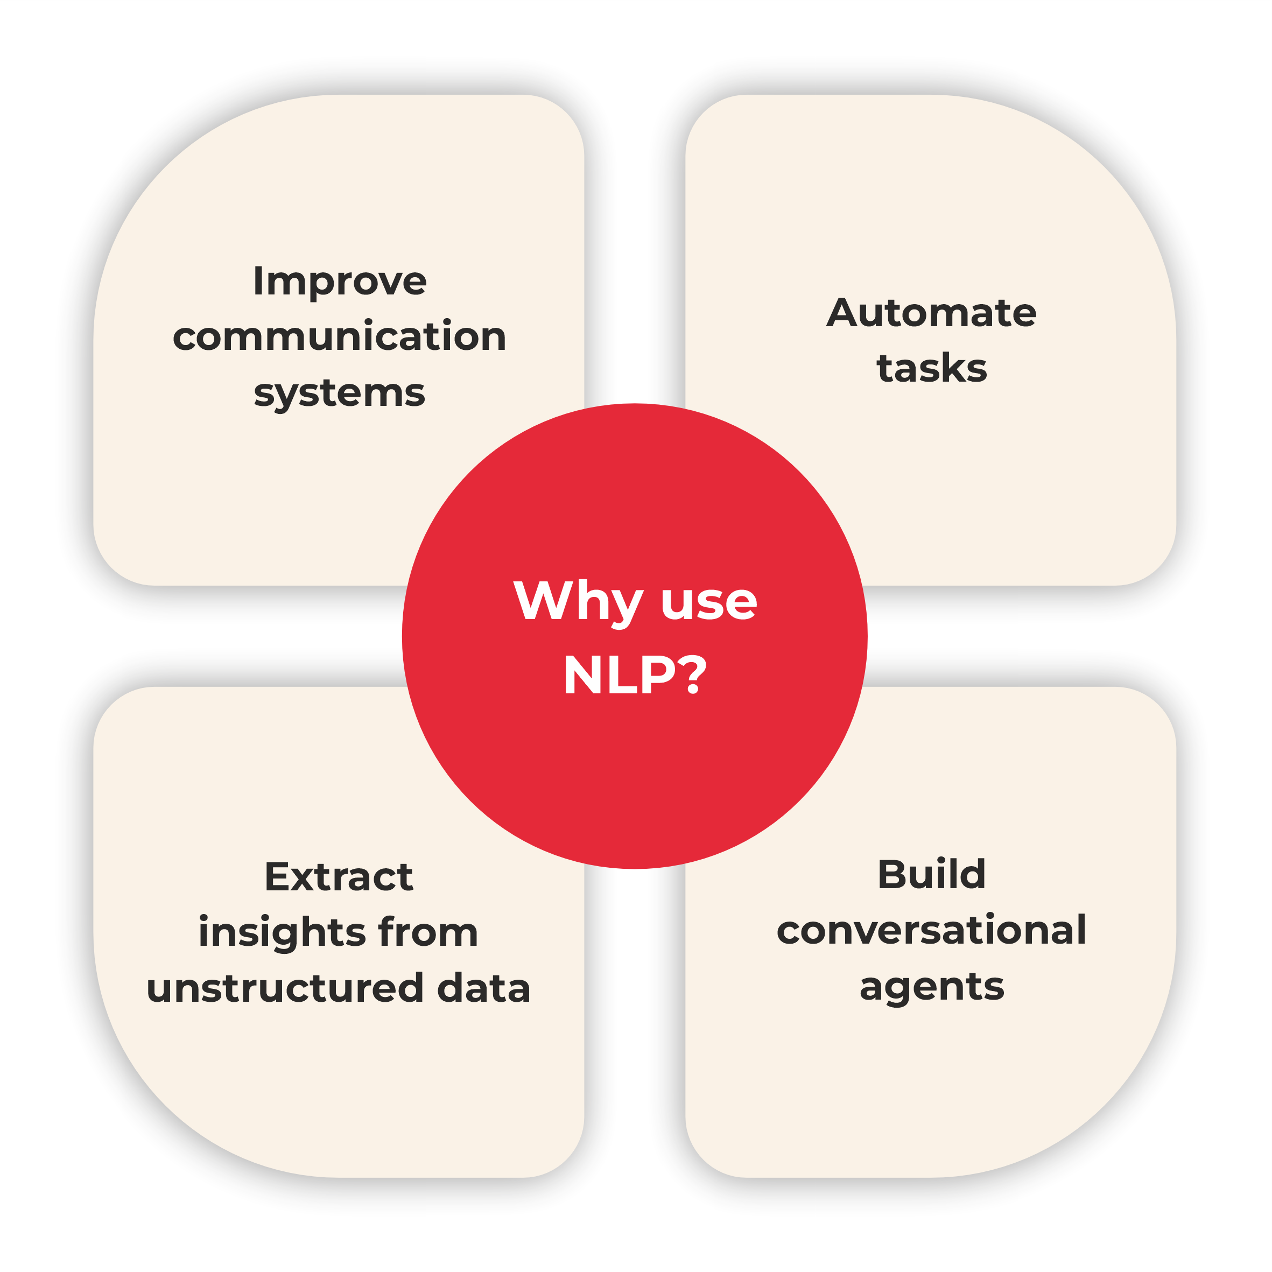

Slide 12
If we mathematically represent it contains the following terms:
NLP: NLP (Natural Language Processing) is in charge of processes such as decisions and actions.
NLU: NLU (Natural Language Understanding) understands the meaning of the text.
NLG: NLG (Natural Language Generation) creates the human language text from the structured data that the system generates to answer.
https://www.tpointtech.com/nlp --> History
https://www.xenonstack.com/blog/natural-language-processing

Slide 13
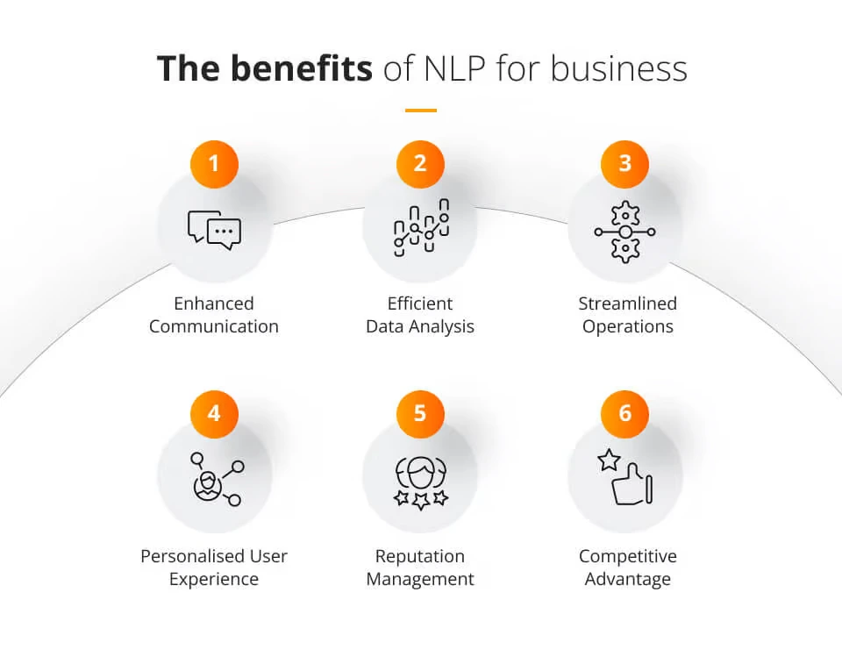
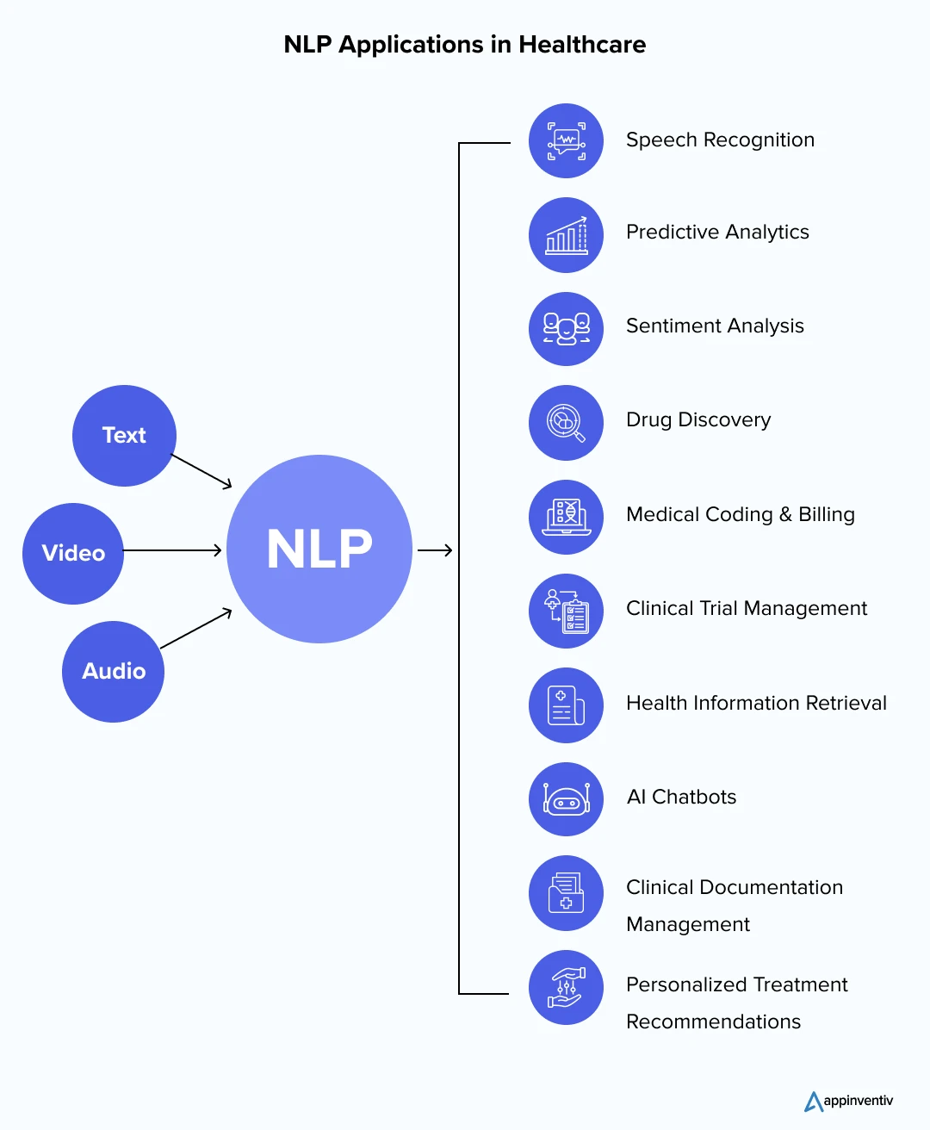
https://www.jaroeducation.com/blog/nlp-for-business-communications/
https://appinventiv.com/blog/nlp-in-healthcare/

Slide 14
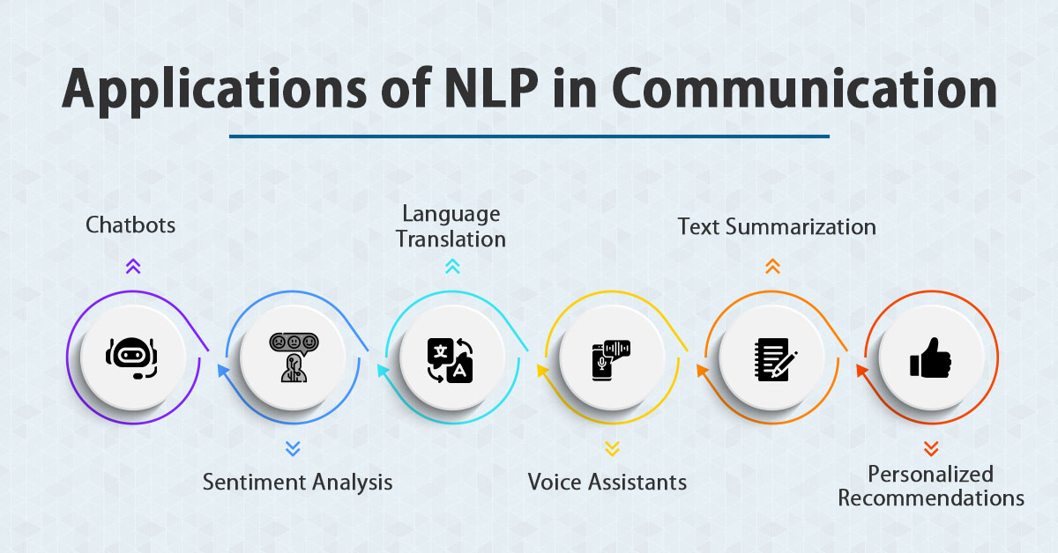
https://www.jaroeducation.com/blog/nlp-for-business-communications/

Slide 15
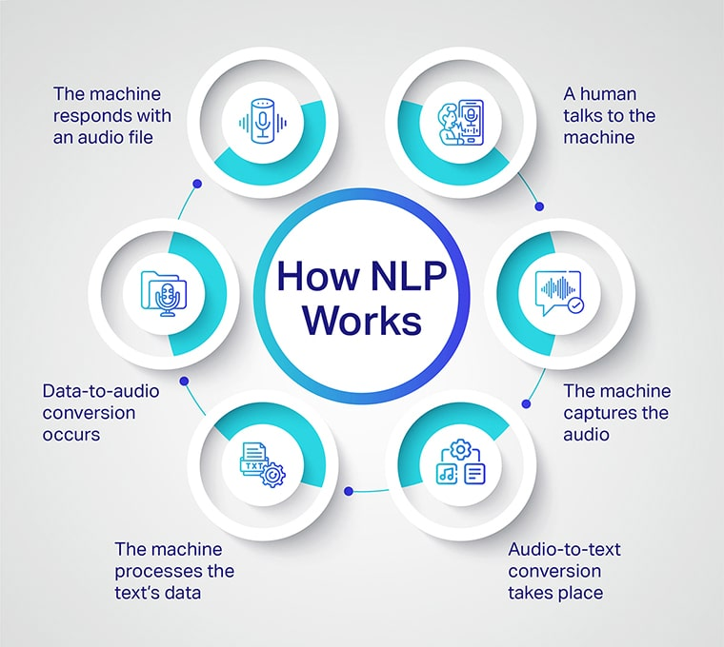

Slide 16
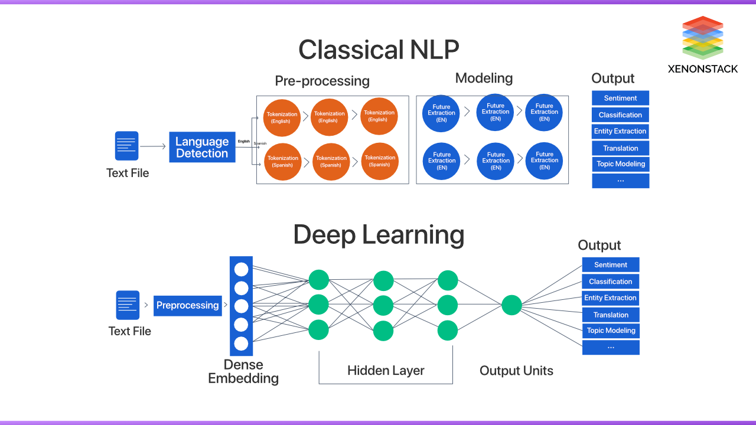

Slide 17
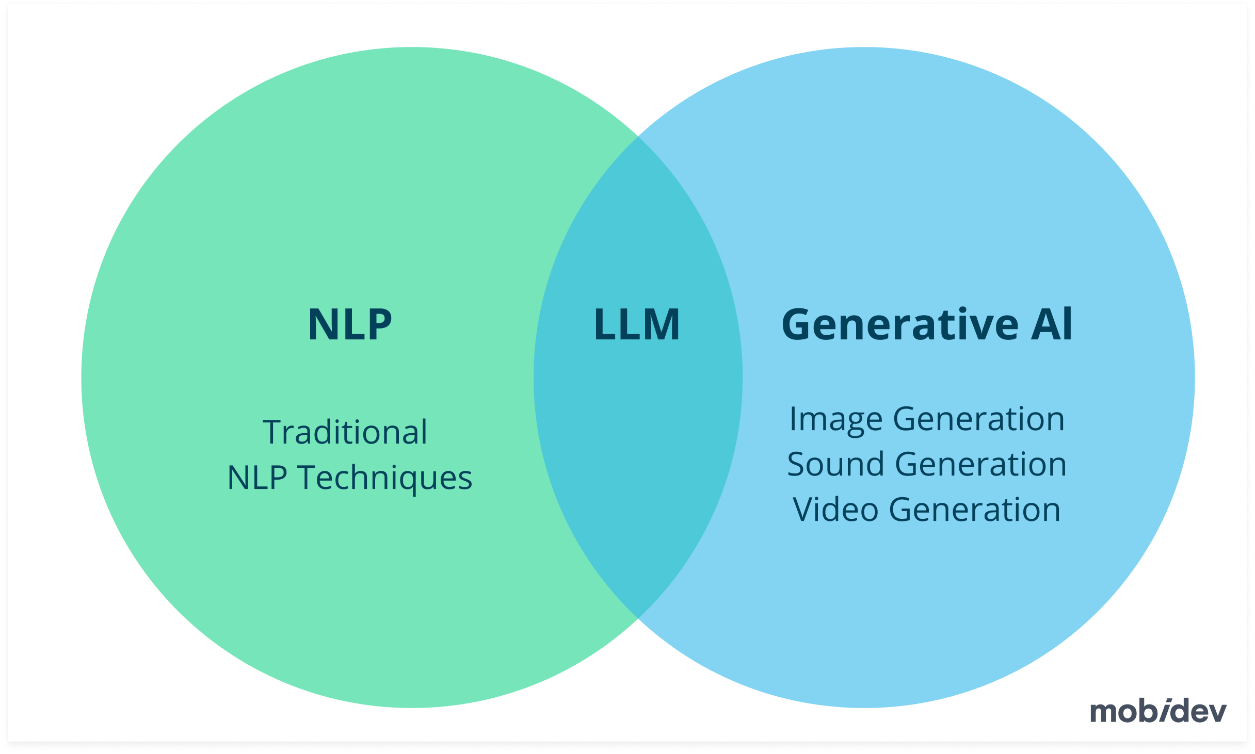
https://mobidev.biz/blog/natural-language-processing-nlp-use-cases-business

Slide 18
What are the 4 types of NLP?
NLP techniques can be broadly categorized into these four types:
Morphological Processing: Focuses on analyzing the structure of words, including prefixes and suffixes.
Syntactic Analysis: Examines sentence structure to ensure grammatical correctness.
Semantic Analysis: Studies meaning in text or speech, including context and word relationships.
Pragmatic Analysis: Looks at the intended meaning behind words, considering tone, culture, and situational context.

Slide 19
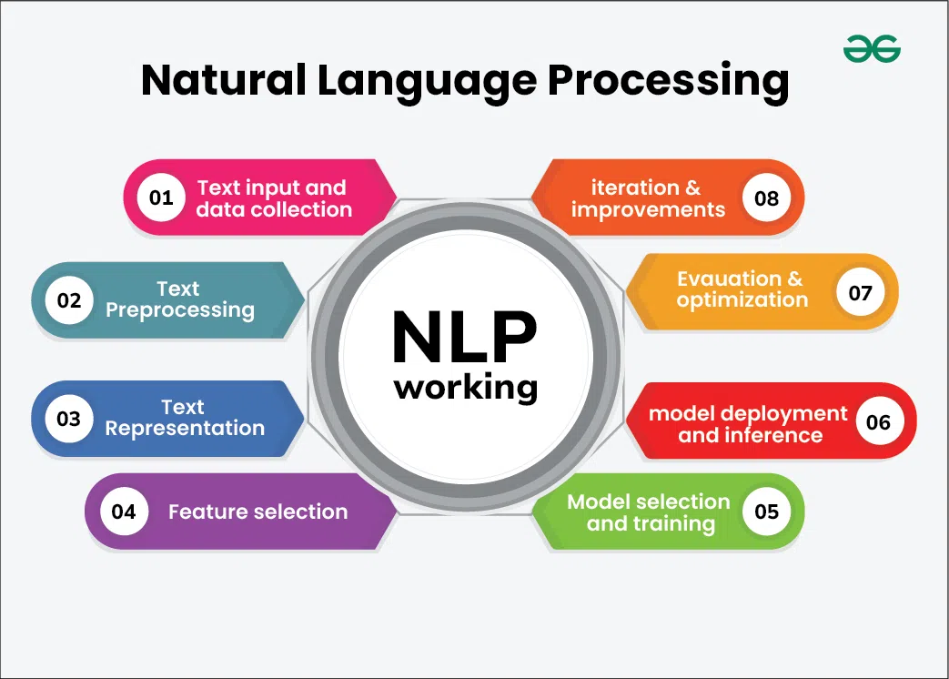

Slide 20
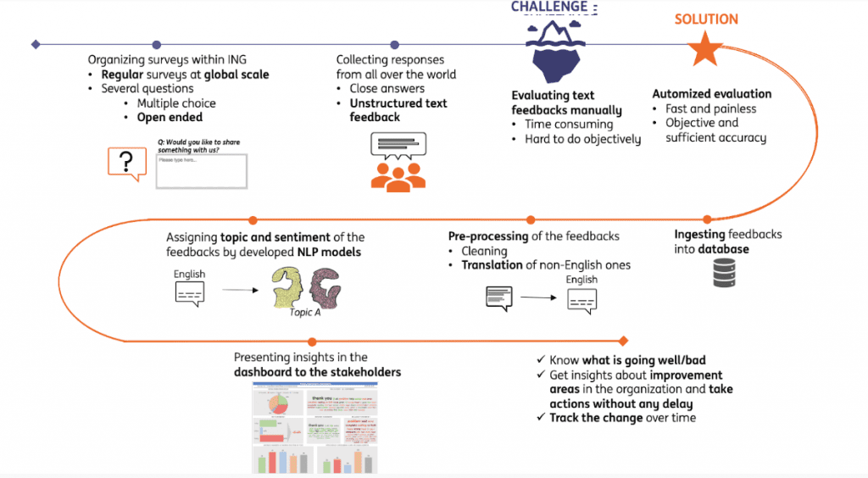
Full Life Cycle of NLP Models
https://hyperight.com/full-life-cycle-of-nlp-models/

Slide 21
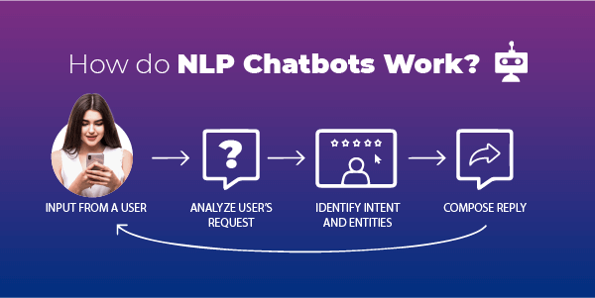
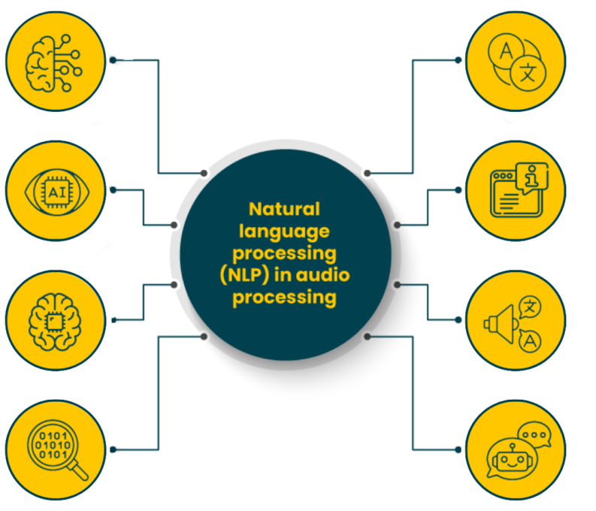
https://routemobile.com/blog/how-do-nlp-chatbots-work/
https://dac.digital/5-practical-applications-of-nlp-in-audio-processing/

Slide 22
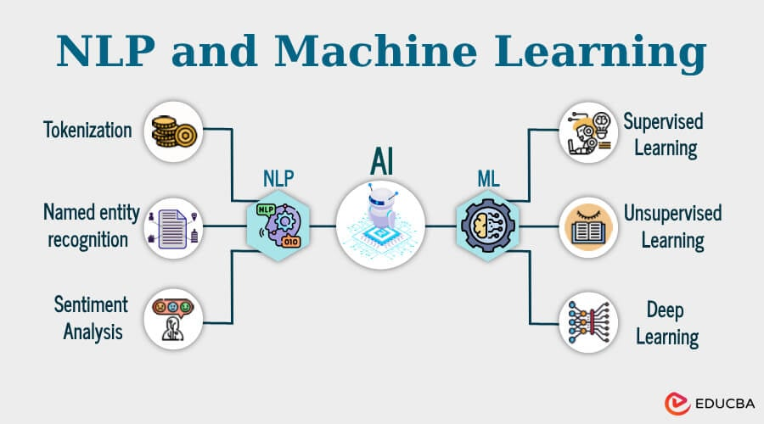

Slide 23
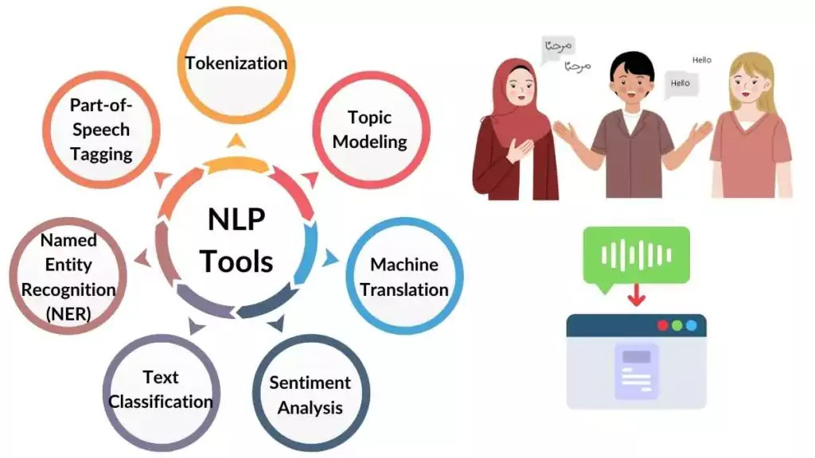
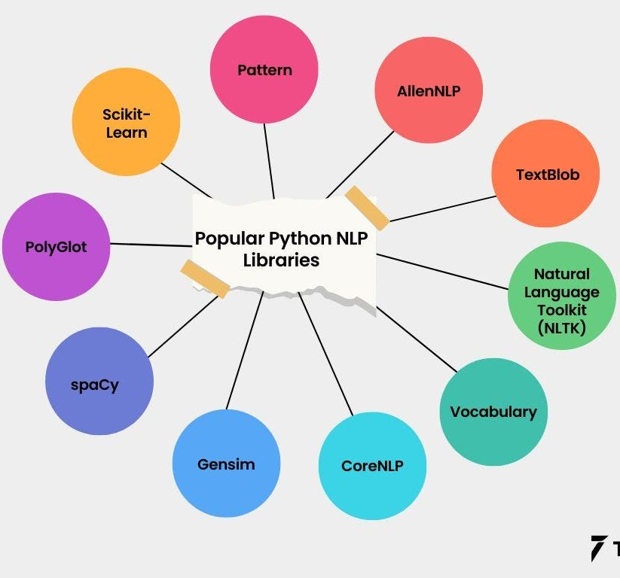
https://spotintelligence.com/2024/01/29/natural-language-processing-nlp-tools/
https://www.turing.com/kb/which-language-is-useful-for-nlp-and-why

Slide 24
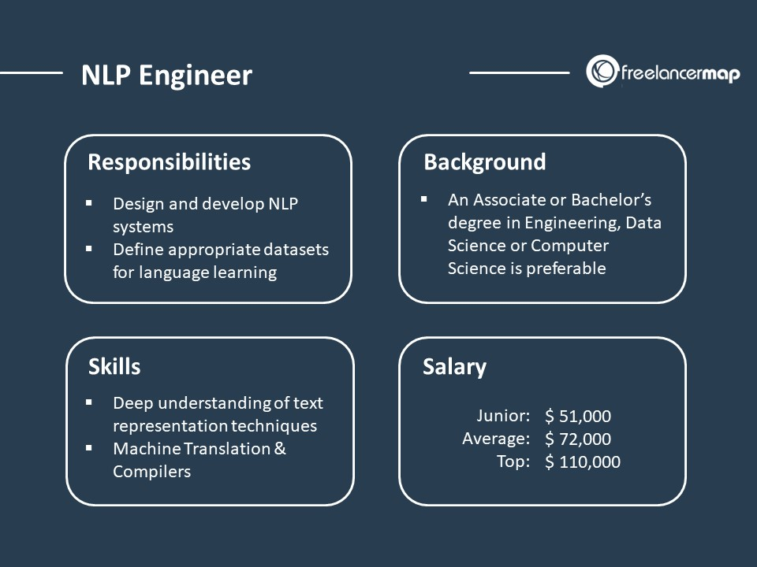
https://www.freelancermap.com/blog/what-does-nlp-engineer-do/

Slide 25
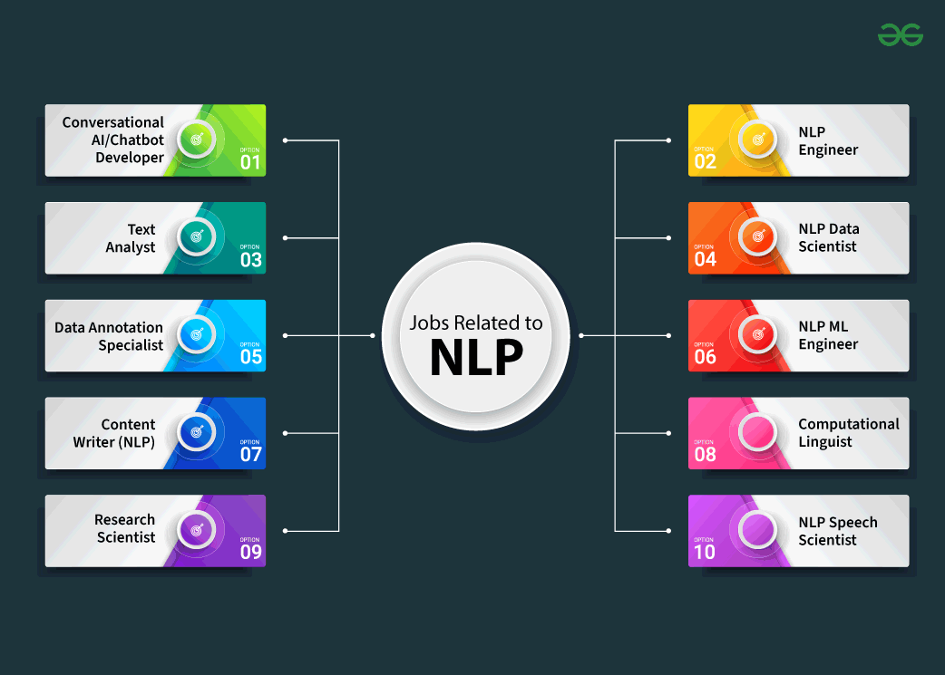
https://www.geeksforgeeks.org/natural-language-processing-nlp-job-roles/

Slide 26
https://analyticsindiamag.com/topics/nlp-vs-llm/

