Slide 1

MySQL Beg to Adv

Slide 2
DBMS (NORMS)
SQL Setup and Basics
Introduction to MySQL
First view of Data
Understanding databases, tables, and rows
Data types, expressions
Assignment
Crafting SQL Databases (DDL) & Mastering Data Control (DML)
Creation of table
Constraints
Modifying the structure of a table
Dropping a table
INSERT, UPDATE, DELETE statement
Assignment
Querying into Data (DQL)
SELECT statement
WHERE clause search condition
Arithmetic, Comparison and Logical operator
Range operator ,List operator ,Like operator
Using ORDER BY, DISTINCT and TOP
Using IS NULL and IS NOT NULL
CASE statement
Assignment
Unlock the Built in Functions
String Function
Math Function
Date Function
Comparison Functions
Aggregate Function
GROUP BY clause with HAVING
Assignment
Connecting Data for Insights
Introduction to Joins
Types of Joins
Types of Sub-queries
Introduction to Views
Assignment
FOR EXPERIENCE
- INDEX
- VIEW
- CTE
- WINDOW FUNCTIONS
OPTIONAL
- STORE PROCEDURES
- TRIGEERS
-FUNCTIONS

Slide 3
******
LEARN
https://www.javatpoint.com/dbms-tutorial
https://www.mysqltutorial.org/mysql-basics/
https://www.javatpoint.com/mysql-tutorial
https://www.geeksforgeeks.org/mysql-tutorial/
QUESTIONS PRACTICE
https://www.w3resource.com/mysql-exercises/join-exercises/
https://test.sanfoundry.com/mysql-tests/ (mcQ)
https://www.interviewbit.com/courses/databases/sql-queries/
https://www.hackerrank.com/domains/sql
learn resource mysql
https://www.mysqltutorial.org
https://www.geeksforgeeks.org/mysql-tutorial/?ref=lbp
- Pracice
1. sqlbotl
3.https://sqlpad.io/playground/mysql/
4. https://8weeksqlchallenge.com/case-study-6/ -- analyst
- Pracice
1. sqlbotl
2, hackerrank
3.https://sqlpad.io/playground/mysql/
4. https://8weeksqlchallenge.com/case-study-6/ -- analyst
- online complier
https://onecompiler.com/mysql

Slide 4
DBMS (NORMS)
teach from pdf DBMS
https://www.javatpoint.com/dbms-normalization
https://www.javatpoint.com/dbms-interview-questions
https://www.interviewbit.com/dbms-interview-questions

Slide 5
workbench
run in shell
After you run MySQL Shell and you have seen following:
mysql-js>
Firstly, you should:
mysql-js>\sql
Secondly:
mysql-sql>\connect username@servername (root@localhost)
And finally:
Enter password:*********

Slide 6
EXTRA TOPICS
https://www.mysqltutorial.org/mysql-basics/import-csv-file-mysql-table/ ***
https://www.mysqltutorial.org/mysql-basics/mysql-export-table-to-csv/
https://www.mysqltutorial.org/getting-started-with-mysql/mysql-sample-database/
TEMPORARY TABLE --> https://www.javatpoint.com/mysql-temporary-table
VIEWS https://www.geeksforgeeks.org/mysql-view/?ref=lbp
INDEX https://www.geeksforgeeks.org/mysql-create-index-statement/?ref=lbp
CTE https://www.javatpoint.com/mysql-common-table-expression
WINDOW FUNC -- https://www.mysqltutorial.org/mysql-window-functions/ https://www.javatpoint.com/mysql-window-functions
JOINS https://www.mysqltutorial.org/mysql-basics/mysql-join/
SUBQUERIES https://www.mysqltutorial.org/mysql-basics/mysql-subquery/
STORE_PROCEDURES https://www.geeksforgeeks.org/different-types-of-procedures-in-mysql/?ref=lbp
FUNTIONS https://www.javatpoint.com/mysql-stored-function
TRIGGERS https://www.geeksforgeeks.org/different-types-of-mysql-triggers-with-examples/?ref=lbp

Slide 7
TOPICS IN DETAILS LINK
https://www.mysqltutorial.org/mysql-basics/import-csv-file-mysql-table/ ***
https://www.mysqltutorial.org/mysql-basics/mysql-export-table-to-csv/
https://www.mysqltutorial.org/getting-started-with-mysql/mysql-sample-database/
https://www.mysqltutorial.org/mysql-basics/mysql-find-duplicate-values/
https://www.mysqltutorial.org/mysql-basics/mysql-compare-two-tables/
https://www.mysqltutorial.org/mysql-basics/mysql-delete-duplicate-rows/
https://www.mysqltutorial.org/mysql-basics/mysql-compare-rows-within-the-same-table/
https://www.mysqltutorial.org/mysql-basics/mysql-select-random/
https://www.mysqltutorial.org/mysql-basics/mysql-export-table-to-csv/
https://www.javatpoint.com/mysql-union-vs-join
https://www.javatpoint.com/mysql-trigger
https://www.javatpoint.com/mysql-export-and-import-database
https://www.javatpoint.com/mysql-common-table-expression
https://www.javatpoint.com/mysql-on-delete-cascade

Slide 8
https://www.javatpoint.com/mysql-date-and-time
https://www.javatpoint.com/mysql-change-column-type ALTER
https://www.javatpoint.com/docker-compose-mysql
https://www.javatpoint.com/azure-mysql
https://www.javatpoint.com/run-mysql-online
https://www.javatpoint.com/free-mysql-hosting
https://www.javatpoint.com/disabling-safe-mode-in-mysql
https://www.javatpoint.com/mysql-import-dump
https://www.javatpoint.com/data-analyst-skills
https://www.javatpoint.com/mysql-fulltext-search
https://www.javatpoint.com/table-vs-view

Slide 9
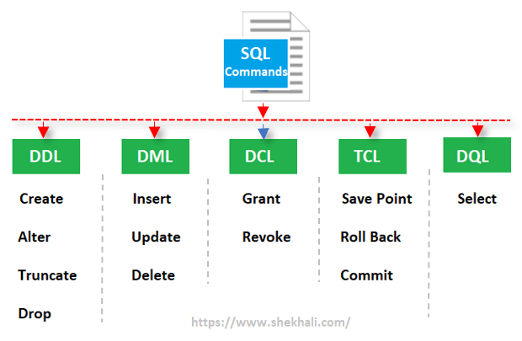

Slide 10
The ALL Operator
The ALL operator:
returns a boolean value as a result
returns TRUE if ALL of the subquery values meet the condition
is used with SELECT, WHERE and HAVING statements
ALL means that the condition will be true only if the operation is true for all values in the range.
ALL Syntax With SELECT
SELECT ALL column_name(s)
FROM table_name
WHERE condition;
The MySQL ANY and ALL Operators
The ANY and ALL operators allow you to perform a comparison between a single column value and a range of other values.
The ANY Operator
The ANY operator:
returns a boolean value as a result
returns TRUE if ANY of the subquery values meet the condition
ANY means that the condition will be true if the operation is true for any of the values in the range.
ANY Syntax
SELECT column_name(s)
FROM table_name
WHERE column_name operator ANY
(SELECT column_name
FROM table_name
WHERE condition);
ALL Syntax With WHERE or HAVING
SELECT column_name(s)
FROM table_name
WHERE column_name operator ALL
(SELECT column_name
FROM table_name
WHERE condition);
Note: The operator must be a standard comparison operator (=, <>, !=, >, >=, <, or <=).

Slide 11
The MySQL UPDATE Statement
The UPDATE statement is used to modify the existing records in a table.
UPDATE Syntax
UPDATE table_name
SET column1 = value1, column2 = value2, ...
WHERE condition;

Slide 12
The MySQL DELETE Statement
The DELETE statement is used to delete existing records in a table.
DELETE Syntax
DELETE FROM table_name WHERE condition;
Note: Be careful when deleting records in a table! Notice the WHERE clause in the DELETE statement. The WHERE clause specifies which record(s) should be deleted. If you omit the WHERE clause, all records in the table will be deleted!

Slide 13
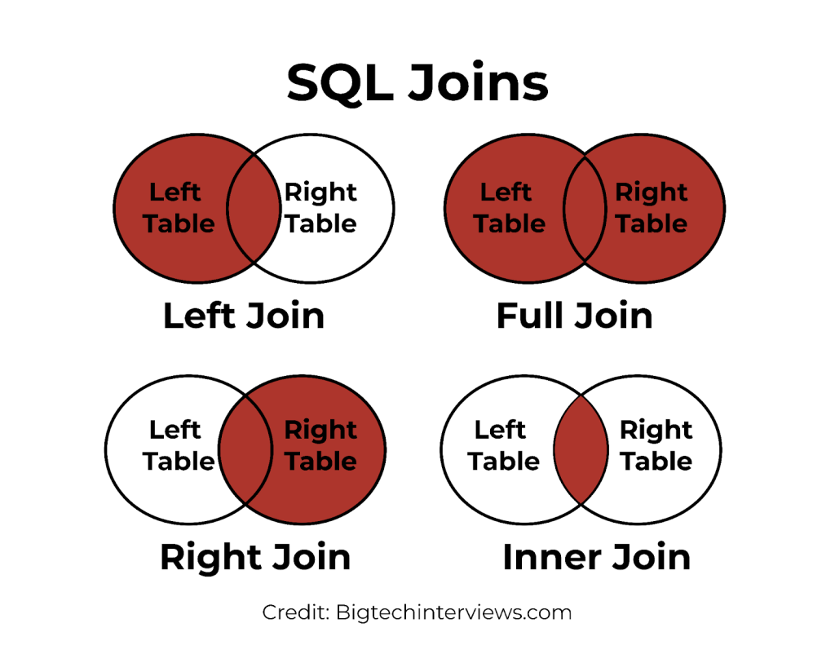

Slide 14
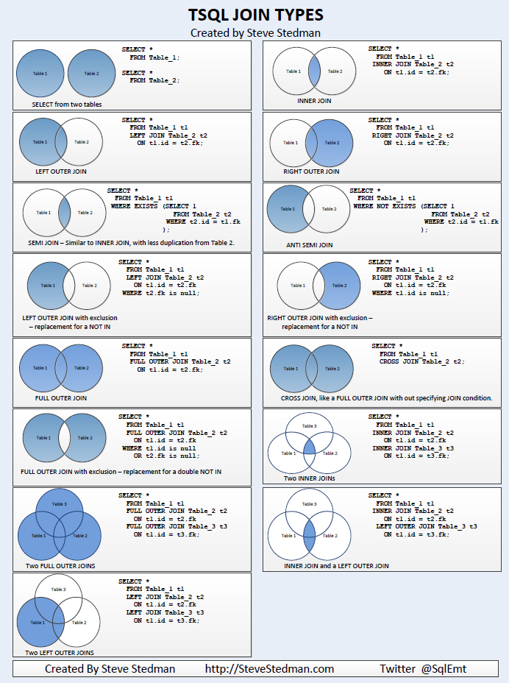

Slide 15
While MySQL doesn't directly support a FULL OUTER JOIN, you can achieve the same result by combining LEFT JOIN, RIGHT JOIN, and UNION ALL.
Here's how:
1. Perform a LEFT JOIN:
Code
SELECT *
FROM table1
LEFTJOIN table2 ON table1.matching_column = table2.matching_column;
2. Perform a RIGHT JOIN:
Code
SELECT *
FROM table1
RIGHTJOIN table2 ON table1.matching_column = table2.matching_column;
3. Combine the results using UNION ALL:
Code
SELECT *
FROM table1
LEFTJOIN table2 ON table1.matching_column = table2.matching_column
UNIONALL
SELECT *
FROM table1
RIGHTJOIN table2 ON table1.matching_column = table2.matching_column;
Explanation:
LEFT JOIN returns all rows from the left table (table1) and matching rows from the right table (table2).
RIGHT JOIN returns all rows from the right table (table2) and matching rows from the left table (table1).
UNION ALL combines the results of the two joins, including all rows from both tables, even if they don't have matches in the other table.
UNION ALL is used instead of UNION to preserve all rows, including duplicates.

Slide 16
Thank You !

