Slide 1

Python

Slide 2
Introduction to Python
What is Python
What are the feature of Python
The application areas of Python
Download and install Python
Execute Python program from command prompt and using IDLE
Assignment
Path setup, environment setup
https://www.programiz.com/python-programming/getting-started
https://www.python.org/downloads/
https://code.visualstudio.com/download
https://colab.research.google.com/
https://jupyter.org/install
https://www.kaggle.com/datasets

Slide 3
Resources
https://docs.python.org/3/tutorial/index.html
https://www.w3schools.com/python/
https://www.tutorialspoint.com/python/index.htm
https://www.geeksforgeeks.org/python-programming-language-tutorial/ python extra
PRACTICE QUESTIONS
https://www.hackerrank.com/domains/python
https://libguides.ntu.edu.sg/python/numpyexercises (Python for Basic Data Analysis)
KAGGLE https://medium.com/@filip.sekan/8-websites-you-can-practice-python-for-data-science-for-free-584ede3fef8f
https://github.com/ajitmane36/Python-Practice/blob/main/Python%20Practice%20Notebook.ipynb
https://github.com/krishnaik06/Python-Practise-Problems/blob/main/Python%20Progamming%20(1).pdf
coding questions
https://prepinsta.com/interview-preparation/coding-interview-questions-in-python/
https://www.interviewbit.com/python-interview-questions/https://www.simplilearn.com/tutorials/python-tutorial/python-interview-questions
https://medium.com/@nikitasilaparasetty/python-interview-coding-questions-with-solutions-for-beginners-7f6d782defac
https://github.com/Tanu-N-Prabhu/Python/blob/master/Python%20Coding%20Interview%20Prep/Python%20Coding%20Interview%20Questions%20(Beginner%20to%20Advanced).md

Slide 4
Data Types & Variable
Data Types
Variables
Identifiers
Literals
Type Casting
Comments
Command Line Arguments
Assignment
https://www.tutorialspoint.com/python/index.htm

Slide 5
Conditional Statement
Indentation in Python
Need of Conditional Statement
Comparison Operators
if...else statement
Logical operators
elif statements
Assignment
https://www.tutorialspoint.com/python/index.htm

Slide 6
Loops in Python
Loops in Python
range() function
Need of Loop
for loop
while loop
Continue, break and pass keyword
Nested loop
Mini Project
Assignment
https://www.tutorialspoint.com/python/index.htm

Slide 7
More on Data types
String
List , List comprehensions
Multidimensional List | tuple , set
Dictionary
Mini Project
Assignment
https://www.tutorialspoint.com/python/index.htm

Slide 8
Function and Modules
Defining and calling function
return statement
Types of Argument-default,variable length
Variable Scope - Global vs Local
Recursive function
Lambda, filter, map, reduce
Need of Module
What is module
Built in Module
User defined Module
Assignment
https://www.tutorialspoint.com/python/index.htm

Slide 9
Object Oriented Programming
What are the feature of OOPs
What is Class, Attributes & Methods
What is Constructor and Destructor ?
What is Inheritance
Data Abstraction
What is Polymorphism
Assignment
python overloading (function overloading, operator overloading)
https://www.tutorialspoint.com/python/index.htm

Slide 10
File Handling
What is file Handling
Different Modes to Open File
Opening Files in Python
Reading Files in Python -Read,Readline ,Readlines
Writing to the Files in Python -Write ,Writelines
Closing Files in Python
Working with file pointers - Seek ,Tell
Pickling & Unpickling
Exception Handling[try,except,finally)
Assignment
https://www.tutorialspoint.com/python/index.htm

Slide 11
Regular Expression & WebScraping
Regular Expression & WebScraping
Character Class in Regular Expression
WebScraping using request & beautifulSoup
Assignment
Python Final Assessment
from notebook

Slide 12
Python Date and Time
Python datetime
Python strftime()
Python strptime()
import os
import sys
List comprehension
Python Lambda/Anonymous Function
Python Iterators
Python Generators
Python Namespace and Scope
Python Closures
Python Decorators
Python @property decorator
Python RegEx
https://www.programiz.com/python-programming/list-comprehension
Precedence and Associativity of Operators in Python
Python Keywords and Identifiers
Python Asserts
Python Json
Python pip
Python *args and **kwargs
sql connector
https://www.w3schools.com/python/python_mysql_getstarted.asp
https://www.w3schools.com/python/python_mongodb_getstarted.asp
https://github.com/GoogleCloudPlatform/cloud-sql-python-connector
https://medium.com/learning-sql/python-for-sql-an-introduction-to-database-connectivity-e1a692e16156
https://cloud.google.com/blog/topics/developers-practitioners/how-connect-cloud-sql-using-python-easy-way
https://stackoverflow.com/questions/73493052/how-to-connect-to-cloud-sql-using-python

Slide 13
Thank You !

Slide 14
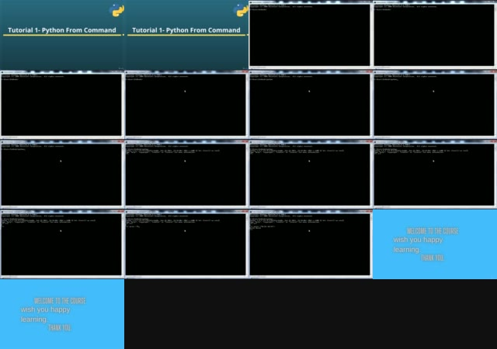
Logging
mysql connector
sql lite
sqlalchemy
pymongodb
Pipelines
os
sys
frozen set
ms- excel file read
functions : zip ,map,reduce,filters,any, chr,ord, sorted,global, local,all
reading pdf
call by value call by reference, passing args by value or pass by regerence
create modules
create packeges
create exe file
create python script file
77. Tutorial 77-Python Module
78. Tutorial 78-Executing Module as Script
79. Tutorial 79-Python Loading Modules
80. Tutorial 80-Namespace And Scoping
81. Tutorial 81- Packages in python

