Slide 1

Python

Slide 2
Resources
https://docs.python.org/3/tutorial/index.html
https://www.w3schools.com/python/
https://www.tutorialspoint.com/python/index.htm
https://www.geeksforgeeks.org/python-programming-language-tutorial/ python extra
PRACTICE QUESTIONS
https://www.hackerrank.com/domains/python
https://libguides.ntu.edu.sg/python/numpyexercises (Python for Basic Data Analysis)
KAGGLE https://medium.com/@filip.sekan/8-websites-you-can-practice-python-for-data-science-for-free-584ede3fef8f
https://github.com/ajitmane36/Python-Practice/blob/main/Python%20Practice%20Notebook.ipynb
https://github.com/krishnaik06/Python-Practise-Problems/blob/main/Python%20Progamming%20(1).pdf
coding questions
https://prepinsta.com/interview-preparation/coding-interview-questions-in-python/
https://www.interviewbit.com/python-interview-questions/https://www.simplilearn.com/tutorials/python-tutorial/python-interview-questions
https://medium.com/@nikitasilaparasetty/python-interview-coding-questions-with-solutions-for-beginners-7f6d782defac
https://github.com/Tanu-N-Prabhu/Python/blob/master/Python%20Coding%20Interview%20Prep/Python%20Coding%20Interview%20Questions%20(Beginner%20to%20Advanced).md

Slide 3
What is Language?
what is Programming language?
Types of Programming language?
PYTHON
Then why Python?

Slide 4
Software and Tools
https://www.python.org/downloads/
https://code.visualstudio.com/download
https://colab.research.google.com/
https://jupyter.org/install
https://www.kaggle.com/datasets
Code Editors
python IDLE
CMD
Jupyter
vscode
pycharm
sublime
Online
google colab
kaggle
online python editor
https://www.programiz.com/python-programming/getting-started

Slide 5
Common cmd commands
OS Module in python for cmd
https://www.geeksforgeeks.org/os-module-python-examples/
Directory Navigation:
cd / dir / mkdir / rmdir / tree: Move between folders, list contents, and create/remove directories.
cls
copy / del / rename / xcopy: Move or remove files and directories.
cd
Changes your current directory.
cd /
Navigates to the root directory.
dir
Displays a list of files and subdirectories in a directory.
mkdir (or md)
Creates a new directory.
rmdir (or rd)
Removes a directory.
tree
Graphically displays the folder structure of a drive or path.
. root file
.. back file
Path setup, environment setup(optional or later)
https://www.geeksforgeeks.org/most-useful-cmd-commands-in-windows/
https://www.geeksforgeeks.org/python-sys-module/?ref=lbp

Slide 6
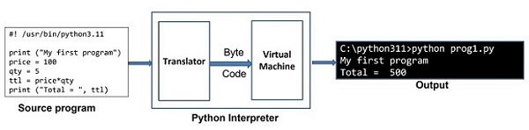
Python Interpreter
https://www.tutorialspoint.com/python/python_interpreter.htm
high level langauge low level language
intrepreter vs compiler
https://builtin.com/software-engineering-perspectives/compiler-vs-interpreter

Slide 7
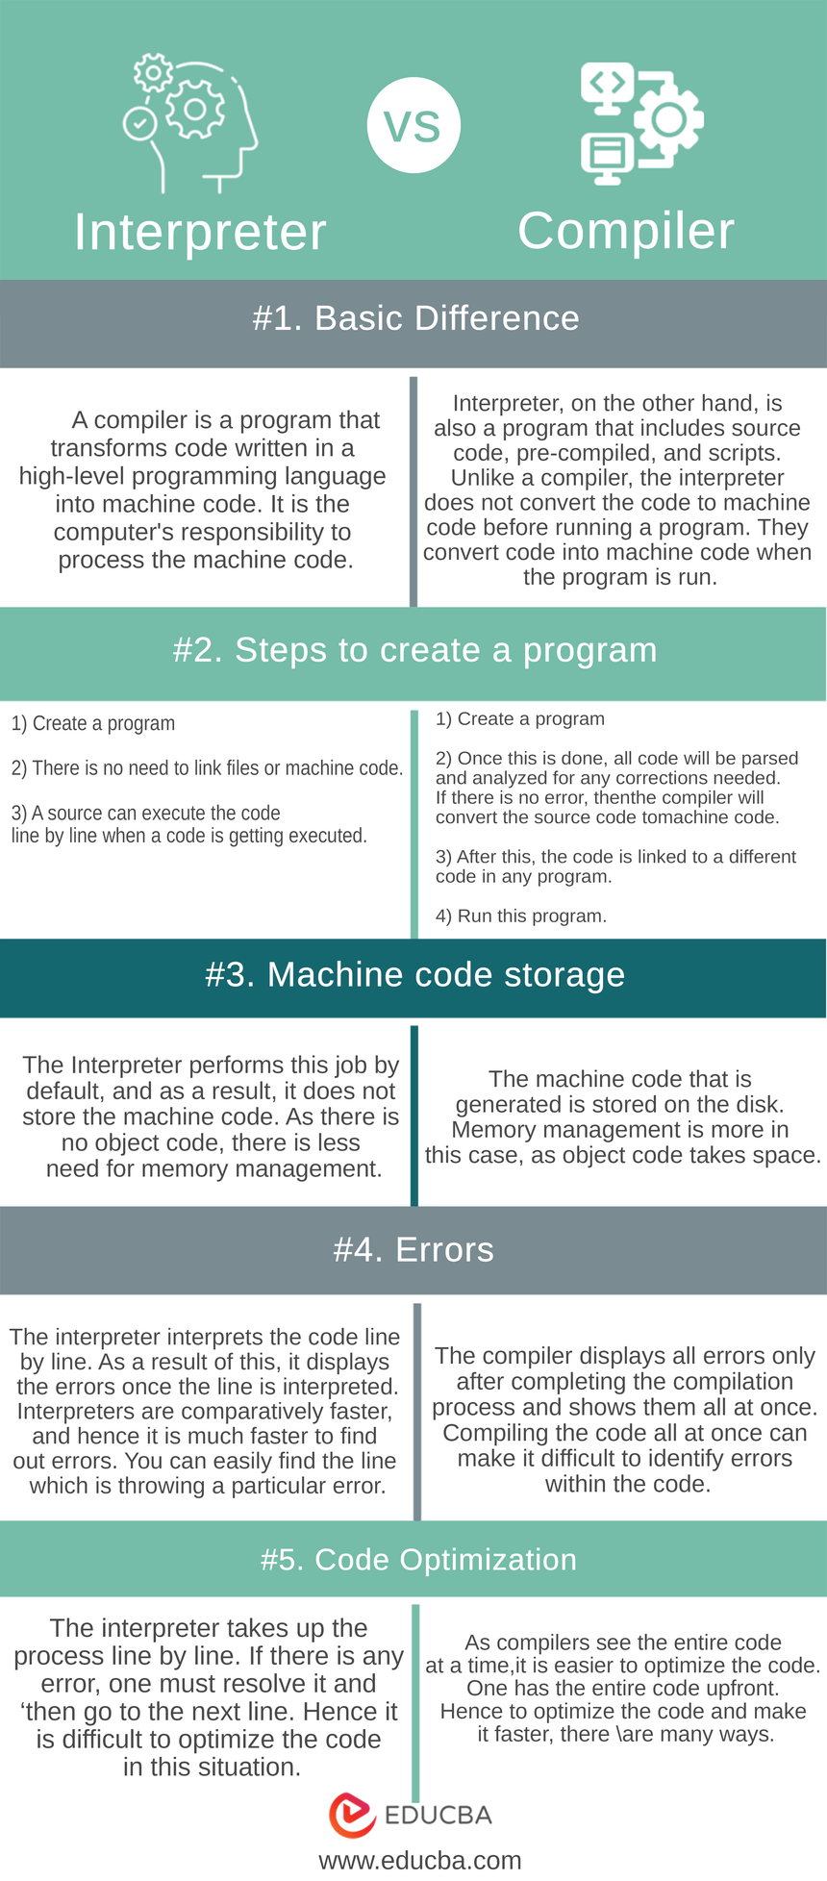
Conclusion
We have gone through many changes between the Interpreter vs Compiler. We can conclude after this above discussion that there are times when confident technical choices need to be relevant to your requirements. If a user wants speed and ease of development, you can mostly go for an interpreter-driven language. Also, all resources must be taken care of when any project is being started.
The revised sentence is more concise and adds the transitional phrase “while” to indicate the contrast between the two statements. Hence it is upon the user how to use both interpreters vs compilers.
https://www.tpointtech.com/compiler-vs-interpreter

Slide 8
Introduction to Python
What is Python
What are the feature of Python
The application areas of Python
Download and install Python
Execute Python program from command prompt and using IDLE
Assignment
https://www.tutorialspoint.com/python/python_history.htm

Slide 9
Python is a widely used high-level, interpreted programming language. It was created by Guido van Rossum in 1991 and further developed by the Python Software Foundation. It was designed with an emphasis on code readability, and its syntax allows programmers to express their concepts in fewer lines of code.
Python is Interpreted − Python is processed at runtime by the interpreter. You do not need to compile your program before executing it. This is similar to PERL and PHP.
Python is Interactive − You can actually sit at a Python prompt and interact with the interpreter directly to write your programs.
Python is Object-Oriented − Python supports Object-Oriented style or technique of programming that encapsulates code within objects.
Python is a Beginner's Language − Python is a great language for the beginner-level programmers and supports the development of a wide range of applications
https://www.geeksforgeeks.org/introduction-to-python/?ref=lbp

Slide 10
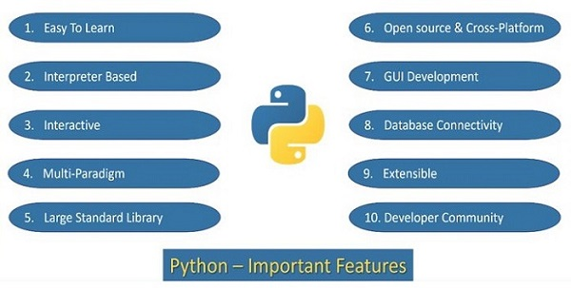
https://www.tutorialspoint.com/python/python_features.htm

Slide 11
https://www.tutorialspoint.com/python/python_vs_cpp.htm

Slide 12
Key Features of Python
Easy to Learn and Use: Python’s simple and readable syntax makes it beginner-friendly.
Cross-Platform Compatibility: Python runs seamlessly on Windows, macOS, and Linux.
Extensive Libraries: Includes robust libraries for tasks like web development, data analysis, and machine learning.
Dynamic Typing: Variable types are determined automatically at runtime, simplifying code writing.
Versatile: Supports multiple programming paradigms, including object-oriented, functional, and procedural programming.
Open Source: Python is free to use, distribute, and modify.
Python Comments
Comments in Python are the lines in the code that are ignored by the interpreter during the execution of the program.
Comments enhance the readability of the code.
Comment can be used to identify functionality or structure the code-base.
Comment can help understanding unusual or tricky scenarios handled by the code to prevent accidental removal or changes.
Comments can be used to prevent executing any specific part of your code, while making changes or testing.
# I am single line comment
""" Multi-line comment used
print("Python Comments") """
Here’s the “Hello World” program:
print("Hello, World!")
Output
How does this work:
print() is a built-in function in Python that tells the program to display something on the screen. We need to add the string in parenthesis of print() function that we are displaying on the screen.
“Hello, World!” is a string text that we want to display. Strings are always enclosed in quotation marks.

Slide 13
Famous Application Built using Python
YouTube: World’s largest video-sharing platform uses Python for features like video streaming and backend services.
Instagram: This popular social media app relies on Python’s simplicity for scaling and handling millions of users.
Spotify: Python is used for backend services and machine learning to personalize music recommendations.
Dropbox: The file hosting service uses Python for both its desktop client and server-side operations.
Netflix: Python powers key components of Netflix’s recommendation engine and content delivery systems (CDN).
Google: Python is one of the key languages used in Google for web crawling, testing, and data analysis.
Uber: Python helps Uber handle dynamic pricing and route optimization using machine learning.
Pinterest: Python is used to process and store huge amounts of image data efficiently

Slide 14
Indentation in Python
In Python, indentation is used to define blocks of code. It tells the Python interpreter that a group of statements belongs to a specific block. All statements with the same level of indentation are considered part of the same block. Indentation is achieved using whitespace (spaces or tabs) at the beginning of each line.
Example:
if10>5:print("This is true!")print("I am tab indentation")print("I have no indentation")
Explanation:
The first two print statements are indented by 4 spaces, so they belong to the if block.
The third print statement is not indented, so it is outside the if block.

Slide 15
Input and Output in Python
Understanding input and output operations is fundamental to Python programming. With the print() function, we can display output in various formats, while the input() function enables interaction with users by gathering input during program execution.
Taking input in Python
Python input() function is used to take user input. By default, it returns the user input in form of a string.
Example:
name=input("Enter your name: ")print("Hello,",name,"! Welcome!")
OutputEnter your name: GeeksforGeeks
Hello, GeeksforGeeks ! Welcome!
The code prompts the user to input their name, stores it in the variable “name” and then prints a greeting message addressing the user by their entered name.

Slide 16
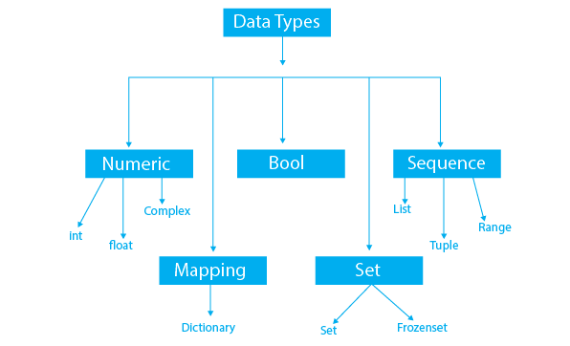
Data Types & Variable
Data Types
Variables
Identifiers
Literals
Type Casting
Comments
Command Line Arguments
Assignment
https://www.programiz.com/python-programming/variables-datatypes
https://www.tutorialspoint.com/python/index.htm

Slide 17
Data Types | Classes | Description
Numeric | int, float, complex | holds numeric values
String | str | holds sequence of characters
Sequence | list, tuple, range | holds collection of items
Mapping | dict | holds data in key-value pair form
Boolean | bool | holds either True or False
Set | set, frozenset | hold collection of unique items

Slide 18
Python data types categorize the values a variable can hold, including numeric (int, float, complex), text (str), sequence (list, tuple, range), binary (bytes, bytearray, memoryview), mapping (dict), set (set, frozenset), and boolean (bool).
Here's a more detailed breakdown:
1. Numeric Data Types:
int (Integer): Represents whole numbers (e.g., 10, -5, 0).
float (Floating-point number): Represents numbers with decimal points (e.g., 3.14, -2.5).
complex (Complex number): Represents numbers with a real and imaginary part (e.g., 2 + 3j).
2. Text Data Type:
str (String): Represents a sequence of characters (e.g., "Hello", "Python").
3. Sequence Data Types:
list (List): An ordered, mutable (changeable) collection of items (e.g., [1, 2, "a"]).
tuple (Tuple): An ordered, immutable (unchangeable) collection of items (e.g., (1, 2, "a")).
range (Range): Represents a sequence of numbers (e.g., range(5) generates 0, 1, 2, 3, 4).
4. Binary Data Types:
bytes (Bytes): Represents a sequence of bytes (e.g., b"Hello").
bytearray (Byte array): Represents a mutable sequence of bytes.
memoryview (Memory view): Allows access to the internal bytes of an object.
5. Mapping Data Type:
dict (Dictionary): An unordered collection of key-value pairs (e.g., {"name": "Alice", "age": 30}).
6. Set Data Types:
set (Set): An unordered collection of unique items (e.g., {1, 2, 3}).
frozenset (Frozen set): An immutable version of a set.
7. Boolean Data Type:
bool (Boolean): Represents truth values (either True or False).
8. None Type:
NoneType (None): Represents the absence of a value.

Slide 19
Python Variables
In programming, a variable is a container (storage area) to hold data. For example,10
Here, number is a variable storing the value 10.
Example: Assigning multiple values to multiple variables
Assigning values to Variables in Python
Changing the Value of a Variable in Python
site_name = 'programiz.pro'
print(site_name)
# assigning a new value to site_name
site_name = 'apple.com'
print(site_name)
https://www.programiz.com/python-programming/variables-constants-literals

Slide 20
In Python, an identifier is a name given to a variable, function, class, or other object, and it must follow specific rules: it can contain letters, digits, and underscores, but cannot start with a digit and is case-sensitive.
Here's a more detailed explanation:
What is an Identifier?
An identifier is essentially a name that you, as a programmer, give to something in your code, like a variable, function, or class.
It's how you refer to that entity within your program.
Think of it as a label or a handle that allows you to access and manipulate the object.
Example: my_variable, calculate_area, MyClass are all examples of identifiers.
Rules for Naming Identifiers:
Allowed Characters:
Letters (a-z, A-Z)
Digits (0-9)
Underscores (\_)
Not Allowed:
Cannot start with a digit
Cannot be a Python keyword (reserved word)
Case Sensitivity: Python is case-sensitive, meaning my_variable and My_variable are considered different identifiers.

Slide 21
Examples of Valid and Invalid Identifiers:
Identifier | Valid/Invalid | Reason
my_variable | Valid | Follows all rules
123_variable | Invalid | Starts with a digit
variable_name | Valid | Follows all rules
for | Invalid | "for" is a Python keyword
my-variable | Invalid | Contains a hyphen, which is not allowed
myVariable | Valid | Case sensitive, but valid
MyVariable | Valid | Case sensitive, but valid
Variables and Identifiers
A variable is a specific type of identifier that is used to store data.
You use an identifier to name a variable, and then assign a value to that variable.
Example: age = 30 (Here, age is the identifier/variable name, and 30 is the value assigned to it).
Variables can hold different types of data (numbers, text, lists, etc.).
Python is dynamically typed, meaning you don't need to declare the type of a variable; it's determined when you assign a value to it.
Best Practices
Choose descriptive names for your identifiers to make your code easier to understand.
Use lowercase letters for variable names, with words separated by underscores (e.g., user_name).
Follow consistent naming conventions within your project.

Slide 22
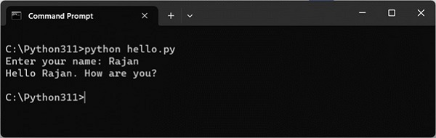
Comments
Command Line Arguments
name =input("Enter your name: ")
print("Hello {}. How are you?".format(name))
python script.py arg1 arg2 arg3
https://www.tutorialspoint.com/python/python_command_line_arguments.htm

Slide 23
Conditional Statement
Indentation in Python
Need of Conditional Statement
Comparison Operators
Logical operators
if...else statement
elif statementsators
Assignment
https://www.tutorialspoint.com/python/index.htm

Slide 24
Loops in Python
Loops in Python
range() function
Need of Loop
for loop
while loop
Continue, break and pass keyword
Nested loop
Mini Project
Assignment
https://www.tutorialspoint.com/python/index.htm

Slide 25
break: It terminates the loop prematurely if a certain condition is met. The program execution resumes at the next statement following the loop.
Python
foriin range(10):
if i == 5:
break
print(i)
# Output: 0 1 2 3 4
continue: It skips the rest of the current iteration of the loop and proceeds to the next iteration. The statements after continue in the current iteration are not executed.
Python
foriin range(10):
if i % 2 == 0:
continue
print(i)
# Output: 1 3 5 7 9
pass: It is a null operation, meaning it does nothing. It is used as a placeholder when a statement is syntactically required, but no action needs to be performed. It's often used when defining functions or classes that will be implemented later.
Python
defmy_function():
pass
classMyClass:
pass

Slide 26
More on Data types
String
List , List comprehensions
Multidimensional List | tuple , set
Dictionary
Mini Project
Assignment
https://www.tutorialspoint.com/python/index.htm
https://www.tutorialspoint.com/python/python_list_comprehension.htm
list1=[x for x inrange(1,21)if x%2==0]
print(list1)
https://python101.pythonlibrary.org/chapter6_comprehensions.html

Slide 27
Function and Modules
Defining and calling function
return statement
Types of Argument-default,variable length
Variable Scope - Global vs Local
Recursive function
Lambda, filter, map, reduce
Need of Module
What is module
Built in Module
User defined Module
Assignment
https://www.tutorialspoint.com/python/index.htm

Slide 28
✅ Example Comparison
Lambda Function:
def Function:
✅ Advantages of lambda in Python:
Compact – Reduces code length.
Faster to write for simple operations.
Useful in functional programming (e.g., map, filter, reduce).
Perfect for GUI or web callback functions.
Improves readability when logic is very simple.
Would you like a printable PDF summary of this comparison for class use?
Lambda functions
Here's a clear comparison table showing the difference between lambda and def functions in Python, along with their advantages:
✅ lambda vs def in Python
Feature | lambda Function | def Function
Syntax | One-liner, anonymous | Multi-line, named
Use Case | Small, throwaway functions | Reusable and complex logic
Return Statement | Implicit (always returns an expression) | Explicit (return keyword)
Function Name | Anonymous (no name unless assigned) | Always has a name
Number of Expressions | Only one expression allowed | Multiple expressions/statements allowed
Readability | More readable for short logic | Better for complex logic
Scope & Reuse | Used once or inline | Can be reused, tested, and maintained
Best With | map(), filter(), sorted(), GUI callbacks | General function definition

Slide 29
is_even = lambda x: x % 2 == 0
print(is_even(10)) # Output: True
print(is_even(7)) # Output: False
Example: Immediate use without assignment
python
CopyEdit
print((lambda x: "Even"if x % 2 == 0else"Odd")(10)) # Output: Even print((lambda x: "Even"if x % 2 == 0else"Odd")(7)) # Output: Odd
Or for a Boolean result:
python
CopyEdit
print((lambda x: x % 2 == 0)(10)) # Output: True (even) print((lambda x: x % 2 == 0)(7)) # Output: False (odd)

Slide 30
Here are the key advantages of using lambda functions in Python, especially in real-world scenarios:
✅ 1. Concise Syntax
Lambda functions allow writing small, throwaway functions in a single line.
No need to define full function with def.
Example:
✅ 2. Useful for Functional Programming
Works seamlessly with functions like map(), filter(), reduce().
Example:
✅ 3. Inline Use – No Need to Name
Perfect for one-time use without polluting the namespace.
Example:
✅ 4. Improves Readability (for small logic)
In places like sorting or filtering, the logic is self-contained and easy to read.
Example:
✅ 5. Common in GUI/Web Development
Frequently used for callbacks, e.g., button actions or event handlers.
Example (Tkinter):
✅ 6. Reduces Boilerplate
No need to write full function definitions for simple logic—saves time and lines of code.
✅ 7. Dynamic Function Behavior
You can generate functions on-the-fly inside loops or based on input.
Example:
Would you like a comparison table between lambda and def functions too?

Slide 31
Here are some real-world use cases where Python lambda functions are commonly used, especially for concise, inline operations in data processing, UI applications, and web development:
✅ 1. Sorting Employee Records by Salary (Dictionary Sorting)
Scenario: You have a list of employees with their details. You want to sort them by salary.
python
CopyEdit
employees = [ {"name": "Alice", "salary": 50000}, {"name": "Bob", "salary": 60000}, {"name": "Charlie", "salary": 40000} ] # Sort by salary using lambda sorted_employees = sorted(employees, key=lambda x: x['salary']) print(sorted_employees)
✅ 2. Filtering Customers with High Purchases
Scenario: You want to filter customers who spent more than ₹10,000.
python
CopyEdit
customers = [8000, 12000, 1500, 18000, 7000] # Filter using lambda high_spenders = list(filter(lambda x: x > 10000, customers)) print(high_spenders) # Output: [12000, 18000]
✅ 3. Transforming Product Prices (e.g., add 18% GST)
Scenario: You need to apply GST on a list of base prices.
python
CopyEdit
prices = [100, 200, 500] # Add 18% GST prices_with_gst = list(map(lambda x: x * 1.18, prices)) print(prices_with_gst)
✅ 4. GUI Button Action in Tkinter
Scenario: You create buttons dynamically and want each to call a different function using a lambda.
python
CopyEdit
import tkinter as tk root = tk.Tk() for i inrange(5): tk.Button(root, text=f"Button {i}", command=lambda i=i: print(f"Button {i} clicked")).pack() root.mainloop()
✅ 5. Web Frameworks (e.g., Flask Route with Inline Logic)
Scenario: You want to quickly handle a route with minimal logic in Flask.
python
CopyEdit
from flask import Flask app = Flask(__name__) @app.route("/double/<int:num>") defdouble(num): returnstr((lambda x: x * 2)(num))
✅ 6. Pandas – Create New Column Based on Condition
Scenario: In a DataFrame, classify age as "Adult" or "Minor".
python
CopyEdit
import pandas as pd df = pd.DataFrame({'Name': ['A', 'B', 'C'], 'Age': [17, 25, 15]}) df['Status'] = df['Age'].apply(lambda x: "Adult"if x >= 18else"Minor") print(df)

Slide 32
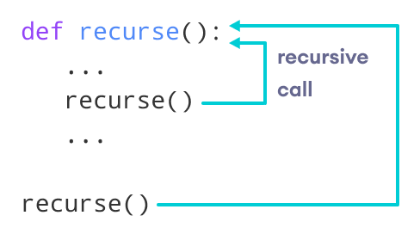
Python Recursion
Recursion is the process of defining something in terms of itself.
A physical world example would be to place two parallel mirrors facing each other. Any object in between them would be reflected recursively.
Python Recursive Function
In Python, we know that a function can call other functions. It is even possible for the function to call itself. These types of construct are termed as recursive functions.
The following image shows the working of a recursive function called recurse.
Following is an example of a recursive function to find the factorial of an integer.
Factorial of a number is the product of all the integers from 1 to that number. For example, the factorial of 6 (denoted as 6!) is 1*2*3*4*5*6 = 720.

Slide 33
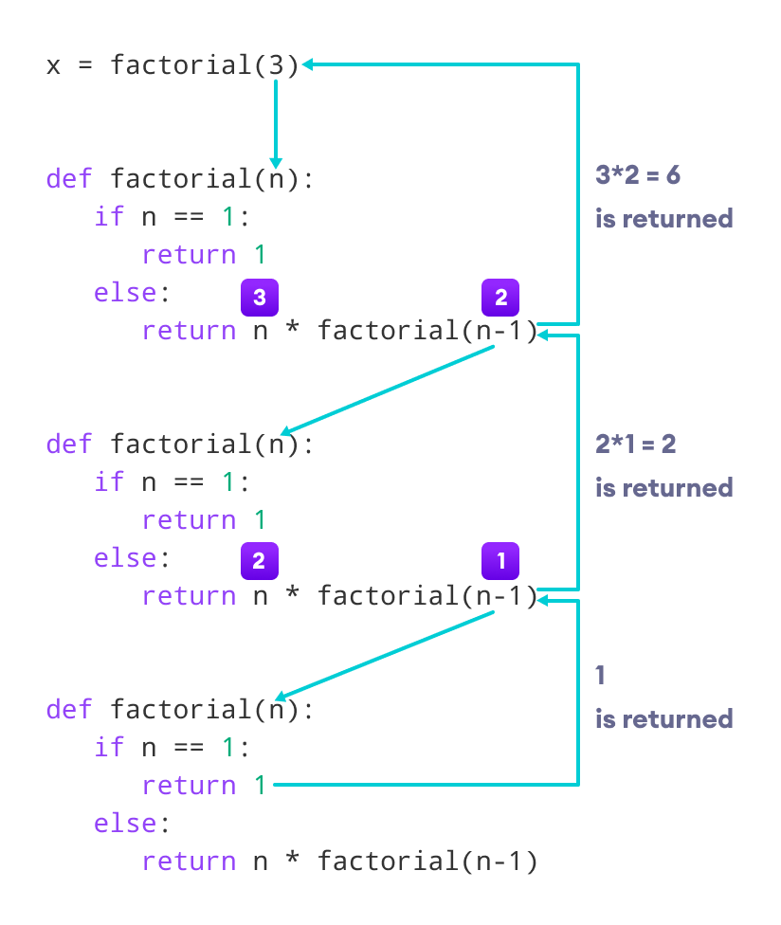
def factorial(x):
"""This is a recursive function
to find the factorial of an integer"""
if x == 1:
return 1
else:
return (x * factorial(x-1))
num = 3
print("The factorial of", num, "is", factorial(num))

Slide 34
Advantages of Recursion
Recursive functions make the code look clean and elegant.
A complex task can be broken down into simpler sub-problems using recursion.
Sequence generation is easier with recursion than using some nested iteration.
Disadvantages of Recursion
Sometimes the logic behind recursion is hard to follow through.
Recursive calls are expensive (inefficient) as they take up a lot of memory and time.
Recursive functions are hard to debug.
Python Program to Find Sum of Natural Numbers Using Recursion
Python Program to Display Fibonacci Sequence Using Recursion

Slide 35
Built-in Functions
Python abs()
Python any()
Python all()
Python enumerate()
Python staticmethod()
Python filter()
Python eval()
Python format()
Python hash()
Python input()
Python id()
Python isinstance()
Python map()
Python property()
Python range()
numbers = [1,2,3,4]
# returns the square of a number
def square(number):
return number * number
# apply square() to each item of the numbers list
squared_numbers = map(square, numbers)
# converting to list for printing
result = list(squared_numbers)
print(result)
# Output: [1,4,9,16]
Python map()
REDUCE
FILTERS
Python zip()
SUPER()
Python map() Function
The map() function executes a given function to each element of an iterable (such as lists, tuples, etc.).

Slide 36
map() Syntax
map() Arguments
The map() function takes two arguments:
function - a function that is applied to each element of an iterable.
iterables - iterables such as lists, tuples, etc.
Note: We can pass more than one iterable to the map() function.
map() Return Value
The map() function returns a map object, which can be easily converted to lists, tuples, etc.
https://www.programiz.com/python-programming/methods/built-in/map

Slide 37
🔁 1. map() Function
Purpose: Applies a given function to all items in an iterable (like a list).
Syntax: map(function, iterable)
✅ Example 1: Square Each Number in a List
numbers = [1, 2, 3, 4, 5]
squared = list(map(lambda x: x ** 2, numbers))
print(squared)
Output:
Explanation: lambda x: x**2 squares each number in the list.
✅ Example 2: Convert List of Strings to Uppercase
words = ['apple', 'banana', 'cherry']
upper_words = list(map(str.upper, words))
print(upper_words)
Output:
Explanation: str.upper converts each string in the list to uppercase.
✅ Example 3: Convert Temperatures from Celsius to Fahrenheit
celsius = [0, 10, 20, 30]
fahrenheit = list(map(lambda c: (c * 9/5) + 32, celsius))
print(fahrenheit)
Output:
Explanation: The lambda function applies the temperature conversion formula to each element.

Slide 38
🧹 3. filter() Function
Purpose: Filters items out of an iterable based on a condition (returns only items for which the function returns True).
Syntax: filter(function, iterable)
✅ Example 1: Filter Even Numbers
numbers = [1, 2, 3, 4, 5, 6]
evens = list(filter(lambda x: x % 2 == 0, numbers))
print(evens)
Output:
Explanation: Keeps numbers that are divisible by 2.
✅ Example 2: Filter Strings Longer Than 3 Characters
words = ['cat', 'lion', 'dog', 'elephant']
long_words = list(filter(lambda w: len(w) > 3, words))
print(long_words)
Output:
Explanation: Keeps strings whose length is more than 3.
✅ Example 3: Filter Positive Numbers
nums = [-10, 5, -2, 3, 0]
positives = list(filter(lambda x: x > 0, nums))
print(positives)
Output:
Explanation: Keeps numbers greater than 0.

Slide 39
🔽 2. reduce() Function
Purpose: Applies a rolling computation to sequential pairs of values in an iterable.
Syntax: reduce(function, iterable)
Note: You need to import it from functools.
✅ Example 1: Sum All Elements in a List
from functools import reduce
numbers = [1, 2, 3, 4]
total = reduce(lambda x, y: x + y, numbers)
print(total)
Output:
Explanation: Adds elements step-by-step: (((1+2)+3)+4)
✅ Example 2: Find Maximum in a List
numbers = [5, 9, 2, 8, 1]
maximum = reduce(lambda x, y: x if x > y else y, numbers)
print(maximum)
Output:
Explanation: Compares each pair and retains the larger number.
✅ Example 3: Multiply All Elements in a List
numbers = [1, 2, 3, 4]
product = reduce(lambda x, y: x * y, numbers)
print(product)
Output:
Explanation: Multiplies numbers step-by-step: (((1*2)*3)*4)
from functools import reduce
numbers = [1, 2, 3, 4, 5, 6]
even_sum = reduce(lambda x, y: x + y if y % 2 == 0 else x, numbers)
print(even_sum)
from functools import reduce
# Helper function to check if a number is prime
def is_prime(n):
if n < 2:
return False
for i in range(2, int(n**0.5) + 1):
if n % i == 0:
return False
return True
numbers = [1, 2, 3, 4, 5, 6, 7, 8, 9, 10]
# Sum prime numbers using reduce with if condition in lambda
prime_sum = reduce(lambda x, y: x + y if is_prime(y) else x, numbers)
print(prime_sum)

Slide 40
Function | Purpose | Returns
map() | Apply a function to all items | New iterable with transformed items
reduce() | Aggregate a list into a single value | Single result value
filter() | Select items meeting a condition | New iterable with selected items

Slide 41
Python Modules
As our program grows bigger, it may contain many lines of code. Instead of putting everything in a single file, we can use modules to separate codes in separate files as per their functionality. This makes our code organized and easier to maintain.
Module is a file that contains code to perform a specific task. A module may contain variables, functions, classes etc. Let's see an example,
Let us create a module. Type the following and save it as example.py
Import modules in Python
Note:
Python has tons of standard modules. You can check out the full list of Python standard modules and their use cases.
Standard modules can be imported the same way as we import our user-defined modules.
Python import with Renaming
IMPORT MATHS AS M

Slide 42
Python Package
A package is a container that contains various functions to perform specific tasks. For example, the math package includes the sqrt() function to perform the square root of a number.
While working on big projects, we have to deal with a large amount of code, and writing everything together in the same file will make our code look messy. Instead, we can separate our code into multiple files by keeping the related code together in packages.
Now, we can use the package whenever we need it in our projects. This way we can also reuse our code.

Slide 43
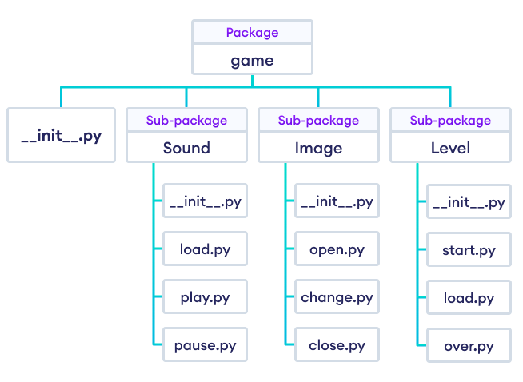
Package Model Structure in Python Programming
Suppose we are developing a game. One possible organization of packages and modules could be as shown in the figure below.

Slide 44
Importing module from a package
In Python, we can import modules from packages using the dot (.) operator.
For example, if we want to import the start module in the above example, it can be done as follows:i
import Game.Level.start
Now, if this module contains a function named select_difficulty(), we must use the full name to reference it.2
Game.Level.start.select_difficulty(2)
https://www.programiz.com/python-programming/package

Slide 45
Python Main function
What is the main() function in Python?
Some programming languages have a special function called main() which is the execution point for a program file. Python interpreter, however, runs each line serially from the top of the file and has no explicit main() function.
Python offers other conventions to define the execution point. One of them is using the main() function and the __name__ property of a python file.
What is __name__ in Python?
The __name__ variable is a special builtin Python variable that shows the name of the current module.
It has different values depending on where we execute the Python file. Let's look at an example.
Running Python File as a Script
Suppose we have a Python file called helloworld.py with the following content:
print(__name__)
if we run helloworld.py from the command line, then it runs as a Python script. We can run the Python program using the following command:
When we run the program as a script, the value of the variable __name__ is set to __main__. So the output of the following program will be:

Slide 46
VARIABLE SCOPE
Python Nonlocal Variables
In Python, the nonlocal keyword is used within nested functions to indicate that a variable is not local to the inner function, but rather belongs to an enclosing function’s scope.
This allows you to modify a variable from the outer function within the nested function, while still keeping it distinct from global variables.
Based on the scope, we can classify Python variables into three types:
Local Variables
Global Variables
Nonlocal Variables
example of how a global variable is created in Python.
# declare global variable
message = 'Hello'
def greet():
# declare local variable
print('Local', message)
greet()
print('Global', message)
# outside function
def outer():
message = 'local'
# nested function
def inner():
# declare nonlocal variable
nonlocal message
message = 'nonlocal'
print("inner:", message)
inner()
print("outer:", message)
outer()

Slide 47
Python Global Keyword
In Python, the global keyword allows us to modify the variable outside of the current scope.
It is used to create a global variable and make changes to the variable in a local context.
Example: Changing Global Variable From Inside a Function using global
# global variable
c = 1
def add():
# use of global keyword
global c
# increment c by 2
c = c + 2
print(c)
add()
# Output: 3
Access and Modify Python Global Variable
# global variable
c = 1
def add():
# increment c by 2
c = c + 2
print(c)
add()
Output
UnboundLocalError: local variable 'c' referenced before assignment
This is because we can only access the global variable but cannot modify it from inside the function.
The solution for this is to use the global keyword.

Slide 48
Rules of global Keyword
The basic rules for global keyword in Python are:
When we create a variable inside a function, it is local by default.
When we define a variable outside of a function, it is global by default. You don't have to use the global keyword.
We use the global keyword to modify (write to) a global variable inside a function.
Use of the global keyword outside a function has no effect.

Slide 49
QUESTIONS
Take value from users --> name ,roll_no , class , email, address
create a functions to store student details in dictonary --->dict = student_details{}
variable = name ,roll_no , class , email, address
{name:["a"],roll_no:[1] , class:[10] , email:[gmail.com], address :[]}

Slide 50
Object Oriented Programming
What are the feature of OOPs
What is Class, Attributes & Methods
What is Constructor and Destructor ?
What is Inheritance
Data Abstraction
What is Polymorphism
Assignment
python overloading (function overloading, operator overloading)
https://www.tutorialspoint.com/python/index.htm

Slide 51
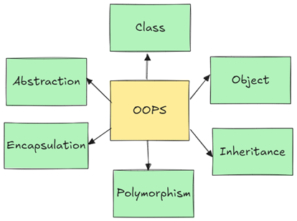
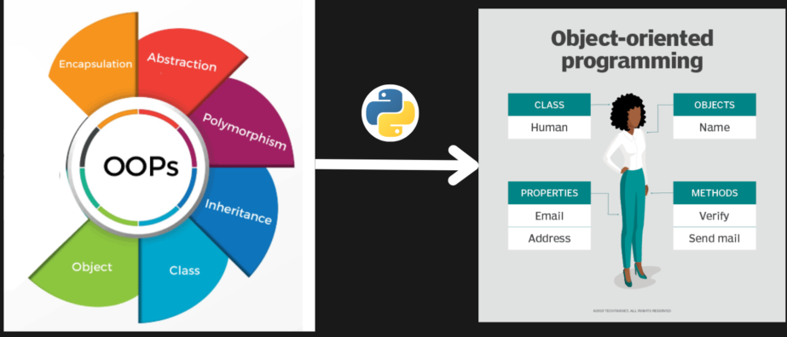
📌 What is OOP?
Object-Oriented Programming (OOP) is a programming paradigm that uses "objects" – instances of "classes" – to model real-world entities. It provides a structured and modular approach for software development.

Slide 52
🌟 Features of OOP
Feature | Description | Real-World Analogy
Class & Object | Blueprint and instance of a blueprint | Blueprint of a Car vs Real Car
Encapsulation | Hides internal state and requires all interaction to be performed through methods | Mobile phone: We use buttons, not internal circuits
Inheritance | A class can inherit attributes and methods from another | Child inherits traits from parent
Polymorphism | Same function behaves differently for different objects | "Drive" function in Bike and Car
Abstraction | Hiding unnecessary details from the user | Driving a car without knowing engine internals

Slide 53
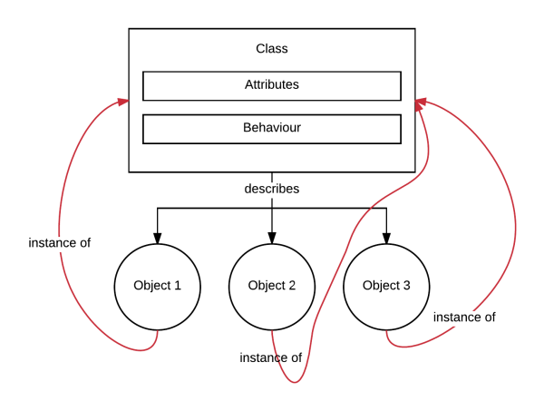
📦 What is a Class, Attributes & Methods
Class: A blueprint to create objects.
Attributes: Variables inside a class (data).
Methods: Functions inside a class (behavior).
# EXAMPLE
class Car:
# attributes
def __init__(self, brand, model):
self.brand = brand
self.model = model
# method
def start(self):
print(f"{self.brand} {self.model} is starting...")
# Create an object
mycar = Car("Toyota", "Camry")
mycar.start()

Slide 54
Classes & Objects:
Class:
The class can be defined as a collection of objects. A class is a blueprint for the object. It is a logical entity that has some specific attributes and methods. Class logically groups the data in such a way that code re-usability becomes easy. Class is a template or blueprint for how to build an object. A class in python logically grouping of data and functions. An instance is a particular realization of a class. A class is a prototype that defines state and behavior common to all objects of its kind python supports both class objects and instance objects. In fact, everything in python is an object, including a class object. Classes describe data and provide methods to manipulate that data, all encompassed under a single object.
Objects:
An Object contains attributes: data attributes (or static attributes or variables) and dynamic behaviors called methods. In the UML diagram, objects are represented by 3-compartment boxes: name, data attributes, and methods

Slide 55
Methods:
The method is a function that is associated with an object. In python, a method is not unique to the class instance. Any object can have methods
There are three types of methods in python. They are
Instance method
Class method
Static method
Instance method:
an instance method is a very basic and easy method that we use regularly when we create classes in python. we should create an object of the class if we wanted to print the instance attributes or methods.
If we are using self as a function parameter or in front of a variable, that is nothing but the calling instance variable or method itself.
As we are working with instance variables, we use the self keyword.
Note: Instance variables are used with instance methods.
https://inprogrammer.com/object-oriented-programming-oops-in-python/

Slide 56
Class method:
There are two ways to create class methods in python:
Using classmethod(function)
Using @classmethod annotation
A class method can be called either using the class (such as C.f()) or using an instance (such as C().f()). The instance is ignored except for its class. If a class method is called from a derived class, the derived class object is passed as the implied first argument.
As we are working with ClassMethod we use the cls keyword. Class variables are used with class methods.
Static method:
A static method can be called without an object for that class, using the class name directly. If you want to do something extra with a class, we use static methods.
We can directly call the static method by directly calling it by its class name.

Slide 57
✅ Example:
classEmployee: def__init__(self, name): self.name = name print(f"Employee {self.name} created.") def__del__(self): print(f"Employee {self.name} deleted.") emp = Employee("John") del emp
📝 Output:
Employee John created. Employee John deleted.
🛠️ What is Constructor and Destructor?
✅ Constructor: __init__()
Special method called when an object is created.
✅ Destructor: __del__()
Called when an object is destroyed (mostly auto-handled by garbage collection).

Slide 58
OOPs PILLARS
Inheritance
Polymorphism
Data Abstraction
Encapsulation

Slide 59
✅ Real-world Scenario:
Dog is a subclass of Animal.
✅ Code Example:
classAnimal: defspeak(self): print("Animal speaks") classDog(Animal): defbark(self): print("Dog barks") d = Dog() d.speak() # inherited d.bark() # own method
🧬 What is Inheritance?
Inheritance is a mechanism that allows us to inherit all the properties from another class. Acquiring base class properties and methods into a child class is known as inheritance.
The main advantage of this is re-usability and increases readability. Python supports single-level, multi-level and multiple inheritances. In python, the object is the parent class of all classes.
It generally means “inheriting or transfer of characteristics from parent to child class without any modification”. The new class is called the derived /child class and the one from which it is derived is called a parent/base class.
Python inheritance super function – super().
With inheritance, the super() function in python actually comes in quite handy. It allows us to call a method from the parent class.

Slide 60
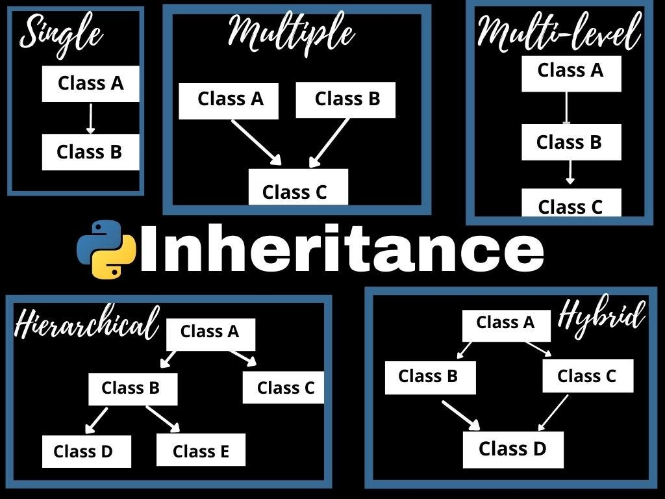
Different forms of inheritances:
Single level inheritance
Multi-level inheritance
Multiple inheritance
Hierarchical inheritance

Slide 61
🔒 Encapsulation in OOP
📖 Definition:
Encapsulation is the process of bundling data (attributes) and methods (functions) that operate on that data into a single unit, typically a class, and restricting direct access to some of the object's components.
This is done to:
Protect internal object state
Control modification using getters and setters
🧠 Real-world Analogy:
Think of a capsule or a mobile phone:
You use the phone to call or message (methods).
You don’t see or access the inner wiring (data is hidden).
You interact using buttons or screen (interface).
🔐 Access Modifiers in Python
Access Type | Prefix | Meaning
Public | None | Accessible from anywhere
Protected | _ | Suggests internal use only (not enforced)
Private | __ | Name mangled to prevent direct access

Slide 62
🧪 Python Example of Encapsulation
classBankAccount: def__init__(self, owner, balance): self.owner = owner # public self.__balance = balance # private # Getter method defget_balance(self): return self.__balance # Setter method defdeposit(self, amount): if amount > 0: self.__balance += amount else: print("Invalid amount") # Another method to demonstrate encapsulation defwithdraw(self, amount): if0 < amount <= self.__balance: self.__balance -= amount else: print("Insufficient funds or invalid amount")
# Usage acc = BankAccount("Alice", 1000) print(acc.owner) print(acc.get_balance()) acc.deposit(500) print(acc.get_balance()) acc.withdraw(2000) # Should print an error
🧠 Why Use Encapsulation?
✅ Prevent unauthorized access
✅ Better control of class behavior
✅ Easier maintenance and debugging
✅ Enhances security

Slide 63
✅ Real-world Use Case:
In a banking system, you don’t want users to directly access or modify their account balance. They must go through controlled methods like deposit() and withdraw().
📚 Assignment on Encapsulation
Problem:
Create a class StudentRecord that stores a student’s name and private marks. Implement methods to:
Set marks (only if between 0-100)
Get marks
Show student details
Expected Output:
python
CopyEdit
s = StudentRecord("John") s.set_marks(85) print(s.get_marks()) # 85

Slide 64
🔁 What is Polymorphism?
✅ Definition:
Same method name behaves differently depending on the context.
✅ Example 1: Built-in Polymorphism
print(len("Hello")) # 5 (string length) print(len([1, 2, 3])) # 3 (list length)
✅ Example 2: User-defined Polymorphism
classBird: deffly(self): print("Bird can fly") classOstrich(Bird): deffly(self): print("Ostrich can't fly") b1 = Bird() b2 = Ostrich() b1.fly() b2.fly()
Polymorphism in python is used for a common function name that can be used for different types. In python, we can find the same operator or function taking multiple forms. It is also useful in creating different classes which will have methods having the same name. The main use of polymorphism is decreasing the code length and complexity by re-using the code.
Polymorphism can be done in two ways.
Method overriding
Operator overloading

Slide 65
🧪 Python Overloading
1️⃣ Function Overloading
Python does not support traditional function overloading. But it can be mimicked:
classGreet: defhello(self, name=None): if name: print("Hello", name) else: print("Hello") g = Greet() g.hello() g.hello("Alice")
2️⃣ Operator Overloading
Using special methods like __add__, __sub__, etc.
python
CopyEdit
classPoint: def__init__(self, x): self.x = x def__add__(self, other): return Point(self.x + other.x) def__str__(self): returnf"Point({self.x})" p1 = Point(10) p2 = Point(20) print(p1 + p2)
📝 Output:
Point(30)

Slide 66
🧱 What is Data Abstraction?
Hiding complex implementation and showing only essential features.
✅ Real-world Example:
ATM hides its internal circuit and shows only buttons/screen.
✅ Code Example using ABC:
from abc import ABC, abstractmethod classVehicle(ABC): @abstractmethod defstart(self): pass classBike(Vehicle): defstart(self): print("Bike started with a key") b = Bike() b.start()

Slide 67
📝 Assignment: OOP Concepts in Python
No | Topic | Task
1 | Class & Object | Create a class Student with name, age, and method to display details
2 | Constructor | Add constructor to initialize values
3 | Inheritance | Create Teacher class inheriting from Person
4 | Abstraction | Create an abstract class Appliance and implement in WashingMachine
5 | Polymorphism | Demonstrate function overriding in parent and child class
6 | Operator Overloading | Overload + operator in a Vector class
7 | Function Overloading | Create a method in a class that behaves differently based on arguments passed

Slide 68
Libraries vs Framework
Frameworks
Definition: Frameworks are more comprehensive and provide a structure for building applications. They include code libraries, templates, and guidelines for how to use the libraries to develop applications.
Control: When using a framework, the framework is in control of the flow. It provides places for the developer to plug in their code, but the framework calls the developer's code as needed. This is known as "inversion of control."
Integration: Frameworks are typically used when starting a new project. Integrating a framework into an existing project can be challenging and often requires significant changes.
Scope: Frameworks are designed to handle a wide range of tasks, such as web application systems, plug-in managers, and GUI systems.
Examples: Angular, Vue.js, Spring, and Django.
Libraries and frameworks are both tools used in software development to help developers write code more efficiently, but they serve different purposes and operate in distinct ways.
Libraries
Definition: Libraries are collections of pre-written code that developers can use to perform specific tasks. They provide predefined functions and classes to simplify the development process.
Control: When using a library, the developer is in control of the flow of the application. The developer decides when and where to call the library functions.
Integration: Libraries can be easily integrated into existing projects to add specific functionality.
Scope: Libraries typically focus on narrow scopes, such as network protocols, image manipulation, string utilities, and math operations.
Examples: jQuery, React (JS library), and Lodash.

Slide 69
Key Differences
Inversion of Control: The most significant difference is the concept of inversion of control. In a library, the developer calls the library functions. In a framework, the framework calls the developer's code.
Flexibility vs. Structure: Libraries offer more flexibility and control to the developer, while frameworks provide a more structured and opinionated approach to development.
Complexity: Frameworks can be more complex to learn and use due to their comprehensive nature, but they can also speed up development by providing a standardized way to build and organize code.
Performance: Libraries generally require less code, leading to faster loading times and better performance. Frameworks, due to their extensive features, can increase loading times and decrease performance.
Use Cases
Libraries: Use libraries when you need to add specific functionality to an existing project or when you want more control over the application flow.
Frameworks: Use frameworks when you are starting a new project and want to leverage a comprehensive set of tools and best practices to speed up development.

Slide 70
Module vs Packages
In Python, the terms "module" and "package" refer to different levels of organization for code, each serving a specific purpose in modular programming.
Module
A module is a single file containing Python code. It can include functions, classes, and variables. Modules are used to organize related code into reusable units. For example, a module named math_operations.py might contain functions for performing various mathematical operations.
Package
A package is a way of organizing related modules into a directory hierarchy. A package is essentially a directory that contains an __init__.py file, which can be empty or include initialization code. The __init__.py file marks the directory as a Python package, allowing it to be imported. Packages can contain sub-packages and modules, providing a hierarchical structure for organizing code.
For example, consider a package named my_package with the following structure:
In this structure:
my_package is the package.
module1.py and module2.py are modules within the package.
sub_package is a sub-package within my_package.
module3.py is a module within the sub-package.
my_package/
__init__.py
module1.py
module2.py
sub_package/
__init__.py
module3.py

Slide 71
Importing Modules and Packages
Importing a Module: You can import a module using the import statement. For example, to
import module1.py from my_package, you would use:import
Importing a Package: You can import a package in a similar way. For example, to import the my_package package, you would use:import
Importing Specific Functions or Classes: You can also import specific functions or classes from a module. For example:fromimport
Key Differences
Scope: A module is a single file, while a package is a directory containing multiple modules and possibly sub-packages.
Organization: Packages provide a way to organize related modules into a hierarchical structure, making it easier to manage large codebases.
Initialization: The __init__.py file in a package can contain initialization code that runs when the package is imported.
import my_package.module1
import my_package
from my_package.module1 import my_function

Slide 72
Example
Here is a simple example to illustrate the difference:
Module: math_operations.py
Using the Module and Package
# Importing the module
import my_package.math_operations
# Using functions from the module
result = my_package.math_operations.add(10, 5)
print(result) # Output: 15
# Importing specific functions from the module
from my_package.math_operations import subtract
# Using the imported function
result = subtract(10, 5)
print(result) # Output: 5
def add(a, b):
return a + b
def subtract(a, b):
return a - b
Package: my_package
In summary, a module is a single file containing Python code, while a package is a directory containing multiple modules and possibly sub-packages, providing a hierarchical structure for organizing code. This organization helps in managing large codebases and promotes modular programming.
my_package/
__init__.py
math_operations.py

Slide 73
File Handling
What is file Handling
Different Modes to Open File
Opening Files in Python
Reading Files in Python -Read,Readline ,Readlines
Writing to the Files in Python -Write ,Writelines
Closing Files in Python
Working with file pointers - Seek ,Tell
Pickling & Unpickling
Exception Handling[try,except,finally)
Assignment
https://www.tutorialspoint.com/python/index.htm

Slide 74
Regular Expression & WebScraping
Regular Expression & WebScraping
Character Class in Regular Expression
WebScraping using request & beautifulSoup
Assignment
Python Final Assessment
from notebook

Slide 75
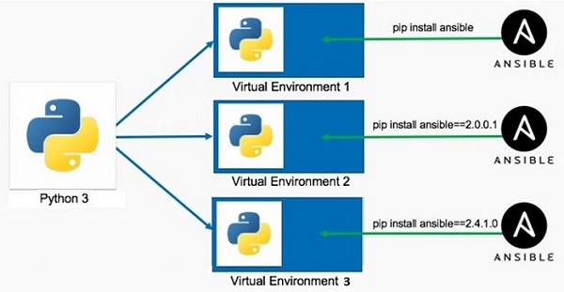
What is Virtual Environment in Python?
A Python virtual environment is:
Considered as disposable.
Used to contain a specific Python interpreter and software libraries and binaries which are needed to support a project.
Contained in a directory, conventionally either named venv or .venv in the project directory.
Not considered as movable or copyable.
https://www.tutorialspoint.com/python/python_virtual_environment.htm

Slide 76
Python Date and Time
Python datetime
Python strftime()
Python strptime()
import os
import sys
List comprehension
Python Lambda/Anonymous Function
Python Iterators
Python Generators
Python Namespace and Scope
Python Closures
Python Decorators
Python @property decorator
Python RegEx
https://www.programiz.com/python-programming/list-comprehension
Precedence and Associativity of Operators in Python
Python Keywords and Identifiers
Python Asserts
Python Json
Python pip
Python *args and **kwargs
sql connector
https://www.w3schools.com/python/python_mysql_getstarted.asp
https://www.w3schools.com/python/python_mongodb_getstarted.asp
https://github.com/GoogleCloudPlatform/cloud-sql-python-connector
https://medium.com/learning-sql/python-for-sql-an-introduction-to-database-connectivity-e1a692e16156
https://cloud.google.com/blog/topics/developers-practitioners/how-connect-cloud-sql-using-python-easy-way
https://stackoverflow.com/questions/73493052/how-to-connect-to-cloud-sql-using-python

Slide 77
Thank You !

Slide 78
Logging
mysql connector
sql lite
sqlalchemy
pymongodb
Pipelines
os
sys
frozen set
ms- excel file read
functions : zip ,map,reduce,filters,any, chr,ord, sorted,global, local,all
reading pdf
call by value call by reference, passing args by value or pass by regerence
create modules
create packeges
create exe file
create python script file
77. Tutorial 77-Python Module
78. Tutorial 78-Executing Module as Script
79. Tutorial 79-Python Loading Modules
80. Tutorial 80-Namespace And Scoping
81. Tutorial 81- Packages in python

