Slide 1


Slide 2
Matplotlib and Seaborn are Python libraries used for data visualization, each offering a different level of abstraction and functionality. Matplotlib is a foundational, low-level library that provides fine-grained control over plots.
Seaborn is a high-level library built on top of Matplotlib, designed for creating more visually appealing and statistically informative graphics with less code.

Slide 3
📘 Module 1: Introduction to Data Visualization & Titanic Dataset
Objective: Understand the purpose and value of data visualization.
Topics:
What is Data Visualization?
Why use Matplotlib and Seaborn?
Overview of Titanic dataset (features and data types)
Loading and exploring Titanic dataset using Pandas
Activities:
Load Titanic dataset using sns.load_dataset("titanic")
Use .head(), .info(), .describe() to explore
Assignment:
Write a summary of 5 interesting things from the Titanic dataset.
📘 Module 2: Matplotlib Basics
Objective: Learn to create basic plots using Matplotlib.
Topics:
Anatomy of a Matplotlib plot (figure, axes, titles, labels, legend)
plot(), bar(), scatter(), hist(), pie()
Customizing plots (color, linestyle, marker)
Adding titles, labels, and legends
Hands-on with Titanic:
Line chart showing number of passengers by age
Bar chart: Number of survivors (survived) by class
Pie chart: Gender distribution
Assignment:
Create 5 different plots using only Matplotlib on Titanic dataset.

Slide 4
📘 Module 3: Matplotlib Advanced Customization
Objective: Improve plot readability and aesthetics.
Topics:
Subplots with plt.subplot() and plt.subplots()
Adding annotations
Grid, ticks, spines
Saving plots as images
Hands-on with Titanic:
Create subplot grid showing survival by class and gender
Annotate highest fare-paying passenger
Assignment:
Create a dashboard of 4 Titanic plots using subplots.
📘 Module 4: Seaborn Basics – Introduction & Categorical Plots
Objective: Learn to build quick statistical plots using Seaborn.
Topics:
Overview of Seaborn aesthetics and themes
countplot(), barplot(), boxplot(), violinplot()
Color palettes and hue, col, row parameters
Hands-on with Titanic:
countplot() of survivors by class and gender
barplot() of average fare by embark_town
violinplot() of age distribution by class
Assignment:
Use at least 3 categorical plots to explore survival vs different features.

Slide 5
📘 Module 5: Seaborn for Numerical Variables
Objective: Visualize distributions and relationships between numeric variables.
Topics:
histplot(), distplot() (legacy), kdeplot()
scatterplot(), lineplot(), regplot()
Hands-on with Titanic:
Age distribution using histplot()
Fare vs age scatterplot() with survival as hue
Survival trend by age using lineplot()
Assignment:
Plot distribution of age and fare; interpret the shapes.
📘 Module 6: Seaborn Pairwise & Matrix Plots
Objective: Use pairwise and heatmap plots for multivariate insights.
Topics:
pairplot(), jointplot()
heatmap() and correlation matrix
Customizing annotations and colormap
Hands-on with Titanic:
Correlation heatmap of numeric features
pairplot() with hue="survived"
Assignment:
Create heatmap and describe 2-3 interesting correlations.

Slide 6
📘 Module 7: Advanced Plot Styling & Themes
Objective: Make plots presentation-ready.
Topics:
Seaborn themes (darkgrid, whitegrid, etc.)
Using set_context() and set_style()
Adjusting figure size, aspect ratios
Hands-on with Titanic:
Recreate previous plots using different themes
Prepare plots for report/presentation
Assignment:
Create 3 styled plots suitable for a business report.
📘 Module 8: Plotting for EDA Storytelling (Mini Project)
Objective: Use plots to tell a story.
Task:
Create an EDA (Exploratory Data Analysis) storyline using 6–8 visualizations.
Interpret and explain: “Who had the highest chances of survival?”
Expected skills:
Use both Matplotlib and Seaborn effectively
Visual storytelling
Use of subplots, titles, colors for narrative
🎯 Capstone Assignment
Title:“Visual Titanic” – End-to-End Visualization Report
Deliverables:
One Jupyter notebook (cleaned and well-commented)
At least:
3 Matplotlib plots
5 Seaborn plots (with at least 1 pairplot and 1 heatmap)
Plot storytelling with conclusions

Slide 7
# install
# pip install matplotlib
# pip install seaborn
import matplotlib.pyplot as plt
import seaborn as sns
# https://matplotlib.org/
# https://seaborn.pydata.org/

Slide 8
# data
importnumpyasnp
importpandasaspd
d1= [1,2,3,4,5,6]
# create line graph using plot
plt.plot(d1)
# plt.show() # only display the plot
x = np.linspace(0,10, 100)
y = np.linspace(1,30)
x
plt.plot(np.linspace(1,50,20))
data = np.random.randint(1,50,20)

Slide 9
# multiple lines in single plot
plt.figure(figsize=(5,5))
x=np.linspace(0, 2, 100)
plt.plot(x, x, label='linear')
plt.plot(x, x**2, label='quadratic')
plt.plot(x, x**3, label='cubic')
plt.xlabel('x label')
plt.ylabel('y label')
plt.title("Simple Plot")
plt.legend()
plt.show()
seaborn use
import seaborn as sns
sns.lineplot(x=x,y=x, label='linear')
sns.lineplot(x=x,y=x**2, label='q')
sns.lineplot(x=x,y=x**3, label='c')
plt.title(" line graph")
plt.show()

Slide 10
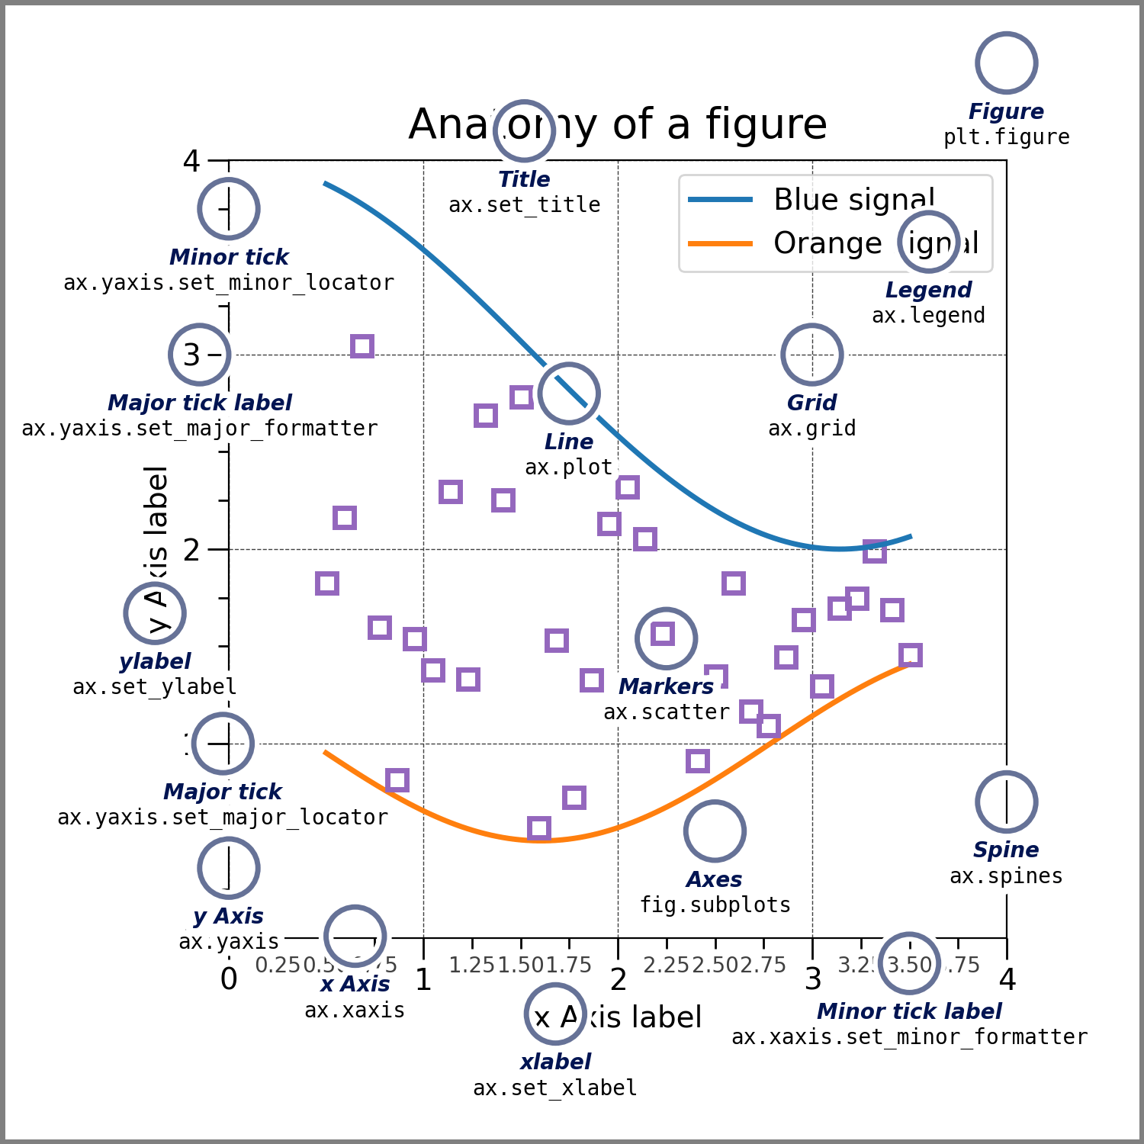

Slide 11
SUBPLOTING
plt.Figure(figsize=(5,5))
# subplot(row,column, ploting area )
plt.subplot(2,1,1)
plt.plot(x, np.sin(x),"--",color="red",label="sin graph")
plt.legend()
plt.subplot(2,1,2)
plt.plot(x, np.cos(x),"--", label="cos graph")
plt.legend()
plt.show()

Slide 12
# figsize=(2,3) width,height
# to define size of graph
plt.figure(figsize=(2,3))
plt.plot(x, np.sin(x),"--",color="red" ,marker="4",markerfacecolor="g",markeredgecolor="g",label="sin graph" )
plt.title("sin graph")
plt.plot(x, np.cos(x),"--", label="cos graph")
#create x and y label
plt.xlabel("range 1 to 10")
plt.ylabel("sin value")
# define the range of the x and y
plt.xticks(np.arange(0,11, 1))
plt.yticks(np.arange(-1,1, 0.1))
# define range of x
plt.xlim(1,20)
plt.ylim(-2,1)
plt.grid()
plt.legend(loc="upper left")
# 'upper left': # 'upper right': ,# 'lower left':#
plt.show()

Slide 13
# create a plot figure
plt.figure()
# create the first of two panels and set current axis
plt.subplot(2, 1, 1) # (rows, columns, panel number)
plt.plot(s)
# create the second of two panels and set current axis
plt.subplot(2, 1, 2) # (rows, columns, panel number)
plt.plot(cos)
plt.figure()
plt.subplot(2,2,1)
plt.plot(s)
plt.subplot(2,2,3)
plt.plot(cos)
plt.subplot(2,2,4)
plt.plot(np.random.randn(50))

Slide 14
BAR CHART
ADD DATA LABEL IN CHART
cat = ["a","b","c"]
sales = [343,384,300]
ax = sns.barplot(x=cat,y=sales , legend=cat, palette=['red', 'blue', 'green'])
for i in range(len(cat)):
ax.bar_label(ax.containers[i], fontsize=10)
plt.title("categories_wise sales")
plt.xlabel("categories")
plt.ylabel("sales amount")
plt.grid(axis="y")
plt.show()
# indivisual color each bar as gradient
HUE AND PALLATE
ax = sns.barplot(x=cat,y=sales ,hue=cat, legend=cat, palette="Greens")
for i in range(len(cat)):
ax.bar_label(ax.containers[i], fontsize=10)
# matplotlib
cat= ["a","b","c"]
sales= [343,384,300]
plt.bar(cat,sales)
plt.title("categories_wise sales")
plt.xlabel("categories")
plt.ylabel("sales amount")
plt.show()
# SEABORN
cat = ["a","b","c"]
sales = [343,384,300]
ax = sns.barplot(x=cat,y=sales ,hue=cat)
ax.bar_label(ax.containers[0], fontsize=10)
ax.bar_label(ax.containers[1], fontsize=10)
ax.bar_label(ax.containers[2], fontsize=10)
plt.title("categories_wise sales")
plt.xlabel("categories")
plt.ylabel("sales amount")
plt.show()
plt.bar(x, y, color='#FF5733')

Slide 15
SCATTER CHART
# scatter continous data --
sales=[45,34,12,67,54,32,23,12,12]
profit=np.random.randint(5, 13, len(sales))
print(sales)
print(profit)
plt.scatter(profit,sales)
gender = ['m','f','m','f','m','f','f','m','f']
sns.scatterplot(x=profit , y=sales,hue=gender)
plt.scatter(x, y, c='r', alpha=.9, marker="X" ) # alpha color intensity

Slide 16
SCATTER CHART
# scatter continous data --
sales=[45,34,12,67,54,32,23,12,12]
profit=np.random.randint(5, 13, len(sales))
print(sales)
print(profit)
plt.scatter(profit,sales)
gender = ['m','f','m','f','m','f','f','m','f']
sns.scatterplot(x=profit , y=sales,hue=gender)

Slide 17
3. Pie Chart
#pie chart
langs= ['C', 'Python', 'Java']
students= [20, 100, 40]
plt.pie(students, labels=langs, autopct='%1.1f%%')
plt.title("Pie chart")
plt.show()
my_explode= (0.0, 0.1, 0.1)
langs= ['C', 'Python', 'Java']
students= [20, 100, 40]
plt.pie(students, labels=langs, autopct='%1.1f%%', explode=my_explode, shadow= True)
plt.title("Pie chart")
plt.show()
plt.pie(data, labels=labels, colors=colors, explode=explode, autopct='%1.1f%%', shadow=True, startangle=90)

Slide 18
# Creating explode data
exp= (0.1, 0.0, 0.2, 0.3)
# Creating color parameters
col= ("orange", "cyan", "brown",
"grey")
a,b,c=plt.pie(sales,labels=cat,autopct="%.2f%%",explode=exp,colors=col)
plt.title('Sales by Category')
plt.show()

Slide 19
HISTOGRAM
# histogram
d1=np.random.randint(1,100, 1000)
d1
plt.hist(d1,bins=100)
#Histogram
data = np.random.randn(1000) #10 bins
plt.hist(data, bins = 20, color ='green')
plt.show()
sns.histplot(x=d1, kde=True)
# COUNT
d1 = np.random.randint(1,10, 1000)
d1
sns.countplot(x=d1)

Slide 20
#Boxplot >> to know outliers
#1, 2, 3, 4, 5, 100 >>> extreme data, for each day give me outlier for total bill
sns.boxplot(x='day', y='total_bill', data=tips, palette='rainbow')
sns.heatmap(tips_num.corr(), annot = True, cmap = 'coolwarm')
sns.countplot(x = 'sex', data=tips)

Slide 21
data.boxplot(column='Balance')
plt.violinplot(data['Balance'])
sns.jointplot(x = tips.total_bill, y=tips.tip)
sns.jointplot(x = tips.total_bill, y=tips.tip, data = tips, kind="reg")
sns.jointplot(x = tips.total_bill, y=tips.tip, data = tips, kind="hex")
sns.pairplot(tips, hue = 'smoker',)
sns.pairplot(tips, hue = 'smoker',palette = 'coolwarm')
# https://seaborn.pydata.org/generated/seaborn.color_palette.html
# https://seaborn.pydata.org/tutorial/color_palettes.html
#Boxplot >> to know outliers
#1, 2, 3, 4, 5, 100 >>> extreme data, for each day give me outlier for total bill
sns.boxplot(x='day', y='total_bill', data=tips, palette='rainbow')
sns.heatmap(tips_num.corr(), annot = True, cmap = 'coolwarm')
sns.countplot(x = 'sex', data=tips)

Slide 22
# 3D plot
x=np.random.rand(20)
y=np.random.rand(20)
z=np.random.rand(20)
fig=plt.figure()
ax=fig.add_subplot(projection='3d')
ax.scatter(x, y, z, c="#FF5733", alpha=.9)
plt.xlabel("x axis")
plt.ylabel("y axis")
plt.show()

Slide 23
1. Line Plot
age_count = titanic['age'].value_counts().sort_index() plt.plot(age_count.index, age_count.values) plt.title('Passenger Count by Age') plt.xlabel('Age') plt.ylabel('Count') plt.grid(True) plt.show()
2. Bar Chart
survived_class = titanic.groupby('pclass')['survived'].sum() survived_class.plot(kind='bar', color='skyblue') plt.title('Survivors by Passenger Class') plt.xlabel('Passenger Class') plt.ylabel('Number of Survivors') plt.show()
3. Pie Chart
gender = titanic['sex'].value_counts() plt.pie(gender, labels=gender.index, autopct='%1.1f%%', startangle=140) plt.title('Gender Distribution') plt.axis('equal') plt.show()
TITANIC DATA
🔢 Loading Titanic Dataset
import seaborn as sns
import pandas as pd
import matplotlib.pyplot as plt
# Load dataset
titanic = sns.load_dataset('titanic')
# Basic Exploration
titanic.head()
titanic.info()
titanic.describe()
Plot Type | Library | Usage Description
Line Plot | Matplotlib | Trends over continuous variables (e.g., age)
Bar Chart | Matplotlib | Compare categories (e.g., class)
Pie Chart | Matplotlib | Show proportions (e.g., gender)
Countplot | Seaborn | Count of categories
Barplot | Seaborn | Aggregated values by category
Violinplot | Seaborn | Distribution + comparison
Histplot | Seaborn | Distribution of single variable
Scatterplot | Seaborn | Relation between two numeric variables
Pairplot | Seaborn | Pairwise relationship + clustering
Heatmap | Seaborn | Correlation or matrix data

Slide 24
🌈 Seaborn Basics
1. Countplotsns.countplot(x='class', hue='survived', data=titanic) plt.title('Survival Count by Class') plt.show()
2. Barplotsns.barplot(x='embark_town', y='fare', data=titanic) plt.title('Average Fare by Embark Town') plt.show()
3. Violinplotsns.violinplot(x='class', y='age', hue='survived', data=titanic, split=True) plt.title('Age Distribution by Class and Survival') plt.show()
📊 Distribution and Regression Plots
1. Histplotsns.histplot(data=titanic, x='age', bins=20, kde=True) plt.title('Age Distribution') plt.show()
2. Scatterplotsns.scatterplot(x='age', y='fare', hue='survived', data=titanic) plt.title('Fare vs Age by Survival') plt.show()
3. Lineplotsns.lineplot(data=titanic, x='age', y='survived') plt.title('Survival Trend by Age') plt.show()
🤝

Slide 25
🤝 Pairplot and Heatmap
1. Pairplotsns.pairplot(titanic[['age', 'fare', 'survived']], hue='survived') plt.show()
2. Correlation Heatmapcorr = titanic.corr(numeric_only=True) sns.heatmap(corr, annot=True, cmap='coolwarm', fmt='.2f') plt.title('Correlation Heatmap') plt.show()
🎭 Customizing and Stylingsns.set_style('whitegrid') sns.set_context('talk') sns.barplot(x='sex', y='survived', data=titanic, palette='pastel') plt.title('Survival Rate by Gender - Styled') plt.show()
🎨 Final EDA Project Task
Create a visual analysis report answering:
Who survived more? (Gender/Class/Age?)
Does age impact survival?
Fare vs survival?

