Slide 1
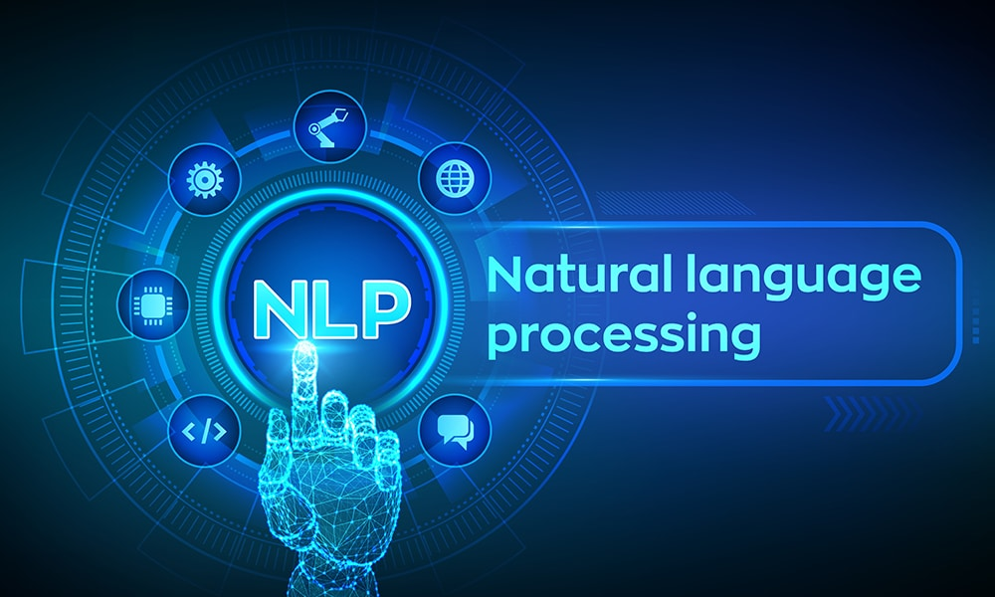

Slide 2
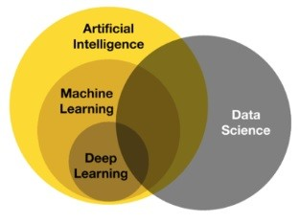
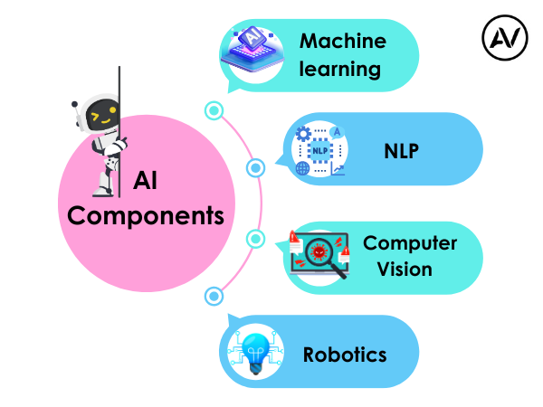
https://ellow.io/components-of-ai/

Slide 3
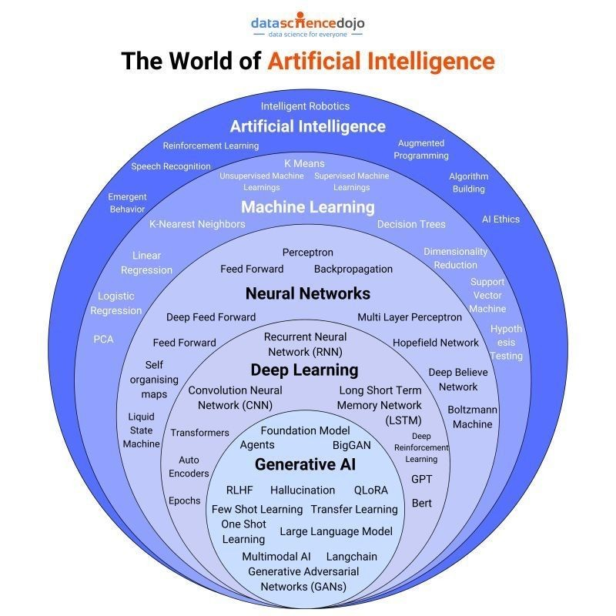
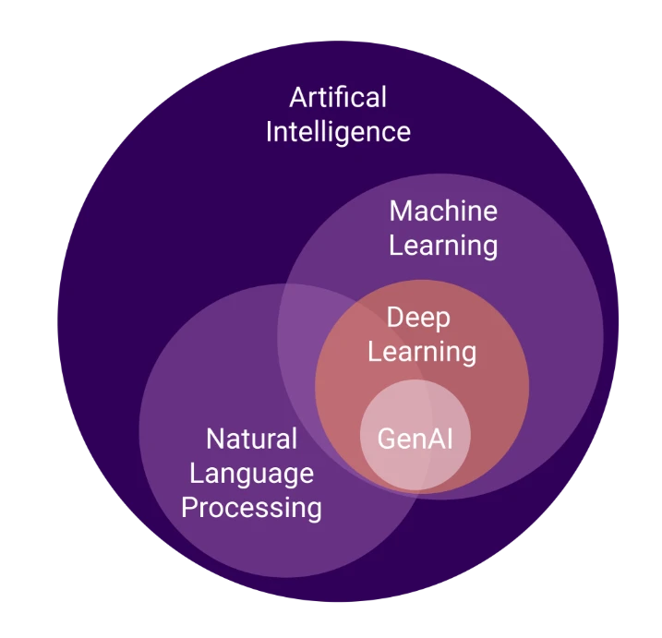
Algorithms and models

Slide 4
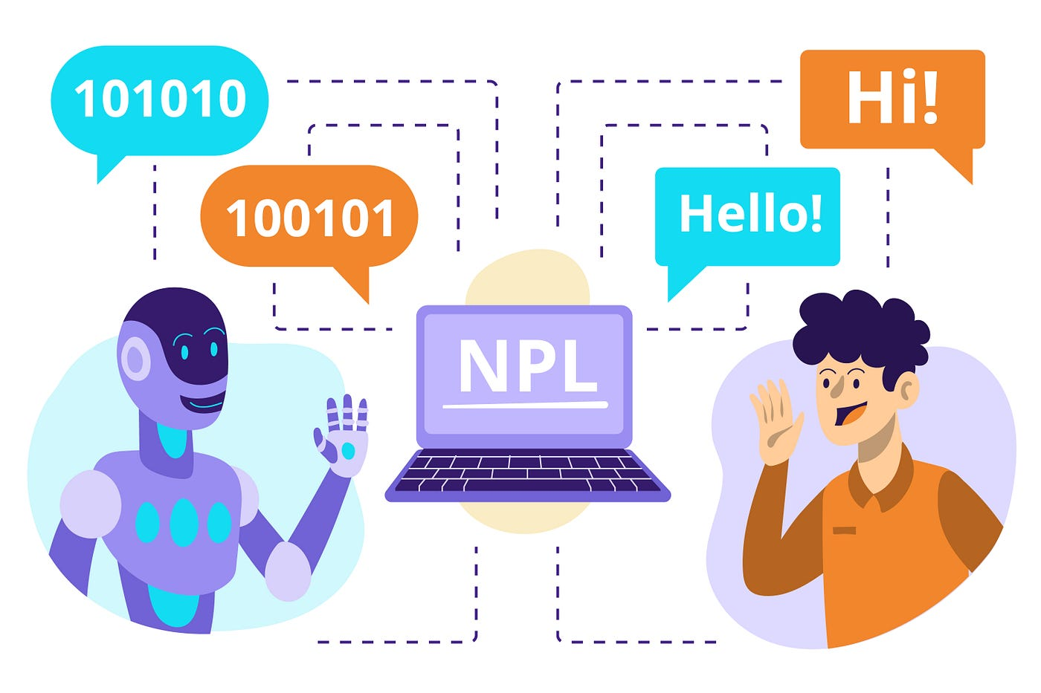

Slide 5
NLP ->to make machines to understand human language
why --> lots of text generate
but problem is
it does not have a universal representational in numbers.
modeling data problem --> no do direct
Image is univeral everyone undersatnd
Types of Problem Solve
1. Classifications (+ve , -ve | issue classification | sentiment analysis)
2. name entity recognization (time,topic, organizations) -->example insurance company read docs to reduce time
3. language Modeling
Q&A, Translations
summarizations
next word generations

Slide 6
Some Definations
Documnents
corpus
token
vocabulary

Slide 7
Embedding-->
1 dimensions of representations of any data
why do -->for neural network-->and it solve 99% real world problems.
Predictions use in industry
Problem in NLP
text --> convert to number
model --> how to create model in text
Text to Number do --> Embedding
prediction
Frequency

Slide 8
Frequency
BOW - It is best way to represent the words
->it solve classifications problem not complex problem
what PROBLEMS:
Sparse data(20 words 20 columns)
large columns
ignore the order of words
No contextual representational.
SOLVE THESE PROBLEM USE
Higher Dimensions
Reduce the stop words
remove punctuations
remove special char
remove numbers( only in classifications not in all case
Context of words (eg: run |ran|running -->run (if not capture any context remove extra
how --> stemming , lemitaziations
Order of Words -->use N-Gram like -->bigram ,trigram
All these see that count the value so called count Vectorizer

Slide 9
NOW
TF-IDF (Term frequency inverse documnent frequency
what is TF --> normalize version of word in doc
IDF
TF-IDF
Till now BOth case the sparsecity and context not understand so only solve classification Problems
SO THESSE are out dated --> so go to Data scientist + lingustic to solve the context of word

Slide 10
Intutions
story -->lambogrini
all word
Projections vector are very similary approx -->so know DS --> Words simillar means --> High cosine similarity --> So questions is
what are these feature.
feature are those things Learn from Historical data
So how many feature --> and so how they learn thsese feature--> train --> so the concept come --> Word2Vec (types --> CBOW , SKIPgram)
we train using Neural Network-->
but the input and output are strings then how we solve using Neural Network (so it clearly so that multiclass classifications Problems --> So come concept Embeddings
Embeddings say you set random vector(RV) in every where (eg: 1500 words create --> RV)

Slide 11
TF-IDF fail in context
Word2vec Failed in some size
So now We thinking about Sequetial Model --> means word2vec not fint by using simple ANN we use to learn the sequence then use it --> then RNN come into picture

Slide 12
ConCept of Sequetial (ANN not design for Sequential data/Model)
RNN
vanising gradient Problem/Forgtting problem
Types of RNN
LSTM
GRU
DEEP RNN
BIDIRECTIONAL RNN
lstm DISADVANTAGE
it cannot learn on very big datasets ,also not learn from Distributibs
all weights are same for all so every words importants for all (which is big disadvantage)
where the Concept of Sequence to sequence |Encode-Decoder | Attentions & Transformers comes (2018 attention is all you need {father of LLM})

Slide 13
Attentions
types of Attentions(Bahdanau ,luong)
ENCODER- DECODER
TRANSFORMERS
part of TRANSFORMERS
BERT(ENCODER) 768 attenetion layers -->JOIN multipe encoder get BERT
GPT(DECODER) 96 layer
TRANSFORMERS
self Attention (what, Scaled dotproduct, Geometric Intutions, why call self)
Multi-Head Attention
Positional Encoding
Layer Normalizations
TRANSFORMERS Architecture
masked Self Attentions
Cross Attentions
Transformer Decoder Architecture
Transformer Inference

Slide 14
Introduction of Prompt Engineering
Genrative AI
LLM
AGENT AI

Slide 15
Before Learn NLP
Machine Learning
Deep Learning
1. Fundamentals of Neural Networks:
Introduction to Artificial Neural Networks (ANNs)
Perceptron model
Activation functions (sigmoid, ReLU, tanh)
Backpropagation algorithm
Loss Functions
Gradient descent optimization

Slide 16
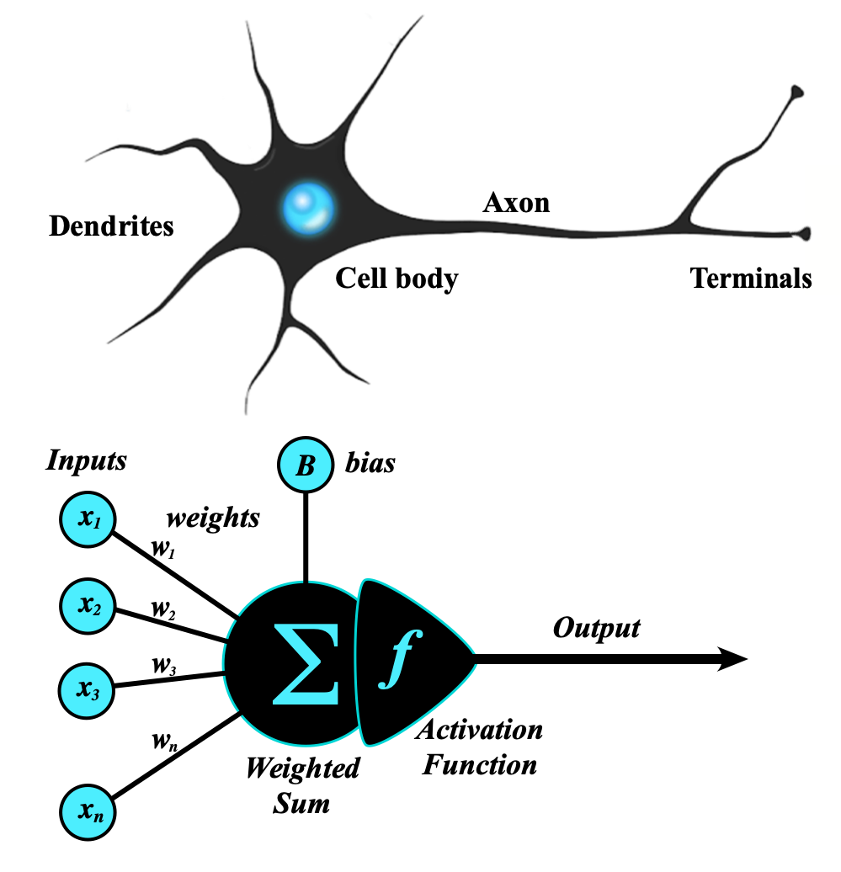
Artificial Neural Network
An artificial neural network (ANN) is a computational network (a system of nodes and the interconnection between nodes) inspired by biological neural networks, which are the complex networks of neurons in human brains (see Figure).
The nodes created in the ANN are supposedly programmed to behave like actual neurons, and hence they are artificial neurons.
The Perceptron was invented in 1957 by Frank Rosenblatt at the Cornell Aeronautics Laboratory. Based on the first concepts of artificial neurons, he proposed the “Perceptron learning rule“.
Perceptron Model
The perceptron is the simplest form of an artificial neural network and serves as the building block of more advanced models.
Components of a Perceptron:
Inputs: Feature values from the dataset.
Weights: Assigned to each input to signify importance.
Summation Function: Computes the weighted sum of inputs.
Activation Function: Applies a threshold to determine output.
https://www.geeksforgeeks.org/neural-networks-a-beginners-guide/
https://s.mriquestions.com/what-is-a-neural-network.html

Slide 17
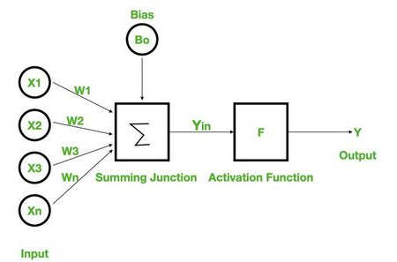
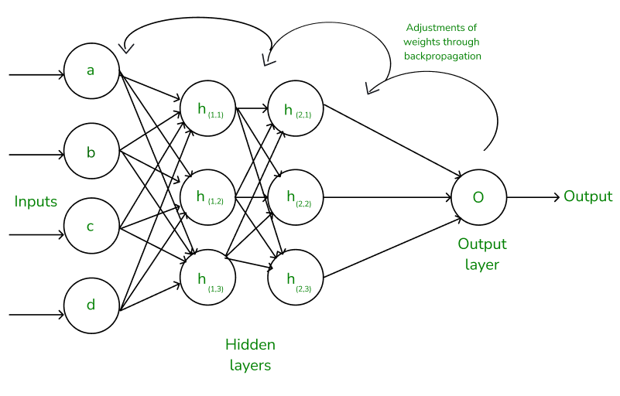
Types of Perceptron Models:
Single-layer perceptron: Can only solve linearly separable problems.
Multi-layer perceptron (MLP): Can solve non-linear problems using multiple layers.
Neural Networks Architecture:
the basic elements of the network's architecture.
made of three core layers:
Input layer
Hidden layers
Output layer

Slide 18
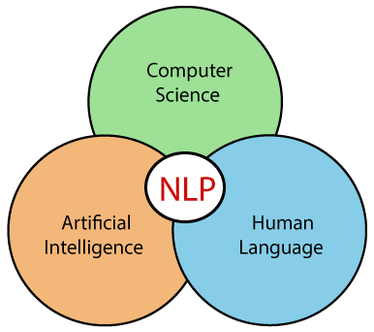
What we Learn in NLP

Slide 19
Introduction to NLP
What is Natural Language Processing
Uses of NLP
Application of NLP
Components of NLP
Stages of NLP
Machine Translation
Introduction to LLM
Sentiment Analysis
What is Sentiment Analysis
Challenges in Sentiment Analysis
Handling Emoticons
Sentiment Analysis with ANN
Assignment
Sequence Model
Sequential Data
Recurrent Neural Network
Multi-layer & Bi-directional RNN
Architecture of RNN
Vanishing Gradient Problem in RNN
Long Short Term Memory
Multi-layer & Bi-directional LSTM
Gated Recurrent Unit
Multi-layer & Bi-directional GRU
Assignment
Text Preprocessing
Tokenization
Non Alphabets Removal
Stopwords Removal
Bag of Words
Stemming & Lemmatization
Part of Speech Taging
Name Entity Recognition
Text Visualization
Assignment
Text Classification
CountVectorization/Text Vecorization
Text Classification with ML
TFIDF Vectorization
Text Classification with ANN
Embedding Layer in Natural Language
Assignment
Transformers Based Models
encoder decoder
Sequence to Sequence Model
Attention Machanism /attentions ,self attentions
Transformers
BERT & GPT
Face Hugging Transformers

Slide 20
RASA Chatbot
What is RASA
RASA Installation
RASA Initialization
RASA Configuration and File System
Intents, Entity,Response and Story
Actions
Assignment
Weather Forecasting using ARIMA Model
Introduction to AR and MA model
Stationarity & Differencing
SariMax of Seasonal Data
Identifying order AR(p), I(d), MA(q)
Implementation of ARIMA
Assignment
Introduction to Time Series Analysis
What is Sequential Data & Time Series
Functional Relationship
Components of Time Series
Mathemetical Representation of Time Series
ETS Decompositon
Classification of Time Series
Defference between ACF & PACF
Assignment
Stock Price Prediction using Sequence Model
Introduction to Sequence Models RNN, LSTM
Preparing Time Series Data for LSTM
Forecasting using LSTM
Future Forecast
Assignment

Slide 21
What we Learn in NLP Advance
Word embedding
Word2vac
Rnn
LSTM
GRU
encoder decoder
attentions
self attentions
transformer
BERT & GPT
Introduction of Prompt Engineering
Genrative AI
LLM
AGENT AI
Libraries
NLTK
SPACY

Slide 22
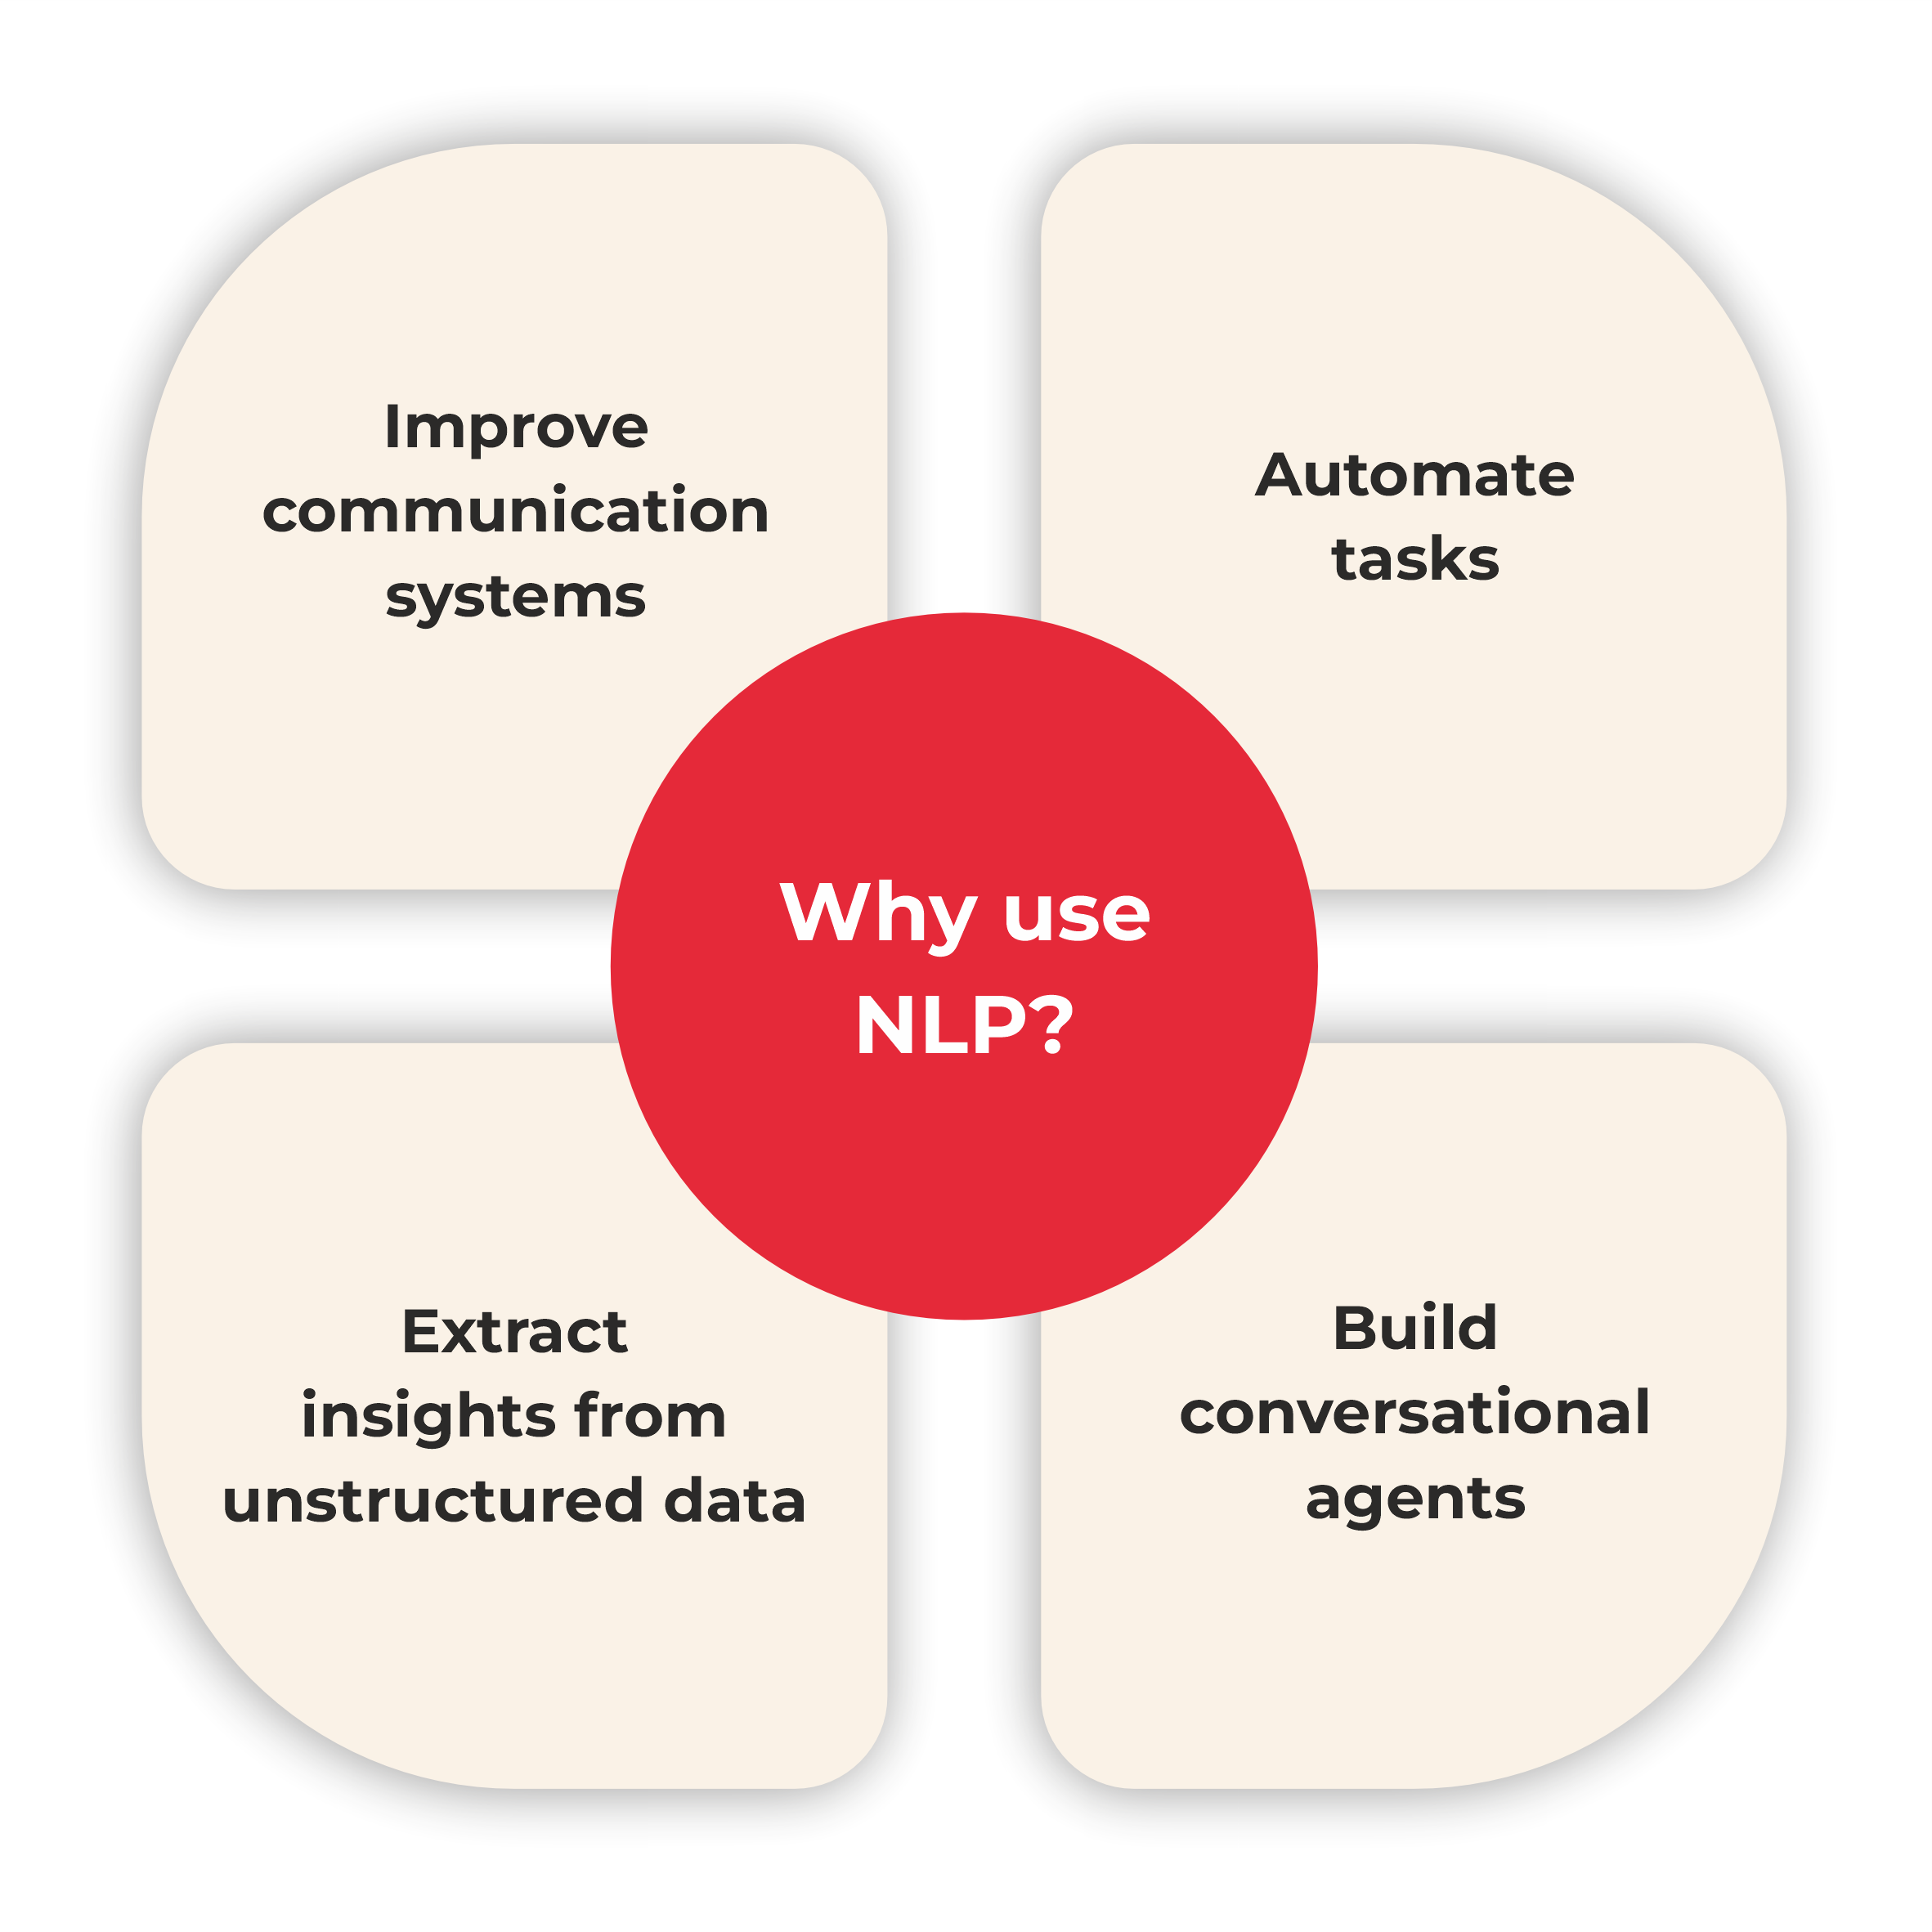

Slide 23
If we mathematically represent it contains the following terms:
NLP: NLP (Natural Language Processing) is in charge of processes such as decisions and actions.
NLU: NLU (Natural Language Understanding) understands the meaning of the text.
NLG: NLG (Natural Language Generation) creates the human language text from the structured data that the system generates to answer.
https://www.tpointtech.com/nlp --> History
https://www.xenonstack.com/blog/natural-language-processing

Slide 24
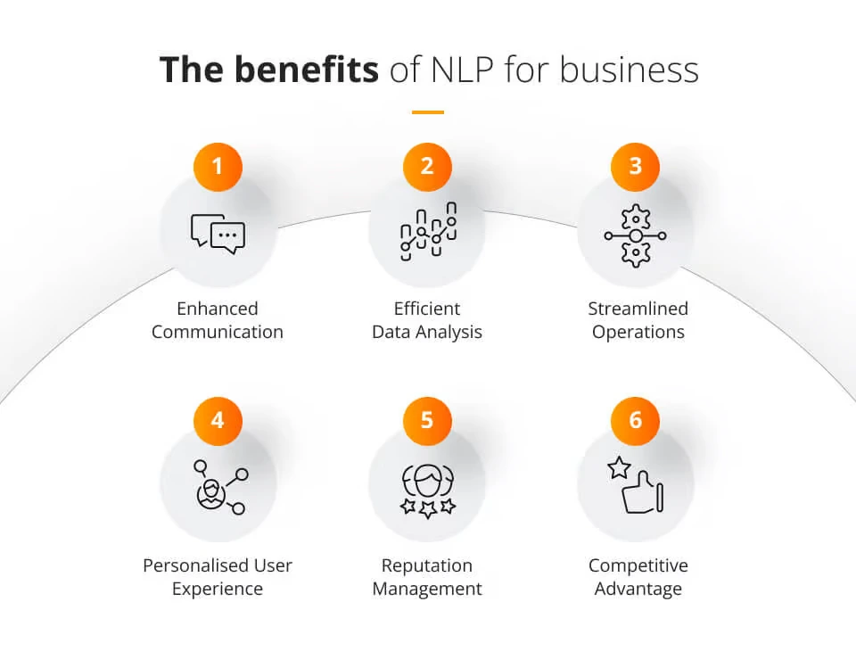
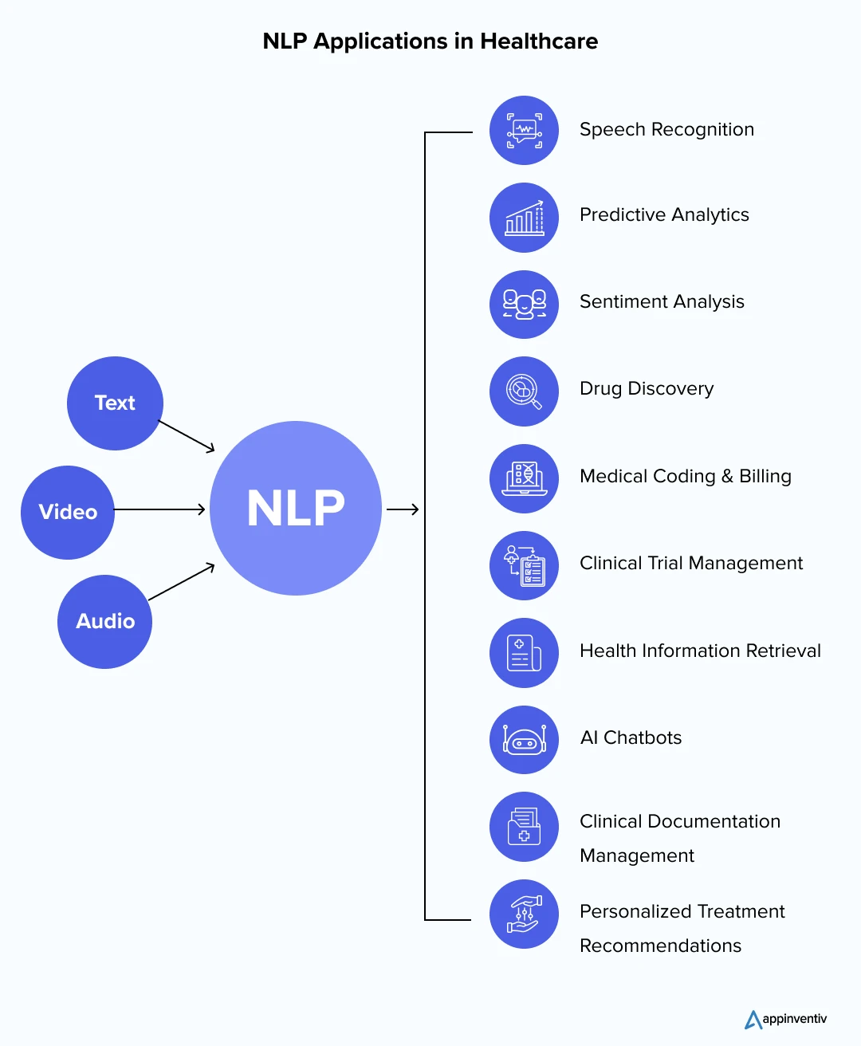
https://www.jaroeducation.com/blog/nlp-for-business-communications/
https://appinventiv.com/blog/nlp-in-healthcare/

Slide 25
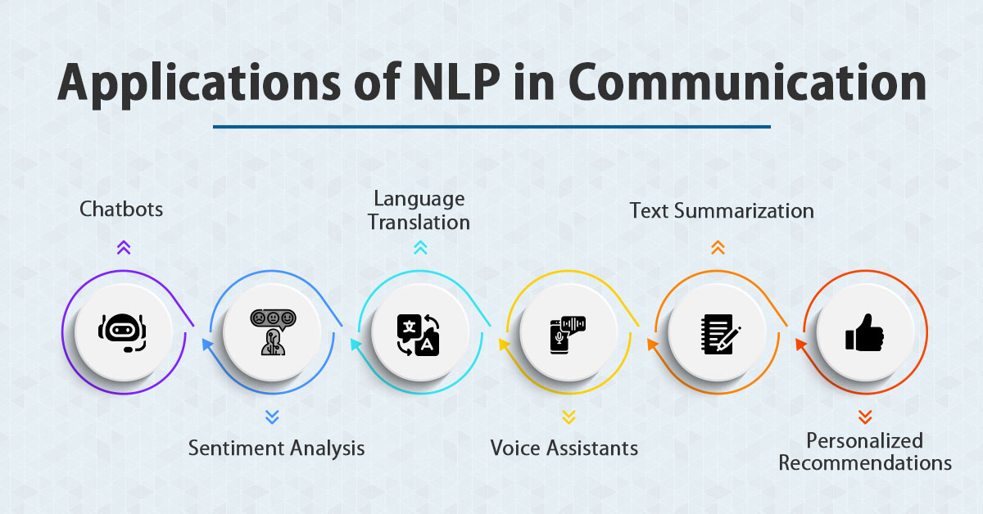
https://www.jaroeducation.com/blog/nlp-for-business-communications/

Slide 26
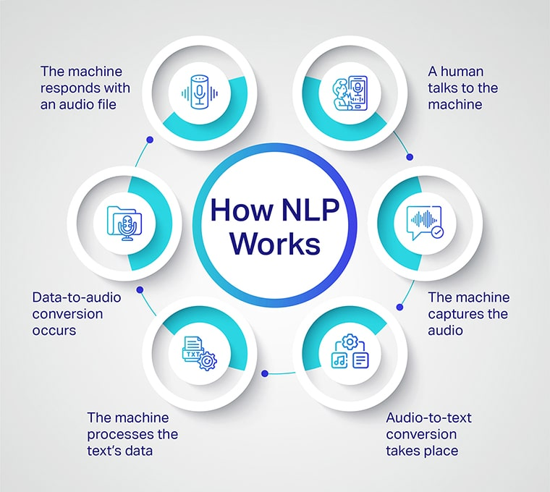

Slide 27
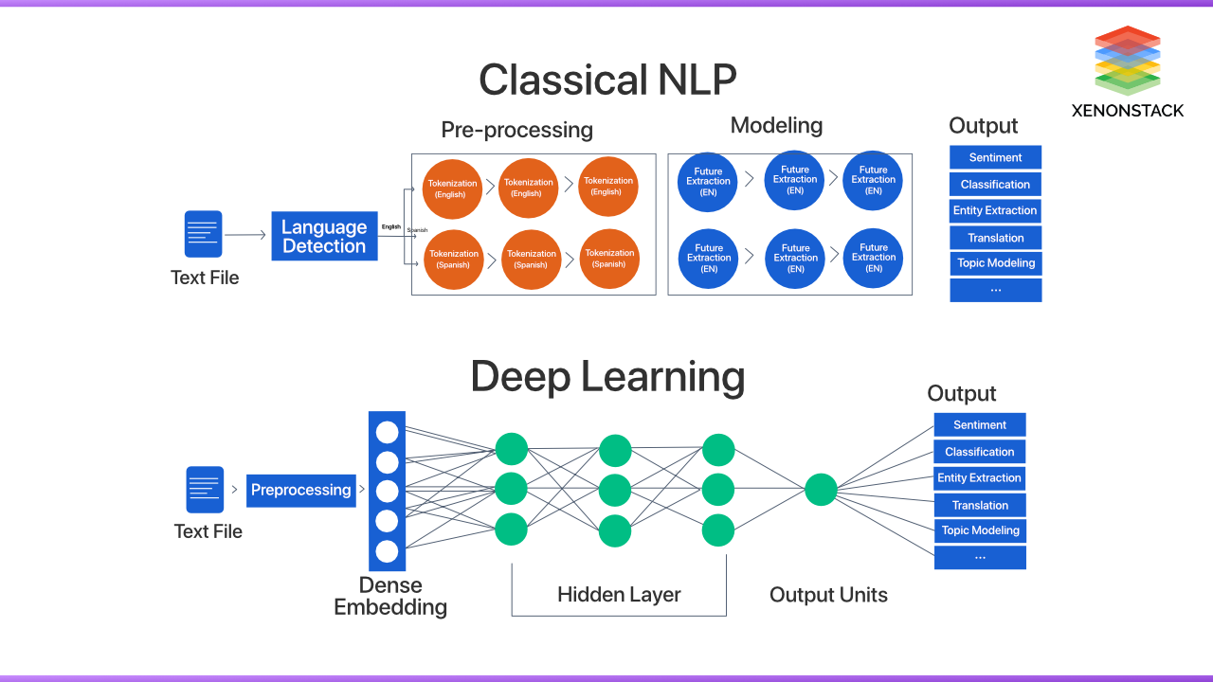

Slide 28
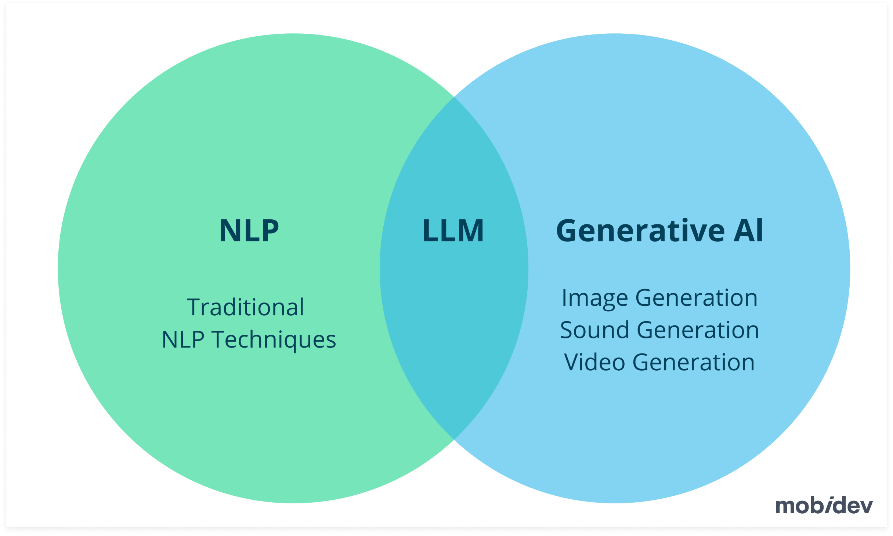
https://mobidev.biz/blog/natural-language-processing-nlp-use-cases-business

Slide 29
What are the 4 types of NLP?
NLP techniques can be broadly categorized into these four types:
Morphological Processing: Focuses on analyzing the structure of words, including prefixes and suffixes.
Syntactic Analysis: Examines sentence structure to ensure grammatical correctness.
Semantic Analysis: Studies meaning in text or speech, including context and word relationships.
Pragmatic Analysis: Looks at the intended meaning behind words, considering tone, culture, and situational context.

Slide 30
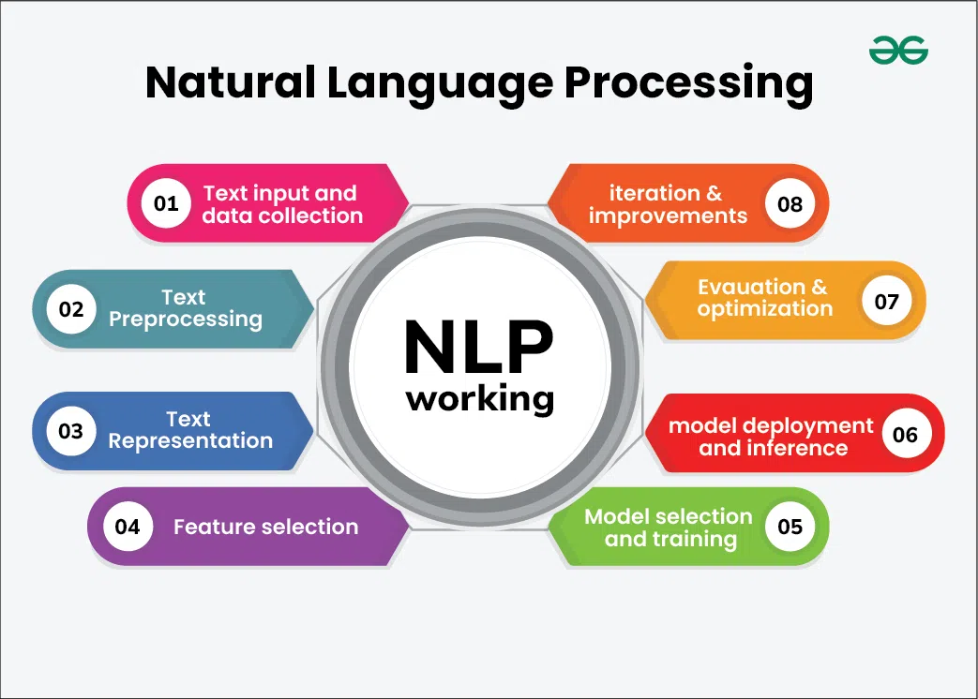

Slide 31
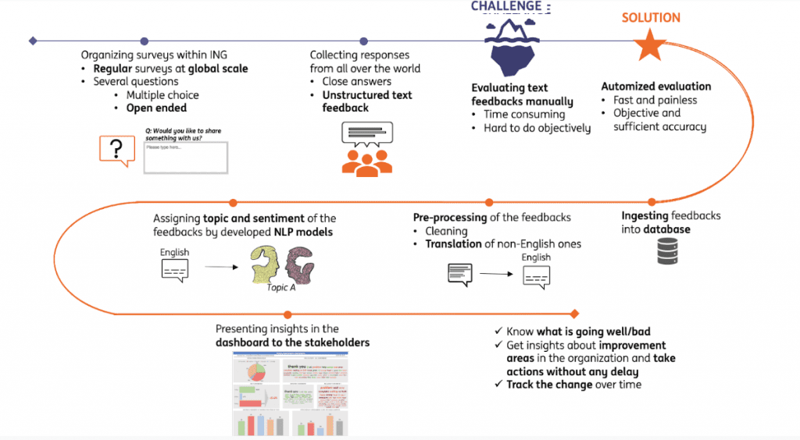
Full Life Cycle of NLP Models
https://hyperight.com/full-life-cycle-of-nlp-models/

Slide 32
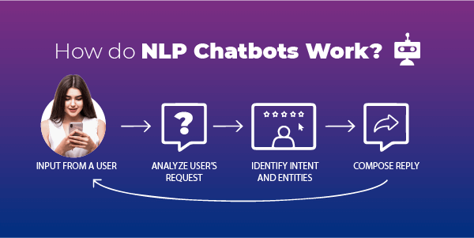
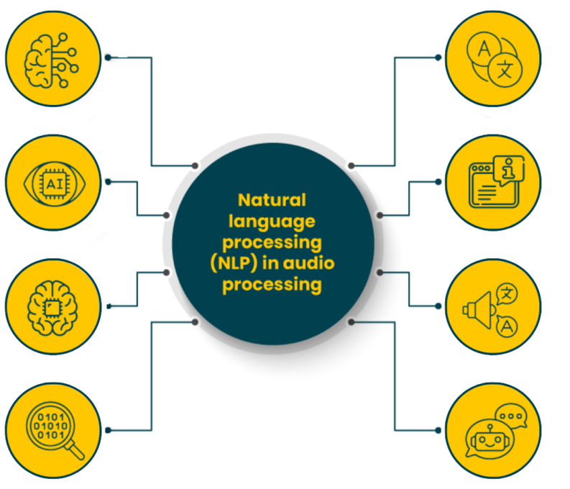
https://routemobile.com/blog/how-do-nlp-chatbots-work/
https://dac.digital/5-practical-applications-of-nlp-in-audio-processing/

Slide 33
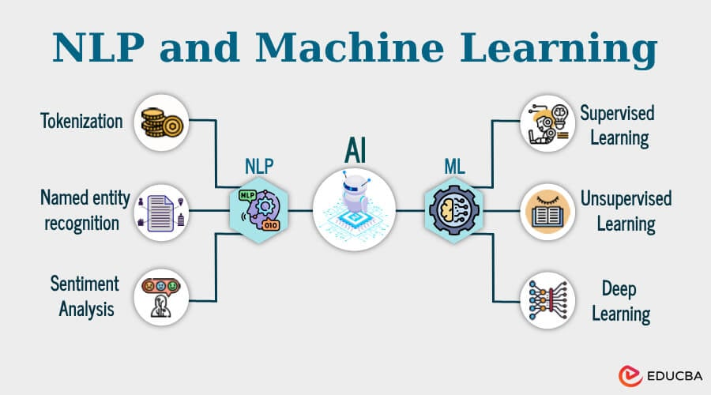

Slide 34
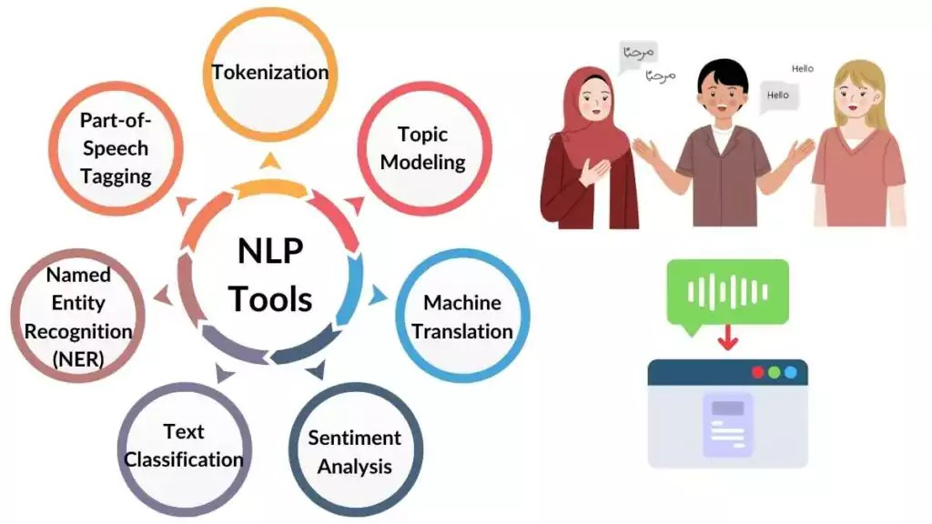
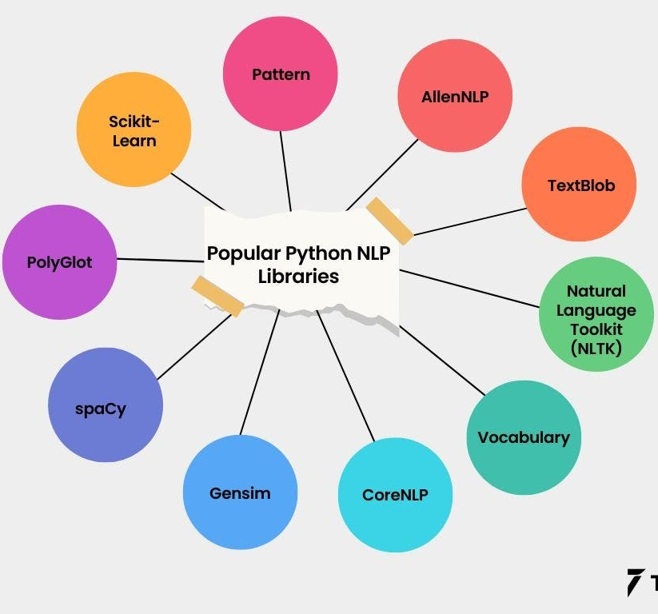
https://spotintelligence.com/2024/01/29/natural-language-processing-nlp-tools/
https://www.turing.com/kb/which-language-is-useful-for-nlp-and-why

Slide 35
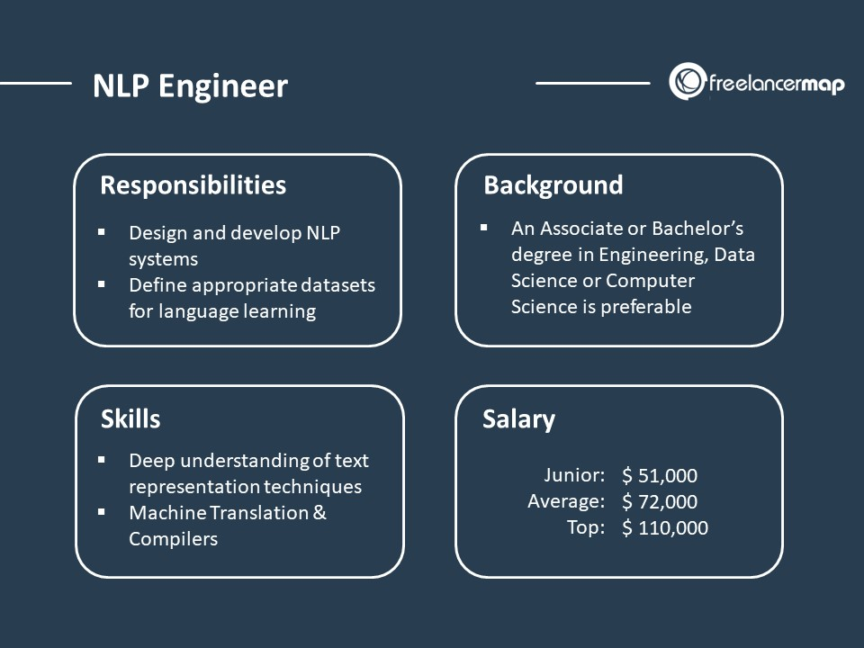
https://www.freelancermap.com/blog/what-does-nlp-engineer-do/

Slide 36
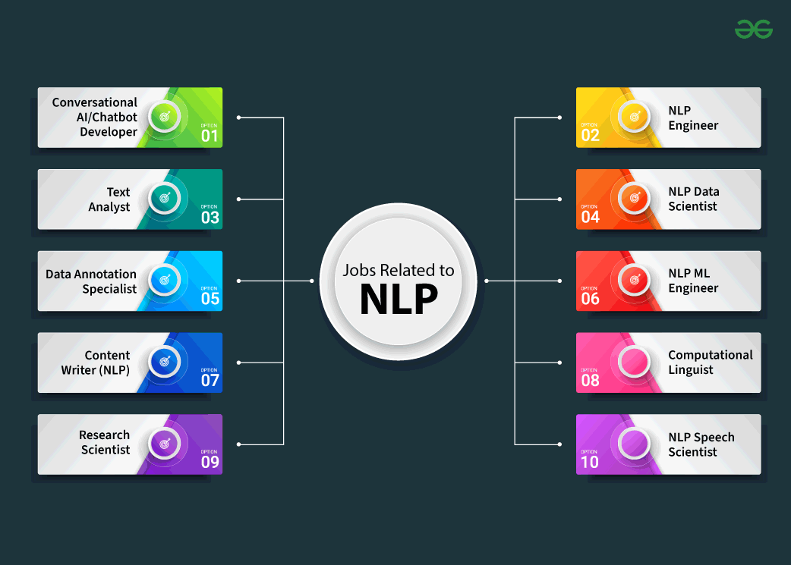
https://www.geeksforgeeks.org/natural-language-processing-nlp-job-roles/

Slide 37
https://analyticsindiamag.com/topics/nlp-vs-llm/

