Slide 1
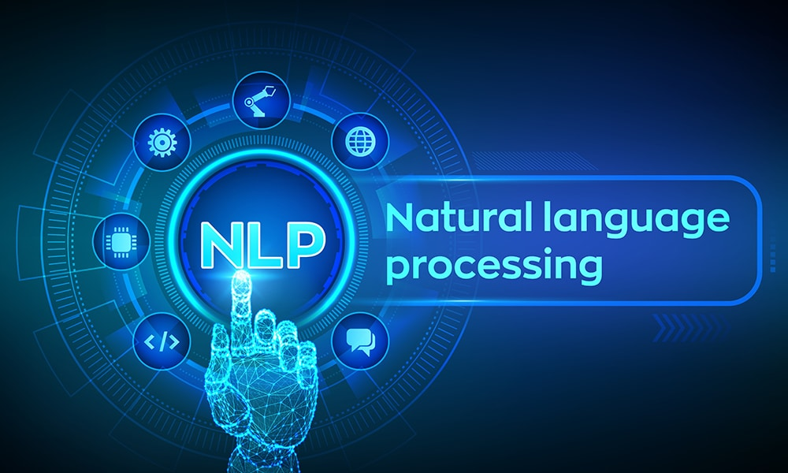
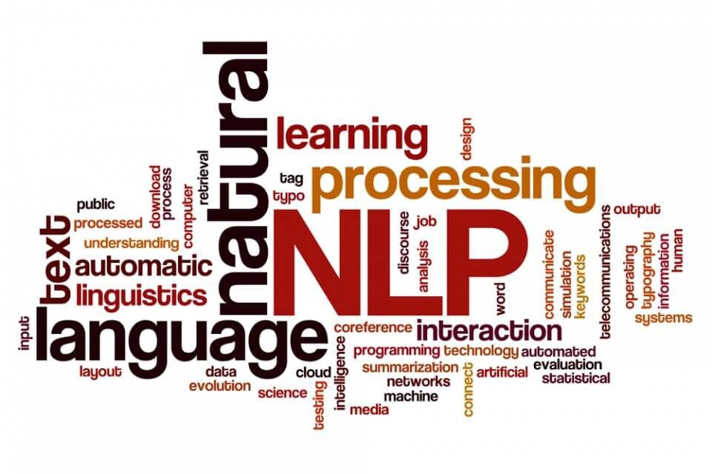

Slide 2
Introduction to NLP
What is Natural Language Processing
Uses of NLP
Application of NLP
Components of NLP
Stages of NLP
Machine Translation
Introduction to LLM
Sentiment Analysis
What is Sentiment Analysis
Challenges in Sentiment Analysis
Handling Emoticons
Sentiment Analysis with ANN
Assignment
Sequence Model
Sequential Data
Recurrent Neural Network
Multi-layer & Bi-directional RNN
Architecture of RNN
Vanishing Gradient Problem in RNN
Long Short Term Memory
Multi-layer & Bi-directional LSTM
Gated Recurrent Unit
Multi-layer & Bi-directional GRU
Assignment
Text Preprocessing
Tokenization
Non Alphabets Removal
Stopwords Removal
Bag of Words
Stemming & Lemmatization
Part of Speech Taging
Name Entity Recognition
Text Visualization
Assignment
Text Classification
CountVectorization/Text Vecorization
Text Classification with ML
TFIDF Vectorization
Text Classification with ANN
Embedding Layer in Natural Language
Assignment
Transformers Based Models
Sequence to Sequence Model
Attention Machanism
Transformers
Face Hugging Transformers

Slide 3
RASA Chatbot
What is RASA
RASA Installation
RASA Initialization
RASA Configuration and File System
Intents, Entity,Response and Story
Actions
Assignment
Weather Forecasting using ARIMA Model
Introduction to AR and MA model
Stationarity & Differencing
SariMax of Seasonal Data
Identifying order AR(p), I(d), MA(q)
Implementation of ARIMA
Assignment
Introduction to Time Series Analysis
What is Sequential Data & Time Series
Functional Relationship
Components of Time Series
Mathemetical Representation of Time Series
ETS Decompositon
Classification of Time Series
Defference between ACF & PACF
Assignment
Stock Price Prediction using Sequence Model
Introduction to Sequence Models RNN, LSTM
Preparing Time Series Data for LSTM
Forecasting using LSTM
Future Forecast
Assignment

Slide 4
What is Natural Language Processing (NLP)
Natural language processing (NLP) is the discipline of building machines that can manipulate human language — or data that resembles human language — in the way that it is written, spoken, and organized. It evolved from computational linguistics, which uses computer science to understand the principles of language, but rather than developing theoretical frameworks, NLP is an engineering discipline that seeks to build technology to accomplish useful tasks. NLP can be divided into two overlapping subfields: natural language understanding (NLU), which focuses on semantic analysis or determining the intended meaning of text, and natural language generation (NLG), which focuses on text generation by a machine. NLP is separate from — but often used in conjunction with — speech recognition, which seeks to parse spoken language into words, turning sound into text and vice versa.
https://www.deeplearning.ai/resources/natural-language-processing/

Slide 5
1.2 Why is Natural Language Processing Important?¶
NLP expands the unmitigated amount of data that can be used for getting insight for use. Since so much of the data we have available is in the major format of text, this is exceedingly important to data science and for Industry !
A specific common application of NLP is each time you use a language conversion tool. This techniques used to accurately convert text from one language to another(Like Google Translator) very much falls under the umbrella of "natural language processing."
1.3 Why is NLP a "hard" problem?
The language is ambiguous. Once, the explanation of a person's sentence can be very different from another person's explanation. Because of this inability to be constantly clear, it is difficult to have a NLP technique that works perfectly.

Slide 6
History of NLP
Natural Language Processing (NLP) emerged in 1950 when Alan Turing published his groundbreaking paper titled Computing Machinery and Intelligence. Turing’s work laid the foundation for NLP, which is a subset of Artificial Intelligence (AI) focused on enabling machines to automatically interpret and generate human language. Over time, NLP technology has evolved, giving rise to different approaches for solving complex language-related tasks.
1. Heuristic-Based NLP
The Heuristic-based approach to NLP was one of the earliest methods used in natural language processing. It relies on predefined rules and domain-specific knowledge. These rules are typically derived from expert insights. A classic example of this approach is Regular Expressions (Regex), which are used for pattern matching and text manipulation tasks.
2. Statistical and Machine Learning-Based NLP
As NLP advanced, Statistical NLP emerged, incorporating machine learning algorithms to model language patterns. This approach applies statistical rules and learns from data to tackle various language processing tasks. Popular machine learning algorithms in this category include:
Naive Bayes
Support Vector Machines (SVM)
Hidden Markov Models (HMM)
3. Neural Network-Based NLP (Deep Learning)
The most recent advancement in NLP is the adoption of Deep Learning techniques. Neural networks, particularly Recurrent Neural Networks (RNNs), Long Short-Term Memory Networks (LSTMs), and Transformers, have revolutionized NLP tasks by providing superior accuracy. These models require large amounts of data and considerable computational power for training

Slide 7
Natural Language Processing (NLP) is a subfield of Artificial Intelligence (AI) and Computational Linguistics that focuses on the interaction between computers and human (natural) languages. The goal is to enable machines to read, understand, interpret, and generate human language in a valuable way.
It combines computer science, linguistics, and machine learning to bridge the gap between human communication and digital data processing.
❓What is Natural Language Processing?
NLP involves the development of algorithms and models that allow computers to process large amounts of natural language data. It includes:
Understanding the structure and meaning of text
Extracting useful information from unstructured text
Converting text to a form that machines can understand and respond to
Example:
When you say "What's the weather like today?" to Alexa or Google Assistant, NLP helps the system:
Interpret your question
Extract the intent (get weather info)
Search the weather
Respond in natural language

Slide 8
🎯 Uses of NLP
NLP is used in many areas across industries. Some common uses include:
Use Case | Description
Chatbots & Virtual Assistants | Siri, Alexa, ChatGPT
Translation Services | Google Translate
Search Engines | Query prediction, document retrieval
Email Filters | Spam detection
Sentiment Analysis | Product review analysis
Speech Recognition | Voice-to-text applications
Text Summarization | News article summarization
Text Classification | Categorizing news, emails, etc.

Slide 9
.
📱 Application of NLP
Here are some real-world applications of NLP:
1. Customer Service
Chatbots, voice assistants, and automated responses using NLP.
2. Healthcare
Extracting information from patient records, identifying symptoms or diseases from doctor's notes.
3. Finance
Sentiment analysis on stock news or social media to predict stock movements.
4. E-Commerce
Product recommendations, review summarization, and customer query analysis.
5. Legal Industry
Legal document analysis, contract review, legal research through NLP engines.

Slide 10
🧩 Components of NLP
NLP has several components that work together to process language effectively:
Component | Description
Lexical Analysis | Dividing text into tokens (words, phrases)
Syntactic Analysis | Analyzing grammar and sentence structure
Semantic Analysis | Understanding the meaning of words and sentences
Discourse Integration | Understanding how preceding sentences affect the meaning of the current one
Pragmatic Analysis | Understanding context and intent behind the sentence

Slide 11
🔄 Stages of NLP (Pipeline)
The NLP pipeline generally consists of these stages:
1. Text Preprocessing
Tokenization: Splitting text into words or sentences
Stopword Removal: Removing common words (is, the, in) that don't add value
Stemming/Lemmatization: Reducing words to their root form
Lowercasing, Punctuation Removal, etc.
2. Text Representation
Bag of Words (BoW)
TF-IDF (Term Frequency-Inverse Document Frequency)
Word Embeddings (Word2Vec, GloVe, BERT)
3. Parsing and Syntax Tree Generation
Understanding structure using parse trees or dependency trees
4. Named Entity Recognition (NER)
Identifying entities like people, places, organizations, etc.
5. Sentiment Analysis / Text Classification
Analyzing sentiment (positive/negative/neutral) or classifying texts into predefined categories
6. Machine Learning / Deep Learning Modeling
Building predictive models using algorithms like Naive Bayes, SVM, RNN, Transformers (e.g., BERT, GPT)
https://www.kaggle.com/code/ashishpatel26/beginner-to-intermediate-nlp-tutorial
https://www.analyticsvidhya.com/blog/2022/01/nlp-tutorials-part-i-from-basics-to-advance/
do it in next

Slide 12
1.4 Glossary¶
Here is some common terminology:
Corpus: (Plural: Corpora) a collection of written texts that serve as our datasets.
nltk: (Natural Language Toolkit) the python module we'll be using repeatedly; it has a lot of useful built-in NLP techniques.
Token: a string of contiguous characters between two spaces, or between a space and punctuation marks. A token can also be an integer, real, or a number with a colon.

Slide 13
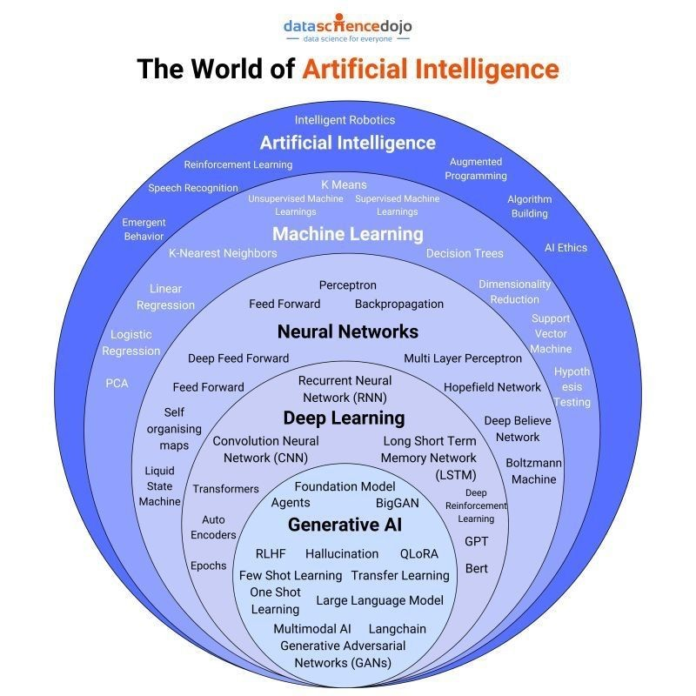
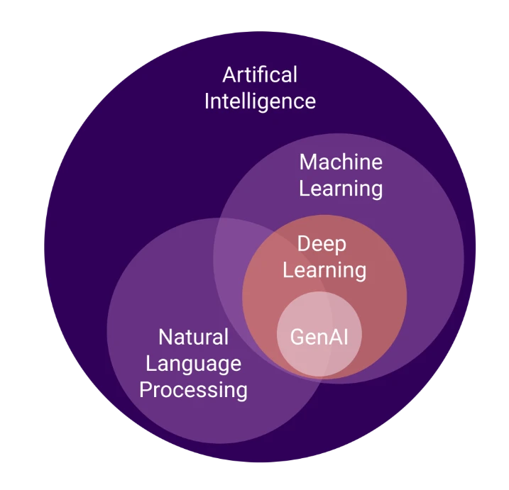
Algorithms and models

Slide 14
Conventional AI vs Generative AI (GenAI)
Conventional AI:
Focuses on classification, prediction, and rule-based decision-making.
Uses structured datasets for training.
Examples: Spam filters, customer service chatbots, recommendation engines.
Generative AI (GenAI):
A type of AI that creates new content, such as text, images, and music.
Uses models like GANs (Generative Adversarial Networks) and transformers (e.g., GPT, DALL-E).
Examples: AI-generated art, chat-based content generation, and text-to-image synthesis.
Future of AI
The future of AI is expected to bring significant advancements and challenges:
AI-Augmented Creativity: More sophisticated generative models for content creation.
Explainable AI (XAI): Enhancing transparency and trust in AI decision-making.
Ethical AI Development: Addressing biases, privacy concerns, and responsible AI use.
AI in Edge Computing: Deployment of AI models on edge devices for real-time processing.
Superintelligence and AGI: Theoretical advancements toward artificial general intelligence (AGI) with human-like reasoning capabilities.
AI continues to evolve, driving innovation and transforming industries worldwide.

Slide 15
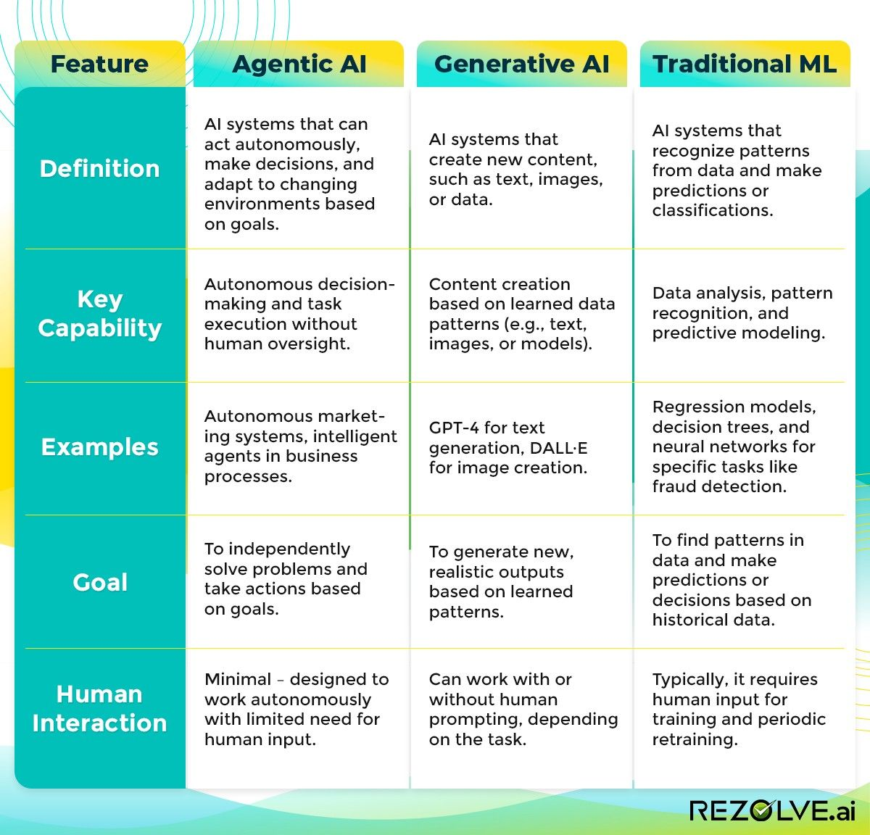

Slide 16
https://www.deeplearning.ai/resources/natural-language-processing/

Slide 17
Applications of NLP
The applications of Natural Language Processing are as follows:
Voice Assistants like Alexa, Siri, and Google Assistant use NLP for voice recognition and interaction.
Tools like Grammarly, Microsoft Word, and Google Docs apply NLP for grammar checking and text analysis.
Information extraction through Search engines such as Google and DuckDuckGo.
Website bots and customer support chatbots leverage NLP for automated conversations and query handling.
Google Translate and similar services use NLP for real-time translation between languages.
Text summarization

Slide 18
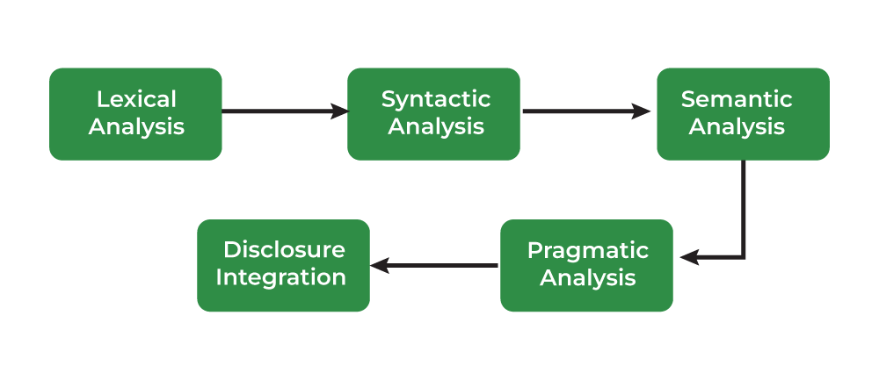
Phases of Natural Language Processing

Slide 19
There are two components of Natural Language Processing:
Natural Language Understanding
Natural Language Generation

Slide 20
Libraries for Natural Language Processing
Some of natural language processing libraries include:
NLTK (Natural Language Toolkit)
spaCy
Transformers (by Hugging Face)
Gensim

Slide 21
Normalizing Textual Data in NLP
Text Normalization transforms text into a consistent format improves the quality and makes it easier to process in NLP tasks.
Key steps in text normalization includes:
1. Regular Expressions (RE) are sequences of characters that define search patterns.
How to write Regular Expressions?
Properties of Regular Expressions
RegEx in Python
Email Extraction using RE
2. Tokenization is a process of splitting text into smaller units called tokens.
How Tokenizing Text, Sentences, and Words Works
Word Tokenization
Rule-based Tokenization
Subword Tokenization
Dictionary-Based Tokenization
Whitespace Tokenization
WordPiece Tokenization
3. Lemmatization reduces words to their base or root form.
4. Stemming reduces works to their root by removing suffixes. Types of stemmers include:
Porter Stemmer
Lancaster Stemmer
Snowball Stemmer
Lovis Stemmer
Rule-based Stemming
5. Stopword removal is a process to remove common words from the document.
6. Parts of Speech (POS) Tagging assigns a part of speech to each word in sentence based on definition and context.

Slide 22
Text Representation or Text Embedding Techniques in NLP
Text representation converts textual data into numerical vectors that are processed by the following methods:
One-Hot Encoding
Bag of Words (BOW)
N-Grams
Term Frequency-Inverse Document Frequency (TF-IDF)
N-Gram Language Modeling with NLTK
Text Embedding Techniques refer to the methods and models used to create these vector representations, including traditional methods (like TFIDF and BOW) and more advanced approaches:
1. Word Embedding
Word2Vec (SkipGram, Continuous Bag of Words – CBOW)
GloVe (Global Vectors for Word Representation)
fastText
2. Pre-Trained Embedding
ELMo (Embeddings from Language Models)
BERT (Bidirectional Encoder Representations from Transformers)
3. Document Embedding – Doc2Vec

Slide 23
Deep Learning Techniques for NLP
Deep learning has revolutionized Natural Language Processing (NLP) by enabling models to automatically learn complex patterns and representations from raw text. Below are some of the key deep learning techniques used in NLP:
Artificial Neural Networks (ANNs)
Recurrent Neural Networks (RNNs)
Long Short-Term Memory (LSTM)
Gated Recurrent Unit (GRU)
Seq2Seq Models
Transformer Models
Pre-Trained Language Models
Pre-trained models understand language patterns, context and semantics. The provided models are trained on massive corpora and can be fine tuned for specific tasks.
GPT (Generative Pre-trained Transformer)
Transformers XL
T5 (Text-to-Text Transfer Transformer)
RoBERTa

Slide 24
Natural Language Processing Tasks
1. Text Classification
Dataset for Text Classification
Text Classification using Naive Bayes
Text Classification using Logistic Regression
Text Classification using RNNs
Text Classification using CNNs
2. Information Extraction
Information Extraction
Named Entity Recognition (NER) using SpaCy
Named Entity Recognition (NER) using NLTK
Relationship Extraction
3. Sentiment Analysis
What is Sentiment Analysis?
Sentiment Analysis using VADER
Sentiment Analysis using Recurrent Neural Networks (RNN)
4. Machine Translation
Statistical Machine Translation of Language
Machine Translation with Transformer
5. Text Summarization
What is Text Summarization?
Text Summarizations using Hugging Face Model
Text Summarization using Sumy
6. Text Generation
Text Generation using Fnet
Text Generation using Recurrent Long Short Term Memory Network
Text2Text Generations using HuggingFace Model

Slide 25
Language Modeling
given all previous words in a text predictnext occuring words
Language Modeling (Pre deep learning)
n-gram LM
types --> uni,bi,tri,
how it works
what is problem in n-gram (loosing context)

Slide 26
NLP
https://www.geeksforgeeks.org/ai-ml-ds-projects/?ref=lbp
https://www.geeksforgeeks.org/natural-language-processing-nlp-tutorial
PROJECT
https://www.geeksforgeeks.org/twitter-sentiment-analysis-using-python/
https://www.geeksforgeeks.org/next-sentence-prediction-using-bert/
https://www.geeksforgeeks.org/fine-tuning-bert-model-for-sentiment-analysis/
https://www.geeksforgeeks.org/sentiment-classification-using-bert/
https://www.geeksforgeeks.org/sentiment-analysis-with-an-recurrent-neural-networks-rnn/
NLP problem Solve
Clasifications (+ve,-ve issue classifier,Sentiment analysis
NER (structure our data)
Language Modeling
Q &A
Translations
summerizations
next word generations
Translations
Text Generations
text summerization
speech to text , text to speech
Language Modeling
pre deep learning
N-gram
Neural network
RNN

Slide 27
https://www.kaggle.com/code/ashishpatel26/beginner-to-intermediate-nlp-tutorial
https://www.deeplearning.ai/resources/natural-language-processing/
https://www.analyticsvidhya.com/blog/2022/01/nlp-tutorials-part-i-from-basics-to-advance/
https://huggingface.co/learn/nlp-course/en/chapter1/1
https://github.com/graykode/nlp-tutorial

Slide 28
