Slide 1
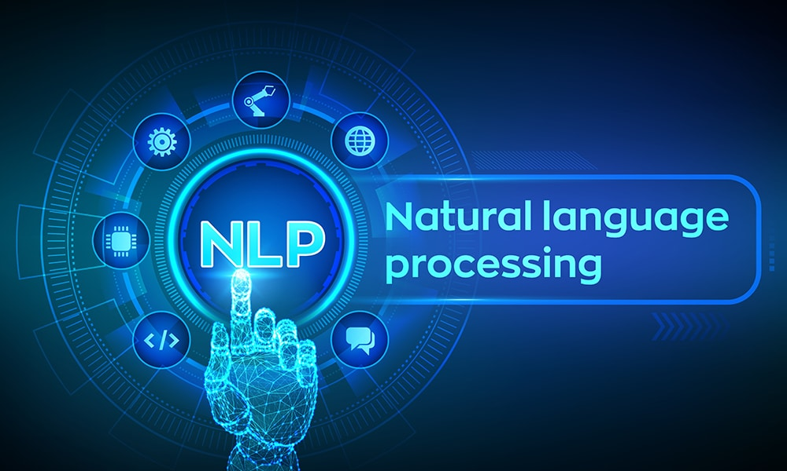

Slide 2
Sentiment Analysis
What is Sentiment Analysis
Challenges in Sentiment Analysis
Handling Emoticons
Sentiment Analysis with ANN
Assignment
Text Preprocessing
Tokenization
Non Alphabets Removal
Stopwords Removal
Bag of Words
Stemming & Lemmatization
Part of Speech Taging
Name Entity Recognition
Text Visualization
Assignment
Sequence Model
Sequential Data
Recurrent Neural Network
Multi-layer & Bi-directional RNN
Architecture of RNN
Vanishing Gradient Problem in RNN
Long Short Term Memory
Multi-layer & Bi-directional LSTM
Gated Recurrent Unit
Multi-layer & Bi-directional GRU
Assignment
Text Classification
CountVectorization/Text Vecorization
Text Classification with ML
TFIDF Vectorization
Text Classification with ANN
Embedding Layer in Natural Language
Assignment
Transformers Based Models
Sequence to Sequence Model
Attention Machanism
Transformers
Face Hugging Transformers

Slide 3
RASA Chatbot
What is RASA
RASA Installation
RASA Initialization
RASA Configuration and File System
Intents, Entity,Response and Story
Actions
Assignment
Weather Forecasting using ARIMA Model
Introduction to AR and MA model
Stationarity & Differencing
SariMax of Seasonal Data
Identifying order AR(p), I(d), MA(q)
Implementation of ARIMA
Assignment
Introduction to Time Series Analysis
What is Sequential Data & Time Series
Functional Relationship
Components of Time Series
Mathemetical Representation of Time Series
ETS Decompositon
Classification of Time Series
Defference between ACF & PACF
Assignment
Stock Price Prediction using Sequence Model
Introduction to Sequence Models RNN, LSTM
Preparing Time Series Data for LSTM
Forecasting using LSTM
Future Forecast
Assignment

Slide 4
Use NLP
Translations
Text Generations
text summerization
speech to text , text to speech
NLP problem Solve
Clasifications (+ve,-ve issue classifier,Sentiment analysis
NER (structure our data)
Language Modeling
Q &A
Translations
summerizations
next word generations
In ML any feature sequence not matter but in nlp matters
like pizza or pizzas -->same na
Language Modeling
pre deep learning
N-gram
Neural network
RNN
Swiggy Review Analysis

Slide 5
What is Natural Language Processing (NLP)
Why Does Natural Language Processing (NLP) Matter?
What is Natural Language Processing (NLP) Used For?
Sentiment analysis is the process of classifying the emotional intent of text. Toxicity classification,Machine translation, Named entity recognition , Spam detection ,Grammatical error correction,Topic modeling ,Text generation
Text generation has been performed using Markov processes, LSTMs, BERT, GPT-2, LaMDA, and other approaches. It’s particularly useful for autocomplete and chatbots. types(Autocomplete , Chatbots ) Information retrieval finds the documents that are most relevant to a query.
How Does Natural Language Processing (NLP) Work?
Data preprocessing:
Steps
nlp
clean text->lower,uper,remove special char
Tokenizations --> word,sentence, stopswords removel,lemmitations, steeming
convert words/text representations
BOW,

Slide 6
🧩 Components of NLP
NLP has several components that work together to process language effectively:
Component | Description
Lexical Analysis | Dividing text into tokens (words, phrases)
Syntactic Analysis | Analyzing grammar and sentence structure
Semantic Analysis | Understanding the meaning of words and sentences
Discourse Integration | Understanding how preceding sentences affect the meaning of the current one
Pragmatic Analysis | Understanding context and intent behind the sentence

Slide 7
🔄 Stages of NLP (Pipeline)
The NLP pipeline generally consists of these stages:
1. Text Preprocessing
Tokenization: Splitting text into words or sentences
Stopword Removal: Removing common words (is, the, in) that don't add value
Stemming/Lemmatization: Reducing words to their root form
Lowercasing, Punctuation Removal, etc.
2. Text Representation
Bag of Words (BoW)
TF-IDF (Term Frequency-Inverse Document Frequency)
Word Embeddings (Word2Vec, GloVe, BERT)
3. Parsing and Syntax Tree Generation
Understanding structure using parse trees or dependency trees
4. Named Entity Recognition (NER)
Identifying entities like people, places, organizations, etc.
5. Sentiment Analysis / Text Classification
Analyzing sentiment (positive/negative/neutral) or classifying texts into predefined categories
6. Machine Learning / Deep Learning Modeling
Building predictive models using algorithms like Naive Bayes, SVM, RNN, Transformers (e.g., BERT, GPT)

Slide 8
text = """Natural Language Processing is an exciting field of AI.
It helps machines understand and interact with human language.
We use it in applications like Siri, Google Translate, and chatbots.
NLP models are trained using large amounts of text data.
It is used in almost every industry today."""
print("Original Paragraph:\n", text)
# Install necessary packages
!pip install nltk spacy textblob scikit-learn --quiet
!python -m textblob.download_corpora
!python -m spacy download en_core_web_sm
Step 1: Basic NLP Setup
import nltk
from nltk.corpus import stopwords
from nltk.tokenize import word_tokenize, sent_tokenize
from nltk.stem import PorterStemmer, WordNetLemmatizer
from textblob import TextBlob
import spacy
import pandas as pd
import numpy as np
nltk.download('punkt')
nltk.download('stopwords')
nltk.download('wordnet')
nlp = spacy.load("en_core_web_sm")
Step 3: Tokenization
# Sentence Tokenization sentences = sent_tokenize(text) print("Sentence Tokenization:\n", sentences) # Word Tokenization words = word_tokenize(text) print("\nWord Tokenization:\n", words)
Step 4: Stopword Removal
stop_words = set(stopwords.words("english")) filtered_words = [word for word in words if word.lower() notin stop_words and word.isalpha()] print("After Stopword Removal:\n", filtered_words)
https://www.analyticsvidhya.com/blog/2022/01/nlp-tutorials-part-i-from-basics-to-advance/

Slide 9
🌱 Step 5: Stemming and Lemmatization
python
CopyEdit
stemmer = PorterStemmer() lemmatizer = WordNetLemmatizer() stemmed = [stemmer.stem(word) for word in filtered_words] lemmatized = [lemmatizer.lemmatize(word) for word in filtered_words] print("Stemmed Words:\n", stemmed) print("Lemmatized Words:\n", lemmatized)

Slide 10
🧺 Step 6: Bag of Words Representation
python
CopyEdit
from sklearn.feature_extraction.text import CountVectorizer corpus = [text] vectorizer = CountVectorizer() X = vectorizer.fit_transform(corpus) df_bow = pd.DataFrame(X.toarray(), columns=vectorizer.get_feature_names_out()) print("Bag of Words:\n") print(df_bow)

Slide 11
😊 Step 7: Sentiment Analysis
python
CopyEdit
blob = TextBlob(text) print("Sentiment Polarity:", blob.sentiment.polarity) print("Sentiment Subjectivity:", blob.sentiment.subjectivity) if blob.sentiment.polarity > 0: print("Overall Sentiment: Positive") elif blob.sentiment.polarity < 0: print("Overall Sentiment: Negative") else: print("Overall Sentiment: Neutral")

Slide 12
⭐ Bonus: Named Entity Recognition using spaCy
python
CopyEdit
doc = nlp(text) print("Named Entities:") for ent in doc.ents: print(ent.text, "|", ent.label_)

Slide 13
NLP
https://www.geeksforgeeks.org/ai-ml-ds-projects/?ref=lbp
https://www.geeksforgeeks.org/natural-language-processing-nlp-tutorial
PROJECT
https://www.geeksforgeeks.org/twitter-sentiment-analysis-using-python/
https://www.geeksforgeeks.org/next-sentence-prediction-using-bert/
https://www.geeksforgeeks.org/fine-tuning-bert-model-for-sentiment-analysis/
https://www.geeksforgeeks.org/sentiment-classification-using-bert/
https://www.geeksforgeeks.org/sentiment-analysis-with-an-recurrent-neural-networks-rnn/

Slide 14
https://www.kaggle.com/code/ashishpatel26/beginner-to-intermediate-nlp-tutorial
https://www.deeplearning.ai/resources/natural-language-processing/
https://www.analyticsvidhya.com/blog/2022/01/nlp-tutorials-part-i-from-basics-to-advance/
https://huggingface.co/learn/nlp-course/en/chapter1/1
https://github.com/graykode/nlp-tutorial

