Slide 1
TensorFlow and Keras
What is TensorFlow?
Lecture incomplete. Progress cannot be changed for this item.Play
Installing and Setting up TensorFlow
8. TensorFlow Architecture
9. A refresher on APIs
10. TensorFlow APls

Slide 2
Introduction to TensorFlow and Keras
TensorFlow and Keras are two of the most widely used deep learning frameworks.
TensorFlow:
Developed by Google Brain.
Provides low-level and high-level APIs for building deep learning models.
Supports large-scale machine learning and deployment.
Keras:
High-level API built on TensorFlow.
Simplifies model building and experimentation.
Allows quick prototyping with minimal code.
Keras is a deep learning API written in Python and capable of running on top of either JAX, TensorFlow, or PyTorch.
Keras is:
Simple – but not simplistic. Keras reduces developer cognitive load to free you to focus on the parts of the problem that really matter.
Flexible – Keras adopts the principle of progressive disclosure of complexity: simple workflows should be quick and easy, while arbitrarily advanced workflows should be possible via a clear path that builds upon what you've already learned.
Powerful – Keras provides industry-strength performance and scalability: it is used by organizations including NASA, YouTube, or Waymo.
https://keras.io/about/
https://www.tensorflow.org/

Slide 3
🔹 Basics of Keras
1️⃣ What is Keras? Why Use Keras?
2️⃣ Installing TensorFlow & Keras
3️⃣ Creating a Simple Neural Network (Basic Keras Example)
🔹 Building Blocks of Keras
4️⃣ Keras Layers & Activation Functions
5️⃣ Model Architectures (Sequential vs Functional API)
6️⃣ Compiling, Training & Evaluating Models
🔹 Data Handling in Keras
7️⃣ Data Preprocessing & Normalization
8️⃣ Handling Image, Text & CSV Data
9️⃣ Data Augmentation Techniques
🔹 Advanced Topics in Keras
🔟 Custom Loss Functions & Metrics
11️⃣ Callbacks (Early Stopping, Model Checkpointing)
12️⃣ Transfer Learning & Fine-Tuning Pretrained Models
13️⃣ Hyperparameter Tuning (Keras Tuner)
14️⃣ Saving & Loading Keras Models
🔹 Real-World Use Cases
15️⃣ Image Classification (CNN)
16️⃣ Text Classification (NLP)
17️⃣ Time Series Forecasting (RNN/LSTM)
18️⃣ Object Detection & GANs
19️⃣ Deploying Keras Models (Flask, FastAPI)

Slide 4
🔰 3️⃣ Creating a Simple Neural Network
import tensorflow as tf from tensorflow import keras import numpy as np # Load dataset (x_train, y_train), (x_test, y_test) = keras.datasets.mnist.load_data() # Normalize data x_train, x_test = x_train / 255.0, x_test / 255.0 # Create model model = keras.Sequential([ keras.layers.Flatten(input_shape=(28, 28)), # Input Layer keras.layers.Dense(128, activation='relu'), # Hidden Layer keras.layers.Dense(10, activation='softmax') # Output Layer ]) # Compile model model.compile(optimizer='adam', loss='sparse_categorical_crossentropy', metrics=['accuracy']) # Train model model.fit(x_train, y_train, epochs=5) # Evaluate test_loss, test_acc = model.evaluate(x_test, y_test) print("Test Accuracy:", test_acc)
🔰 1️⃣ What is Keras? Why Use Keras?
Keras is a user-friendly deep learning framework built on TensorFlow that allows quick model development.
✅ Why use Keras?
✔️ Easy to learn and implement
✔️ Works with both CPUs and GPUs
✔️ Supports multiple backends (TensorFlow, Theano, etc.)
✔️ Prebuilt layers, optimizers, and loss functions
🔰 2️⃣ Installing TensorFlow & Keras
pip install tensorflow
✅ Keras is integrated into TensorFlow (tf.keras).
✅ Use Case:Digit Recognition using MNIST dataset.

Slide 5
🔰 4️⃣ Keras Layers & Activation Functions
Keras provides different layers:
keras.layers.Dense(64, activation='relu') # Fully connected layer keras.layers.Conv2D(32, (3,3), activation='relu') # CNN layer keras.layers.LSTM(50) # LSTM layer for time series
✅ Use Case: Image classification, NLP, and time series prediction.
🔰 5️⃣ Model Architectures
🔹 Sequential API (Easy to Use)
python
CopyEdit
model = keras.Sequential([ keras.layers.Dense(64, activation='relu', input_shape=(10,)), keras.layers.Dense(32, activation='relu'), keras.layers.Dense(1, activation='sigmoid') ])
🔹 Functional API (For Complex Models)
python
CopyEdit
inputs = keras.Input(shape=(10,)) x = keras.layers.Dense(64, activation='relu')(inputs) x = keras.layers.Dense(32, activation='relu')(x) outputs = keras.layers.Dense(1, activation='sigmoid')(x) model = keras.Model(inputs, outputs)
✅ Use Case: Functional API is used for multi-input & multi-output models.
https://medium.com/@speaktoharisudhan/architecting-neural-networks-in-tensorflow-unraveling-sequential-models-functional-apis-model-6ebe5502219b

Slide 6
🔰 6️⃣ Compiling, Training & Evaluating Models
python
CopyEdit
model.compile(optimizer='adam', loss='binary_crossentropy', metrics=['accuracy']) model.fit(X_train, y_train, epochs=10, batch_size=32, validation_split=0.2) model.evaluate(X_test, y_test)
✅ Use Case: Fine-tuning deep learning models.
8️⃣ Handling CSV & Text Data
python
CopyEdit
import pandas as pd df = pd.read_csv("data.csv") X = df.drop("target", axis=1).values y = df["target"].values
✅ Use Case:Loading CSV for structured data models.
🔰 🔟 Custom Loss Functions & Metrics
python
CopyEdit
defcustom_loss(y_true, y_pred): return tf.reduce_mean(tf.square(y_true - y_pred)) # Mean Squared Error model.compile(optimizer='adam', loss=custom_loss, metrics=['accuracy'])
✅ Use Case: Custom loss for specific applications.
🔰 7️⃣ Data Preprocessing & Normalization
python
CopyEdit
from tensorflow.keras.preprocessing.image import ImageDataGenerator datagen = ImageDataGenerator(rescale=1./255, rotation_range=20, width_shift_range=0.2) train_generator = datagen.flow_from_directory("dataset/train", target_size=(150, 150), batch_size=32, class_mode='binary')
✅ Use Case:Image Augmentation for better model performance.

Slide 7
🔰 11 Callbacks (Early Stopping & Model Checkpoints)
python
CopyEdit
callbacks = [ keras.callbacks.EarlyStopping(patience=3, monitor='val_loss'), keras.callbacks.ModelCheckpoint("best_model.h5", save_best_only=True) ] model.fit(X_train, y_train, epochs=50, validation_split=0.2, callbacks=callbacks)
✅ Use Case: Save the best model automatically.
🔰 15 Image Classification Example (CNN)
model = keras.Sequential([ keras.layers.Conv2D(32, (3,3), activation='relu', input_shape=(64, 64, 3)), keras.layers.MaxPooling2D(2,2), keras.layers.Conv2D(64, (3,3), activation='relu'), keras.layers.MaxPooling2D(2,2), keras.layers.Flatten(), keras.layers.Dense(128, activation='relu'), keras.layers.Dense(1, activation='sigmoid') ])
✅ Use Case:Dog vs. Cat Classification.
🔰 12 Transfer Learning (Using Pretrained Models)
base_model = keras.applications.VGG16(weights='imagenet', include_top=False, input_shape=(224,224,3)) for layer in base_model.layers: layer.trainable = False model = keras.Sequential([ base_model, keras.layers.Flatten(), keras.layers.Dense(256, activation='relu'), keras.layers.Dense(1, activation='sigmoid') ])
✅ Use Case:Fine-tuning a powerful model like VGG16 for new tasks.

Slide 8
🔰 19 Deploying Keras Models with Flask
python
CopyEdit
from flask import Flask, request, jsonify import tensorflow as tf app = Flask(__name__) model = tf.keras.models.load_model("best_model.h5") @app.route("/predict", methods=["POST"]) defpredict(): data = request.json["input"] prediction = model.predict([data]) return jsonify({"prediction": prediction.tolist()}) app.run()
✅ Use Case: Deploy model as an API using Flask.

Slide 9
TensorFlow

Slide 10
TensorFlow code
What is TensorFlow?
TensorFlow is an end-to-end open-source machine learning platform with a focus on deep neural networks. Deep learning is a subtype of machine learning that analyses massive amounts of unstructured data. Since it works with structured data, deep learning is different from normal machine learning.
importtensorflowastfprint("TensorFlow version:",tf.__version__)
How to install TensorFlow ?
pip install tensorflow
If you have a good graphics card in your computer,
pip install tensorflow-gpu
Check Installation
import tensorflow as tf
print(tf.__version__)
Some TensorFlow Fundamentals

Slide 11
Some TensorFlow Fundamentals
a tensor is a multi-dimensional array of data that can be used to represent data and perform mathematical operations. Tensors are a generalization of vectors and matrices,
What are tensors used for?
Training neural networks: Tensors store the weights and parameters of neural networks, and are used in the algorithms that train them
Representing data: Tensors can represent data such as images, movies, sounds, and relationships between words
Clustering: Tensors can be used in clustering algorithms such as k-means clustering
Support vector machines: Tensors can represent data in support vector machines
Why are tensors important?
Tensors are efficient with memory, making them ideal for parallel computing environments
Tensors are versatile and efficient at handling data

Slide 12
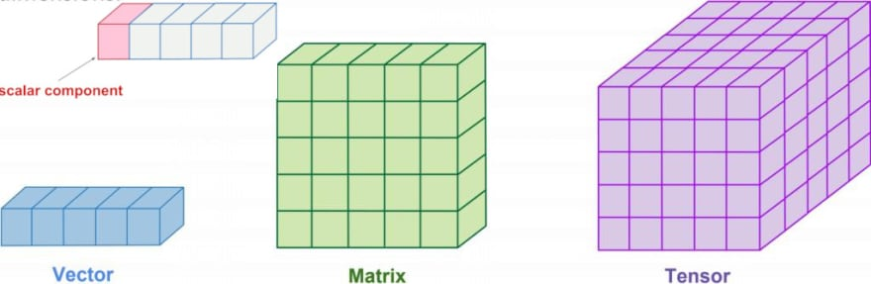
What are tensors built from?
The values in a tensor contain identical data types with a specified shape. Dimensionality is represented by the shape. A vector, for example, is a one-dimensional tensor, a matrix is a two-dimensional tensor, and a scalar is a zero-dimensional tensor.
import tensorflow as tf
x=tf.constant([[1.,2.,3.],[4.,5.,6.]])
print(x)
print(x.shape)
print(x.dtype)

Slide 13
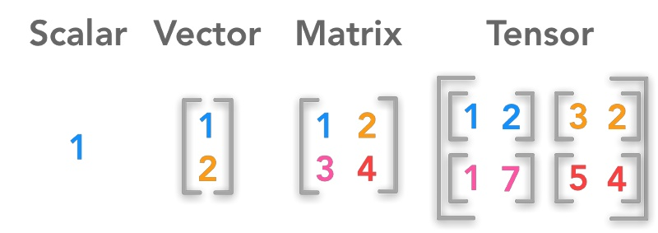
Shape
In the TensorFlow Python library, the shape corresponds to the dimensionality of the tensor. In simple terms, the number of elements in each dimension defines a tensor’s shape.

Slide 14
https://www.geeksforgeeks.org/cifar-10-image-classification-in-tensorflow/

