Slide 1
Computer Vision Project

Slide 2
Image Classification - FACE RECOGNITION PROJECT
Haar Cascade Clasifier
Image Classification with CNN

Slide 3
Image Classification (binary ,multiclass)
Object Detection & Localizations
Image Segmentations
Siamese Network (comparision bw 2 img
GAN(Generative Adversal Networks) --> create Syntatic Images
https://www.analyticsvidhya.com/blog/2023/08/introduction-and-implementation-of-siamese-networks/
https://www.geeksforgeeks.org/cifar-10-image-classification-in-tensorflow/
https://www.geeksforgeeks.org/python-image-classification-using-keras/
https://www.geeksforgeeks.org/object-detection-vs-object-recognition-vs-image-segmentation/
https://www.geeksforgeeks.org/yolo-v2-object-detection/ https://yolov8.com/
https://youtube.com/playlist?list=PLZCA39VpuaZZ1cjH4vEIdXIb0dCpZs3Y5&si=_reS59AkQ13wsUCu yolo8

Slide 4
Image Segmentations
https://github.com/facebookresearch/segment-anything
https://colab.research.google.com/github/roboflow-ai/notebooks/blob/main/notebooks/how-to-segment-anything-with-sam.ipynb
https://colab.research.google.com/github/roboflow-ai/notebooks/blob/main/notebooks/how-to-segment-anything-with-sam.ipynb#scrollTo=DxH9V2nHQC4M
https://github.com/ayoolaolafenwa/PixelLib

Slide 5
GAN(Generative Adversal Networks)
https://youtu.be/Fe1MzID2BNg?feature=shared
https://youtube.com/playlist?list=PLhhyoLH6IjfwIp8bZnzX8QR30TRcHO8Va&feature=shared
https://github.com/nicknochnack/GANBasics
https://youtu.be/AALBGpLbj6Q?feature=shared

Slide 6
🧠 What is a Siamese Network?
Siamese Networks compare two inputs (typically images) and learn the similarity between them.
Used for face verification, signature verification, one-shot learning, product matching, etc.
It uses twin subnetworks that share weights and learn a distance metric.
✅ Let's Plan the Siamese Network Project
1. Project Structure
siamese_network_project/ │ ├── app.py # Main Streamlit app ├── siamese_model.py # Model architecture (Siamese Network) ├── utils.py # Helper functions (data loading, preprocessing) ├── inference.py # Perform prediction/similarity check ├── data/ │ ├── anchor/ # Anchor images │ └── positive/ # Positive examples │ └── negative/ # Negative examples ├── README.md # Project overview └── requirements.txt # List of required Python packages
🛠 Step-by-Step Plan:
a. Siamese Network Architecture
Two identical CNN branches.
Calculate the distance (e.g., Euclidean distance).
A final dense layer to predict similarity.
b. Dataset
We’ll simulate a small dummy dataset like:
Anchor: Original images.
Positive: Same class (similar images).
Negative: Different class (dissimilar images).
(We can later replace it with real datasets like LFW or Omniglot.)

Slide 7
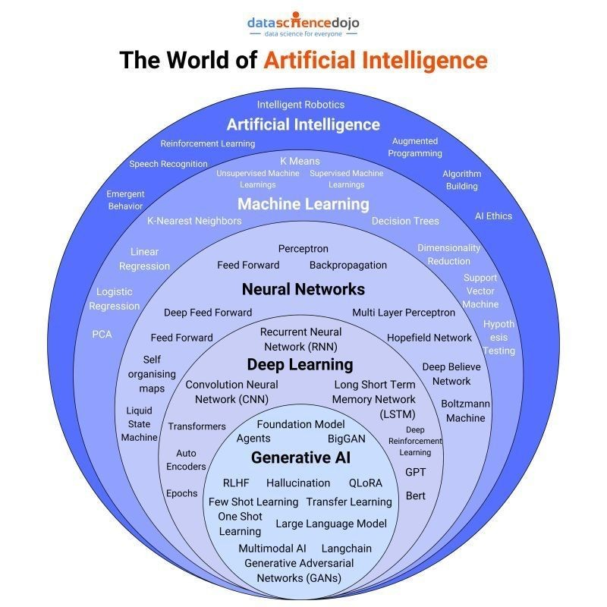
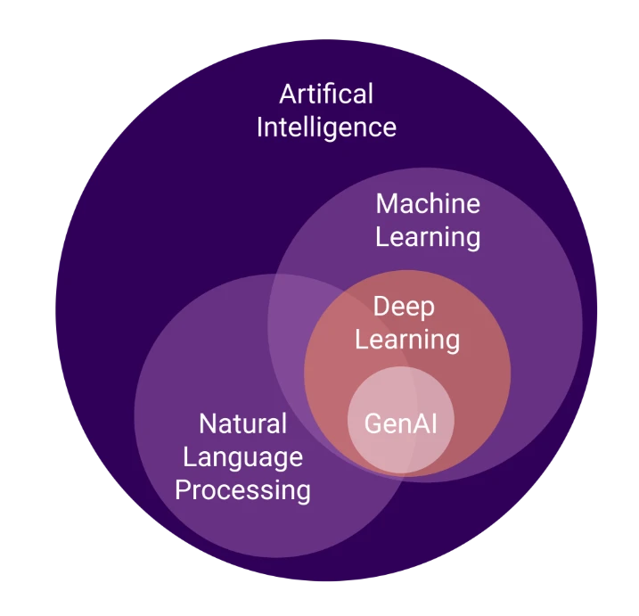
Algorithms and models

Slide 8
Object Detection - CAR DEFECT DETECTION
Template Matching
Edge Detection
Car Defect Detection
Detecting surface or structural issues in car images using Template Matching and Edge Detection (OpenCV-based classical methods).
1. Template Matching
Template Matching is a technique where a small portion of an image (template) is slid over the larger image to find matching patterns.
How it Works
Uses cv2.matchTemplate() to calculate similarity.
The location with the highest similarity score is assumed to be the matching area.
💡 Use Case in Car Defect Detection
Find missing parts (headlights, logo, grill, etc.)
Detect scratches by comparing against a scratch-free template
✅ Advantages
Simple and quick to implement
Effective for detecting fixed shape components like logos, bolts, or license plates
Works well when object and template are of the same size, orientation, and lighting
❌ Limitations
Sensitive to:
Rotation
Scale
Lighting changes
Works only when the defected region is very similar to the template
Fails on dynamic scenes or cluttered backgrounds
🛠 How to Overcome
Use multi-scale template matching
Apply edge-based or normalized template matching
Combine with feature matching (ORB, SIFT) or CNN-based methods

Slide 9
✂️ 2. Edge Detection
Edge detection highlights object boundaries and sharp transitions in images, usually indicating shape outlines, corners, or surface breaks.
🧠 How it Works
Converts image to grayscale
Finds strong intensity changes using filters (Sobel, Laplacian, or Canny)
💡 Use Case in Car Defect Detection
Detect scratches, cracks, and dents
Identify asymmetry or deformation in the car structure
Compare edge maps of normal vs defected cars
✅ Advantages
Highlights fine details such as cracks and scratch lines
Doesn’t require prior templates
Works well for unknown types of defects
❌ Limitations
Highly sensitive to noise
Might detect false edges (reflections, shadows)
Cannot classify defect type (just detects edges)
🛠 How to Overcome
Use preprocessing like Gaussian blur to reduce noise
Combine edge maps with contour detection or morphology
Integrate with ML/CNN models to classify defects based on edge maps

Slide 10
🌍 Real-World Scenarios
Scenario | Method | Example
Logo or missing component detection | Template Matching | Detect missing brand logo
Dent/Scratch detection | Edge Detection | Find scratches after collisions
Surface Quality Control | Edge Detection + Morphology | Crack detection in body panels
Headlight or license plate verification | Template Matching | Spot mismatch or missing parts
Suggested Pipeline for Car Defect Detection
Preprocessing: Resize, convert to grayscale, denoise
Edge Detection: Use Canny for scratches/cracks
Template Matching: Locate specific parts
Morphology: Clean edge maps
Classification/Alert: Mark defected areas
Optional CNN: Predict defect type
CODE IS IN CV FOLDER SCRATCH CODE

Slide 11
OCR Engine
Introduction to Pytesseract
Text Recognition
Text Recognition from image
https://github.com/tesseract-ocr/tesseract
pytesseract is a Python wrapper for the Tesseract-OCR engine.
1. pip install pytesseract
2. You may need to set the path to the tesseract.exe in Python:
pytesseract.pytesseract.tesseract_cmd = r'C:\Program Files\Tesseract-OCR\tesseract.exe'
🧠 What is OCR?
Optical Character Recognition (OCR) is a technology that converts images of typed, handwritten, or printed text into machine-encoded text.
Use Cases:
Invoice/data digitizatio
Document scanning
License plate recognition
Passport, ID scanning
Text extraction from screenshots
🔍 OCR Engine Overview
The most popular open-source OCR engine is Tesseract OCR, developed by HP and later maintained by Google.
Key Features of Tesseract:
Multilingual support (over 100 languages)
Handwriting recognition (limited)
Custom training possible
CLI and Python bindings available
Basic Text Recognition from Image
import cv2 import pytesseract # Load image img = cv2.imread('sample_text.png') # Convert to grayscale gray = cv2.cvtColor(img, cv2.COLOR_BGR2GRAY) # Apply OCR text = pytesseract.image_to_string(gray) print("Extracted Text:") print(text)

Slide 12
⚙Other Useful Functions
python
CopyEdit
pytesseract.image_to_boxes(image) # Get character bounding boxes pytesseract.image_to_data(image) # Detailed OCR with position & confidence pytesseract.image_to_string(image, lang='eng+deu') # Multilingual OCR
🧪 Preprocessing Tips
OCR accuracy depends heavily on image quality. Use these techniques:
Technique | Code Example
Resize | cv2.resize()
Thresholding | cv2.threshold() or cv2.adaptiveThreshold()
Noise removal | cv2.GaussianBlur()
Morphology | cv2.morphologyEx()
Edge sharpening | cv2.filter2D()

Slide 13
✅ Advantages of Pytesseract
Easy Python integration
Free and open-source
Good language support
Works well for printed text
❌ Limitations
Weak on handwriting
Poor performance on noisy/blurred images
Requires preprocessing
Not optimized for speed
🌍 Real-World Scenarios
🔍 Searchable document archives
📦 Automating receipts/invoice scanning
🛂 Passport/ID scanning
📱 Mobile scanning apps (with OpenCV)
🚘 Vehicle number plate detection
💡 How to Overcome Limitations
Problem | Solution
Poor image quality | Preprocess with OpenCV
Skewed text | Apply deskewing
Low confidence | Use image_to_data() and filter
Custom fonts/langs | Train Tesseract with new data

Slide 14
Object Detection
What is Object Detection
Object Detection using Haar Cascade
MobileNet SSD
RCNN and YOLO
📚 What is Object Detection?
Object Detection is a computer vision technique that involves identifying and locating objects within an image or video. The goal is not only to recognize the objects (like in image classification) but also to determine the positions (bounding boxes) where these objects are found in the image.
Key Tasks in Object Detection:
Classification: Recognize what objects are in the image.
Localization: Find where the objects are in the image using bounding boxes.
Tracking (in video): Keep track of the objects as they move across frames.
Use Cases:
Self-driving cars: Detecting pedestrians, cars, traffic signs.
Face detection in photos.
Surveillance cameras.
Image analysis in medical fields.
Retail: Automated checkout systems.

Slide 15
🏞️ Object Detection using Haar Cascade
import cv2
# Load pre-trained Haar Cascade classifier for face detection
face_cascade = cv2.CascadeClassifier(cv2.data.haarcascades + 'haarcascade_frontalface_default.xml')
# Read image
image = cv2.imread('image.jpg')
gray = cv2.cvtColor(image, cv2.COLOR_BGR2GRAY)
# Detect faces
faces = face_cascade.detectMultiScale(gray, 1.3, 5)
# Draw rectangle around the faces
for (x, y, w, h) in faces:
cv2.rectangle(image, (x, y), (x+w, y+h), (255, 0, 0), 2)
# Display result
cv2.imshow('Image', image)
cv2.waitKey(0)
cv2.destroyAllWindows()
Haar Cascades are a machine learning object detection method used to identify objects in images or video. Haar Cascade Classifiers were popularized by the OpenCV library and are often used for tasks like face detection.
How Haar Cascade works:
Haar Features: A set of features (based on rectangles) used to represent parts of an image. These features capture information like edges, lines, and regions of interest.
Cascade Classifier: A sequence of increasingly complex classifiers used to detect an object at different stages. It is called a "cascade" because each classifier in the series focuses on progressively more difficult parts of the object.
Training: Haar Cascade classifiers are trained on a large number of positive and negative samples.
Advantages:
Simple to implement.
Fast processing for tasks like face detection.
Limitations:
Limited to simpler tasks and low-quality images.
Struggles with complex or varied objects.

Slide 16
📱 MobileNet SSD (Single Shot Multibox Detector)
import cv2
# Load MobileNet SSD pre-trained model
net = cv2.dnn.readNetFromCaffe('deploy.prototxt', 'mobilenet_iter_73000.caffemodel')
# Load image
image = cv2.imread('image.jpg')
(h, w) = image.shape[:2]
# Prepare image for MobileNet SSD
blob = cv2.dnn.blobFromImage(image, 0.007843, (300, 300), 127.5, 127.5, 127.5, 0)
# Perform detection
net.setInput(blob)
detections = net.forward()
# Loop through detections and draw bounding boxes
for i in range(detections.shape[2]):
confidence = detections[0, 0, i, 2]
if confidence > 0.2:
box = detections[0, 0, i, 3:7] * np.array([w, h, w, h])
(startX, startY, endX, endY) = box.astype("int")
cv2.rectangle(image, (startX, startY), (endX, endY), (0, 255, 0), 2)
cv2.imshow("MobileNet SSD", image)
cv2.waitKey(0)
cv2.destroyAllWindows()
MobileNet SSD is a popular lightweight deep learning model used for real-time object detection on mobile devices and embedded systems. It's built using a combination of MobileNet (a lightweight architecture) and the SSD framework (a fast detection framework).
How it works:
MobileNet: Efficient convolutional neural network (CNN) designed for mobile and embedded applications, with fewer parameters than traditional models.
SSD: A framework for object detection that divides the image into a grid and performs detection on multiple scales simultaneously.
Advantages:
Real-time detection.
Lightweight and efficient for mobile devices.
Can detect multiple objects in an image.
Limitations:
Might not be as accurate as larger models like Faster R-CNN.
Performance drops with higher resolution images.

Slide 17
🤖 RCNN (Region-based CNN)
RCNN (Region-based Convolutional Neural Network) is one of the earliest deep learning-based object detection methods. It divides the image into regions of interest (RoIs) and applies CNNs on each region for object classification.
How it works:
Selective Search: Proposes regions (bounding boxes) that could contain objects.
CNN-based Feature Extraction: Each region is passed through a CNN to extract features.
Classification: The extracted features are passed to a classifier (like SVM) to identify the object.
Advantages:
High accuracy for object detection.
Works well for both classification and localization.
Limitations:
Slow: Multiple steps (region proposal, CNN extraction, etc.) lead to high computational costs.
Requires significant computational resources.
R-CNN Explained
https://youtu.be/5DvljLV4S1E?feature=shared
Fast R-CNN , Faster R-CNN

Slide 18
⚡ YOLO (You Only Look Once)
YOLO is a real-time object detection system that is both fast and accurate. Unlike traditional methods (e.g., RCNN), YOLO performs detection in a single pass, which allows it to be extremely fast and suitable for real-time applications.
How it works:
Single Neural Network: YOLO divides the image into a grid and predicts bounding boxes and class probabilities for each grid cell in a single pass.
Unified Prediction: All outputs (bounding boxes and class predictions) are generated at once, making it faster than traditional methods.
Advantages:
Real-time: Extremely fast, making it ideal for video processing.
Accurate: High accuracy due to unified prediction.
Works well for both small and large objects.
Limitations:
Struggles with detecting very small objects.
Can sometimes miss objects at the edges of the image.
import cv2
import numpy as np
# Load YOLO pre-trained model
net = cv2.dnn.readNet("yolov3.weights", "yolov3.cfg")
layer_names = net.getLayerNames()
output_layers = [layer_names[i - 1] for i in net.getUnconnectedOutLayers()]
# Load image
image = cv2.imread('image.jpg')
blob = cv2.dnn.blobFromImage(image, 0.00392, (416, 416), (0, 0, 0), True, crop=False)
net.setInput(blob)
# Perform detection
outs = net.forward(output_layers)
# Draw bounding boxes and labels
for out in outs:
for detection in out:
scores = detection[5:]
class_id = np.argmax(scores)
confidence = scores[class_id]
if confidence > 0.5:
center_x = int(detection[0] * image.shape[1])
center_y = int(detection[1] * image.shape[0])
w = int(detection[2] * image.shape[1])
h = int(detection[3] * image.shape[0])
cv2.rectangle(image, (center_x - w // 2, center_y - h // 2),
(center_x + w // 2, center_y + h // 2), (0, 255, 0), 2)
cv2.imshow("YOLO Detection", image)
cv2.waitKey(0)
cv2.destroyAllWindows()

Slide 19
🧑‍🏫 Summary:
Haar Cascade is a simple, fast method but works best with smaller and simpler objects.
MobileNet SSD is efficient for real-time detection on mobile devices, but may lack accuracy compared to heavier models.
RCNN provides high accuracy but is computationally expensive.
YOLO is fast, real-time, and highly accurate, ideal for detecting multiple objects in videos or real-time applications.

Slide 20
MediaPipe
Introduction to MediaPipe
FaceMesh
Hand, Pose and Holistic Models
Assignment
https://mediapipe.readthedocs.io/en/latest/solutions/face_mesh.html
https://learnopencv.com/introduction-to-mediapipe/
https://www.youtube.com/watch?v=3NePkYhFkiw
https://www.youtube.com/watch?v=WKr8qOJvNas

Slide 21
🧠 Introduction to MediaPipe
MediaPipe is a cross-platform framework developed by Google for building multi-modal (video, audio, etc.) ML pipelines. It is especially popular for real-time computer vision applications.
🔑 Key Features:
Real-time performance
Cross-platform (Python, C++, Android, iOS, Web)
Built-in ML models
Easy-to-use APIs
import cv2
import mediapipe as mp
mp_face_mesh = mp.solutions.face_mesh
face_mesh = mp_face_mesh.FaceMesh()
cap = cv2.VideoCapture(0)
while cap.isOpened():
success, image = cap.read()
if not success:
break
image_rgb = cv2.cvtColor(image, cv2.COLOR_BGR2RGB)
results = face_mesh.process(image_rgb)
if results.multi_face_landmarks:
for landmarks in results.multi_face_landmarks:
mp.solutions.drawing_utils.draw_landmarks(
image, landmarks, mp_face_mesh.FACEMESH_TESSELATION)
cv2.imshow('FaceMesh', image)
if cv2.waitKey(1) & 0xFF == 27:
break
cap.release()
cv2.destroyAllWindows()
Installation pip install mediapipe opencv-python
🧑‍🦰 1. FaceMesh with MediaPipe
FaceMesh detects 468 landmarks on the face, enabling detailed facial analysis.
✅ Applications:
Face filters (like Snapchat)
Virtual try-on (glasses, makeup)
Emotion recognition

Slide 22
✋ 2. Hand Tracking with MediaPipe
Hand module detects 21 landmarks per hand.
✅ Applications:
Sign language recognition
Virtual painting
Hand gesture control
import cv2
import mediapipe as mp
mp_hands = mp.solutions.hands
hands = mp_hands.Hands()
cap = cv2.VideoCapture(0)
while cap.isOpened():
success, image = cap.read()
image_rgb = cv2.cvtColor(image, cv2.COLOR_BGR2RGB)
result = hands.process(image_rgb)
if result.multi_hand_landmarks:
for hand_landmarks in result.multi_hand_landmarks:
mp.solutions.drawing_utils.draw_landmarks(
image, hand_landmarks, mp_hands.HAND_CONNECTIONS)
cv2.imshow('Hand Tracking', image)
if cv2.waitKey(1) & 0xFF == 27:
break
cap.release()
cv2.destroyAllWindows()

Slide 23
🧍 3. Pose Detection with MediaPipe
The Pose model detects 33 key points of the full human body in real time.
✅ Applications:
Yoga posture correction
Fitness apps
Dance motion tracking
import cv2
import mediapipe as mp
mp_pose = mp.solutions.pose
pose = mp_pose.Pose()
cap = cv2.VideoCapture(0)
while cap.isOpened():
success, image = cap.read()
image_rgb = cv2.cvtColor(image, cv2.COLOR_BGR2RGB)
result = pose.process(image_rgb)
if result.pose_landmarks:
mp.solutions.drawing_utils.draw_landmarks(
image, result.pose_landmarks, mp_pose.POSE_CONNECTIONS)
cv2.imshow('Pose Detection', image)
if cv2.waitKey(1) & 0xFF == 27:
break
cap.release()
cv2.destroyAllWindows()

Slide 24
🤖 4. Holistic Model
The Holistic model combines:
FaceMesh
Hand Tracking
Full-body Pose estimation
✅ Applications:
Full-body AR filters
Motion tracking for animations
Multi-modal human-computer interaction
import cv2
import mediapipe as mp
mp_holistic = mp.solutions.holistic
holistic = mp_holistic.Holistic()
cap = cv2.VideoCapture(0)
while cap.isOpened():
success, image = cap.read()
image_rgb = cv2.cvtColor(image, cv2.COLOR_BGR2RGB)
result = holistic.process(image_rgb)
# Draw all components
mp.solutions.drawing_utils.draw_landmarks(image, result.face_landmarks, mp_holistic.FACEMESH_TESSELATION)
mp.solutions.drawing_utils.draw_landmarks(image, result.right_hand_landmarks, mp_holistic.HAND_CONNECTIONS)
mp.solutions.drawing_utils.draw_landmarks(image, result.left_hand_landmarks, mp_holistic.HAND_CONNECTIONS)
mp.solutions.drawing_utils.draw_landmarks(image, result.pose_landmarks, mp_holistic.POSE_CONNECTIONS)
cv2.imshow('Holistic Model', image)
if cv2.waitKey(1) & 0xFF == 27:
break
cap.release()
cv2.destroyAllWindows()

Slide 25
✅ Assignment
🧠 Build a Gesture-Controlled App using MediaPipe:
Use the Hand Module.
Implement at least 3 gestures:
✋ Show palm → “Pause”
👊 Fist → “Play”
🤏 Pinch → “Screenshot”
Bonus: Integrate sound or webcam snapshot actions based on gesture.

