Slide 1
Transfer Learning
https://www.kaggle.com/code/dansbecker/transfer-learning
https://www.kaggle.com/code/dansbecker/exercise-transfer-learning
https://www.kaggle.com/code/gpreda/cats-or-dogs-using-cnn-with-transfer-learning
https://www.kaggle.com/code/odins0n/emotion-detection
https://www.kaggle.com/code/samuelcortinhas/transfer-learning-with-pytorch-resnet50
https://www.kaggle.com/code/shtrausslearning/pytorch-multiclass-image-classification
https://www.kaggle.com/code/samuelcortinhas/transfer-learning-with-pytorch-resnet50
What is Transfer Learning? Transfer Learning in Keras | Fine Tuning Vs Feature Extraction
Keras Functional Model | How to build non-linear Neural Networks?
Alexnet
VGG-16
VGG-!9
Inception net
Resnet

Slide 2
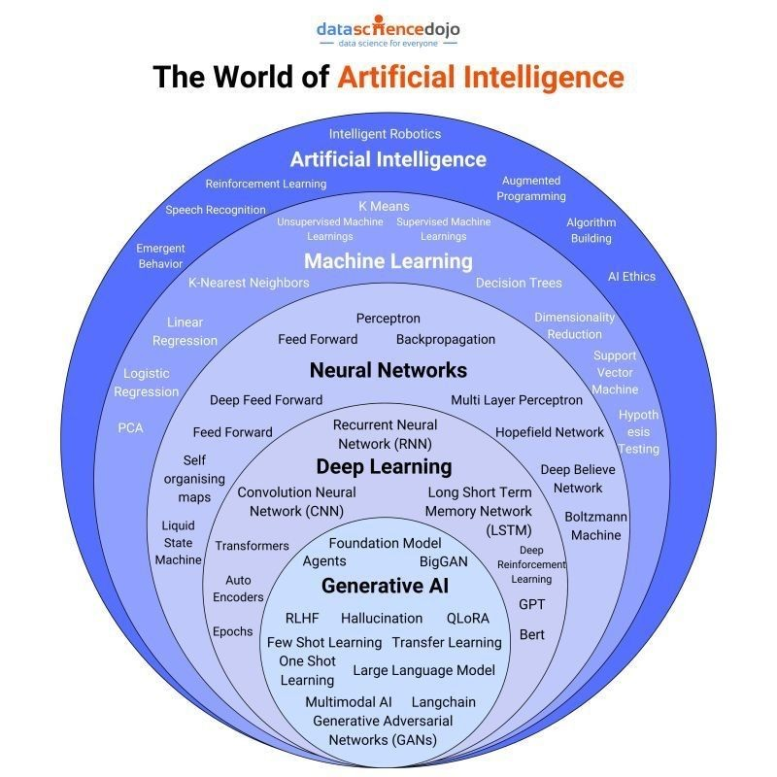
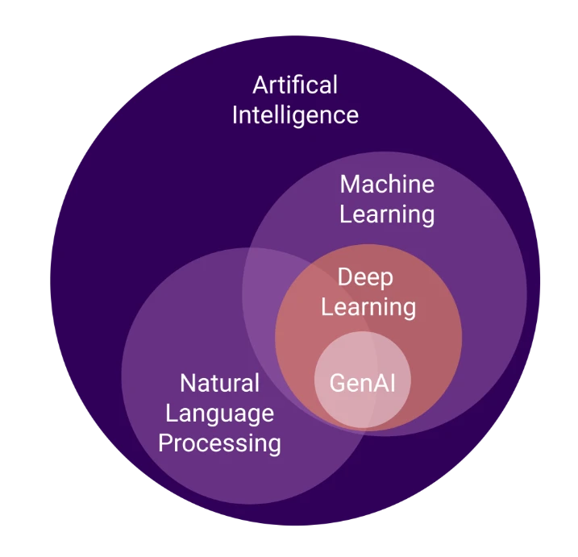
Algorithms and models

Slide 3
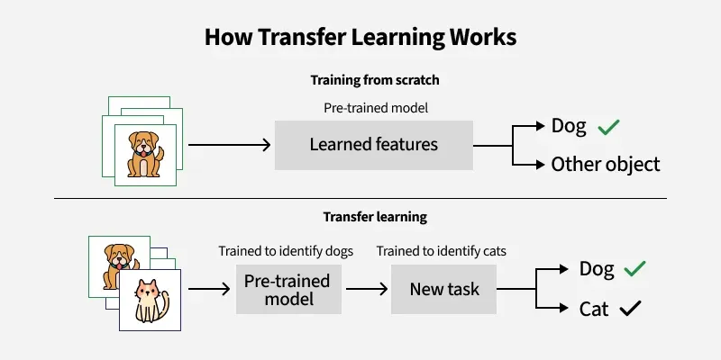
https://www.geeksforgeeks.org/ml-introduction-to-transfer-learning/
https://medium.com/@davidfagb/guide-to-transfer-learning-in-deep-learning-1f685db1fc94

Slide 4
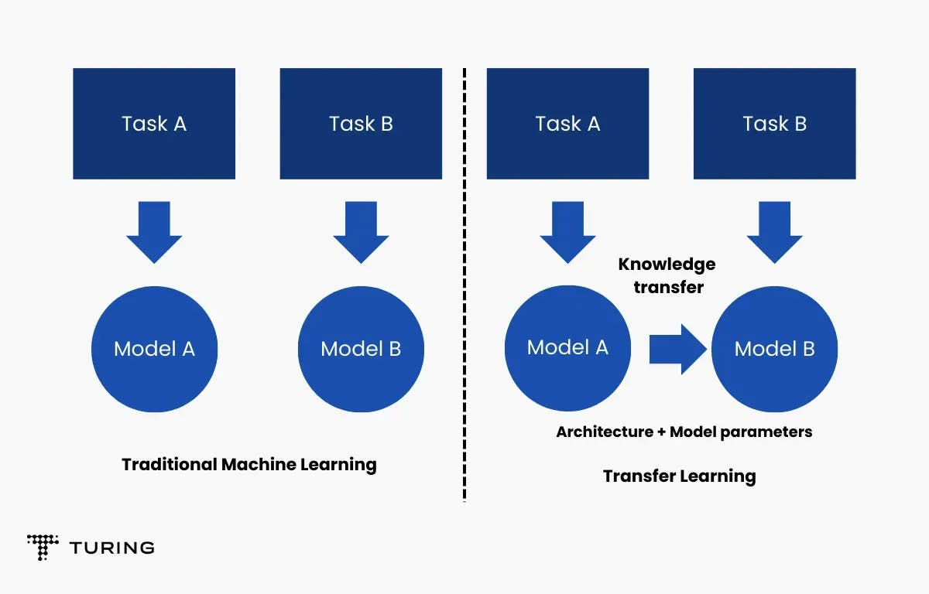

Slide 5
Transfer learning in deep learning
involves using knowledge gained from a pre-trained model on one task and applying it to a new, related task. This technique is particularly useful when data for the target task is limited, as it leverages the pre-trained model's learned features and reduces training time and resources.
How it works:
1. Pre-trained Model:
A model is trained on a large dataset for a specific task (e.g., image classification on ImageNet). This model learns generic features and patterns that can be valuable for other tasks.
2. Base Model:
The pre-trained model is used as a starting point, with its layers acting as a base for the new task.
3. Transfer Layers:
Specific layers in the base model are identified as containing generic information applicable to both the source and target tasks. These layers are often the higher-level layers of the network.
4. Fine-tuning:
The identified layers are fine-tuned with data from the new task. This process adjusts the parameters of the selected layers to better suit the target task while retaining the knowledge learned from the source task.

Slide 6
Benefits of Transfer Learning:
Reduced Training Time and Resources:
Transfer learning significantly reduces the time and computational resources needed for training a new model, as it leverages the pre-trained model's existing knowledge.
Improved Performance with Limited Data:
When data for the target task is scarce, transfer learning can help achieve better performance than training from scratch.
Exploitation of Existing Knowledge:
Transfer learning allows for the reuse of knowledge learned from one task to improve the performance on a related task.
Enhanced Generalization:
By leveraging pre-trained models, transfer learning can improve the generalization ability of models on new, unseen data.
Examples of Transfer Learning:
Image Classification:
Using a model pre-trained on ImageNet to classify different types of objects or scenes.
Natural Language Processing:
Transferring knowledge from a language model pre-trained on a large corpus to tasks like sentiment analysis or text generation.
Object Detection:
Leveraging pre-trained models to detect objects in images or videos.
Speech Recognition:
Using pre-trained acoustic models to improve the performance of speech recognition systems.

Slide 7
https://www.geeksforgeeks.org/vgg-16-cnn-model/
https://www.turing.com/kb/transfer-learning-using-cnn-vgg16
https://universe.roboflow.com/project-4ppiz/car-defect-detection-xxpkc/model/2

Slide 8
References
https://www.kaggle.com/competitions/aptos2019-blindness-detection/discussion/102812#593578
https://www.kaggle.com/code/hmendonca/mask-rcnn-and-coco-transfer-learning-lb-0-155
https://www.kaggle.com/code/odins0n/video-anomaly-detection
https://www.kaggle.com/code/iamsouravbanerjee/image-classification-decoded-case-study
https://www.kaggle.com/discussions/accomplishments/451236

