Slide 1


Slide 2
Introduction:--
Pandas is a Python library used for data manipulation and analysis. Pandas provides a convenient way to analyze and clean data.
The Pandas library introduces two new data structures to Python - Series and DataFrame, both of which are built on top of NumPy.
What is Pandas Used for?
Pandas is a powerful library generally used for:
- Data Cleaning
- Data Transformation
- Data Analysis
- Machine Learning
- Data Visualization

Slide 3
### Why Use Pandas?
Some of the reasons why we should use Pandas are as follows:
1.**Handle Large Data Efficiently**
Pandas is designed for handling large datasets. It provides powerful tools that simplify tasks like data filtering, transforming, and merging.
It also provides built-in functions to work with formats like CSV, JSON, TXT, Excel, and SQL databases.
2.**Tabular Data Representation**
Pandas DataFrames, the primary data structure of Pandas, handle data in tabular format. This allows easy indexing, selecting, replacing, and slicing of data.
3.**Data Cleaning and Preprocessing**
Data cleaning and preprocessing are essential steps in the data analysis pipeline, and Pandas provides powerful tools to facilitate these tasks. It has methods for handling missing values, removing duplicates, handling outliers, data normalization, etc.
4.**Time Series Functionality**
Pandas contains an extensive set of tools for working with dates, times, and time-indexed data as it was initially developed for financial modeling.
5.**Free and Open-Source**
Pandas follows the same principles as Python, allowing you to use and distribute Pandas for free, even for commercial use.

Slide 4
### Install Pandas
To install pandas, you need Python and PIP installed on your system. If you have Python and PIP installed already, you can install pandas by entering the following command in the terminal:
```bash
pipinstallpandas
```
If the installation completes without any errors, Pandas is now successfully installed on your system. You can start using it in your Python projects by importing the Pandas library.
### Import Pandas in Python
We can import Pandas in Python using the import statement:
```python
import pandas as pd
```

Slide 5
data manipulation and data wrangling
Series and dataFrame
indexing and slicing
df.set_index(0,1),df.reset_index(drop=True, inplace=True)
import files (csv,excel .sql , sql connection)
Data overview
head, tail, desc(o, all), info ,dtypes, df.columns, df.samples
slicing indexing, loc & iloc
Data Cleaning
check duplicate ,drop duplicate,inplace
check null values, replace null, change value, drop null
data type
handle outliers
create new columns (apply functions) ,delete columns
save the data
# data transformation
# pivot, melt, groupby, sort, sortby, rank, quantile, shift,
# data merging
# concat(row,col,ignore_index=True), append, join, merge
# data analysis
# summary statistics, count,unique,nunique,boolean indexing
# descriptive statistics(mean,sum)
argmax,df[["Sex","Fare"]].groupby("Sex").aggregate(['mean','min','max','sum'])
correlation, regression, time series analysis
# data visualization
# plot, scatter plot, bar plot, histogram, box plot, violin plot, heatmap
# data export
# to_csv, to_excel, to_json, to_pickle, to_sql
convert json

Slide 6
import pandas as pd

Slide 8
# pip install lxml
import lxml
url_df=pd.read_html("https://www.basketball-reference.com/leagues/NBA_2015_totals.html")
type(url_df)
# mysql connector
importmysql.connector
#Create the connection object
myconn=mysql.connector.connect(host="127.0.0.1", user="root",passwd="@" ,database="mavenmovies")
#creating the cursor object
cur=myconn.cursor()
try:
#Reading the Employee data
cur.execute("select * from Actor")
#fetching the rows from the cursor object
result=cur.fetchall()
#printing the result
forxinresult:
print(x);
except:
myconn.rollback()
myconn.close()
json="https://api.github.com/repos/pandas-dev/pandas/issues"
foriinrange(len(df)):
print(df[i]['user']['node_id'])
df=pd.DataFrame(df, columns= ['user', 'timeline_url'])

Slide 9
df=pd.read_csv("https://raw.githubusercontent.com/datasciencedojo/datasets/master/titanic.csv")
df
df.columns
df.head()
df.tail()
df.dtypes
df.size
df.sample(1)
df.columns
list(df.columns)
df.info()
df.dtypes
df.shape
df.describe() #numerical data
# 2d slicing
df2[["a","c"]][1:] #but not using slicing in 2d
# loc
# df.loc[rows , columns]
df2.loc["y"]
# df.iloc[rows , columns]
df2.iloc[1: ,1:3] # index base slicing
pd.Categorical(df['Cabin'])
df['Cabin'].unique()
df['Cabin'].nunique()
df['Cabin'].value_counts()
df
df.head()
# group by for single columns
df.groupby(["customer segment"])["Fare"].sum()
df.groupby('Survived').mean(numeric_only=True) #for recent pandas version
df.groupby('Survived').describe()
df.groupby('Survived').aggregate([min, 'max', 'mean', 'median', 'count', 'var'])

Slide 10
# Data Cleaning
df4.duplicated()
df4.duplicated().sum()
df4.drop_duplicates()
df4.isna()
df4.isna().sum()
df4.drop(columns=["Unnamed: 0","Cabin"] ,axis=1)
df4.drop(columns=["Unnamed: 0","Cabin"] ,axis=1,inplace=True)
df4.isnull().sum()
df.drop(1, inplace=True)
df
df.set_index('Name', inplace=True) #time series data>>you will be making date time column as index
df
df.reset_index(inplace=True)
df
# use aggrigate funtions
df4["Age"].mean() # for replace value find mean
# fill null age value # replace missing values with 0
df4["Age"].fillna(df4["Age"].mean(), inplace=True)
df4.dropna(inplace=True)
# change the datatypes
df4["SibSp"].astype("float32")
# remove duplicates based on column 'A'
df.drop_duplicates(subset=['A'], keep='first', inplace=True)
# rename columns
df.rename(columns={'A': 'Age', 'B': 'Name', 'C': 'Salary'}, inplace=True)
# remove rows with missing values
df.dropna(inplace=True)
# How to remove columns containing only NaN values?
# check which columns contain only NaN values
columns_with_nan=df.columns[df.isnull().all()]
# drop the columns containing only NaN values
df=df.drop(columns=columns_with_nan)
# 2. Handle Error Values
df=pd.DataFrame({
'Name': ['Alice', 'Bob', 'Charlie'],
'Score': [85, 'error', 92]
})
# Replace 'error' with NaN and convert column to numeric
df['Score'] =pd.to_numeric(df['Score'], errors='coerce')
# Rename columns
df.rename(columns={'A': 'Age'}, inplace=True)

Slide 11
# Questions form dataset
#Q. How many passengers are less than 5 years old
df2.drop(["Unnamed: 0"], inplace=True,axis=1)
# unique value count of age
df2['Age'].value_counts()
df['Age'] <5
df[df['Age'] <5]
len(df[df['Age'] <5])
#no of passenger >18
len(df[df['Age'] >18])
#how many passengers are less than 18 years old
len(df) -len(df[df['Age'] >18])
len(df[df['Age'] <=18]) #missing value in age column
#Q. How many passengers have paid less than avg fare
df['Fare'].mean()
df[df['Fare']<df['Fare'].mean()]
len(df[df['Fare'] >df['Fare'].mean()])
#How many passengers paid 0 fare
list(df[df['Fare'] ==0].Name)
#Qhow many passengers are male and female
len(df[df['Sex'] =="male"])
len(df[df['Sex'] =="female"])
df['Sex'].value_counts(normalize=True)
#Q how many passengers of class 1
df[df['Pclass'] ==1]
#How many passengers survived
df[df['Survived'] ==1]
df['Survived'].value_counts(normalize=True)
#How many females paid more than avg fare
df['Sex'] =='female'
df['Fare'].mean()
df[(df['Sex'] =='female') & (df['Fare'] >df['Fare'].mean())]
#Q how many passengers are male or who paid greater than avg fare >>or
#Qhow many male passenger paid more than avg >>and
df[(df['Sex'] =='male') | (df['Fare'] >df['Fare'].mean())]
np.mean(df['Fare'])
df['Fare'].mean()
max(df['Fare'])
min(df['Fare'])
#who are the passengers who paid maximum fare
df[df['Fare'] ==max(df['Fare'])]['Name']
# Q. How many passenger have parch greater than 3
# Q. How many passenger who survived paid the maximum fare
# Q. How many passengers who didnt survived was from class 1
# Q. How many passengers are children(<5 years old)

Slide 12
# Sorting by values
df.sort_values(by="Fare", ascending=False)
df.sort_index( axis=0,ascending=False)
pd.DataFrame(d1)
pd.merge(d1, d2, how='left')
# # Sorting by column "Population"
df.sort_values(by=['Fare'], ascending=False)

Slide 13
# Definitions and Use Cases:
# ------------------------------------------------------------
# concat: Combines DataFrames either vertically (row-wise) or horizontally (column-wise).
# Use case: Combine data from multiple CSVs or append new data.
# merge: Combines DataFrames based on common columns (similar to SQL joins).
# Use case: Merge customer info with transaction data.
# join: Joins DataFrames using their index.
# Use case: Combine metadata indexed by unique IDs.
# pivot: Reshapes data by turning unique values in a column into new columns.
# Use case: Create summary tables like Excel pivot tables.
# melt (unpivot): Converts wide-format data into long-format.
# Use case: Prepare data for analysis/visualization by tidying it.

Slide 14
importnumpyasnp
numeric_columns=df.select_dtypes(include=[np.number]).columns
result=df.groupby('Survived')[numeric_columns].aggregate([np.min, 'max', 'mean', 'median', 'count', 'var'])
result

Slide 15
#date time
df=pd.DataFrame({"date": ['2024-02-08', '2024-02-09', '2024-02-10']})
df
df.dtypes
df['updated_date'] =pd.to_datetime(df['date'])
df
df.dtypes
df['month'] =df['updated_date'].dt.month
df
df['year'] =df['updated_date'].dt.year
df
df['day'] =df['updated_date'].dt.day
df
# Convert to date:datatype
df['Date'] =pd.to_datetime(df['Date'])

Slide 16
https://www.datacamp.com/blog/top-python-pandas-interview-questions-and-answers
https://leetcode.com/studyplan/30-days-of-pandas/
https://skphd.medium.com/pandas-interview-questions-and-answers-a9e823a222c7
apply map
pandas profiling

Slide 17
#To convert the result to dataframe
df.groupby(['Sex', 'Pclass'])['Survived'].sum().to_frame()
df.groupby(['Sex', 'Pclass'])['Survived'].sum().unstack()
# This is useful for categorizing passengers
# by age groups, which can be helpful for further analysis (e.g., checking survival rates by age group).
df['Age_Group'] =pd.cut(df['Age'], bins=[0, 12, 18, 60, 80], labels=['Child', 'Teen', 'Adult', 'Senior'])
# pd.cut() function, which segments the data into bins (ranges) and labels those
# bins with categorical names (e.g., 'Child', 'Teen', 'Adult', 'Senior') based on the values in the Age column.
### 🔁 Different `orient` options in `.to_json()`
| Orient | Description | Output Format |
| ----------- | ------------------------------ | ----------------------------------- |
| `'split'` | Dict with index, columns, data | `{index, columns, data}` |
| `'records'` | List like row-wise dicts | `[{"col1":val1, "col2":val2}, ...]` |
| `'index'` | Dict of dicts (index as key) | `{index: {col:val}}` |
| `'columns'` | Dict of columns | `{col: {index:val}}` |
| `'values'` | Just the data as list of lists | `[[...], [...]]` |
| `'table'` | JSON Table Schema | Complex (used in API) |
df.to_json(path_or_buf=None, orient=None, lines=False)

Slide 18
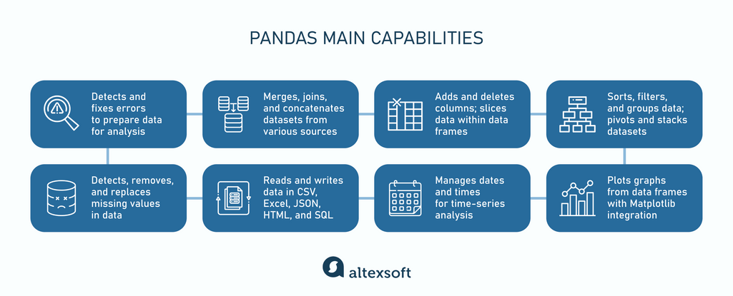

Slide 19
Thank You!

