Slide 1
Convolutional Neural Network (CNN)

Slide 2
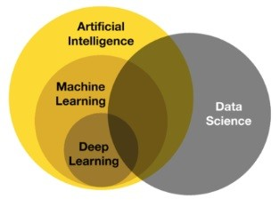
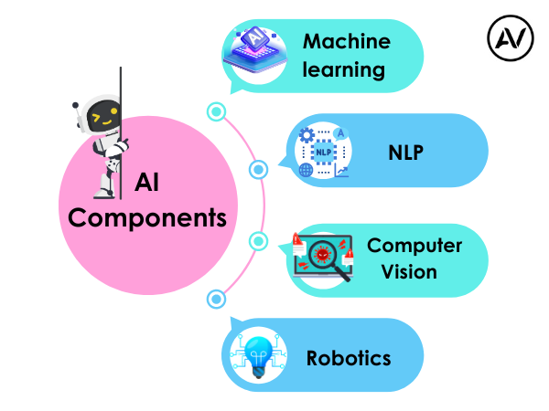
https://ellow.io/components-of-ai/

Slide 3
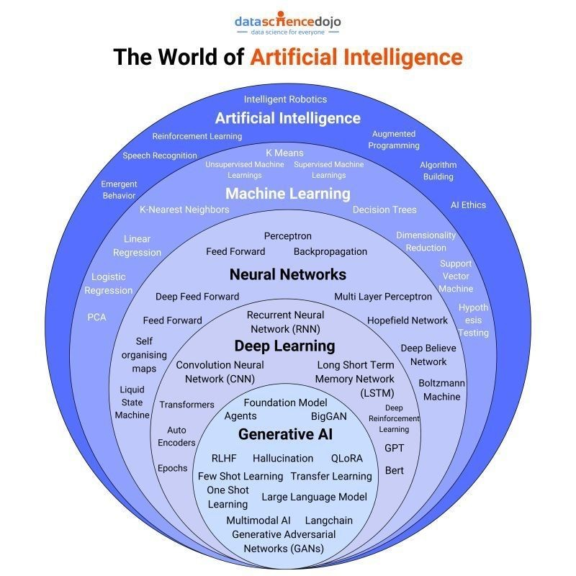
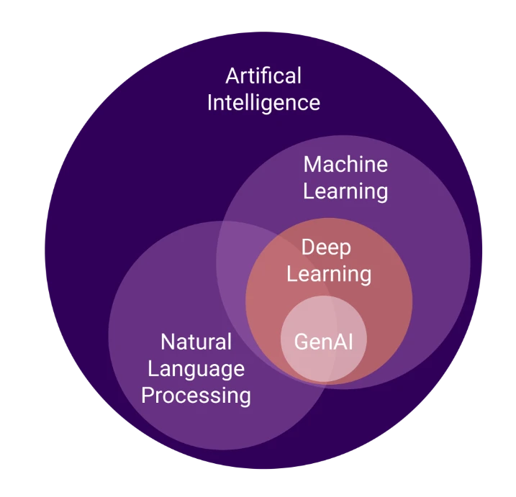
Algorithms and models

Slide 4
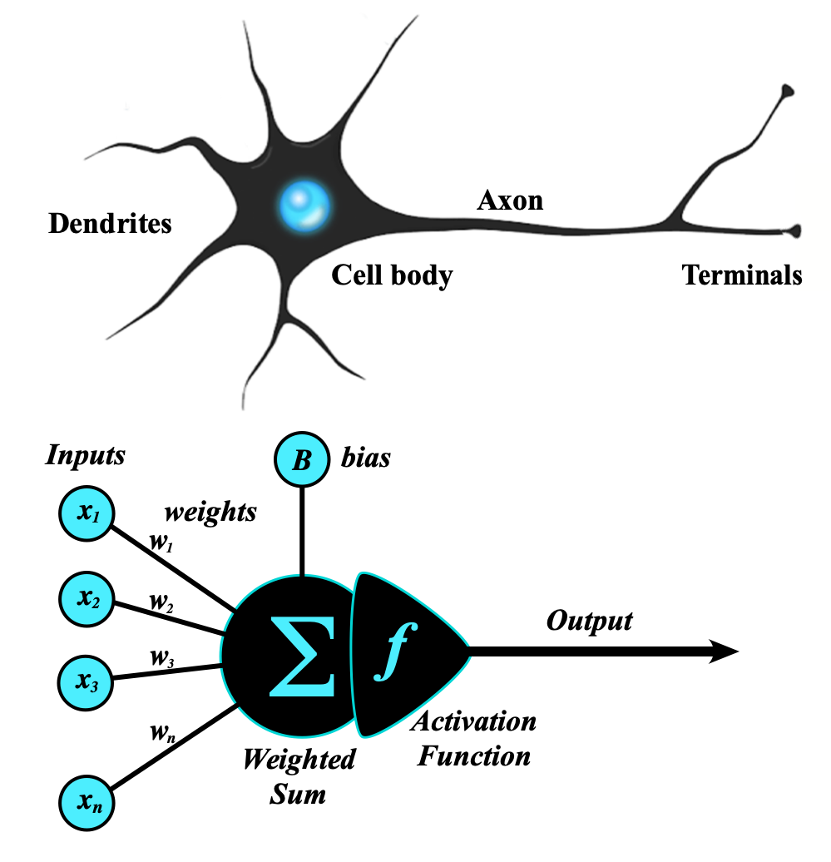
Artificial Neural Network
An artificial neural network (ANN) is a computational network (a system of nodes and the interconnection between nodes) inspired by biological neural networks, which are the complex networks of neurons in human brains (see Figure).
The nodes created in the ANN are supposedly programmed to behave like actual neurons, and hence they are artificial neurons.
The Perceptron was invented in 1957 by Frank Rosenblatt at the Cornell Aeronautics Laboratory. Based on the first concepts of artificial neurons, he proposed the “Perceptron learning rule“.
Perceptron Model
The perceptron is the simplest form of an artificial neural network and serves as the building block of more advanced models.
Components of a Perceptron:
Inputs: Feature values from the dataset.
Weights: Assigned to each input to signify importance.
Summation Function: Computes the weighted sum of inputs.
Activation Function: Applies a threshold to determine output.
https://www.geeksforgeeks.org/neural-networks-a-beginners-guide/
https://s.mriquestions.com/what-is-a-neural-network.html

Slide 5
What is cnn
CNN Vs Visual Cortex | The Famous Cat Experiment | History of CNN
Convolutional Operations
Paddings &Strides
Polling (MAx polling. Average polling)
CNN ARCHtiecture (LeNet5, imagenet)
Comparing CNN VS ANN
CNN BackPropagation
Cat Vs Dog Image Classification Project | Deep Learning Project | CNN Project
Data Augmentation in Deep Learning | CNN
Pretrained models in CNN | ImageNET Dataset | ILSVRC | Keras Code
What does a CNN see? | Visualizing CNN Filters and Feature Maps | CampusX

