Slide 1

Power Bi

Slide 2
INTERVIEW QUESTIONS
https://youtu.be/u7yAypveDRo?si=uKmf_74MuuUAwDn6
https://www.simplilearn.com/power-bi-interview-questions-and-answers-article
https://github.com/virajbhutada/power-BI-resources
https://medium.com/microsoft-power-bi/power-bi-interview-questions-part-2-de5c7b16db84
https://medium.com/microsoft-power-bi/power-bi-interview-questions-part-1-4982de3be327

Slide 3
Introduction to Power BI
Introduction to Business Intelligence
Self Service Business Intelligence
SSBI Tools
What is Power BI?
Key Benefits of Power BI
Architecture of Power BI
Building Blocks of Power BI
Power BI Job Role
https://www.javatpoint.com/power-bi
Getting Started with Power BI
▪ Setting Up Office365 Business Basic Trial Account
▪ Power BI Service License Comparison
▪ Downloading Power BI Desktop
https://www.microsoft.com/en-AU/microsoft-365/business/compare-all-microsoft-365-business-products-b
https://app.powerbi.com/
https://youtu.be/J1g_NbRfIX4?si=wgPDsAVrwNrEdlmC

Slide 4
Power BI Desktop & Power Query
Introduction to Power BI Desktop
Installation of Power Bi Desktop
Data Sources in Power BI Desktop
How to connect to different Data Sources Using Power BI Desktop
Introduction to Query Editor in Power Bi
Cleaning irregularly formatted data
Combining Data: Merging and Appending
Query Duplicate, Query Reference
https://learn.microsoft.com/en-us/power-bi/fundamentals/desktop-getting-started
https://www.tutorialspoint.com/power_bi/index.htm
https://www.geeksforgeeks.org/power-bi-tutorial/

Slide 5
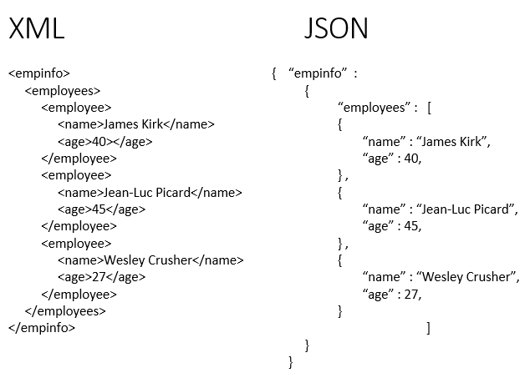
Clean and Transform data
Editing Rows and Columns
Replacing Values
Changing Data Types of columns
Pivoting and Unpivoting Columns
Splitting Columns
Adding New Columns E.g. Conditional Columns,Index Columns etc.
Assignment
To clean data in Power BI, leverage the Power Query Editor by importing your data, then using its features to remove duplicates, handle missing values, standardize formats, correct errors, remove unnecessary columns, and detect/remove outliers.
Introduction to Data Modeling
Understanding Data Modeling
Cardinality and Cross Filter Direction
▪ Deleting Relationships
▪ Creating New Relationships: Drag and Drop
https://learn.microsoft.com/en-us/power-bi/transform-model/desktop-relationships-understand
https://pivotalstats.com/complete-guide-to-create-data-models-table-relationships-in-power-bi/
https://www.phdata.io/blog/data-modeling-fundamentals-in-power-bi/

Slide 6
Here's a more detailed breakdown:
1. Import Your Data:
Open Power BI and click "Get Data".
Select your data source (Excel, CSV, database, etc.).
Choose the specific file or table to import.
2. Open the Power Query Editor:
Once the data is imported, click "Transform Data" or "Edit Queries" to open the Power Query Editor.
3. Data Cleaning Techniques:
Remove Duplicate Records:
Select the columns that should be unique.
Right-click and choose "Remove Duplicates".
Handle Missing Values:
Identify missing values (e.g., blank cells, null values).
Use "Fill" or "Replace Values" to address them.
Standardize Data Formats:
Ensure data consistency by converting data types (e.g., text, numbers, dates).
Select a column, right-click, and choose "Change Type" to the desired format.
Correct Errors and Inaccuracies:
Identify and correct any errors or inaccuracies in the data.
Use "Replace Values" or custom formulas to make necessary corrections.
Remove Unnecessary Columns:
Select the columns to remove and then select "Remove Columns" on the Home tab.
Alternatively, select the columns to keep and then select "Remove Columns" > "Remove Other Columns".
Detect and Remove Outliers:
Identify outliers using statistical methods or visual inspection.
Remove or transform outliers as needed.
Rename Columns:
Right-click on a column header and select "Rename".
Type the new name and press Enter.
Split Columns:
Select the column you want to split.
Go to the "Transform" tab and choose "Split Column".
Unpivot Columns:
Unpivot columns to transform rows into columns and vice versa.
Remove Irrelevant Rows:
Use "Remove Rows" to eliminate blank or meaningless rows.
Filter Data:
Use the filter icon to filter the data based on specific criteria.
4. Validate and Apply Changes:
Review the cleaned data in the Power Query Editor.
Click "Close & Apply" to apply the changes and load the data into Power BI.

Slide 7
Data Analysis Expressions (DAX)
Introduction to DAX
Difference Between M Query and DAX Query
https://www.linkedin.com/pulse/whats-difference-between-dax-power-query-m-enterprisednaofficial-fyvac/
DAX Data Types ,DAX Operators https://learn.microsoft.com/en-us/dax/dax-operator-reference
DAX Measures and Calculations , ROW Context and Filter Context https://www.geeksforgeeks.org/row-context-and-filter-context-in-power-bi/
Aggregation functions -Sum,Sumx,count family,min,minx,mina,max,maxx,average,averagex
https://learn.microsoft.com/en-us/dax/aggregation-functions-dax
Text Functions
https://www.geeksforgeeks.org/power-bi-dax-text-functions/
https://learn.microsoft.com/en-us/dax/

Slide 8
Date and Time Function, Time Intelligence : CALENDER AND CALENDER AUTO, Deriving Year, Quarter, Month, Day
https://learn.microsoft.com/en-us/dax/time-intelligence-functions-dax
Filter Function : ALL,ALLEXCEPT,ALLSELECT,FILTER,CALCULATE TABLE,RANK,SELECTEDVALUE,SUMMERIZE,TOPN
https://learn.microsoft.com/en-us/dax/filter-functions-dax
Most Versatile DAX Function:-CALCULATE DAX https://www.datacamp.com/tutorial/power-bi-calculate-tutorial
IF and Switch in DAX https://radacad.com/write-conditional-statement-using-switch-in-dax-and-power-bi
https://www.geeksforgeeks.org/data-analysis-expressions-dax/
https://radacad.com/power-bi-dax-all-vs-allselected
https://medium.com/@arpita3696/dax-all-allselected-allexcept-85ff3cf7bf9d

Slide 9
Data Visualization
Introduction to Data Visualizations
Charts in Power BI
Matrixes and tables
Map Visualizations
Gauges and Cards https://learn.microsoft.com/en-us/power-bi/visuals/power-bi-visualization-radial-gauge-charts
KPI Visuals
https://learn.microsoft.com/en-us/power-bi/visuals/power-bi-visualization-waterfall-charts
https://www.datacamp.com/tutorial/power-bi-kpi
Color Formatting and Configuring Visualizations
https://learn.microsoft.com/en-us/power-bi/visuals/service-getting-started-with-color-formatting-and-axis-properties
https://learn.microsoft.com/en-us/power-bi/create-reports/desktop-conditional-table-formatting

Slide 10
Shapes, Text Boxes and Images
https://learn.microsoft.com/en-us/power-bi/create-reports/service-dashboard-add-widget
Page Layout and Z-order
https://learn.microsoft.com/en-us/power-bi/create-reports/desktop-gridlines-snap-to-grid?tabs=powerbi-desktop#use-z-order
https://qmetrix.com.au/bi-dashboards-visualisation-techniques-design-elements-and-screen-real-estate/
What Are Custom Visuals?
https://blogs.perficient.com/2022/09/09/top-custom-visuals-in-power-bi/
Assignment
https://github.com/Sanjesh12/Power-BI-Assignment
https://learn.microsoft.com/en-us/power-bi/create-reports/desktop-grouping-visuals
https://learn.microsoft.com/en-us/power-bi/visuals/power-bi-visualization-slicers
https://learn.microsoft.com/en-us/power-bi/create-reports/buttons-apply-all-clear-all-slicers
https://learn.microsoft.com/en-us/power-bi/create-reports/desktop-drill-through-buttons
https://www.phdata.io/blog/how-to-create-a-drill-through-in-power-bi/
https://learn.microsoft.com/en-us/power-bi/create-reports/desktop-drillthrough
https://learn.microsoft.com/en-us/power-bi/consumer/end-user-q-and-a
https://qmetrix.com.au/bi-dashboards-visualisation-techniques-design-elements-and-screen-real-estate/

Slide 11
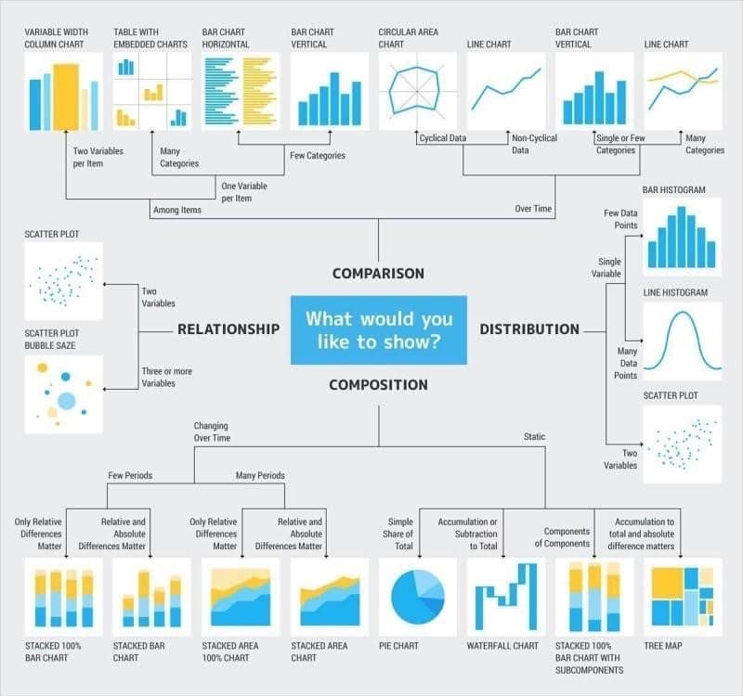

Slide 12
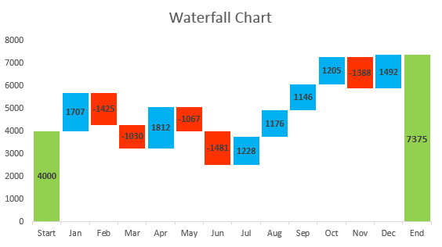
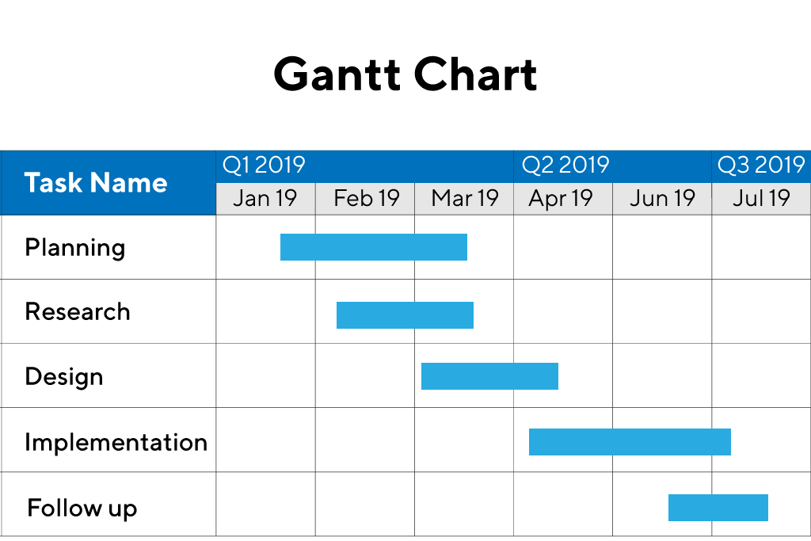
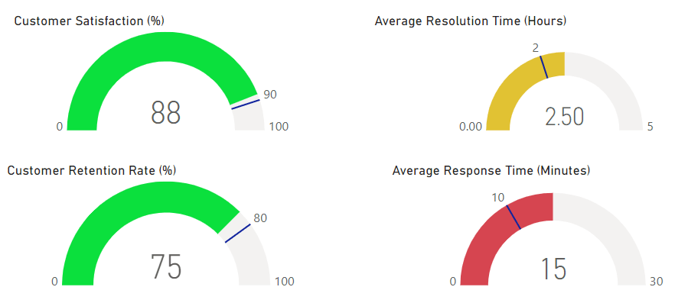
https://www.ablebits.com/office-addins-blog/waterfall-chart-in-excel/
https://www.productplan.com/glossary/gantt-chart/
https://blog.coupler.io/power-bi-gauge/

Slide 13
Introduction to Power BI Dashboard, Q&A and Data Insights
Create Dashboard with interactivity (Slicers and Filters)
https://skillzcafe.com/blog/microsoft/power-bi/creating-interactive-reports-with-power-bi-filters-and-slicers
Q & A
https://www.acuitytraining.co.uk/news-tips/qa-visual-in-power-bi/
Smart Narrative
https://www.acuitytraining.co.uk/news-tips/smart-narrative-visual/
Decomposition Tree
https://www.acuitytraining.co.uk/news-tips/decomposition-tree-visual-in-power-bi/
Key Infulencers
https://www.acuitytraining.co.uk/news-tips/key-influencer-visual/
Power BI Mobile
https://learn.microsoft.com/en-us/power-bi/consumer/mobile/mobile-apps-quickstart-view-dashboard-report
https://www.acuitytraining.co.uk/news-tips/creating-a-gantt-chart-in-power-bi/
https://www.acuitytraining.co.uk/news-tips/power-bi-bullet-chart/
https://infiniticube.com/blog/how-do-you-create-interactive-dashboards-with-power-bi/

Slide 14
Power Bi Service
Power BI Service Introduction to app.powerbi.com
Schedule refresh
https://www.analyticodigital.com/blog/how-to-set-up-scheduled-refreshes-power-bi
Data flow and use power bi from online
https://www.phdata.io/blog/how-and-when-to-use-dataflows-in-power-bi/
Download data as live in power point and more
https://learn.microsoft.com/en-us/power-bi/collaborate-share/end-user-powerpoint
Power BI is a collection of software services, apps, and connectors that work together to help you create, share, and consume business insights in the way that serves you and your business most effectively.
https://playground.powerbi.com/en-us/
https://3cloudsolutions.com/resources/what-are-power-bi-apps/
https://epmstrategy.com/power-bi-how-to-create-an-app-on-the-microsoft-power-bi-service/

Slide 15
Power BI Direct Connectivity
Data Gateways
https://radacad.com/the-power-bi-gateway-all-you-need-to-know
DirectQuery, Live Connection or Import Data
https://radacad.com/directquery-live-connection-or-import-data-tough-decision
Connect to on-premises SQL Server database using Gateway
https://nishantrana.me/2020/07/06/configuring-on-premises-data-gateway-to-connect-tosql-server-on-premise-data-source-power-platform/

Slide 16
Case Study/Project
Cricket World Cup Analysis Introducing PowerBI with AI
https://www.youtube.com/watch?v=YxVnWfY20M0

Slide 17
Case Study/Project
CAR SALES PROJECT

Slide 18
Publish https://learn.microsoft.com/en-us/power-bi/create-reports/desktop-upload-desktop-files
copilot https://www.datacamp.com/tutorial/power-bi-copilot
https://learn.microsoft.com/en-us/power-bi/create-reports/copilot-introduction
power platform
paginated report
https://learn.microsoft.com/en-us/power-bi/paginated-reports/paginated-reports-report-builder-power-bi
https://learn.microsoft.com/en-us/power-bi/paginated-reports/paginated-reports-samples
https://www.inogic.com/blog/2023/06/develop-paginated-report-using-power-bi-report-builder/
power apps
https://learn.microsoft.com/en-us/power-apps/powerapps-overview
https://medium.com/@thomas.j.blessing/power-bi-vs-power-apps-vs-power-automate-9ca45e5d9773
power automate
https://www.datapears.com/post/power-bi-power-automate-everything-you-need-to-know
https://learn.microsoft.com/en-us/power-bi/create-reports/power-bi-automate-visual
https://hatfullofdata.blog/power-automate-get-data-from-a-power-bi-dataset/

Slide 19
Buttons
https://databear.com/buttons-in-power-bi/
https://www.cittros.com/insights/create-buttons-in-power-bi
https://learn.microsoft.com/en-us/power-bi/create-reports/desktop-buttons?tabs=powerbi-desktop
Parameters
https://learn.microsoft.com/en-us/power-query/power-query-query-parameters
https://www.sqlbi.com/articles/fields-parameters-in-power-bi/
https://www.red-gate.com/simple-talk/databases/sql-server/bi-sql-server/power-bi-introduction-working-with-parameters-in-power-bi-desktop-part-4/
https://learn.microsoft.com/en-us/power-bi/transform-model/desktop-what-if
view
bookmark
https://learn.microsoft.com/en-us/power-bi/create-reports/desktop-bookmarks
https://www.tpximpact.com/knowledge-hub/blogs/tech/power-bi-bookmarks-buttons-toggles
https://www.wallstreetmojo.com/power-bi-bookmarks/
filters
selections
sync filters
Optimize

Slide 20
Project: 1 Project - In United States, there are many stores in which a survey was conducted based on students i.e. how much they are spending on different kind of purchases like Video games, Indoor games, Toys, Books, Gadgets etc. In the data set (Student Survey), Store setting is the column that explains the Type of location in which the store is present. By using data set (Student Survey), try to extract the meaningful Insights.
Industry Type – Retail Store
Data set - Student survey https://docs.google.com/spreadsheets/d/19PAZIJ7T2pvf50t94_R5tZCiog_aaP24/edit?usp=sharing&ouid=113177982973203432452&rtpof=true&sd=true
Problem Statement- Create a Power BI Report: 1. Tabular Visualization - Format the total amount of purchase (TAP) based on ‘Store location’ and ‘Store setting’: -
• If 0<TAP<35000, then records should be in red color ·
• If 35000<=TAP<60000, then records should be in yellow color
• If TAP>=60000, then records should be in Blue color

Slide 21
2 Matrix Visualization – Create Matrix Visualization to show the amount spent on Outdoor sports across different ages and ‘Store setting’. Do the color formatting for the amount spent in total outdoor sports.
3. Funnel chart – Create a Funnel chart to show Total amount of purchase by ‘Store setting’. Show the data labels as Percentage of First.
4. Pie chart – Show the total amount of purchase by different ‘Store location’ for Suburban ‘Store setting’ only. Hint: Use Filter context
5. a) Scatter plot - Video games purchase and Outdoor sports spent across the different ages. b) any plot - Indoor sports and Video games spent across the different age groups.
6. Restrict data access for the given users in User mapping table. For ex. Mani deals with Rural area only so she should be able to view the data which belongs to Rural only, not urban and suburban data.
7. Publish the report on Power BI cloud service and Design the Master Dashboard consisting of Funnel chart and scatter plots. Then create a schedule refresh for six times in every 4 hours for the Dashboard in a day.
8. Use Q&A feature of Power BI –
a) To show average age of students
b) Donut chart for total amount of purchases by ‘Store location

Slide 22
Row-Level Security (RLS) in Power BI allows you to restrict data access at the row level, ensuring that users only see the data they are authorized to view, based on their roles or permissions. You can define roles and rules within Power BI Desktop and publish them to the Power BI service to configure RLS.
How to Implement RLS in Power BI:
Define Roles and Rules in Power BI Desktop:
Create Roles: In the Power BI Desktop modeling view, go to "Manage Roles" and create the necessary roles.
Define DAX Expressions: For each role, define a DAX expression (Data Analysis Expressions) that filters the data based on the role's requirements.
Example: A DAX expression could check the "Region" column and only show data for the current user's region.
Publish to Power BI Service:
Publish your Power BI report to the Power BI service.
The role definitions and DAX expressions are also published.
Assign Users to Roles:
In the Power BI service, you can assign users to the roles you created.
Only semantic model owners or workspace admins can add members to roles.
Test the Security:
Test the security by logging in as different users and verifying that they only see the data they are authorized to view.
https://www.edureka.co/blog/row-level-security-in-power-bi/

Slide 23
Types of RLS:
Static RLS:
Security logic is hardcoded within the PBIX file and doesn't change dynamically.
Dynamic RLS:
Security logic can be adjusted based on the user's context (e.g., their username or role).
https://learn.microsoft.com/en-us/fabric/security/service-admin-row-level-security

Slide 24
Direct Query
What is a direct query in Power BI?
DirectQuery is a direct connection to data source. Data will NOT be stored in Power BI model. Power BI will be a visualization layer, then query the data from data source every time. Power BI will only store metadata of tables (table names, column names, relationships…) but not the data.
https://blog.coupler.io/power-bi-directquery/

Slide 25
In Power BI's Power Query Editor, "Pivot" transforms rows into columns, while "Unpivot" does the opposite, turning columns into rows, allowing for data reorganization and analysis.
Pivot:
Purpose:
Transforms data from a long format (many rows, few columns) to a wide format (few rows, many columns).
How:
Select the columns you want to pivot, then choose "Transform" > "Pivot Column".
Example:
If you have a table with "Region" and "Sales Amount" in separate columns, pivoting on "Region" will create separate columns for each region, with the "Sales Amount" values in those columns.
Aggregation:
Pivot also aggregates the values in the remaining columns (e.g., if you have multiple "Sales Amount" values for the same region, it will sum or average them).

Slide 26
Unpivot:
Purpose:
Transforms data from a wide format to a long format.
How:
Select the columns you want to unpivot, then choose "Transform" > "Unpivot Columns".
Example:
If you have a table with "North", "South", and "East" as columns, unpivoting them will create a single "Region" column with "North", "South", and "East" as values, and a "Sales Amount" column with the corresponding values.
Outcome:
Unpivot converts column names into a single "Attribute" column and the values into a "Value" column.
https://www.youtube.com/watch?v=pXrAXtLhDWU&t=273

Slide 27
Drill Through in Power BI is a powerful feature that helps you dive deeper into your data without leaving your main report.
In Power BI, "drillthrough" allows users to navigate from a summary report page to a more detailed page, focusing on a specific data point, by right-clicking and selecting the drillthrough option.
Here's a breakdown of how drillthrough works:
Purpose:
Drillthrough enables users to explore data in more detail by moving from a summary view to a page with specific context.
How it works:
Source Visual: You start on a report page with a visual containing summary data.
Drillthrough Target: You create a destination page (or "drillthrough page") that focuses on a specific entity or data point.
Initiating Drillthrough: When a user right-clicks a data point in the source visual, they can select the "Drillthrough" option to navigate to the target page.
Contextual Filtering: The target page will be filtered to show only the data related to the selected data point, providing a detailed view.

Slide 28
Setting up Drillthrough:
Create a Drillthrough Page: Design a page in your report that will display the detailed information.
Define Drillthrough Fields: In the source visual, select the fields that you want to use for drillthrough.
Configure Drillthrough Action: Right-click on the visual and select "Drillthrough" to configure the drillthrough action.
Cross-Report Drillthrough: You can also use cross-report drillthrough to navigate between different reports in the same Power BI service workspace or app.
Drillthrough Buttons:
You can also create drillthrough buttons for a more obvious and user-friendly experience.
Example:
Imagine a sales summary report showing sales by region. A user can drillthrough from a specific region (e.g., "Bengaluru") to a detailed sales report for that region, showing sales by product, customer, or other relevant metrics.
https://www.xelplus.com/power-bi-drill-through/

Slide 29
schedule refresh incremental refresh

Slide 30
Others Tolls
https://www.qlik.com/us
tableau
https://www.alteryx.com/
https://lookerstudio.google.com/navigation/reporting
https://www.microsoft.com/en-us/microsoft-fabric
GCP
looker
Bigquery--> data-analytics-and-ai
https://cloud.google.com/solutions/data-analytics-and-ai
https://medium.com/@22.gautam/gcp-ai-and-ml-services-a-comparative-analysis-with-aws-and-azure-67327b8c687c

Slide 31
Real-time Data Streaming and Analytics:
Amazon Kinesis:
A managed service for real-time data streaming and analytics, allowing businesses to process and analyze data quickly.
Amazon Kinesis Data Firehose:
A fully managed service that delivers data to Amazon S3, Amazon Redshift, and other services for real-time analytics.
Amazon Kinesis Data Streams:
A fully managed service for real-time data streaming that can be used for building custom analytics applications.
Business Intelligence and Visualization:
Amazon QuickSight:
A scalable, cloud-based business intelligence service that enables users to create interactive dashboards and visualizations.
Amazon CloudWatch:
A monitoring service that provides real-time insights into the performance of AWS resources and applications.
Other Analytics Services:
Amazon EMR:
A managed Hadoop and Spark service for processing large datasets.
Amazon OpenSearch Service:
A managed service for deploying and managing Elasticsearch clusters for search and analytics.
AWS Data Pipeline:
A service for moving data between different AWS services and on-premises data sources.
Amazon SageMaker:
A machine learning platform that allows users to build, train, and deploy machine learning models
breakdown of some key AWS analytics services:
Data Warehousing and SQL Analytics:
Amazon Redshift:
A fully managed, petabyte-scale data warehouse service that uses SQL-based queries for analyzing large datasets.
Amazon Athena:
Enables interactive query processing of data stored in Amazon S3 using standard SQL, without the need for a separate data warehouse.
Amazon Glue:
A fully managed ETL (Extract, Transform, Load) service that helps prepare and load data for analytics.
Amazon Lake Formation:
Simplifies the creation of secure data lakes, allowing for the combination of various analytics tools to discover insights

Slide 32
Thank You !

