Slide 1
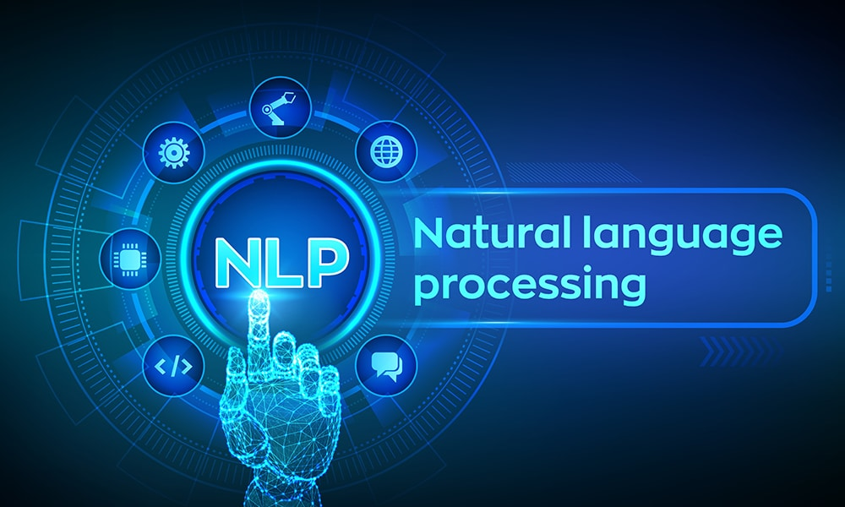
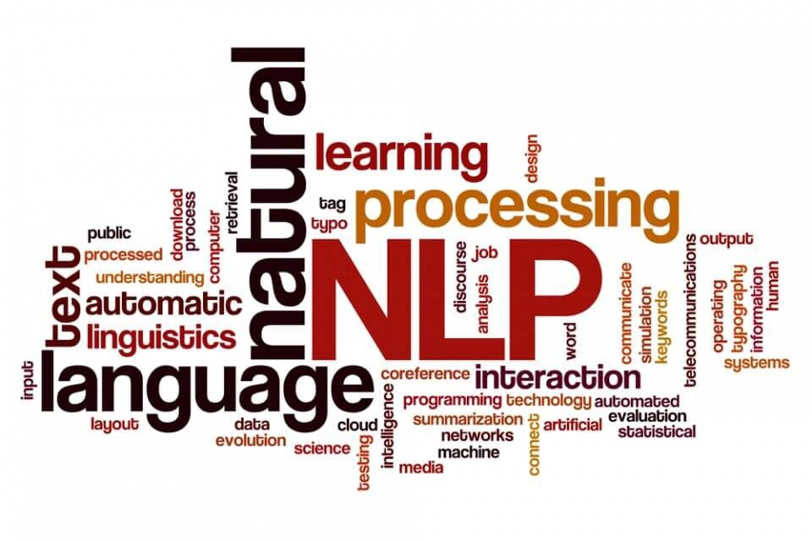

Slide 2
Introduction to NLP
What is Natural Language Processing
Uses of NLP
Application of NLP
Components of NLP
Stages of NLP
Machine Translation
Introduction to LLM
Sentiment Analysis
What is Sentiment Analysis
Challenges in Sentiment Analysis
Handling Emoticons
Sentiment Analysis with ANN
Assignment
Sequence Model
Sequential Data
Recurrent Neural Network
Multi-layer & Bi-directional RNN
Architecture of RNN
Vanishing Gradient Problem in RNN
Long Short Term Memory
Multi-layer & Bi-directional LSTM
Gated Recurrent Unit
Multi-layer & Bi-directional GRU
Assignment
Text Preprocessing
Tokenization
Non Alphabets Removal
Stopwords Removal
Bag of Words
Stemming & Lemmatization
Part of Speech Taging
Name Entity Recognition
Text Visualization
Assignment
Text Classification
CountVectorization/Text Vecorization
Text Classification with ML
TFIDF Vectorization
Text Classification with ANN
Embedding Layer in Natural Language
Assignment
Transformers Based Models
Sequence to Sequence Model
Attention Machanism
Transformers
Face Hugging Transformers

Slide 3
RASA Chatbot
What is RASA
RASA Installation
RASA Initialization
RASA Configuration and File System
Intents, Entity,Response and Story
Actions
Assignment
Weather Forecasting using ARIMA Model
Introduction to AR and MA model
Stationarity & Differencing
SariMax of Seasonal Data
Identifying order AR(p), I(d), MA(q)
Implementation of ARIMA
Assignment
Introduction to Time Series Analysis
What is Sequential Data & Time Series
Functional Relationship
Components of Time Series
Mathemetical Representation of Time Series
ETS Decompositon
Classification of Time Series
Defference between ACF & PACF
Assignment
Stock Price Prediction using Sequence Model
Introduction to Sequence Models RNN, LSTM
Preparing Time Series Data for LSTM
Forecasting using LSTM
Future Forecast
Assignment

Slide 4
What is Natural Language Processing (NLP)
Natural language processing (NLP) is the discipline of building machines that can manipulate human language — or data that resembles human language — in the way that it is written, spoken, and organized. It evolved from computational linguistics, which uses computer science to understand the principles of language, but rather than developing theoretical frameworks, NLP is an engineering discipline that seeks to build technology to accomplish useful tasks. NLP can be divided into two overlapping subfields: natural language understanding (NLU), which focuses on semantic analysis or determining the intended meaning of text, and natural language generation (NLG), which focuses on text generation by a machine. NLP is separate from — but often used in conjunction with — speech recognition, which seeks to parse spoken language into words, turning sound into text and vice versa.
https://www.deeplearning.ai/resources/natural-language-processing/

Slide 5
1.2 Why is Natural Language Processing Important?¶
NLP expands the unmitigated amount of data that can be used for getting insight for use. Since so much of the data we have available is in the major format of text, this is exceedingly important to data science and for Industry !
A specific common application of NLP is each time you use a language conversion tool. This techniques used to accurately convert text from one language to another(Like Google Translator) very much falls under the umbrella of "natural language processing."
1.3 Why is NLP a "hard" problem?
The language is ambiguous. Once, the explanation of a person's sentence can be very different from another person's explanation. Because of this inability to be constantly clear, it is difficult to have a NLP technique that works perfectly.

Slide 6
History of NLP
Natural Language Processing (NLP) emerged in 1950 when Alan Turing published his groundbreaking paper titled Computing Machinery and Intelligence. Turing’s work laid the foundation for NLP, which is a subset of Artificial Intelligence (AI) focused on enabling machines to automatically interpret and generate human language. Over time, NLP technology has evolved, giving rise to different approaches for solving complex language-related tasks.
1. Heuristic-Based NLP
The Heuristic-based approach to NLP was one of the earliest methods used in natural language processing. It relies on predefined rules and domain-specific knowledge. These rules are typically derived from expert insights. A classic example of this approach is Regular Expressions (Regex), which are used for pattern matching and text manipulation tasks.
2. Statistical and Machine Learning-Based NLP
As NLP advanced, Statistical NLP emerged, incorporating machine learning algorithms to model language patterns. This approach applies statistical rules and learns from data to tackle various language processing tasks. Popular machine learning algorithms in this category include:
Naive Bayes
Support Vector Machines (SVM)
Hidden Markov Models (HMM)
3. Neural Network-Based NLP (Deep Learning)
The most recent advancement in NLP is the adoption of Deep Learning techniques. Neural networks, particularly Recurrent Neural Networks (RNNs), Long Short-Term Memory Networks (LSTMs), and Transformers, have revolutionized NLP tasks by providing superior accuracy. These models require large amounts of data and considerable computational power for training

Slide 7
Natural Language Processing (NLP) is a subfield of Artificial Intelligence (AI) and Computational Linguistics that focuses on the interaction between computers and human (natural) languages. The goal is to enable machines to read, understand, interpret, and generate human language in a valuable way.
It combines computer science, linguistics, and machine learning to bridge the gap between human communication and digital data processing.
❓What is Natural Language Processing?
NLP involves the development of algorithms and models that allow computers to process large amounts of natural language data. It includes:
Understanding the structure and meaning of text
Extracting useful information from unstructured text
Converting text to a form that machines can understand and respond to
Example:
When you say "What's the weather like today?" to Alexa or Google Assistant, NLP helps the system:
Interpret your question
Extract the intent (get weather info)
Search the weather
Respond in natural language

Slide 8
🎯 Uses of NLP
NLP is used in many areas across industries. Some common uses include:
Use Case | Description
Chatbots & Virtual Assistants | Siri, Alexa, ChatGPT
Translation Services | Google Translate
Search Engines | Query prediction, document retrieval
Email Filters | Spam detection
Sentiment Analysis | Product review analysis
Speech Recognition | Voice-to-text applications
Text Summarization | News article summarization
Text Classification | Categorizing news, emails, etc.

Slide 9
📱 Application of NLP
Here are some real-world applications of NLP:
1. Customer Service
Chatbots, voice assistants, and automated responses using NLP.
2. Healthcare
Extracting information from patient records, identifying symptoms or diseases from doctor's notes.
3. Finance
Sentiment analysis on stock news or social media to predict stock movements.
4. E-Commerce
Product recommendations, review summarization, and customer query analysis.
5. Legal Industry
Legal document analysis, contract review, legal research through NLP engines.
Applications of NLP
The applications of Natural Language Processing are as follows:
Voice Assistants like Alexa, Siri, and Google Assistant use NLP for voice recognition and interaction.
Tools like Grammarly, Microsoft Word, and Google Docs apply NLP for grammar checking and text analysis.
Information extraction through Search engines such as Google and DuckDuckGo.
Website bots and customer support chatbots leverage NLP for automated conversations and query handling.
Google Translate and similar services use NLP for real-time translation between languages.
Text summarization

Slide 10
What is Natural Language Processing (NLP)
Why Does Natural Language Processing (NLP) Matter?
What is Natural Language Processing (NLP) Used For?
Sentiment analysis is the process of classifying the emotional intent of text. Toxicity classification,Machine translation, Named entity recognition , Spam detection ,Grammatical error correction,Topic modeling ,Text generation
Text generation has been performed using Markov processes, LSTMs, BERT, GPT-2, LaMDA, and other approaches. It’s particularly useful for autocomplete and chatbots. types(Autocomplete , Chatbots ) Information retrieval finds the documents that are most relevant to a query.
How Does Natural Language Processing (NLP) Work?
Data preprocessing:

Slide 11
There are two components of Natural Language Processing:
Natural Language Understanding
Natural Language Generation
2️ Natural Language Generation (NLG)
NLG is the process of enabling machines to generate human-like language from structured data or internal representations.
🧠 What it Involves:
Content planning (what to say)
Sentence planning (how to say it)
Surface realization (forming grammatically correct sentences)
📌 Example:
Input Data: Weather: 30°C, Humid
NLG Output: "Today is hot and humid with a temperature of 30 degrees Celsius."
🎯 Why it's Important:
It enables machines to communicate with humans in a natural, readable, and context-aware way.
💼 Use Cases:
Chatbot Responses
Text Summarization
Report Generation (e.g., business reports, weather reports)
Language Translation (target sentence generation)
NLU enables machines to understand the meaning and interpret the intent behind human language (text or speech).
🧠 What it Involves:
Lexical Analysis (word-level understanding)
Syntactic Analysis (grammar structure)
Semantic Analysis (word meaning)
Pragmatic Analysis (context & intention)
Discourse Integration (multi-sentence understanding)
📌 Example:
Input: "Book a flight to Paris"
NLU Output:
Intent: Travel Booking
Destination: Paris
Action: Book flight
🎯 Why it's Important:
It helps machines comprehend what users mean, even when they use different words or sentence structures.
💼 Use Cases:
Chatbots & Virtual Assistants (e.g., Siri, Alexa)
Language Translation
Sentiment Analysis
Text Classification
Question Answering

Slide 12
🧠 NLU vs NLG Summary
Feature | Natural Language Understanding (NLU) | Natural Language Generation (NLG)
Purpose | Understand human input | Generate human-like output
Direction | Human → Machine | Machine → Human
Tasks Included | Parsing, Intent Detection, Sentiment | Summarization, Description, Answer Generation
Example | "What's the weather?" → Find intent | "It’s sunny and 25°C" → Generate response
Techniques Used | Tokenization, POS, NER, Sentiment Analysis | Text planning, sentence planning, realization

Slide 13
🧩 Components of NLU
NLU has several components that work together to process language effectively:
Component | Description
Lexical Analysis | Dividing text into tokens (words, phrases)
Syntactic Analysis | Analyzing grammar and sentence structure
Semantic Analysis | Understanding the meaning of words and sentences
Discourse Integration | Understanding how preceding sentences affect the meaning of the current one
Pragmatic Analysis | Understanding context and intent behind the sentence

Slide 14
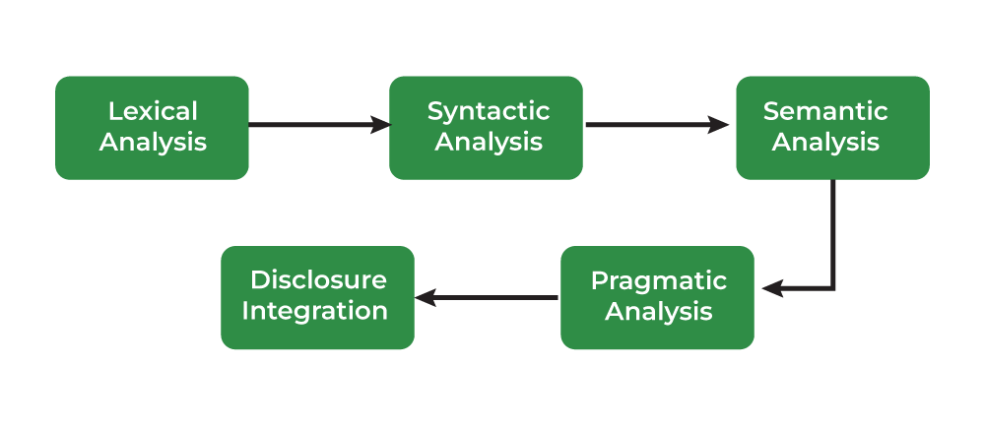
Phases of Natural Language Processing
five key stages of Natural Language Processing (NLP), often referred to as the pipeline of language understanding.
This process moves from understanding words → to sentence structure → to meaning → to context → to coherence.

Slide 15
1. 🔹 Lexical Analysis
✅ Definition:
Lexical analysis is the first step in NLP, where the text is broken into tokens (words, numbers, punctuation).
📌 Example:
Input: "Natural Language Processing is powerful."
Tokens: ['Natural', 'Language', 'Processing', 'is', 'powerful', '.']
🎯 Why use it?
Identifies individual words and symbols.
Forms the basis for further processing (parsing, tagging, etc.)
💼 Use Case:
Used in tokenization engines for search engines, chatbots, and text mining systems.
2. 🔹 Syntactic Analysis (Parsing)
✅ Definition:
Syntactic analysis, also known as parsing, checks the grammar of a sentence and builds a parse tree.
📌 Example:
Input: "The boy eats an apple."
Output:
mathematica
CopyEdit
S /| \ NP VP . | | \ DetN VNP | | | | Theboyeatsanapple
🎯 Why use it?
Understands the sentence structure.
Ensures the sentence follows grammatical rules.
💼 Use Case:
Used in grammar checkers, syntax highlighters, and voice assistants.

Slide 16
3. 🔹 Semantic Analysis
✅ Definition:
Semantic analysis focuses on deriving the meaning of the sentence or words in context.
📌 Example:
Input: "Apple is a fruit." vs. "Apple is a company."
Word "Apple" has different meanings based on context.
🎯 Why use it?
Determines word sense disambiguation.
Helps machines understand meanings behind words.
💼 Use Case:
Used in question answering systems, chatbots, and virtual assistants like Alexa or Siri.
4. 🔹 Pragmatic Analysis
✅ Definition:
Pragmatic analysis considers the context and intent behind the statement rather than just the literal meaning.
📌 Example:
Sentence: "Can you pass the salt?"
Literally: A question about ability
Actually: A request to pass the salt.
🎯 Why use it?
Helps understand implied meaning, sarcasm, requests, or commands.
💼 Use Case:
Used in chatbots, customer support systems, human-computer interaction.

Slide 17
5. 🔹 Discourse Integration
✅ Definition:
Discourse analysis looks at multiple sentences and how they relate to each other to form coherent meaning.
📌 Example:
Text:
Sentence 1: "John went to the market."
Sentence 2: "He bought apples."
→ "He" refers to "John".
🎯 Why use it?
Helps resolve pronouns, coreference, story flow.
Builds understanding of narrative or multi-sentence inputs.
💼 Use Case:
Used in document summarization, context-aware chatbots, story generation, etc.

Slide 18
🧠 Summary Table
Stage | What it Does | Example | Use Case
Lexical Analysis | Breaks text into tokens | "NLP is cool." → ['NLP', 'is', 'cool'] | Tokenization, Search
Syntactic Analysis | Checks sentence structure | Parse Tree of "The cat sleeps." | Grammar Checker, Auto-correct
Semantic Analysis | Derives literal meaning | "Apple" → Fruit vs Company | Named Entity Recognition, Chatbots
Pragmatic Analysis | Understands context and intent | "Can you open the window?" = Request | Voice Assistants, Chatbots
Discourse Integration | Connects meaning across sentences | "He = John" in connected sentences | Summarization, Multi-turn conversations

Slide 19
Libraries for Natural Language Processing
Some of natural language processing libraries include:
NLTK (Natural Language Toolkit)
spaCy
Transformers (by Hugging Face)
Gensim

Slide 20
🔄 Stages of NLP (Pipeline)
The NLP pipeline generally consists of these stages:
1. Text Preprocessing
Tokenization: Splitting text into words or sentences
Stopword Removal: Removing common words (is, the, in) that don't add value
Stemming/Lemmatization: Reducing words to their root form
Lowercasing, Punctuation Removal, etc.
2. Text Representation
Bag of Words (BoW)
TF-IDF (Term Frequency-Inverse Document Frequency)
Word Embeddings (Word2Vec, GloVe, BERT)
3. Parsing and Syntax Tree Generation
Understanding structure using parse trees or dependency trees
4. Named Entity Recognition (NER)
Identifying entities like people, places, organizations, etc.
5. Sentiment Analysis / Text Classification
Analyzing sentiment (positive/negative/neutral) or classifying texts into predefined categories
6. Machine Learning / Deep Learning Modeling
Building predictive models using algorithms like Naive Bayes, SVM, RNN, Transformers (e.g., BERT, GPT)
https://www.kaggle.com/code/ashishpatel26/beginner-to-intermediate-nlp-tutorial
https://www.analyticsvidhya.com/blog/2022/01/nlp-tutorials-part-i-from-basics-to-advance/
do it in next

Slide 21
1.4 Glossary¶
Here is some common terminology:
Corpus: (Plural: Corpora) a collection of written texts that serve as our datasets.
nltk: (Natural Language Toolkit) the python module we'll be using repeatedly; it has a lot of useful built-in NLP techniques.
Token: a string of contiguous characters between two spaces, or between a space and punctuation marks. A token can also be an integer, real, or a number with a colon.

Slide 22
Normalizing Textual Data in NLP / Text Pre-Processing
Text Normalization transforms text into a consistent format improves the quality and makes it easier to process in NLP tasks.
Key steps in text normalization includes:
1. Regular Expressions (RE) are sequences of characters that define search patterns.
How to write Regular Expressions?
Properties of Regular Expressions
RegEx in Python
Email Extraction using RE
2. Tokenization is a process of splitting text into smaller units called tokens.
How Tokenizing Text, Sentences, and Words Works
Word Tokenization
Rule-based Tokenization
Subword Tokenization
Dictionary-Based Tokenization
Whitespace Tokenization
WordPiece Tokenization
3. Lemmatization reduces words to their base or root form.
4. Stemming reduces works to their root by removing suffixes. Types of stemmers include:
Porter Stemmer
Lancaster Stemmer
Snowball Stemmer
Lovis Stemmer
Rule-based Stemming
5. Stopword removal is a process to remove common words from the document.
6. Parts of Speech (POS) Tagging assigns a part of speech to each word in sentence based on definition and context.

Slide 23
Text Representation or Text Embedding Techniques in NLP
Text representation converts textual data into numerical vectors that are processed by the following methods:
One-Hot Encoding
Bag of Words (BOW)
N-Grams
Term Frequency-Inverse Document Frequency (TF-IDF)
N-Gram Language Modeling with NLTK
Text Embedding Techniques refer to the methods and models used to create these vector representations, including traditional methods (like TFIDF and BOW) and more advanced approaches:
1. Word Embedding
Word2Vec (SkipGram, Continuous Bag of Words – CBOW)
GloVe (Global Vectors for Word Representation)
fastText
2. Pre-Trained Embedding
ELMo (Embeddings from Language Models)
BERT (Bidirectional Encoder Representations from Transformers)
3. Document Embedding – Doc2Vec

Slide 24
Deep Learning Techniques for NLP
Deep learning has revolutionized Natural Language Processing (NLP) by enabling models to automatically learn complex patterns and representations from raw text. Below are some of the key deep learning techniques used in NLP:
Artificial Neural Networks (ANNs)
Recurrent Neural Networks (RNNs)
Long Short-Term Memory (LSTM)
Gated Recurrent Unit (GRU)
Seq2Seq Models
Transformer Models
Pre-Trained Language Models
Pre-trained models understand language patterns, context and semantics. The provided models are trained on massive corpora and can be fine tuned for specific tasks.
GPT (Generative Pre-trained Transformer)
Transformers XL
T5 (Text-to-Text Transfer Transformer)
RoBERTa

Slide 25
Natural Language Processing Tasks
1. Text Classification
Dataset for Text Classification
Text Classification using Naive Bayes
Text Classification using Logistic Regression
Text Classification using RNNs
Text Classification using CNNs
2. Information Extraction
Information Extraction
Named Entity Recognition (NER) using SpaCy
Named Entity Recognition (NER) using NLTK
Relationship Extraction
3. Sentiment Analysis
What is Sentiment Analysis?
Sentiment Analysis using VADER
Sentiment Analysis using Recurrent Neural Networks (RNN)
4. Machine Translation
Statistical Machine Translation of Language
Machine Translation with Transformer
5. Text Summarization
What is Text Summarization?
Text Summarizations using Hugging Face Model
Text Summarization using Sumy
6. Text Generation
Text Generation using Fnet
Text Generation using Recurrent Long Short Term Memory Network
Text2Text Generations using HuggingFace Model

Slide 26
Language Modeling
Language Modeling is the task of assigning a probability to a sequence of words.
In simple terms:
Given a set of previous words, predict the next word in a sentence or evaluate how likely a sentence is.
🧠 Why Use Language Modeling?
Next-word prediction (e.g., mobile keyboard suggestions)
Speech recognition (determine the most probable word sequences)
Spell-checking & grammar correction
Machine translation
Chatbots
Language Modeling (Pre deep learning)
n-gram LM
types --> uni,bi,tri,
how it works
what is problem in n-gram (loosing context)

Slide 27
🔁 N-gram Language Models
📌 What is an N-gram?
An N-gram is a contiguous sequence of N items (words) from a given text.
N-gram Type | Example for N=
Unigram | "I", "love", "NLP"
Bigram | "I love", "love NLP"
Trigram | "I love NLP"
💡 How It Works:
We estimate the probability of a word based on the previous N−1 words:
For trigram (N=3):
P(w3 | w1, w2) ≈ Count(w1, w2, w3) / Count(w1, w2)
Sentence probability example (bigram model):
P(I love NLP) ≈ P(I) × P(love|I) × P(NLP|love)
⚠Problems in N-gram Models
Problem | Explanation
❌ Data Sparsity | Large number of combinations = many zero counts for rare phrases
❌ Context Loss | Only considers fixed previous N−1 words, not the whole sentence
❌ No Semantic Meaning | Doesn't understand word meaning or grammar
❌ Out of Vocabulary | Fails when a new word appears (OOV problem)
❌ Memory Usage | Huge memory needed to store all N-gram combinations

Slide 28
Simple Code Example (Bigram Model)
from nltk import word_tokenize
from nltk.util import ngrams
from collections import Counter
text = "I love natural language processing and love to learn NLP"
tokens = word_tokenize(text.lower())
# Create bigrams
bigrams = list(ngrams(tokens, 2))
bigram_freq = Counter(bigrams)
print("Bigram Frequencies:")
for pair, freq in bigram_freq.items():
print(f"{pair} : {freq}")
📌 Summary Table
Feature | N-gram LM
Based on | Word sequences
Type | Statistical
Example | Bigram, Trigram
Pros | Easy to implement
Cons | Context loss, high memory, sparsity

Slide 29
NLP
https://www.geeksforgeeks.org/ai-ml-ds-projects/?ref=lbp
https://www.geeksforgeeks.org/natural-language-processing-nlp-tutorial
PROJECT
https://www.geeksforgeeks.org/twitter-sentiment-analysis-using-python/
https://www.geeksforgeeks.org/next-sentence-prediction-using-bert/
https://www.geeksforgeeks.org/fine-tuning-bert-model-for-sentiment-analysis/
https://www.geeksforgeeks.org/sentiment-classification-using-bert/
https://www.geeksforgeeks.org/sentiment-analysis-with-an-recurrent-neural-networks-rnn/
NLP problem Solve
Clasifications (+ve,-ve issue classifier,Sentiment analysis
NER (structure our data)
Language Modeling
Q &A
Translations
summerizations
next word generations
Translations
Text Generations
text summerization
speech to text , text to speech
Language Modeling
pre deep learning
N-gram
Neural network
RNN

Slide 30
https://www.kaggle.com/code/ashishpatel26/beginner-to-intermediate-nlp-tutorial
https://www.deeplearning.ai/resources/natural-language-processing/
https://www.analyticsvidhya.com/blog/2022/01/nlp-tutorials-part-i-from-basics-to-advance/
https://huggingface.co/learn/nlp-course/en/chapter1/1
https://github.com/graykode/nlp-tutorial

Slide 31
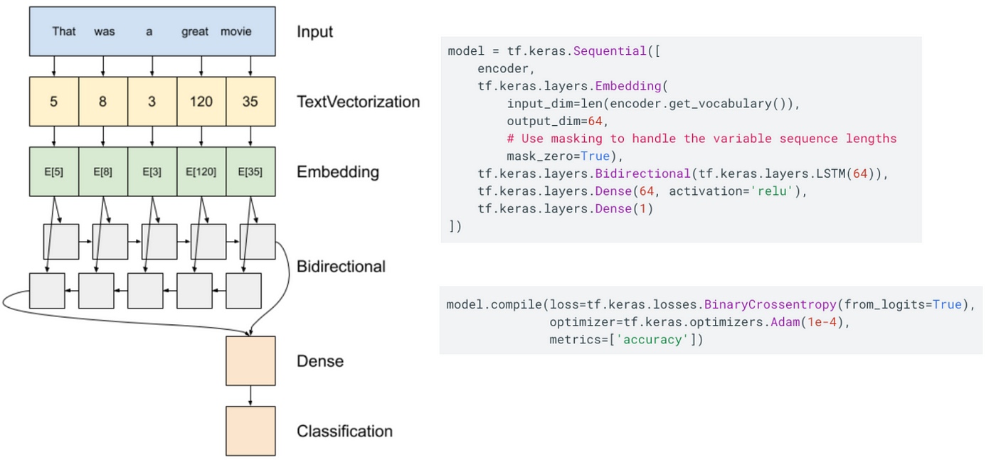

Slide 32
END

