Slide 1
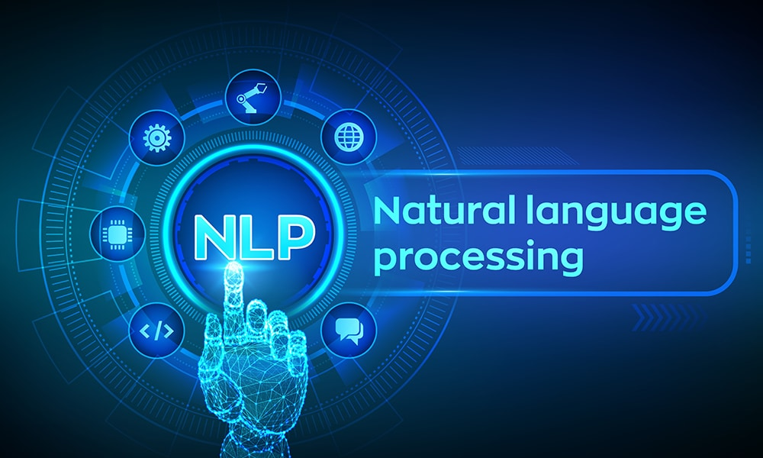

Slide 2
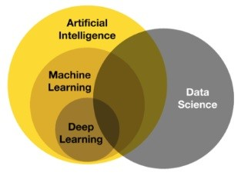
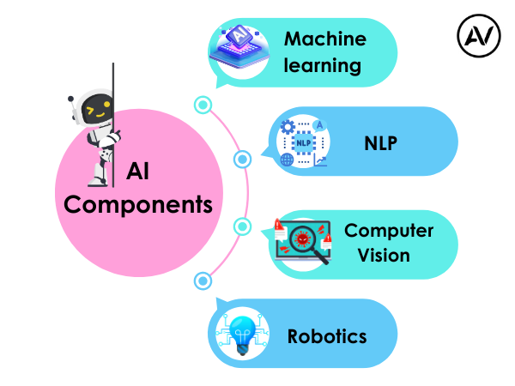
https://ellow.io/components-of-ai/

Slide 3
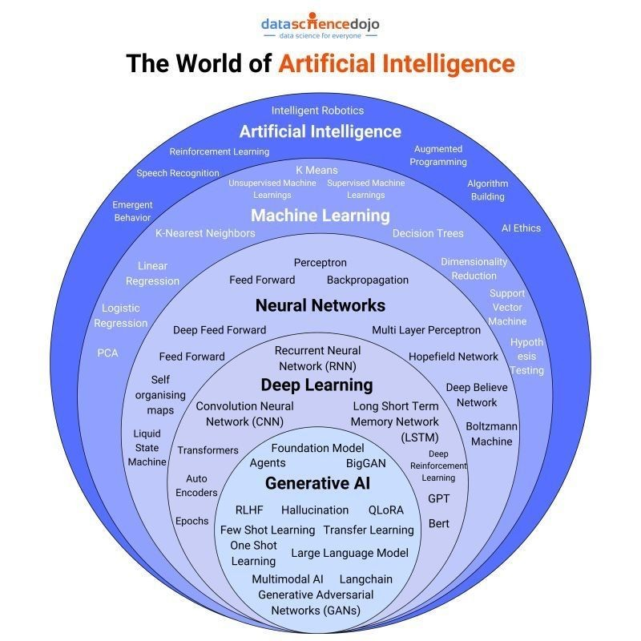
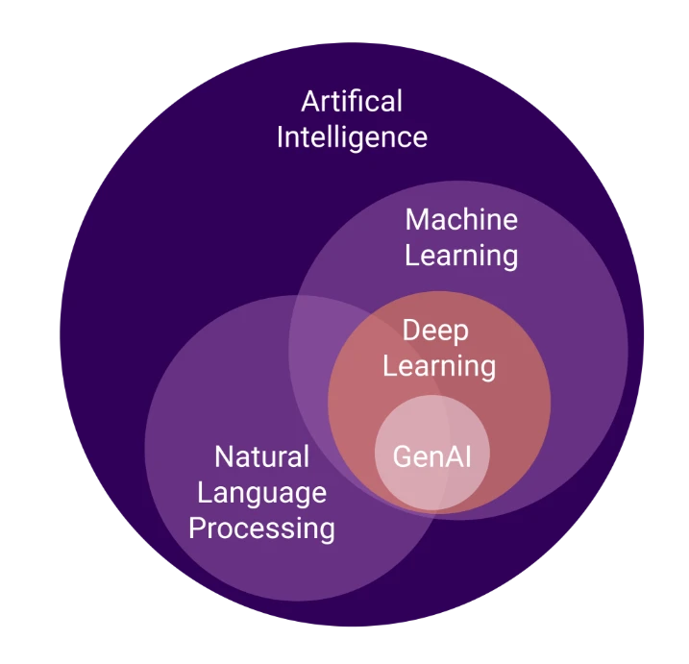
Algorithms and models

Slide 4
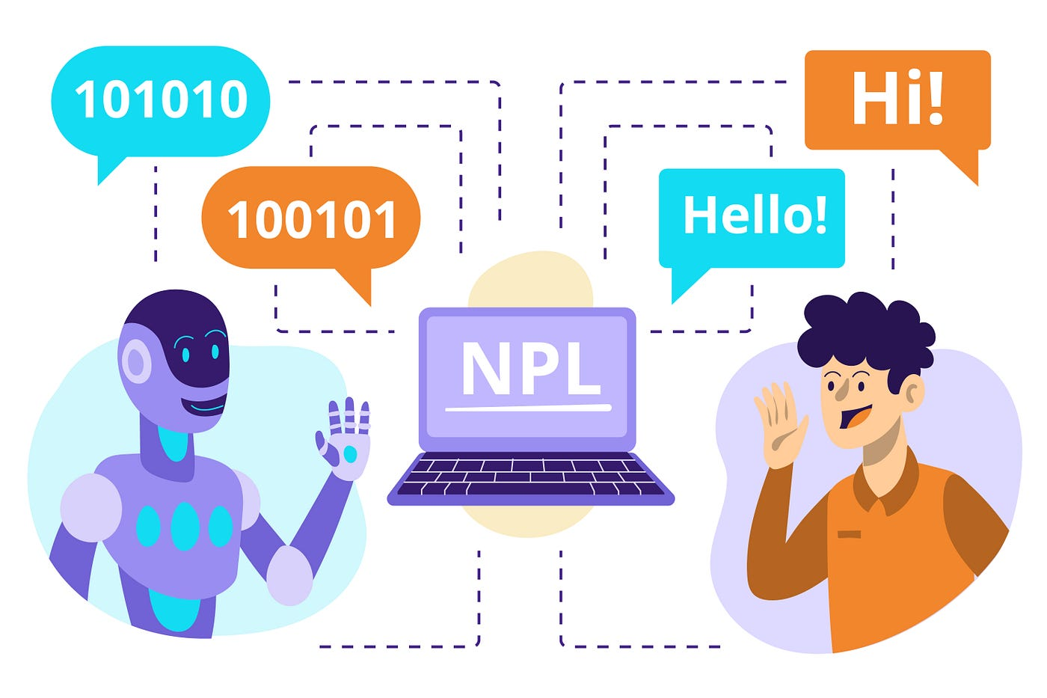

Slide 5
Before Learn NLP
Machine Learning
Deep Learning
1. Fundamentals of Neural Networks:
Introduction to Artificial Neural Networks (ANNs)
Perceptron model
Activation functions (sigmoid, ReLU, tanh)
Backpropagation algorithm
Loss Functions
Gradient descent optimization

Slide 6
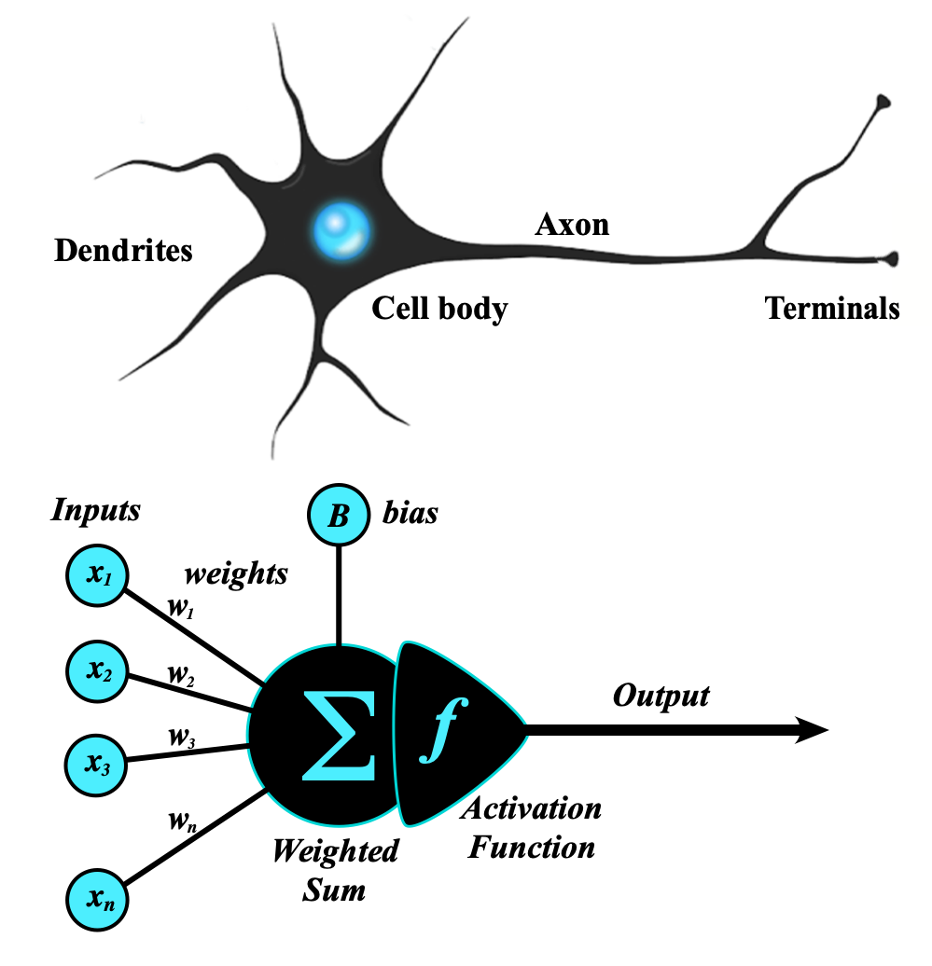
Artificial Neural Network
An artificial neural network (ANN) is a computational network (a system of nodes and the interconnection between nodes) inspired by biological neural networks, which are the complex networks of neurons in human brains (see Figure).
The nodes created in the ANN are supposedly programmed to behave like actual neurons, and hence they are artificial neurons.
The Perceptron was invented in 1957 by Frank Rosenblatt at the Cornell Aeronautics Laboratory. Based on the first concepts of artificial neurons, he proposed the “Perceptron learning rule“.
Perceptron Model
The perceptron is the simplest form of an artificial neural network and serves as the building block of more advanced models.
Components of a Perceptron:
Inputs: Feature values from the dataset.
Weights: Assigned to each input to signify importance.
Summation Function: Computes the weighted sum of inputs.
Activation Function: Applies a threshold to determine output.
https://www.geeksforgeeks.org/neural-networks-a-beginners-guide/
https://s.mriquestions.com/what-is-a-neural-network.html

Slide 7
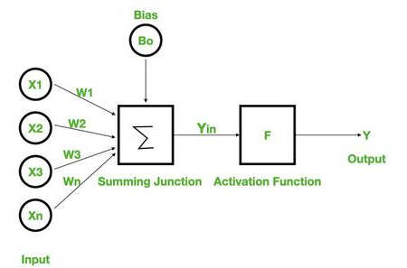
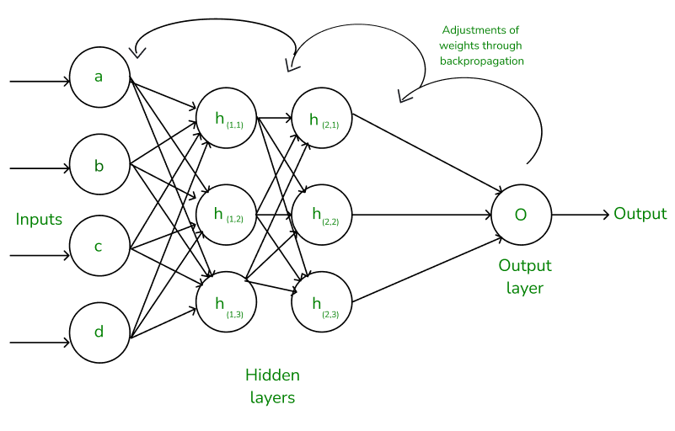
Types of Perceptron Models:
Single-layer perceptron: Can only solve linearly separable problems.
Multi-layer perceptron (MLP): Can solve non-linear problems using multiple layers.
Neural Networks Architecture:
the basic elements of the network's architecture.
made of three core layers:
Input layer
Hidden layers
Output layer

Slide 8
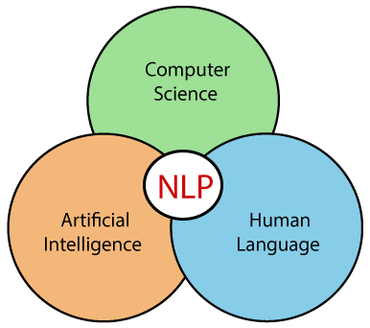
What we Learn in NLP
Word embedding
Word2vac
Rnn
LSTM
GRU
encoder decoder
attentions
self attentions
transformer
BERT & GPT
Introduction of Prompt Engineering
Genrative AI
LLM
AGENT AI
Libraries
NLTK
SPACY

Slide 9
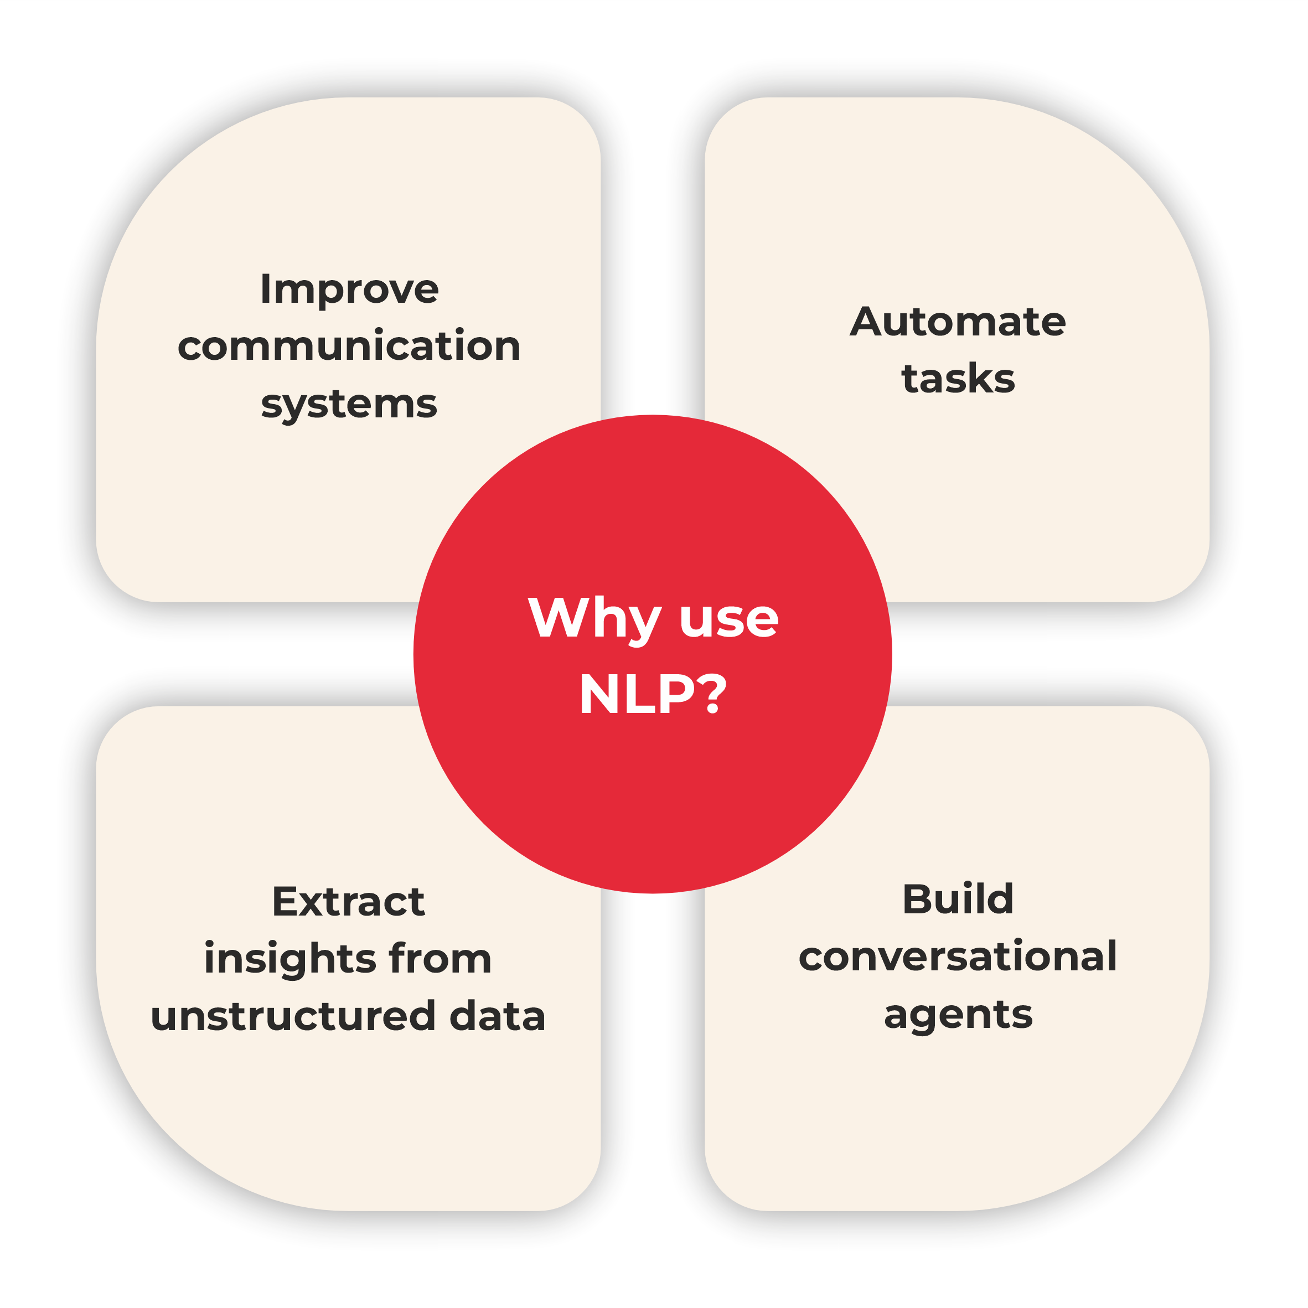

Slide 10
If we mathematically represent it contains the following terms:
NLP: NLP (Natural Language Processing) is in charge of processes such as decisions and actions.
NLU: NLU (Natural Language Understanding) understands the meaning of the text.
NLG: NLG (Natural Language Generation) creates the human language text from the structured data that the system generates to answer.
https://www.tpointtech.com/nlp --> History
https://www.xenonstack.com/blog/natural-language-processing

Slide 11
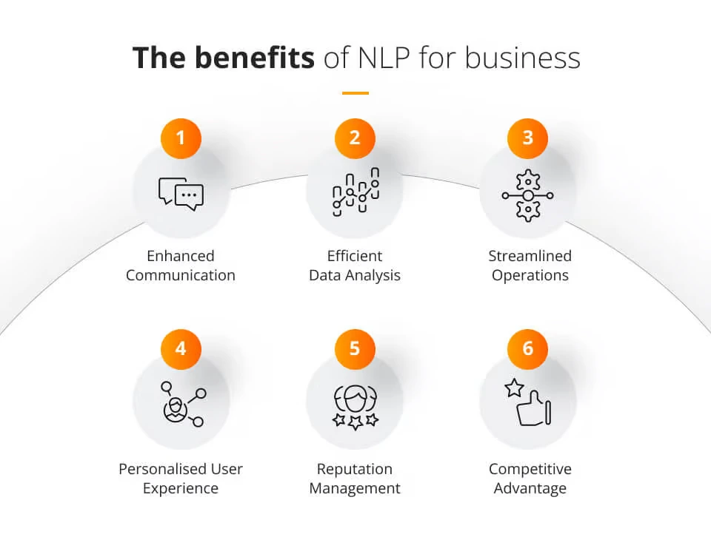
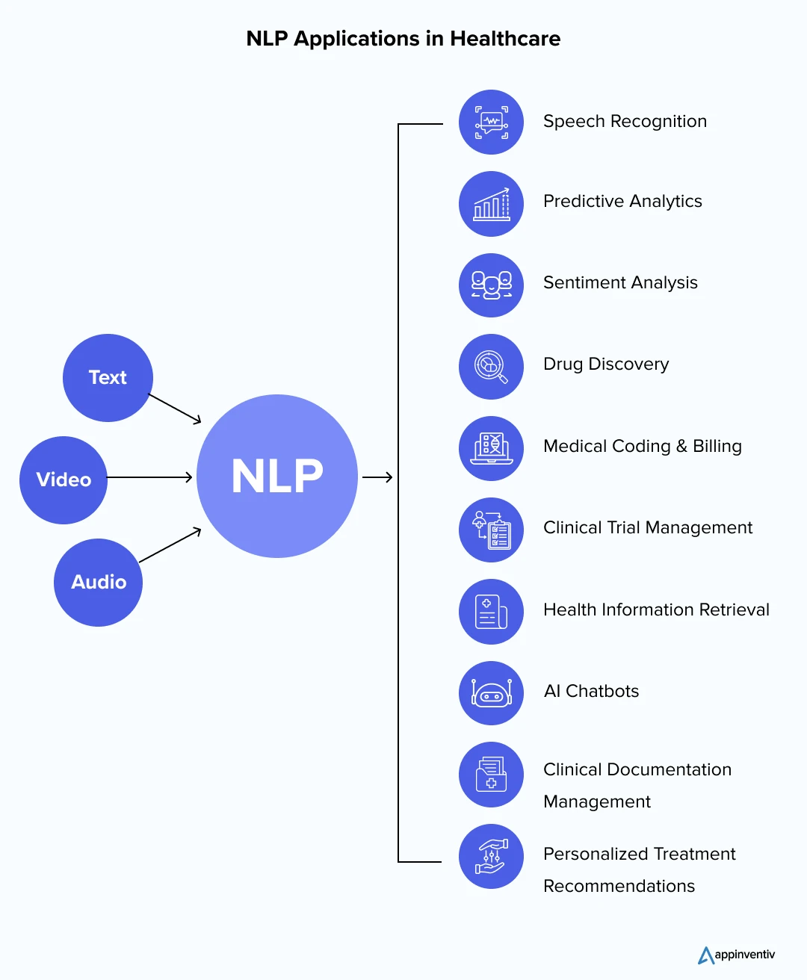
https://www.jaroeducation.com/blog/nlp-for-business-communications/
https://appinventiv.com/blog/nlp-in-healthcare/

Slide 12
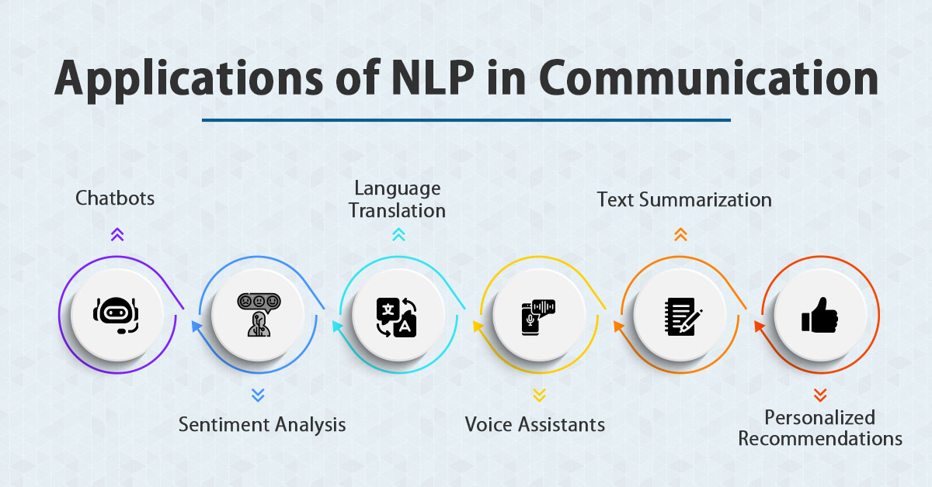
https://www.jaroeducation.com/blog/nlp-for-business-communications/

Slide 13
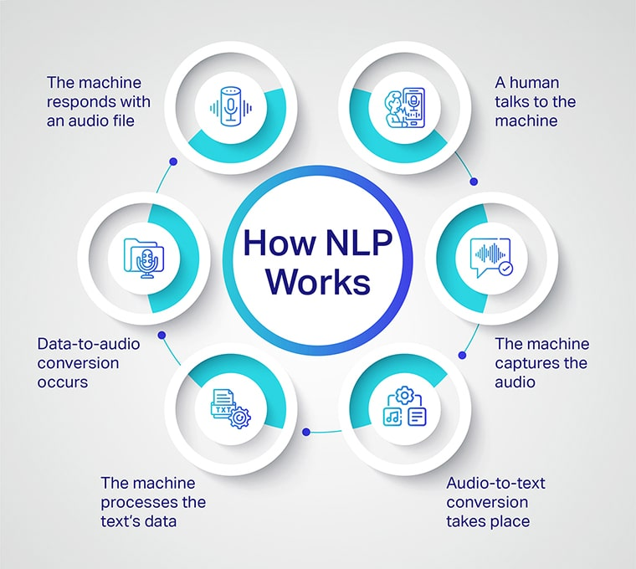

Slide 14
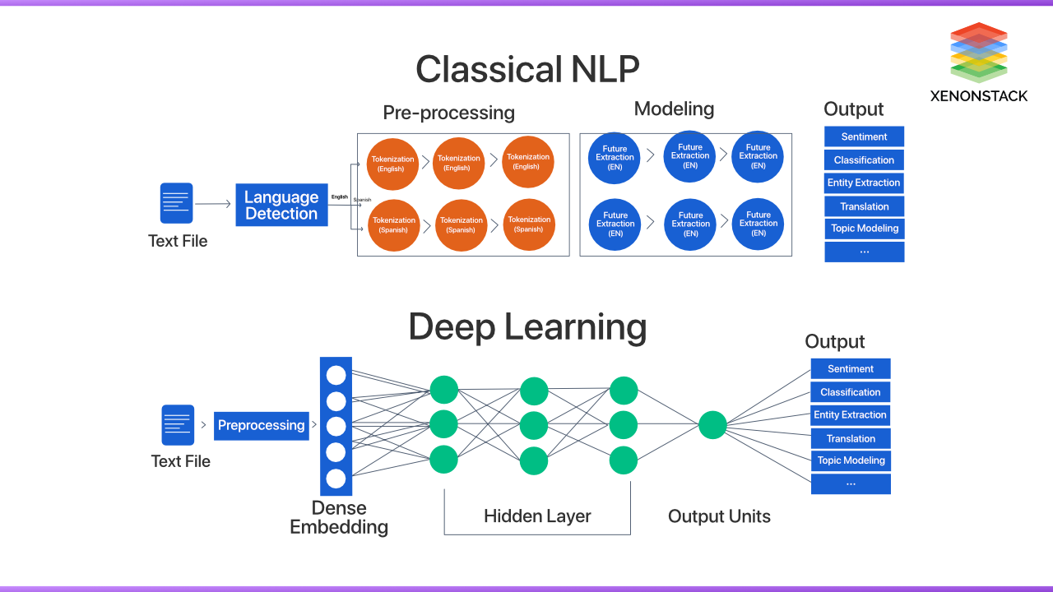

Slide 15
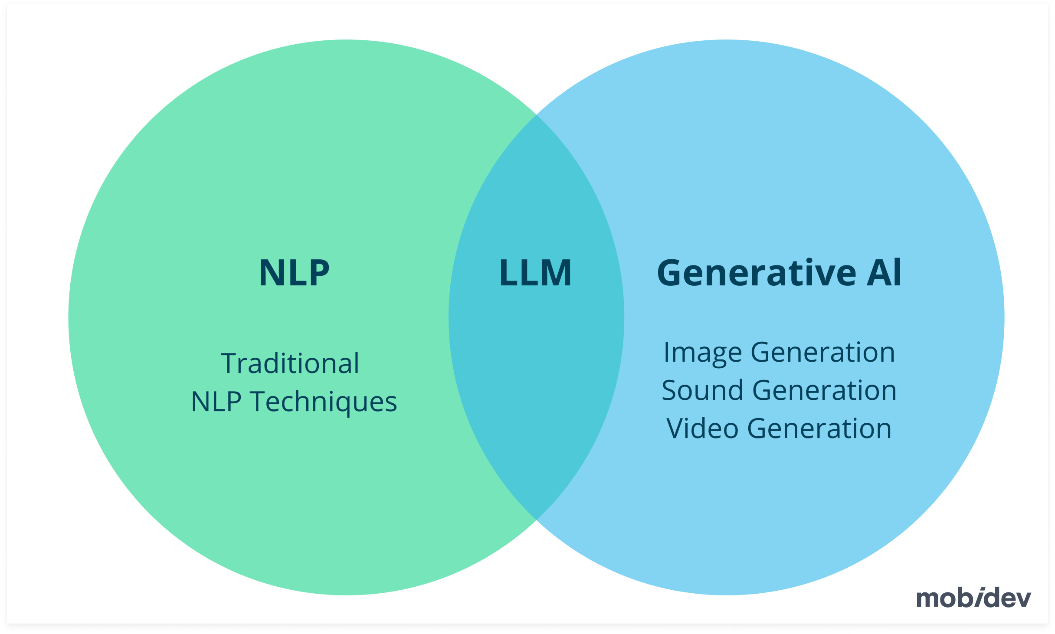
https://mobidev.biz/blog/natural-language-processing-nlp-use-cases-business

Slide 16
What are the 4 types of NLP?
NLP techniques can be broadly categorized into these four types:
Morphological Processing: Focuses on analyzing the structure of words, including prefixes and suffixes.
Syntactic Analysis: Examines sentence structure to ensure grammatical correctness.
Semantic Analysis: Studies meaning in text or speech, including context and word relationships.
Pragmatic Analysis: Looks at the intended meaning behind words, considering tone, culture, and situational context.

Slide 17
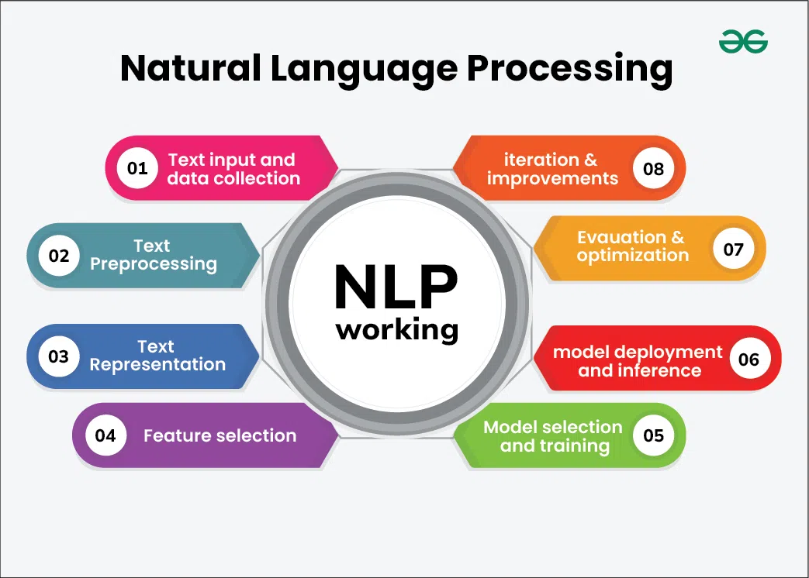

Slide 18
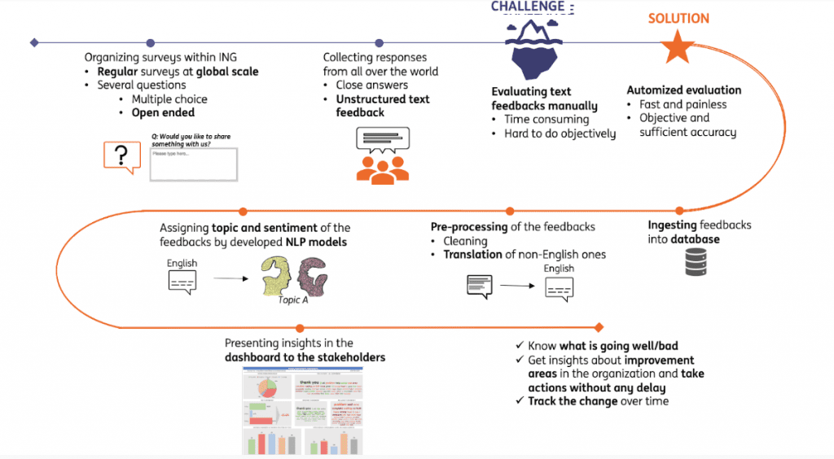
Full Life Cycle of NLP Models
https://hyperight.com/full-life-cycle-of-nlp-models/

Slide 19
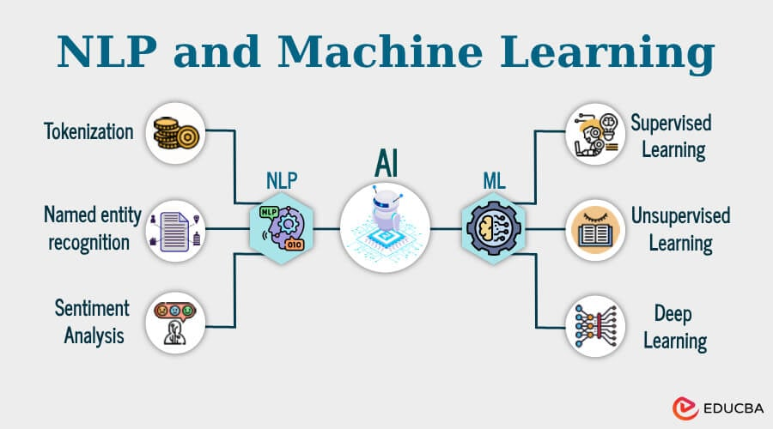

Slide 20
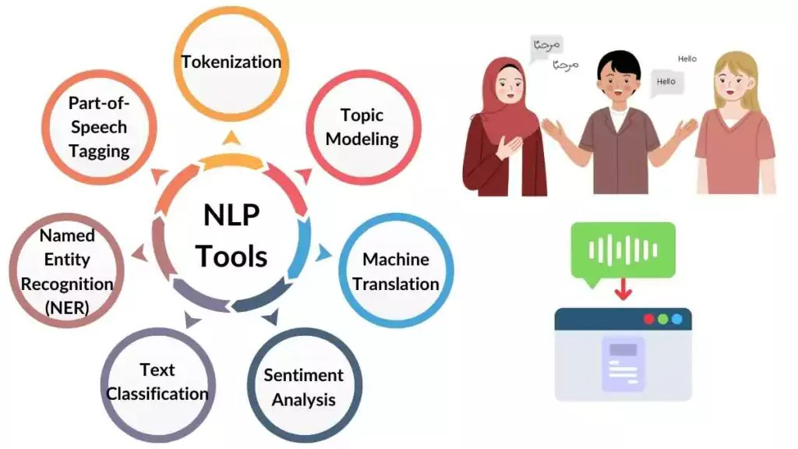
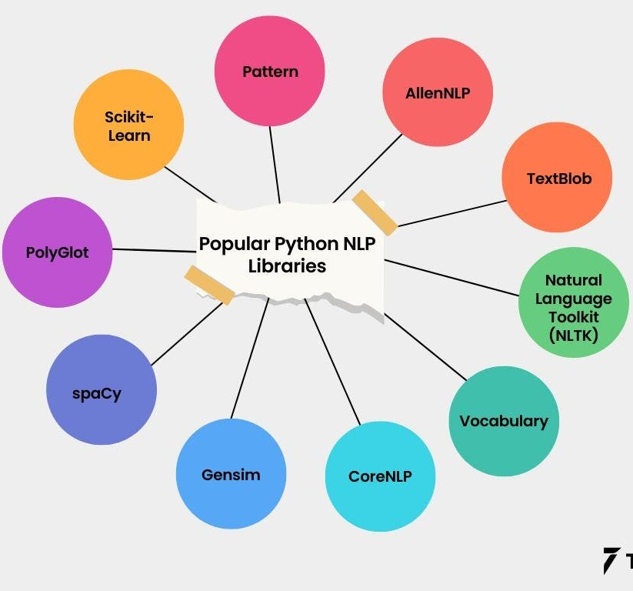
https://spotintelligence.com/2024/01/29/natural-language-processing-nlp-tools/
https://www.turing.com/kb/which-language-is-useful-for-nlp-and-why

Slide 21
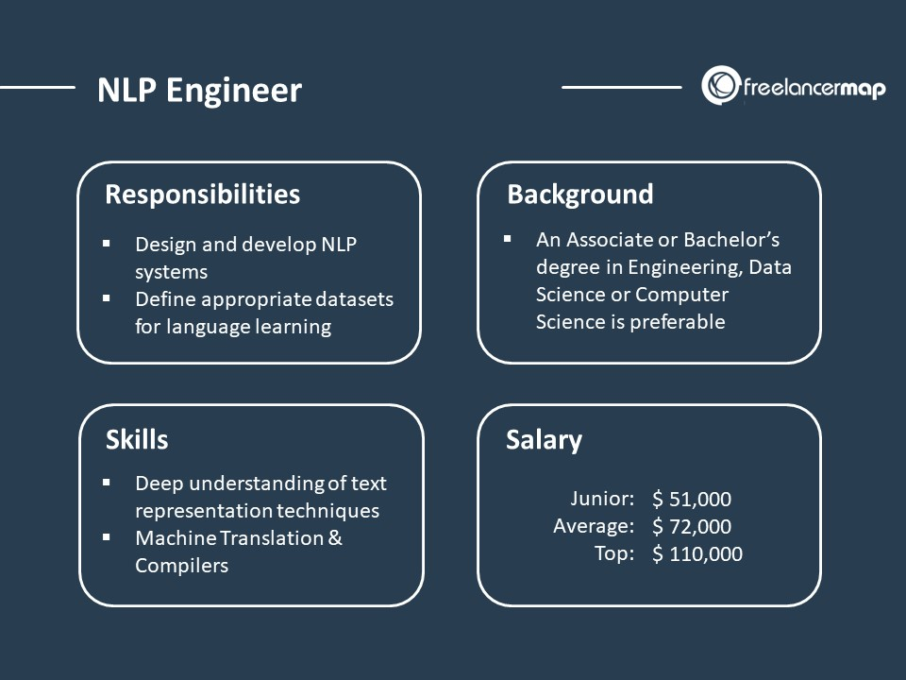
https://www.freelancermap.com/blog/what-does-nlp-engineer-do/

Slide 22
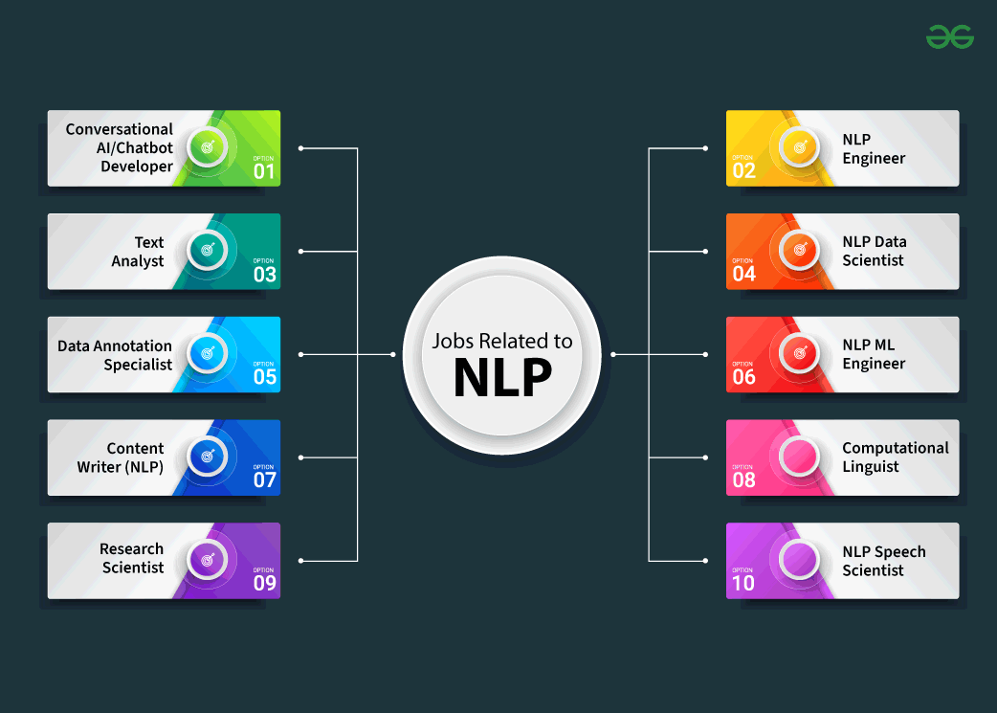
https://www.geeksforgeeks.org/natural-language-processing-nlp-job-roles/

Slide 23
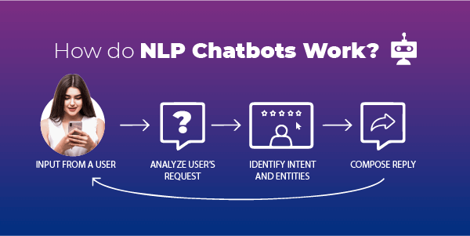
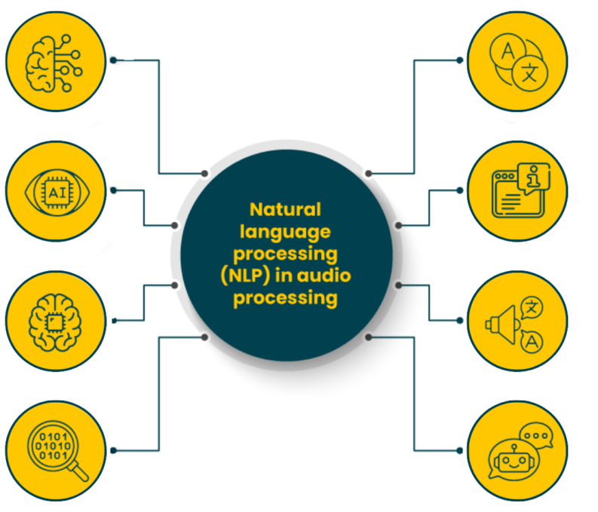
https://routemobile.com/blog/how-do-nlp-chatbots-work/
https://dac.digital/5-practical-applications-of-nlp-in-audio-processing/

Slide 24
https://analyticsindiamag.com/topics/nlp-vs-llm/

