Slide 1
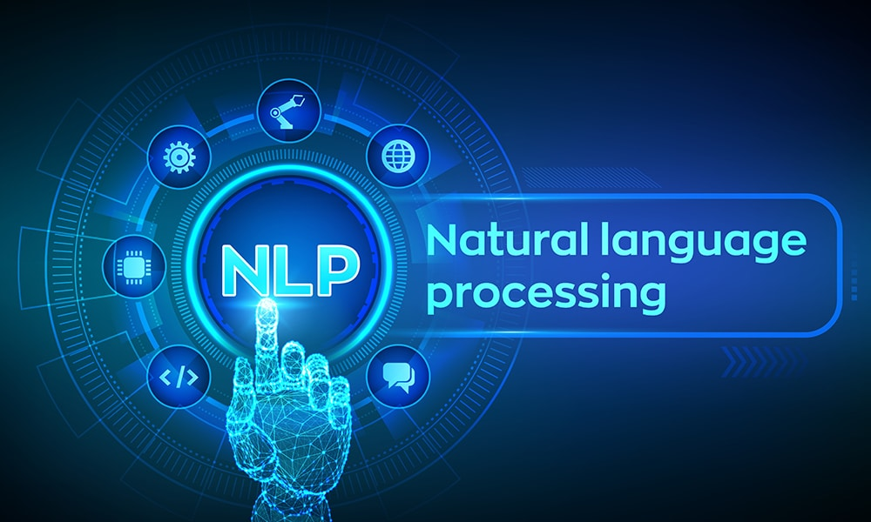

Slide 2
Introduction to NLP
What is Natural Language Processing
Uses of NLP
Application of NLP
Components of NLP
Stages of NLP
Machine Translation
Introduction to LLM
Sentiment Analysis
What is Sentiment Analysis
Challenges in Sentiment Analysis
Handling Emoticons
Sentiment Analysis with ANN
Assignment
Sequence Model
Sequential Data
Recurrent Neural Network
Multi-layer & Bi-directional RNN
Architecture of RNN
Vanishing Gradient Problem in RNN
Long Short Term Memory
Multi-layer & Bi-directional LSTM
Gated Recurrent Unit
Multi-layer & Bi-directional GRU
Assignment
Text Preprocessing
Tokenization
Non Alphabets Removal
Stopwords Removal
Bag of Words
Stemming & Lemmatization
Part of Speech Taging
Name Entity Recognition
Text Visualization
Assignment
Text Classification
CountVectorization/Text Vecorization
Text Classification with ML
TFIDF Vectorization
Text Classification with ANN
Embedding Layer in Natural Language
Assignment
Transformers Based Models
Sequence to Sequence Model
Attention Machanism
Transformers
Face Hugging Transformers

Slide 3
RASA Chatbot
What is RASA
RASA Installation
RASA Initialization
RASA Configuration and File System
Intents, Entity,Response and Story
Actions
Assignment
Weather Forecasting using ARIMA Model
Introduction to AR and MA model
Stationarity & Differencing
SariMax of Seasonal Data
Identifying order AR(p), I(d), MA(q)
Implementation of ARIMA
Assignment
Introduction to Time Series Analysis
What is Sequential Data & Time Series
Functional Relationship
Components of Time Series
Mathemetical Representation of Time Series
ETS Decompositon
Classification of Time Series
Defference between ACF & PACF
Assignment
Stock Price Prediction using Sequence Model
Introduction to Sequence Models RNN, LSTM
Preparing Time Series Data for LSTM
Forecasting using LSTM
Future Forecast
Assignment

Slide 4
Natural Language Processing (NLP) is a subfield of Artificial Intelligence (AI) and Computational Linguistics that focuses on the interaction between computers and human (natural) languages. The goal is to enable machines to read, understand, interpret, and generate human language in a valuable way.
It combines computer science, linguistics, and machine learning to bridge the gap between human communication and digital data processing.
❓What is Natural Language Processing?
NLP involves the development of algorithms and models that allow computers to process large amounts of natural language data. It includes:
Understanding the structure and meaning of text
Extracting useful information from unstructured text
Converting text to a form that machines can understand and respond to
Example:
When you say "What's the weather like today?" to Alexa or Google Assistant, NLP helps the system:
Interpret your question
Extract the intent (get weather info)
Search the weather
Respond in natural language

Slide 5
🎯 Uses of NLP
NLP is used in many areas across industries. Some common uses include:
Use Case | Description
Chatbots & Virtual Assistants | Siri, Alexa, ChatGPT
Translation Services | Google Translate
Search Engines | Query prediction, document retrieval
Email Filters | Spam detection
Sentiment Analysis | Product review analysis
Speech Recognition | Voice-to-text applications
Text Summarization | News article summarization
Text Classification | Categorizing news, emails, etc.

Slide 6
.
📱 Application of NLP
Here are some real-world applications of NLP:
1. Customer Service
Chatbots, voice assistants, and automated responses using NLP.
2. Healthcare
Extracting information from patient records, identifying symptoms or diseases from doctor's notes.
3. Finance
Sentiment analysis on stock news or social media to predict stock movements.
4. E-Commerce
Product recommendations, review summarization, and customer query analysis.
5. Legal Industry
Legal document analysis, contract review, legal research through NLP engines.

Slide 7
🧩 Components of NLP
NLP has several components that work together to process language effectively:
Component | Description
Lexical Analysis | Dividing text into tokens (words, phrases)
Syntactic Analysis | Analyzing grammar and sentence structure
Semantic Analysis | Understanding the meaning of words and sentences
Discourse Integration | Understanding how preceding sentences affect the meaning of the current one
Pragmatic Analysis | Understanding context and intent behind the sentence

Slide 8
🔄 Stages of NLP (Pipeline)
The NLP pipeline generally consists of these stages:
1. Text Preprocessing
Tokenization: Splitting text into words or sentences
Stopword Removal: Removing common words (is, the, in) that don't add value
Stemming/Lemmatization: Reducing words to their root form
Lowercasing, Punctuation Removal, etc.
2. Text Representation
Bag of Words (BoW)
TF-IDF (Term Frequency-Inverse Document Frequency)
Word Embeddings (Word2Vec, GloVe, BERT)
3. Parsing and Syntax Tree Generation
Understanding structure using parse trees or dependency trees
4. Named Entity Recognition (NER)
Identifying entities like people, places, organizations, etc.
5. Sentiment Analysis / Text Classification
Analyzing sentiment (positive/negative/neutral) or classifying texts into predefined categories
6. Machine Learning / Deep Learning Modeling
Building predictive models using algorithms like Naive Bayes, SVM, RNN, Transformers (e.g., BERT, GPT)

Slide 9
NLP
https://www.geeksforgeeks.org/ai-ml-ds-projects/?ref=lbp
https://www.geeksforgeeks.org/natural-language-processing-nlp-tutorial
PROJECT
https://www.geeksforgeeks.org/twitter-sentiment-analysis-using-python/
https://www.geeksforgeeks.org/next-sentence-prediction-using-bert/
https://www.geeksforgeeks.org/fine-tuning-bert-model-for-sentiment-analysis/
https://www.geeksforgeeks.org/sentiment-classification-using-bert/
https://www.geeksforgeeks.org/sentiment-analysis-with-an-recurrent-neural-networks-rnn/
NLP problem Solve
Clasifications (+ve,-ve issue classifier,Sentiment analysis
NER (structure our data)
Language Modeling
Q &A
Translations
summerizations
next word generations
Translations
Text Generations
text summerization
speech to text , text to speech
Language Modeling
pre deep learning
N-gram
Neural network
RNN

Slide 10
https://www.kaggle.com/code/ashishpatel26/beginner-to-intermediate-nlp-tutorial
https://www.deeplearning.ai/resources/natural-language-processing/
https://www.analyticsvidhya.com/blog/2022/01/nlp-tutorials-part-i-from-basics-to-advance/
https://huggingface.co/learn/nlp-course/en/chapter1/1
https://github.com/graykode/nlp-tutorial

Slide 11
