Slide 1

TENSOR FLOW
TensorFlow
is an open-source machine learning library developed by Google. TensorFlow is used to build and train deep learning models as it facilitates the creation of computational graphs and efficient execution on various hardware platforms.

Slide 2
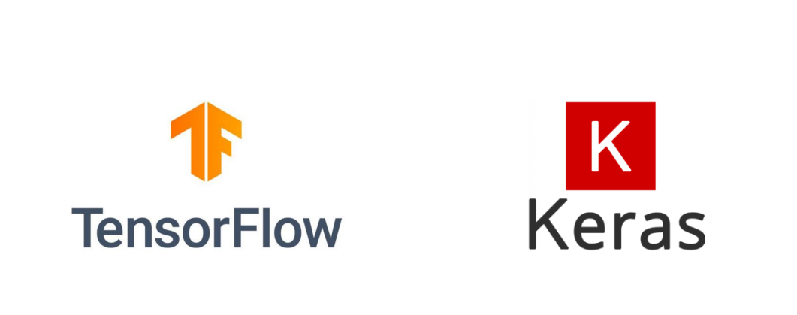
Introduction to TensorFlow and Keras
TensorFlow and Keras are two of the most widely used deep learning frameworks.
TensorFlow:
Developed by Google Brain.
Provides low-level and high-level APIs for building deep learning models.
Supports large-scale machine learning and deployment.
Keras:
High-level API built on TensorFlow.
Simplifies model building and experimentation.
Allows quick prototyping with minimal code.
TensorFlow 1.x/2.x
An open source Deep Learning library
● >1,800 contributors worldwide
● Apache 2.0 license
● Released by Google in 2015
TensorFlow 2.0
Easier to learn and use
For beginners and experts
Available today
​

Slide 3
Why Use TensorFlow?
One of TensorFlow’s best qualities is that it makes code development easy. The readily available APIs save users from rewriting some of the code that would otherwise have been time-consuming. TensorFlow speeds up the process of training a model. Additionally, the chances of errors in the program are also reduced, typically by 55 to 85 percent.
https://www.simplilearn.com/tutorials/deep-learning-tutorial/tensorflow

Slide 4
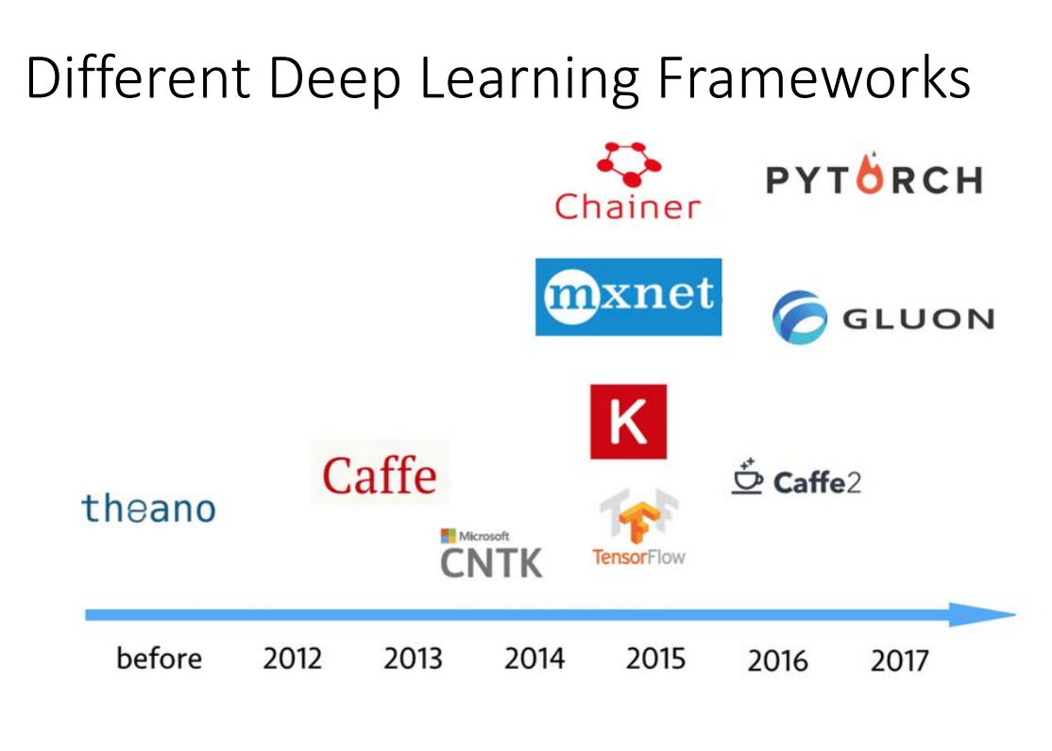

Slide 5
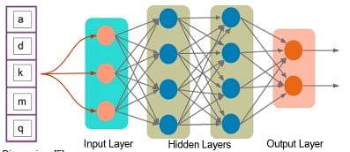
What Is a Tensor?
A tensor is a mathematical object represented as arrays of higher dimensions. These arrays of data with different sizes and ranks get fed as input to the neural network. These are the tensors.
You can have arrays or vectors, which are one-dimensional, or matrices, which are two-dimensional. But tensors can be more than three, four or five-dimensional. Therefore, it helps in keeping the data very tight in one place and then performing all the analysis around that.

Slide 6
INSTALL LIBRARY
pip install tensorflow
1. basic beginners
https://docs.google.com/presentation/d/1x5hCQOkgXsTvWOVwU6Kf3tn1RxPY14kObxz9pR7q1GQ/htmlpresent
https://www.tensorflow.org/tutorials
https://www.iitg.ac.in/cseweb/osint/iNN-week-3.php

Slide 7
What is new in TF2.o
Easy model building with Keras and eager execution (activated by default in TF2.0).
Robust model deployment in production on any platform.
Powerful experimentation for research.
Simplifying the API by cleaning up deprecated APIs and reducing duplication (relevant in case you have code developed in TensorFlow 1.X and you need to convert it)
Load your data using tf.data. Training data is read using input pipelines which are created using tf.data.
Build, train and validate your model with tf.keras, or use Premade Estimators.
TensorFlow Hub.
Run and debug with eager execution, then use tf.function for the benefits of graphs.
Use Distribution Strategies for distributed training.
hardware accelerators like CPUs, GPUs, and TPUs; you can enable training workloads to be distributed to single-node/multi-accelerator as well as multi-node/multi-accelerator configurations, including TPU Pods.
Export to SavedModel. TensorFlow will standardize on SavedModel as an interchange format for TensorFlow Serving, TensorFlow Lite, TensorFlow.js, TensorFlow Hub, and more.
Tensorflow Datasets
​

Slide 8
Check the installed version
import tensorflow as tf
print(tf.__version__)
When you change TF version you need to restart the runtime in Google Colab
Types of Tensors?
0d ,1d ,2d,3d,

Slide 9
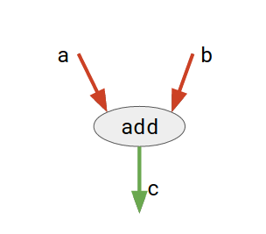
TensorFlow
TensorFlow is basically a software library for numerical computation using data flow graphs where:
nodes in the graph represent mathematical operations.
edges in the graph represent the multidimensional data arrays (called tensors) communicated between them. (Please note that tensor is the central unit of data in TensorFlow).
Consider the diagram given below:
Here, add is a node which represents addition operation. a and b are input tensors and c is the resultant tensor. This flexible architecture allows you to deploy computation to one or more CPUs or GPUs in a desktop, server, or mobile device with a single API!

Slide 10
# importing tensorflow
import tensorflow as tf
# creating nodes in computation graph
node1 = tf.constant(3, dtype=tf.int32)
node2 = tf.constant(5, dtype=tf.int32)
node3 = tf.add(node1, node2)
# create tensorflow session object
sess = tf.compat.v1.Session()
# evaluating node3 and printing the result
print("sum of node1 and node2 is :",sess.run(node3))
# closing the session
sess.close()

