Slide 1
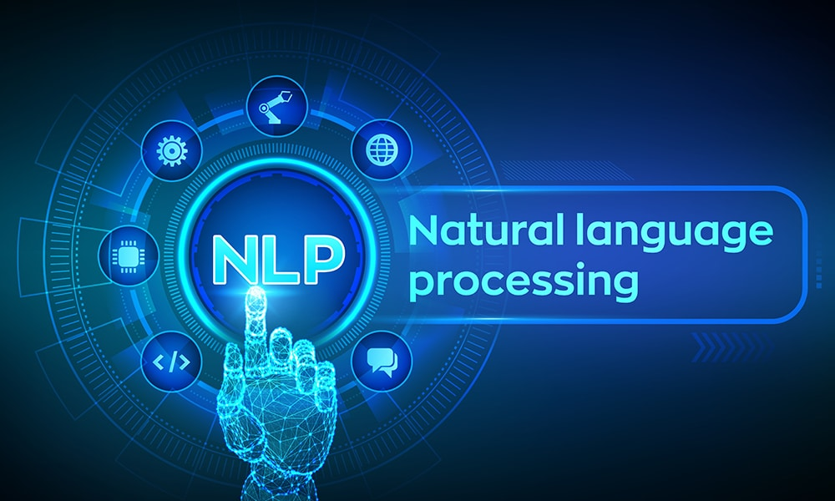

Slide 2
Text Preprocessing
Tokenization
Non Alphabets Removal
Stopwords Removal
Bag of Words
Stemming & Lemmatization
Part of Speech Taging
Name Entity Recognition
Text Visualization
Assignment

Slide 3
Text preprocessing is the process of cleaning and preparing raw text data before feeding it into NLP models.
It helps models understand text more efficiently and accurately.
Steps
clean text->lower,uper,remove special char
Tokenizations --> word,sentence, stopswords removel,lemmitations, stemming
convert words/text representations
BOW,

Slide 4
🔄 Stages of NLP (Pipeline)
The NLP pipeline generally consists of these stages:
1. Text Preprocessing
Tokenization: Splitting text into words or sentences
Stopword Removal: Removing common words (is, the, in) that don't add value
Stemming/Lemmatization: Reducing words to their root form
Lowercasing, Punctuation Removal, etc.
2. Text Representation
Bag of Words (BoW)
TF-IDF (Term Frequency-Inverse Document Frequency)
Word Embeddings (Word2Vec, GloVe, BERT)
3. Parsing and Syntax Tree Generation
Understanding structure using parse trees or dependency trees
4. Named Entity Recognition (NER)
Identifying entities like people, places, organizations, etc.
5. Sentiment Analysis / Text Classification
Analyzing sentiment (positive/negative/neutral) or classifying texts into predefined categories
6. Machine Learning / Deep Learning Modeling
Building predictive models using algorithms like Naive Bayes, SVM, RNN, Transformers (e.g., BERT, GPT)

Slide 5
text = """Natural Language Processing is an exciting field of AI.
It helps machines understand and interact with human language.
We use it in applications like Siri, Google Translate, and chatbots.
NLP models are trained using large amounts of text data.
It is used in almost every industry today."""
print("Original Paragraph:\n", text)
# Install necessary packages
!pip install nltk spacy textblob scikit-learn --quiet
!python -m textblob.download_corpora
!python -m spacy download en_core_web_sm
Step 1: Basic NLP Setup
import nltk
from nltk.corpus import stopwords
from nltk.tokenize import word_tokenize, sent_tokenize
from nltk.stem import PorterStemmer, WordNetLemmatizer
from textblob import TextBlob
import spacy
import pandas as pd
import numpy as np
nltk.download('punkt')
nltk.download('stopwords')
nltk.download('wordnet')
nlp = spacy.load("en_core_web_sm")
Step 3: Tokenization
# Sentence Tokenization sentences = sent_tokenize(text) print("Sentence Tokenization:\n", sentences) # Word Tokenization words = word_tokenize(text) print("\nWord Tokenization:\n", words)
Step 4: Stopword Removal
stop_words = set(stopwords.words("english")) filtered_words = [word for word in words if word.lower() notin stop_words and word.isalpha()] print("After Stopword Removal:\n", filtered_words)
https://www.analyticsvidhya.com/blog/2022/01/nlp-tutorials-part-i-from-basics-to-advance/

Slide 6
🌱 Step 5: Stemming and Lemmatization
stemmer = PorterStemmer() lemmatizer = WordNetLemmatizer()
stemmed = [stemmer.stem(word) for word in filtered_words] lemmatized = [lemmatizer.lemmatize(word) for word in filtered_words] print("Stemmed Words:\n", stemmed) print("Lemmatized Words:\n", lemmatized)

Slide 7
🧺 Step 6: Bag of Words Representation
from sklearn.feature_extraction.text import CountVectorizer corpus = [text] vectorizer = CountVectorizer() X = vectorizer.fit_transform(corpus) df_bow = pd.DataFrame(X.toarray(), columns=vectorizer.get_feature_names_out()) print("Bag of Words:\n") print(df_bow)

Slide 8
😊 Step 7: Sentiment Analysis
blob = TextBlob(text) print("Sentiment Polarity:", blob.sentiment.polarity) print("Sentiment Subjectivity:", blob.sentiment.subjectivity) if blob.sentiment.polarity > 0: print("Overall Sentiment: Positive") elif blob.sentiment.polarity < 0: print("Overall Sentiment: Negative") else: print("Overall Sentiment: Neutral")

Slide 9
⭐ Bonus: Named Entity Recognition using spaCy
doc = nlp(text) print("Named Entities:") for ent in doc.ents: print(ent.text, "|", ent.label_)

Slide 10
Vectorization Techniques in NLP
Vectorization in NLP is the process of converting text data into numerical vectors that can be processed by machine learning algorithms.
OHE
https://neptune.ai/blog/vectorization-techniques-in-nlp-guide
https://www.geeksforgeeks.org/vectorization-techniques-in-nlp/

Slide 11
Text Classification
CountVectorization/Text Vecorization
Text Classification with ML
TFIDF Vectorization
Text Classification with ANN
Embedding Layer in Natural Language
Assignment

Slide 12
What is Vectorization?
Vectorization is the process of converting text data into numerical vectors. In the context of Natural Language Processing (NLP), vectorization transforms words, phrases, or entire documents into a format that can be understood and processed by machine learning models. These numerical representations capture the semantic meaning and contextual relationships of the text, allowing algorithms to perform tasks such as classification, clustering, and prediction.
Why is Vectorization Important in NLP?
Vectorization is crucial in NLP for several reasons:
Machine Learning Compatibility: Machine learning models require numerical input to perform calculations. Vectorization converts text into a format that these models can process, enabling the application of statistical and machine learning techniques to textual data.
Capturing Semantic Meaning: Effective vectorization methods, like word embeddings, capture the semantic relationships between words. This allows models to understand context and perform better on tasks like sentiment analysis, translation, and summarization.
Dimensionality Reduction: Techniques like TF-IDF and word embeddings reduce the dimensionality of the data compared to one-hot encoding. This not only makes computation more efficient but also helps in capturing the most relevant features of the text.
Handling Large Vocabulary: Vectorization helps manage large vocabularies by creating fixed-size vectors for words or documents. This is essential for handling the vast amount of text data available in applications like search engines and social media analysis.
Improving Model Performance: Advanced vectorization techniques, such as contextualized embeddings, significantly enhance model performance by providing rich, context-aware representations of words. This leads to better generalization and accuracy in NLP tasks.
Facilitating Transfer Learning: Pre-trained models like BERT and GPT use vectorization to create embeddings that can be fine-tuned for various NLP tasks. This transfer learning approach saves time and resources by leveraging existing knowledge.

Slide 13
Traditional Vectorization Techniques in NLP
Here, we explore three traditional vectorization techniques:
Bag of Words (BoW)
Term Frequency-Inverse Document Frequency (TF-IDF)
Count Vectorizer.
from sklearn.feature_extraction.text import CountVectorizer
# Sample documents
documents = [
"The cat sat on the mat.",
"The dog sat on the log.",
"Cats and dogs are pets."
]
# Initialize CountVectorizer
vectorizer = CountVectorizer()
X = vectorizer.fit_transform(documents)
# Convert to array and print
print(X.toarray())
print(vectorizer.get_feature_names_out())
1. Bag of Words (BoW)
The Bag of Words model represents text by converting it into a collection of words (or tokens) and their frequencies, disregarding grammar, word order, and context. Each document is represented as a vector of word counts, with each element in the vector corresponding to the frequency of a specific word in the document.
Output:
[[0 0 1 0 0 0 0 1 1 0 1 2]
[0 0 0 0 1 0 1 0 1 0 1 2]
[1 1 0 1 0 1 0 0 0 1 0 0]]
['and' 'are' 'cat' 'cats' 'dog' 'dogs' 'log' 'mat' 'on' 'pets' 'sat' 'the']

Slide 14
Advantages of Bag of Words (BoW)
Simple and easy to implement.
Provides a clear and interpretable representation of text.
Disadvantages of Bag of Words (BoW)
Ignores the order and context of words.
Results in high-dimensional and sparse matrices.
Fails to capture semantic meaning and relationships between words.

Slide 15
2. Term Frequency-Inverse Document Frequency (TF-IDF)
TF-IDF is an extension of BoW that weighs the frequency of words by their importance across documents.
Term Frequency (TF): Measures the frequency of a word in a document.
TF(t,d)= Total number of terms in document d/
Number of times term t appears in document d
​
Inverse Document Frequency (IDF): Measures the importance of a word across the entire corpus.
IDF(t)=log( Total number of documents
/Number of documents containing term t )
https://mallahyari.github.io/ml_tutorial/tfidf/

Slide 16
The TF-IDF score is the product of TF and IDF.
Output:
[[0. 0. 0.42755362 0. 0. 0.
0. 0.42755362 0.32516555 0. 0.32516555 0.6503311 ]
[0. 0. 0. 0. 0.42755362 0.
0.42755362 0. 0.32516555 0. 0.32516555 0.6503311 ]
[0.4472136 0.4472136 0. 0.4472136 0. 0.4472136
0. 0. 0. 0.4472136 0. 0. ]]
['and' 'are' 'cat' 'cats' 'dog' 'dogs' 'log' 'mat' 'on' 'pets' 'sat' 'the']
from sklearn.feature_extraction.text import TfidfVectorizer
# Sample documents
documents = [
"The cat sat on the mat.",
"The dog sat on the log.",
"Cats and dogs are pets."
]
# Initialize TfidfVectorizer
tfidf_vectorizer = TfidfVectorizer()
X_tfidf = tfidf_vectorizer.fit_transform(documents)
# Convert to array and print
print(X_tfidf.toarray())
print(tfidf_vectorizer.get_feature_names_out())
Advantages of TF-IDF
Reduces the impact of common words that appear frequently across documents.
Helps in highlighting more informative and discriminative words.
Disadvantages of TF-IDF
Still results in sparse matrices.
Does not capture word order or context.
Computationally more expensive than BoW.

Slide 17
3. Count Vectorizer
The Count Vectorizer is similar to BoW but focuses on counting the occurrences of each word in the document. It converts a collection of text documents to a matrix of token counts, where each element represents the count of a word in a specific document.
from sklearn.feature_extraction.text import CountVectorizer
# Sample documents
documents = [
"The cat sat on the mat.",
"The dog sat on the log.",
"Cats and dogs are pets."
]
# Initialize CountVectorizer
count_vectorizer = CountVectorizer()
X_count = count_vectorizer.fit_transform(documents)
# Convert to array and print
print(X_count.toarray())
print(count_vectorizer.get_feature_names_out())
Output:
[[0 0 1 0 0 0 0 1 1 0 1 2]
[0 0 0 0 1 0 1 0 1 0 1 2]
[1 1 0 1 0 1 0 0 0 1 0 0]]
['and' 'are' 'cat' 'cats' 'dog' 'dogs' 'log' 'mat' 'on' 'pets' 'sat' 'the']

Slide 18
2. Neural Approach
Advanced Vectorization Techniques in Natural Language Processing (NLP)
Advanced vectorization techniques provide more sophisticated methods for representing text data as numerical vectors, capturing semantic relationships and contextual meaning. Here, we explore word embeddings and document embeddings.
https://dash.gallery/dash-word-arithmetic/
Language modelling
https://medium.com/plotly/understanding-word-embedding-arithmetic-why-theres-no-single-answer-to-king-man-woman-cd2760e2cb7f

Slide 19
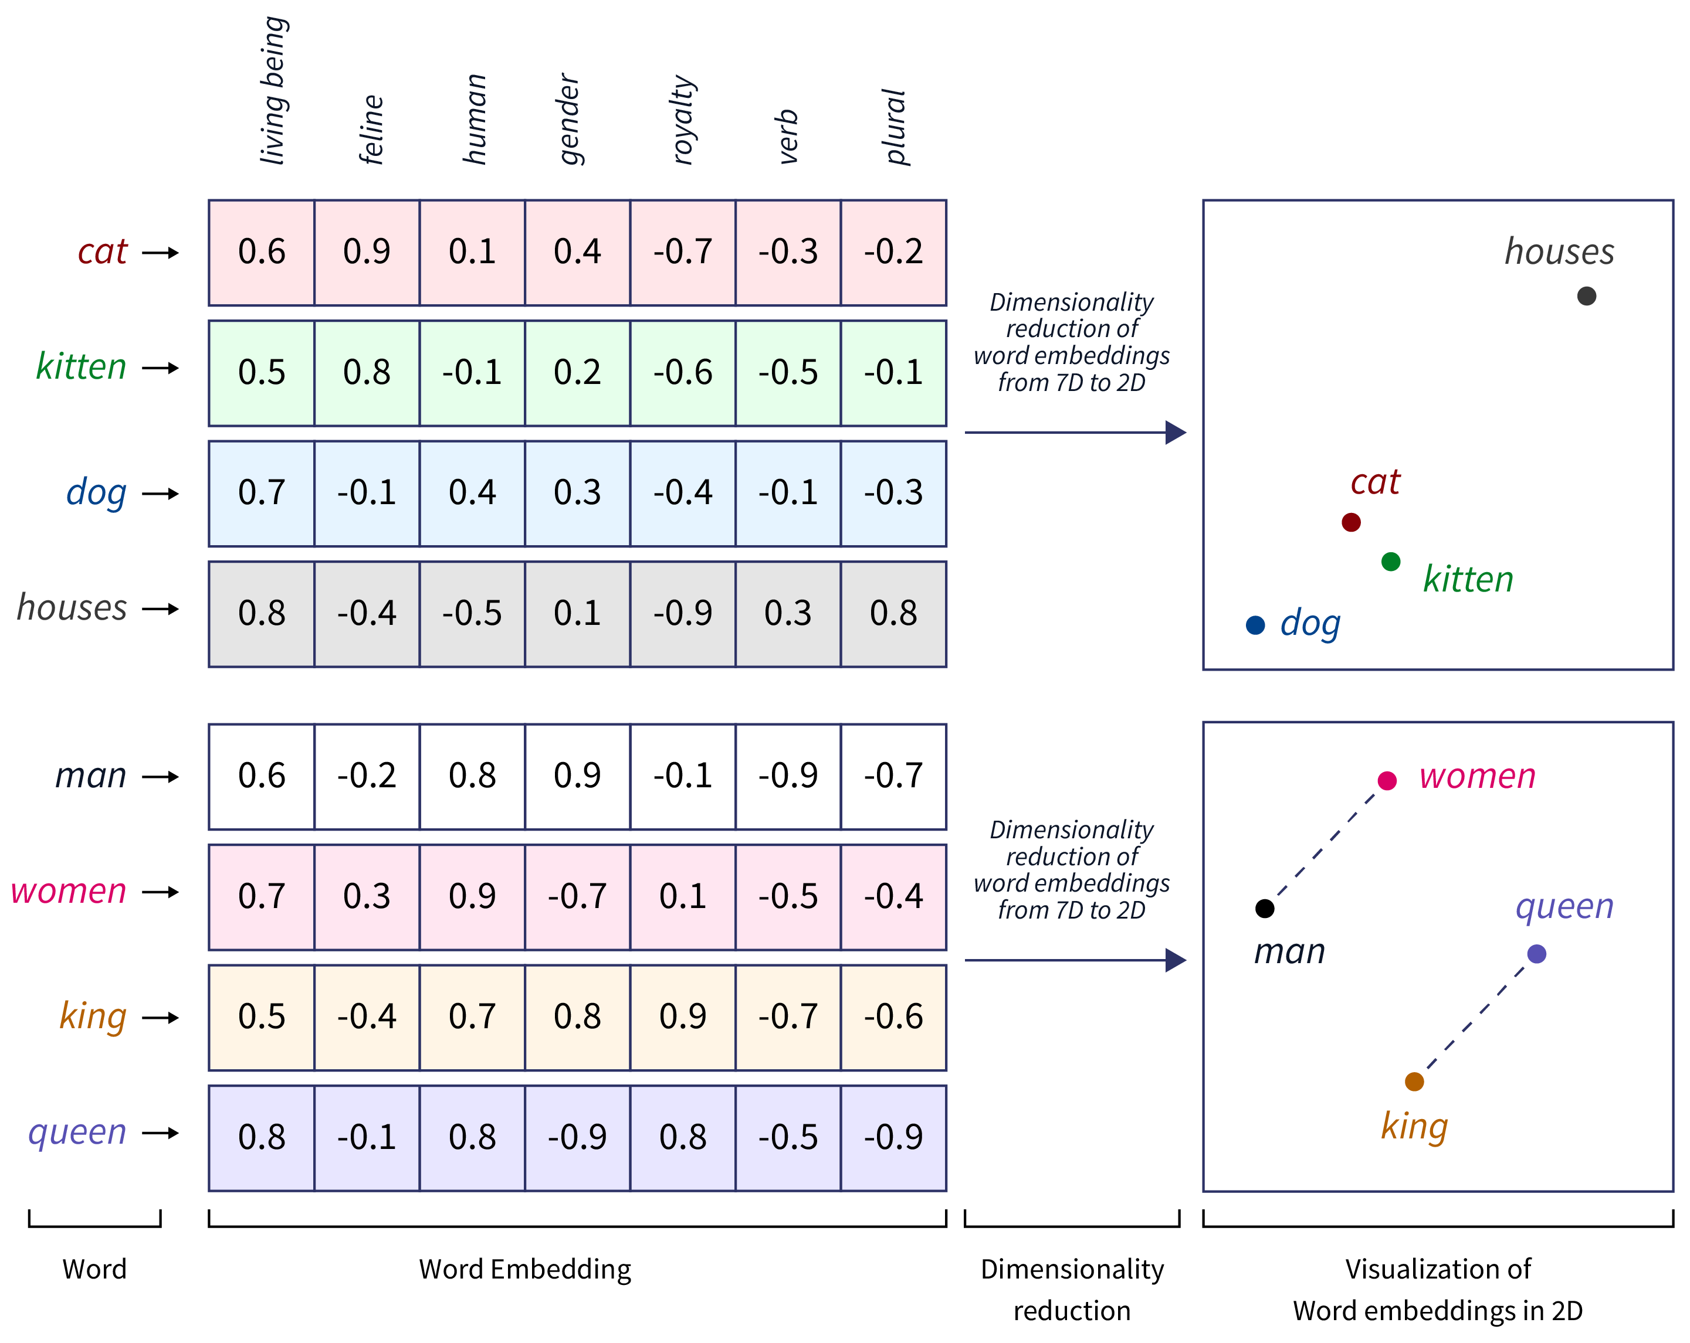
1. Word Embeddings
is a neural approach for generating word embeddings.
Word embeddings are dense vector representations of words in a continuous vector space, where semantically similar words are located closer to each other.
These embeddings capture the context of a word, its syntactic role, and semantic relationships with other words, leading to better performance in various NLP tasks.
Advantages:
Captures semantic meaning and relationships between words.
Dense representations are computationally efficient.
Handles out-of-vocabulary words (especially with FastText).
Disadvantages:
Requires large corpora for training high-quality embeddings.
May not capture complex linguistic nuances in all contexts.
https://www.scaler.com/topics/tensorflow/tensorflow-word-embeddings/
https://helboukkouri.github.io/embedding-visualization/
https://www.ruder.io/word-embeddings-1/

Slide 20
Types of Word Embeddings
1. Word2Vec:
Developed by Google, Word2Vec models use neural networks to generate word embeddings.
https://jalammar.github.io/illustrated-word2vec/
Skip-gram Model: Predicts the context words given a target word. It focuses on capturing the context within a specific window size around the target word.
Continuous Bag of Words (CBOW) Model: Predicts a target word based on the context words within a window size. It tends to be faster and more efficient than the Skip-gram model.
2. GloVe (Global Vectors for Word Representation):
Developed by Stanford, GloVe combines the advantages of global matrix factorization and local context window methods. It generates word vectors by factoring in the co-occurrence matrix of words in a corpus, capturing global statistical information.
3. FastText:
Developed by Facebook, FastText extends Word2Vec by representing words as bags of character n-grams. This helps in handling out-of-vocabulary words and capturing subword information.
https://projector.tensorflow.org/
https://www.kaggle.com/code/auxeno/word-embedding-visualisations-nlp
https://home.ttic.edu/~kgimpel/wordembviz/wordembviz.html

Slide 21
https://github.com/dfgrisales5078/Text-Classification-Project/tree/main/CovidDataSet
https://github.com/topics/text-classification?o=asc&s=forks&utm_source=chatgpt.com
https://www.kaggle.com/datasets/bittlingmayer/amazonreviews
https://github.com/nafisalawalidris/Product-Review-Sentiment-Analysis/blob/main/Product_Review_Analysis.ipynb

Slide 22
2. Document Embeddings
Document embeddings extend word embeddings to represent entire documents as fixed-length vectors. These embeddings capture the overall semantics and contextual information of the document, making them useful for tasks like document classification, clustering, and retrieval.
Advantages:
Captures overall semantics of documents.
Useful for various document-level NLP tasks.
Handles variable-length text inputs.
Disadvantages:
Requires substantial computational resources for training on large datasets.
May not capture nuanced details in very large documents.
Types of Document Embeddings
1. Doc2Vec:
An extension of Word2Vec, Doc2Vec generates vector representations for documents using two models: Distributed Memory (DM) and Distributed Bag of Words (DBOW).
2. TF-IDF Weighted Word Embeddings:
Combines TF-IDF with word embeddings by weighting each word vector with its TF-IDF score, then averaging to get the document vector.

Slide 23
Contextualized Embeddings in NLP
1. ELMo (Embeddings from Language Models)
ELMo generates word representations that capture both syntactic and semantic aspects of words and their usage across different contexts in a sentence. It uses deep bidirectional language models to achieve this.
Advantages
Captures deep contextual information.
Improves performance on various NLP tasks.
Disadvantages
Computationally expensive.
Requires substantial memory resources.
2. BERT (Bidirectional Encoder Representations from Transformers)
BERT is a transformer-based model that pre-trains bidirectional representations by jointly conditioning on both left and right context in all layers. It can be fine-tuned for specific tasks, making it highly versatile.
Advantages
State-of-the-art performance on many NLP tasks.
Captures bidirectional context.
Disadvantages
Very large model size.
High computational requirements for training and inference.

Slide 24
3. GPT (Generative Pre-trained Transformer)
GPT is a transformer-based model that generates text by predicting the next word in a sequence, making it highly effective for language generation tasks.
Advantages
Excellent performance in text generation tasks.
Can be fine-tuned for various applications.
Disadvantages
High computational cost.
Requires large amounts of data for training.

Slide 26
Teach Language Modeling after Text Preprocessing and Vectorization.
🔍 Why?
Language Modeling (LM), whether traditional (n-gram) or deep learning-based (RNNs, Transformers), relies on clean, tokenized text. That’s where preprocessing comes in.
🧑‍🏫 Recommended Teaching Sequence for NLP Foundations:
1. Start with: Text Preprocessing
Tokenization
Lowercasing
Removing stopwords, punctuation
Stemming / Lemmatization
POS tagging (optional)
These steps make text ready for modeling.
2. Then: Vectorization Techniques
Introduce feature extraction methods:
Bag of Words (BoW)
TF-IDF
Word2Vec / GloVe (semantic vector representations)
One-hot encoding (for N-gram LM examples)
This bridges the gap between raw text and numeric input for models.
3. Next: Language Modeling
Now teach:
N-gram models (statistical LM)
Problems with N-gram (sparsity, limited context)
Transition to neural LMs (Word2Vec embeddings → RNN → Transformer)

Slide 27
✅ 1. Start with the Motivation
Goal: Why do we need language models?
Predict next word → "I am going to the ___"
Measure how likely a sentence is
Use cases: autocomplete, translation, speech-to-text, grammar correction, chatbots
🔸 Use relatable real-world examples: like typing on a smartphone or Google search suggestions.
✅ 2. Define Language Modeling
A language model gives a probability to a sequence of words.
Explain it in this way:
P("I love NLP") = P(I) * P(love | I) * P(NLP | I, love)
Shows how likely a sentence is in that language.

Slide 28
Language Modeling
Language Modeling is the task of assigning a probability to a sequence of words.
In simple terms:
Given a set of previous words, predict the next word in a sentence or evaluate how likely a sentence is.
🧠 Why Use Language Modeling?
Next-word prediction (e.g., mobile keyboard suggestions)
Speech recognition (determine the most probable word sequences)
Spell-checking & grammar correction
Machine translation
Chatbots
Language Modeling (Pre deep learning)
n-gram LM
types --> uni,bi,tri,
how it works
what is problem in n-gram (loosing context)

Slide 29
📘 Language Modeling in NLP
A Language Model (LM) is a statistical or machine learning model that assigns a probability to a sequence of words. It helps a system predict the next word or check if a sentence is grammatically correct or likely to occur in a language.
🔍 Why Language Modeling is Important:
Powers text prediction (e.g., keyboard suggestions)
Helps in speech recognition, machine translation, text generation, chatbots
Acts as the backbone of most NLP tasks
Types of Language Models:
1️⃣ Statistical Language Models
These are traditional models based on probability and statistics.
🔸 N-gram Language Models:
Use previous N−1 words to predict the next word.
Example: A bigram model (N=2) uses 1 previous word.
Example:
Sentence: "I love machine learning"
Bigram probabilities:
P(love | I)
P(machine | love)
P(learning | machine)
📌 Formula:
For a trigram (N=3):
less
CopyEdit
P(w1, w2, ..., wn) ≈ Π P(wi | wi-2, wi-1)
✅ Limitations:
Cannot handle long dependencies
Requires a lot of memory for large vocabularies
Doesn’t generalize well to unseen words (Out of Vocabulary problem)
✅ N-gram Language Models
Define N-gram (unigram, bigram, trigram)
Show how probabilities are calculated from frequency counts
Emphasize:
Unigram = P(w1)
Bigram = P(w2 | w1)
Trigram = P(w3 | w1, w2)
📌 Show examples using small sentences:
text = "I love NLP and I love teaching" tokens = ["I", "love", "NLP", "and", "I", "love", "teaching"] bigrams = list(ngrams(tokens, 2))

Slide 30
✅ 5. Discuss Limitations of N-grams
Limitation | Why it matters
❌ Context loss | Only uses last N-1 words
❌ Data sparsity | Rare combinations get zero probability
❌ OOV problem | New words not in training data
❌ No understanding | Doesn’t know word meaning
👉 Help them understand why deep learning models (RNNs, Transformers) were developed later.
✅ 6. Transition to Deep Learning
Once limitations are clear, briefly introduce:
Neural Language Models
Word embeddings (Word2Vec, GloVe)
RNNs → LSTMs → Transformers
GPT-like models (optional preview)

Slide 31
why we use N-grams (and later Word2Vec, Transformers, etc.), it's crucial to explain the evolution of NLP techniques—how each one solves limitations of the previous approach.
🔁 Evolution of NLP Representations & Models – WHY Each One Was Introduced
✅ 1. Text Preprocessing
Makes text clean, consistent, and model-ready.
But: It doesn’t help the model understand relationships or meaning between words.
✅ 2. Bag of Words (BoW)
Converts words into numbers by counting them in a sentence/document.
📌 Why BoW?
First simple way to convert text to numbers for ML models like Naive Bayes, SVM.
❌ Limitations:
Ignores word order and context.
Treats “dog bites man” and “man bites dog” the same.
Very sparse vectors (1s and 0s with mostly 0s).

Slide 32
✅ 3. TF-IDF
Improves BoW by reducing importance of frequent words like "the", "is".
📌 Why TF-IDF?
Highlights important words in a document relative to all others.
❌ Still:
Ignores context and meaning.
Cannot predict next word or generate text.
✅ 4. N-gram Language Models
Predict next word based on previous N–1 words.
📌 Why N-grams?
Introduce basic idea of context and word sequence.
Example:
Bigram: P("bites" | "dog")
Trigram: P("bites" | "dog", "never")
✅ Can be used for:
Autocomplete
Spelling correction
Generating simple text
❌ Problems:
Sparsity: Unseen phrases → zero probability
Context limitation: Only sees last N-1 words
Memory heavy: Needs to store many combinations

Slide 33
✅ 5. Word Embeddings (Word2Vec, GloVe)
Represent words as dense vectors (not just 1s and 0s)
Similar words are close together in space.
📌 Why Word2Vec?
Captures semantic meaning (king - man + woman = queen)
Solves sparsity and context problems of N-grams
✅ Used in:
Classification
Sentiment analysis
Named Entity Recognition
❌ Still:
Context-independent: "bank" in "river bank" vs "money bank" gets same vector.
✅ 6. Contextual Embeddings (ELMo, BERT, GPT)
Words have different meanings depending on context.
📌 Why contextual models?
They understand full sentence meaning using deep learning.
Can generate, translate, summarize, answer questions.
✅ Powered by Transformers
Self-attention mechanism understands long-range dependencies

Slide 34
📘 Summary Table: Why Each Step Was Needed
Technique | Solves Which Problem?
BoW | Represent text numerically
TF-IDF | Reduce noise from frequent/common words
N-gram LM | Add word order & simple context
Word2Vec/GloVe | Add semantic similarity & dense vectors
BERT/GPT | Understand full context, polysemy, long-range meaning

Slide 35
🧑‍🏫 Teaching Tip:
Ask your students:
Can BoW know word order? (No)
Can N-gram understand full sentence context? (No)
Can Word2Vec treat “bank” differently in two contexts? (No)
What solves all these? (BERT/GPT)

Slide 36
Yes — while BERT and GPT are incredibly powerful and state-of-the-art, they also come with several important limitations and challenges.
it’s important to present both the strengths and the weaknesses of these models for a balanced understanding.
❗ Issues and Limitations in BERT and GPT
1. High Computational Requirements
Requires powerful GPUs/TPUs and large memory for training and inference.
Training models like BERT and GPT from scratch is not feasible on a normal laptop.
🔍 Use case impact: Not ideal for real-time or mobile environments without optimization.
2. Large Dataset Requirement
Needs huge amounts of text data to learn language patterns effectively.
Fine-tuning works on smaller data, but pretraining still depends on data scale.
3. Bias in Predictions
BERT/GPT inherits biases from the data it is trained on.
Can generate or reinforce:
Gender stereotypes
Racial, political, or cultural bias
🔍 Tip: Always discuss ethical AI when introducing these models.

Slide 37
4. Context Window Limitations
BERT: Typically limited to 512 tokens.
GPT-2/GPT-3: Longer, but still limited (e.g., GPT-3 = 2048 tokens).
⚠ Long documents get truncated, which affects understanding.
5. Explainability is Low
These are black-box models.
It’s hard to know why the model made a particular prediction or generated a certain response.
6. BERT Is Not Good at Text Generation
BERT is trained using Masked Language Modeling (MLM).
Not designed for tasks like:
Chatbots
Story generation
Translation
✅ GPT (Generative Pretrained Transformer) is used for generation tasks instead.
7. Cost of Deployment
Hosting large models on servers (e.g., Hugging Face, AWS) can be expensive.
Need for optimization or distilled versions (DistilBERT, TinyBERT).

Slide 38
✅ Summary Table: Limitations of BERT and GPT
Issue | BERT | GPT | Explanation
Needs large compute | ✅ | ✅ | Costly to train/run
Needs large dataset | ✅ | ✅ | Millions to billions of tokens
Contains bias | ✅ | ✅ | From training data
Limited input length | ✅ | ✅ | Truncates long documents
Black box (not explainable) | ✅ | ✅ | Hard to interpret
Not good at generation | ✅ ❌ | ✅ | BERT isn't generative
Expensive to deploy | ✅ | ✅ | High memory usage

Slide 39
NEXT
Sequence Model
Sequential Data
Recurrent Neural Network
Multi-layer & Bi-directional RNN
Architecture of RNN
Vanishing Gradient Problem in RNN
Long Short Term Memory
Multi-layer & Bi-directional LSTM
Gated Recurrent Unit
Multi-layer & Bi-directional GRU
Assignment
Sentiment Analysis
What is Sentiment Analysis
Challenges in Sentiment Analysis
Handling Emoticons
Sentiment Analysis with ANN
Assignment
Transformers Based Models
Sequence to Sequence Model
Attention Machanism
Transformers
Face Hugging Transformers

Slide 40
RASA Chatbot
What is RASA
RASA Installation
RASA Initialization
RASA Configuration and File System
Intents, Entity,Response and Story
Actions
Assignment
Weather Forecasting using ARIMA Model
Introduction to AR and MA model
Stationarity & Differencing
SariMax of Seasonal Data
Identifying order AR(p), I(d), MA(q)
Implementation of ARIMA
Assignment
Introduction to Time Series Analysis
What is Sequential Data & Time Series
Functional Relationship
Components of Time Series
Mathemetical Representation of Time Series
ETS Decompositon
Classification of Time Series
Defference between ACF & PACF
Assignment
Stock Price Prediction using Sequence Model
Introduction to Sequence Models RNN, LSTM
Preparing Time Series Data for LSTM
Forecasting using LSTM
Future Forecast
Assignment

Slide 41
NLP Reference
https://www.geeksforgeeks.org/natural-language-processing-nlp-tutorial
PROJECT
https://www.geeksforgeeks.org/twitter-sentiment-analysis-using-python/
https://www.geeksforgeeks.org/next-sentence-prediction-using-bert/
https://www.geeksforgeeks.org/fine-tuning-bert-model-for-sentiment-analysis/
https://www.geeksforgeeks.org/sentiment-classification-using-bert/
https://www.geeksforgeeks.org/sentiment-analysis-with-an-recurrent-neural-networks-rnn/
https://www.geeksforgeeks.org/ai-ml-ds-projects/?ref=lbp

Slide 42
https://www.kaggle.com/code/ashishpatel26/beginner-to-intermediate-nlp-tutorial
https://www.deeplearning.ai/resources/natural-language-processing/
https://www.analyticsvidhya.com/blog/2022/01/nlp-tutorials-part-i-from-basics-to-advance/
https://huggingface.co/learn/nlp-course/en/chapter1/1
https://github.com/graykode/nlp-tutorial

