Slide 1

GCP cloud

Slide 2
Cloud Computing for Beginners
https://www.udemy.com/course/cloud-computing-for-beginners-course/learn/lecture/37788200
1. Google Cloud (GCP) MasterClass : GCP Live Projects
https://www.udemy.com/course/google-cloud-specialization/learn/lecture/28226158?start=0#overview
2. Google Certified Professional Machine Learning Engineer
https://www.udemy.com/course/google-certified-professional-machine-learning-engineer/learn/lecture/38542400?start=1365#overview
Master ML Algorithms, Data Modeling, TensorFlow & Google Cloud AI/ML Services. 137 Questions, Answers with Explanations
3. Google AI Studio Masterclass - A Gen-AI Certification Course
https://www.udemy.com/course/google-ai-studio-masterclass-a-gen-ai-certification-course/learn/lecture/48749967

Slide 3
TOPICS
IAM
Billing
storage
compute Engine( cloud GPU,TPU
BigQUERY
SQL
AUTO SCALING
Load BAlancing
Vertex ai
notebook
analytics lake housse
cloud dataflow
auto ml
Google AI Studio Masterclass
container service (cloud CICD (cloud deploy),multi-cloud GKE

Slide 4
https://cloud.google.com/docs/get-started/aws-azure-gcp-service-comparison
Data analytics | Data integration / ETL | Cloud Data Fusion | Implement fully managed, cloud-first data integration at scale. | AWS Glue | Azure Data Factory
Data analytics | Data processing | Dataproc | Managed Hadoop and Spark services for data engineering, data science, and machine learning. | Amazon Elastic MapReduce (EMR), AWS Batch, AWS Glue | Azure Data Lake Analytics, HDInsight, Azure Databricks
Data analytics | Data warehouse | BigQuery | Serverless, highly scalable, and cost-effective multi-cloud data warehouse designed for business agility. | Amazon Redshift | Azure Synapse Analytics
Data analytics | Messaging | Pub/Sub | A highly scalable messaging service for publishing and subscribing. | Amazon Kinesis Data Streams, Amazon MQ | Azure Service Bus Messaging
Data analytics | Query service | BigQuery | Analyze petabytes of data at scale using ANSI SQL and gain significantly lower three-year total cost of ownership (TCO) than competing cloud data warehouses. | Amazon Athena | Microsoft Fabric
Data analytics | Stream data processing | Dataflow | Unify stream and batch data processing that's serverless, fast, and cost-effective. | AWS Kinesis Data Streams with Amazon Managed Service for Apache Flink | Azure Stream Analytics
Data analytics | Workflow orchestration | Cloud Composer | Author, schedule, and monitor pipelines that span across hybrid and multi-cloud environments using this fully managed workflow orchestration service built on Apache Airflow. | Managed Workflows for Apache Airflow | Workflow Orchestration Manager for Azure Data Factory
Database | RDBMS | Cloud SQL | Manage relational data for MySQL, PostgreSQL, and SQL Server for workloads under 64 TB. | Amazon Relational Database Service (RDS), Amazon Aurora | Azure Database for MySQL, Azure Database for PostgreSQL, Azure SQL Database

Slide 5
Developer tools | Client libraries | Google Cloud SDK | Tools and libraries for interacting with Google Cloud products and services. | AWS SDKs | Azure SDKs
Developer tools | Cloud-based IDE | Cloud Shell | Manage your infrastructure and develop your applications from any browser. | AWS CloudShell | Azure Cloud Shell
Developer tools | Command-line interface (CLI) | Google Cloud SDK | Tools and libraries for interacting with Google Cloud products and services. | AWS CLI | Azure CLI
Generative AI services | Model deployment | Vertex AI Studio | Rapidly prototype and test generative AI models. | AWS App Studio | Azure AI Studio

Slide 6
https://www.digitalocean.com/resources/articles/comparing-aws-azure-gcp
https://www.datacamp.com/cheat-sheet/aws-azure-and-gcp-service-comparison-for-data-science-and-ai
https://medium.com/@22.gautam/gcp-ai-and-ml-services-a-comparative-analysis-with-aws-and-azure-67327b8c687c

Slide 7
https://cloud.google.com/sql/docs
https://cloud.google.com/sql/docs/mysql
Before you begin
In the Google Cloud console, on the project selector page, select or create a Google Cloud project.
Make sure that billing is enabled for your Google Cloud project.
Install the Google Cloud CLI.
If you're using an external identity provider (IdP), you must first sign in to the gcloud CLI with your federated identity.
To initialize the gcloud CLI, run the following command:
gcloud init
Make sure you have the Cloud SQL Admin and Compute Viewer roles on your user account.
Go to the IAM page
Learn more about roles and permissions.

Slide 8
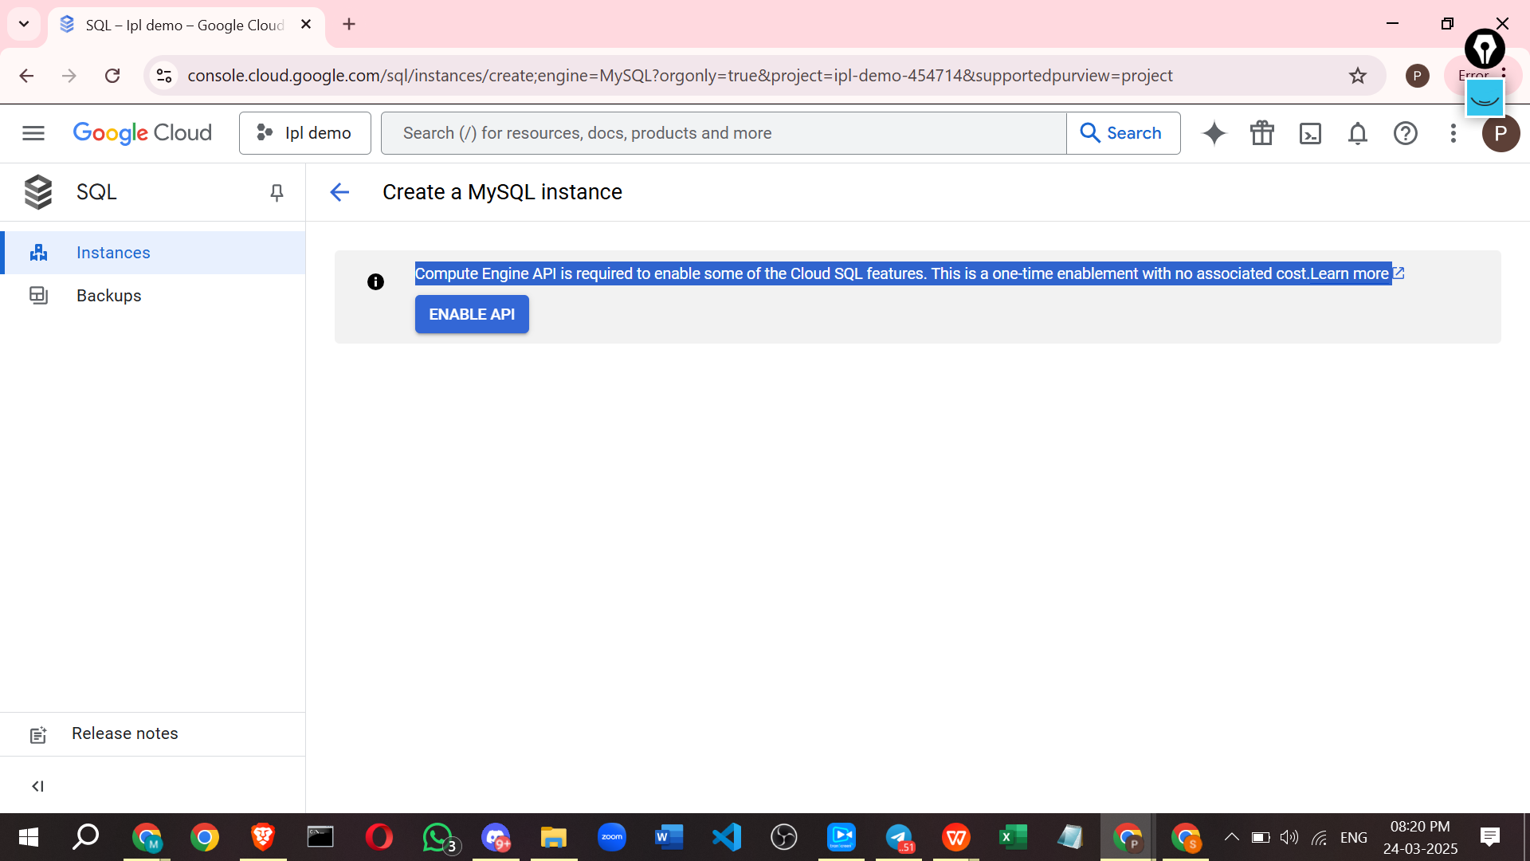
Public IP | Adds a public IP address for your instance. You can then add authorized networks to connect to the instance.Your instance can have both a public and a private IP address. Learn more about using public IP.
Authorized networks | Add the name for the new network and the Network address.

Slide 9
To allow any user to access your Google Cloud SQL (MySQL) database, follow these steps. However, be careful about security risks when making your database publicly accessible.
✅ Best Practices for Secure Access
Before opening access to all users, consider these secure options:
Use Cloud SQL Proxy (Recommended, Secure).
Create Specific User Accounts with limited privileges.
Whitelist Specific IPs instead of allowing all (0.0.0.0/0).
🚀 Method 1: Secure Access via Cloud SQL Proxy (Recommended)
This is the best method because it does not expose your database to the internet.
Step 1: Enable Cloud SQL Proxy
Find your Cloud SQL Instance Connection Name
Go to Google Cloud Console → SQL
Click on your MySQL instance.
Copy the Connection Name (Format: project-id:region:instance-id).
In your local machine or Google Colab, install and start the proxy:
(Replace "my-gcp-project:us-central1:my-mysql-instance" with your actual connection name.)
Connect to MySQL using mysql-connector-python:
Why this is better?
✔ No need to open the database to all users.
✔ Works securely without exposing MySQL to the public.
❌ Method 2: Public IP Access (Less Secure)
If you want anyone to access your database, you must:
Enable Public IP in Cloud SQL.
Allow all IP addresses (0.0.0.0/0).
Step 1: Enable Public IP in Google Cloud SQL
Go to Google Cloud Console → SQL.
Click on your MySQL instance.
Go to Connections → Public IP → Click Enable.
Copy the Public IP Address (e.g., 34.31.78.164).
Step 2: Whitelist All IP Addresses
Go to Cloud SQL → Connections.
Under Authorized Networks, add:
Name: AllowAll
Network CIDR: 0.0.0.0/0 (This allows access from any IP).
Click Save.
🚨 Security Warning:
This makes your database publicly accessible!
Use firewall rules and user privileges to limit access.
Step 3: Open MySQL Port (3306) in Firewall
Go to Google Cloud Console → VPC Network → Firewall Rules.
Click Create Firewall Rule.
Set the following:
Name: allow-mysql
Target: All instances
Source IP range: 0.0.0.0/0
Protocols and ports: TCP: 3306
Click Create.
🚨 This is risky! Open the database only to trusted users.
Step 4: Connect using MySQL Connector
Now, any user can connect using:
🔒 Method 3: Create User Accounts with Permissions
To restrict access, create a user with limited privileges:
🔹 % allows login from any IP.
🔹 Change privileges based on user needs (SELECT, INSERT, etc.).
🚀 Best Approach?
Method | Security | Complexity | Best For
Cloud SQL Proxy ✅ | High 🔒 | Medium ⚡ | Secure, recommended for private access
Public IP Access ❌ | Low ⚠️ | Easy ✅ | Quick access but risky
Custom User Accounts ✅ | Medium 🔐 | Medium ⚡ | Control over access per user
✅ Best Practice:
Use Cloud SQL Proxy for secure access. Avoid making MySQL publicly accessible unless necessary.
Let me know if you need more help! 🚀

