Slide 1

Cloud Computing
https://www.udemy.com/course/cloud-computing-for-beginners-course/learn/lecture/37788200#content

Slide 2
What You’ll Learn:
The core concepts of cloud computing without technical jargon.
How traditional IT systems are transforming through digital innovation.
A clear breakdown of cloud service models (IaaS, PaaS, SaaS, FaaS, BaaS,) and deployment models (Public, Private, Hybrid and Community).
Virtualization and containerization are explained in simple terms.
Essential cloud infrastructure elements: storage, networking, and security.
Modern architectures like Serverless Computing and Function-as-a-Service (FaaS).
Core Concept knowledge of Docker, Kubernetes, and other container technologies.
Understanding of cloud pricing models and how to optimize costs.
Why Enroll in This Course?
No complicated jargon—just simple explanations.
Real-world examples to make complex concepts fun and relatable.
Learn at your own pace with easy-to-follow modules.
Get a strong foundation to start a career in cloud computing or enhance your current role.
Course Topics Include:
Key Cloud Terminologies
Cloud Service & Deployment Models
Infrastructure & Virtualization
Cloud Management Tools
Security Essentials
Practical Applications & Real-World Scenarios
In this course, you will learn about the Cloud Computing Core Concepts like:
Terminology Of Cloud Computing
Digital Transformation Journey of Traditional IT Landscape.
Cloud Service Models
Cloud Deployment Models
Virtualization and Containerization
IT Infrastructure Models
Cloud Infrastructure
Cloud Storage
Cloud Networking
Serverless Architecture
Cloud Management Tools
Cloud Security
Cloud Data Center & Regions
Cloud Pricing Models
Practical Applications of Cloud Computing
You will also learn the Concepts like:
Runtime
Platforms
Virtualizations
Containerization
Virtual Machines
Containers
Dockers
Kubernetes
Serverless Architecture - Function As A Service (FaaS)
Backend As A Service (BaaS)
Storage - Files, Block, Object
Cloud Networking - Firewall, Load Balancing, HA
Cloud Management Platforms Tools (CMPS)
Cloud Security - Shared Responsibility Model, IAM, Compliance, Encryption etc.
And many more concepts.
By the end of this course, you’ll confidently understand how the cloud works and how to leverage its power for your business or career.
Ready to start your cloud journey?
Enroll now and take the first step toward becoming a cloud computing expert!
What you’ll learn
Understand the Terminology used in Cloud Computing Topics.
Complete Understanding Of What Cloud Computing means.
Understand the Business Challenges and How they need to adopt Cloud Computing.
Understand Different Types of Cloud Service Models.
Learn about Different Types of Cloud Deployment Options.
Detailed Understanding Of Virtualization and Containerization Concepts with Examples.
Understand Cloud Runtimes & Platform. (Kubernetes & Docker).
Learn about Different Cloud Providers - AWS, Azure & Google
Understanding of Cloud Security, Cloud Management Tools, Data Regions and Pricing Models.
What are the Advantages of Cloud Computing for Business Growth.
What Challenges of Cloud Computing that everyone need to deal with.
Learn Different Type Cloud Architecture (Eg. Serverless Architecture).
How Companies are setting up the IT Landscape on Cloud.
Understand Company Digital Transformation Journey.
Practical Applications of Cloud Computing
Are there any course requirements or prerequisites?
This Course is for Absolute Beginners without any Programming Background.
No Programming Experience Required.
Access to Internet to access various Cloud Computing Options.
Course is in English.
Who this course is for:
Anyone who wants to Learn the Basics of Cloud Computing.
Understand the Tools and Services From Cloud Providers on Cloud Computing.
For Every Developer, Consultant, Team Leader, Manager and Architect.
This Course is for Students who wants to Learn the Fundamentals of Cloud Computing.
If you want to understand why companies are moving towards Cloud.
How Companies are Setting up the IT Landscape on Cloud Computing.

Slide 3
Section 1: Welcome To The Course
Section 4: Your Company Scenario
29. What You'll Learn In This Section
30. Your Company IT Landscape
31. Problems of IT Landscape
32. What You Learned In This Section
Section 5: Digital Transformation Journey
Play
33. What is Digital Transformation
10min
Play
34. Benefits Of Digital Transformation
1min
Play
35. Examples Of Digital Transformation
2min
Play
36. Summary Of Digital Transformation
1min
Play
37. Understanding Internet of Things (IoT)
7min
Play
38. How IoT Devices Are Connected
4min
Play
39. What is Big Data?
3min
Play
40. Importance Of Real Time Analytics
6min
Play
41. What is This Machine Learning Means?
5min
Play
42. What is Unstructured Data?
2. What You'll Learn In This Section
3. What is Cloud?
4. What is Computing?
5. What is Cloud Computing?
6. What are Cloud Computing Services?
7. Uses Of Cloud Computing
8. Benefits Of Cloud Computing
9. What You Learned In This Section
Section 3: Understanding the Cloud 10. What 10. You'll Learn In This Section
11. What is Cloud Terminology?
12. What is Cloud Native?
13. What is Cloud Providers?
14. What is Cloud Consumers?
15. On-Premise vs Cloud
16. What is Business Means?
17. What is Technology Means?
18. What is Platform Means?
19. What is Technology Platform Means?
20. What is Business Domain Means?
21. What is Applications, Services, Infrastructure, Storage and Software?
22. What is Runtime?
23. What is Container?
24. What is Application?
25. What is Containers Runtime?
26. What is Application Runtime?
27. What is Cloud Native Application Runtime?
28. What You Learned In This Section
Section 6: Business Challenges
Play
43. 10 Business Expectations From IT - 1
7min
Play
44. 10 Business Expectations From IT - 2
9min
Play
45. 10 Business Expectations From IT - 3
9min
Play
46. How Traditional IT Landscape Operates Today
4min
Play
47. First Cloud Computing Footprint
2min
Play
48. How Cloud Computing Helps To Solve Business Challenges
3min
Play
49. Economics of Cloud Computing
Section 7: Digital Transformation for Business
Section 8: Characteristic of Cloud Computing
Section 9: Cloud Service Models
Section 10: Cloud Deployment Options
Section 11: Virtualization and Containerization in Cloud Computing
Section 12: IT Infrastructure Models
Section 13: Cloud Infrastructure Walkthrough
Section 14: Cloud Storage
Section 15: Cloud Networking
Section 16: Serverless Architecture
Section 17: Cloud Management Tools
Section 18: Cloud Security
Section 19: Cloud Data Center & Regions
Section 20: Cloud Pricing Models
Section 21: Practical Applications of Cloud Computing
Section 22: Course Conclusion
Section 23: Bonus Section

Slide 4
https://www.digitalocean.com/resources/articles/comparing-aws-azure-gcp
https://www.datacamp.com/cheat-sheet/aws-azure-and-gcp-service-comparison-for-data-science-and-ai
https://medium.com/@22.gautam/gcp-ai-and-ml-services-a-comparative-analysis-with-aws-and-azure-67327b8c687c

Slide 5
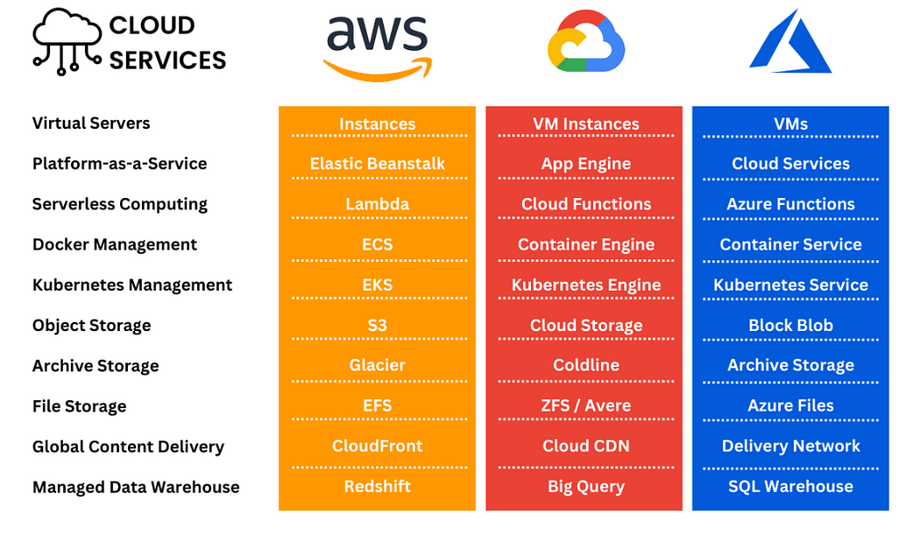

Slide 6
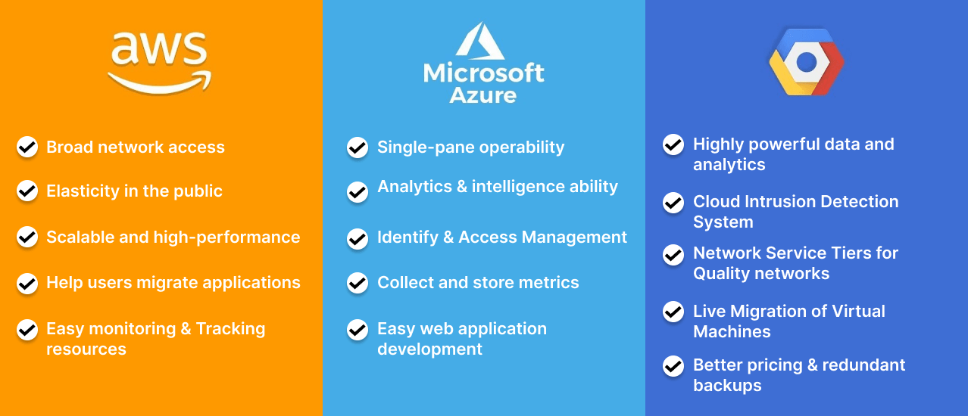
https://www.orangemantra.com/blog/aws-vs-azure-vs-google-cloud-platform/

Slide 7
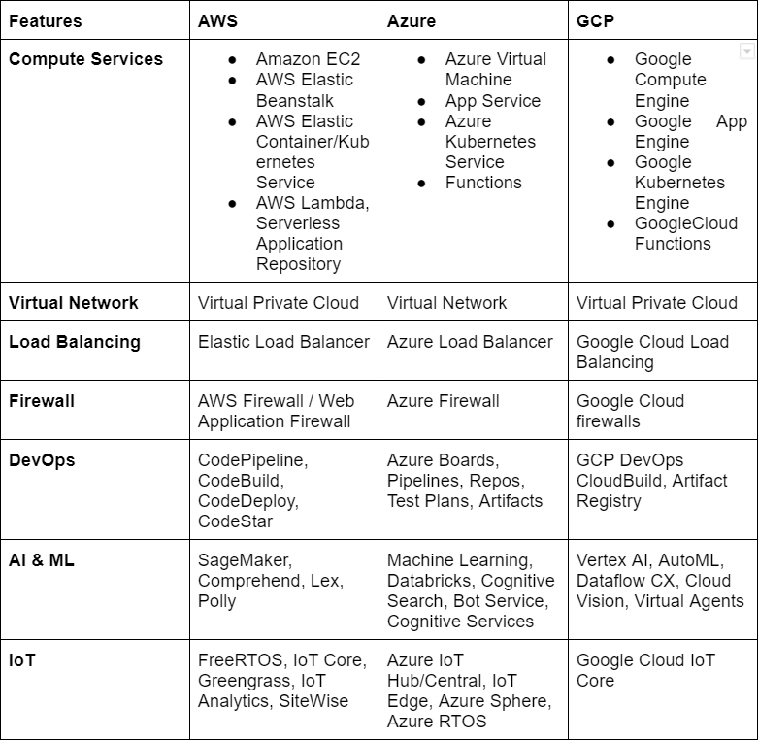

Slide 8
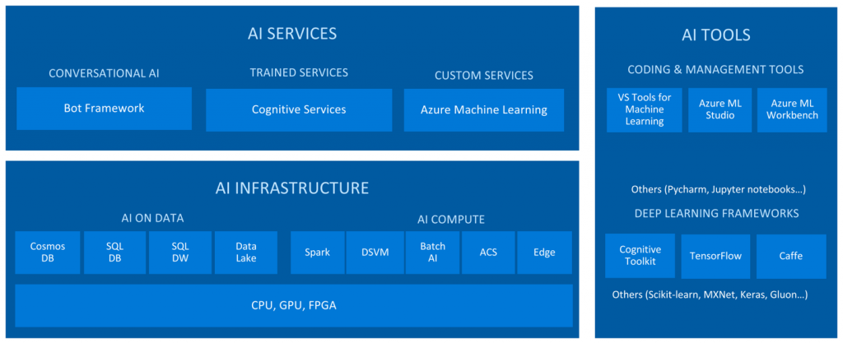

Slide 9
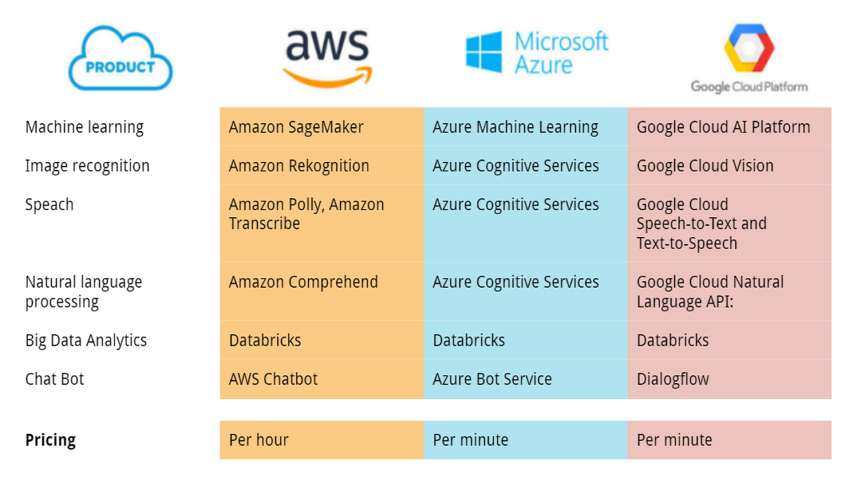

Slide 10
