Slide 1

Python

Slide 2
Introduction to Python
What is Python
What are the feature of Python
The application areas of Python
Download and install Python
Execute Python program from command prompt and using IDLE
Assignment
Path setup, environment setup
python IDLE
CMD
Jupyter
vscode
pycharm
sublime
Online
google colab
kaggle
online python editor
https://www.programiz.com/python-programming/getting-started
https://www.python.org/downloads/
https://code.visualstudio.com/download
https://colab.research.google.com/
https://jupyter.org/install
https://www.kaggle.com/datasets

Slide 3
Common cmd commands
OS Module in python for cmd
https://www.geeksforgeeks.org/os-module-python-examples/
Directory Navigation:
cd / dir / mkdir / rmdir / tree: Move between folders, list contents, and create/remove directories.
cls
copy / del / rename / xcopy: Move or remove files and directories.
cd
Changes your current directory.
cd /
Navigates to the root directory.
dir
Displays a list of files and subdirectories in a directory.
mkdir (or md)
Creates a new directory.
rmdir (or rd)
Removes a directory.
tree
Graphically displays the folder structure of a drive or path.
. root file
.. back file
https://www.geeksforgeeks.org/most-useful-cmd-commands-in-windows/
https://www.geeksforgeeks.org/python-sys-module/?ref=lbp

Slide 4
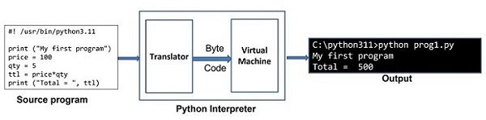
Python Interpreter
https://www.tutorialspoint.com/python/python_interpreter.htm
high level langauge low level language
intrepreter vs compiler
https://builtin.com/software-engineering-perspectives/compiler-vs-interpreter

Slide 5
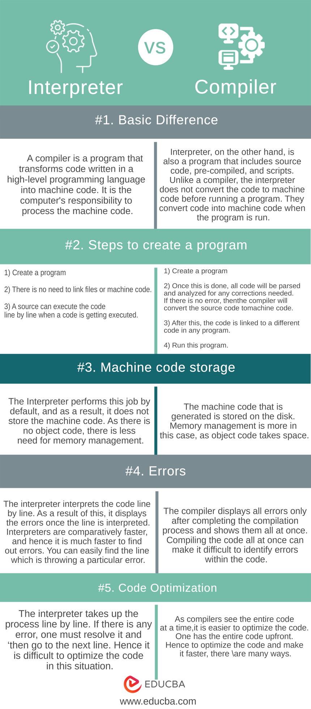
https://www.tpointtech.com/compiler-vs-interpreter
Conclusion
We have gone through many changes between the Interpreter vs Compiler. We can conclude after this above discussion that there are times when confident technical choices need to be relevant to your requirements. If a user wants speed and ease of development, you can mostly go for an interpreter-driven language. Also, all resources must be taken care of when any project is being started. The revised sentence is more concise and adds the transitional phrase “while” to indicate the contrast between the two statements. Hence it is upon the user how to use both interpreters vs compilers.

Slide 7
Resources
https://docs.python.org/3/tutorial/index.html
https://www.w3schools.com/python/
https://www.tutorialspoint.com/python/index.htm
https://www.geeksforgeeks.org/python-programming-language-tutorial/ python extra
PRACTICE QUESTIONS
https://www.hackerrank.com/domains/python
https://libguides.ntu.edu.sg/python/numpyexercises (Python for Basic Data Analysis)
KAGGLE https://medium.com/@filip.sekan/8-websites-you-can-practice-python-for-data-science-for-free-584ede3fef8f
https://github.com/ajitmane36/Python-Practice/blob/main/Python%20Practice%20Notebook.ipynb
https://github.com/krishnaik06/Python-Practise-Problems/blob/main/Python%20Progamming%20(1).pdf
coding questions
https://prepinsta.com/interview-preparation/coding-interview-questions-in-python/
https://www.interviewbit.com/python-interview-questions/https://www.simplilearn.com/tutorials/python-tutorial/python-interview-questions
https://medium.com/@nikitasilaparasetty/python-interview-coding-questions-with-solutions-for-beginners-7f6d782defac
https://github.com/Tanu-N-Prabhu/Python/blob/master/Python%20Coding%20Interview%20Prep/Python%20Coding%20Interview%20Questions%20(Beginner%20to%20Advanced).md

Slide 8
https://www.tutorialspoint.com/python/python_history.htm
Introduction to Python
What is Python
What are the feature of Python
The application areas of Python
Download and install Python
Execute Python program from command prompt and using IDLE

Slide 9
Python is a widely used high-level, interpreted programming language. It was created by Guido van Rossum in 1991 and further developed by the Python Software Foundation. It was designed with an emphasis on code readability, and its syntax allows programmers to express their concepts in fewer lines of code.
Python is Interpreted − Python is processed at runtime by the interpreter. You do not need to compile your program before executing it. This is similar to PERL and PHP.
Python is Interactive − You can actually sit at a Python prompt and interact with the interpreter directly to write your programs.
Python is Object-Oriented − Python supports Object-Oriented style or technique of programming that encapsulates code within objects.
Python is a Beginner's Language − Python is a great language for the beginner-level programmers and supports the development of a wide range of applications
https://www.geeksforgeeks.org/introduction-to-python/?ref=lbp

Slide 10
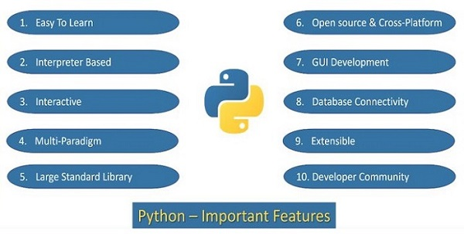
https://www.tutorialspoint.com/python/python_features.htm

Slide 11
https://www.tutorialspoint.com/python/python_vs_cpp.htm

Slide 12
Key Features of Python
Easy to Learn and Use: Python’s simple and readable syntax makes it beginner-friendly.
Cross-Platform Compatibility: Python runs seamlessly on Windows, macOS, and Linux.
Extensive Libraries: Includes robust libraries for tasks like web development, data analysis, and machine learning.
Dynamic Typing: Variable types are determined automatically at runtime, simplifying code writing.
Versatile: Supports multiple programming paradigms, including object-oriented, functional, and procedural programming.
Open Source: Python is free to use, distribute, and modify.
Python Comments
Comments in Python are the lines in the code that are ignored by the interpreter during the execution of the program.
Comments enhance the readability of the code.
Comment can be used to identify functionality or structure the code-base.
Comment can help understanding unusual or tricky scenarios handled by the code to prevent accidental removal or changes.
Comments can be used to prevent executing any specific part of your code, while making changes or testing.
# I am single line comment
""" Multi-line comment used
print("Python Comments") """
Here’s the “Hello World” program:
print("Hello, World!")
Output
How does this work:
print() is a built-in function in Python that tells the program to display something on the screen. We need to add the string in parenthesis of print() function that we are displaying on the screen.
“Hello, World!” is a string text that we want to display. Strings are always enclosed in quotation marks.

Slide 13
Famous Application Built using Python
YouTube: World’s largest video-sharing platform uses Python for features like video streaming and backend services.
Instagram: This popular social media app relies on Python’s simplicity for scaling and handling millions of users.
Spotify: Python is used for backend services and machine learning to personalize music recommendations.
Dropbox: The file hosting service uses Python for both its desktop client and server-side operations.
Netflix: Python powers key components of Netflix’s recommendation engine and content delivery systems (CDN).
Google: Python is one of the key languages used in Google for web crawling, testing, and data analysis.
Uber: Python helps Uber handle dynamic pricing and route optimization using machine learning.
Pinterest: Python is used to process and store huge amounts of image data efficiently

Slide 14
Indentation in Python
In Python, indentation is used to define blocks of code. It tells the Python interpreter that a group of statements belongs to a specific block. All statements with the same level of indentation are considered part of the same block. Indentation is achieved using whitespace (spaces or tabs) at the beginning of each line.
Example:
if10>5:print("This is true!")print("I am tab indentation")print("I have no indentation")
Explanation:
The first two print statements are indented by 4 spaces, so they belong to the if block.
The third print statement is not indented, so it is outside the if block.

Slide 15
Input and Output in Python
Understanding input and output operations is fundamental to Python programming. With the print() function, we can display output in various formats, while the input() function enables interaction with users by gathering input during program execution.
Taking input in Python
Python input() function is used to take user input. By default, it returns the user input in form of a string.
Example:
name=input("Enter your name: ")print("Hello,",name,"! Welcome!")
OutputEnter your name: GeeksforGeeks
Hello, GeeksforGeeks ! Welcome!
The code prompts the user to input their name, stores it in the variable “name” and then prints a greeting message addressing the user by their entered name.

Slide 16
Data Types & Variable
Data Types
Variables
Identifiers
Literals
Type Casting
Comments
Command Line Arguments
Assignment
https://www.tutorialspoint.com/python/index.htm

Slide 17
Python Variables
In programming, a variable is a container (storage area) to hold data. For example,10
Here, number is a variable storing the value 10.
Example: Assigning multiple values to multiple variables
53.2'Hello'print# prints 5print# prints 3.2print# prints Hello
Assigning values to Variables in Python
Changing the Value of a Variable in Python
site_name = 'programiz.pro'
print(site_name)
# assigning a new value to site_name
site_name = 'apple.com'
print(site_name)
https://www.programiz.com/python-programming/variables-constants-literals

Slide 18
Rules for Naming Python Variables
1. Constant and variable names should have a combination of letters in lowercase (a to z) or uppercase (A to Z) or digits (0 to 9) or an underscore (_). For example:
snake_case
MACRO_CASE
camelCase
CapWords

Slide 19
Conditional Statement
Indentation in Python
Need of Conditional Statement
Comparison Operators
if...else statement
Logical operators
elif statements
Assignment
https://www.tutorialspoint.com/python/index.htm

Slide 20
Loops in Python
Loops in Python
range() function
Need of Loop
for loop
while loop
Continue, break and pass keyword
Nested loop
Mini Project
Assignment
https://www.tutorialspoint.com/python/index.htm

Slide 21
More on Data types
String
List , List comprehensions
Multidimensional List | tuple , set
Dictionary
Mini Project
Assignment
https://www.tutorialspoint.com/python/index.htm

Slide 22
Function and Modules
Defining and calling function
return statement
Types of Argument-default,variable length
Variable Scope - Global vs Local
Recursive function
Lambda, filter, map, reduce
Need of Module
What is module
Built in Module
User defined Module
Assignment
https://www.tutorialspoint.com/python/index.htm

Slide 23
Object Oriented Programming
What are the feature of OOPs
What is Class, Attributes & Methods
What is Constructor and Destructor ?
What is Inheritance
Data Abstraction
What is Polymorphism
Assignment
python overloading (function overloading, operator overloading)
https://www.tutorialspoint.com/python/index.htm

Slide 24
Libraries vs Framework
Frameworks
Definition: Frameworks are more comprehensive and provide a structure for building applications. They include code libraries, templates, and guidelines for how to use the libraries to develop applications.
Control: When using a framework, the framework is in control of the flow. It provides places for the developer to plug in their code, but the framework calls the developer's code as needed. This is known as "inversion of control."
Integration: Frameworks are typically used when starting a new project. Integrating a framework into an existing project can be challenging and often requires significant changes.
Scope: Frameworks are designed to handle a wide range of tasks, such as web application systems, plug-in managers, and GUI systems.
Examples: Angular, Vue.js, Spring, and Django.
Libraries and frameworks are both tools used in software development to help developers write code more efficiently, but they serve different purposes and operate in distinct ways.
Libraries
Definition: Libraries are collections of pre-written code that developers can use to perform specific tasks. They provide predefined functions and classes to simplify the development process.
Control: When using a library, the developer is in control of the flow of the application. The developer decides when and where to call the library functions.
Integration: Libraries can be easily integrated into existing projects to add specific functionality.
Scope: Libraries typically focus on narrow scopes, such as network protocols, image manipulation, string utilities, and math operations.
Examples: jQuery, React (JS library), and Lodash.

Slide 25
Key Differences
Inversion of Control: The most significant difference is the concept of inversion of control. In a library, the developer calls the library functions. In a framework, the framework calls the developer's code.
Flexibility vs. Structure: Libraries offer more flexibility and control to the developer, while frameworks provide a more structured and opinionated approach to development.
Complexity: Frameworks can be more complex to learn and use due to their comprehensive nature, but they can also speed up development by providing a standardized way to build and organize code.
Performance: Libraries generally require less code, leading to faster loading times and better performance. Frameworks, due to their extensive features, can increase loading times and decrease performance.
Use Cases
Libraries: Use libraries when you need to add specific functionality to an existing project or when you want more control over the application flow.
Frameworks: Use frameworks when you are starting a new project and want to leverage a comprehensive set of tools and best practices to speed up development.

Slide 26
Module vs Packages
In Python, the terms "module" and "package" refer to different levels of organization for code, each serving a specific purpose in modular programming.
Module
A module is a single file containing Python code. It can include functions, classes, and variables. Modules are used to organize related code into reusable units. For example, a module named math_operations.py might contain functions for performing various mathematical operations.
Package
A package is a way of organizing related modules into a directory hierarchy. A package is essentially a directory that contains an __init__.py file, which can be empty or include initialization code. The __init__.py file marks the directory as a Python package, allowing it to be imported. Packages can contain sub-packages and modules, providing a hierarchical structure for organizing code.
For example, consider a package named my_package with the following structure:
In this structure:
my_package is the package.
module1.py and module2.py are modules within the package.
sub_package is a sub-package within my_package.
module3.py is a module within the sub-package.
my_package/
__init__.py
module1.py
module2.py
sub_package/
__init__.py
module3.py

Slide 27
Importing Modules and Packages
Importing a Module: You can import a module using the import statement. For example, to
import module1.py from my_package, you would use:import
Importing a Package: You can import a package in a similar way. For example, to import the my_package package, you would use:import
Importing Specific Functions or Classes: You can also import specific functions or classes from a module. For example:fromimport
Key Differences
Scope: A module is a single file, while a package is a directory containing multiple modules and possibly sub-packages.
Organization: Packages provide a way to organize related modules into a hierarchical structure, making it easier to manage large codebases.
Initialization: The __init__.py file in a package can contain initialization code that runs when the package is imported.
import my_package.module1
import my_package
from my_package.module1 import my_function

Slide 28
Example
Here is a simple example to illustrate the difference:
Module: math_operations.py
Using the Module and Package
# Importing the module
import my_package.math_operations
# Using functions from the module
result = my_package.math_operations.add(10, 5)
print(result) # Output: 15
# Importing specific functions from the module
from my_package.math_operations import subtract
# Using the imported function
result = subtract(10, 5)
print(result) # Output: 5
def add(a, b):
return a + b
def subtract(a, b):
return a - b
Package: my_package
In summary, a module is a single file containing Python code, while a package is a directory containing multiple modules and possibly sub-packages, providing a hierarchical structure for organizing code. This organization helps in managing large codebases and promotes modular programming.
my_package/
__init__.py
math_operations.py

Slide 29
File Handling
What is file Handling
Different Modes to Open File
Opening Files in Python
Reading Files in Python -Read,Readline ,Readlines
Writing to the Files in Python -Write ,Writelines
Closing Files in Python
Working with file pointers - Seek ,Tell
Pickling & Unpickling
Exception Handling[try,except,finally)
Assignment
https://www.tutorialspoint.com/python/index.htm

Slide 30
Regular Expression & WebScraping
Regular Expression & WebScraping
Character Class in Regular Expression
WebScraping using request & beautifulSoup
Assignment
Python Final Assessment
from notebook

Slide 31
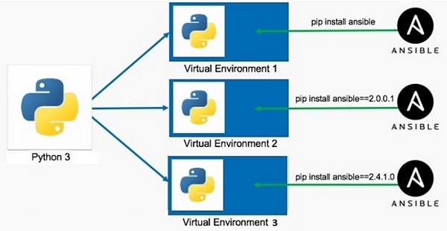
What is Virtual Environment in Python?
A Python virtual environment is:
Considered as disposable.
Used to contain a specific Python interpreter and software libraries and binaries which are needed to support a project.
Contained in a directory, conventionally either named venv or .venv in the project directory.
Not considered as movable or copyable.
https://www.tutorialspoint.com/python/python_virtual_environment.htm

Slide 32
Python Date and Time
Python datetime
Python strftime()
Python strptime()
import os
import sys
List comprehension
Python Lambda/Anonymous Function
Python Iterators
Python Generators
Python Namespace and Scope
Python Closures
Python Decorators
Python @property decorator
Python RegEx
https://www.programiz.com/python-programming/list-comprehension
Precedence and Associativity of Operators in Python
Python Keywords and Identifiers
Python Asserts
Python Json
Python pip
Python *args and **kwargs
sql connector
https://www.w3schools.com/python/python_mysql_getstarted.asp
https://www.w3schools.com/python/python_mongodb_getstarted.asp
https://github.com/GoogleCloudPlatform/cloud-sql-python-connector
https://medium.com/learning-sql/python-for-sql-an-introduction-to-database-connectivity-e1a692e16156
https://cloud.google.com/blog/topics/developers-practitioners/how-connect-cloud-sql-using-python-easy-way
https://stackoverflow.com/questions/73493052/how-to-connect-to-cloud-sql-using-python

Slide 33
Thank You !

Slide 34
Logging
mysql connector
sql lite
sqlalchemy
pymongodb
Pipelines
os
sys
frozen set
ms- excel file read
functions : zip ,map,reduce,filters,any, chr,ord, sorted,global, local,all
reading pdf
call by value call by reference, passing args by value or pass by regerence
create modules
create packeges
create exe file
create python script file
77. Tutorial 77-Python Module
78. Tutorial 78-Executing Module as Script
79. Tutorial 79-Python Loading Modules
80. Tutorial 80-Namespace And Scoping
81. Tutorial 81- Packages in python

