Slide 1
https://www.geeksforgeeks.org/ai-ml-ds-projects/?ref=lbp
NLP
https://www.geeksforgeeks.org/natural-language-processing-nlp-tutorial
PROJECT
https://www.geeksforgeeks.org/twitter-sentiment-analysis-using-python/
https://www.geeksforgeeks.org/next-sentence-prediction-using-bert/
https://www.geeksforgeeks.org/fine-tuning-bert-model-for-sentiment-analysis/
https://www.geeksforgeeks.org/sentiment-classification-using-bert/
https://www.geeksforgeeks.org/sentiment-analysis-with-an-recurrent-neural-networks-rnn/
NLP problem Solve
Clasifications (+ve,-ve issue classifier,Sentiment analysis
NER (structure our data)
Language Modeling
Q &A
Translations
summerizations
next word generations
Translations
Text Generations
text summerization
speech to text , text to speech
Language Modeling
pre deep learning
N-gram
Neural network
RNN

Slide 2
https://www.kaggle.com/code/ashishpatel26/beginner-to-intermediate-nlp-tutorial
https://www.deeplearning.ai/resources/natural-language-processing/
https://www.analyticsvidhya.com/blog/2022/01/nlp-tutorials-part-i-from-basics-to-advance/
https://huggingface.co/learn/nlp-course/en/chapter1/1
https://github.com/graykode/nlp-tutorial

Slide 3
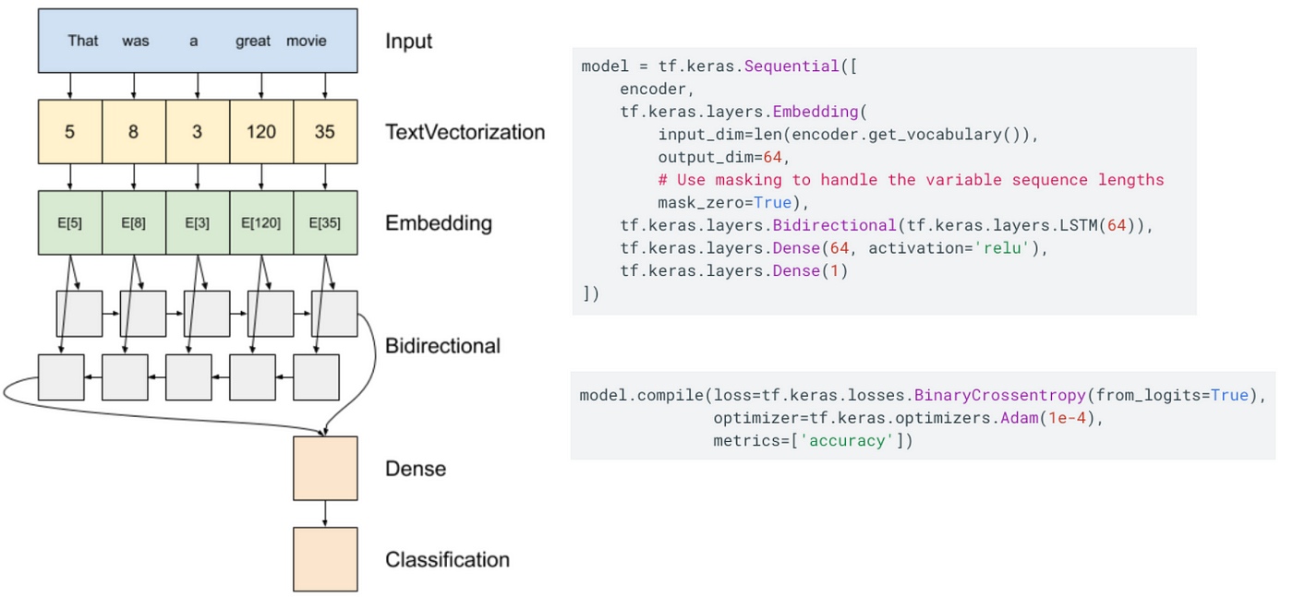

Slide 4
OLD SYLLABUS
ntroduction to NLP
What is Natural Language Processing
Uses of NLP
Application of NLP
Components of NLP
Stages of NLP
Assignment
Sentiment Analysis
What is Sentiment Analysis
Challenges in Sentiment Analysis
Handling Emoticons
Sentiment Analysis with ANN
Assignment
Sequence Model
Sequential Data
Recurrent Neural Network
Multi-layer & Bi-directional RNN
Architecture of RNN
Vanishing Gradient Problem in RNN
Long Short Term Memory
Multi-layer & Bi-directional LSTM
Gated Recurrent Unit
Multi-layer & Bi-directional GRU
Assignment
Text Preprocessing
Tokenization
Non Alphabets Removal
Stopwords Removal
Bag of Words
Stemming & Lemmatization
Part of Speech Taging
Name Entity Recognition
Text Visualization
Assignment
Text Classification
CountVectorization
Text Classification with ML
TFIDF Vectorization
Text Classification with ANN
Assignment
Transformers Based Models
Sequence to Sequence Model
Attention Machanism
Transformers
Face Hugging Transformers

Slide 5
NEW SYLLABUS
Natural Language Processing
Introduction to NLP
Text Preprocessing
Text Vecorization and Classification
Embedding Layer in Natural Language Processing
Sentiment Analysis
Sequence Model
Machine Translation
Introduction to LLM
Recurrent Neural Network
Introduction to RNN
LSTM
GRU

Slide 6
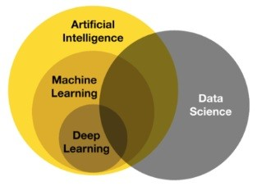
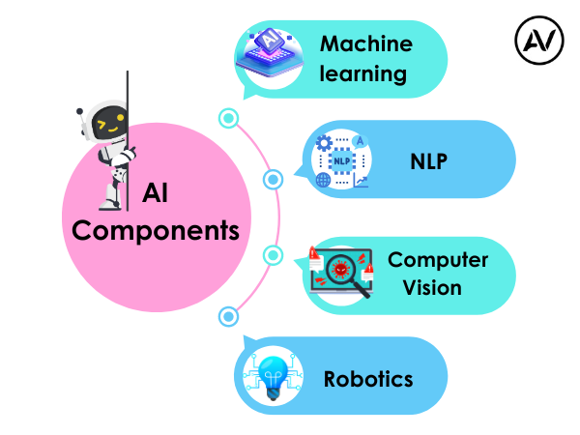
https://ellow.io/components-of-ai/

Slide 7
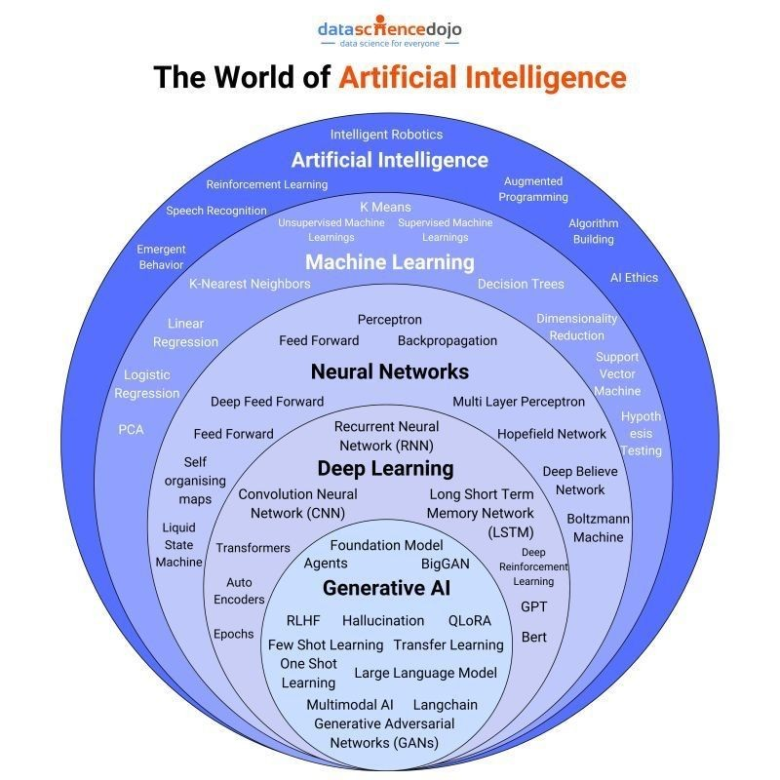
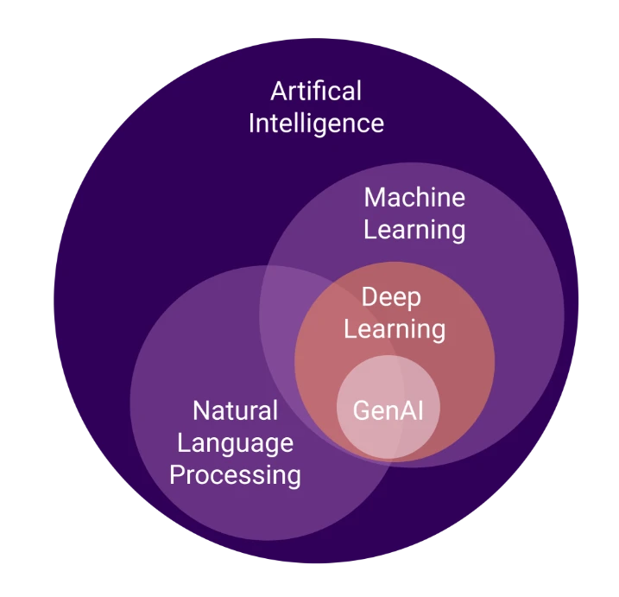
Algorithms and models

