Slide 1
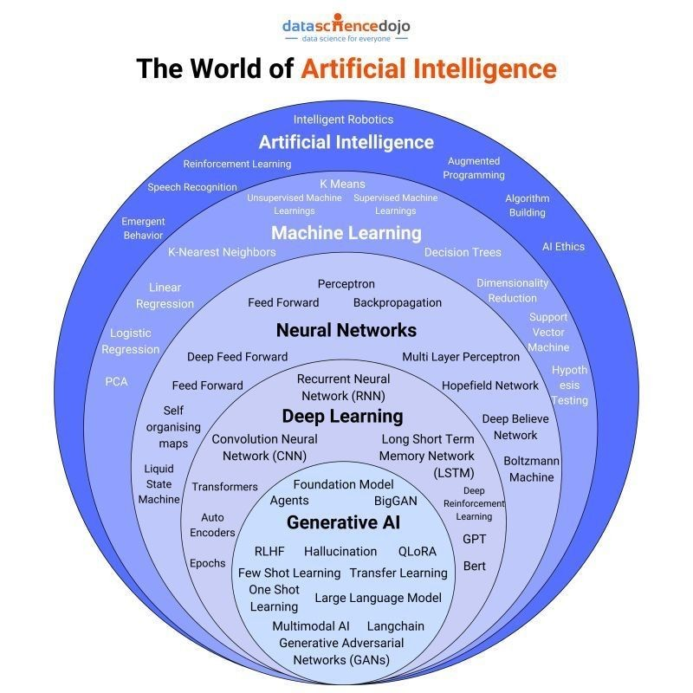
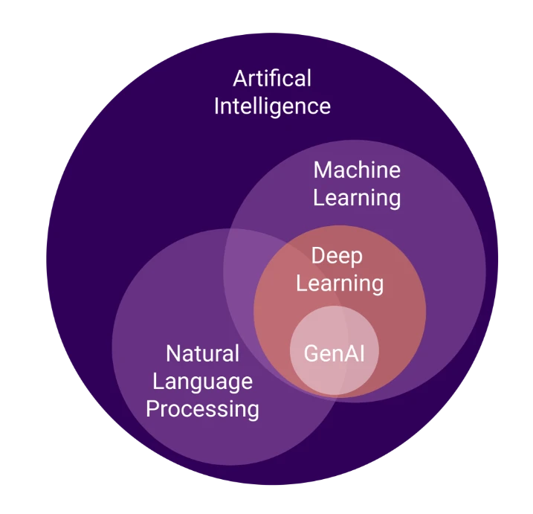
Gen AI

Slide 2
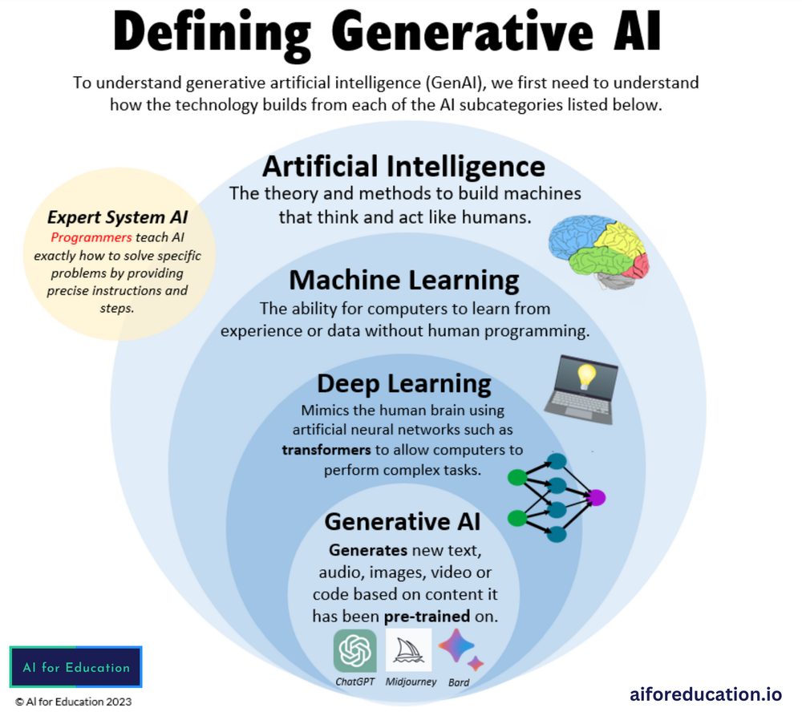

Slide 3
https://www.aegissofttech.com/insights/generative-ai-models/
LLM Basics - Tokens, Context Window, Prompt, Prompt Tuning etc.(What are Tokens,Context Window,What is a Prompt?,Prompt Tuning,Prompt Structures)
Retrieval Augmented Generation(Introduction to RAGs,RAGs - What and Why,RAGs - Use Cases,RAGs reserch paper,RAGs Architectures + VectorDB Architecture,RAGs - Detailed Architecture,RAGs - Research Paper based Chatbot using Open AI (Practicals)
LangChain
Introduction to Prompt Engineering,Types of Prompting,Few Shot Limitations,Chain of Thoughts Prompting
Vector Databases,Vector Index vs Vector Database,How Vector db works,Vector Database (Practicals),LSH
Deploy GEN AI APP(Introduction,Introduction to Flask,Flask Basic App,Model Building (Breast Cancer),Flask App (Breast Cancer),Role of Cloud in Deployment (AWS),AWS Deployment)
GEN AI PROJECT (Research RAG Chatbot,Chat Scholar Chatbot + Essay Grading System,AI Powered Insurance Claims Processing,AI Career Coach (Part 1),AI Career Coach (Part 2),AI Career Coach (Deployment),Sustainability Chatbot (GROK AI)
Gen AI Interview Guide
https://www.udemy.com/course/mastering-generative-ai/learn/lecture/45656721?start=0#overview
Gen AI Pre-requisite
python’
basic ML
NLP(
basic(Welcome to the module on NLp, NLP Key Challenges,Linguistics
embedding(word2vec, cbow,skipgram,glove,cosine similarity)
NN(RNN,LSTM, GRU, BI-RNN)
DL(Ann, Activation, CNN,VGG16,MobileNet, Transfer Learning)
Transformers( Welcome to the journey of Gen AI,Transformers Types,Self Attention is all you need!!,Encoder Architecture,Contextual Embeddings,Decoder Architecture )
encoder ony arch(BERT Configurations,BERT Fine Tuning,BERT Pre Training (Masked LM),Input Embeddings BERT,ARLM vs AELM,RoBERTa,DistilBERT,AlBERT)
decoder only arch(GPT Architecture,GPT (Masked Multi Head Attention),GPT Blocks,GPT Training)
nlp basic
Case Folding
Special Character Removal
Handling Contractions
Tokenization
Stop Words Removal
nGrams
Vectorization
Word Embeddings
Bag of Words (Theory)
Bag of Words (Practicals)
TF-IDF (Theory)
TF-IDF (Practicals)
Part of Speech Tagging & NER
Named Entity Recognition (Practicals)

Slide 4
TRANSFORMERS
Encoder Decoder
Attention
Self attentions and their Geometric intutions
Scaled Dot product Attention
Why is Self Attention called "Self"? | Self Attention Vs Luong Attention in Depth Lecture | CampusX
What is Multi-head Attention in Transformers | Multi-head Attention v Self Attention | Deep Learning
Positional Encoding in Transformers | Deep Learning | CampusX
Layer Normalization in Transformers | Layer Norm Vs Batch Norm
Transformer Architecture | Part 1 Encoder Architecture | CampusX
Masked Self Attention | Masked Multi-head Attention in Transformer | Transformer Decoder
Cross Attention in Transformers | 100 Days Of Deep Learning | CampusX
Transformer Decoder Architecture | Deep Learning | CampusX
Transformer Inference | How Inference is done in Transformer? | Deep Learning | CampusX

Slide 5
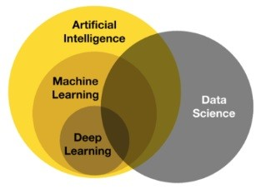
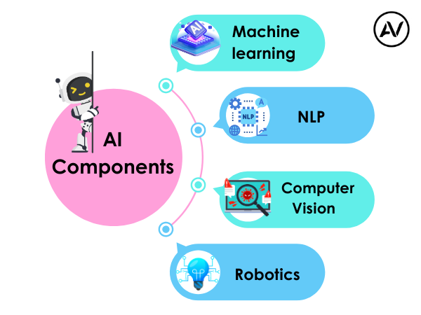
https://ellow.io/components-of-ai/

Slide 6
Conventional AI vs Generative AI (GenAI)
Conventional AI:
Focuses on classification, prediction, and rule-based decision-making.
Uses structured datasets for training.
Examples: Spam filters, customer service chatbots, recommendation engines.
Generative AI (GenAI):
A type of AI that creates new content, such as text, images, and music.
Uses models like GANs (Generative Adversarial Networks) and transformers (e.g., GPT, DALL-E).
Examples: AI-generated art, chat-based content generation, and text-to-image synthesis.
Future of AI
The future of AI is expected to bring significant advancements and challenges:
AI-Augmented Creativity: More sophisticated generative models for content creation.
Explainable AI (XAI): Enhancing transparency and trust in AI decision-making.
Ethical AI Development: Addressing biases, privacy concerns, and responsible AI use.
AI in Edge Computing: Deployment of AI models on edge devices for real-time processing.
Superintelligence and AGI: Theoretical advancements toward artificial general intelligence (AGI) with human-like reasoning capabilities.
AI continues to evolve, driving innovation and transforming industries worldwide.

Slide 7
