Slide 1
Hugging Face
Hugging Face is a company and open-source community that focuses on Natural Language Processing (NLP) and Artificial Intelligence (AI). It is best known for its Transformers library, which provides tools and pre-trained models for a wide range of NLP tasks, such as text classification, sentiment analysis, machine translation, and more.

Slide 2
TRANSFORMERS
Encoder Decoder
Attention
Self attentions and their Geometric intutions
Scaled Dot product Attention
Why is Self Attention called "Self"? | Self Attention Vs Luong Attention in Depth Lecture | CampusX
What is Multi-head Attention in Transformers | Multi-head Attention v Self Attention | Deep Learning
Positional Encoding in Transformers | Deep Learning | CampusX
Layer Normalization in Transformers | Layer Norm Vs Batch Norm
Transformer Architecture | Part 1 Encoder Architecture | CampusX
Masked Self Attention | Masked Multi-head Attention in Transformer | Transformer Decoder
Cross Attention in Transformers | 100 Days Of Deep Learning | CampusX
Transformer Decoder Architecture | Deep Learning | CampusX
Transformer Inference | How Inference is done in Transformer? | Deep Learning | CampusX

Slide 3
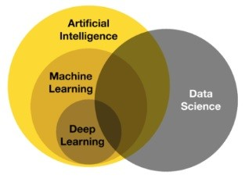
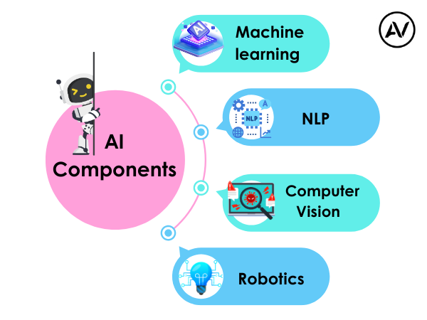
https://ellow.io/components-of-ai/

Slide 4
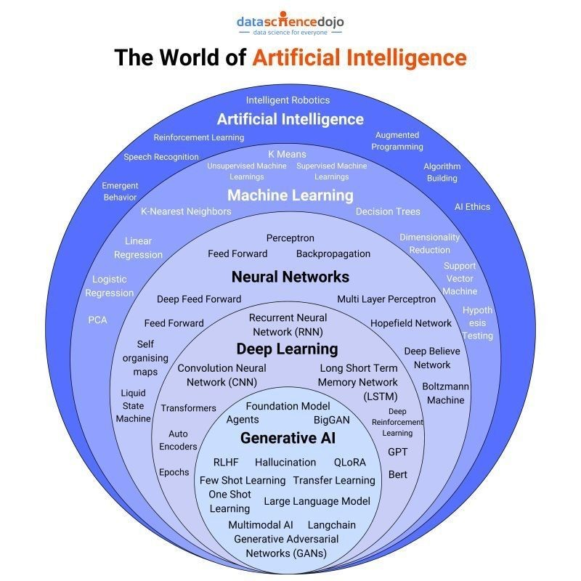
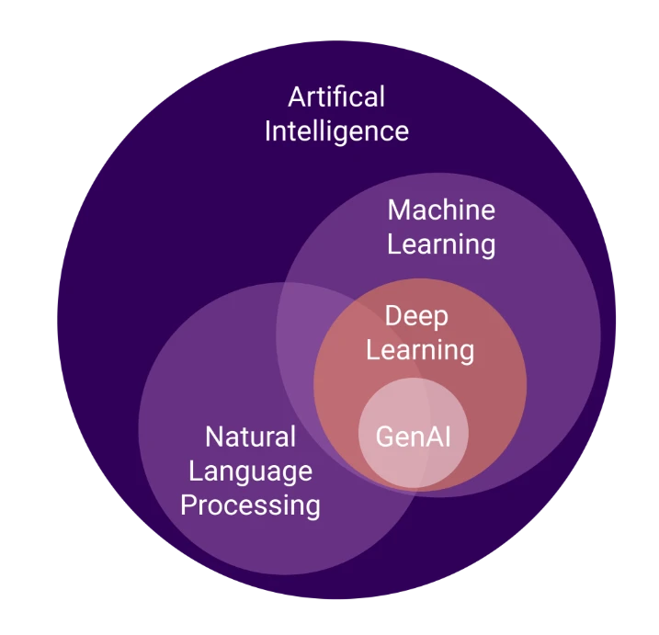
Algorithms and models

Slide 5
https://studyopedia.com/tutorials/hugging-face/
https://huggingface.co/learn/llm-course/chapter1/1
How to Build Streamlit App with 3 Hugging Face Transformers | Python Code + Project
https://youtu.be/dWnJMp-4db8?feature=shared
https://huggingface.co/docs

Slide 6
PROJECTS
https://www.kdnuggets.com/2023/02/simple-nlp-pipelines-huggingface-transformers.html
https://www.kdnuggets.com/a-simple-to-implement-end-to-end-project-with-huggingface
https://www.analyticsvidhya.com/blog/2025/01/hugging-face-ai-projects/
https://www.analyticsvidhya.com/blog/2025/01/hugging-face-ai-projects/
https://huggingface.co/huggingface-projects

Slide 7
Building AI Products with Hugging Face
https://www.youtube.com/watch?v=T6GPytSmUQM
#1-Getting Started Building Generative AI Using HuggingFace Open Source Models And Langchain
https://youtu.be/bFB4zqkcatU?feature=shared

Slide 8
