Slide 1

TENSOR FLOW
TensorFlow
is an open-source machine learning library developed by Google. TensorFlow is used to build and train deep learning models as it facilitates the creation of computational graphs and efficient execution on various hardware platforms.

Slide 2

Introduction to TensorFlow and Keras
TensorFlow and Keras are two of the most widely used deep learning frameworks.
TensorFlow:
Developed by Google Brain.
Provides low-level and high-level APIs for building deep learning models.
Supports large-scale machine learning and deployment.
Keras:
High-level API built on TensorFlow.
Simplifies model building and experimentation.
Allows quick prototyping with minimal code.
TensorFlow 1.x/2.x
An open source Deep Learning library
● >1,800 contributors worldwide
● Apache 2.0 license
● Released by Google in 2015
TensorFlow 2.0
Easier to learn and use
For beginners and experts
Available today
​

Slide 3
Why Use TensorFlow?
One of TensorFlow’s best qualities is that it makes code development easy. The readily available APIs save users from rewriting some of the code that would otherwise have been time-consuming. TensorFlow speeds up the process of training a model. Additionally, the chances of errors in the program are also reduced, typically by 55 to 85 percent.
https://www.simplilearn.com/tutorials/deep-learning-tutorial/tensorflow

Slide 4
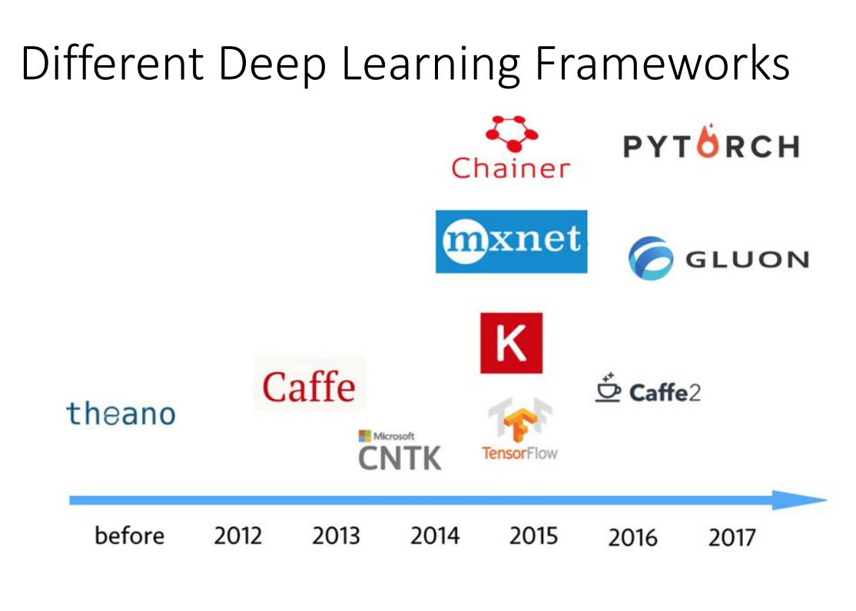

Slide 5
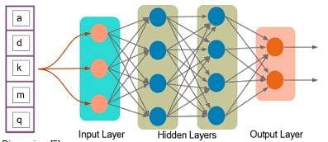
What Is a Tensor?
A tensor is a mathematical object represented as arrays of higher dimensions. These arrays of data with different sizes and ranks get fed as input to the neural network. These are the tensors.
You can have arrays or vectors, which are one-dimensional, or matrices, which are two-dimensional. But tensors can be more than three, four or five-dimensional. Therefore, it helps in keeping the data very tight in one place and then performing all the analysis around that.

Slide 6
INSTALL LIBRARY
pip install tensorflow
1. basic beginners
https://docs.google.com/presentation/d/1x5hCQOkgXsTvWOVwU6Kf3tn1RxPY14kObxz9pR7q1GQ/htmlpresent
https://www.tensorflow.org/tutorials
https://www.iitg.ac.in/cseweb/osint/iNN-week-3.php

Slide 7
What is new in TF2.o
Easy model building with Keras and eager execution (activated by default in TF2.0).
Robust model deployment in production on any platform.
Powerful experimentation for research.
Simplifying the API by cleaning up deprecated APIs and reducing duplication (relevant in case you have code developed in TensorFlow 1.X and you need to convert it)
Load your data using tf.data. Training data is read using input pipelines which are created using tf.data.
Build, train and validate your model with tf.keras, or use Premade Estimators.
TensorFlow Hub.
Run and debug with eager execution, then use tf.function for the benefits of graphs.
Use Distribution Strategies for distributed training.
hardware accelerators like CPUs, GPUs, and TPUs; you can enable training workloads to be distributed to single-node/multi-accelerator as well as multi-node/multi-accelerator configurations, including TPU Pods.
Export to SavedModel. TensorFlow will standardize on SavedModel as an interchange format for TensorFlow Serving, TensorFlow Lite, TensorFlow.js, TensorFlow Hub, and more.
Tensorflow Datasets
​

Slide 8
Check the installed version
import tensorflow as tf
print(tf.__version__)
When you change TF version you need to restart the runtime in Google Colab
Types of Tensors?
0d ,1d ,2d,3d,

Slide 9
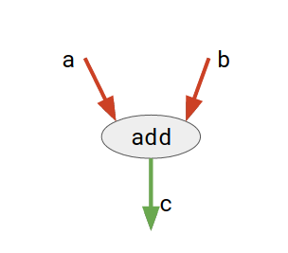
TensorFlow
TensorFlow is basically a software library for numerical computation using data flow graphs where:
nodes in the graph represent mathematical operations.
edges in the graph represent the multidimensional data arrays (called tensors) communicated between them. (Please note that tensor is the central unit of data in TensorFlow).
Consider the diagram given below:
Here, add is a node which represents addition operation. a and b are input tensors and c is the resultant tensor. This flexible architecture allows you to deploy computation to one or more CPUs or GPUs in a desktop, server, or mobile device with a single API!

Slide 10
# importing tensorflow
import tensorflow as tf
# creating nodes in computation graph
node1 = tf.constant(3, dtype=tf.int32)
node2 = tf.constant(5, dtype=tf.int32)
node3 = tf.add(node1, node2)
# create tensorflow session object
sess = tf.compat.v1.Session()
# evaluating node3 and printing the result
print("sum of node1 and node2 is :",sess.run(node3))
# closing the session
sess.close()

Slide 12
Keras
Keras is a high-level deep learning API that simplifies the process of building and training neural networks.
https://keras.io/api/

Slide 13
🔹 Advanced Topics in Keras
🔟 Custom Loss Functions & Metrics
11️⃣ Callbacks (Early Stopping, Model Checkpointing)
12️⃣ Transfer Learning & Fine-Tuning Pretrained Models
13️⃣ Hyperparameter Tuning (Keras Tuner)
14️⃣ Saving & Loading Keras Models
🔹 Real-World Use Cases
15️⃣ Image Classification (CNN)
16️⃣ Text Classification (NLP)
17️⃣ Time Series Forecasting (RNN/LSTM)
18️⃣ Object Detection & GANs
19️⃣ Deploying Keras Models (Flask, FastAPI)
Basics of Keras
1️⃣ What is Keras? Why Use Keras?
2️⃣ Installing TensorFlow & Keras
3️⃣ Creating a Simple Neural Network (Basic Keras Example)
🔹 Building Blocks of Keras
4️⃣ Keras Layers & Activation Functions
5️⃣ Model Architectures (Sequential vs Functional API)
6️⃣ Compiling, Training & Evaluating Models
🔹 Data Handling in Keras
7️⃣ Data Preprocessing & Normalization
8️⃣ Handling Image, Text & CSV Data
9️⃣ Data Augmentation Techniques

Slide 14
🔰 1️⃣ What is Keras? Why Use Keras?
Keras is a user-friendly deep learning framework built on TensorFlow that allows quick model development.
✅ Why use Keras?
✔️ Easy to learn and implement
✔️ Works with both CPUs and GPUs
✔️ Supports multiple backends (TensorFlow, Theano, etc.)
✔️ Prebuilt layers, optimizers, and loss functions
🔰 2️⃣ Installing TensorFlow & Keras
pip install tensorflow
✅ Keras is integrated into TensorFlow (tf.keras).
Creating a Simple Neural Network
Let's build a basic neural network for classifying numbers from the MNIST dataset.

Slide 15
import tensorflow as tf
from tensorflow import keras
import numpy as np
# Load dataset
(x_train, y_train), (x_test, y_test) = keras.datasets.mnist.load_data()
# Normalize data
x_train, x_test = x_train / 255.0, x_test / 255.0
# Create model
model = keras.Sequential([
keras.layers.Flatten(input_shape=(28, 28)), # Input Layer
keras.layers.Dense(128, activation='relu'), # Hidden Layer
keras.layers.Dense(10, activation='softmax') # Output Layer
])
# Compile model
model.compile(optimizer='adam', loss='sparse_categorical_crossentropy', metrics=['accuracy'])
# Train model
model.fit(x_train, y_train, epochs=5)
# Evaluate
test_loss, test_acc = model.evaluate(x_test, y_test)
print("Test Accuracy:", test_acc)
✅ Use Case: Digit Recognition using MNIST dataset.

Slide 16
🔰 4️⃣ Keras Layers & Activation Functions
Keras provides different layers:
python
CopyEdit
keras.layers.Dense(64, activation='relu') # Fully connected layer keras.layers.Conv2D(32, (3,3), activation='relu') # CNN layer keras.layers.LSTM(50) # LSTM layer for time series
✅ Use Case: Image classification, NLP, and time series prediction.
🔰 5️⃣ Model Architectures
🔹 Sequential API (Easy to Use)
python
CopyEdit
model = keras.Sequential([ keras.layers.Dense(64, activation='relu', input_shape=(10,)), keras.layers.Dense(32, activation='relu'), keras.layers.Dense(1, activation='sigmoid') ])

Slide 17
🔹 Functional API (For Complex Models)
python
CopyEdit
inputs = keras.Input(shape=(10,)) x = keras.layers.Dense(64, activation='relu')(inputs) x = keras.layers.Dense(32, activation='relu')(x) outputs = keras.layers.Dense(1, activation='sigmoid')(x) model = keras.Model(inputs, outputs)
✅ Use Case: Functional API is used for multi-input & multi-output models.
🔰 6️⃣ Compiling, Training & Evaluating Models
python
CopyEdit
model.compile(optimizer='adam', loss='binary_crossentropy', metrics=['accuracy']) model.fit(X_train, y_train, epochs=10, batch_size=32, validation_split=0.2) model.evaluate(X_test, y_test)
✅ Use Case: Fine-tuning deep learning models.

Slide 18
🔰 7️⃣ Data Preprocessing & Normalization
python
CopyEdit
from tensorflow.keras.preprocessing.image import ImageDataGenerator datagen = ImageDataGenerator(rescale=1./255, rotation_range=20, width_shift_range=0.2) train_generator = datagen.flow_from_directory("dataset/train", target_size=(150, 150), batch_size=32, class_mode='binary')
✅ Use Case:Image Augmentation for better model performance.
🔰 8️⃣ Handling CSV & Text Data
python
CopyEdit
import pandas as pd df = pd.read_csv("data.csv") X = df.drop("target", axis=1).values y = df["target"].values
✅ Use Case:Loading CSV for structured data models.

Slide 19
🔰 🔟 Custom Loss Functions & Metrics
python
CopyEdit
defcustom_loss(y_true, y_pred): return tf.reduce_mean(tf.square(y_true - y_pred)) # Mean Squared Error model.compile(optimizer='adam', loss=custom_loss, metrics=['accuracy'])
✅ Use Case: Custom loss for specific applications.
🔰 11 Callbacks (Early Stopping & Model Checkpoints)
callbacks = [ keras.callbacks.EarlyStopping(patience=3, monitor='val_loss'), keras.callbacks.ModelCheckpoint("best_model.h5", save_best_only=True) ] model.fit(X_train, y_train, epochs=50, validation_split=0.2, callbacks=callbacks)
✅ Use Case: Save the best model automatically.

Slide 20
🔰 12 Transfer Learning (Using Pretrained Models)
python
CopyEdit
base_model = keras.applications.VGG16(weights='imagenet', include_top=False, input_shape=(224,224,3)) for layer in base_model.layers: layer.trainable = False model = keras.Sequential([ base_model, keras.layers.Flatten(), keras.layers.Dense(256, activation='relu'), keras.layers.Dense(1, activation='sigmoid') ])
✅ Use Case:Fine-tuning a powerful model like VGG16 for new tasks.

Slide 21
🔰 15 Image Classification Example (CNN)
python
CopyEdit
model = keras.Sequential([ keras.layers.Conv2D(32, (3,3), activation='relu', input_shape=(64, 64, 3)), keras.layers.MaxPooling2D(2,2), keras.layers.Conv2D(64, (3,3), activation='relu'), keras.layers.MaxPooling2D(2,2), keras.layers.Flatten(), keras.layers.Dense(128, activation='relu'), keras.layers.Dense(1, activation='sigmoid') ])
✅ Use Case:Dog vs. Cat Classification.

Slide 22
🔰 19 Deploying Keras Models with Flask
from flask import Flask, request, jsonify import tensorflow as tf app = Flask(__name__) model = tf.keras.models.load_model("best_model.h5") @app.route("/predict", methods=["POST"]) defpredict(): data = request.json["input"] prediction = model.predict([data]) return jsonify({"prediction": prediction.tolist()}) app.run()
✅ Use Case: Deploy model as an API using Flask.
🎯 Summary
🚀 Beginner to Advanced Keras Covered!
📌 With Code, Examples, & Use Cases
💡 Would you like additional project-based learning (e.g., chatbot, GANs, LSTM)?

