Slide 1


Slide 2
Matplotlib and Seaborn are Python libraries used for data visualization, each offering a different level of abstraction and functionality. Matplotlib is a foundational, low-level library that provides fine-grained control over plots.
Seaborn is a high-level library built on top of Matplotlib, designed for creating more visually appealing and statistically informative graphics with less code.

Slide 3
## Table of Contents
1. Introduction
2. Overview of Python Data Visualization Tools
3. Introduction to Matplotlib
4. Import Matplotlib
5. Displaying Plots in Matplotlib
6. Matplotlib Object Hierarchy
7. Matplotlib interfaces
8. Pyplot API
9. Object-Oriented API
10. Figure and Subplots
11. First plot with Matplotlib
12. Multiline Plots
13. Parts of a Plot
14. Saving the Plot
15. Line Plot
16. Scatter Plot
17. Histogram
18. Bar Chart
19. Horizontal Bar Chart
20. Error Bar Chart
21. Stacked Bar Chart
22. Pie Chart
23. Box Plot
24. Area Chart
25. Contour Plot
26. Styles with Matplotlib Plots
27. Adding a grid
28. Handling axes
29. Handling X and Y ticks
30. Adding labels
31. Adding a title
32. Adding a legend
33. Control colours
34. Control line styles
35. Summary

Slide 4
📘 Module 1: Introduction to Data Visualization & Titanic Dataset
Objective: Understand the purpose and value of data visualization.
Topics:
What is Data Visualization?
Why use Matplotlib and Seaborn?
Overview of Titanic dataset (features and data types)
Loading and exploring Titanic dataset using Pandas
Activities:
Load Titanic dataset using sns.load_dataset("titanic")
Use .head(), .info(), .describe() to explore
Assignment:
Write a summary of 5 interesting things from the Titanic dataset.
📘 Module 2: Matplotlib Basics
Objective: Learn to create basic plots using Matplotlib.
Topics:
Anatomy of a Matplotlib plot (figure, axes, titles, labels, legend)
plot(), bar(), scatter(), hist(), pie()
Customizing plots (color, linestyle, marker)
Adding titles, labels, and legends
Hands-on with Titanic:
Line chart showing number of passengers by age
Bar chart: Number of survivors (survived) by class
Pie chart: Gender distribution
Assignment:
Create 5 different plots using only Matplotlib on Titanic dataset.

Slide 5
📘 Module 3: Matplotlib Advanced Customization
Objective: Improve plot readability and aesthetics.
Topics:
Subplots with plt.subplot() and plt.subplots()
Adding annotations
Grid, ticks, spines
Saving plots as images
Hands-on with Titanic:
Create subplot grid showing survival by class and gender
Annotate highest fare-paying passenger
Assignment:
Create a dashboard of 4 Titanic plots using subplots.
📘 Module 4: Seaborn Basics – Introduction & Categorical Plots
Objective: Learn to build quick statistical plots using Seaborn.
Topics:
Overview of Seaborn aesthetics and themes
countplot(), barplot(), boxplot(), violinplot()
Color palettes and hue, col, row parameters
Hands-on with Titanic:
countplot() of survivors by class and gender
barplot() of average fare by embark_town
violinplot() of age distribution by class
Assignment:
Use at least 3 categorical plots to explore survival vs different features.

Slide 6
📘 Module 5: Seaborn for Numerical Variables
Objective: Visualize distributions and relationships between numeric variables.
Topics:
histplot(), distplot() (legacy), kdeplot()
scatterplot(), lineplot(), regplot()
Hands-on with Titanic:
Age distribution using histplot()
Fare vs age scatterplot() with survival as hue
Survival trend by age using lineplot()
Assignment:
Plot distribution of age and fare; interpret the shapes.
📘 Module 6: Seaborn Pairwise & Matrix Plots
Objective: Use pairwise and heatmap plots for multivariate insights.
Topics:
pairplot(), jointplot()
heatmap() and correlation matrix
Customizing annotations and colormap
Hands-on with Titanic:
Correlation heatmap of numeric features
pairplot() with hue="survived"
Assignment:
Create heatmap and describe 2-3 interesting correlations.

Slide 7
📘 Module 7: Advanced Plot Styling & Themes
Objective: Make plots presentation-ready.
Topics:
Seaborn themes (darkgrid, whitegrid, etc.)
Using set_context() and set_style()
Adjusting figure size, aspect ratios
Hands-on with Titanic:
Recreate previous plots using different themes
Prepare plots for report/presentation
Assignment:
Create 3 styled plots suitable for a business report.
📘 Module 8: Plotting for EDA Storytelling (Mini Project)
Objective: Use plots to tell a story.
Task:
Create an EDA (Exploratory Data Analysis) storyline using 6–8 visualizations.
Interpret and explain: “Who had the highest chances of survival?”
Expected skills:
Use both Matplotlib and Seaborn effectively
Visual storytelling
Use of subplots, titles, colors for narrative
🎯 Capstone Assignment
Title:“Visual Titanic” – End-to-End Visualization Report
Deliverables:
One Jupyter notebook (cleaned and well-commented)
At least:
3 Matplotlib plots
5 Seaborn plots (with at least 1 pairplot and 1 heatmap)
Plot storytelling with conclusions

Slide 8
# install
# pip install matplotlib
# pip install seaborn
# Import
import matplotlib.pyplot as plt
import seaborn as sns
# https://matplotlib.org/
# https://seaborn.pydata.org/

Slide 9
# data
importnumpyasnp
importpandasaspd
d1= [1,2,3,4,5,6]
# create line graph using plot
plt.plot(d1)
# plt.show() # only display the plot
x = np.linspace(0,10, 100)
y = np.linspace(1,30)
x
plt.plot(np.linspace(1,50,20))
data = np.random.randint(1,50,20)

Slide 10
Line Design
'b' as blue
'g' as green
'r' as red
'c' as cyan
'm' as magenta
'y' as yellow
'k' as black
'w' as white
plt.plot(x,y, "g-",)
plt.plot(x,y, "-.",c="blue", linewidth=2,marker='2',markerfacecolor='g', mec="r")
# add extra information on chart
plt.plot(x,y, "g", linewidth=2, marker='o',markerfacecolor='r',markersize=8,mec="r")
plt.title("Line Plot chart")
plt.xlabel("X")
plt.ylabel("Y")
plt.legend(["Line Plot"])
plt.show()
linestyle | description
'-' or 'solid' | solid line
'--' or 'dashed' | dashed line
'-.' or 'dashdot' | dash-dotted line
':' or 'dotted' | dotted line
'none', 'None', ' ', or '' | draw nothing
filled_markers = ('.', 'o', 'v', '^', '<', '>', '8', 's', 'p', '*', 'h', 'H', 'D', 'd', 'P', 'X')
https://matplotlib.org/stable/users/explain/colors/colors.html#colors-def
https://www.geeksforgeeks.org/python/matplotlib-pyplot-colors-in-python/
https://www.geeksforgeeks.org/python/matplotlib-tutorial/

Slide 11
# multiple lines in single plot
plt.figure(figsize=(5,5))
x=np.linspace(0, 2, 100)
plt.plot(x, x, label='linear')
plt.plot(x, x**2, label='quadratic')
plt.plot(x, x**3, label='cubic')
plt.xlabel('x label')
plt.ylabel('y label')
plt.title("Simple Plot")
plt.legend()
plt.show()
seaborn use
import seaborn as sns
sns.lineplot(x=x,y=x, label='linear')
sns.lineplot(x=x,y=x**2, label='q')
sns.lineplot(x=x,y=x**3, label='c')
plt.title(" line graph")
plt.show()

Slide 12
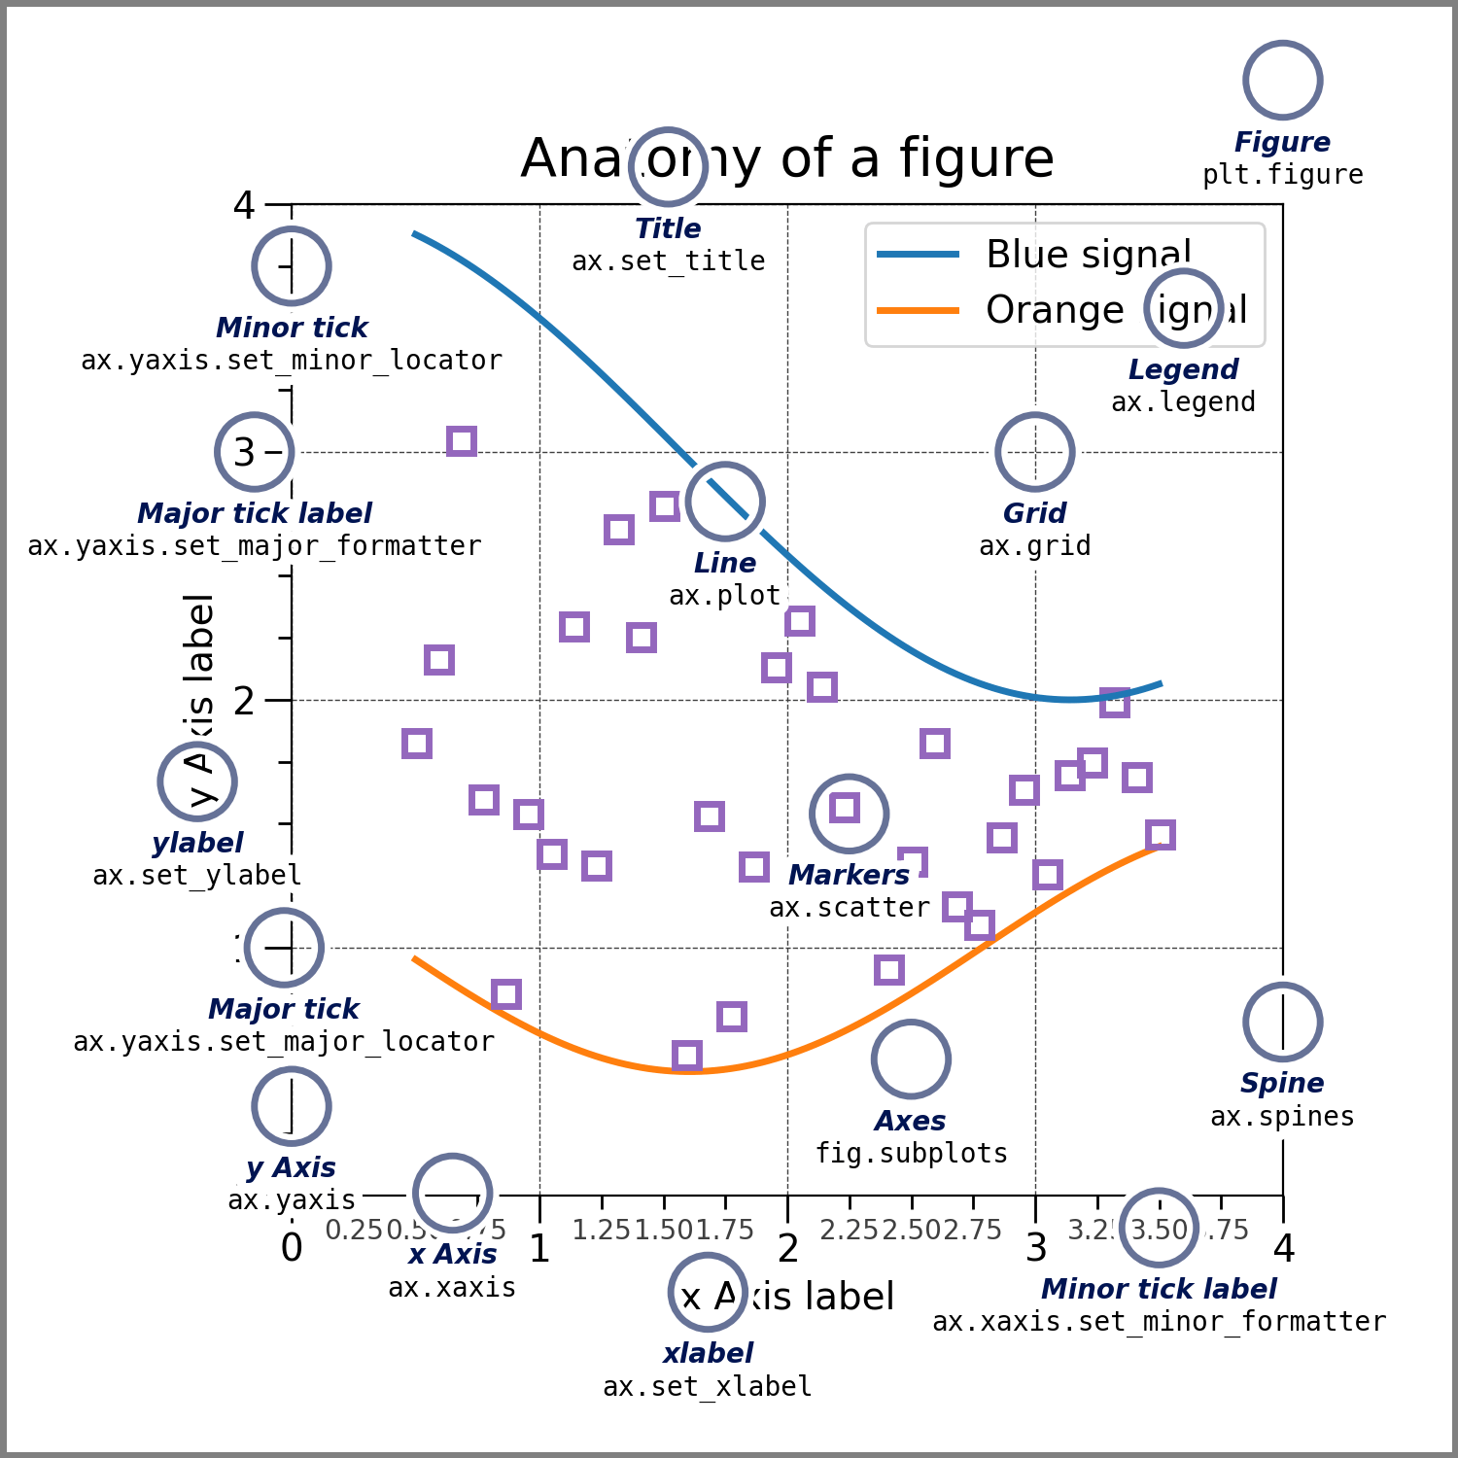

Slide 13
SUBPLOTING
# create a plot figure
plt.figure()
# create the first of two panels and set current axis
plt.subplot(2, 1, 1) # (rows, columns, panel number)
plt.plot(x1, np.sin(x1))
# create the second of two panels and set current axis
plt.subplot(2, 1, 2) # (rows, columns, panel number)
plt.plot(x1, np.cos(x1));
#==================================================================
plt.Figure(figsize=(5,5))
# subplot(row,column, ploting area )
plt.subplot(2,1,1)
plt.plot(x, np.sin(x),"--",color="red",label="sin graph")
plt.legend()
plt.subplot(2,1,2)
plt.plot(x, np.cos(x),"--", label="cos graph")
plt.legend(loc= 'upper left')
plt.show()
str or pair of floats, default: rcParams["legend.loc"] (default: 'best')
The location of the legend.
The strings 'upper left', 'upper right', 'lower left', 'lower right' place the legend at the corresponding corner of the axes.

Slide 14
# figsize=(2,3) width,height
# to define size of graph
plt.figure(figsize=(2,3))
plt.plot(x, np.sin(x),"--",color="red" ,marker="4",markerfacecolor="g",markeredgecolor="g",label="sin graph" )
plt.title("sin graph")
plt.plot(x, np.cos(x),"--", label="cos graph")
#create x and y label
plt.xlabel("range 1 to 10")
plt.ylabel("sin value")
# define the range of the x and y
plt.xticks(np.arange(0,11, 1))
plt.yticks(np.arange(-1,1, 0.1))
# define range of x
plt.xlim(1,20)
plt.ylim(-2,1)
plt.grid()
plt.legend(loc="upper left")
# 'upper left': # 'upper right': ,# 'lower left':#
plt.show()

Slide 15
# create a plot figure
plt.figure()
# create the first of two panels and set current axis
plt.subplot(2, 1, 1) # (rows, columns, panel number)
plt.plot(s)
# create the second of two panels and set current axis
plt.subplot(2, 1, 2) # (rows, columns, panel number)
plt.plot(cos)
plt.figure()
plt.subplot(2,2,1)
plt.plot(s)
plt.subplot(2,2,3)
plt.plot(cos)
plt.subplot(2,2,4)
plt.plot(np.random.randn(50))

Slide 16
BAR CHART
ADD DATA LABEL IN CHART
cat = ["a","b","c"]
sales = [343,384,300]
ax = sns.barplot(x=cat,y=sales , legend=cat, palette=['red', 'blue', 'green'])
for i in range(len(cat)):
ax.bar_label(ax.containers[i], fontsize=10)
plt.title("categories_wise sales")
plt.xlabel("categories")
plt.ylabel("sales amount")
plt.grid(axis="y")
plt.show()
# indivisual color each bar as gradient
HUE AND PALLATE
ax = sns.barplot(x=cat,y=sales ,hue=cat, legend=cat, palette="Greens")
for i in range(len(cat)):
ax.bar_label(ax.containers[i], fontsize=10)
# matplotlib
cat= ["a","b","c"]
sales= [343,384,300]
plt.bar(cat,sales)
plt.title("categories_wise sales")
plt.xlabel("categories")
plt.ylabel("sales amount")
plt.show()
# SEABORN
cat = ["a","b","c"]
sales = [343,384,300]
ax = sns.barplot(x=cat,y=sales ,hue=cat)
ax.bar_label(ax.containers[0], fontsize=10)
ax.bar_label(ax.containers[1], fontsize=10)
ax.bar_label(ax.containers[2], fontsize=10)
plt.title("categories_wise sales")
plt.xlabel("categories")
plt.ylabel("sales amount")
plt.show()
plt.bar(x, y, color='#FF5733')

Slide 17
SCATTER CHART
# scatter continous data --
sales=[45,34,12,67,54,32,23,12,12]
profit=np.random.randint(5, 13, len(sales))
print(sales)
print(profit)
plt.scatter(profit,sales)
gender = ['m','f','m','f','m','f','f','m','f']
sns.scatterplot(x=profit , y=sales,hue=gender)
plt.scatter(x, y, c='r', alpha=.9, marker="X" ) # alpha color intensity

Slide 18
SCATTER CHART
# scatter continous data --
sales=[45,34,12,67,54,32,23,12,12]
profit=np.random.randint(5, 13, len(sales))
print(sales)
print(profit)
plt.scatter(profit,sales)
gender = ['m','f','m','f','m','f','f','m','f']
sns.scatterplot(x=profit , y=sales,hue=gender)

Slide 19
3. Pie Chart
#pie chart
langs= ['C', 'Python', 'Java']
students= [20, 100, 40]
plt.pie(students, labels=langs, autopct='%1.1f%%')
plt.title("Pie chart")
plt.show()
my_explode= (0.0, 0.1, 0.1)
langs= ['C', 'Python', 'Java']
students= [20, 100, 40]
plt.pie(students, labels=langs, autopct='%1.1f%%', explode=my_explode, shadow= True)
plt.title("Pie chart")
plt.show()
plt.pie(data, labels=labels, colors=colors, explode=explode, autopct='%1.1f%%', shadow=True, startangle=90)

Slide 20
# Creating explode data
exp= (0.1, 0.0, 0.2, 0.3)
# Creating color parameters
col= ("orange", "cyan", "brown",
"grey")
a,b,c=plt.pie(sales,labels=cat,autopct="%.2f%%",explode=exp,colors=col)
plt.title('Sales by Category')
plt.show()

Slide 21
HISTOGRAM
# histogram
d1=np.random.randint(1,100, 1000)
d1
plt.hist(d1,bins=100)
#Histogram
data = np.random.randn(1000) #10 bins
plt.hist(data, bins = 20, color ='green')
plt.show()
sns.histplot(x=d1, kde=True)
# COUNT
d1 = np.random.randint(1,10, 1000)
d1
sns.countplot(x=d1)

Slide 22
#Boxplot >> to know outliers
#1, 2, 3, 4, 5, 100 >>> extreme data, for each day give me outlier for total bill
sns.boxplot(x='day', y='total_bill', data=tips, palette='rainbow')
sns.heatmap(tips_num.corr(), annot = True, cmap = 'coolwarm')
sns.countplot(x = 'sex', data=tips)

Slide 23
data.boxplot(column='Balance')
plt.violinplot(data['Balance'])
sns.jointplot(x = tips.total_bill, y=tips.tip)
sns.jointplot(x = tips.total_bill, y=tips.tip, data = tips, kind="reg")
sns.jointplot(x = tips.total_bill, y=tips.tip, data = tips, kind="hex")
sns.pairplot(tips, hue = 'smoker',)
sns.pairplot(tips, hue = 'smoker',palette = 'coolwarm')
# https://seaborn.pydata.org/generated/seaborn.color_palette.html
# https://seaborn.pydata.org/tutorial/color_palettes.html
#Boxplot >> to know outliers
#1, 2, 3, 4, 5, 100 >>> extreme data, for each day give me outlier for total bill
sns.boxplot(x='day', y='total_bill', data=tips, palette='rainbow')
sns.heatmap(tips_num.corr(), annot = True, cmap = 'coolwarm')
sns.countplot(x = 'sex', data=tips)

Slide 24
# 3D plot
x=np.random.rand(20)
y=np.random.rand(20)
z=np.random.rand(20)
fig=plt.figure()
ax=fig.add_subplot(projection='3d')
ax.scatter(x, y, z, c="#FF5733", alpha=.9)
plt.xlabel("x axis")
plt.ylabel("y axis")
plt.show()

Slide 25
1. Line Plot
age_count = titanic['age'].value_counts().sort_index() plt.plot(age_count.index, age_count.values) plt.title('Passenger Count by Age') plt.xlabel('Age') plt.ylabel('Count') plt.grid(True) plt.show()
2. Bar Chart
survived_class = titanic.groupby('pclass')['survived'].sum() survived_class.plot(kind='bar', color='skyblue') plt.title('Survivors by Passenger Class') plt.xlabel('Passenger Class') plt.ylabel('Number of Survivors') plt.show()
3. Pie Chart
gender = titanic['sex'].value_counts() plt.pie(gender, labels=gender.index, autopct='%1.1f%%', startangle=140) plt.title('Gender Distribution') plt.axis('equal') plt.show()
TITANIC DATA
🔢 Loading Titanic Dataset
import seaborn as sns
import pandas as pd
import matplotlib.pyplot as plt
# Load dataset
titanic = sns.load_dataset('titanic')
# Basic Exploration
titanic.head()
titanic.info()
titanic.describe()
Plot Type | Library | Usage Description
Line Plot | Matplotlib | Trends over continuous variables (e.g., age)
Bar Chart | Matplotlib | Compare categories (e.g., class)
Pie Chart | Matplotlib | Show proportions (e.g., gender)
Countplot | Seaborn | Count of categories
Barplot | Seaborn | Aggregated values by category
Violinplot | Seaborn | Distribution + comparison
Histplot | Seaborn | Distribution of single variable
Scatterplot | Seaborn | Relation between two numeric variables
Pairplot | Seaborn | Pairwise relationship + clustering
Heatmap | Seaborn | Correlation or matrix data

Slide 26
🌈 Seaborn Basics
1. Countplotsns.countplot(x='class', hue='survived', data=titanic) plt.title('Survival Count by Class') plt.show()
2. Barplotsns.barplot(x='embark_town', y='fare', data=titanic) plt.title('Average Fare by Embark Town') plt.show()
3. Violinplotsns.violinplot(x='class', y='age', hue='survived', data=titanic, split=True) plt.title('Age Distribution by Class and Survival') plt.show()
📊 Distribution and Regression Plots
1. Histplotsns.histplot(data=titanic, x='age', bins=20, kde=True) plt.title('Age Distribution') plt.show()
2. Scatterplotsns.scatterplot(x='age', y='fare', hue='survived', data=titanic) plt.title('Fare vs Age by Survival') plt.show()
3. Lineplotsns.lineplot(data=titanic, x='age', y='survived') plt.title('Survival Trend by Age') plt.show()
🤝

Slide 27
🤝 Pairplot and Heatmap
1. Pairplot
sns.pairplot(titanic[['age', 'fare', 'survived']], hue='survived') plt.show()
2. Correlation Heatmap
corr = titanic.corr(numeric_only=True) sns.heatmap(corr, annot=True, cmap='coolwarm', fmt='.2f') plt.title('Correlation Heatmap') plt.show()
🎭 Customizing and Styling
sns.set_style('whitegrid') sns.set_context('talk') sns.barplot(x='sex', y='survived', data=titanic, palette='pastel') plt.title('Survival Rate by Gender - Styled') plt.show()
🎨 Final EDA Project Task
Create a visual analysis report answering:
Who survived more? (Gender/Class/Age?)
Does age impact survival?
Fare vs survival?

Slide 28
THANK YOU

