Slide 1

Power Bi

Slide 2
learn resource mysql
https://www.mysqltutorial.org
https://www.geeksforgeeks.org/mysql-tutorial/?ref=lbp
- online complier
https://onecompiler.com/mysql
- Pracice
1. sqlbotl
2, hackerrank
3.https://sqlpad.io/playground/mysql/
4. https://8weeksqlchallenge.com/case-study-6/ -- analyst
INTERVIEW QUESTIONS
https://youtu.be/u7yAypveDRo?si=uKmf_74MuuUAwDn6
https://www.simplilearn.com/power-bi-interview-questions-and-answers-article
https://github.com/virajbhutada/power-BI-resources
https://medium.com/microsoft-power-bi/power-bi-interview-questions-part-2-de5c7b16db84
https://medium.com/microsoft-power-bi/power-bi-interview-questions-part-1-4982de3be327

Slide 3
Introduction to Power BI
Introduction to Business Intelligence
Self Service Business Intelligence
SSBI Tools
What is Power BI?
Key Benefits of Power BI
Architecture of Power BI
Building Blocks of Power BI
Power BI Job Role
https://www.javatpoint.com/power-bi
Getting Started with Power BI
▪ Setting Up Office365 Business Basic Trial Account
▪ Power BI Service License Comparison
▪ Downloading Power BI Desktop
https://www.microsoft.com/en-AU/microsoft-365/business/compare-all-microsoft-365-business-products-b
https://app.powerbi.com/
https://youtu.be/J1g_NbRfIX4?si=wgPDsAVrwNrEdlmC

Slide 4
Power BI Desktop & Power Query
Introduction to Power BI Desktop
Installation of Power Bi Desktop
Data Sources in Power BI Desktop
How to connect to different Data Sources Using Power BI Desktop
Introduction to Query Editor in Power Bi
Cleaning irregularly formatted data
Combining Data: Merging and Appending
Query Duplicate, Query Reference
https://learn.microsoft.com/en-us/power-bi/fundamentals/desktop-getting-started
https://www.tutorialspoint.com/power_bi/index.htm
https://www.geeksforgeeks.org/power-bi-tutorial/

Slide 5
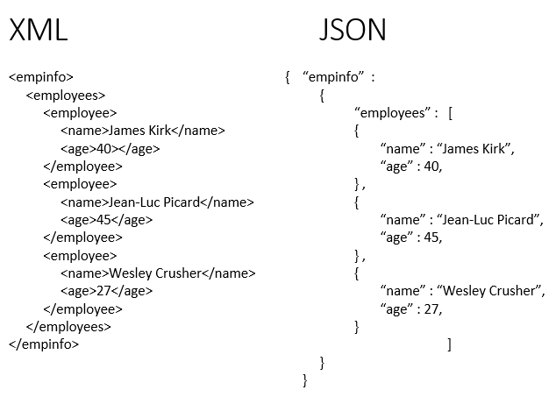
Clean and Transform data
Editing Rows and Columns
Replacing Values
Changing Data Types of columns
Pivoting and Unpivoting Columns
Splitting Columns
Adding New Columns E.g. Conditional Columns,Index Columns etc.
Assignment
Introduction to Data Modeling
Understanding Data Modeling
Cardinality and Cross Filter Direction
▪ Deleting Relationships
▪ Creating New Relationships: Drag and Drop
https://learn.microsoft.com/en-us/power-bi/transform-model/desktop-relationships-understand
https://pivotalstats.com/complete-guide-to-create-data-models-table-relationships-in-power-bi/
https://www.phdata.io/blog/data-modeling-fundamentals-in-power-bi/

Slide 6
Data Analysis Expressions (DAX)
Introduction to DAX
Difference Between M Query and DAX Query
https://www.linkedin.com/pulse/whats-difference-between-dax-power-query-m-enterprisednaofficial-fyvac/
DAX Data Types ,DAX Operators https://learn.microsoft.com/en-us/dax/dax-operator-reference
DAX Measures and Calculations , ROW Context and Filter Context https://www.geeksforgeeks.org/row-context-and-filter-context-in-power-bi/
Aggregation functions -Sum,Sumx,count family,min,minx,mina,max,maxx,average,averagex
https://learn.microsoft.com/en-us/dax/aggregation-functions-dax
Text Functions
https://www.geeksforgeeks.org/power-bi-dax-text-functions/
https://learn.microsoft.com/en-us/dax/

Slide 7
Date and Time Function, Time Intelligence : CALENDER AND CALENDER AUTO, Deriving Year, Quarter, Month, Day
https://learn.microsoft.com/en-us/dax/time-intelligence-functions-dax
Filter Function : ALL,ALLEXCEPT,ALLSELECT,FILTER,CALCULATE TABLE,RANK,SELECTEDVALUE,SUMMERIZE,TOPN
https://learn.microsoft.com/en-us/dax/filter-functions-dax
Most Versatile DAX Function:-CALCULATE DAX https://www.datacamp.com/tutorial/power-bi-calculate-tutorial
IF and Switch in DAX https://radacad.com/write-conditional-statement-using-switch-in-dax-and-power-bi
https://www.geeksforgeeks.org/data-analysis-expressions-dax/
https://radacad.com/power-bi-dax-all-vs-allselected
https://medium.com/@arpita3696/dax-all-allselected-allexcept-85ff3cf7bf9d

Slide 8
Data Visualization
Introduction to Data Visualizations
Charts in Power BI
Matrixes and tables
Map Visualizations
Gauges and Cards https://learn.microsoft.com/en-us/power-bi/visuals/power-bi-visualization-radial-gauge-charts
KPI Visuals
https://learn.microsoft.com/en-us/power-bi/visuals/power-bi-visualization-waterfall-charts
https://www.datacamp.com/tutorial/power-bi-kpi
Color Formatting and Configuring Visualizations
https://learn.microsoft.com/en-us/power-bi/visuals/service-getting-started-with-color-formatting-and-axis-properties
https://learn.microsoft.com/en-us/power-bi/create-reports/desktop-conditional-table-formatting

Slide 9
Shapes, Text Boxes and Images
https://learn.microsoft.com/en-us/power-bi/create-reports/service-dashboard-add-widget
Page Layout and Z-order
https://learn.microsoft.com/en-us/power-bi/create-reports/desktop-gridlines-snap-to-grid?tabs=powerbi-desktop#use-z-order
https://qmetrix.com.au/bi-dashboards-visualisation-techniques-design-elements-and-screen-real-estate/
What Are Custom Visuals?
https://blogs.perficient.com/2022/09/09/top-custom-visuals-in-power-bi/
Assignment
https://github.com/Sanjesh12/Power-BI-Assignment
https://learn.microsoft.com/en-us/power-bi/create-reports/desktop-grouping-visuals
https://learn.microsoft.com/en-us/power-bi/visuals/power-bi-visualization-slicers
https://learn.microsoft.com/en-us/power-bi/create-reports/buttons-apply-all-clear-all-slicers
https://learn.microsoft.com/en-us/power-bi/create-reports/desktop-drill-through-buttons
https://www.phdata.io/blog/how-to-create-a-drill-through-in-power-bi/
https://learn.microsoft.com/en-us/power-bi/create-reports/desktop-drillthrough
https://learn.microsoft.com/en-us/power-bi/consumer/end-user-q-and-a
https://qmetrix.com.au/bi-dashboards-visualisation-techniques-design-elements-and-screen-real-estate/

Slide 10
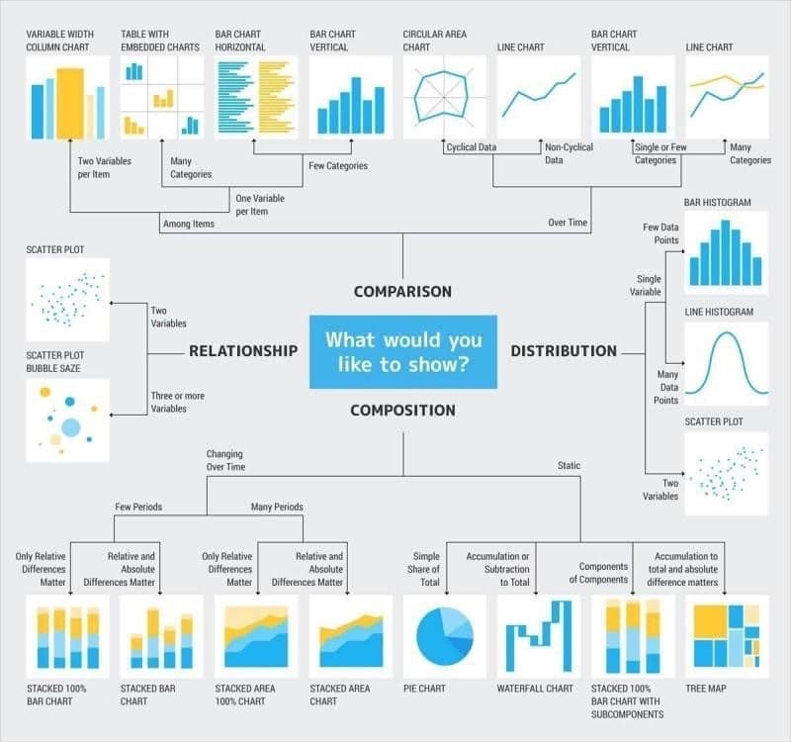

Slide 11
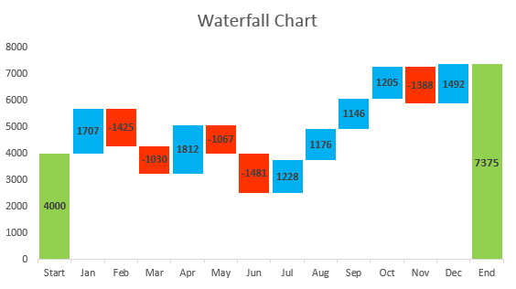
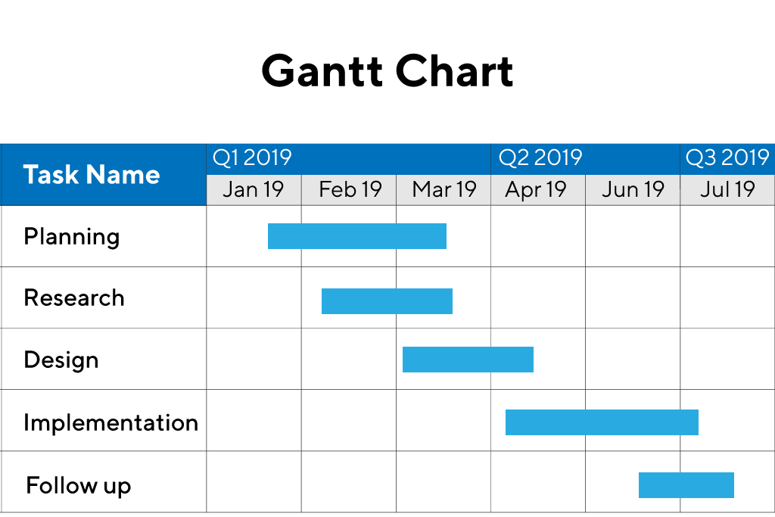
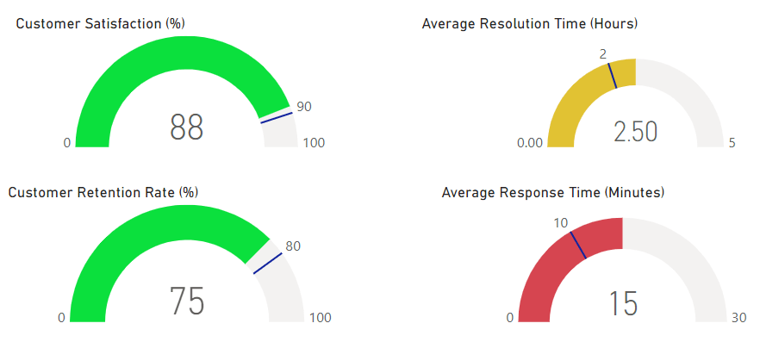
https://www.ablebits.com/office-addins-blog/waterfall-chart-in-excel/
https://www.productplan.com/glossary/gantt-chart/
https://blog.coupler.io/power-bi-gauge/

Slide 12
Introduction to Power BI Dashboard, Q&A and Data Insights
Create Dashboard with interactivity (Slicers and Filters)
https://skillzcafe.com/blog/microsoft/power-bi/creating-interactive-reports-with-power-bi-filters-and-slicers
Q & A
https://www.acuitytraining.co.uk/news-tips/qa-visual-in-power-bi/
Smart Narrative
https://www.acuitytraining.co.uk/news-tips/smart-narrative-visual/
Decomposition Tree
https://www.acuitytraining.co.uk/news-tips/decomposition-tree-visual-in-power-bi/
Key Infulencers
https://www.acuitytraining.co.uk/news-tips/key-influencer-visual/
Power BI Mobile
https://learn.microsoft.com/en-us/power-bi/consumer/mobile/mobile-apps-quickstart-view-dashboard-report
https://www.acuitytraining.co.uk/news-tips/creating-a-gantt-chart-in-power-bi/
https://www.acuitytraining.co.uk/news-tips/power-bi-bullet-chart/
https://infiniticube.com/blog/how-do-you-create-interactive-dashboards-with-power-bi/

Slide 13
Power Bi Service
Power BI Service Introduction to app.powerbi.com
Schedule refresh
https://www.analyticodigital.com/blog/how-to-set-up-scheduled-refreshes-power-bi
Data flow and use power bi from online
https://www.phdata.io/blog/how-and-when-to-use-dataflows-in-power-bi/
Download data as live in power point and more
https://learn.microsoft.com/en-us/power-bi/collaborate-share/end-user-powerpoint
Power BI is a collection of software services, apps, and connectors that work together to help you create, share, and consume business insights in the way that serves you and your business most effectively.
https://playground.powerbi.com/en-us/
https://3cloudsolutions.com/resources/what-are-power-bi-apps/
https://epmstrategy.com/power-bi-how-to-create-an-app-on-the-microsoft-power-bi-service/

Slide 14
Power BI Direct Connectivity
Data Gateways
https://radacad.com/the-power-bi-gateway-all-you-need-to-know
DirectQuery, Live Connection or Import Data
https://radacad.com/directquery-live-connection-or-import-data-tough-decision
Connect to on-premises SQL Server database using Gateway
https://nishantrana.me/2020/07/06/configuring-on-premises-data-gateway-to-connect-tosql-server-on-premise-data-source-power-platform/

Slide 15
Case Study/Project
Cricket World Cup Analysis Introducing PowerBI with AI
https://www.youtube.com/watch?v=YxVnWfY20M0

Slide 16
Case Study/Project
CAR SALES PROJECT

Slide 17
Publish https://learn.microsoft.com/en-us/power-bi/create-reports/desktop-upload-desktop-files
copilot https://www.datacamp.com/tutorial/power-bi-copilot
https://learn.microsoft.com/en-us/power-bi/create-reports/copilot-introduction
power platform
paginated report
https://learn.microsoft.com/en-us/power-bi/paginated-reports/paginated-reports-report-builder-power-bi
https://learn.microsoft.com/en-us/power-bi/paginated-reports/paginated-reports-samples
https://www.inogic.com/blog/2023/06/develop-paginated-report-using-power-bi-report-builder/
power apps
https://learn.microsoft.com/en-us/power-apps/powerapps-overview
https://medium.com/@thomas.j.blessing/power-bi-vs-power-apps-vs-power-automate-9ca45e5d9773
power automate
https://www.datapears.com/post/power-bi-power-automate-everything-you-need-to-know
https://learn.microsoft.com/en-us/power-bi/create-reports/power-bi-automate-visual
https://hatfullofdata.blog/power-automate-get-data-from-a-power-bi-dataset/

Slide 18
Buttons
https://databear.com/buttons-in-power-bi/
https://www.cittros.com/insights/create-buttons-in-power-bi
https://learn.microsoft.com/en-us/power-bi/create-reports/desktop-buttons?tabs=powerbi-desktop
Parameters
https://learn.microsoft.com/en-us/power-query/power-query-query-parameters
https://www.sqlbi.com/articles/fields-parameters-in-power-bi/
https://www.red-gate.com/simple-talk/databases/sql-server/bi-sql-server/power-bi-introduction-working-with-parameters-in-power-bi-desktop-part-4/
https://learn.microsoft.com/en-us/power-bi/transform-model/desktop-what-if
view
bookmark
https://learn.microsoft.com/en-us/power-bi/create-reports/desktop-bookmarks
https://www.tpximpact.com/knowledge-hub/blogs/tech/power-bi-bookmarks-buttons-toggles
https://www.wallstreetmojo.com/power-bi-bookmarks/
filters
selections
sync filters
Optimize

Slide 19
Project: 1 Project - In United States, there are many stores in which a survey was conducted based on students i.e. how much they are spending on different kind of purchases like Video games, Indoor games, Toys, Books, Gadgets etc. In the data set (Student Survey), Store setting is the column that explains the Type of location in which the store is present. By using data set (Student Survey), try to extract the meaningful Insights.
Industry Type – Retail Store
Data set - Student survey https://docs.google.com/spreadsheets/d/19PAZIJ7T2pvf50t94_R5tZCiog_aaP24/edit?usp=sharing&ouid=113177982973203432452&rtpof=true&sd=true
Problem Statement- Create a Power BI Report: 1. Tabular Visualization - Format the total amount of purchase (TAP) based on ‘Store location’ and ‘Store setting’: -
• If 0<TAP<35000, then records should be in red color ·
• If 35000<=TAP<60000, then records should be in yellow color
• If TAP>=60000, then records should be in Blue color

Slide 20
2 Matrix Visualization – Create Matrix Visualization to show the amount spent on Outdoor sports across different ages and ‘Store setting’. Do the color formatting for the amount spent in total outdoor sports.
3. Funnel chart – Create a Funnel chart to show Total amount of purchase by ‘Store setting’. Show the data labels as Percentage of First.
4. Pie chart – Show the total amount of purchase by different ‘Store location’ for Suburban ‘Store setting’ only. Hint: Use Filter context
5. a) Scatter plot - Video games purchase and Outdoor sports spent across the different ages. b) any plot - Indoor sports and Video games spent across the different age groups.
6. Restrict data access for the given users in User mapping table. For ex. Mani deals with Rural area only so she should be able to view the data which belongs to Rural only, not urban and suburban data.
7. Publish the report on Power BI cloud service and Design the Master Dashboard consisting of Funnel chart and scatter plots. Then create a schedule refresh for six times in every 4 hours for the Dashboard in a day.
8. Use Q&A feature of Power BI –
a) To show average age of students
b) Donut chart for total amount of purchases by ‘Store location

Slide 21
Thank You !

