Slide 1

Diving into world of data

Slide 2
https://github.com/krishnaik06/Python-Practise-Problems/blob/main/7%20dayss%20Statistics-converted%20(1).pdf
https://www.geeksforgeeks.org/ml-linear-regression/
also here the maths topics shows

Slide 3
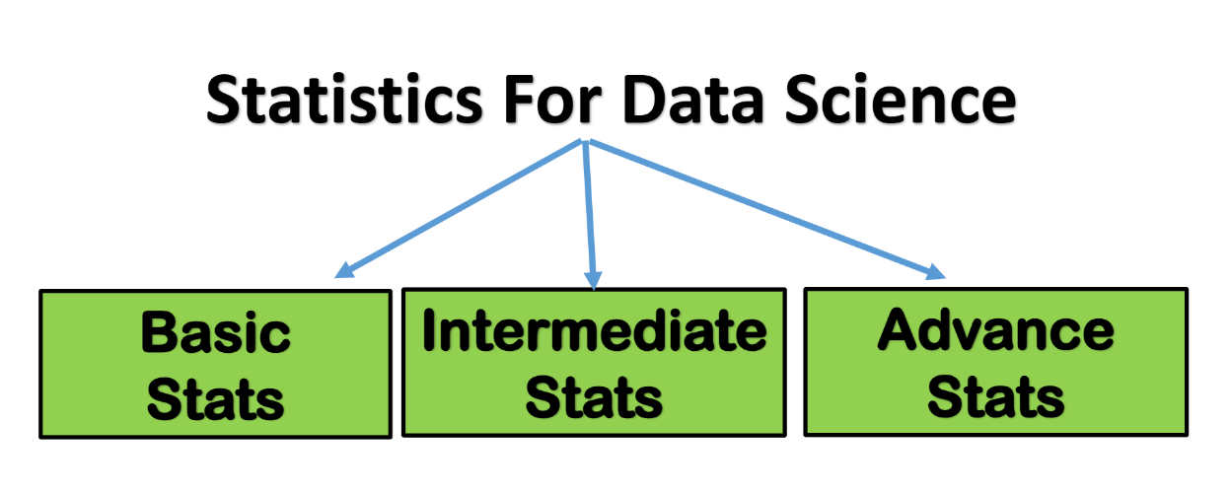
Predicting from Data (Inferential Statistics) Sep 10, 2024
Sampling Technique-Random Sampling,Stratified Sampling
Hypothesis Testing
Central Limit Theorem
Estimating Population Parameters
P values, Type 1 and Type 2 Errors
Visualising Data Sep 02, 2024
What is Data
Data Definition
Line Chart, Scatter Chart
Bar Graph, Histogram, Pie Chart, Frequency Graphs
Characterising Data (Descriptive Statistics)
Measure of Central Tendency
Measure of Dispersion
Measure of Association
Skewness
Probability Basics
Uniform Distribution
Binomial Distribution
Standard Normal Distribution
Craft your Data
Data Collection Techniques
Data Cleaning and Preparation (Raw to Processed)

Slide 4
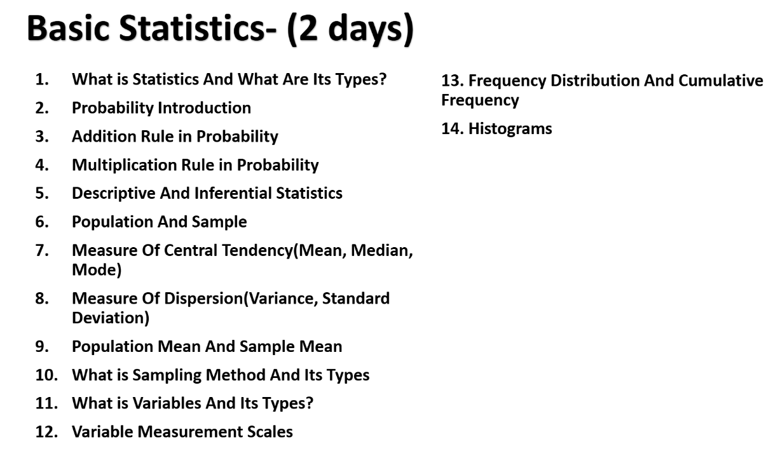

Slide 5
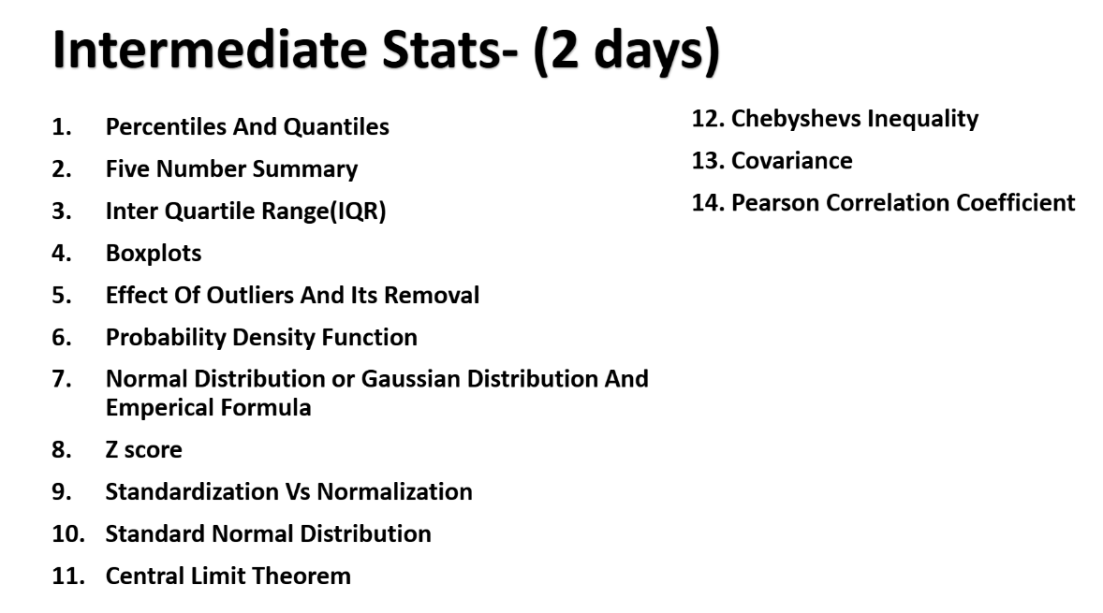

Slide 6
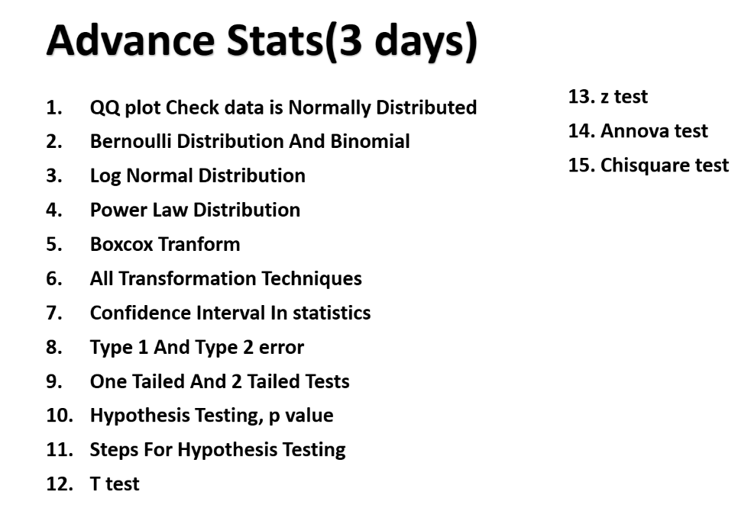

Slide 7
https://github.com/OBenner/data-engineering-interview-questions/blob/master/content/spark.md
https://github.com/ml-tooling/best-of-ml-python?tab=readme-ov-file

Slide 9
Thank You !

