Slide 1


Slide 2
CONTEXT
Module 3: Array Indexing and Slicing
Accessing elements (1-D, 2-D, 3-D arrays).
Negative indexing.
Slicing: [start:end:step] syntax.
Slicing in 2-D and higher-dimensional arrays.
Fancy indexing and boolean indexing.
Module 4: Data Types and Type Conversion
NumPy data types (int, float, bool, string, etc.).
Specifying dtype during array creation.
Type conversion using astype().
Difference between copy() and view().
Module 1: Introduction to NumPy
What is NumPy and why use it?
Key features of NumPy vs Python lists.
Installing and importing NumPy.
Checking NumPy version and basic setup.
Real-world applications of NumPy in Data Science & Machine Learning.
Module 2: NumPy Arrays
Understanding ndarray (NumPy array object).
Creating arrays:
From lists and tuples.
Using functions: np.array(), np.zeros(), np.ones(), np.arange(), np.linspace(), np.eye().
Random arrays: np.random.rand(), np.random.randint(), np.random.choice().
Understanding array dimensions: 0-D, 1-D, 2-D, 3-D, n-D arrays.
Attributes of arrays: ndim, shape, size, dtype, itemsize.
https://docs.google.com/document/d/1WWJhu9yMGZv3hJsg_XWFucGUqpI78G6XZj5sZQbXY8Q/edit?usp=sharing

Slide 3
Module 5: Array Shape & Reshaping
Understanding the shape of arrays (shape attribute).
Reshaping arrays: reshape().
Flattening arrays: flatten(), ravel().
Adding or removing dimensions.
Using ndmin to create multi-dimensional arrays.
Unknown dimension -1 in reshape.
Module 6: Iterating Arrays
Iterating 1-D, 2-D, and 3-D arrays.
Using nditer() and ndenumerate() for efficient iteration.
Module 7: Array Operations
Element-wise operations: +, -, *, /, **.
Universal functions (ufuncs):
Mathematical functions: sqrt, exp, log, log10.
Trigonometric functions: sin, cos, tan.
Aggregation functions:
sum, mean, median, min, max, std, var.
Comparison operations: ==, !=, >, <.
Logical operations: np.logical_and(), np.logical_or().
Module 8: Broadcasting
What is broadcasting?
Rules of broadcasting.
Broadcasting with different shapes.
Functions: np.broadcast(), np.maximum(), np.minimum().
Module 9: Array Manipulation
Transpose of an array (.T).
Stacking: hstack(), vstack(), dstack().
Splitting arrays: split(), hsplit(), vsplit().
Concatenation: concatenate().
Insertion and deletion.
Module 10: Sorting & Searching
Sorting arrays: np.sort().
Indices of sorted elements: np.argsort().
Searching:
np.where()
np.searchsorted()
np.nonzero()

Slide 4
Module 11: Random Number Generation
np.random.rand(), np.random.randint().
np.random.choice().
Shuffling arrays: np.random.shuffle().
Random sampling.
Module 12: Linear Algebra in NumPy
Matrix multiplication: dot(), matmul(), @.
Determinant: np.linalg.det().
Inverse of a matrix: np.linalg.inv().
Rank and trace.
Solving linear equations: np.linalg.solve(A, b).
Eigenvalues and Eigenvectors.
Module 13: Stats & Data Analysis
mean, median, percentile.
Variance and standard deviation.
Covariance matrix: np.cov().
Correlation matrix: np.corrcoef().
Histograms: np.histogram().
Module 14: Handling Missing Data
Checking for NaN values: np.isnan().
Checking finite values: np.isfinite().
Replacing or removing NaN values.
Module 15: Advanced Topics
Memory layout: C_CONTIGUOUS vs F_CONTIGUOUS.
Performance optimization with vectorization.
Broadcasting tricks in machine learning.
Working with large datasets using NumPy.
Module 16: Real-World Applications
Representing datasets as matrices.
Implementing Linear Regression with NumPy.
PCA using covariance and eigenvectors.
Matrix operations in Neural Networks (forward propagation example).

Slide 5
Module 17: Interview Preparation
Conceptual Questions:
Difference between Python lists and NumPy arrays.
What is broadcasting and vectorization?
Difference between reshape() and ravel().
Difference between copy() and view().
Coding Questions:
Create a checkerboard matrix (8x8).
Normalize a random 1-D array.
Find the common elements of two arrays.
Replace odd numbers with -1.
Solve a system of equations using np.linalg.solve().
Module 18: Practice Assignments
50 coding exercises:
Array creation, slicing, indexing tasks.
Matrix manipulations and broadcasting exercises.
Real-world tasks:
Generate synthetic datasets (random samples).
Perform statistics on sample datasets.
Implement simple ML algorithms using NumPy.

Slide 6
Introduction:--
NumPy is a Python library.
NumPy is used for working with arrays.
NumPy is short for "Numerical Python".
It also has functions for working in domain of linear algebra, fourier transform, and matrices.
NumPy was created in 2005 by Travis Oliphant. It is an open source project and you can use it freely.
NumPy stands for Numerical Python.

Slide 8
NumPy Introduction
Create a NumPy array:
import numpy as np
arr = np.array([1, 2, 3, 4, 5])
print(arr)
print(type(arr))
print(arr.dtype)

Slide 9
Why Use NumPy?
NumPy aims to provide an array object that is up to 50x faster than traditional Python lists.
The array object in NumPy is called ndarray, it provides a lot of supporting functions that make working with ndarray very easy.
Arrays are very frequently used in data science, where speed and resources are very important.
NumPy arrays are stored at one continuous place in memory unlike lists, so processes can access and manipulate them very efficiently.
This behavior is called locality of reference in computer science.
This is the main reason why NumPy is faster than lists. Also it is optimized to work with latest CPU architectures.

Slide 10
Checking NumPy Version
import numpy as np
print(np.__version__)

Slide 11
Create a NumPy ndarray Object
NumPy is used to work with arrays. The array object in NumPy is called ndarray.
We can create a NumPy ndarray object by using the array() function.
import numpy as np
arr = np.array([1, 2, 3, 4, 5])
print(arr)
print(type(arr))
type(): This built-in Python function tells us the type of the object passed to it. Like in above code it shows that arr is numpy.ndarray type.
To create an ndarray, we can pass a list, tuple or any array-like object into the array() method, and it will be converted into an ndarray:

Slide 12
Dimensions in Arrays
A dimension in arrays is one level of array depth (nested arrays).
0-D Arrays
0-D arrays, or Scalars, are the elements in an array. Each value in an array is a 0-D array.
import numpy as np
arr = np.array(42)
print(arr)

Slide 13
1-D Arrays
An array that has 0-D arrays as its elements is called uni-dimensional or 1-D array.
These are the most common and basic arrays.
Create a 1-D array containing the values 1,2,3,4,5:
import numpy as np
arr = np.array([1, 2, 3, 4, 5])
print(arr)

Slide 14
2-D Arrays
An array that has 1-D arrays as its elements is called a 2-D array.
These are often used to represent matrix or 2nd order tensors.
NumPy has a whole sub module dedicated towards matrix operations called numpy.mat
Create a 2-D array containing two arrays with the values 1,2,3 and 4,5,6:
import numpy as np
arr = np.array([[1, 2, 3], [4, 5, 6]])
print(arr)

Slide 15
3-D arrays
An array that has 2-D arrays (matrices) as its elements is called 3-D array.
These are often used to represent a 3rd order tensor.
Example
Create a 3-D array with two 2-D arrays, both containing two arrays with the values 1,2,3 and 4,5,6:
import numpy as np
arr = np.array([[[1, 2, 3], [4, 5, 6]], [[1, 2, 3], [4, 5, 6]]])
print(arr)

Slide 16
Check Number of Dimensions?
NumPy Arrays provides the ndim attribute that returns an integer that tells us how many dimensions the array have.

Slide 17
Higher Dimensional Arrays
An array can have any number of dimensions.
When the array is created, you can define the number of dimensions by using the ndmin argument.
Example
Create an array with 5 dimensions and verify that it has 5 dimensions:
import numpy as np
arr = np.array([1, 2, 3, 4], ndmin=5)
print(arr)
print('number of dimensions :', arr.ndim)

Slide 18
In this array the innermost dimension (5th dim) has 4 elements, the 4th dim has 1 element that is the vector, the 3rd dim has 1 element that is the matrix with the vector, the 2nd dim has 1 element that is 3D array and 1st dim has 1 element that is a 4D array.

Slide 19
NumPy Array Indexing
Array indexing is the same as accessing an array element.
You can access an array element by referring to its index number.
The indexes in NumPy arrays start with 0, meaning that the first element has index 0, and the second has index 1 etc.
import numpy as np
arr = np.array([1, 2, 3, 4])
print(arr[0])

Slide 20
Access 2-D Arrays
To access elements from 2-D arrays we can use comma separated integers representing the dimension and the index of the element.
Think of 2-D arrays like a table with rows and columns, where the dimension represents the row and the index represents the column.
import numpy as np
arr = np.array([[1,2,3,4,5], [6,7,8,9,10]])
print('2nd element on 1st row: ', arr[0, 1])

Slide 21
Access 3-D Arrays
To access elements from 3-D arrays we can use comma separated integers representing the dimensions and the index of the element.
import numpy as np
arr = np.array([[[1, 2, 3], [4, 5, 6]], [[7, 8, 9], [10, 11, 12]]])
print(arr[0, 1, 2])

Slide 22
Example Explained
arr[0, 1, 2] prints the value 6.
And this is why:
The first number represents the first dimension, which contains two arrays: [[1, 2, 3], [4, 5, 6]] and: [[7, 8, 9], [10, 11, 12]] Since we selected 0, we are left with the first array: [[1, 2, 3], [4, 5, 6]]
The second number represents the second dimension, which also contains two arrays: [1, 2, 3]

Slide 23
and: [4, 5, 6] Since we selected 1, we are left with the second array: [4, 5, 6]
The third number represents the third dimension, which contains three values: 4 5 6 Since we selected 2, we end up with the third value: 6

Slide 24
Negative Indexing
Use negative indexing to access an array from the end.
Example
Print the last element from the 2nd dim:
import numpy as np
arr = np.array([[1,2,3,4,5], [6,7,8,9,10]])
print('Last element from 2nd dim: ', arr[1, -1])

Slide 25
NumPy Array Slicing
Slicing in python means taking elements from one given index to another given index.
We pass slice instead of index like this: [start:end].
We can also define the step, like this: [start:end:step].
If we don't pass start its considered 0
If we don't pass end its considered length of array in that dimension
If we don't pass step its considered 1
import numpy as np
arr = np.array([1, 2, 3, 4, 5, 6, 7])
print(arr[1:5])

Slide 26
Slicing 2-D Arrays
import numpy as np
arr = np.array([[1, 2, 3, 4, 5], [6, 7, 8, 9, 10]])
print(arr[1, 1:4])

Slide 27
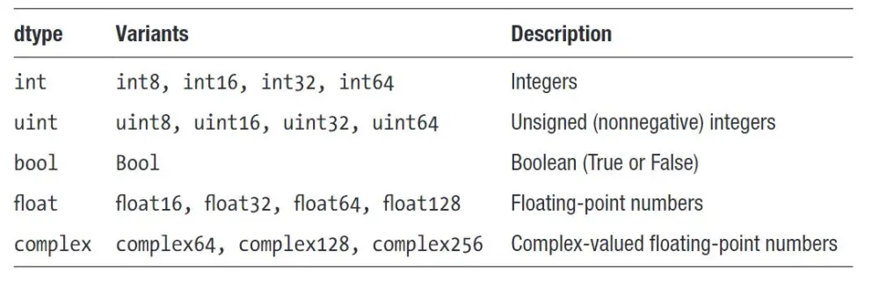
Data Types in NumPy
NumPy has some extra data types, and refer to data types with one character, like i for integers, u for unsigned integers etc.
Below is a list of all data types in NumPy and the characters used to represent them.
i - integer
b - boolean
u - unsigned integer
f - float
c - complex float
m - timedelta
M - datetime
O - object
S - string
U - unicode string
V - fixed chunk of memory for other type ( void )

Slide 28
Creating Arrays With a Defined Data Type
We use the array() function to create arrays, this function can take an optional argument: dtype that allows us to define the expected data type of the array elements:
import numpy as np
arr = np.array([1, 2, 3, 4], dtype='S')
print(arr)
print(arr.dtype)

Slide 29
Converting Data Type on Existing Arrays
The best way to change the data type of an existing array, is to make a copy of the array with the astype() method.
The astype() function creates a copy of the array, and allows you to specify the data type as a parameter.
The data type can be specified using a string, like 'f' for float, 'i' for integer etc. or you can use the data type directly like float for float and int for integer.
import numpy as np
arr = np.array([1.1, 2.1, 3.1])
newarr = arr.astype('i')
print(newarr)
print(newarr.dtype)

Slide 30
As mentioned above, copies owns the data, and views does not own the data, but how can we check this?
Every NumPy array has the attribute base that returns None if the array owns the data.
Otherwise, the base attribute refers to the original object.
import numpy as np
arr = np.array([1, 2, 3, 4, 5])
x = arr.copy()
y = arr.view()
print(x.base)
print(y.base)

Slide 31
NumPy Array Shape
The shape of an array is the number of elements in each dimension.
NumPy arrays have an attribute called shape that returns a tuple with each index having the number of corresponding elements.
import numpy as np
arr = np.array([[1, 2, 3, 4], [5, 6, 7, 8]])
print(arr.shape)

Slide 32
Create an array with 5 dimensions using ndmin using a vector with values 1,2,3,4 and verify that last dimension has value 4:
import numpy as np
arr = np.array([1, 2, 3, 4], ndmin=5)
print(arr)
print('shape of array :', arr.shape)

Slide 33
NumPy Array Reshaping
Reshaping arrays
Reshaping means changing the shape of an array.
The shape of an array is the number of elements in each dimension.
By reshaping we can add or remove dimensions or change number of elements in each dimension.
Reshape From 1-D to 2-D
import numpy as np
arr = np.array([1, 2, 3, 4, 5, 6, 7, 8, 9, 10, 11, 12])
newarr = arr.reshape(4, 3)
print(newarr)

Slide 34
Reshape From 1-D to 3-D
import numpy as np
arr = np.array([1, 2, 3, 4, 5, 6, 7, 8, 9, 10, 11, 12])
newarr = arr.reshape(2, 3, 2)
print(newarr)

Slide 35
Unknown Dimension
You are allowed to have one "unknown" dimension.
Meaning that you do not have to specify an exact number for one of the dimensions in the reshape method.
Pass -1 as the value, and NumPy will calculate this number for you.
import numpy as np
arr = np.array([1, 2, 3, 4, 5, 6, 7, 8])
newarr = arr.reshape(2, 2, -1)
print(newarr)
Convert 1D array with 8 elements to 3D array with 2x2 elements:

Slide 36
Iterating Arrays
Iterating means going through elements one by one.
As we deal with multi-dimensional arrays in numpy, we can do this using basic for loop of python.
If we iterate on a 1-D array it will go through each element one by one.
import numpy as np
arr = np.array([1, 2, 3])
for x in arr:
print(x)

Slide 37
Iterating 2-D Arrays
import numpy as np
arr = np.array([[1, 2, 3], [4, 5, 6]])
for x in arr:
print(x)

Slide 38
Iterate on each scalar element of the 2-D array:
import numpy as np
arr = np.array([[1, 2, 3], [4, 5, 6]])
for x in arr:
for y in x:
print(y)

Slide 39
Iterating 3-D Arrays
import numpy as np
arr = np.array([[[1, 2, 3], [4, 5, 6]], [[7, 8, 9], [10, 11, 12]]])
for x in arr:
print(x)

Slide 40
Iterate down to the scalars:
import numpy as np
arr = np.array([[[1, 2, 3], [4, 5, 6]], [[7, 8, 9], [10, 11, 12]]])
for x in arr:
for y in x:
for z in y:
print(z)

Slide 41
Iterating Arrays Using nditer()
The function nditer() is a helping function that can be used from very basic to very advanced iterations. It solves some basic issues which we face in iteration, lets go through it with examples.
import numpy as np
arr = np.array([[[1, 2], [3, 4]], [[5, 6], [7, 8]]])
for x in np.nditer(arr):
print(x)

Slide 42
Some other NumPy Arrays
arr_zeros = np.zeros((3, 4)) # 3 rows and 4 columns
# With ones
arr_ones = np.ones((2, 3)) # 2 rows and 3 columns
# With a range of values
arr_range = np.arange(0, 10, 2) # start, stop, step
# With equally spaced values
arr_linspace = np.linspace(0, 1, 5) # start, stop, number of values
# With random values
arr_random = np.random.rand(3, 2) # 3 rows and 2 columns with values between 0 and 1

Slide 43
Array Operations
NumPy supports various element-wise mathematical operations on arrays:
import numpy as np
arr1 = np.array([1, 2, 3])
arr2 = np.array([4, 5, 6])
# Element-wise addition
result_add = arr1 + arr2
# Element-wise subtraction
result_subtract = arr1 - arr2
# Element-wise multiplication
result_multiply = arr1 * arr2
# Element-wise division
result_divide = arr1 / arr2
# Element-wise power
result_power = arr1 ** arr2

Slide 44
Universal Functions (ufuncs)
NumPy provides universal functions, or ufuncs, which are functions that operate element-wise on arrays, broadcasting the operations as necessary:

Slide 45
import numpy as np
arr = np.array([1, 2, 3, 4, 5])
# Square root
result_sqrt = np.sqrt(arr)
# Exponential
result_exp = np.exp(arr)
# Trigonometric functions
result_sin = np.sin(arr)
result_cos = np.cos(arr)
# Sum and mean
result_sum = np.sum(arr)
result_mean = np.mean(arr)

Slide 46
Aggregation Functions
_{import numpy as np}
arr = np.array([1, 2, 3, 4, 5])
_{# Minimum and maximum}
_{result_min = np.min(arr)}
_{result_max = np.max(arr)}
_{# Sum and product}
_{result_sum = np.sum(arr)}
_{result_product = np.prod(arr)}
_{# Mean and median}
_{result_mean = np.mean(arr)}
_{result_median = np.median(arr)}
# Variance and standard deviation
_{result_var = np.var(arr)}
_{result_std = np.std(arr)}

Slide 47
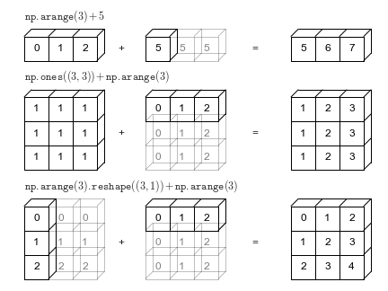
Broadcasting
Broadcasting allows NumPy to perform element-wise operations on arrays of different shapes and sizes:
import numpy as np
arr1 = np.array([[1, 2, 3], [4, 5, 6]])
arr2 = np.array([10, 20, 30])
# Broadcasting the addition
result_broadcast = arr1 + arr2
https://jakevdp.github.io/PythonDataScienceHandbook/02.05-computation-on-arrays-broadcasting.html

Slide 48
Broadcasting and Element-wise Operations
np.broadcast(): Return an object that allows broadcasting of two arrays.
np.maximum(): Element-wise maximum between two arrays.
np.minimum(): Element-wise minimum between two arrays.
# Create two arrays of different shapes
arr1 = np.array([1, 2, 3])
arr2 = np.array([[1], [2], [3]])
# 1. np.broadcast(): Return an object that allows broadcasting of two arrays
broadcast_obj = np.broadcast(arr1, arr2)
# Use broadcasting to perform element-wise addition
broadcasted_sum = arr1 + arr2
# 2. np.maximum(): Element-wise maximum between two arrays
arr3 = np.array([1, 4, 3, 2])
arr4 = np.array([2, 3, 5, 1])
maximum_result = np.maximum(arr3, arr4)
print("Element-wise maximum:", maximum_result)
# Output: [2 4 5 2]
https://jakevdp.github.io/PythonDataScienceHandbook/02.05-computation-on-arrays-broadcasting.html

Slide 49
Array Manipulation
NumPy offers numerous functions to manipulate arrays:
import numpy as np
arr = np.array([[1, 2, 3], [4, 5, 6]])
# Transpose
arr_transposed = arr.T
# Reshape
arr_reshaped = arr.reshape((3, 2))
# Flatten
arr_flattened = arr.flatten()
# Concatenate
arr_concatenated = np.concatenate((arr, arr), axis=1)

Slide 50
Random Number Generation
NumPy provides functions to generate random numbers:
import numpy as np
# Random integers
random_int = np.random.randint(0, 10, size=(3, 3)) # 3x3 array with values between 0 and 9

Slide 51
Linear Algebra with NumPy
NumPy provides a comprehensive set of linear algebra functions:
import numpy as np
# Matrix multiplication
matrix1 = np.array([[1, 2], [3, 4]])
matrix2 = np.array([[5, 6], [7, 8]])
result_matrix_mult = np.dot(matrix1, matrix2)
# Determinant
det = np.linalg.det(matrix1)
# Inverse
inv = np.linalg.inv(matrix1)

Slide 52
np.transpose
import numpy as np
# Example of a system of linear equations: Ax = b
A = np.array([[3, 2], [1, 2]])
b = np.array([8, 7])
# Solve for x
x = np.linalg.solve(A, b)
print("Solution:", x)
# Features (X): matrix with 3 rows (samples) and 2 columns (features)
X = np.array([[1, 1500],
[1, 1200],
[1, 1800]])
# Coefficients (β): vector
β = np.array([50000, 200])
# Predicted Prices (Y): matrix multiplication
Y = np.dot(X, β)
print("Predicted Prices:", Y)

Slide 53
Solve Linear Equeations
import numpy as np
# Coefficient matrix A
A = np.array([[2, 3, 1],
[4, 1, 2],
[3, 2, 3]])
# Right-hand side vector b
b = np.array([1, 2, 3])
# Solve the system of equations
solution = np.linalg.solve(A, b)
# Extract the values of x, y, z
x, y, z = solution
print(f"Solution: x = {x}, y = {y}, z = {z}")
2x+3y+z=1
4x+y+2z=2
3x+2y+3z=3

Slide 54
Additional Functions inMachine Learning
Statistics and Data Analysis
np.mean(): Compute the mean of an array.
np.median(): Compute the median of an array.
np.percentile(): Compute the q-th percentile of the data along the specified axis.
np.cov(): Compute the covariance matrix.
np.corrcoef(): Compute the correlation coefficient matrix.
np.histogram(): Compute the histogram of a set of data.

Slide 55
Mathematical Operations
np.exp(): Calculate the exponential of all elements in the array.
np.log(): Compute natural logarithm (base e) element-wise.
np.log10(): Compute the base-10 logarithm of all elements.

Slide 56
Sorting and Searching
np.sort(): Sort an array in ascending order.
np.argsort(): Return the indices that would sort an array.
np.searchsorted(): Find the indices to insert elements to maintain order.
import numpy as np
# Create an array
arr = np.array([50, 10, 40, 20, 30])
# 1. np.sort(): Sort an array in ascending order
sorted_arr = np.sort(arr)
print("Sorted array:", sorted_arr)
# Output: [10 20 30 40 50]

Slide 57
# 2. np.argsort(): Return the indices that would sort an array
sorted_indices = np.argsort(arr)
print("Indices that would sort the array:", sorted_indices)
# Output: [1 3 4 2 0]
# Explanation: The element at index 1 (value 10) is the smallest, so it's placed first.
# 3. np.searchsorted(): Find indices where elements should be inserted to maintain order
# Searching for positions to insert 25 and 35 to maintain the sorted order
insert_positions = np.searchsorted(sorted_arr, [25, 35])
print("Insert positions for 25 and 35:", insert_positions)
# Output: [2 3]
# Explanation: 25 should be inserted at index 2 and 35 at index 3 to maintain order.

Slide 58
Element-wise Comparisons
np.equal(): Compare if two arrays have the same elements.
np.not_equal(): Compare if two arrays have different elements.
np.logical_and(), np.logical_or(), np.logical_not(): Perform element-wise logical operations.
import numpy as np
# Create two arrays
arr1 = np.array([1, 2, 3, 4, 5])
arr2 = np.array([1, 3, 2, 4, 5])
# 1. np.equal(): Compare if two arrays have the same elements
equal_result = np.equal(arr1, arr2)
print("Equal comparison:", equal_result)
# Output: [ True False False True True ]
# Explanation: Elements at positions 0, 3, and 4 are equal between the two arrays.
# 2. np.not_equal(): Compare if two arrays have different elements
not_equal_result = np.not_equal(arr1, arr2)
print("Not equal comparison:", not_equal_result)
# Output: [False True True False False]
# Explanation: Elements at positions 1 and 2 are not equal between the two arrays.

Slide 59
# 3. np.logical_and(): Perform element-wise logical AND operation
logical_and_result = np.logical_and(arr1 > 2, arr2 > 2)
print("Logical AND result:", logical_and_result)
# Output: [False False True True True]
# Explanation: Both arr1 and arr2 must have elements greater than 2 for the result to be True.
# 4. np.logical_or(): Perform element-wise logical OR operation
logical_or_result = np.logical_or(arr1 > 2, arr2 > 2)
print("Logical OR result:", logical_or_result)
# Output: [False True True True True]
# Explanation: If either arr1 or arr2 have elements greater than 2, the result is True.
# 5. np.logical_not(): Perform element-wise logical NOT operation
logical_not_result = np.logical_not(arr1 > 3)
print("Logical NOT result:", logical_not_result)
# Output: [ True True True False False]
# Explanation: Elements where arr1 > 3 are False, and others are True.

Slide 60
Handling Missing Data
np.isnan(): Check for NaN (Not a Number) elements in an array.
nan_check = np.isnan(arr)
np.isfinite(): Check for finite elements in an array.
arr = np.array([1, 2, np.nan, 4, np.inf, -np.inf, 7])
finite_check = np.isfinite(arr)

Slide 61
Data Generation and Sampling
np.linspace(): Generate equally spaced values within a specified range.
np.random.choice(): Generate a random sample from a given 1-D array.
np.random.shuffle(): Shuffle the elements of an array in-place.
random_sample = np.random.choice([10, 20, 30, 40, 50], size=3, replace=False)
np.random.shuffle(arr)

Slide 62
Use Case
Matrices are a fundamental tool in data science, enabling efficient computation, data representation, and algorithm implementation. They are essential for handling large datasets, performing linear algebra operations, and implementing machine learning algorithms.
Data Representation
Datasets are represented as matrices:
Rows: Individual data points.
Columns: Features/variables.
Example: A house prices dataset with columns for bedrooms, size, and price.
https://pengfeinie.github.io/convolution-operation-on-images/

Slide 63
Linear Regression
Uses matrices to model relationships:
X: Feature matrix.
β: Coefficient vector.
Y: Predicted values.
Formula: Y=X×β.
Principal Component Analysis (PCA)
Dimensionality reduction using:
Covariance Matrix: Captures variance/covariance.
Eigenvectors/Eigenvalues: Identify principal components
Neural Networks
Matrix operations are key in neural networks:
Input: Data as a matrix.
Weights: Matrices for connections.
Output: Matrix multiplications/activations.

Slide 64
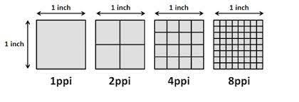
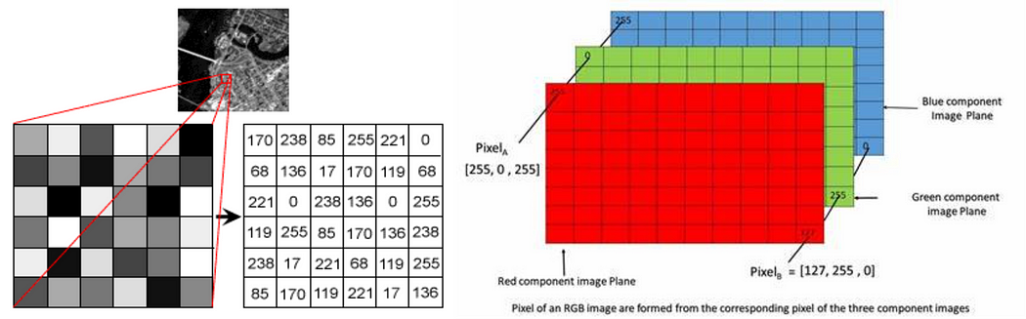

Slide 65
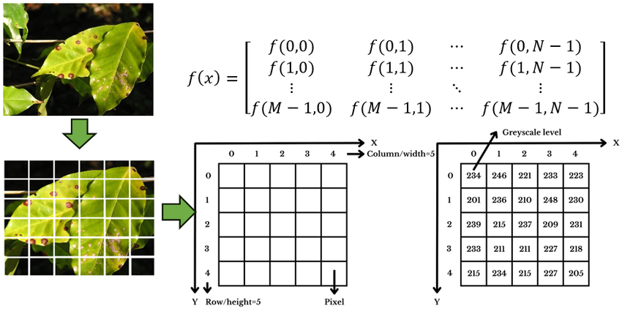

Slide 66
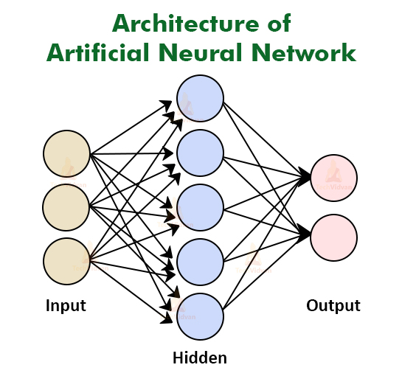
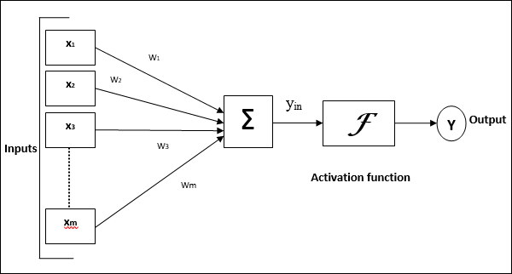
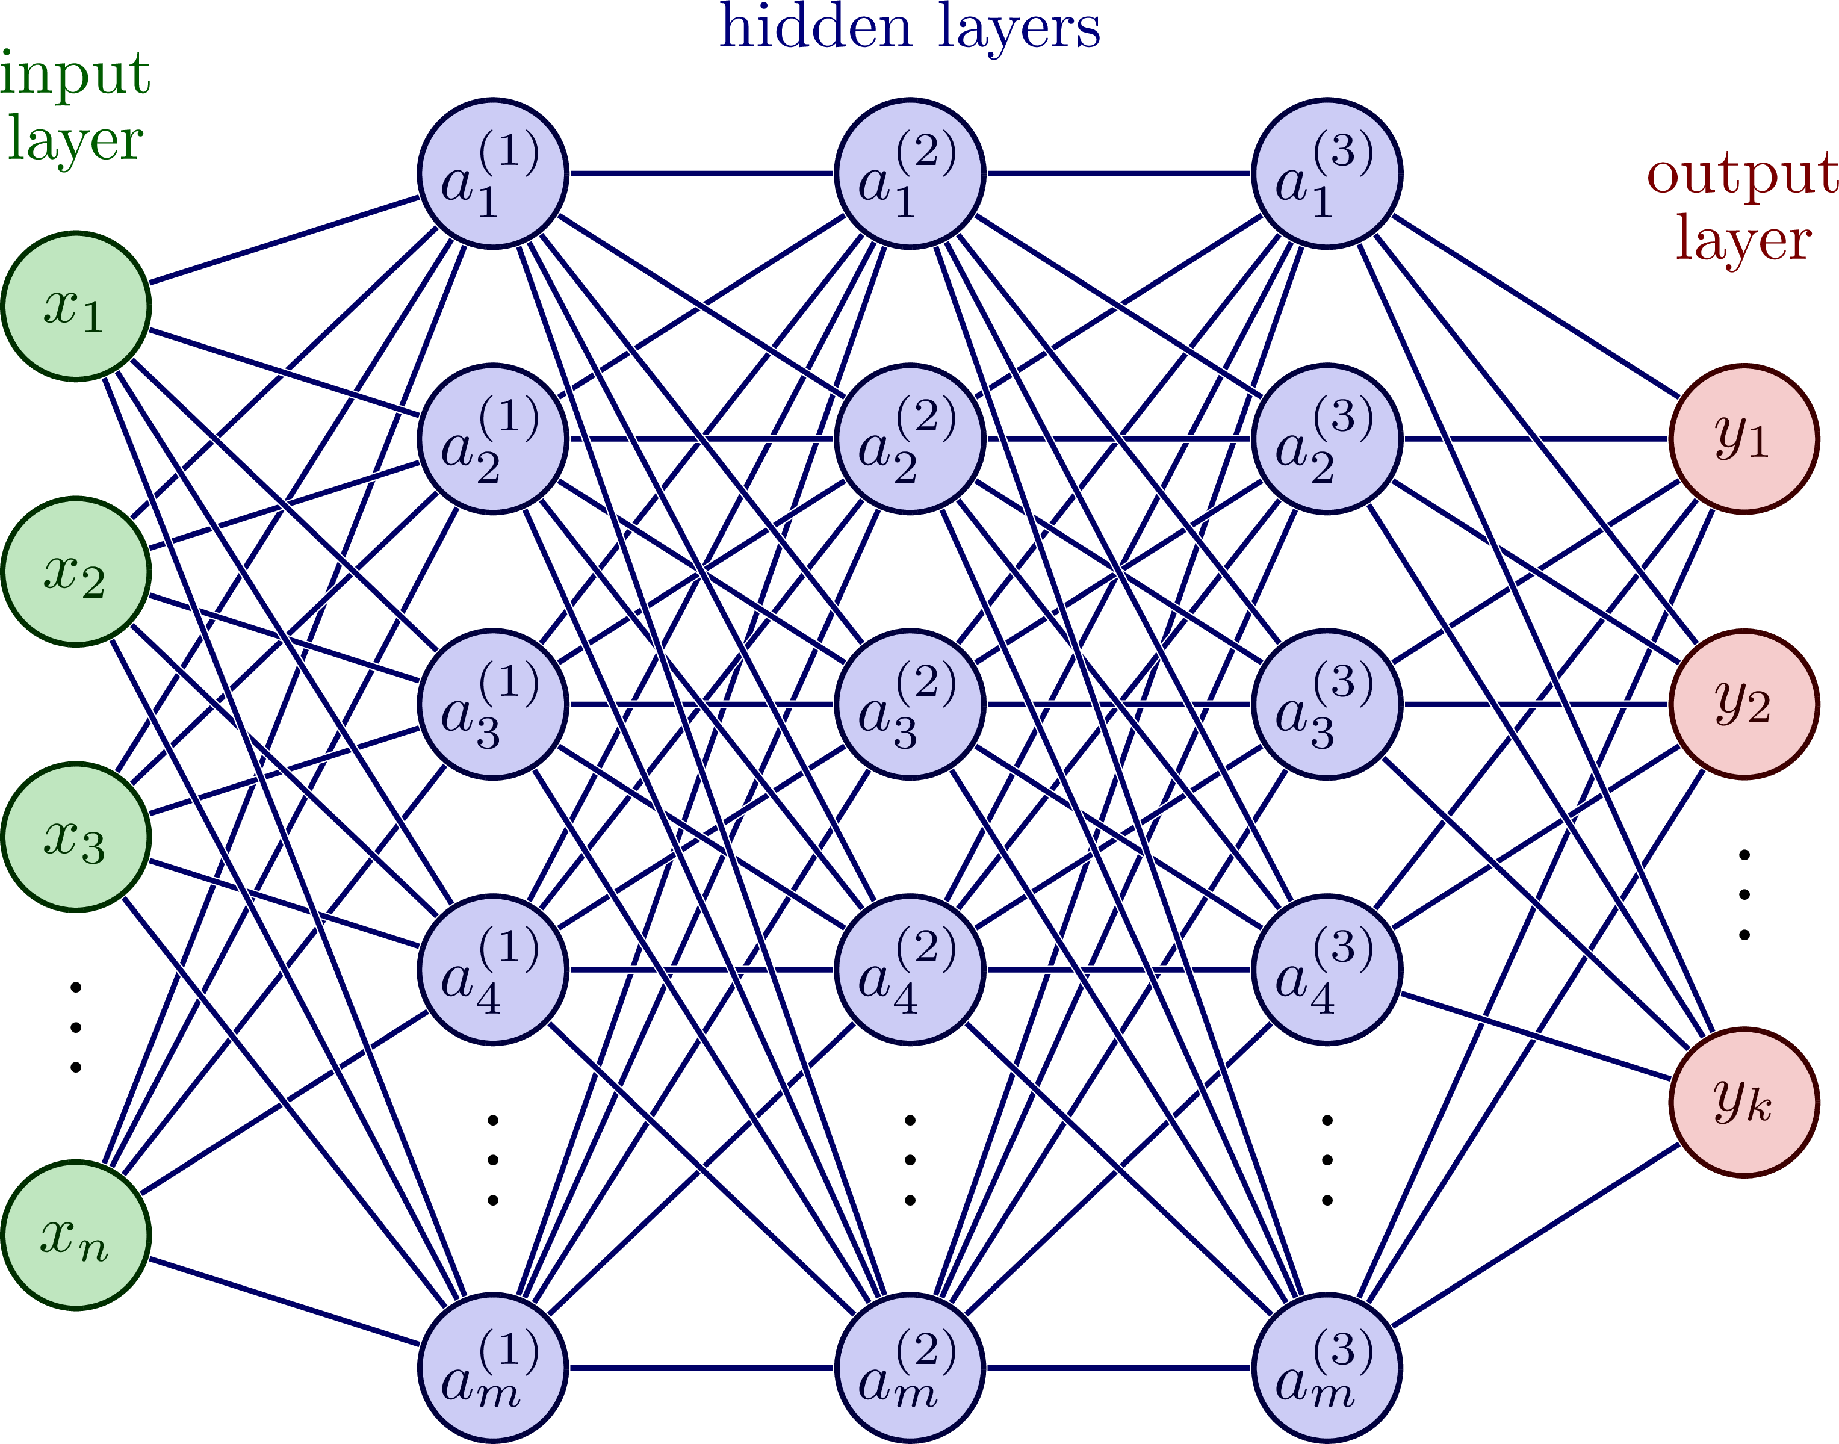
Artificial Neural Network - Basic Concepts
Y= MX+ C concept use with activation functions

Slide 67
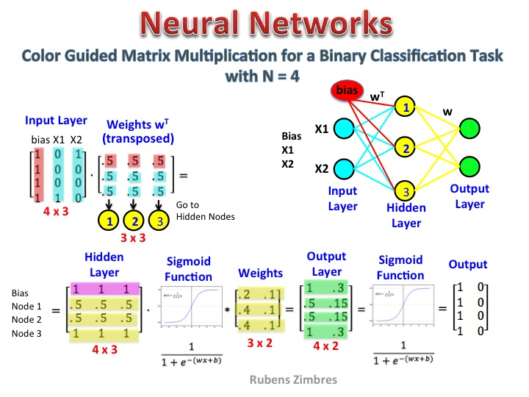
https://python-course.eu/machine-learning/neural-networks-structure-weights-and-matrices.php

Slide 68
Thank You!

Slide 69
https://github.com/Devinterview-io/numpy-interview-questions
https://www.interviewbit.com/numpy-interview-questions/
https://www.datacamp.com/blog/numpy-interview-questions

