Slide 1
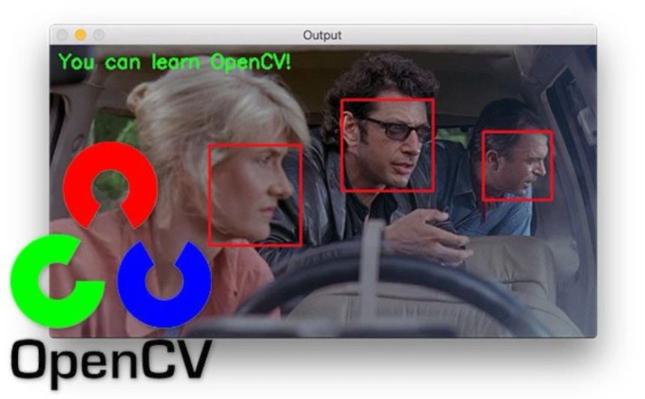
Computer Vision
OpenCV

Slide 2
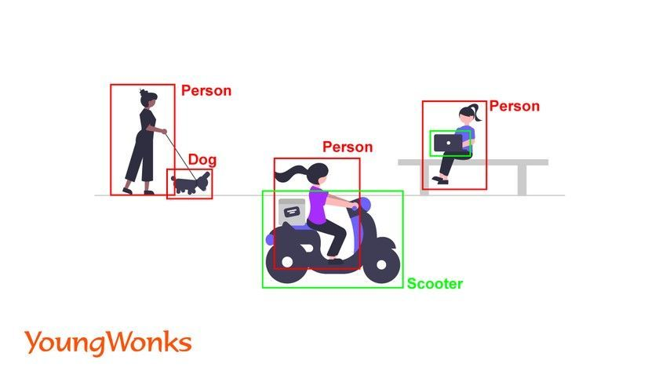

Slide 3
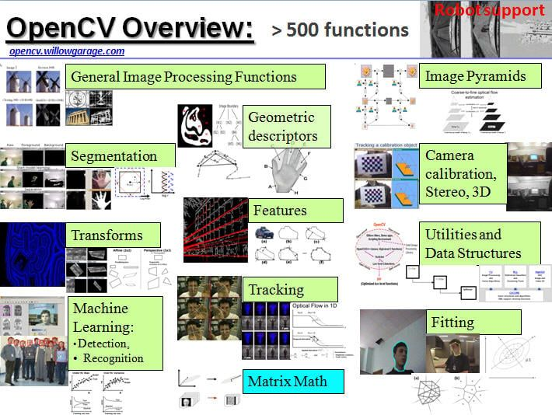

Slide 4
Computer vision is an Artificial Intelligence (AI) field that enables computers to "see," interpret, and understand visual information from the world through digital images and videos. It involves training machines to identify and classify objects, recognize patterns, and extract meaningful data, effectively mimicking human sight and cognitive ability. Key applications include medical image analysis, autonomous vehicles, security surveillance, and manufacturing quality control.
How it Works
1. Data Acquisition:
Cameras and sensors capture real-world scenes, converting them into digital images or videos.
2. Image Processing:
Algorithms process these images, which are essentially arrays of pixels, to prepare them for analysis.
3. Pattern Recognition:
Using deep learning models, such as Convolutional Neural Networks (CNNs), computers learn to identify features like edges, shapes, and textures in the data.
4. Object Recognition:
The system then uses these learned features to recognize, classify, and locate specific objects or people within the visual input.
5. Decision Making:
Based on the interpreted information, the computer can perform actions, such as making real-time driving decisions for autonomous vehicles or flagging suspicious activity in security footage.

Slide 5
Key Applications
Healthcare:
Analyzing X-rays, MRIs, and other medical scans for quicker and more accurate diagnoses of diseases.
Autonomous Vehicles:
Enabling self-driving cars to perceive their surroundings, identify road signs, pedestrians, and other vehicles for safe navigation.
Manufacturing:
Performing quality control on assembly lines by detecting defects, verifying products, and monitoring machinery.
Security:
Monitoring public spaces for crowd management, tracking people or objects of interest, and detecting security threats.
Agriculture:
Analyzing satellite imagery and drone footage to monitor crops, detect diseases, and optimize farming practices.
Retail:
Tracking customer movement and analyzing shopping patterns to improve store layouts and customer experiences.

Slide 6
Computer Vision History
Computer vision research began in the 1950s with the idea of simulating human vision, leading to early work on edge detection and the perceptron in the 1960s and 70s. Progress accelerated through the 80s and 90s with the development of more advanced algorithms for 3D reconstruction and motion analysis, fueled by digital cameras and increased computing power. A major breakthrough occurred in the 2010s with the rise of deep learning and convolutional neural networks (CNNs), which, combined with large datasets and powerful GPUs, enabled human-level performance in tasks like object recognition and transformed the field.
Early Beginnings (1950s-1960s)
1950s:
Research began with the concept of teaching computers to interpret visual data.
1960s:
Larry Roberts' PhD thesis explored extracting 3D information from 2D images. The first experiments involved trying to have a computer "describe what it saw".
Foundational Algorithms (1970s-1980s)
1970s:
Focus shifted to developing techniques for edge detection, feature extraction, and the beginning of 3D modeling.
1980s:
More advanced techniques emerged, such as shape inference from shading, texture, and focus, alongside contour models called "snakes". The company Automatix pioneered industrial applications of computer vision for manufacturing.

Slide 7
Digital Revolution and the Internet (1990s)
The rise of digital cameras and the internet provided more visual data, which spurred further research.
Techniques for camera calibration, sparse and dense 3D reconstructions from multiple images, and multi-view stereo were developed.
The Deep Learning Revolution (2010s-Present)
2012:
The introduction of AlexNet, a convolutional neural network, at the ImageNet Large Scale Visual Recognition Challenge (ILSVRC), marked a turning point.
Factors enabling the revolution:
Increased Computing Power: Advances in hardware, including NVIDIA's Graphics Processing Units (GPUs), provided the necessary computational resources.
Large Datasets: The availability of large, labeled datasets like ImageNet was crucial for training deep learning models.
Deep Learning Models: CNNs and other deep learning architectures were able to learn complex visual patterns effectively.
Impact:
These advancements led to human-level or even superhuman performance in image classification and other recognition tasks, transforming computer vision and driving its integration into various applications.

Slide 8
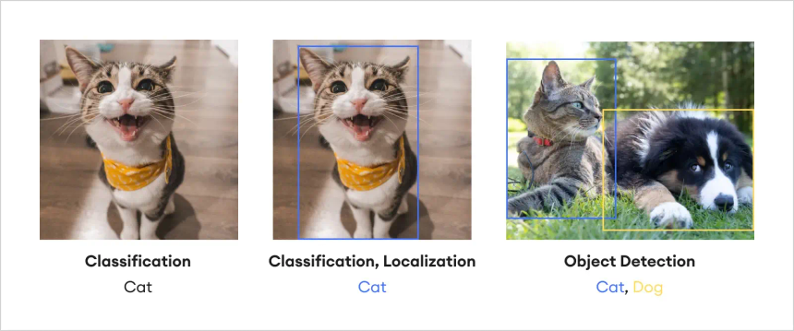
What we Do
Image Classification
Object Detection & Localizations
Image Sentiment Analysis
Image Segmentations
Siamese Network
GAN(Generative Adversal Networks)

Slide 9
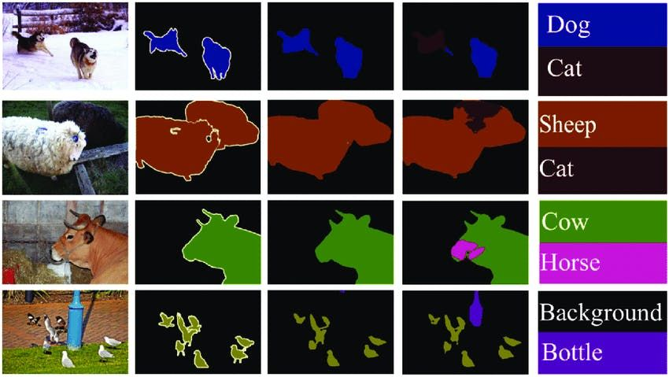
Image Segmentation

Slide 10
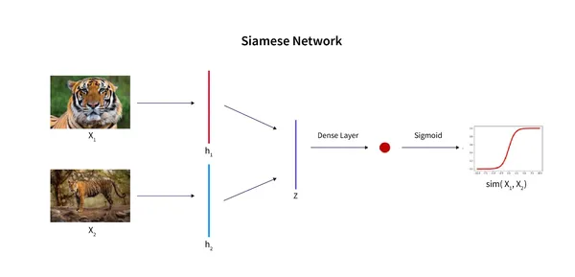
https://www.analyticsvidhya.com/blog/2023/08/introduction-and-implementation-of-siamese-networks/

Slide 11
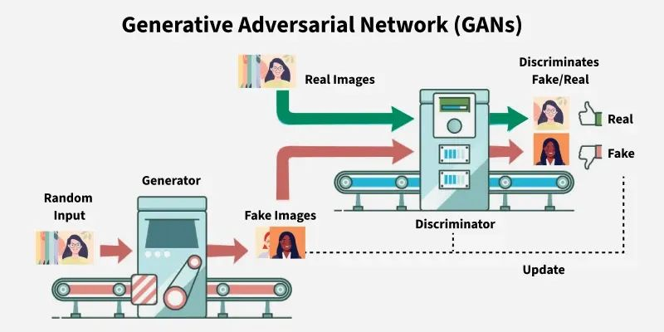
https://www.geeksforgeeks.org/generative-adversarial-network-gan/

Slide 12
SYLLABUS
https://docs.google.com/document/d/1wf_RDyYB3tXqQs7g9Ug-2h8BrYIH1uxqm7aIO-PdcLg/edit?tab=t.0#heading=h.89jfyrdga9dr

Slide 13
Resources
https://www.geeksforgeeks.org/essential-opencv-functions-to-get-started-into-computer-vision
https://www.geeksforgeeks.org/opencv-python-tutorial/
https://www.geeksforgeeks.org/getting-started-scikit-image-image-processing-python
computer vision
CNN
Transfer learning
Undestanding Image Embedding
Siamese Network
Object detection
Object detection and Localizations
YOLO
Segmentation
Siamese
GANs
https://www.geeksforgeeks.org/face-detection-using-python-and-opencv-with-webcam/
https://www.geeksforgeeks.org/live-webcam-drawing-using-opencv/
https://www.geeksforgeeks.org/transition-from-opencv-2-to-opencv-3-x/
https://www.geeksforgeeks.org/image-processing-without-opencv-python/
https://www.geeksforgeeks.org/detect-and-recognize-car-license-plate-from-a-video-in-real-time/?ref=lbp ---> also OCR include
https://www.geeksforgeeks.org/machine-learning-projects/?ref=lbp

Slide 14
Introduction to Computer Vision (CV)
What is Computer Vision?
Computer Vision (CV) is a field of artificial intelligence (AI) that allows computers to interpret and understand the world visually, much like humans do. Through CV, computers can identify objects, track movements, and recognize patterns in images and videos. It's the technology behind applications like facial recognition, self-driving cars, medical image analysis, and augmented reality.
https://www.edge-ai-vision.com/2011/11/introduction-to-computer-vision-using-opencv-article/
Basic Concepts and Terminology:
Image: A picture or a visual representation that is composed of pixels.
Pixel: The smallest unit of an image. Each pixel has color and brightness values.
Frame: A single image in a sequence of images (e.g., in a video).
Feature: Specific patterns or structures in an image, like edges, textures, or corners.
Object Detection: Identifying specific objects in an image or video (e.g., cars, people).
Face Recognition: A sub-field of CV that identifies or verifies a person from an image or video.

Slide 15
Real-World Business Problem:
Let’s say you work in a warehouse that receives packages daily. The company needs to automate the process of checking whether the right items are packed into the boxes and whether the boxes are properly labeled.
Problem: Human workers are slow and error-prone in checking boxes.
Solution: Implement a Computer Vision System to automate the inspection process. The system can:
Detect objects in the boxes.
Read labels on the packages.
Verify items by comparing the detected objects against the expected ones.
Basic Tools and Libraries in Computer Vision
OpenCV: An open-source computer vision library. It helps with tasks such as image processing, object detection, and face recognition.
NumPy: A Python library for numerical operations that is essential when manipulating images.
Matplotlib: A Python library for plotting images and visualizing data.
TensorFlow / PyTorch: Advanced libraries used for machine learning and deep learning models in CV.

Slide 16
Steps to Solve the Problem with OpenCV
1. Setup OpenCV:
You first need to install OpenCV and other libraries.
pip install opencv-python numpy matplotlib
2. Capture Images or Video
You can use a camera or a video file to capture the images. OpenCV provides tools to access your camera and video files.
import cv2
# Capture video from camera
cap = cv2.VideoCapture(0)
while True:
ret, frame = cap.read() # Capture a frame
if not ret:
break
cv2.imshow('Frame', frame) # Show the frame
if cv2.waitKey(1) & 0xFF == ord('q'): # Quit when 'q' is pressed
break
cap.release()
cv2.destroyAllWindows()
https://www.analyticsvidhya.com/blog/2019/03/opencv-functions-computer-vision-python/
https://www.freecodecamp.org/news/how-to-use-opencv-and-python-for-computer-vision-and-ai/

Slide 17
3. Preprocessing Images
Before processing, it’s important to preprocess the images. This could involve:
Converting the image to grayscale.
Resizing the image to a specific size.
Blurring the image to reduce noise.
# Convert to grayscale gray = cv2.cvtColor(frame, cv2.COLOR_BGR2GRAY) # Resize image resized = cv2.resize(gray, (500, 500)) # Gaussian blur to reduce noise blurred = cv2.GaussianBlur(resized, (5, 5), 0)
import cv2 as cv
import numpy as np
from matplotlib import pyplot as plt
img = cv.imread('gradient.png', cv.IMREAD_GRAYSCALE)
assert img is not None, "file could not be read, check with os.path.exists()"
ret,thresh1 = cv.threshold(img,127,255,cv.THRESH_BINARY)
ret,thresh2 = cv.threshold(img,127,255,cv.THRESH_BINARY_INV)
ret,thresh3 = cv.threshold(img,127,255,cv.THRESH_TRUNC)
ret,thresh4 = cv.threshold(img,127,255,cv.THRESH_TOZERO)
ret,thresh5 = cv.threshold(img,127,255,cv.THRESH_TOZERO_INV)
titles = ['Original Image','BINARY','BINARY_INV','TRUNC','TOZERO','TOZERO_INV']
images = [img, thresh1, thresh2, thresh3, thresh4, thresh5]
for i in range(6):
plt.subplot(2,3,i+1),plt.imshow(images[i],'gray',vmin=0,vmax=255)
plt.title(titles[i])
plt.xticks([]),plt.yticks([])
plt.show()
Simple Thresholding
https://docs.opencv.org/4.x/d7/d4d/tutorial_py_thresholding.html
cv.THRESH_BINARY
cv.THRESH_BINARY_INV
cv.THRESH_TRUNC
cv.THRESH_TOZERO
cv.THRESH_TOZERO_INV

Slide 18
4. Object Detection
You can use simple techniques like contour detection or Haar cascades (for detecting faces, for example) or even advanced methods like YOLO (You Only Look Once) for detecting multiple objects in real-time.
Here’s an example of using Haar cascades to detect faces:
# Load the pre-trained Haar Cascade for face detection face_cascade = cv2.CascadeClassifier(cv2.data.haarcascades + 'haarcascade_frontalface_default.xml') # Detect faces faces = face_cascade.detectMultiScale(gray, scaleFactor=1.1, minNeighbors=5, minSize=(30, 30)) # Draw rectangles around faces for (x, y, w, h) in faces: cv2.rectangle(frame, (x, y), (x + w, y + h), (255, 0, 0), 2) # Display the output cv2.imshow('Detected Faces', frame) cv2.waitKey(0) cv2.destroyAllWindows()

Slide 19
5. Label Detection and Verification
For detecting labels or text on packages, you can use OCR (Optical Character Recognition) libraries like Tesseract. This helps extract text from images.
Install Tesseract:
6. Comparison and Automation
Once labels or objects are detected, the system can compare them with expected data (like a list of items) and automatically verify whether the package is correct.
python
Copy
expected_items = ['item1', 'item2', 'item3'] detected_items = ['item1', 'item4', 'item3'] ifset(expected_items) == set(detected_items): print("Package is correct") else: print("Package is incorrect")
pip install pytesseract
import pytesseract
# Convert image to text using Tesseract
text = pytesseract.image_to_string(frame)
# Print the extracted text
print("Detected text:", text)

Slide 20
Key Techniques in Computer Vision
Edge Detection: Used to find boundaries in images, such as the edges of objects.
Common algorithms: Canny Edge Detector, Sobel Operator.
Feature Matching: Finding and matching key features in images. It's used in object recognition.
Common algorithms: SIFT (Scale-Invariant Feature Transform), ORB (Oriented FAST and Rotated BRIEF).
Object Tracking: Following objects in a video stream. Used in surveillance and robotics.
Algorithms: Kalman Filter, Meanshift, Optical Flow.
Deep Learning: Advanced models like Convolutional Neural Networks (CNN) are used for complex tasks like object detection, image segmentation, and classification.

Slide 21
https://www.geeksforgeeks.org/top-python-libraries-for-image-processing/?ref=ml_lbp
https://www.geeksforgeeks.org/image-processing-with-keras-in-python/?ref=ml_lbp
https://www.geeksforgeeks.org/getting-started-scikit-image-image-processing-python/?ref=ml_lbp
https://www.geeksforgeeks.org/how-to-convert-images-to-numpy-array/?ref=lbp
https://www.geeksforgeeks.org/how-to-convert-an-image-to-numpy-array-and-saveit-to-csv-file-using-python/?ref=lbp
https://www.geeksforgeeks.org/convert-a-numpy-array-to-an-image/?ref=lbp

Slide 22
https://www.geeksforgeeks.org/ai-ml-ds-projects/?ref=lbp
https://www.codementor.io/@innat_2k14/image-data-analysis-using-numpy-opencv-part-1-kfadbafx6

Slide 24
OLD SYLLABUS
Object Detection - CAR DEFECT DETECTION
Template Matching
Edge Detection
Assignment
Computer Vision & OpenCV
What is Computer Vision
History of Computer Vision
Tools & Technology used in Computer Vision
Application of Computer Vision
What is OpenCV
Installation of OpenCV
First program with OpenCV
Reading & Writing Images
Capture Videos from Camera
Reading & Saving Videos
Assignment
OCR Engine
Introduction to Pytesseract
Text Recognition
Text Recognition from image
Assignment
Object Detection
What is Object Detection
Object Detection using Haar Cascade
MobileNet SSD
RCNN and YOLO
Assignment
Image Classification - FACE RECOGNITION PROJECT
Haar Cascade Clasifier
Image Classification with CNN
Assignment
MediaPipe
Introduction to MediaPipe
FaceMesh
Hand, Pose and Holistic Models
Assignment

Slide 25
NEWSYLLABUS
Computer Vision
Object Detection
Region Proposal Techniques
Semantic Segmentation
Assignment
Convolution Neural Network
Introduction to CNN
Architecture of CNN - Kernel / Filter, Stride, Padding, Activation Function Max Pooling and Avg Pooling
Assignment
Computer Vision with OpenCV
Working with images
Working with Videos
OCR
Media Pipe - FaceMesh, Pose Detection
Assignment

Slide 26
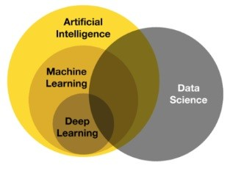
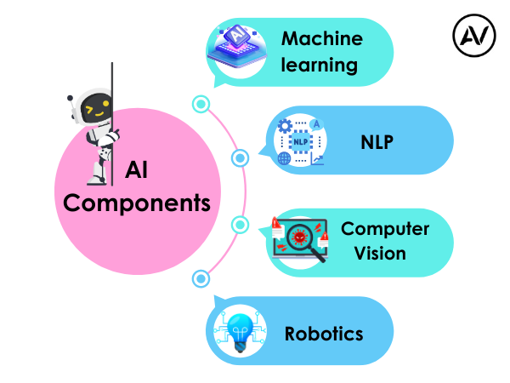
https://ellow.io/components-of-ai/

Slide 27
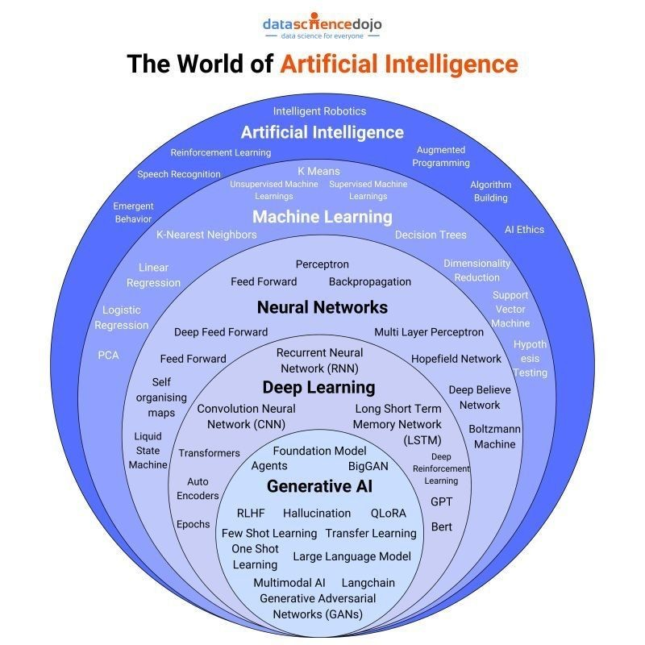
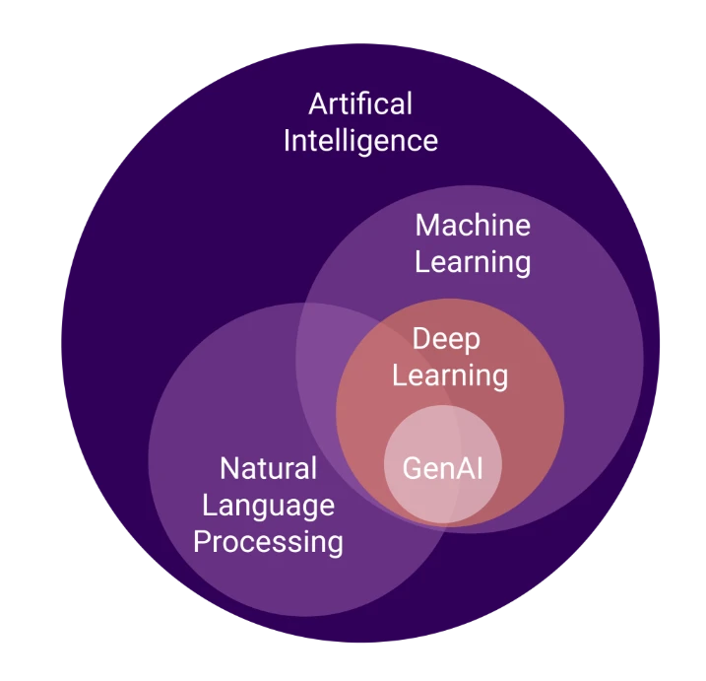
Algorithms and models

Slide 28
Installation
Installation on Windows
Follow the instructions on http://docs.opencv.org/3.1.0/d5/de5/tutorial_py_setup_in_windows.html
Installation on (Debian/Ubuntu) Linux
Follow the instructions on https://milq.github.io/install-opencv-ubuntu-debian/
First remove any OpenCV version you have installed, because it can conflict with the newest version.
sudo apt-get install libopencv-dev python-opencv
Download the Linux install script:
wget https://raw.githubusercontent.com/milq/milq/master/scripts/bash/install-opencv.sh
Then change the rights and run it:
chmod 755 install-opencv.sh
./install-opencv.sh
It may take a while depending on the speed of your computer. On my 32bit Intel i3 laptop the installation took about an hour. I've tested it with Ubuntu Linux 16.04 LTS

Slide 29
1. What is Computer Vision?
Definition:
Computer Vision is a field of Artificial Intelligence (AI) that enables machines to interpret and understand visual data from the world, such as images and videos. It mimics human vision by processing, analyzing, and making decisions based on visual inputs.
Example:
Face recognition in smartphones.
Object detection in self-driving cars.
Optical Character Recognition (OCR) to extract text from images.
Key Components:
Image Processing
Feature Extraction
Pattern Recognition
Machine Learning & Deep Learning

Slide 30
2. History of Computer Vision
1960s: Initial research began with image processing and pattern recognition.
1970s: Development of edge detection techniques like Sobel and Canny.
1980s: Emergence of neural networks for image recognition.
1990s: Evolution of robust feature extraction techniques like SIFT and SURF.
2000s: Introduction of deep learning models like Convolutional Neural Networks (CNNs).
2010s-Present: Advances in AI, deep learning, and frameworks like OpenCV, TensorFlow, and PyTorch.

Slide 31
3. Tools & Technology Used in Computer Vision
Programming Languages:
Python (Most popular)
C++
MATLAB
Java
Libraries & Frameworks:
OpenCV: Image processing and computer vision tasks.
TensorFlow/Keras: Deep learning-based vision models.
PyTorch: Neural network training and deployment.
Dlib: Facial recognition and feature extraction.
Hardware:
GPUs (for deep learning models)
Edge devices (NVIDIA Jetson, Raspberry Pi)
Cameras (RGB, infrared, depth cameras)

Slide 32
4. Applications of Computer Vision
Real-World Use Cases:
Healthcare: Disease detection in X-rays and MRIs.
Automotive: Lane detection and pedestrian recognition in self-driving cars.
Retail: Automated checkout in supermarkets.
Security: Face and fingerprint recognition.
Agriculture: Crop health monitoring.
Sports: Motion tracking in athlete performance analysis.

Slide 33
5. What is OpenCV?
Definition:
Open Source Computer Vision Library (OpenCV) is an open-source library that provides tools for image and video processing, object detection, and machine learning tasks.
Features:
Image transformation (resizing, filtering, thresholding)
Object detection (face, eyes, body, etc.)
Video processing (reading, writing, frame extraction)
Machine learning integrations

Slide 34
6. Installation of OpenCV
Installing OpenCV in Python:
Step 1: Install Python & pip
Ensure Python is installed (Python 3.x recommended).
python --version
Step 2: Install OpenCV
pip install opencv-python
pip install opencv-python-headless
# For servers without GUI
Step 3: Verify Installation
import cv2
print(cv2.__version__)
7. First Program with OpenCV
Code to Display an Imageimport cv2 # Load image image = cv2.imread('image.jpg') # Display image cv2.imshow('Displayed Image', image) cv2.waitKey(0) cv2.destroyAllWindows()
Explanation:
cv2.imread() loads an image.
cv2.imshow() displays the image.
cv2.waitKey(0) waits for a key press before closing.
cv2.destroyAllWindows() closes all OpenCV windows.
8. Reading & Writing Images
Code to Read and Save an Imageimport cv2 # Read Image image = cv2.imread('input.jpg') # Save Image cv2.imwrite('output.jpg', image)
Use Cases:
Data preprocessing for deep learning.
Image enhancement and noise reduction.

Slide 35
9. Capture Videos from Camera
Code to Capture Video from Webcamimport cv2 # Open camera cap = cv2.VideoCapture(0) while True: ret, frame = cap.read() if not ret: break cv2.imshow('Live Video', frame) if cv2.waitKey(1) & 0xFF == ord('q'): break cap.release() cv2.destroyAllWindows()
Explanation:
cv2.VideoCapture(0): Opens the default camera.
cap.read(): Captures a frame.
cv2.imshow(): Displays the video.
Press 'q' to exit.
10. Reading & Saving Videos
Code to Read and Save a Videoimport cv2 # Open video file cap = cv2.VideoCapture('input.mp4') # Define codec and create VideoWriter fourcc = cv2.VideoWriter_fourcc(*'XVID') out = cv2.VideoWriter('output.avi', fourcc, 20.0, (640, 480)) while cap.isOpened(): ret, frame = cap.read() if not ret: break out.write(frame) cv2.imshow('Video', frame) if cv2.waitKey(1) & 0xFF == ord('q'): break cap.release() out.release() cv2.destroyAllWindows()
Use Cases:
Saving security camera footage.
Video preprocessing for AI models.

Slide 36
Reading and Displaying an Image using OpenCV
Article 1: Reading and Displaying an Image using OpenCV
Introduction:
In computer vision, reading and displaying an image is a basic yet essential task. OpenCV, a powerful library, makes it simple to read an image from a file and display it in a window. This article walks you through reading an image and displaying it using OpenCV.
Code Explanation:
python
Copy codeimport cv2
# Read an image from file
image = cv2.imread('input_image.jpg') # Replace 'input_image.jpg' with your image path
# Show the original image
cv2.imshow('Original Image', image)
cv2.waitKey(0) # Wait until any key is pressed
cv2.destroyAllWindows()
Step-by-Step Breakdown:
Reading the Image:
The function cv2.imread() is used to load an image from a specified file path.
Make sure to provide the correct path to your image file.
Displaying the Image:
cv2.imshow() opens a window to display the image. The first argument is the window title, and the second argument is the image to display.
Waiting for a Key Press:
The cv2.waitKey(0) function keeps the window open until any key is pressed.
Once a key is pressed, cv2.destroyAllWindows() closes the window.
Note: Due to some technical concerns, this lecture is in article form. Our team will try our best to update the article with videos soon, and you will be updated accordingly. Until then, feel free to review this article-based lecture. Thank you!

Slide 37
Cropping an Image using OpenCV
Introduction:
Cropping allows you to extract a portion of an image for further processing or analysis. OpenCV enables easy cropping by using image slicing. In this article, you will learn how to crop an image.
Code Explanation:
python
Copy code# Cropping the image (here we're cropping a 100x100 square from the top-left corner)
cropped_image = image[0:100,0:100]
# Show the cropped image
cv2.imshow('Cropped Image', cropped_image)
cv2.waitKey(0)
cv2.destroyAllWindows()
Step-by-Step Breakdown:
Cropping the Image:
OpenCV stores images as NumPy arrays, and cropping is achieved by slicing the array.
The code image[0:100, 0:100] selects the pixel rows from 0 to 100 and columns from 0 to 100, resulting in a 100x100 cropped image.
Displaying the Cropped Image:
The cropped portion of the image is displayed using the cv2.imshow() function, similar to how the full image was displayed earlier.
Closing the Window:
As before, cv2.waitKey(0) waits for a key press and cv2.destroyAllWindows() closes the window.
Note: Due to some technical concerns, this lecture is in article form. Our team will try our best to update the article with videos soon, and you will be updated accordingly. Until then, feel free to review this article-based lecture. Thank you!

Slide 38
Resizing an Image using OpenCV
Introduction:
Resizing is important when working with images, especially for creating thumbnails or adjusting image dimensions for further analysis. OpenCV allows you to resize an image by scaling its width and height. This article explains how to resize an image in OpenCV.
Code Explanation:
python
Copy code# Resizing the image (scaling it down to 50% of its original size)
resized_image = cv2.resize(image,(0,0), fx=0.5, fy=0.5)
# Show the resized image
cv2.imshow('Resized Image', resized_image)
cv2.waitKey(0)
cv2.destroyAllWindows()
Step-by-Step Breakdown:
Resizing the Image:
The cv2.resize() function is used to resize the image.
Setting (0, 0) for the size and using the fx=0.5 and fy=0.5 parameters scale the width and height by 50%, effectively resizing the image to half its original size.
Displaying the Resized Image:
The resized image is displayed in a new window using cv2.imshow(), just as the original image was displayed.
Closing the Window:
The window is closed using cv2.waitKey(0) and cv2.destroyAllWindows().
Note: Due to some technical concerns, this lecture is in article form. Our team will try our best to update the article with videos soon, and you will be updated accordingly. Until then, feel free to review this article-based lecture. Thank you!

Slide 39
Saving Cropped and Resized Images using OpenCV
Introduction:
After processing an image, you may want to save the output for future use. OpenCV makes saving images easy with the cv2.imwrite() function. In this article, we will save cropped and resized images using OpenCV.
Code Explanation:
python
Copy code# Save the cropped and resized images
cv2.imwrite('cropped_image.jpg', cropped_image)
cv2.imwrite('resized_image.jpg', resized_image)
print('Images have been saved successfully.')
Step-by-Step Breakdown:
Saving Images:
The function cv2.imwrite() saves an image to the specified file path.
The first argument is the file path where the image will be saved, and the second argument is the image to save.
In this example, the cropped and resized images are saved as 'cropped_image.jpg' and 'resized_image.jpg', respectively
.
Completion Message:
After saving the images, a message is printed to indicate success.
Note: Due to some technical concerns, this lecture is in article form. Our team will try our best to update the article with videos soon, and you will be updated accordingly. Until then, feel free to review this article-based lecture. Thank you!

Slide 40
Image Classification - FACE RECOGNITION PROJECT
Haar Cascade Clasifier
Image Classification with CNN
Assignment

Slide 41
1. Haar Cascade Classifier
What is Haar Cascade Classifier?
Haar Cascade is a machine learning-based object detection algorithm used to identify faces, eyes, smiles, and other objects in an image. It works by training a cascade of classifiers using positive and negative images.
Steps to Implement Face Detection using Haar Cascade
Install OpenCV
bash
CopyEdit
pip install opencv-python
Download Pretrained Haar Cascade Files
OpenCV provides pre-trained XML files for detecting faces, eyes, and smiles:
haarcascade_frontalface_default.xml
haarcascade_eye.xml
Load Haar Cascade Classifier in Python
import cv2 # Load Haar cascade classifier face_cascade = cv2.CascadeClassifier(cv2.data.haarcascades + 'haarcascade_frontalface_default.xml') # Read Image image = cv2.imread('face.jpg') gray = cv2.cvtColor(image, cv2.COLOR_BGR2GRAY) # Detect Faces faces = face_cascade.detectMultiScale(gray, scaleFactor=1.1, minNeighbors=5, minSize=(30, 30)) # Draw rectangles around detected faces for (x, y, w, h) in faces: cv2.rectangle(image, (x, y), (x+w, y+h), (255, 0, 0), 2) # Show the result cv2.imshow('Face Detection', image) cv2.waitKey(0) cv2.destroyAllWindows()
Use Cases of Haar Cascade
Face detection in security cameras
Attendance systems
Mobile applications for facial recognition

Slide 42
What is CNN (Convolutional Neural Network)?
CNNs are deep learning models specialized in image recognition. They use convolutional layers to extract features from images and classify them into categories.
Steps to Implement Image Classification with CNN
Install Required Libraries
pip install tensorflow keras numpy matplotlib
Load Dataset (Using CIFAR-10 as an Example)
import tensorflow as tf from tensorflow.keras import layers, models import matplotlib.pyplot as plt # Load CIFAR-10 dataset (train_images, train_labels), (test_images, test_labels) = tf.keras.datasets.cifar10.load_data() # Normalize pixel values train_images, test_images = train_images / 255.0, test_images / 255.0 # Display sample images plt.figure(figsize=(10,10)) for i inrange(25): plt.subplot(5,5,i+1) plt.xticks([]) plt.yticks([]) plt.grid(False) plt.imshow(train_images[i]) plt.show()
2. Image Classification with CNN

Slide 43
Build the CNN Model
model = models.Sequential([ layers.Conv2D(32, (3,3), activation='relu', input_shape=(32, 32, 3)), layers.MaxPooling2D((2,2)), layers.Conv2D(64, (3,3), activation='relu'), layers.MaxPooling2D((2,2)), layers.Conv2D(64, (3,3), activation='relu'), layers.Flatten(), layers.Dense(64, activation='relu'), layers.Dense(10, activation='softmax') # 10 classes in CIFAR-10 ]) model.compile(optimizer='adam', loss='sparse_categorical_crossentropy', metrics=['accuracy']) # Train the model model.fit(train_images, train_labels, epochs=10, validation_data=(test_images, test_labels))
Evaluate Model
test_loss, test_acc = model.evaluate(test_images, test_labels, verbose=2) print(f"Test Accuracy: {test_acc}")
Use Cases of CNN for Image Classification
Facial recognition in social media
Medical image diagnosis (X-rays, MRI scans)
Self-driving car object detection
Final Assignment
Task 1: Face Detection with Haar Cascade
Implement face detection using OpenCV and the Haar Cascade classifier.
Try detecting multiple faces in a single image.
Task 2: Train a Custom CNN Model
Train a CNN model using your own dataset (e.g., classify between smiling and neutral faces).
Use TensorFlow/Keras for model training.

Slide 44
Object Detection - CAR DEFECT DETECTION
Template Matching
Edge Detection
Assignment
https://www.youtube.com/watch?v=bXeq57e_BNg
https://universe.roboflow.com/project-4ppiz/car-defect-detection-xxpkc/model/2
https://intelliarts.com/blog/computer-vision-for-car-damage-detection/
https://www.tandfonline.com/doi/full/10.1080/21642583.2023.2185916#d1e1098
https://norma.ncirl.ie/6212/1/kishorelakshmanan.pdf
A short recording of the computer vision demo. The video presents an overview of the functionality of a two-model computer vision solution developed by the Intelliarts team of engineers. The model can detect the area of impact in images of damaged cars. Potentially, it can be used in automated insurance claims processing. The demo is available via the
below link: https://huggingface.co/spaces/intelli...
For more details read the article: https://intelliarts.com/blog/computer...
https://www.kaggle.com/code/shakib221b/car-damage-detection-inference
https://www.kaggle.com/code/shakib221b/car-damage-detection-train-test

Slide 45
Object Detection - CAR DEFECT DETECTION
Template Matching
Edge Detection
Assignment
OCR Engine
Introduction to Pytesseract
Text Recognition
Text Recognition from image
Assignment
Object Detection
What is Object Detection
Object Detection using Haar Cascade
MobileNet SSD
RCNN and YOLO
Assignment
MediaPipe
Introduction to MediaPipe
FaceMesh
Hand, Pose and Holistic Models
Assignment

Slide 46
https://github.com/sandesh-01/Car_Damage_detection-/blob/main/Damage_Detection_Detectron2%20(2).ipynb
https://github.com/louisyuzhe/car-damage-detector

Slide 47
1. Template Matching
What is Template Matching?
Template Matching is a technique in image processing where a small template image is slid over a larger image to find a match. It is used for detecting specific patterns, such as car defects.
Steps for Template Matching
Install OpenCV
pip install opencv-python
Load the Car Image and Template
import cv2 import numpy as np # Load main image and template car_image = cv2.imread('car.jpg', 0) # Convert to grayscale template = cv2.imread('scratch_template.jpg', 0) # Defect template w, h = template.shape[::-1] # Get template size
# Apply Template Matching result = cv2.matchTemplate(car_image, template, cv2.TM_CCOEFF_NORMED) threshold = 0.8 # Set threshold for matching loc = np.where(result >= threshold) # Draw rectangles around detected defects for pt inzip(*loc[::-1]): cv2.rectangle(car_image, pt, (pt[0] + w, pt[1] + h), (255, 0, 0), 2) # Display result cv2.imshow('Car Defect Detection', car_image) cv2.waitKey(0) cv2.destroyAllWindows()
Use Cases of Template Matching
Detecting scratches, dents, and missing parts in cars.
Recognizing logos or text in vehicle images.
Matching defective parts in industrial inspection.
Considerations
Template Selection:The effectiveness of template matching depends on the quality and representativeness of the defect template.​
Lighting Conditions:Variations in lighting can affect the matching process. Preprocessing steps like histogram equalization may help normalize lighting differences.​
Rotation and Scale Variations:Template matching is sensitive to changes in scale and rotation. For defects that vary in size or orientation, consider using more robust methods like feature-based matching or machine learning approaches.

Slide 48
2. Edge Detection
What is Edge Detection?
Edge Detection identifies boundaries in an image, helping to detect cracks, scratches, and damages in cars. The Canny Edge Detector is one of the most widely used techniques.
Steps for Edge Detection in Car Defect Detection
Load Image and Convert to Grayscale
import cv2 # Load image image = cv2.imread('car.jpg') # Convert to grayscale gray = cv2.cvtColor(image, cv2.COLOR_BGR2GRAY) # Apply Gaussian Blur blurred = cv2.GaussianBlur(gray, (5, 5), 0) # Detect edges using Canny edges = cv2.Canny(blurred, 50, 150) # Display the edges cv2.imshow('Car Defect Edges', edges) cv2.waitKey(0) cv2.destroyAllWindows()
Use Cases of Edge Detection
Identifying cracks or scratches in car surfaces.
Detecting contours for part inspections in manufacturing.
Analyzing vehicle damage from accident images.

Slide 49
Combining Both Methods
For a more robust car defect detection system, combining Template Matching and Edge Detection can be effective.Edge Detection can first highlight potential defect regions, and Template Matching can then be applied to these regions to confirm the presence of specific defects.​
Implementation Steps
Perform Edge Detection
Use the steps outlined in the Edge Detection section to identify potential defect areas.
Extract Regions of Interest (ROIs)
Identify and extract regions from the edge-detected image that are likely to contain defects.
Apply Template Matching on ROIs
Use Template Matching within these ROIs to detect specific defects, as described in the Template Matching section.
Considerations
Efficiency:By narrowing down the areas where Template Matching is applied, the process becomes more efficient.​
Accuracy:Combining both methods can reduce false positives and improve detection accuracy.​

Slide 50
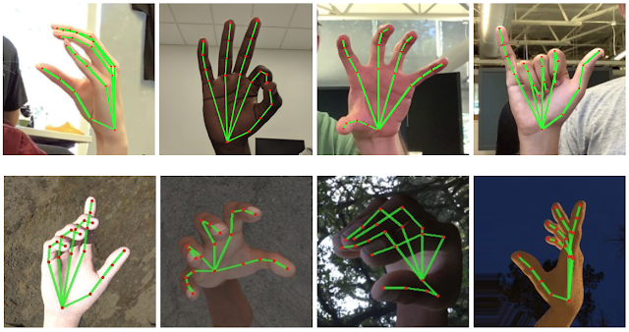
YOLOv7 Pose vs MediaPipe in Human Pose Estimation

