Slide 1


Slide 2
Introduction:--
Pandas is a Python library used for data manipulation and analysis. Pandas provides a convenient way to analyze and clean data.
The Pandas library introduces two new data structures to Python - Series and DataFrame, both of which are built on top of NumPy.
What is Pandas Used for?
Pandas is a powerful library generally used for:
- Data Cleaning
- Data Transformation
- Data Analysis
- Machine Learning
- Data Visualization

Slide 3
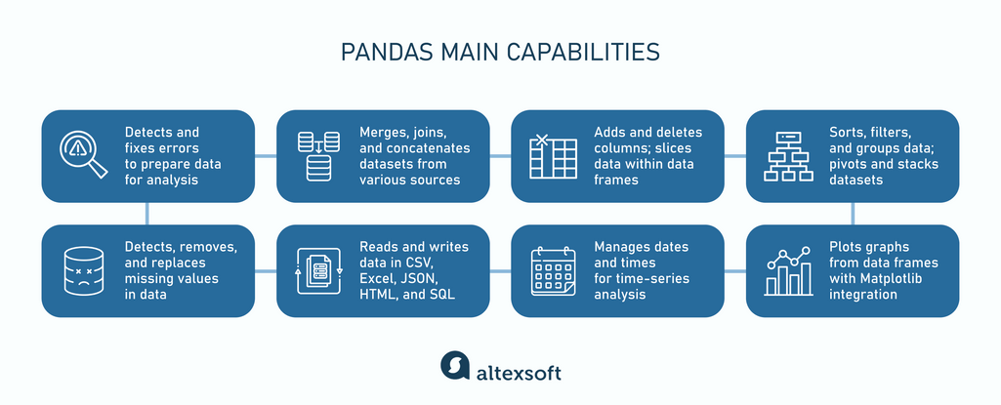

Slide 4
NumPy Introduction
Create a NumPy array:
import numpy as np
arr = np.array([1, 2, 3, 4, 5])
print(arr)
print(type(arr)

Slide 5
Why Use NumPy?
NumPy aims to provide an array object that is up to 50x faster than traditional Python lists.
The array object in NumPy is called ndarray, it provides a lot of supporting functions that make working with ndarray very easy.
Arrays are very frequently used in data science, where speed and resources are very important.
NumPy arrays are stored at one continuous place in memory unlike lists, so processes can access and manipulate them very efficiently.
This behavior is called locality of reference in computer science.
This is the main reason why NumPy is faster than lists. Also it is optimized to work with latest CPU architectures.

Slide 6
Checking NumPy Version
import numpy as np
print(np.__version__)

Slide 7
Create a NumPy ndarray Object
NumPy is used to work with arrays. The array object in NumPy is called ndarray.
We can create a NumPy ndarray object by using the array() function.
import numpy as np
arr = np.array([1, 2, 3, 4, 5])
print(arr)
print(type(arr))
type(): This built-in Python function tells us the type of the object passed to it. Like in above code it shows that arr is numpy.ndarray type.
To create an ndarray, we can pass a list, tuple or any array-like object into the array() method, and it will be converted into an ndarray:

Slide 8
Dimensions in Arrays
A dimension in arrays is one level of array depth (nested arrays).
0-D Arrays
0-D arrays, or Scalars, are the elements in an array. Each value in an array is a 0-D array.
import numpy as np
arr = np.array(42)
print(arr)

Slide 9
1-D Arrays
An array that has 0-D arrays as its elements is called uni-dimensional or 1-D array.
These are the most common and basic arrays.
Create a 1-D array containing the values 1,2,3,4,5:
import numpy as np
arr = np.array([1, 2, 3, 4, 5])
print(arr)

Slide 10
2-D Arrays
An array that has 1-D arrays as its elements is called a 2-D array.
These are often used to represent matrix or 2nd order tensors.
NumPy has a whole sub module dedicated towards matrix operations called numpy.mat
Create a 2-D array containing two arrays with the values 1,2,3 and 4,5,6:
import numpy as np
arr = np.array([[1, 2, 3], [4, 5, 6]])
print(arr)

Slide 11
3-D arrays
An array that has 2-D arrays (matrices) as its elements is called 3-D array.
These are often used to represent a 3rd order tensor.
Example
Create a 3-D array with two 2-D arrays, both containing two arrays with the values 1,2,3 and 4,5,6:
import numpy as np
arr = np.array([[[1, 2, 3], [4, 5, 6]], [[1, 2, 3], [4, 5, 6]]])
print(arr)

Slide 12
Check Number of Dimensions?
NumPy Arrays provides the ndim attribute that returns an integer that tells us how many dimensions the array have.

Slide 13
Higher Dimensional Arrays
An array can have any number of dimensions.
When the array is created, you can define the number of dimensions by using the ndmin argument.
Example
Create an array with 5 dimensions and verify that it has 5 dimensions:
import numpy as np
arr = np.array([1, 2, 3, 4], ndmin=5)
print(arr)
print('number of dimensions :', arr.ndim)

Slide 14
In this array the innermost dimension (5th dim) has 4 elements, the 4th dim has 1 element that is the vector, the 3rd dim has 1 element that is the matrix with the vector, the 2nd dim has 1 element that is 3D array and 1st dim has 1 element that is a 4D array.

Slide 15
NumPy Array Indexing
Array indexing is the same as accessing an array element.
You can access an array element by referring to its index number.
The indexes in NumPy arrays start with 0, meaning that the first element has index 0, and the second has index 1 etc.
import numpy as np
arr = np.array([1, 2, 3, 4])
print(arr[0])

Slide 16
Access 2-D Arrays
To access elements from 2-D arrays we can use comma separated integers representing the dimension and the index of the element.
Think of 2-D arrays like a table with rows and columns, where the dimension represents the row and the index represents the column.
import numpy as np
arr = np.array([[1,2,3,4,5], [6,7,8,9,10]])
print('2nd element on 1st row: ', arr[0, 1])

Slide 17
Access 3-D Arrays
To access elements from 3-D arrays we can use comma separated integers representing the dimensions and the index of the element.
import numpy as np
arr = np.array([[[1, 2, 3], [4, 5, 6]], [[7, 8, 9], [10, 11, 12]]])
print(arr[0, 1, 2])

Slide 18
Example Explained
arr[0, 1, 2] prints the value 6.
And this is why:
The first number represents the first dimension, which contains two arrays: [[1, 2, 3], [4, 5, 6]] and: [[7, 8, 9], [10, 11, 12]] Since we selected 0, we are left with the first array: [[1, 2, 3], [4, 5, 6]]
The second number represents the second dimension, which also contains two arrays: [1, 2, 3]

Slide 19
and: [4, 5, 6] Since we selected 1, we are left with the second array: [4, 5, 6]
The third number represents the third dimension, which contains three values: 4 5 6 Since we selected 2, we end up with the third value: 6

Slide 20
Negative Indexing
Use negative indexing to access an array from the end.
Example
Print the last element from the 2nd dim:
import numpy as np
arr = np.array([[1,2,3,4,5], [6,7,8,9,10]])
print('Last element from 2nd dim: ', arr[1, -1])

Slide 21
NumPy Array Slicing
Slicing in python means taking elements from one given index to another given index.
We pass slice instead of index like this: [start:end].
We can also define the step, like this: [start:end:step].
If we don't pass start its considered 0
If we don't pass end its considered length of array in that dimension
If we don't pass step its considered 1
import numpy as np
arr = np.array([1, 2, 3, 4, 5, 6, 7])
print(arr[1:5])

Slide 22
Slicing 2-D Arrays
import numpy as np
arr = np.array([[1, 2, 3, 4, 5], [6, 7, 8, 9, 10]])
print(arr[1, 1:4])

Slide 23
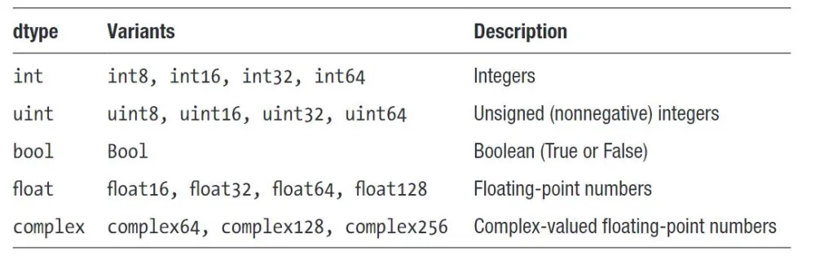
Data Types in NumPy
NumPy has some extra data types, and refer to data types with one character, like i for integers, u for unsigned integers etc.
Below is a list of all data types in NumPy and the characters used to represent them.
i - integer
b - boolean
u - unsigned integer
f - float
c - complex float
m - timedelta
M - datetime
O - object
S - string
U - unicode string
V - fixed chunk of memory for other type ( void )

Slide 24
Creating Arrays With a Defined Data Type
We use the array() function to create arrays, this function can take an optional argument: dtype that allows us to define the expected data type of the array elements:
import numpy as np
arr = np.array([1, 2, 3, 4], dtype='S')
print(arr)
print(arr.dtype)

Slide 25
Converting Data Type on Existing Arrays
The best way to change the data type of an existing array, is to make a copy of the array with the astype() method.
The astype() function creates a copy of the array, and allows you to specify the data type as a parameter.
The data type can be specified using a string, like 'f' for float, 'i' for integer etc. or you can use the data type directly like float for float and int for integer.
import numpy as np
arr = np.array([1.1, 2.1, 3.1])
newarr = arr.astype('i')
print(newarr)
print(newarr.dtype)

Slide 26
As mentioned above, copies owns the data, and views does not own the data, but how can we check this?
Every NumPy array has the attribute base that returns None if the array owns the data.
Otherwise, the base attribute refers to the original object.
import numpy as np
arr = np.array([1, 2, 3, 4, 5])
x = arr.copy()
y = arr.view()
print(x.base)
print(y.base)

Slide 27
NumPy Array Shape
The shape of an array is the number of elements in each dimension.
NumPy arrays have an attribute called shape that returns a tuple with each index having the number of corresponding elements.
import numpy as np
arr = np.array([[1, 2, 3, 4], [5, 6, 7, 8]])
print(arr.shape)

Slide 28
Create an array with 5 dimensions using ndmin using a vector with values 1,2,3,4 and verify that last dimension has value 4:
import numpy as np
arr = np.array([1, 2, 3, 4], ndmin=5)
print(arr)
print('shape of array :', arr.shape)

Slide 29
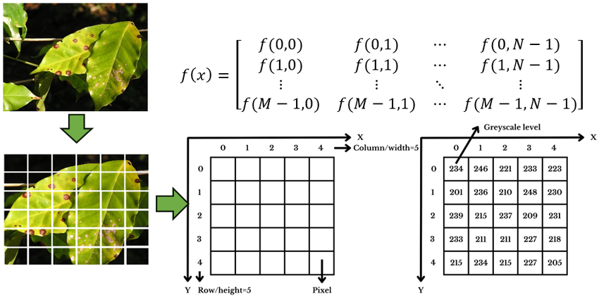

Slide 30
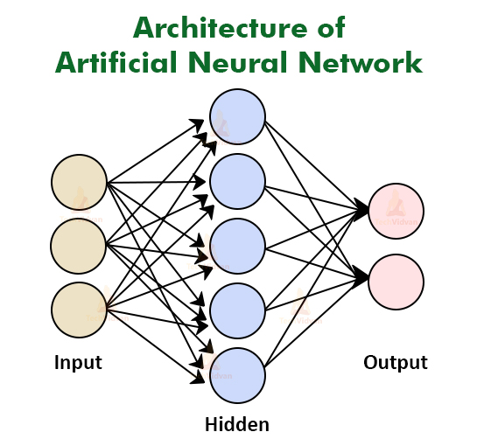
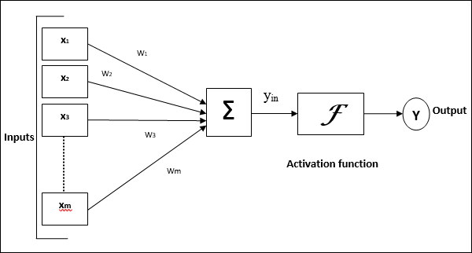
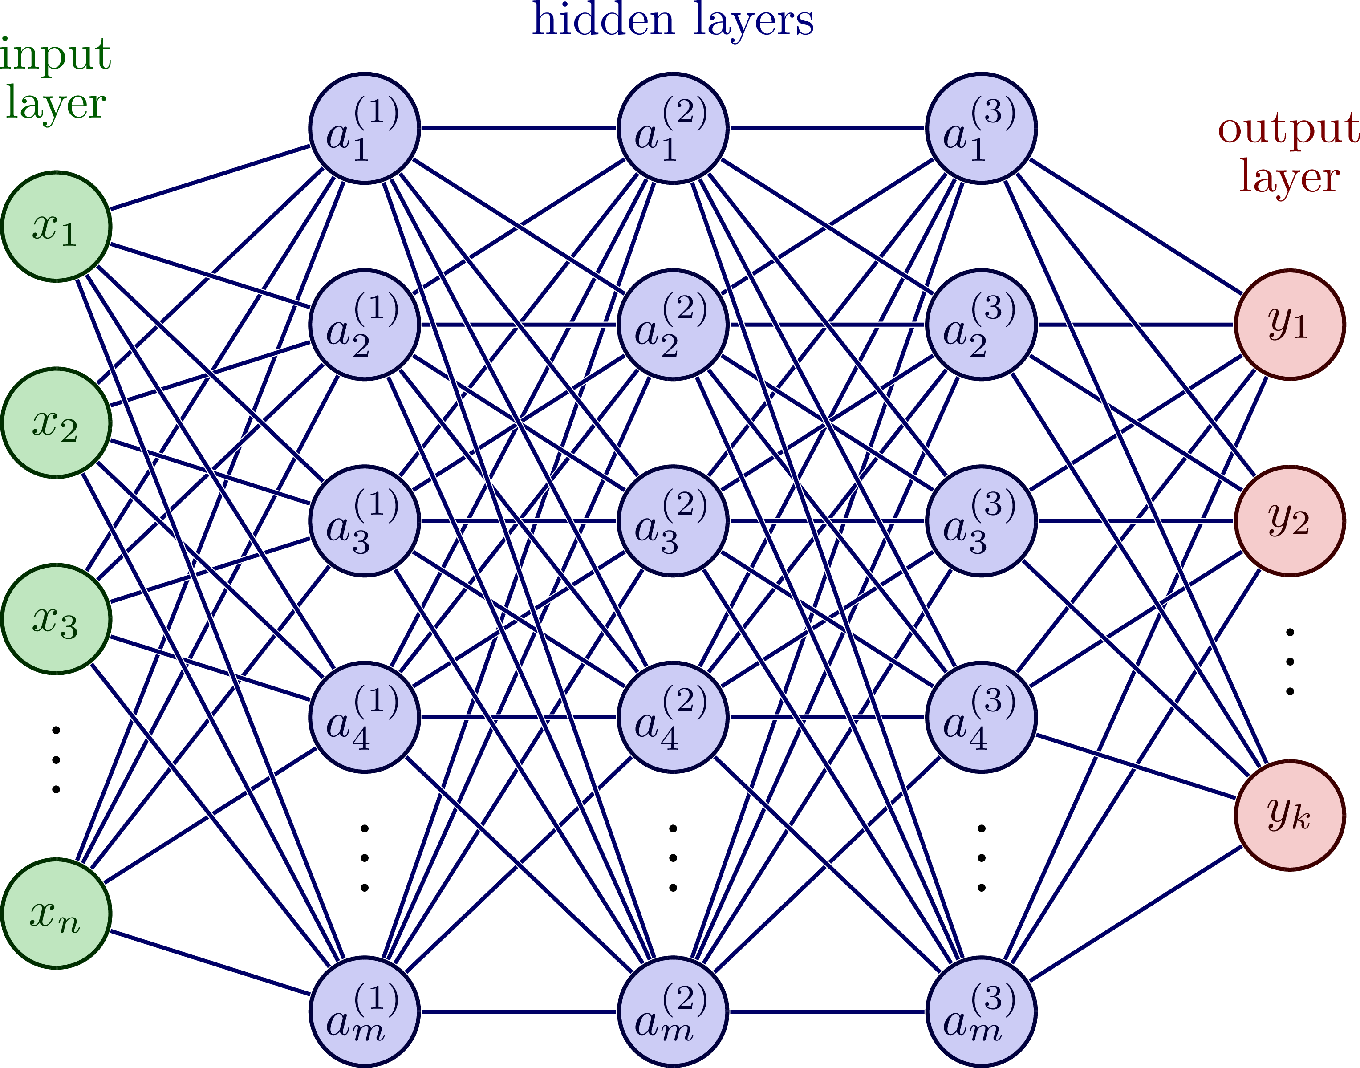
Artificial Neural Network - Basic Concepts
Y= MX+ C concept use with activation functions

Slide 31
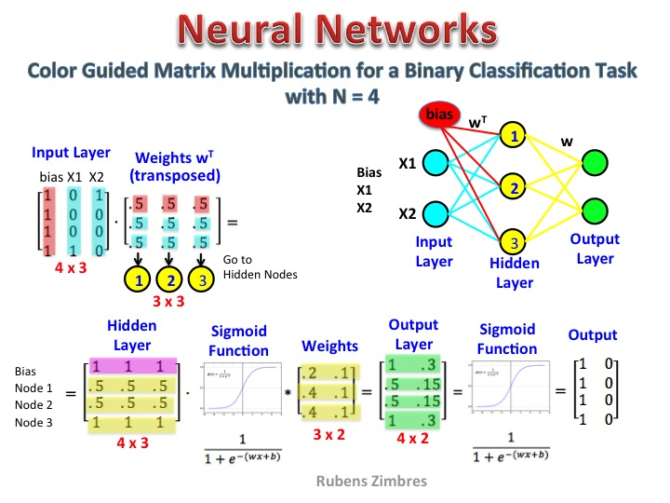
https://python-course.eu/machine-learning/neural-networks-structure-weights-and-matrices.php

Slide 32
Thank You!

