Slide 1
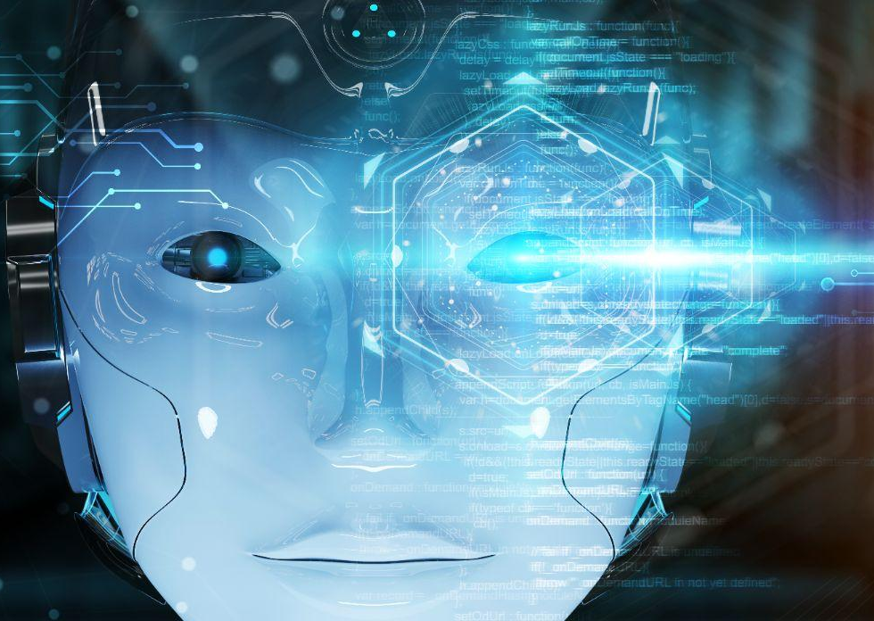
Computer Vision

Slide 2
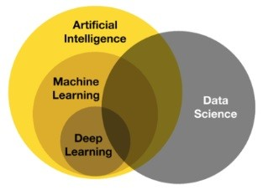
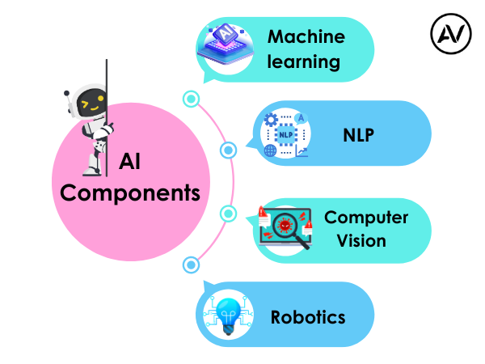
https://ellow.io/components-of-ai/

Slide 3
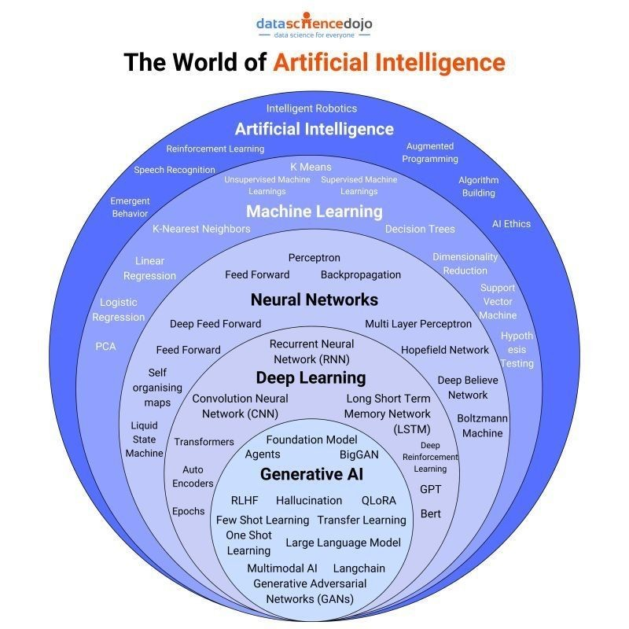
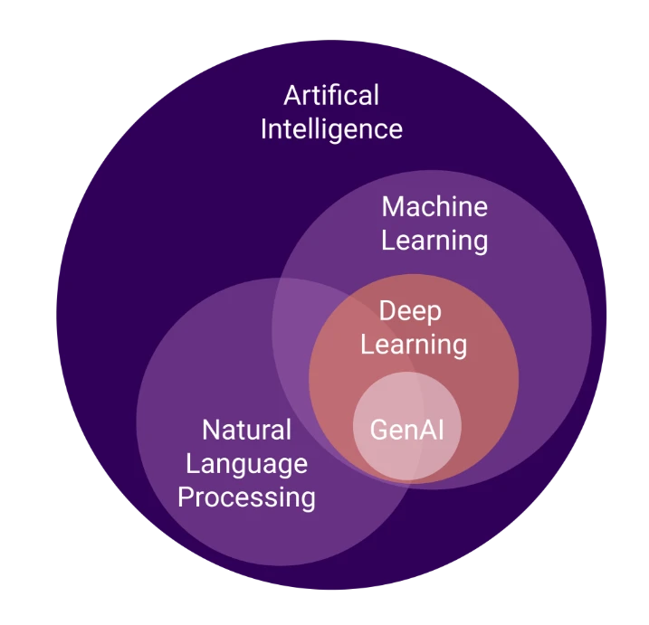
Algorithms and models

Slide 4
Computer Vision
Computer vision is a field of artificial intelligence (AI) that enables computers to "see" and interpret images and videos, much like humans do.
Image Classification (binary ,multiclass)
Object Detection & Localizations
Image Segmentations
Siamese Network (comparision bw 2 img)
GAN(Generative Adversal Networks) --> create Syntatic Images
computer vision,( tf,pytorch)
CNN
Transfer learning
Undestanding Image Embedding
Siamese Network
Object detection
Object detection and Localizations
YOLO
Segmentation
Siamese
GANs
https://www.geeksforgeeks.org/opencv-python-tutorial/?ref=shm

Slide 5
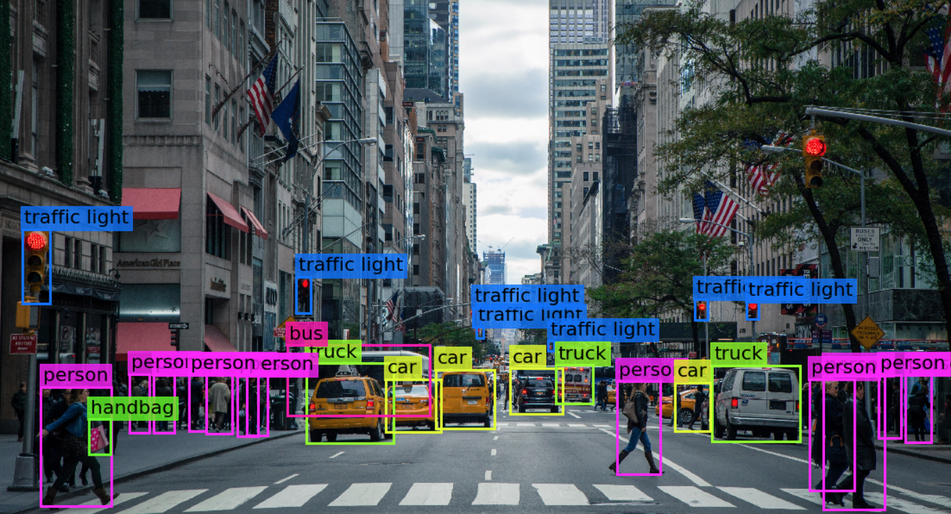

Slide 6
OLD SYLLABUS
Object Detection - CAR DEFECT DETECTION
Template Matching
Edge Detection
Assignment
Computer Vision & OpenCV
What is Computer Vision
History of Computer Vision
Tools & Technology used in Computer Vision
Application of Computer Vision
What is OpenCV
Installation of OpenCV
First program with OpenCV
Reading & Writing Images
Capture Videos from Camera
Reading & Saving Videos
Assignment
OCR Engine
Introduction to Pytesseract
Text Recognition
Text Recognition from image
Assignment
Object Detection
What is Object Detection
Object Detection using Haar Cascade
MobileNet SSD
RCNN and YOLO
Assignment
Image Classification - FACE RECOGNITION PROJECT
Haar Cascade Clasifier
Image Classification with CNN
Assignment
MediaPipe
Introduction to MediaPipe
FaceMesh
Hand, Pose and Holistic Models
Assignment

Slide 7
NEW SYLLABUS
Computer Vision
Object Detection
Region Proposal Techniques
Semantic Segmentation
Assignment
Computer Vision with OpenCV
Working with images
Working with Videos
OCR
Media Pipe - FaceMesh, Pose Detection
Assignment
Convolution Neural Network
Introduction to CNN
Architecture of CNN - Kernel / Filter, Stride, Padding, Activation Function Max Pooling and Avg Pooling
Assignment

Slide 8
Image Classification (binary ,multiclass)
Object Detection & Localizations
Image Segmentations
Siamese Network (comparision bw 2 img)
GAN(Generative Adversal Networks) --> create Syntatic Images
All We Can Implement in CNN
CNNs are designed to mimic the human visual cortex, where neurons respond to specific regions of the visual field.
This design allows CNNs to recognize patterns and features in images, even when objects are shifted or transformed.
They use convolutional layers to detect features like edges and textures, pooling layers to reduce the spatial dimensions of the input, and fully connected layers to make predictions based on the learned features.

Slide 9
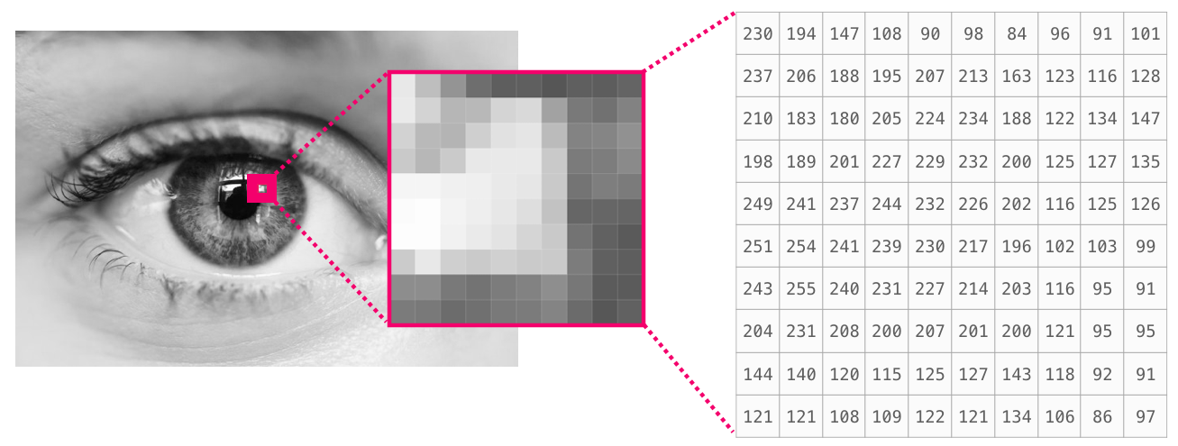
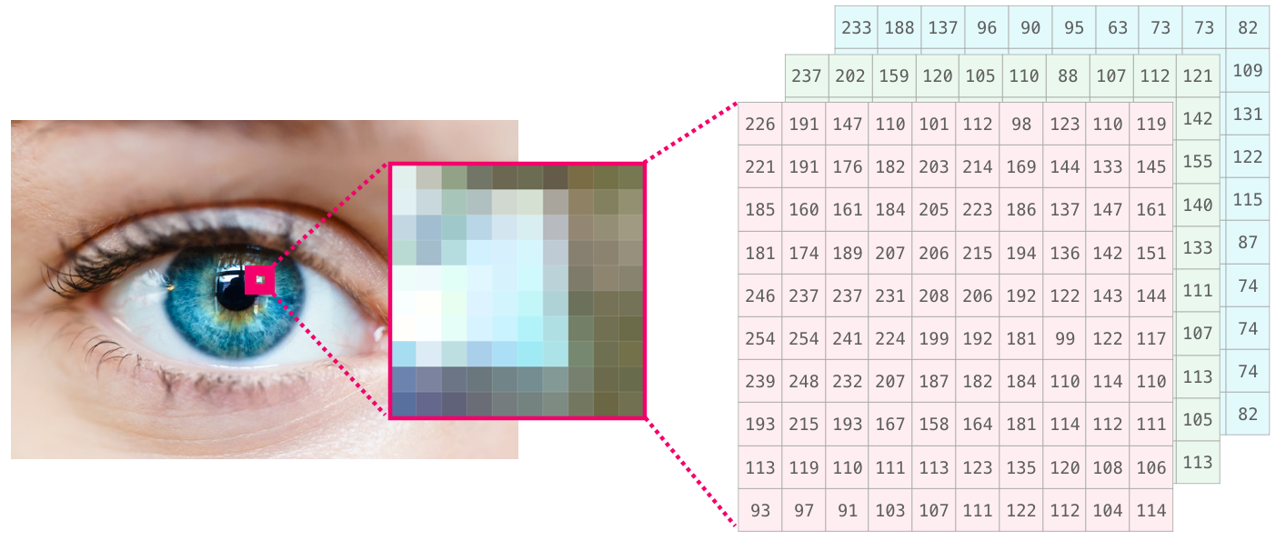
what is Image?
- pixel image
- viriance in colour intensity
So we use another algoritm use to sole this
- Image are special Corelations
Image are special
Use cv2 library for image and video Manupulations

Slide 10
Computer Vision & OpenCV
What is Computer Vision
History of Computer Vision
Tools & Technology used in Computer Vision
Application of Computer Vision
What is OpenCV
Installation of OpenCV
First program with OpenCV
Reading & Writing Images
Capture Videos from Camera
Reading & Saving Videos
Assignment
Reading, Writing and Displaying Images
Changing Color Spaces
Resizing Images
Image Rotation
Image Translation
Simple Image Thresholding
Adaptive Thresholding
Image Segmentation (Watershed Algorithm)
Bitwise Operations
Edge Detection
Image Filtering
Image Contours
Scale Invariant Feature Transform (SIFT)
Speeded-Up Robust Features (SURF)
Feature Matching
Face Detection

Slide 11
How to Train model for Computer Vision
using Machine Learing or Deep Learning
IN Deep Learning
using ANN
OR use Sepcial type OF ANN -->called CNN

Slide 12
Artificial Neural Networks (ANNs) are general-purpose neural networks. They work well for many tasks, but they struggle with image data. Convolutional Neural Networks (CNNs) are designed specifically to handle images more efficiently.
👀 Visual Example:
Imagine you're trying to classify handwritten digits using the MNIST dataset (28x28 grayscale images of digits 0–9).
🧠 Using ANN:
You flatten the image (28x28 = 784 pixels) into a 1D vector.
Feed it into a fully connected ANN.
Problems with this approach:
Loss of spatial information: The 2D structure of the image (how pixels are placed relative to each other) is lost.
Too many parameters: If each input neuron connects to each neuron in the next layer, the model becomes large and slow, especially for big images.
No concept of locality: ANNs don't focus on small features like edges or textures that often matter in images.
🧠 Using CNN:
You keep the image in 2D form.
Use convolutional layers to scan small patches (e.g., 3x3 or 5x5) across the image.
The model learns features like edges, corners, and shapes hierarchically.
Advantages:
Preserves spatial structure: CNNs understand where features are located.
Fewer parameters: Because the same filter is used across the image.
Better at detecting patterns: Local patterns like eyes in a face or digits in an image.

