Slide 1
Transfer Learning
What is Transfer Learning? Transfer Learning in Keras | Fine Tuning Vs Feature Extraction
Keras Functional Model | How to build non-linear Neural Networks?
Alexnet
VGG-16
VGG-!9
Inception net
Resnet

Slide 2
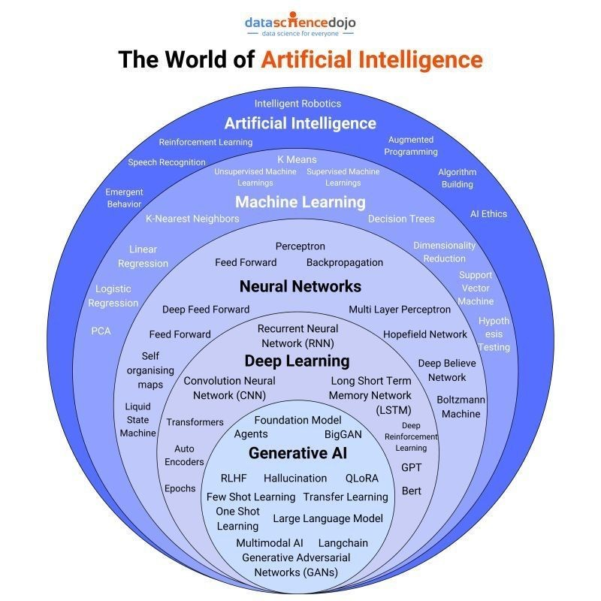
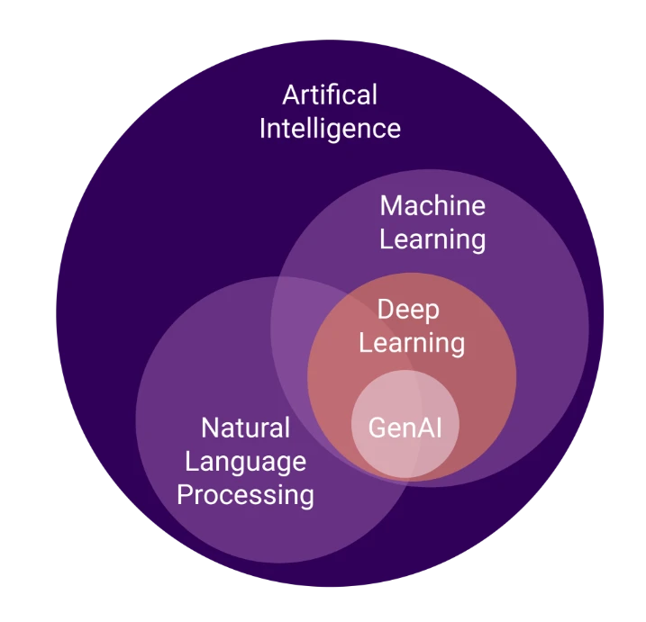
Algorithms and models

Slide 3
Image Classification (binary ,multiclass)
Object Detection & Localizations
Image Segmentations
Siamese Network (comparision bw 2 img
GAN(Generative Adversal Networks) --> create Syntatic Images

Slide 4
Image Classification - FACE RECOGNITION PROJECT
Haar Cascade Clasifier
Image Classification with CNN

Slide 5
Object Detection - CAR DEFECT DETECTION
Template Matching
Edge Detection
Car Defect Detection
Detecting surface or structural issues in car images using Template Matching and Edge Detection (OpenCV-based classical methods).
1. Template Matching
Template Matching is a technique where a small portion of an image (template) is slid over the larger image to find matching patterns.
How it Works
Uses cv2.matchTemplate() to calculate similarity.
The location with the highest similarity score is assumed to be the matching area.
💡 Use Case in Car Defect Detection
Find missing parts (headlights, logo, grill, etc.)
Detect scratches by comparing against a scratch-free template
✅ Advantages
Simple and quick to implement
Effective for detecting fixed shape components like logos, bolts, or license plates
Works well when object and template are of the same size, orientation, and lighting
❌ Limitations
Sensitive to:
Rotation
Scale
Lighting changes
Works only when the defected region is very similar to the template
Fails on dynamic scenes or cluttered backgrounds
🛠 How to Overcome
Use multi-scale template matching
Apply edge-based or normalized template matching
Combine with feature matching (ORB, SIFT) or CNN-based methods

Slide 6
✂️ 2. Edge Detection
Edge detection highlights object boundaries and sharp transitions in images, usually indicating shape outlines, corners, or surface breaks.
🧠 How it Works
Converts image to grayscale
Finds strong intensity changes using filters (Sobel, Laplacian, or Canny)
💡 Use Case in Car Defect Detection
Detect scratches, cracks, and dents
Identify asymmetry or deformation in the car structure
Compare edge maps of normal vs defected cars
✅ Advantages
Highlights fine details such as cracks and scratch lines
Doesn’t require prior templates
Works well for unknown types of defects
❌ Limitations
Highly sensitive to noise
Might detect false edges (reflections, shadows)
Cannot classify defect type (just detects edges)
🛠 How to Overcome
Use preprocessing like Gaussian blur to reduce noise
Combine edge maps with contour detection or morphology
Integrate with ML/CNN models to classify defects based on edge maps

Slide 7
🌍 Real-World Scenarios
Scenario | Method | Example
Logo or missing component detection | Template Matching | Detect missing brand logo
Dent/Scratch detection | Edge Detection | Find scratches after collisions
Surface Quality Control | Edge Detection + Morphology | Crack detection in body panels
Headlight or license plate verification | Template Matching | Spot mismatch or missing parts
Suggested Pipeline for Car Defect Detection
Preprocessing: Resize, convert to grayscale, denoise
Edge Detection: Use Canny for scratches/cracks
Template Matching: Locate specific parts
Morphology: Clean edge maps
Classification/Alert: Mark defected areas
Optional CNN: Predict defect type
CODE IS IN CV FOLDER SCRATCH CODE

Slide 8
OCR Engine
Introduction to Pytesseract
Text Recognition
Text Recognition from image
https://github.com/tesseract-ocr/tesseract
pytesseract is a Python wrapper for the Tesseract-OCR engine.
1. pip install pytesseract
2. You may need to set the path to the tesseract.exe in Python:
pytesseract.pytesseract.tesseract_cmd = r'C:\Program Files\Tesseract-OCR\tesseract.exe'
🧠 What is OCR?
Optical Character Recognition (OCR) is a technology that converts images of typed, handwritten, or printed text into machine-encoded text.
Use Cases:
Invoice/data digitizatio
Document scanning
License plate recognition
Passport, ID scanning
Text extraction from screenshots
🔍 OCR Engine Overview
The most popular open-source OCR engine is Tesseract OCR, developed by HP and later maintained by Google.
Key Features of Tesseract:
Multilingual support (over 100 languages)
Handwriting recognition (limited)
Custom training possible
CLI and Python bindings available
Basic Text Recognition from Image
import cv2 import pytesseract # Load image img = cv2.imread('sample_text.png') # Convert to grayscale gray = cv2.cvtColor(img, cv2.COLOR_BGR2GRAY) # Apply OCR text = pytesseract.image_to_string(gray) print("Extracted Text:") print(text)

Slide 9
⚙Other Useful Functions
python
CopyEdit
pytesseract.image_to_boxes(image) # Get character bounding boxes pytesseract.image_to_data(image) # Detailed OCR with position & confidence pytesseract.image_to_string(image, lang='eng+deu') # Multilingual OCR
🧪 Preprocessing Tips
OCR accuracy depends heavily on image quality. Use these techniques:
Technique | Code Example
Resize | cv2.resize()
Thresholding | cv2.threshold() or cv2.adaptiveThreshold()
Noise removal | cv2.GaussianBlur()
Morphology | cv2.morphologyEx()
Edge sharpening | cv2.filter2D()

Slide 10
✅ Advantages of Pytesseract
Easy Python integration
Free and open-source
Good language support
Works well for printed text
❌ Limitations
Weak on handwriting
Poor performance on noisy/blurred images
Requires preprocessing
Not optimized for speed
🌍 Real-World Scenarios
🔍 Searchable document archives
📦 Automating receipts/invoice scanning
🛂 Passport/ID scanning
📱 Mobile scanning apps (with OpenCV)
🚘 Vehicle number plate detection
💡 How to Overcome Limitations
Problem | Solution
Poor image quality | Preprocess with OpenCV
Skewed text | Apply deskewing
Low confidence | Use image_to_data() and filter
Custom fonts/langs | Train Tesseract with new data

Slide 11
Object Detection
What is Object Detection
Object Detection using Haar Cascade
MobileNet SSD
RCNN and YOLO
MediaPipe
Introduction to MediaPipe
FaceMesh
Hand, Pose and Holistic Models
Assignment

