Slide 5
https://data-flair.training/blogs/html-tags-with-examples/
https://www.mygreatlearning.com/blog/css-tutorial/

Slide 6
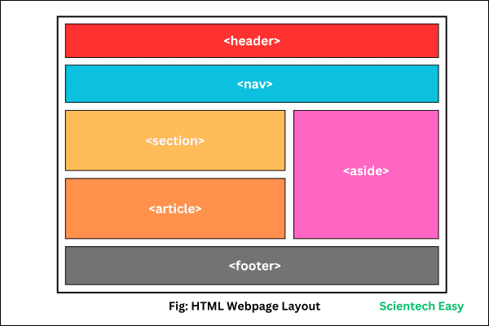

Slide 7
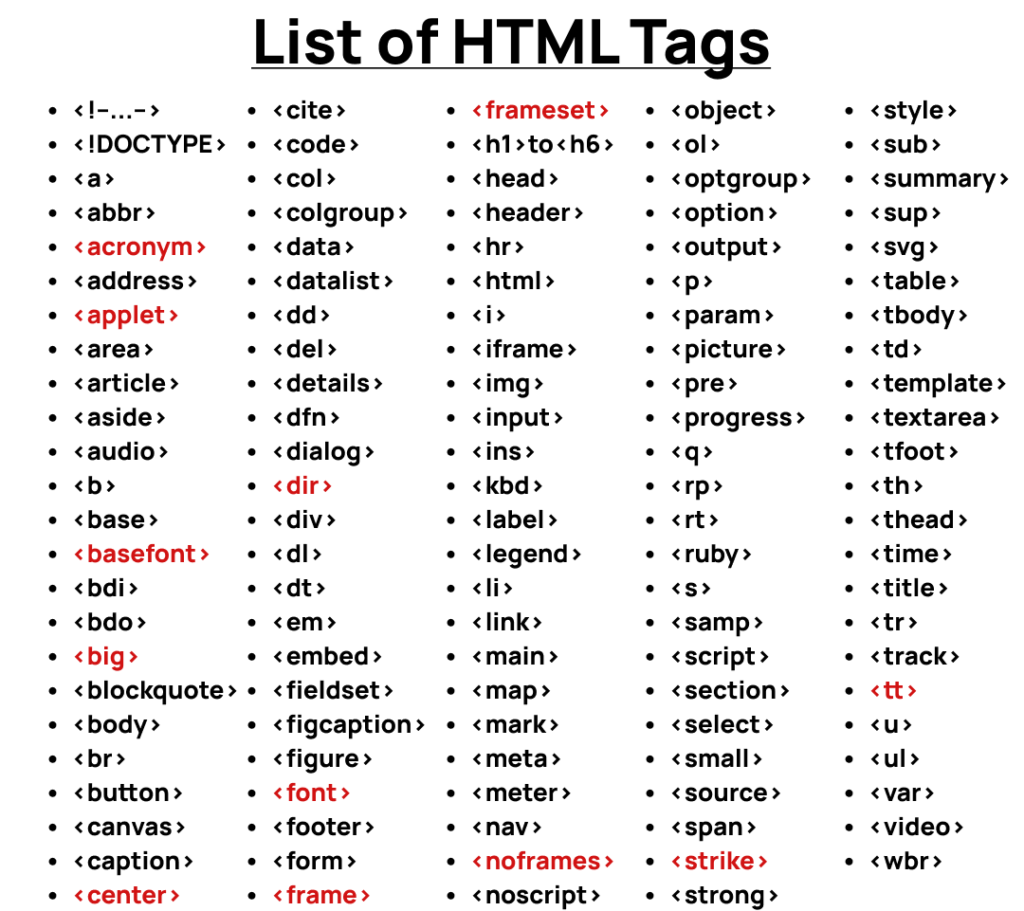
https://www.codewithfaraz.com/article/79/a-comprehensive-list

Slide 9
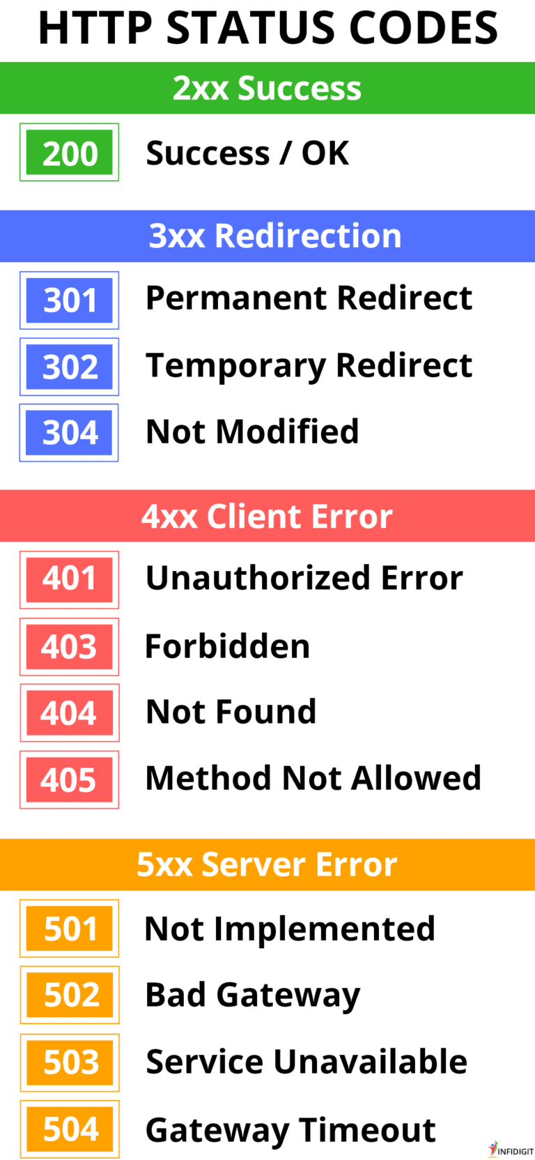
https://www.infidigit.com/blog/http-status-codes/

