Slide 1
Hugging Face
Hugging Face is a company and open-source community that focuses on Natural Language Processing (NLP) and Artificial Intelligence (AI). It is best known for its Transformers library, which provides tools and pre-trained models for a wide range of NLP tasks, such as text classification, sentiment analysis, machine translation, and more.
Syllabus
https://docs.google.com/document/d/1Cf5seDbswIgBwqpcgSfBrLj4f0jCv4mpTkPr3EKMm1I/edit?usp=sharing
https://github.com/laxmimerit/NLP-Tutorials-with-HuggingFace

Slide 2
KEY terms Model
datasets
inference
from transformers import pipeline
Architectures
checkpoints
config
AutoTokenizer class and its from_pretrained()
from transformers import AutoTokenizer
checkpoint = "distilbert-base-uncased-finetuned-sst-2-english"
tokenizer = AutoTokenizer.from_pretrained(checkpoint)
# output
raw_inputs = [
"I've been waiting for a HuggingFace course my whole life.",
"I hate this so much!",
]
inputs = tokenizer(raw_inputs, padding=True, truncation=True, return_tensors="pt")
print(inputs)
Deep dive into Text Generation Inference with LLMs
https://huggingface.co/learn/llm-course/chapter1/8?fw=pt

Slide 3
Preprocessing with a TOKENIZER
we use the AutoTokenizer class and its from_pretrained() method. Using the checkpoint name of our model, it will automatically fetch the data associated with the model’s tokenizer and cache it
https://huggingface.co/learn/llm-course/chapter2/2?fw=pt
from transformers import BertTokenizer
tokenizer = BertTokenizer.from_pretrained("bert-base-cased")
https://huggingface.co/learn/llm-course/chapter2/4?fw=pt
from transformers import AutoTokenizer
tokenizer = AutoTokenizer.from_pretrained("bert-base-cased")
To specify the type of tensors we want to get back (PyTorch, TensorFlow, or plain NumPy), we use the return_tensors argument:
raw_inputs = [
"I've been waiting for a HuggingFace course my whole life.",
"I hate this so much!",
]
inputs = tokenizer(raw_inputs, padding=True, truncation=True, return_tensors="pt")
print(inputs)
from transformers import AutoModel
checkpoint = "distilbert-base-uncased-finetuned-sst-2-english"
model = AutoModel.from_pretrained(checkpoint)

Slide 4
Tokenization
The tokenization process is done by the tokenize() method of the tokenizer:
Copiedfromimport"bert-base-cased""Using a Transformer network is simple"print
The output of this method is a list of strings, or tokens:
Copied'Using''a''transform''##er''network''is''simple'

Slide 5
Creating a Transformer
The first thing we’ll need to do to initialize a BERT model is load a configuration object:
from transformers import BertConfig, BertModel
# Building the config
config = BertConfig()
# Building the model from the config
model = BertModel(config)
# ===
from_pretrained() method:
from transformers import BertModel
model = BertModel.from_pretrained("bert-base-cased")
Saving methods
model.save_pretrained("directory_on_my_computer")
This saves two files to your disk:
ls directory_on_my_computer
config.json pytorch_model.bin
Using a Transformer model for inference

Slide 6
Available pipelines for different modalities
Text pipelines
text-generation: Generate text from a prompt
text-classification: Classify text into predefined categories
summarization: Create a shorter version of a text while preserving key information
translation: Translate text from one language to another
zero-shot-classification: Classify text without prior training on specific labels
feature-extraction: Extract vector representations of text
Image pipelines
image-to-text: Generate text descriptions of images
image-classification: Identify objects in an image
object-detection: Locate and identify objects in images
Audio pipelines
automatic-speech-recognition: Convert speech to text
audio-classification: Classify audio into categories
text-to-speech: Convert text to spoken audio
Multimodal pipelines
image-text-to-text: Respond to an image based on a text prompt
Using any model from the Hub in a pipeline
from transformers import pipeline
generator = pipeline("text-generation", model="HuggingFaceTB/SmolLM2-360M")
generator(
"In this course, we will teach you how to",
max_length=30,
num_return_sequences=2,
)

Slide 7
Language models are a type of AI that predict and generate human language. They are essentially machine learning models trained on vast amounts of text data to understand the patterns and relationships within language. This allows them to perform tasks like text generation, translation, question answering, and more.
Here's a more detailed explanation:
What they do:
Predict the next word:
Language models analyze sequences of words (sentences, paragraphs, etc.) and predict the probability of different words following a given sequence.
Generate text:
By predicting the next word, language models can generate coherent and contextually relevant text, like articles, stories, or even code.
Understand language:
They can also be used for tasks like translation, sentiment analysis, and question answering, demonstrating their ability to understand the meaning and context of language.
How they work:
Training: Language models are trained on massive datasets of text and code.
Statistical and probabilistic techniques: They use statistical and probabilistic techniques to analyze the data and learn the relationships between words and phrases.
Neural networks: Many modern language models, especially large language models (LLMs), are built using neural networks, particularly the transformer architecture.
Examples and Applications:
Large Language Models (LLMs):
These are advanced language models, like OpenAI's GPT series and Google's PaLM, that have been trained on massive datasets and can perform a wide range of tasks.
Applications:
Language models are used in various applications, including:
Chatbots and virtual assistants: Providing conversational AI.
Machine translation: Translating text from one language to another.
Text generation: Creating different forms of text content.
Code generation: Assisting with writing and debugging code.
Summarization and information retrieval: Extracting key information from large documents.
Accessibility tools: Assisting individuals with disabilities.

Slide 8
Transformers are language models
All the Transformer models mentioned above (GPT, BERT, T5, etc.) have been trained as language models. This means they have been trained on large amounts of raw text in a self-supervised fashion.
Transformers are big models
Transfer Learning
General Transformer architecture
Each of these parts can be used independently, depending on the task:
Encoder-only models: Good for tasks that require understanding of the input, such as sentence classification and named entity recognition.
Decoder-only models: Good for generative tasks such as text generation.
Encoder-decoder models or sequence-to-sequence models: Good for generative tasks that require an input, such as translation or summarization.
Attention layers
Types of language models
Encoder-only models (like BERT): These models use a bidirectional approach to understand context from both directions.
Decoder-only models (like GPT, Llama):
Encoder-decoder models (like T5, BART):
Transformer models for language
How language models work
There are two main approaches for training a transformer model:
Masked language modeling (MLM):
Causal language modeling (CLM)

Slide 9
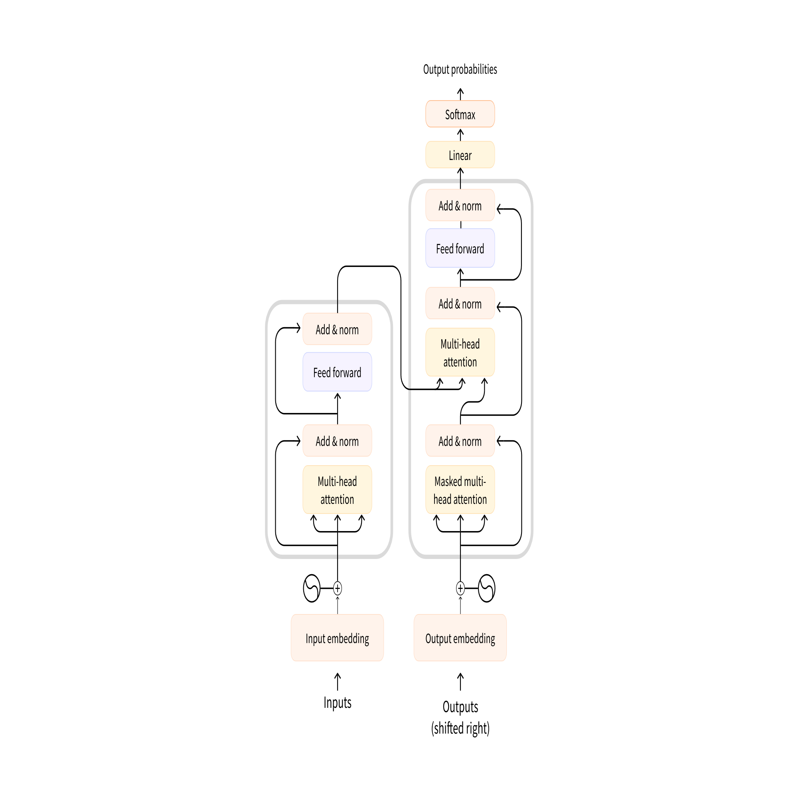

Slide 10
Architectures vs. checkpoints
As we dive into Transformer models in this course, you’ll see mentions of architectures and checkpoints as well as models. These terms all have slightly different meanings:
Architecture: This is the skeleton of the model — the definition of each layer and each operation that happens within the model.
Checkpoints: These are the weights that will be loaded in a given architecture.
Model: This is an umbrella term that isn’t as precise as “architecture” or “checkpoint”: it can mean both. This course will specify architecture or checkpoint when it matters to reduce ambiguity.

Slide 11
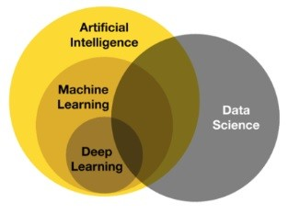
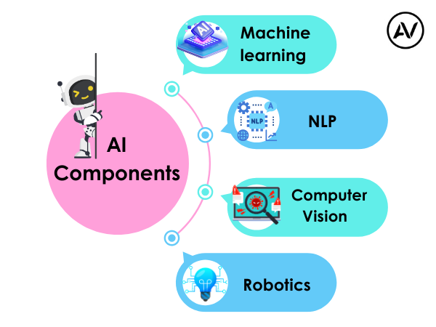
https://ellow.io/components-of-ai/

Slide 12
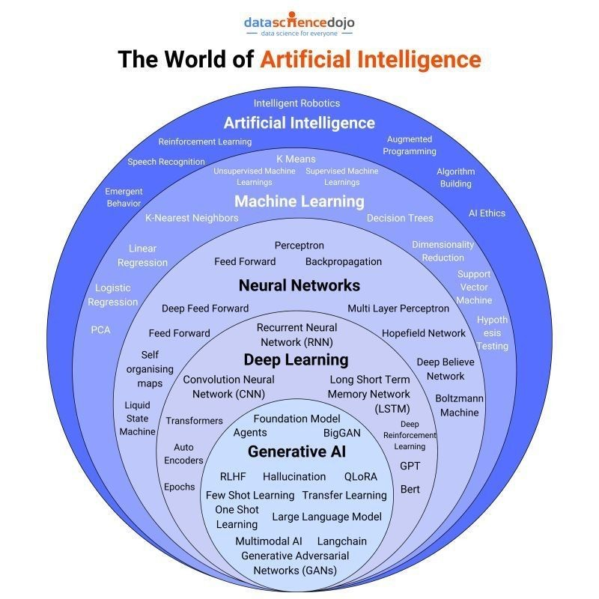
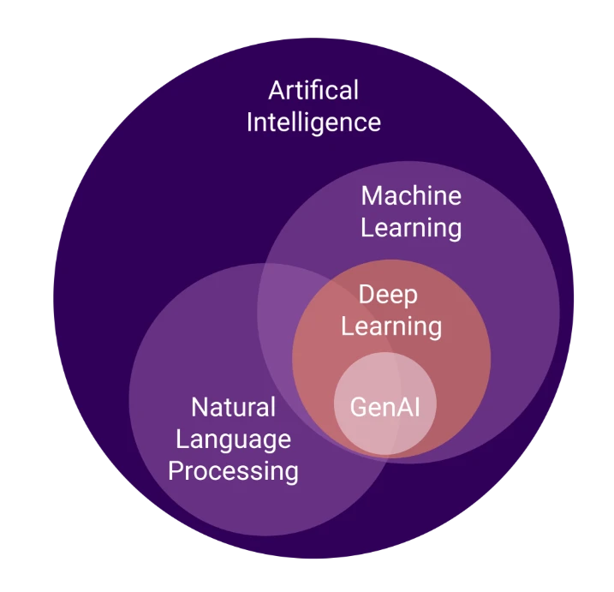
Algorithms and models

Slide 13
TRANSFORMERS
Encoder Decoder
Attention
Self attentions and their Geometric intutions
Scaled Dot product Attention
Why is Self Attention called "Self"? | Self Attention Vs Luong Attention in Depth Lecture | CampusX
What is Multi-head Attention in Transformers | Multi-head Attention v Self Attention | Deep Learning
Positional Encoding in Transformers | Deep Learning | CampusX
Layer Normalization in Transformers | Layer Norm Vs Batch Norm
Transformer Architecture | Part 1 Encoder Architecture | CampusX
Masked Self Attention | Masked Multi-head Attention in Transformer | Transformer Decoder
Cross Attention in Transformers | 100 Days Of Deep Learning | CampusX
Transformer Decoder Architecture | Deep Learning | CampusX
Transformer Inference | How Inference is done in Transformer? | Deep Learning | CampusX

Slide 14
tutorial
https://www.youtube.com/playlist?list=PLo2EIpI_JMQvWfQndUesu0nPBAtZ9gP1o
https://huggingface.co/learn/llm-course/chapter1/1
https://studyopedia.com/tutorials/hugging-face/
How to Build Streamlit App with 3 Hugging Face Transformers | Python Code + Project
https://youtu.be/dWnJMp-4db8?feature=shared
https://huggingface.co/docs

Slide 15
PROJECTS
https://www.kdnuggets.com/2023/02/simple-nlp-pipelines-huggingface-transformers.html
https://www.kdnuggets.com/a-simple-to-implement-end-to-end-project-with-huggingface
https://www.analyticsvidhya.com/blog/2025/01/hugging-face-ai-projects/
https://www.analyticsvidhya.com/blog/2025/01/hugging-face-ai-projects/
https://huggingface.co/huggingface-projects
Building AI Products with Hugging Face
https://www.youtube.com/watch?v=T6GPytSmUQM
#1-Getting Started Building Generative AI Using HuggingFace Open Source Models And Langchain
https://youtu.be/bFB4zqkcatU?feature=shared

Slide 16
LLM (Large Language Model) inference is the process of using a trained LLM to make predictions or generate new content based on a given input. It's like putting the model into action after it has been trained. This involves taking an input, typically a prompt, and passing it through the model's parameters to generate relevant outputs like text, code, or translations.
What is the LSH method?
Locality Sensitive Hashing (LSH) is a technique used to perform approximate nearest neighbor searches in high-dimensional spaces. The core idea of LSH is to hash input items in such a way that similar items are more likely to be hashed into the same bucket.

Slide 17
Available pipelines for different modalities
The pipeline() function supports multiple modalities, allowing you to work with text, images, audio, and even multimodal tasks.
Text pipelines
text-generation: Generate text from a prompt
text-classification: Classify text into predefined categories
summarization: Create a shorter version of a text while preserving key information
translation: Translate text from one language to another
zero-shot-classification: Classify text without prior training on specific labels
feature-extraction: Extract vector representations of text
Image pipelines
image-to-text: Generate text descriptions of images
image-classification: Identify objects in an image
object-detection: Locate and identify objects in images
Audio pipelines
automatic-speech-recognition: Convert speech to text
audio-classification: Classify audio into categories
text-to-speech: Convert text to spoken audio
Multimodal pipelines
image-text-to-text: Respond to an image based on a text prompt

Slide 18
We’ll cover the following models and their corresponding tasks:
Wav2Vec2 for audio classification and automatic speech recognition (ASR)
Vision Transformer (ViT) and ConvNeXT for image classification
DETR for object detection
Mask2Former for image segmentation
GLPN for depth estimation
BERT for NLP tasks like text classification, token classification and question answering that use an encoder
GPT2 for NLP tasks like text generation that use a decoder
BART for NLP tasks like summarization and translation that use an encoder-decoder
Modalities beyond text
Speech and audio --> https://huggingface.co/learn/llm-course/chapter1/5?fw=pt
Whisper is a encoder-decoder (sequence-to-sequence) transformer pretrained on 680,000 hours of labeled audio data.
Automatic speech recognition
# Automatic speech recognition
from transformers import pipeline
transcriber = pipeline(
task="automatic-speech-recognition", model="openai/whisper-base.en"
)
transcriber("https://huggingface.co/datasets/Narsil/asr_dummy/resolve/main/mlk.flac")
# Output: {'text': ' I have a dream that one day this nation will rise up and live out the true meaning of its creed.'}

Slide 19
Computer vision
Image classification

Slide 20
