Slide 1
InvoiceFlow
Carried Out By
Dharmik Parmar (22CEUES090)
GST Invoice & Business Management System
B.Tech – Computer Engineering
Dharmsinh Desai University, Nadiad
Company: RKIT Software Pvt. Ltd., Rajkot
Internal Guide
External Guide
Prof. Shaifali Malukani
Assistant Professor
Dept. of Comp. Engg.
DDU, Nadiad
Ms. Yashvi Shah
Project Coordinator
RKIT Software Pvt. Ltd.

Slide 2
Introduction & Objective
What is InvoiceFlow?
A full-stack, cloud-ready GST Invoice and Business Management System for Indian SMEs – automating invoicing, GST calculation, payments and compliance reporting from one platform.
Core Objectives:
Simplify GST-compliant invoicing reduce manual effort and billing errors for Indian SMEs.
Automate CGST+SGST vs IGST computation using HSN/SAC code-based detection.
Track receivables through payment entries, outstanding balances, and AR aging reports.
Enable secure team collaboration via role-based access (Admin / Accountant / Viewer).
Provide GST-ready reports GSTR-1 style summaries, GST output vs input net liability.

Slide 3
Types of Users
Three roles with distinct access levels:
Admin : Full control — manage users, invite/approve team, configure roles & permissions, view all analytics, override GST rates (AUTO vs MANUAL).
Accountant : Operational access — create and manage invoices, manage customer/vendor masters, record payments, generate reports. Cannot manage roles.
Viewer : Read-only access — view invoices, dashboard and reports. No creation or edit rights.
Authorization pattern in API:
Read endpoints → [Authorize]
Mutations → [Authorize(Roles="Admin,Accountant")]
Admin-only → [Authorize(Roles="Admin")]

Slide 4
Key Features
Invoice & GST Engine:
Team & Access:
Draft → Sent → Partial → Paid / Overdue / Cancelled.
HSN/SAC longest-prefix matching, auto-detects GST rate (0/5/12/18/28%).
Intrastate: CGST + SGST split equally. Interstate: full IGST.
Invitation-based onboarding with token-validated self-registration.
Admin approval before access granted.
JWT secured sessions, auto-logout on 401.
Business Operations:
Analytics & Reporting:
Customer, vendor and product master data with soft-delete.
Payment posting with outstanding validation and auto status transitions.
Business-scoped multi-tenant isolation, every query filtered by business.
Dashboard: FY KPIs, revenue trend, top customers, status counts.
Reports: GSTR-1 style, sales, AR aging, products, GST net summary.
Export to PDF and Excel; print-ready invoice views.

Slide 5
Technology & Tools
Frontend:
Backend:
React 18 + TypeScript + Vite (SPA)
React Router v6 | TanStack React Query
Axios + fetch wrapper (dual API clients)
shadcn/ui + Radix + Tailwind CSS
Recharts | jsPDF + autoTable + xlsx for exports
ASP.NET Core 8 Web API
Entity Framework Core: Pomelo MySQL provider
JWT bearer authentication + BCrypt hashing
Swagger / OpenAPI with bearer token support
3-layer: InvoiceFlow.API → .Application → .Infrastructure
Database & Infrastructure:
Development Tools:
MySQL 8.0 in Docker
Docker Compose for container orchestration
SQL seed scripts
Visual Studio 2022 (backend) | VS Code (frontend)
Git & GitHub | Postman | MySQL Workbench

Slide 6
Backend Architecture - Layered Design
Three-layer structure:
API Layer
· HTTP contracts
· Controllers
· Auth attributes
· Input validation
· Response shaping
· Swagger
Application Layer
Business orchestration
· IAuthService
· IUserService
· IApprovalService
· IEmailService
Infrastructure Layer
· EF Core DbContext
· Entity mapping
· MySQL persistence
· Tenant-scoped queries
Domain
· POCO Models
· DTOs
Middleware pipeline order:
DI lifetimes:
CORS → Swagger (dev only) → Authentication → Authorization → Controller endpoints
Scoped: AuthService, UserService, ApprovalService, EmailService
Singleton: GstMappingService

Slide 7
Flow of the System
[ System Flow / Sequence Diagram ]
Flow summary:
Login → JWT issued → Role check → Invoice / Customer / GST Engine → Invoice saved → Report / Export

Slide 8
GST Calculation Engine
Interstate vs Intrastate - determined by comparing Business State vs Customer State:
Taxable value (per line):
Taxable = Qty × UnitPrice × (1 − Discount/100)
Intrastate (CGST + SGST):
CGST = Taxable × Rate/200
SGST = Taxable × Rate/200
Interstate (IGST):
IGST = Taxable × Rate/100
Line total:
Total = Taxable + CGST + SGST + IGST
Invoice no. format:
invoicePrefix + "-" + zeroPad(counter, 4) → INV-0012
GST rates:
0% · 5% · 12% · 18% · 28% - HSN/SAC longest-prefix matching

Slide 9
Invoice Creation Flow
User opens invoice create page — frontend loads customers, products, and GST rates in parallel (Promise.all).
User selects customer and adds line items with quantities and discounts.
On submit → POST /api/invoices — backend validates customer and GST rate references.
Backend computes per-line taxable value, CGST/SGST or IGST based on state codes; aggregates invoice totals.
Invoice number generated: invoicePrefix + zeroPad(counter, 4) — counter incremented atomically in same save.
Status starts as Draft. Accountant/Admin can transition: Draft → Sent → Paid/Partial/Overdue/Cancelled.
Admin-only: Cancel action sets status = 'cancelled' — no physical row deletion (audit trail preserved).

Slide 10
Payment Reconciliation Logic
Rules enforced on every payment:
Cannot post payment on a cancelled invoice.
Amount must be > 0 and cannot exceed outstanding balance.
Outstanding = Total Amount − Amount Paid
Status transitions on payment create:
amountPaid ≥ totalAmount → 'paid' else → 'partial'
Status transitions on payment delete (reverse):
amountPaid ≤ 0 → 'sent'
amountPaid < total → 'partial' else → 'paid'
Invoice status lifecycle:
draft → sent → partial → paid → overdue → cancelled

Slide 11
Authentication & User Onboarding
Auth endpoints (AuthController):
POST /api/auth/register - self-registration (basic).
POST /api/auth/login - credentials login → JWT issued.
GET /api/auth/me - resolve current user, role, approval status, business metadata.
POST /api/auth/google - OAuth code exchange → local JWT issued.
Invite & approval flow:
Admin creates invitation link with role assignment and expiry.
Invitee opens tokenized URL → validates token via public API endpoint.
Invitee submits credentials → pending user created, invitation marked accepted.
Admin reviews pending entries → approves or rejects via AdminUsersController.
On approval: final role assigned, user status activated → user can now log in.

Slide 12
Implementation Details – Backend
Tenant scoping pattern (applied in every controller):
userId = JWT.claims(NameIdentifier)
businessId = users.where(id==userId).select(BusinessProfileId)
records = table.where(BusinessId == businessId)
Soft-delete strategy:
Customers: hard delete only if no dependent invoices; otherwise deactivate (is_active = 0).
Vendors: always soft-deactivate — preserves purchase invoice history.
Products: hard delete blocked if referenced by any invoice line item.
Invoices: cancel sets status = 'cancelled' — no physical row deletion.
Rationale: preserve accounting/audit trail; avoid orphan references in historical reports.

Slide 13
Implementation Details – Frontend
AuthContext state machine:
Data fetch patterns:
Boot: reads token from localStorage.
If token: calls me() to hydrate user, role, business profile.
Derives flags: isAdmin · isAccountant · canModify · isPendingApproval.
On me() failure: clears token → redirects to /auth.
AppLayout guard: if !loading && !user → navigate('/auth').
Promise.all for form bootstrapping (customers + products + rates loaded in parallel).
React Query for caching with stale-while-revalidate.
Toast feedback for success/failure visibility.
Local state patch after mutations — avoids full page refetch.
Axios interceptors:
Dual API clients (known issue):
Request: injects Authorization: Bearer <token>.
Response: HTTP 401 → remove token + redirect to /auth.
Centralizes session handling — no scattered auth checks in pages.
Axios services in /src/api/ for most feature endpoints.
Separate fetch wrapper in /src/lib/api.ts also in use.
Consolidation recommended for production — avoids contract drift.

Slide 14
Reports & Analytics
Available reports:
Dashboard KPIs:
GSTR-1 Style — outward supply by GST rate (month/year).
Sales Report — date-range sales by customer with tax breakdown.
AR Aging — bucketed receivables: Current · 1-30 · 31-60 · 61-90 · 90+ days.
Products Report — sales volume and revenue per product.
Total invoices, Revenue Collected (FY), Pending Amount, Overdue Amount.
Top customers by revenue (current FY).
Invoice status distribution chart.
Monthly revenue trend (invoiced vs collected).
Export to PDF, Excel. Print-ready invoice view.
GST summary logic:
Output GST = Σ sales taxes
Input GST = Σ purchase taxes
Net GST = Output − Input
(sent / partial / paid / overdue only — excludes draft & cancelled)

Slide 15
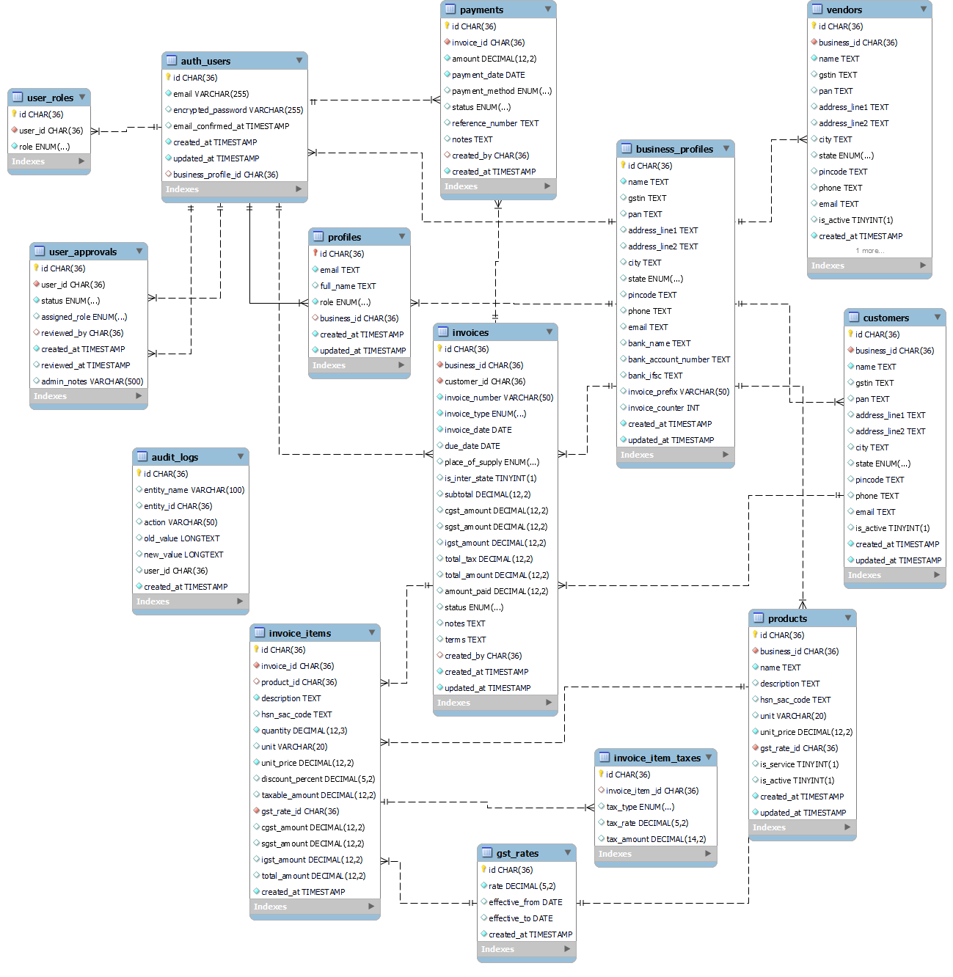
System Analysis – ER Diagram

Slide 16
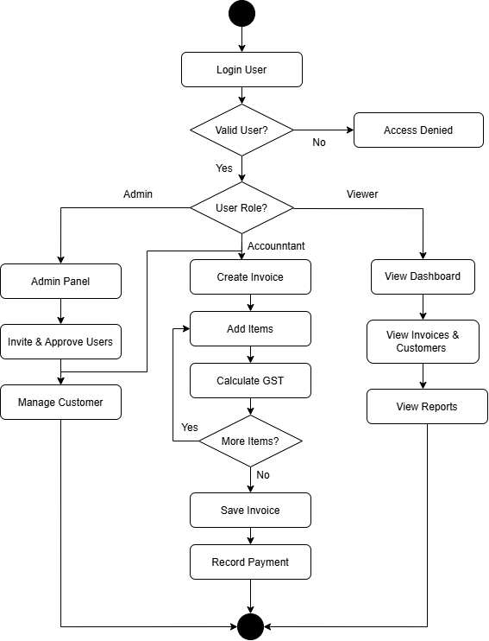
System Analysis – Use Case Diagram

Slide 17
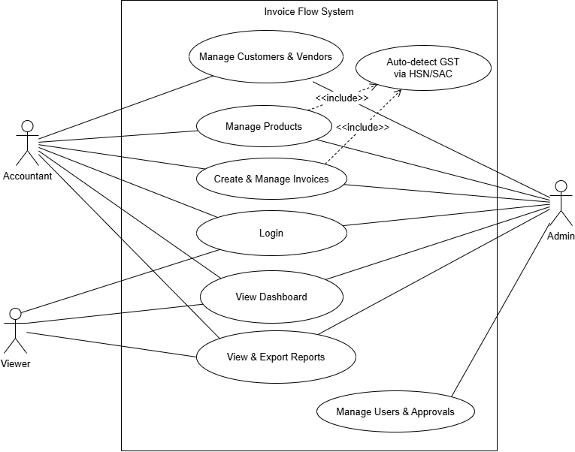
System Analysis – Activity Diagram
[ Activity Diagram ]

Slide 18
System Analysis – Data Flow Diagram
Level-0 DFD
Level-1 DFD
[ Level-0 DFD ]
[ Level-1 DFD ]
Key data flows:
Admin ↔ InvoiceFlow: user management, roles, approvals, dashboard.
Accountant ↔ InvoiceFlow: invoice create, customer/vendor mgmt, payment posting.
Viewer ↔ InvoiceFlow: read-only report and dashboard access.

Slide 19
Role And Permission Page
[ Role & Permissions Page Screenshot ]
Permission model:
Each module has independent Can View / Can Add-Edit / Can Delete toggles. Super Admin has full access by default.

Slide 20
Dashboard & Invoices
Dashboard
Invoices Page
[ Dashboard Screenshot ]
[ Invoices Page Screenshot ]
View & Export Invoice
[ Invoice Detail / Export Screenshot ]

Slide 21
Customers, Vendors & Reports
Customers & Vendors
Reports & Analytics
[ Customers / Vendors Screenshot ]
[ Reports / Charts Screenshot ]
Invoice Generate & Excel Export
[ Invoice PDF + Excel Export Screenshot ]

Slide 22
Conclusion
InvoiceFlow is a production-ready, GST-compliant invoicing platform covering the full lifecycle — onboarding, invoice generation, GST computation, payment tracking, and compliance reporting.
The HSN/SAC longest-prefix GST engine eliminates manual tax selection and significantly reduces billing errors for Indian SMEs.
Invitation-based onboarding with role-based access (Admin/Accountant/Viewer) ensures controlled and auditable multi-user access.
Modern layered architecture React 18 + ASP.NET Core 8 + EF Core + MySQL maintainable, modular, and cloud-deployment ready.
Rich reporting: GSTR-1 style summaries, AR aging, product analytics, and GST output vs input net liability for data-driven compliance.
With incremental hardening (automated tests, API client consolidation, production CORS), the system is well-positioned for scale-up.

Slide 23
Limitations & Future Extensions
Current Limitations:
Future Extensions:
No direct GSTN/IRP government API integration yet.
HSN mapping table requires periodic manual updates.
Cloud-based limited offline functionality.
Web-only no mobile application currently.
Dual frontend API clients (Axios + fetch) contract duplication.
CORS permissive in dev must be restricted for production.
GST Return Filing GSTN API for GSTR-1 & GSTR-3B auto-filing.
E-Invoicing IRP integration for IRN + QR codes.
E-Way Bill generation via NIC APIs.
AI-based HSN/SAC suggestion from product descriptions.
React Native mobile application.
Automated test suite: unit + integration + API contract.
Formal invoice state machine to prevent status drift.

Slide 24
References
[1]
ASP.NET Core 8 Web API Documentation
https://learn.microsoft.com/en-us/aspnet/core/
[2]
Entity Framework Core — Pomelo MySQL Provider
https://learn.microsoft.com/en-us/ef/core/
[3]
JWT Authentication in ASP.NET Core
https://learn.microsoft.com/en-us/aspnet/core/security/authentication/
[4]
React 18 + TypeScript + Vite
https://vitejs.dev/ | https://react.dev/
[5]
TanStack React Query
https://tanstack.com/query/latest
[6]
shadcn/ui + Radix + Tailwind CSS
https://ui.shadcn.com/
[7]
Recharts — Charting Library
https://recharts.org/
[8]
GST India — Official Portal
https://www.gst.gov.in/
[9]
N-Tier Architecture (Azure)
https://learn.microsoft.com/en-us/azure/architecture/guide/architecture-styles/n-tier
[10]
Docker Compose Reference
https://docs.docker.com/compose/

Slide 25
THANK YOU!
Do you have any questions?
Dharmik Parmar (22CEUES090)
B.Tech – Computer Engineering | Dharmsinh Desai University | April 2026

