Slide 1

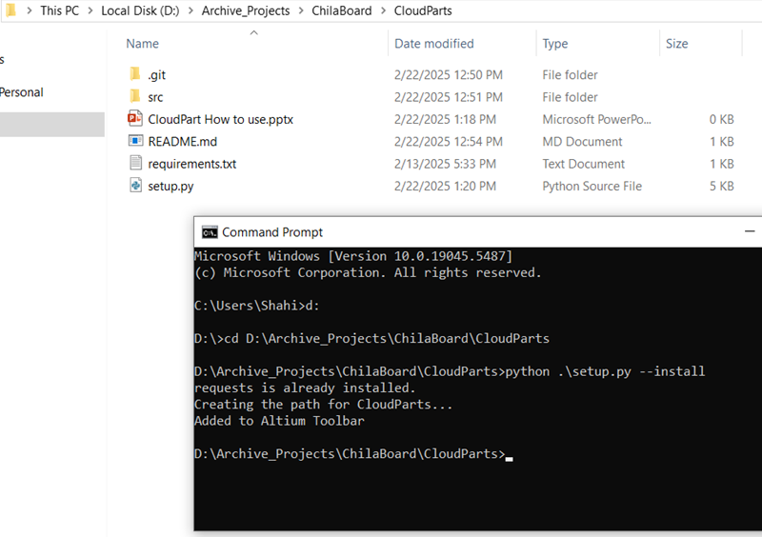
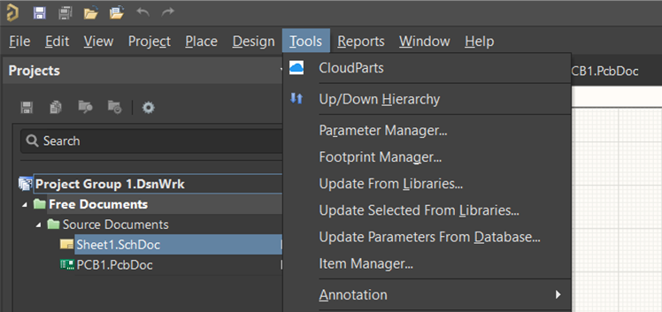
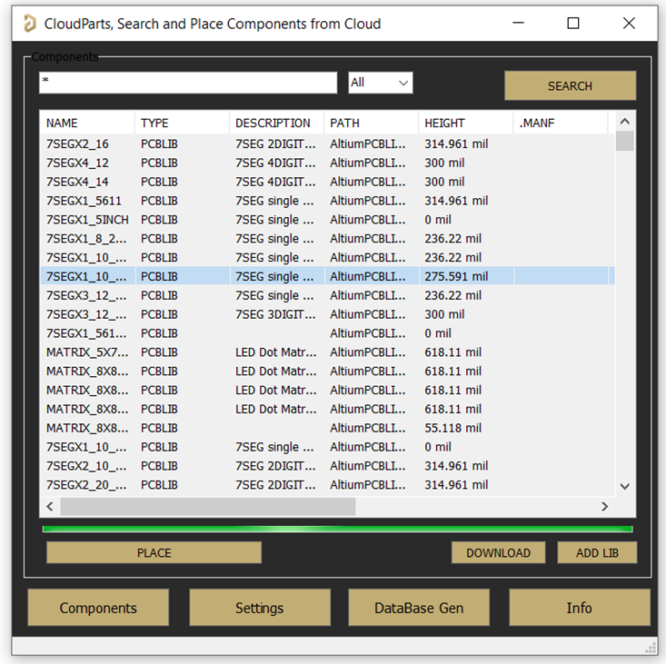
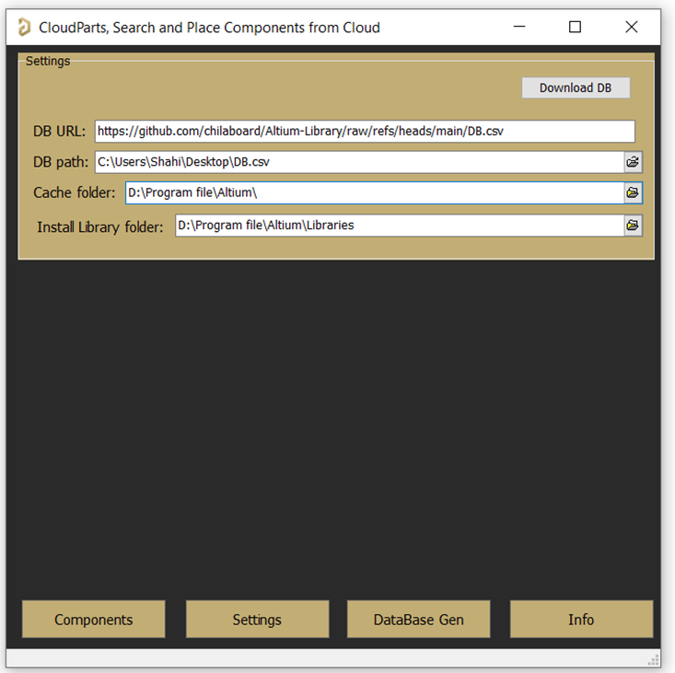
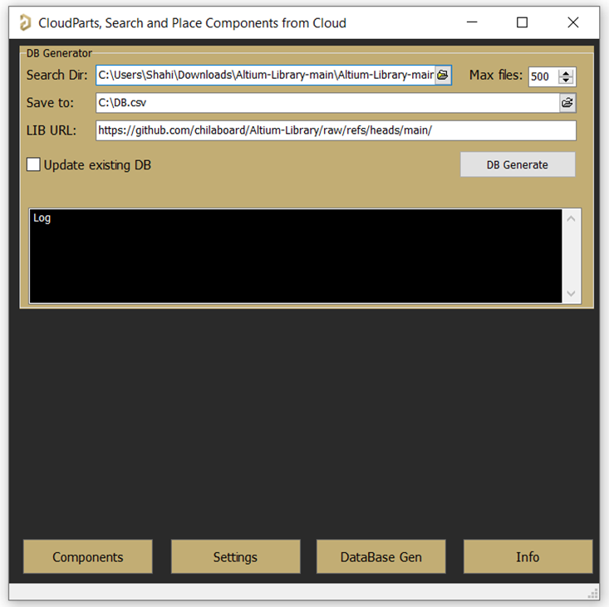
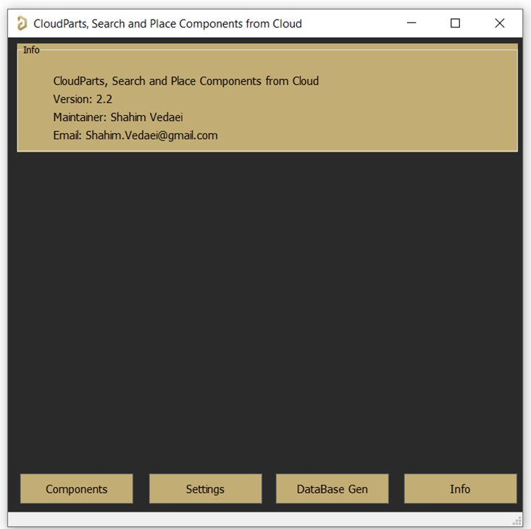
Altium
What is CloudParts:
CouldParts is an Open source extension for Altium Designer in which you can search and place components directly from a Github repository without initially downloading all libraries and installing them. Hence, by having a database csv file from them you can search, then place them directly inside Altium.
CloudParts
1
Download/Clone the CloudParts repository.
2
This Extension needs python3, please download and install the latest version of python3 from https://www.python.org/downloads/
Python version shall be >= 3.11.9
IMPORTANT:
Add python to the Windows PATH during installation
3
Close Altium Designer app. Any instances of this app should NOT be open during the installation.
4
Open a CMD and change directory to CloudParts Extension.
Hint: Use ‘d:’ to change base to D:\ drive for example. Then, cd <CloudParts path>
5
Run the setup script.
python .\setup --install
All done, you are ready to use the extension.
6
Open Altium Designer and create/open a new Schematic or PCB.
From Tools, select CloudParts
7
First select Settings tab as you need to set these fields:
DB URL: if you want to directly download a database file from a git repository, you may enter its address here. Then, by clicking on Download DB, the csv database will be downloaded to cache directory.
Hint: The repo maintainer must provide this path and upload the csv file to its GitHub.
DB path: Select the database .csv file. This files contains all necessary information to search and download from a Github repository.
Cache folder: Select an empty folder on your PC, every time the App tries to download a library, it will place it here.
Install Library folder: In case you want to install a library on Altium Designer, the Cache directory is not a suitable place to store long term.
By ADD LIB, the library first copied from Cache directory to this path, then it will be installed on Altium
8
After selecting the csv database from setting tab, select Component tab, and SEARCH for the desired objects. You may filter for SCHLIB or PCBLIB.
9
Select an item from the list and hit the PLACE button, it automatically download the files from Github to the Cache directory, then place it on Schematic or PCB.
You can individually, download the library by clicking on DOWNLOAD button. Or if needed you may install them to the Altium by clicking ADD LIB.
10
If you want to create your own csv data base with your libraries and place them on Github, you may need to generate a DB file.
Search Dir: This directory on your PC, should contain the root of all your libraries that are in Github. The root should be the same as what is available on your Github repository. It is recommended to clone your repo, then select it as your search dir.
Save to: The final generated database .csv file will be created in this path.
LIB URL: App uses this link to download from the Github, please set your Github repository path to here.
IMPORTANT:
Make sure add the branch to the your Github url so the extension will be able to download the files in raw format.
<repo url>/raw/refs/heads/<branch>/
Max files: You can limit the maximum number of libraries for search and generating the database.
Update existing DB: This feature is not implemented yet, but it is intended to update the existing .csv file. So, only updates the changes on the csv database.
Finally, select DB Generate. Wait until it is done. You can now add this file to your Github. So, others can use it on their Settings->DB URL, to download and use it directly.
11
On Info tab you can check the Extension version and the contact information to the maintainer.
12
To uninstall the extension
Open a CMD and change directory to CloudParts Extension.
Run the setup script.
python .\setup --uninstall
Feb 2025
User Manual: V 1.0

