Slide 1

Grocery Store Management
Presented by
Shahin
Batch No:460

Slide 2
Agenda
In this presentation, I will discuss:
Objective of the Project
Dataset Overview
ER Diagram and schema explanation
Key analysis questions
SQL query results with screenshots or summaries
Final business insights and recommendations
Challenges working on SQL – Data Analysis Project.
Conclusion

Slide 3
Business Problem :
The grocery store lacks a structured system to manage products, suppliers, customers, and orders efficiently.
Sales data is not properly analyzed to identify revenue trends and high-performing products.
There is no clear tracking of employee performance and supplier contribution.
Business decisions are made without proper data insights.
Manual data handling can lead to errors and data inconsistency.
Business Problem Statement :
Maintain proper inventory tracking to avoid stock shortages and expired products.
Use a computerized billing system to reduce manual errors and save time.
Monitor daily sales and profit reports to identify fast-moving and slow-moving items.
Control expenses and analyze data regularly to improve overall business growth.

Slide 4
Objectives
The main goals of this SQL project are:
To design and implement a relational database for a grocery store
To retrieve and manipulate data using SQL queries
To perform data analysis to identify top customers, best-selling products, and revenue trends
To analyze supplier contribution, employee performance, and order behavior
To practice advanced SQL concepts like JOINs, GROUP BY ,Aggregations,
Subqueries, and Window functions

Slide 5
Dataset Overview
The dataset consists of 7 main tables:
Products
Suppliers
Employees
Orders
Order Details
Customers
Categories
These tables represent real grocery store sales operations and are connected using primary and foreign keys.

Slide 6
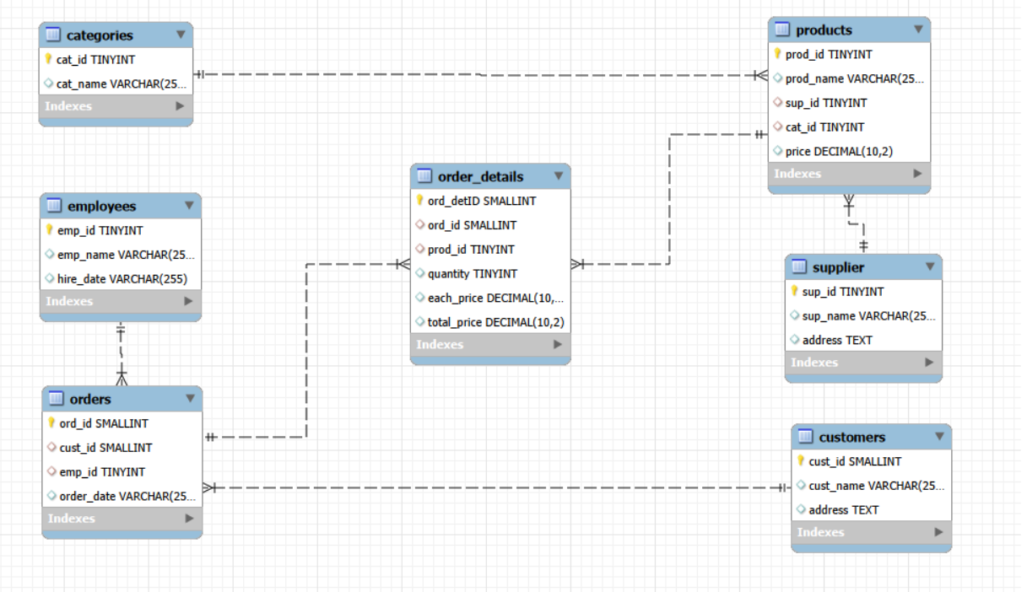
ER - Diagram
The ER diagram shows the relationships between all tables.Most relationships are One-to-Many.

Slide 7
Schema Explanation :
Each Supplier acts as a master record and is connected to the Products table through the foreign key (sup_id).
Each Category is linked to multiple Products using (cat_id).
Each Customer is connected to multiple Orders using (cust_id).
Each Employee handles multiple Orders through (emp_id).
Each Order is connected to multiple products through the Order_Details table using (ord_id).
Each Product can appear in multiple Order_Details records using (prod_id).
This design creates one-to-many relationships where:
One Supplier → Many Products
One Category → Many Products
One Customer → Many Orders
One Employee → Many Orders
One Order → Many Order_Details
One Product → Many Order_Details
This schema design ensures proper data organization, maintains relationships using foreign keys, and prevents orphan records using cascade constraints.

Slide 8
Cascade Rules in Grocery Store Database
ON UPDATE CASCADE:
It automatically updates foreign key values in related tables when the primary key changes.
This ensures data consistency across related tables and prevents broken relationships.
For example, if a supplier ID changes, all related products will automatically update.
Where used in this project:
supplier → products
categories → products
customers → orders
employees → orders

Slide 9
ON DELETE CASCADE :
It automatically deletes related child records when a parent record is removed.
Keeps the database clean and valid when deleting orders/customers/suppliers.
This prevents orphan records and maintains referential integrity.
For example, when an order is deleted,
the related order details are also deleted automatically.
Where used in this project:
orders → order_details
supplier → products
categories → products

Slide 10
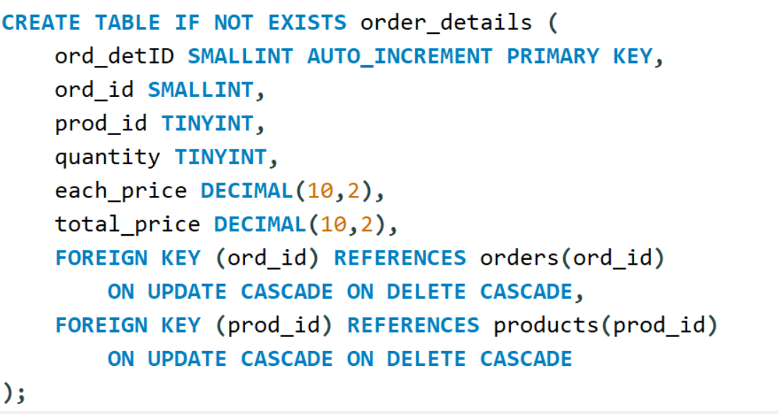
Update cascade and Delete cascade

Slide 11
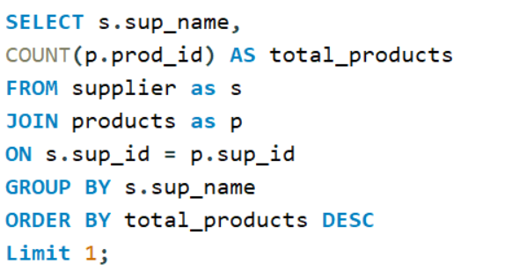

Supplier Performance :
Key Analysis
Identify the most active and profitable suppliers.
1. Which supplier provides the most products?

Slide 12
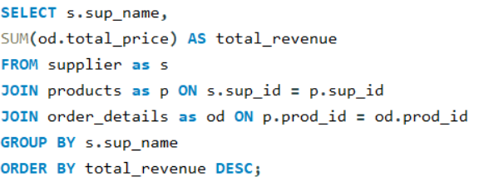
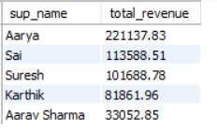
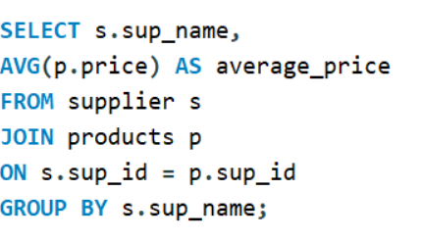
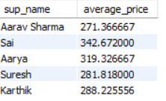
Which suppliers contribute the most to total product sales (by revenue)?
What is the average price of products from each supplier?

Slide 13

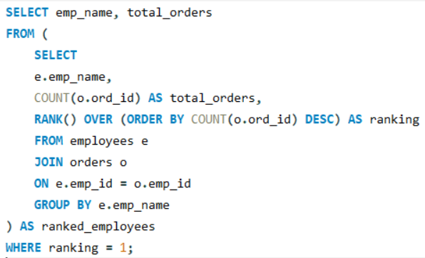
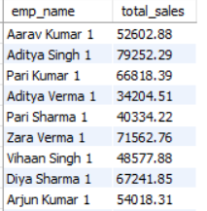
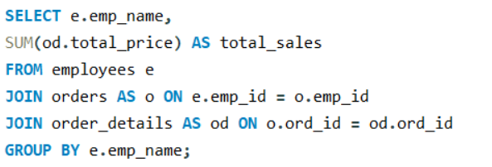
Employee Performance
Employee who handled the most orders
What is the total sales value processed by each employee?

Slide 14
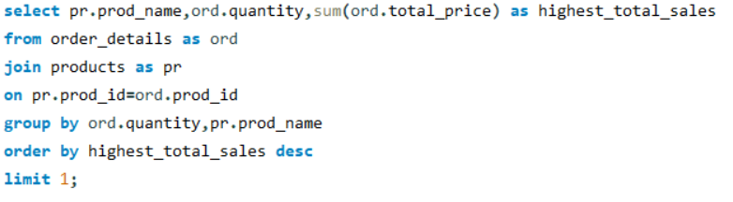

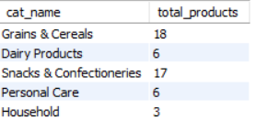
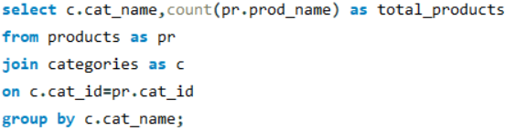
Product Performance
Which products have the highest total sales volume (by quantity)?
How many products exist in each category?

Slide 15
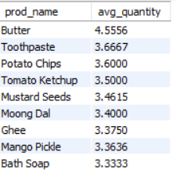
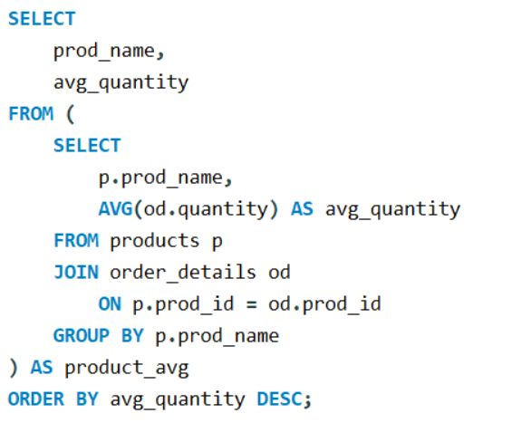
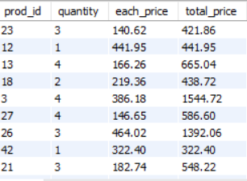
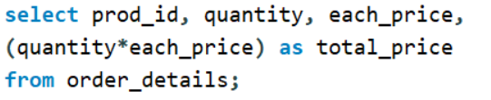
Order Details Deep Dive :
What is Average quantity per product ?
What is the relationship between quantity ordered and total price?

Slide 16
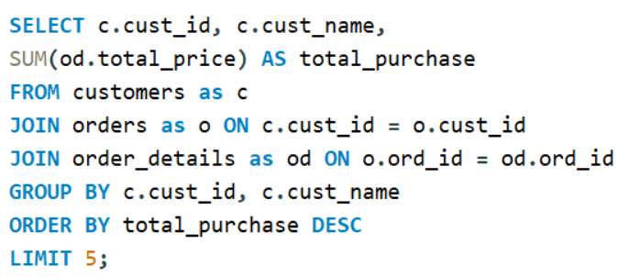
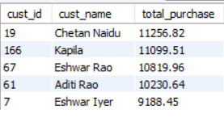
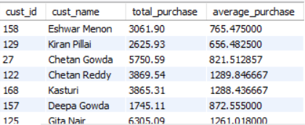
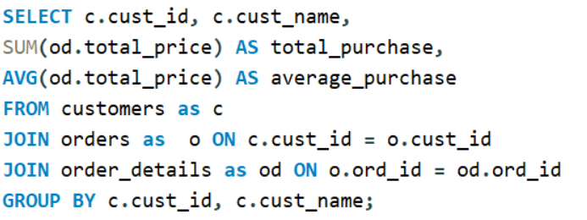
Customer Insights :
Who are the top 5 customers by total purchase amount?
What is the total and average purchase value per customer?

Slide 17
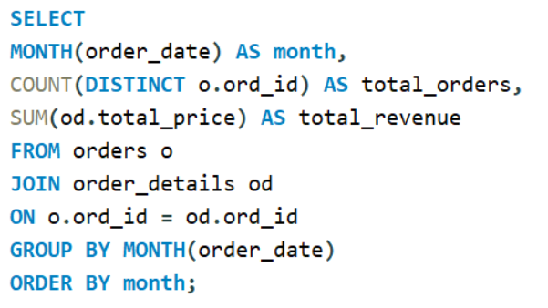

Sales and Order Trends
What are the monthly trends in order volume and revenue ?

Slide 18
Combined Business Insights :
Supplier Insights :
One supplier provides the highest number of products in the store.
The same supplier generates the highest revenue compared to others.
The business depends more on this major supplier for overall sales performance.
Employee Insights :
Some employees handle more orders than others.
Employees who process more orders generate higher sales.
Balanced workload and proper training can improve employee performance.
Order Insights :
Higher quantity orders generate higher total revenue.
Some products are ordered more frequently than others.
There are small price differences for the same product in different orders.

Slide 19
Recommendations :
Based on the analysis, I recommend:
Strengthening relationships with top-performing suppliers
Providing training for underperforming employees
Standardizing pricing strategy
Improving inventory planning
Automating order tracking systems

Slide 20
Challenges Faced :
During this project, I faced challenges such as:
Understanding table relationships
Writing complex JOIN queries
Performing accurate aggregations
Interpreting query results correctly
These challenges helped me improve my SQL skills.

Slide 21
Conclusion :
In conclusion, this project demonstrates how SQL can be used to analyze real-world business data.
SQL helped extract actionable business insights
Project demonstrates capability in data interpretation
It improved my database design skills and analytical thinking.
The analysis provides valuable insights to improve supplier management, employee performance, and sales operations.
Sets foundation for advanced analytics and dashboards.

Slide 22
Q & A

Slide 23

THANK YOU

