Slide 1

Math4AI Capstone From Linear Scores to a Single Hidden Layer: A Mathematical Study of Simple Learning Systems
Students: Shahin Alakparov
Davud Gurbanov
Murad Asgarov
Gurban Burjuzada

Slide 2

01
When does a one-hidden-layer neural network genuinely outperform a linear classifier And when is the added complexity unnecessary?
Both models perform well on linearly separable data, yet it is not the case if the data possess non-linear relations between input features and the target

Slide 3
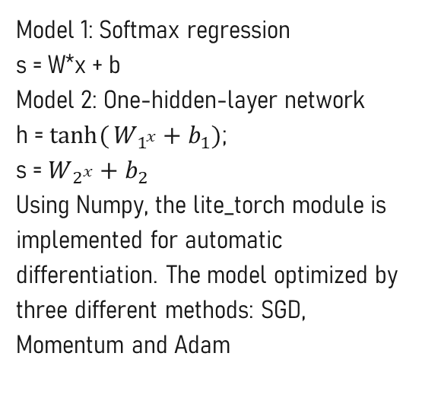
Our Models and Data
Models
Datasets
Model 1: Softmax regression
s = W*x + b
Model 2: One-hidden-layer network
h = $tanh({W_{1^{x}}+b_{1}})$;
s = $W_{2^{x}}+b_{2}$
Using Numpy, the lite_torch module is implemented for automatic differentiation. The model optimized by three different methods: SGD, Momentum and Adam
Linear Gaussian — linearly separable, 2D, 2 classes
Moons — nonlinearly structured, 2D, 2 classes
Digits — real benchmark, 64D, 10 classes

Slide 4
Experimental Protocol
Same train / validation / test split for both models
Model selection using validation cross-entropy only
Test set evaluated exactly once per seed after configuration fixed
5 random seeds on digits benchmark → mean ± 95% confidence interval
Reported metrics: classification accuracy + mean cross-entropy loss

Slide 5
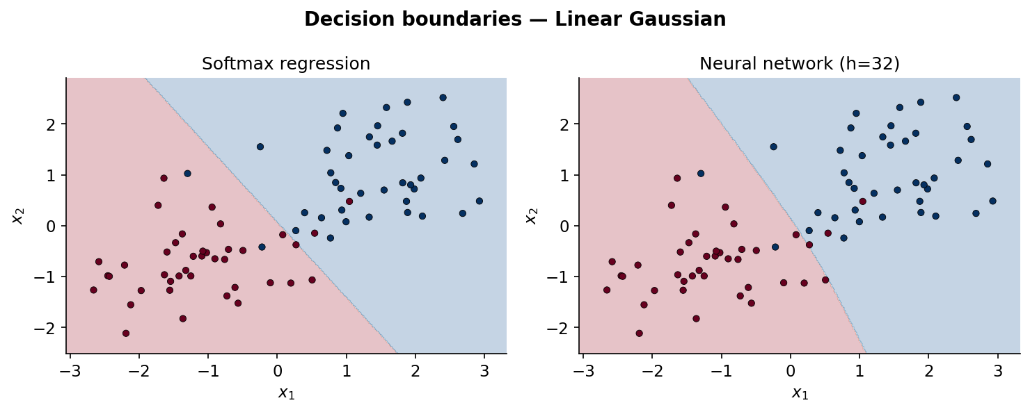
When Linear Model is Enough
Both models draw nearly identical straight-line boundaries.
Softmax regression already finds the correct decision boundary
Neural network adds zero benefit — same accuracy, more parameters.
Conclusion: when classes are linearly separable, complexity is unjustified

Slide 6
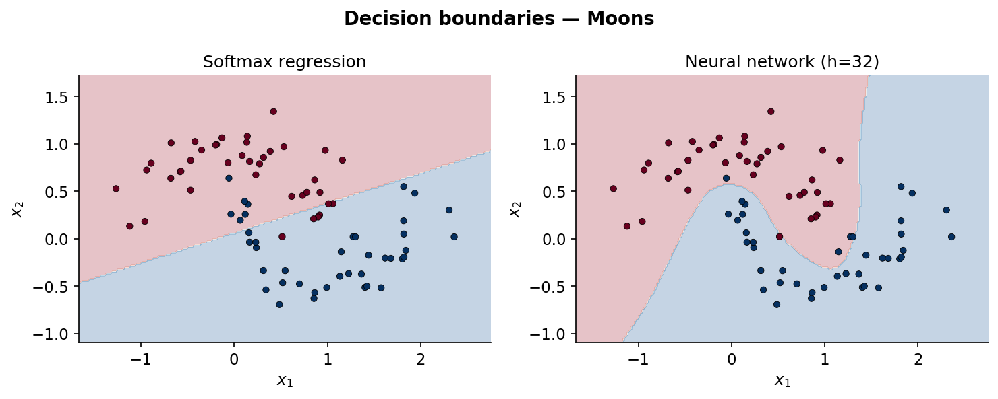
When The Hidden Layer Changes Everything
Neural network learns a curved, wave-like boundary that follows the data geometry
The hidden layer warps the input space before classification — making a nonlinear problem linearly separable in the transformed space
Conclusion: when the true boundary is curved, the hidden layer is genuinely necessary

Slide 7
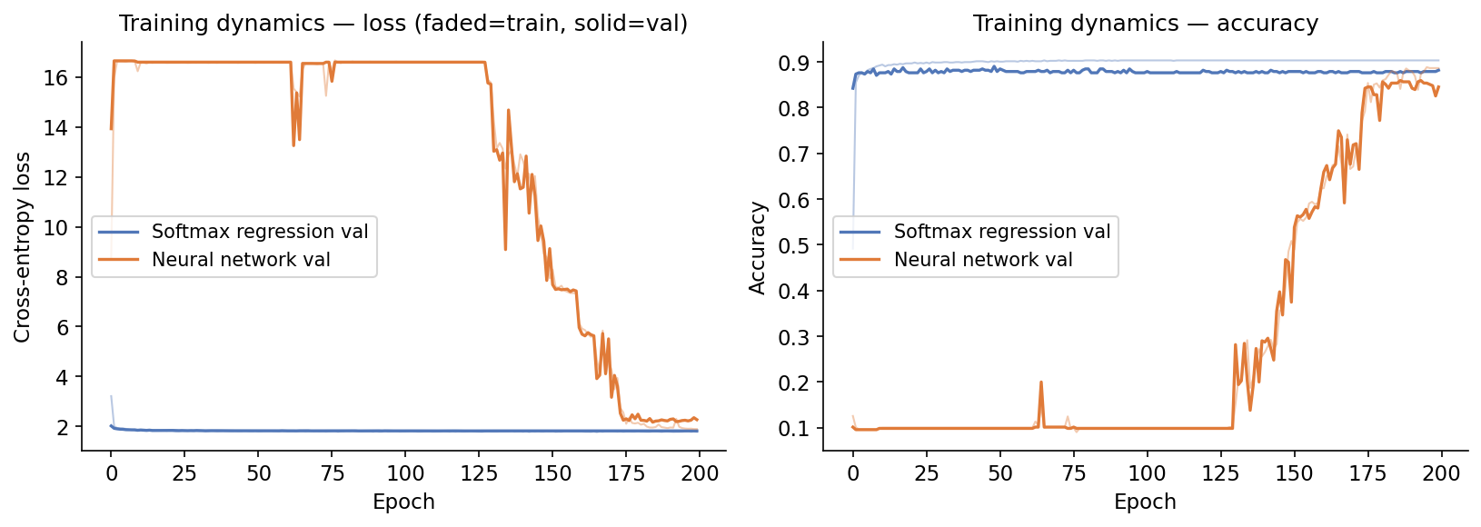
Digits Benchmark — An Honest Result
Softmax regression: ~88% accuracy, stable training from epoch 1
Neural network with SGD: optimization instability — loss plateaus around 11, accuracy stalls at ~40%
Sudden jumps in loss curve indicate learning rate too large for the higher-dimensional parameter space
This is our failure case: the neural network fails not because the problem is linear, but because SGD at lr=0.05 is too aggressive for this architecture
A more expressive model can underperform if optimization is not properly tuned

Slide 8
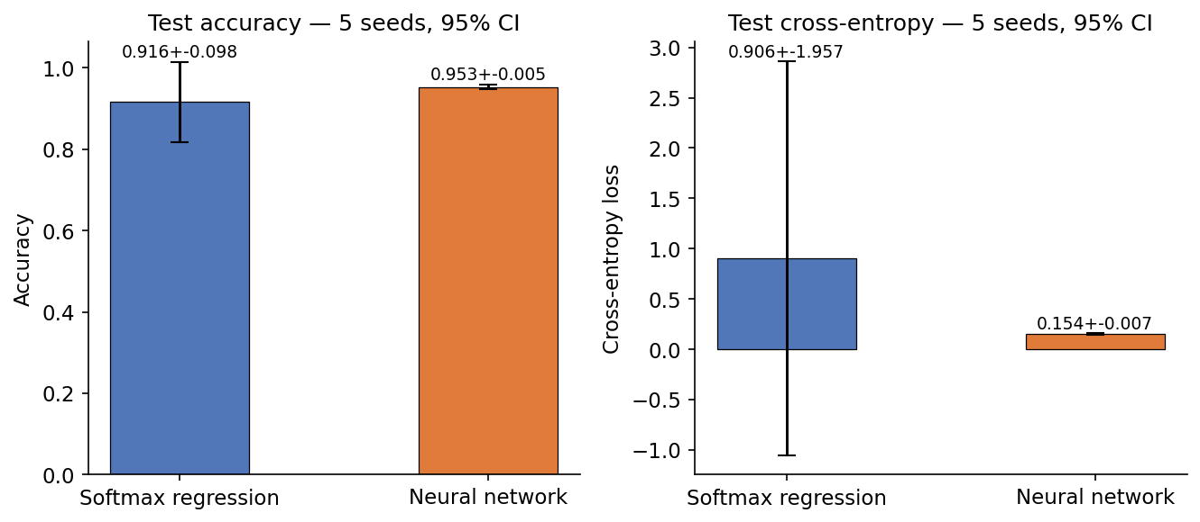
What Five Seeds Add Beyond One Run
A single run could be lucky or unlucky due to random initialization
Five seeds give us a distribution of outcomes, not a single point
We report: mean test accuracy ± 2.776 · s/√5 (95% CI, t-distribution df=4)
If confidence intervals overlap → difference is not statistically reliable
If they don't → we can make a genuine claim about which model generalizes better

Slide 9
Limitations and Conclusion
Limitations
Conclusion
Only one hidden layer tested — deeper networks not explored
Small datasets — conclusions may not generalize to larger problems
Adam Optimizer is used for main comparison; Though different techniques may give also different outcomes
Five seeds is a modest sample for statistical claims
Linear model is sufficient when data is linearly separable — Gaussian task
Hidden layer is necessary when boundary is curved — Moons task
Model complexity must earn its place through held-out evidence, not assumed superiority
Optimization choice matters as much as architecture — failure case on digits

Slide 10
Thanks for Your Attention

