Slide 1
Stock Analysis Dashboard
Shahin Alakparov

Slide 2
Technical Task
    Problems:
Script was static and not interactive.
Hard‑coded indicator parameters.
No dynamic UI, no visualization.
    Solution:
Needed to refactor code into modular library and build a "Vanilla" Front-End application

Slide 3
Approach
Refactored logic into modular OOP backend.
Created FastAPI REST API for dynamic data.
Built Vanilla JS frontend with Chart.js.
Real-time parameter adjustment.

Slide 4
Pipeline
Load CSV stock data
Apply selected indicators via classes
Send results through API
Frontend fetches & updates chart live

Slide 5
Features
Fully interactive dashboard
Adjustable MA, RSI, EMA, MACD, ATR, BB
Multiple choice of indicators
Real‑time updating chart without page reload
Real-time updating processed table
Downloading CSV of processed data
Clean scalable backend structure

Slide 6
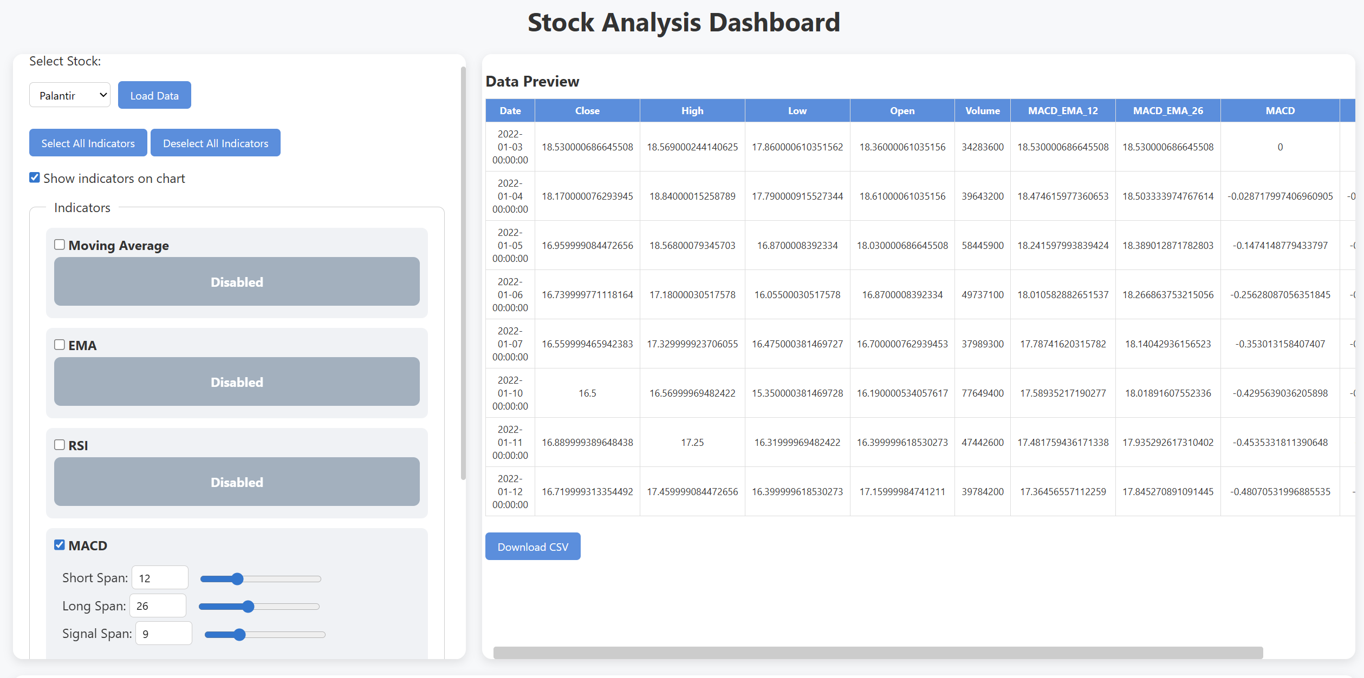
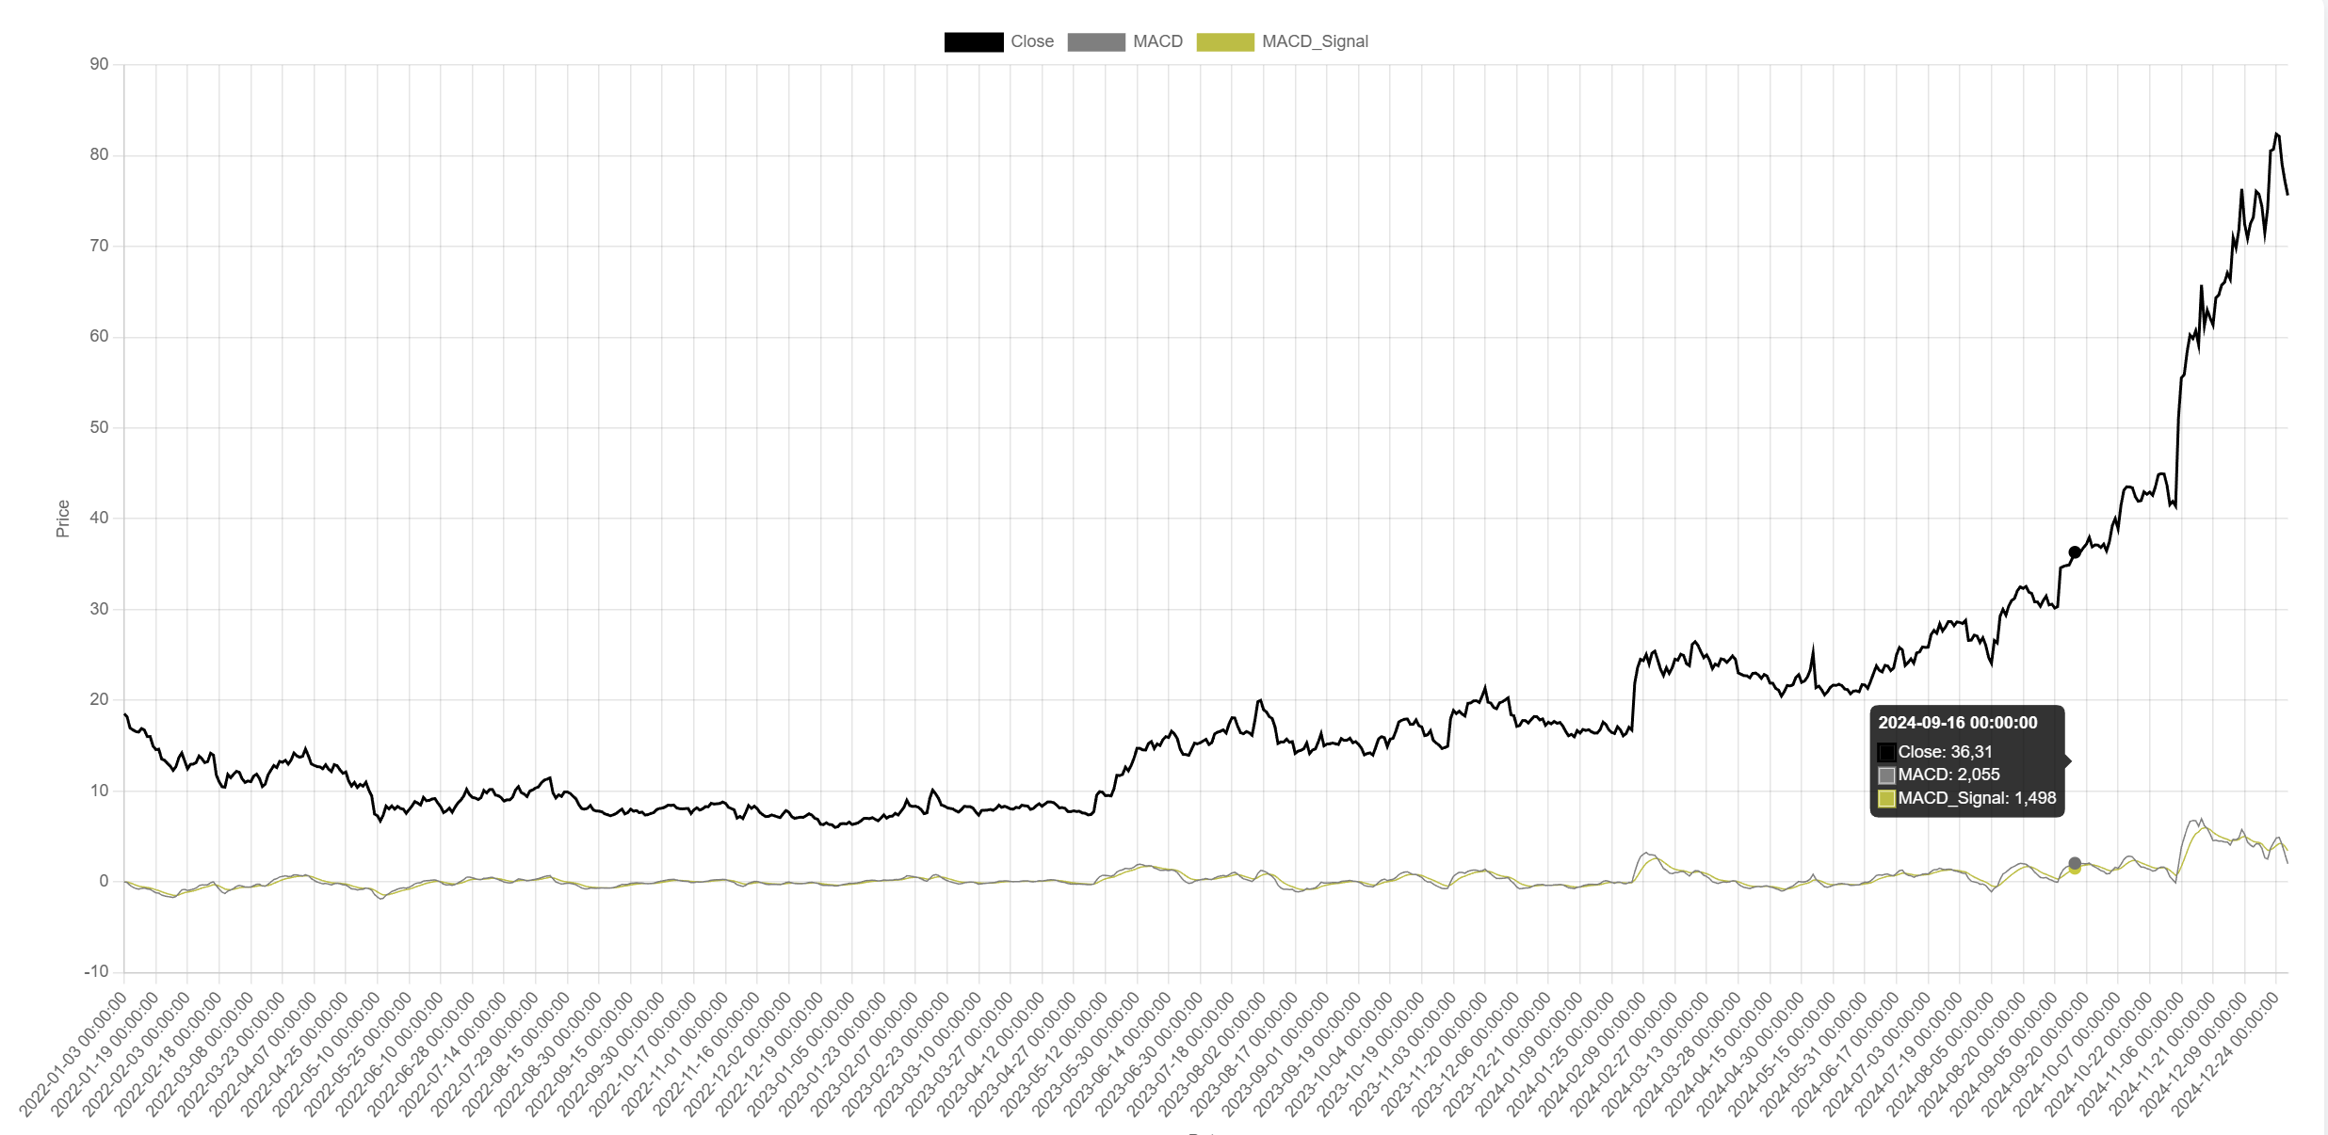
Application Overview

Slide 7
Challenges
Handling NaN/Infinity values
Mapping UI selections to API params
Ensuring that, there are no fetching errors
Enabling real-time chart updating

Slide 8
Conclusion
Converted static script into application to visualize the data.
Scalable, modular Python architecture
Clean UI with real‑time interaction

Slide 9
Thank You!
Shahin Alakparov
16/01/2026

