Slide 1

GPS
General Particle Source
Giovanni Santin
ESA / ESTEC and RheaTech Ltd
On behalf of the Geant4 collaboration
Ecole Geant4
Annecy, 18-21 and 25-28 Nov 2008

Slide 2
Outline
Introduction
Basic functioning
Position, angular & energy distributions
Examples

Slide 3
Introduction

Slide 4
Motivation
After first simple tutorial trials, modelling sources in realistic set-up soon requires relatively more complex sources
G4ParticleGun can be used in most cases
(as in the series of examples during this tutorial), but
  users still needs to code (C++) almost every change and
  add related UI commands for interactive control
Requirements for advanced primary particle modelling are often common to many users in different communities
  E.g. uniform vertex distribution on a surface, isotropic generation, energy spectrum,…
Introduction
Basic functioning
Position, angular & energy distributions
Examples

Slide 5
What is GPS?
Introduction
Basic functioning
Position, angular & energy distributions
Examples
The General Particle Source (GPS) offers as pre-defined
many common options for particle generation
(energy, angular and spatial distributions)
  GPS is a concrete implementation of G4VPrimaryGenerator (as G4ParticleGun but more advanced)
  G4 class name: G4GeneralParticleSource (in the event category)
User cases: space radiation environment, medical physics, accelerator (fixed target)
First development (2000) University of Southampton (ESA contract), maintained and upgraded now mainly by QinetiQ and ESA
Extensive up-to-date documentation at http://reat.space.qinetiq.com/gps

Slide 6
Summary of GPS features
Primary vertex can be randomly positioned with several options
  Emission from point, plane,…
Angular emission
  Several distributions; isotropic, cosine-law, focused, …
  With some additional parameters (min/max-theta, min/max-phi,…)
Kinetic energy of the primary particle can also be randomized.
  Common options (e.g. mono-energetic, power-law), some extra shapes (e.g. black-body) or user defined
Multiple sources
  With user defined relative intensity
Capability of event biasing (variance reduction).
  By enhancing particle type, distribution of vertex point, energy and/or direction
Introduction
Basic functioning
Position, angular & energy distributions
Examples

Slide 7
Basic functioning

Slide 8
GPS vs G4ParticleGun
User messenger (UI)
Introduction
Basic functioning
Position, angular & energy distributions
Examples
MyPrimaryGenerator
(G4VUserPrimaryGeneratorAction)
Computes desired
primary properties
G4ParticleGun
(G4VPrimaryGenerator)
Vertices and
Primary particles
are created
G4Event
Primaries are stored
for later tracking
G4GeneralParticleSource
(G4VPrimaryGenerator)
Computes desired
primary properties
Creates vertices and
primary particles
MyPrimaryGenerator
(G4VUserPrimaryGeneratorAction)
G4Event
Primaries are stored
for later tracking
GPS messenger (UI)
user geant4

Slide 9
GPS control: scripting UI
All features can be used via C++ or command line (or macro) UI
Example of isotropic emission in UserPrimaryGenerator C++ code:
examples/advanced/human_phantom/src/G4HumanPhantomPrimaryGeneratorAction.cc
G4double a,b,c;
G4double n;
do {
a = (G4UniformRand()-0.5)/0.5;
b = (G4UniformRand()-0.5)/0.5;
c = (G4UniformRand()-0.5)/0.5;
n = a*a+b*b+c*c;
} while (n > 1 || n == 0.0);
n = std::sqrt(n);
a /= n;
b /= n;
c /= n;
G4ThreeVector direction(a,b,c);
particleGun->SetParticleMomentumDirection(direction);
Equivalent GPS (script)
/gps/ang/type iso
Introduction
Basic functioning
Position, angular & energy distributions
Examples

Slide 10
UserPrimaryGeneratorAction class
Introduction
Basic functioning
Position, angular & energy distributions
Examples
Can be extremely simple:
MyPrimaryGeneratorAction::MyPrimaryGeneratorAction() {
m_particleGun = new G4GeneralParticleSource();
}
MyPrimaryGeneratorAction::~MyPrimaryGeneratorAction() {
delete m_particleGun;
}
void MyPrimaryGeneratorAction::GeneratePrimaries(G4Event* anEvent) {
m_particleGun->GeneratePrimaryVertex(anEvent);
}
All user instructions given via macro UI commands

Slide 11
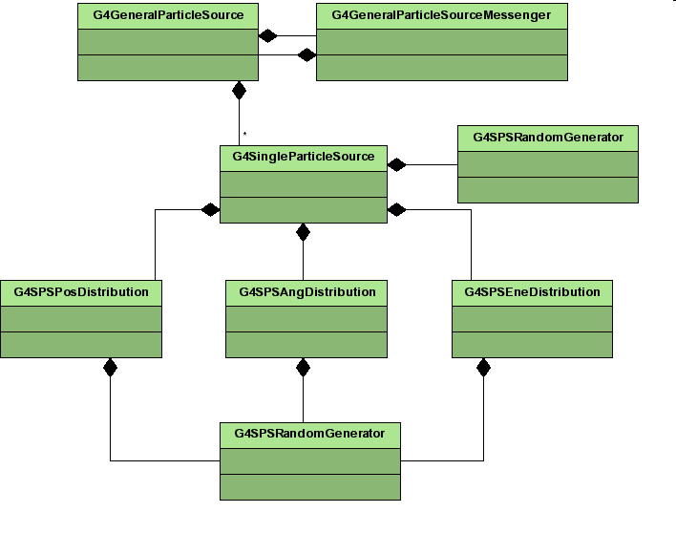
Class diagram
Introduction
Basic functioning
Position, angular & energy distributions
Examples

Slide 12
Multiple sources
Introduction
Basic functioning
Position, angular & energy distributions
Examples
Definition of multiple “parallel” sources
One source per event is used
Sampling according to relative intensity
First source is always already present (implicitly created)
  one can add intensity information
/gps/source/intensity 5.
Additional sources must be added explicitly
/gps/source/add 10.

Slide 13
Biasing
Introduction
Basic functioning
Position, angular & energy distributions
Examples
Users can bias distributions by entering a histogram
It is the random numbers from which the quantities are picked that are biased
→ so one needs a histogram only from 0 to 1
Great care must be taken when using this option
Bias histograms are entered in the same way as other user-defined histograms
/gps/hist/type biasx
| biasy | biasz | biast | biasp | biaspt | biaspp | biase

Slide 14
Position, angular & energy distributions

Slide 15
Position distributions /gps/pos/…
Point
  E.g. /gps/pos/type Point
  /gps/pos/centre 0. 0. 0. cm
Beam
  E.g. /gps/pos/type Beam
  /gps/pos/shape Circle
  /gps/pos/radius 1. mm
  /gps/pos/sigma_r 2. mm
Plane
  Shape: Circle, Annulus, Ellipsoid, Square or Rectangle
  E.g. /gps/pos/type Plane
  /gps/pos/shape Rectangle
  /gps/pos/halfx 50 cm
  /gps/pos/halfy 70 cm
Surface or Volume
  Shape: Sphere, Ellipsoid, Cylinder or Para
  Surface: zenith automatically oriented as normal to surface at point
  E.g. /gps/pos/type Surface
  /gps/pos/shape Sphere
  /gps/pos/radius 1. m
Introduction
Basic functioning
Position, angular & energy distributions
Examples

Slide 16
Position distributions
/gps/pos/… (2)
Introduction
Basic functioning
Position, angular & energy distributions
Examples
Some shared UI commands
/gps/pos/centre
/gps/pos/halfx | y | z
/gps/pos/radius
/gps/pos/inner_radius
/gps/pos/sigmar
/gps/pos/sigmax | y
/gps/pos/rot1
/gps/pos/rot2
When usinig Volume type, one can limit the emission from within a certain volume in the “mass” geometry
/gps/pos/confine your_physical_volume_name

Slide 17
Angular distributions /gps/ang/…
Introduction
Basic functioning
Position, angular & energy distributions
Examples
Isotropic (iso)
Cosine-law (cos)
  See next slides for more information
Planar wave (planar)
  Standard emission in one direction
  (it’s also implicitly set by /gps/direction x y z)
Accelerator beam
  1-d or 2-d gaussian emission, beam1d or beam2d
Focusing to a point (focused)
User-defined (user)

Slide 18

Isotropic radiation in space: Cos VS Iso ?
I. Slab source
Objective:
model an isotropic flux in space, shooting from a planar surface (assuming flux from right is stopped)
By definition of isotropic flux:
→ The flux passing through a surface (such as A) is not dependent on the direction
The slab B sees
  Full flux for a direction normal to its surface
  reduced by a factor cos() for tilted directions (/cm² !)
→ We must use “cosine-law” angular distribution when shooting primaries from the slab
A
B
B
❑
A
B
If one shoots an isotropic flux from a slab the final distribution in space is not isotropic !
  Different fluences through surfaces at different angles

Slide 19
Isotropic radiation in space: Cos VS Iso ?
II. Sphere source
Introduction
Basic functioning
Position, angular & energy distributions
Examples
B
B
A
❑
A
Same is valid for a spherical surface
  the fluence for each direction is proportional to the cosine of the angle between the source direction and the local normal to the sphere surface
Cosine-law angular emission actually works not only for the sphere, but for generic surfaces (e.g. shooting from a box)
Isotropic angular emission from the surface leads to non isotropic fluence in the volume
  E.g. for each emission direction the final distribution is not flat on a plane normal to the emission direction
One can verify the various options by placing an oriented detector in different positions/orientations in the volume

Slide 20
Energy distributions
/gps/ene/…
Kinetic energy of the primary particle can also be randomized, with
several predefined options:
Common options (e.g. mono-energetic, power-law, exponential, gaussian, etc)
  mono-energetic (Mono)
  linear (Lin)
  power-law (Pow)
  exponential (Exp)
  gaussian (Gauss)
Some extra predefined spectral shapes (bremsstrahlung, black-body, cosmic diffuse gamma ray,…)
  bremsstrahlung (Brem)
  black-body (Bbody)
  cosmic diffuse gamma ray (Cdg)
User defined
  user-defined histogram (User)
  arbitrary point-wise spectrum (Arb) and
  user-defined energy per nucleon histogram (Epn)
Introduction
Basic functioning
Position, angular & energy distributions
Examples

Slide 21
Examples

Slide 22
Example: proton source of exercises jour 2a 2b 2c
Introduction
Basic functioning
Position, angular & energy distributions
Examples
Vertices on rectangle along xz at edge of World
Parallel emission along -y
Monoenergetic: 500 MeV
Macro
/gps/particle proton
/gps/ene/type Mono
/gps/ene/mono 500 MeV
/gps/pos/type Plane
/gps/pos/shape Rectangle
/gps/pos/rot1 0 0 1
/gps/pos/rot2 1 0 0
/gps/pos/halfx 46.2 cm
/gps/pos/halfy 57.2 cm
/gps/pos/centre 0. 57.2 0. cm
/gps/direction 0 –1 0

Slide 23
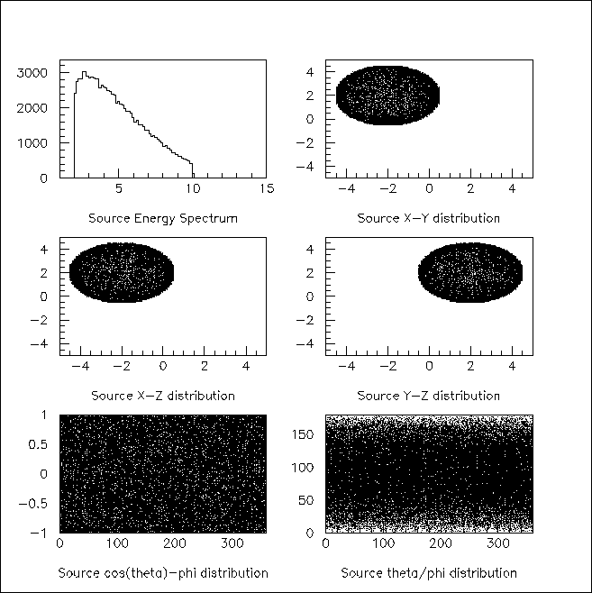
GPS
Example 6
Introduction
Basic functioning
Position, angular & energy distributions
Examples
Vertex on sphere surface
Isotropic emission
Pre-defined spectrum (black-body)
Macro
/gps/particle geantino
/gps/pos/type Surface
/gps/pos/shape Sphere
/gps/pos/centre -2. 2. 2. cm
/gps/pos/radius 2.5 cm
/gps/ang/type iso
/gps/ene/type Bbody
/gps/ene/min 2. MeV
/gps/ene/max 10. MeV
/gps/ene/temp 2e10
/gps/ene/calculate

Slide 24
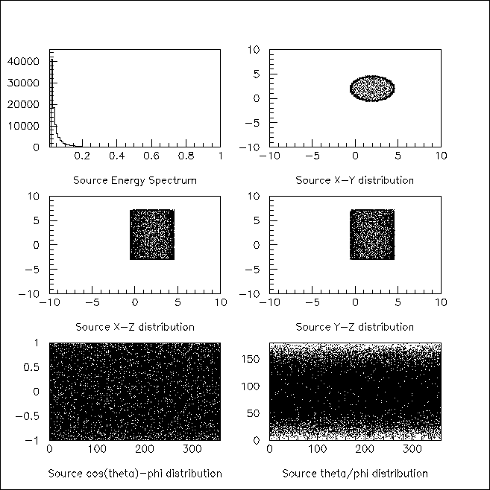
GPS
Example 7
Vertex on cylinder surface
Cosine-law emission
(to mimic isotropic source in space)
Pre-defined spectrum
(Cosmic Diffuse Gamma)
Introduction
Basic functioning
Position, angular & energy distributions
Examples
Macro
/gps/particle gamma
/gps/pos/type Surface
/gps/pos/shape Cylinder
/gps/pos/centre 2. 2. 2. cm
/gps/pos/radius 2.5 cm
/gps/pos/halfz 5. cm
/gps/ang/type cos
/gps/ene/type Cdg
/gps/ene/min 20. keV
/gps/ene/max 1. MeV
/gps/ene/calculate

Slide 25
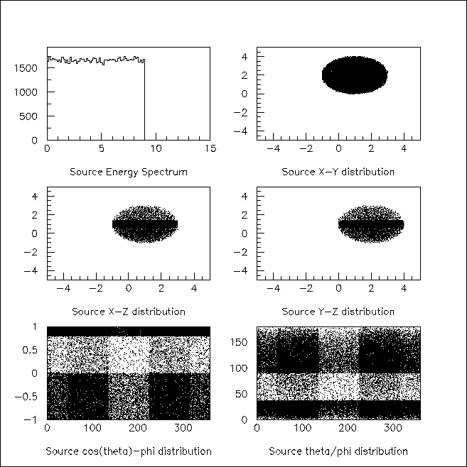
GPS
Example 24
Macro
/gps/particle geantino
/gps/pos/type Volume
/gps/pos/shape Sphere
/gps/pos/centre 1. 2. 1. cm
/gps/pos/radius 2. Cm
/gps/ang/type iso
/gps/ene/type Arb
/gps/ene/diffspec 0
/gps/hist/type arb
/gps/hist/point 0.0 11.
/gps/hist/point 1.0 10.
/gps/hist/point 2.0 9.
/gps/hist/point 3.0 8.
/gps/hist/point 4.0 7.
/gps/hist/point 7.0 4.
/gps/hist/point 8.0 3.
/gps/hist/point 9.0 2.
/gps/hist/point 10.0 1.
/gps/hist/point 11.0 0.
/gps/hist/inter Lin
/gps/hist/type biasz
/gps/hist/point 0. 0.
/gps/hist/point 0.4 0.5
/gps/hist/point 0.6 1.
/gps/hist/point 1. 0.2
/gps/hist/type biast
/gps/hist/point 0. 0.
/gps/hist/point 0.1 1.
/gps/hist/point 0.5 0.1
/gps/hist/point 1. 1.
/gps/hist/type biasp
/gps/hist/point 0. 0.
/gps/hist/point 0.125 1.
/gps/hist/point 0.375 4.
/gps/hist/point 0.625 1.
/gps/hist/point 0.875 4.
/gps/hist/point 1. 1.
Introduction
Basic functioning
Position, angular & energy distributions
Examples
Vertex in sphere volume
with z biasing
Isotropic radiation
with theta and phi biasing
Integral arbitrary point-wise energy
distribution with linear interpolation.

Slide 26
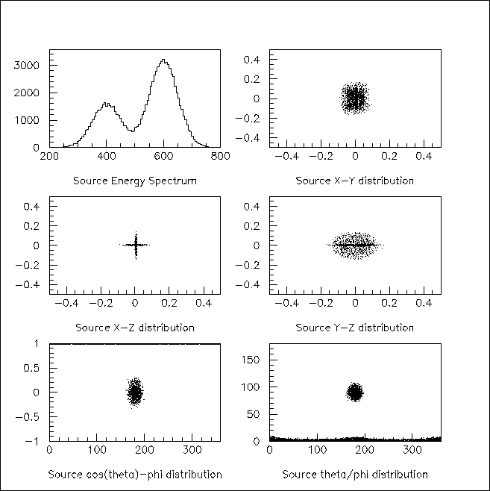
GPS
Example 31
Macro
# beam #1
# default intensity is 1,
# now change to 5.
/gps/source/intensity 5.
/gps/particle proton
/gps/pos/type Beam
# the incident surface is
# in the y-z plane
/gps/pos/rot1 0 1 0
/gps/pos/rot2 0 0 1
# the beam spot is centered
# at the origin and is
# of 1d gaussian shape
# with a 1 mm central plateau
/gps/pos/shape Circle
/gps/pos/centre 0. 0. 0. mm
/gps/pos/radius 1. mm
/gps/pos/sigma_r .2 mm
# the beam is travelling
# along the X_axis
# with 5 degrees dispersion
/gps/ang/rot1 0 0 1
/gps/ang/rot2 0 1 0
/gps/ang/type beam1d
/gps/ang/sigma_r 5. deg
# the beam energy is in
# gaussian profile centered
# at 400 MeV
/gps/ene/type Gauss
/gps/ene/mono 400 MeV
/gps/ene/sigma 50. MeV
# beam #2
# 2x the instensity of beam #1
/gps/source/add 10.
# this is a electron beam
...
Two-beam source definition
(multiple sources)
Gaussian profile
Can be focused / defocused
Introduction
Basic functioning
Position, angular & energy distributions
Examples

Slide 27
Exercises
Cobalt-60 gamma source
Proton accelerator source
Space electron environment
Introduction
Basic functioning
Position, angular & energy distributions
Examples

Slide 28
Documentation and support
Primary Generation in Geant4
Lecture 4 : Generation of primary particles
GPS
Website: http://reat.space.qinetiq.com/gps/
Support from users and developers
Geant4 HyperNews – Particles
questions, proposal of new capabilities
http://hypernews.slac.stanford.edu/HyperNews/geant4/get/particles.html

Slide 29
Spare

Slide 30
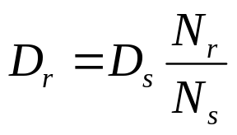
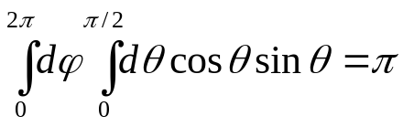
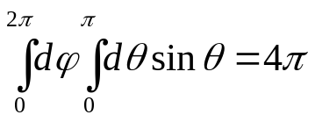
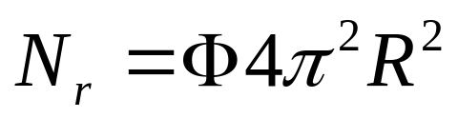
Normalisation for Isotropic radiation in space, Sphere surface
N_{r} is the number of particles traversing my source volume in the real world
N_{r} depends on the external flux, integrated on relevant source surface and solid angle
  Only the source geometry is relevant for source normalisation, no detector parameter
Φ → external flux (energy integrated) [/ cm² s sr]
Two possible approaches
Method 1
  Integrate over the 2 π emission angle, →
  with cosine-law biasing
  Then integrate over the source sphere surface: S = 4π R²
Method 2 (euristic)
  Assume isotropic source in space →
  (no cosine-law)
  Take only sphere equatorial surface as effective geometrical cross section: S = π R²
R
S
S
R

