Slide 1
PAGING

Slide 2
Paging
Paging is a memory-management scheme that permits the physical address space of a process to be non contiguous.
Paging avoids the considerable problem of fitting memory chunks of varying sizes onto the backing store.
Basic Method
Breaking physical memory into fixed-sized blocks called frames and breaking logical memory into blocks of the same size called pages.
When a process is to be executed, its pages are loaded into any available memory frames from the backing store.
The backing store is divided into fixed-sized blocks that are of the same size as the memory frames.

Slide 3
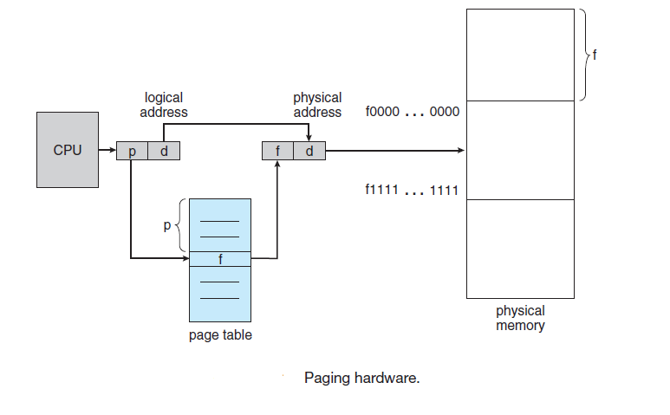
Paging

Slide 4
Paging
Every address generated by the CPU is divided into two parts: a page number (p) and a page offset (d).
The page number is used as an index into a page table.
The page table contains the base address of each page in physical memory.
This base address is combined with the page offset to define the physical memory address that is sent to the memory unit.

Slide 5
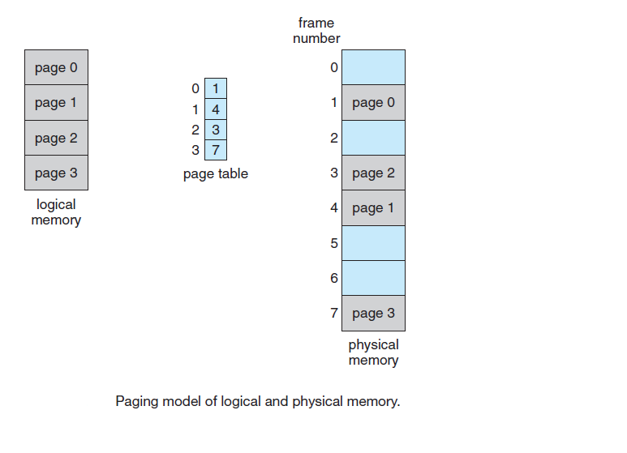
Paging

Slide 6
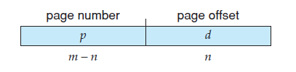
Paging
The page size (like the frame size) is defined by the hardware.
The size of a page is typically a power of 2, varying between 512 bytes and 16 MB per page, depending on the computer architecture.
If the size of logical address space is 2^{m} and a page size is 2^{n} addressing units (bytes or words), then the high-order m – n bits of a logical address designate the page number, and the n low-order bits designate the page offset.
where p is an index into the page table and d is the displacement within the page.

Slide 7
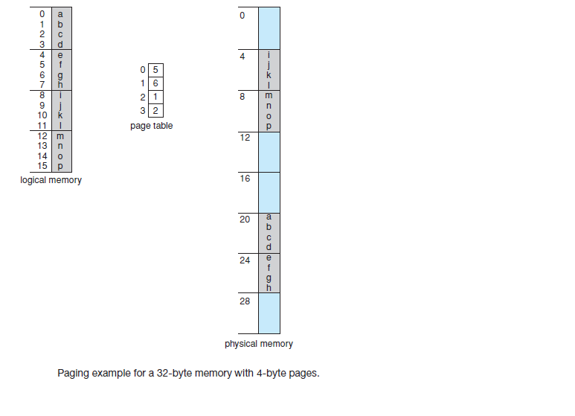
Paging:Example

Slide 8
Paging: Example
Page size of 4 bytes and a physical memory of 32 bytes (8 pages.
page 0 is in frame 5.
Thus, logical address 0 maps to physical address 20 (= (5 x 4) + 0).
Logical address 3 (page 0, offset 3) maps to physical address 23 =( (5x4) + 3).
Logical address 4 is page 1, offset 0; Thus, logical address 4 maps to physical address 24 (= (6x4) + 0).
Logical address 13 maps to physical address 9.

Slide 9
Paging-Disadvantage
When we use a paging scheme, there is no external fragmentation: Any free frame can be allocated to a process that needs it.
Paging have internal fragmentation.
If the memory requirements of a process do not coincide with page boundaries, the last frame allocated may not be completely full.
For example, if page size is 2,048 bytes, a process of 72,766 bytes would need 35 pages plus 1,086 bytes. It would be allocated 36 frames, resulting in an internal fragmentation of 2,048-1,086 = 962 bytes.
In the worst case, a process would need n pages plus 1 byte. It would be allocated, n + 1 frames, resulting in an internal fragmentation of almost an entire frame.

Slide 10
Paging
When a process arrives in the system to be executed, its size, expressed in pages, is examined.
Each page of the process needs one frame.
If the process requires n pages, at least n frames must be available in memory.
If n frames are available, they are allocated to this arriving process.
The first page of the process is loaded into one of the allocated frames, and the frame number is put in the page table for this process. The next page is loaded into another frame, and its frame number is put into the page table, and so on

Slide 11
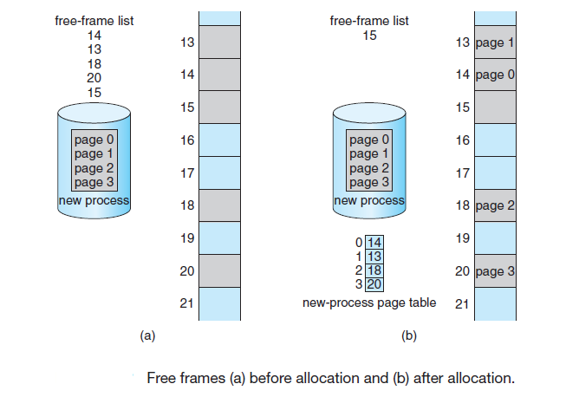
Paging

Slide 12
Paging-Hardware Support
Each operating system has its own methods for storing page tables.
Some allocate a page table for each process.
A pointer to the page table is stored with the other register values (like the instruction counter) in the process control block.
When the dispatcher is told to start a process, it must reload the user registers and define the correct hardware page-table values from the stored user page table.

Slide 13
Hardware implementation of page table
1)Using Hardware registers
A single page table consisting of an array of fast hardware registers, with one entry for each virtual page, indexed by virtual page number.
When a process is started up, the operating system loads the registers with the process‘ page table, taken from a copy kept in main memory.
Advantages: It is straightforward and requires no memory references during mapping.
Disadvantage: Potentially expensive (if the page table is large). Having to load the full page table at every context switch hurts performance.

Slide 14
Page Tables-Implementation
2)Page table stored entirely in main memory.
Page table base register (PTBR) points to the start of the page table.
Changing the page table requires changing only this register thereby reducing context switch time.
Disadvantage
This scheme, requires two memory accesses to access a byte (one for the page-table entry, one for the byte).

Slide 15
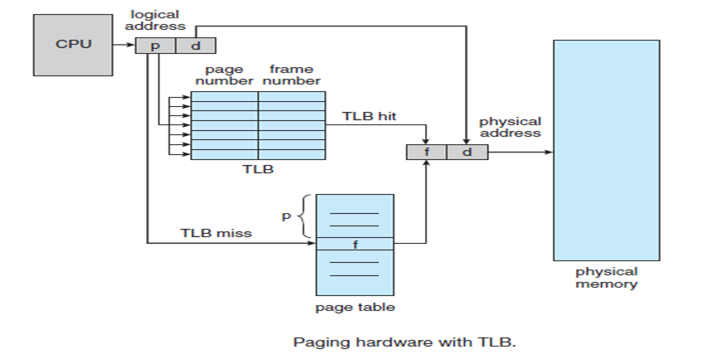
3) Translation Lookaside Buffer (TLB)

Slide 16
The TLB is associative, high-speed memory.
Each entry in the TLB consists of two parts:a key (or tag) and a value.
When the associative memory is presented with an item, the item is compared with all keys simultaneously.
If item is found, corresponding value field is returned.
The search is fast;
The TLB contains only a few of the page-table entries.
When a logical address is generated by the CPU, its page number is presented to the TLB.
If the page number is found, its frame number is immediately available and is used to access memory.

Slide 17
If the page number is not in the TLB (known as a TLB miss), a memory reference to the page table must be made.
Then add the page number and frame number to the TLB.
If the TLB is already full of entries, an existing entry must be selected for replacement.
Replacement policies range from least recently used (LRU) through round-robin to random.
Some TLBs allow certain entries to be wired down, meaning that they cannot be removed from the TLB. Typically, TLB entries for kernel code are wired down.

Slide 18
Some TLBs store address-space identifiers (ASIDs) in each TLB entry.
An ASID uniquely identifies each process and is used to provide address-space protection for that process.
When the TLB attempts to resolve virtual page numbers, it ensures that the ASID for the currently running process matches the ASID associated with the virtual page.
If the ASIDs do not match, the attempt is treated as a TLB miss.
ASID allows the TLB to contain entries for several different processes simultaneously.

Slide 19
The percentage of times that the page number of interest is found in the TLB is called the hit ratio.
Eg: An 80-percent hit ratio, means that we find the desired page number in the TLB 80 percent of the time.

Slide 20
Problem: If it takes 20 nanoseconds to search TLB and 100 nanoseconds to access memory. Find the effective memory access time? hit ratio is 80%.
Effective access time=(hit ratio*memory access time) +(miss ratio *memory access time)
=hit ratio*(time to search TLB+ memory access time for desired byte)+ miss ratio*(time to search TLB+ memory access time for the page table and frame number+ memory access time for desired byte)
=0.8*120+0.20*220
=140 nanoseconds

