Slide 1

Item Serialization with a Unicorn?

Slide 2
What is item serialization?
Database
File system
Creation of files from database records/Sitecore items

Slide 3
What is it for?
Versionable (git, SVN, TFS)
Supports item creation/update without database script/item package
Database
File system
Git repo

Slide 4

What is Unicorn?
A tool which is supporting item sync/serialization
The generated YAML files are
Deployable
Versionable
„Easily” mergeable

Slide 5
How does it work?
2 base functoin
Syncronization
File reading and copy to database
Serialization
Item reading from database and YAML file generation
File system
Database
Database
File system

Slide 6
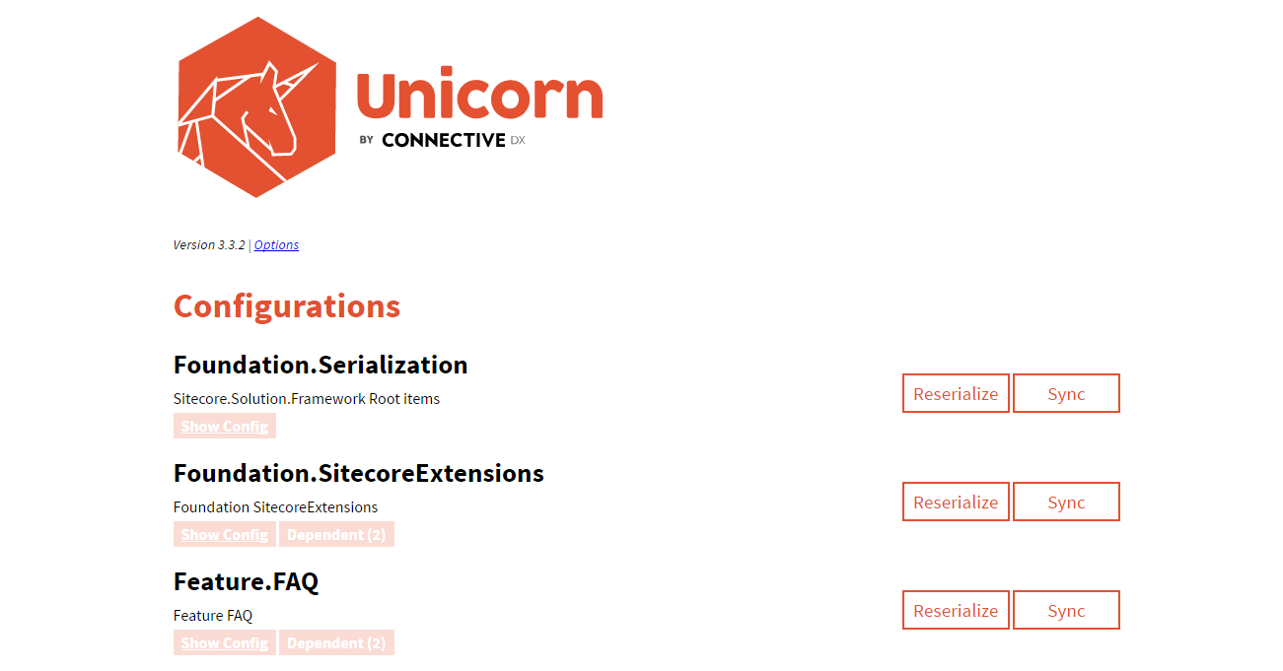
DEMO
Notes:
Simple config
Initial Serialization
Sync
Serialize
Deploy once config
YAML file-ok megmutatása

Slide 7
Other features
Easy and transparent item syncronization
/unicorn.aspx is executable from build script
By default the item sync is done on every item save
Content Editor notification if the selected item is controlled by Unicorn
Transparent Sync: file reading from file system to Sitecore automatically→ Not needed item sync on every „git pull”

Slide 8
Unicorn vs. TDS
Unicorn | TDS
Simple, less features than TDS | Much more feautres (code generation, msbuild/deploy support)
Configurable by config files, only 1 UI- /unicorn.aspx | Built in Visual Studio UI-s (around 7 seven different UI-s with different purpose)
No code generation built-in | Built-in code generation
Open source | Not free licence
Independent from Visual Studio | Depending on Visual Studio versions because of the UI-s

Slide 9
Summary – some keywords
Continues Integration
Team Development
Helix Principle Support
Code Generation

Slide 10
Useful links
Unicorn: https://github.com/kamsar/Unicorn
Rainbow Code Generation: https://github.com/heikof/RainbowCodeGeneration
Presented demo: https://github.com/trnktms/Meetup.Unicorn.Demo

Slide 11
Thank you for your attention!
Twitter: @trnktms
Sitecore Slack: @trnktms
Sitecore StackExchange: @trnktms
Blog: www.trnktms.wordpress.com

