Slide 1
Supermarket Sales Data Management System
Presented By : SHAHIN SULAIMAN.M
Date : 18.10.2024

Slide 2

Table of Contents
Introduction
Project Overview
Class Definitions
Parent Class: Sale
Child Class: DiscountedSale
File Handling
Main Function Workflow
Running the Application
Conclusion

Slide 3

Introduction
Welcome to the Supermarket Sales Data Management System! This project is designed to help manage and record supermarket sales efficiently using Python's Object-Oriented Programming (OOP) principles. The application allows users to input sales data, apply discounts, and save the information to a file for future reference.

Slide 4
Project Overview
The system is structured around two main classes:
Sale: Represents a basic sale transaction.
DiscountedSale: Inherits from Sale and adds functionality to handle discounts.
Additional functionalities include:
File Handling: Saving sales data to a file.
Exception Handling: Managing invalid inputs and file errors.
User Interaction: Allowing users to input sale details interactively.

Slide 5
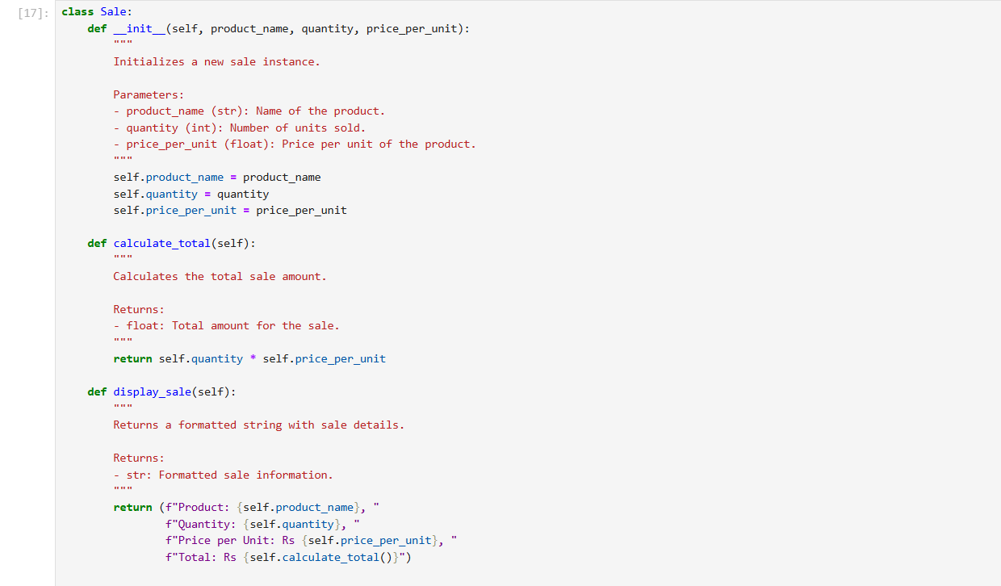
Class Definition Parent Class:

Slide 6
Key Components
Attributes:
product_name: Name of the product sold.
quantity: Number of units sold.
price_per_unit: Cost per unit.
Methods:
__init__: Constructor to initialize sale details.
calculate_total: Computes the total sale amount.
display_sale: Returns a string representation of the sale.

Slide 7
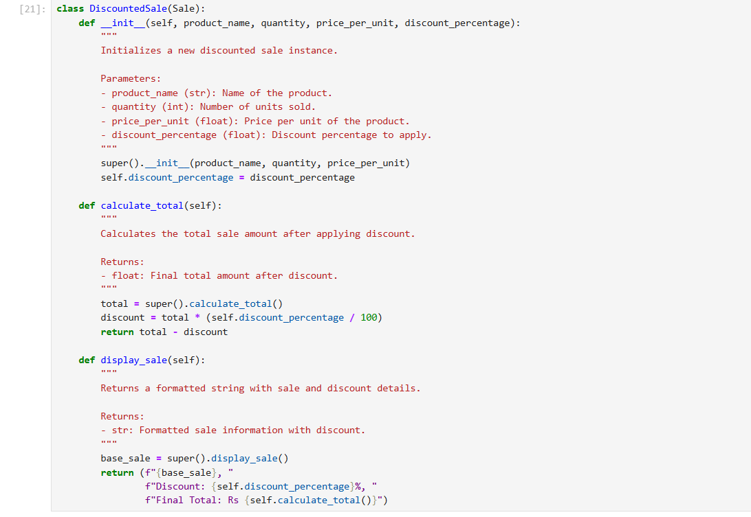
Child Class

Slide 8
Key Enhancements
Additional Attribute:
discount_percentage: The percentage discount applied to the sale.
Overridden Methods:
calculate_total: Overrides the parent method to apply the discount.
display_sale: Extends the parent method to include discount details.

Slide 9
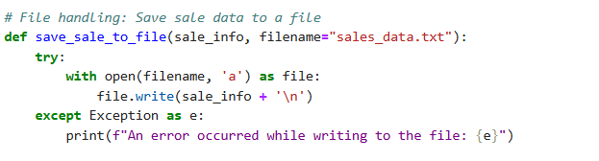
File Handling
Parameters:
sale_info: The essential data to be logged.
filename: Offers flexibility to specify different log files.
Operations:
File Handling: Efficiently opens and writes to files using append mode and the with statement.
Error Management: Handles potential errors, ensuring the program remains stable and informative

Slide 10
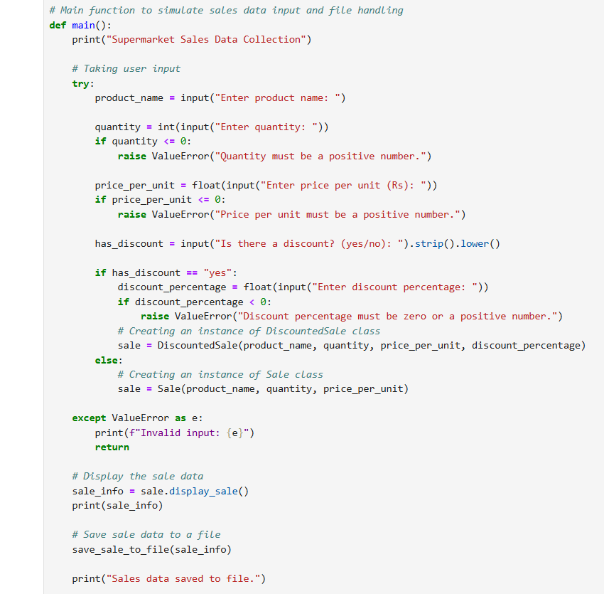
Main Function Workflow

Slide 11
Workflow Steps
User Input:
- Gets product name, quantity, price per unit.
- Asks if there is a discount ("yes" or "no").
Discount Handling:
- If "yes", gets discount percentage and creates a `DiscountedSale` instance.
- If "no", creates a `Sale` instance.
Input Validation: Catches input errors (e.g., invalid numbers) and shows an error message.
Display Sale Data: Prints sale information using `sale.display_sale()`.
Save Sale Data: Saves the sale information to a file with `save_sale_to_file()`.
Confirmation: Prints "Sales data saved to file."
Run Main Function: Executes `main()` if the script is run directly.

Slide 12
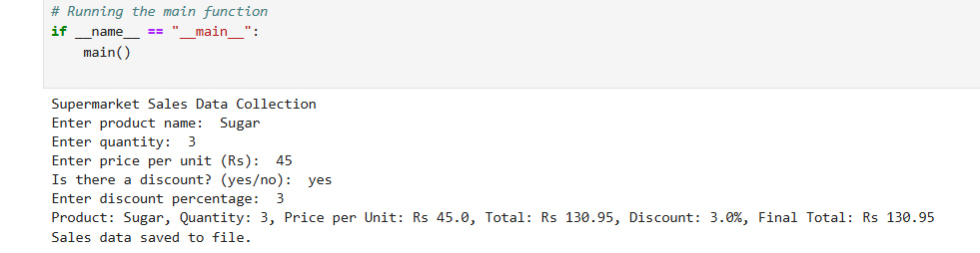
Running the Application

Slide 13
Conclusion
This Supermarket Sales Data Management System effectively demonstrates the application of Object-Oriented Programming principles in Python. By leveraging classes, inheritance, and method overriding, the system provides a flexible and scalable solution for managing sales data. Additionally, robust file handling and exception management ensure data integrity and user-friendly interactions.
Key Takeaways:
OOP Principles: Enhances code reusability and organization.
Exception Handling: Improves application robustness and user experience.
File Handling: Facilitates persistent data storage and retrieval.

Slide 14


